Slide 1
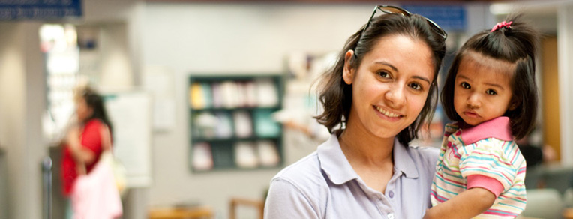
Communities Joined in Action
2017 National Conference
Specialty Access for the Uninsured Program (SAUP)

Slide 2
Removing Barriers to Specialty Care
for the Uninsured:
a patient-centered approach
Betty Ragalie
Project Director
Milwaukee Health Care Partnership
Specialty Access for the Uninsured (SAUP) Initiative

Slide 3
Milwaukee Health Care Partnership
Launched in 2007, the Milwaukee Health Care Partnership is a public/private consortium dedicated to improving health care for low-income, underserved populations in Milwaukee County, with the aim of improving:
health outcomes,
reducing disparities,
and lowering the total cost of care.
Notes:
Driving Forces:
Intractable and growing health needs; significant disparities
Limited resources, escalating costs – concerns among providers about ‘fair share’ of uncompensated care
Multiple, well-meaning but fragmented efforts – often duplicative. Providers working in silos. Gov’t agencies not at the table. Reactive vs. strategic

Slide 4
Goals
Secure adequate and affordable health insurance coverage for all
Ensure timely and appropriate access to quality health care providers and services
Enhance care coordination and navigation across the health care delivery system
Improve community and population health through cross-sector collaboration
Notes:
Today our goals are not only focused on securing coverage, ensuring access and improving care coordination but being engaged in select cross sector communit / population health initiatives
The Parntership’s core functions are to:
Assess & build awareness of community needs
Develop & implement a community-wide plan
Secure public & private funding for priority initiatives
Measure & report outcomes, promote transparency
And to serve as “A forum for communication and collaboration among key stakeholders”
4

Slide 5
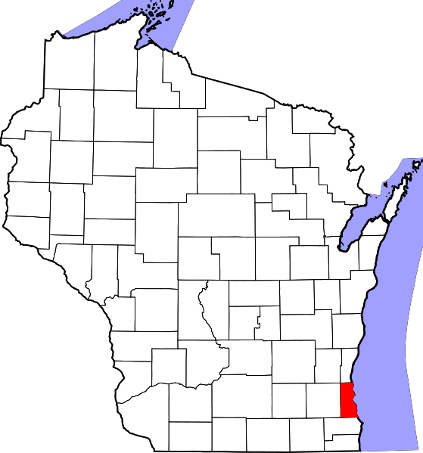
Milwaukee County
956,406 total population
22% live below the federal poverty level
34% enrolled in Medicaid
53% of children are covered by Medicaid
10% uninsured
4 Health Systems
~ 25 Safety Net Clinics
9 serve as primary care medical homes (FQHCs and free clinics)
Notes:
There are actually more than 25 safety net clinics, but 9 that are function as ‘primary care medical homes’ – including 4 Federally Qualified Health Centers
Map image source: https://upload.wikimedia.org/wikipedia/commons/thumb/3/34/Map_of_Wisconsin_highlighting_Milwaukee_County.svg/559px-Map_of_Wisconsin_highlighting_Milwaukee_County.svg.png

Slide 6
Issue:
Lack of access to specialty diagnostics and treatment for uninsured individuals served at safety net clinics.
Notes:
Securing access to specialty care for low-income, uninsured individuals is a complex and intractable issue. There are many barriers to receiving specialty care in a timely and coordinated manner, even for those with an established medical home. Primary care providers serving the uninsured often refer patients to an emergency department to access needed services, or rely on personal relationships with individual specialists who will provide free care.
A 2008 survey of primary care providers revealed that access to specialty care for the uninsured was their top concern.
In 2012, the Partnership launched the Specialty Access for Uninsured Program (SAUP) to replace this fragmented and costly care delivery “system” with a managed and more cost-effective model of care. The program is implemented across the three adult health systems in Milwaukee County and the largest safety net clinics that serve as medical homes for uninsured individuals.
Image Source: http://img.medscape.com/thumbnail_library/is_151027_sign_door_specialist_800x600.jpg

Slide 7
Before SAUP
Disparities in care for low-income
Delay in specialty care until the condition was acute – send to ED
Inefficient
MD ‘phone a friend’
Fragmented and costly care delivery “system”
Notes:
Image Source: http://clipart-library.com/clipart/416560.htm

Slide 8
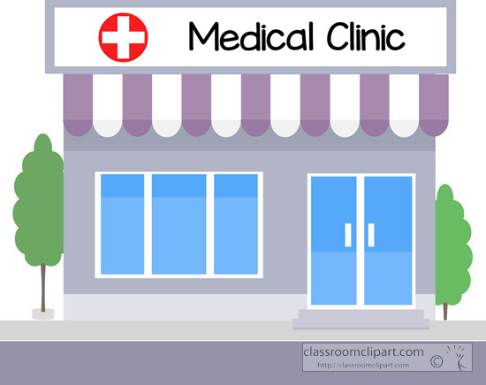
What did we do?
Safety Net Clinics
Specialty Access for the Uninsured Program (SAUP)
Launched in 2012
Model: Pair safety net clinics with health system partners for managed access to specialty care
Hospital System

Slide 9
Specialty Access for Uninsured Program - SAUP
Goals:
Improve specialty care delivery and care management processes
Improve efficiency and effectiveness of care
Improve health outcomes
Decrease total cost of care
Target Population:
Approximately 16,000 Milwaukee County residents who:
Are established patients with a SAUP safety net clinic
Have income up to 250% of the Federal Poverty Level
Are unable to secure public insurance

Slide 10
SAUP Model
The safety net clinics identify eligible patients. The clinics provide primary care, medication access, benefit counseling, enrollment assistance, and navigation and social supports.
The health systems each secure a network of specialists and provide inpatient and outpatient specialty services.
All usual and customary specialty consultation, testing and treatments are “covered” under SAUP, with no out-of-pocket cost to patients.
Patients are referred for a single episode of care, and returned to the primary care provider for ongoing care management.
Ongoing specialty access is also provided for individuals with chronic conditions.
Notes:
Functions as a “medical home”*
Accepts uninsured or both Medicaid and uninsured, providing free care or sliding scale
Has Medicaid certification, if receiving Medicaid patients
Provides primary care, medication access, benefit counseling and enrollment assistance and other wrap around services for uninsured patients
Provides specialty care referral management, including pre-referral screening and post specialty care follow up
Has physician or nurse practitioner staffing model, with adequate physician coverage
Provides care 30 or more hours per week with back-up coverage
Maintains a medical record
Located in Milwaukee County and meets geographic or population access need
Complies with SAUP protocol, including outreach, data collection, and participation in quality improvement efforts
Independent physician practices are excluded
2 preventive services:
Diabetic retinopathy screening.
Colonoscopy for high risk.

Slide 11
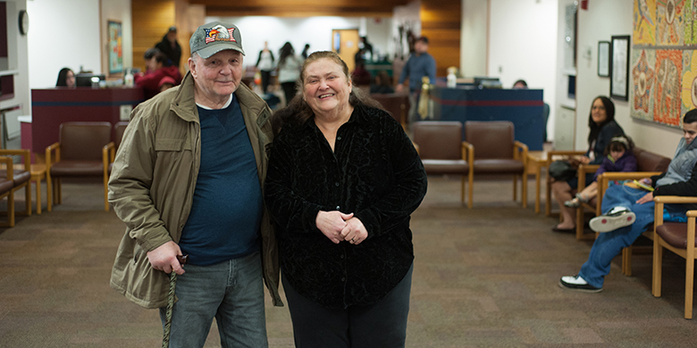
Outcomes
10,851 referrals to specialty care have been made between 2012 - 2016, with a 93% show rate.
Top 3 specialty diagnostic categories for SAUP in 2015
Urology
Gastroenterology
Orthopedics

Slide 12
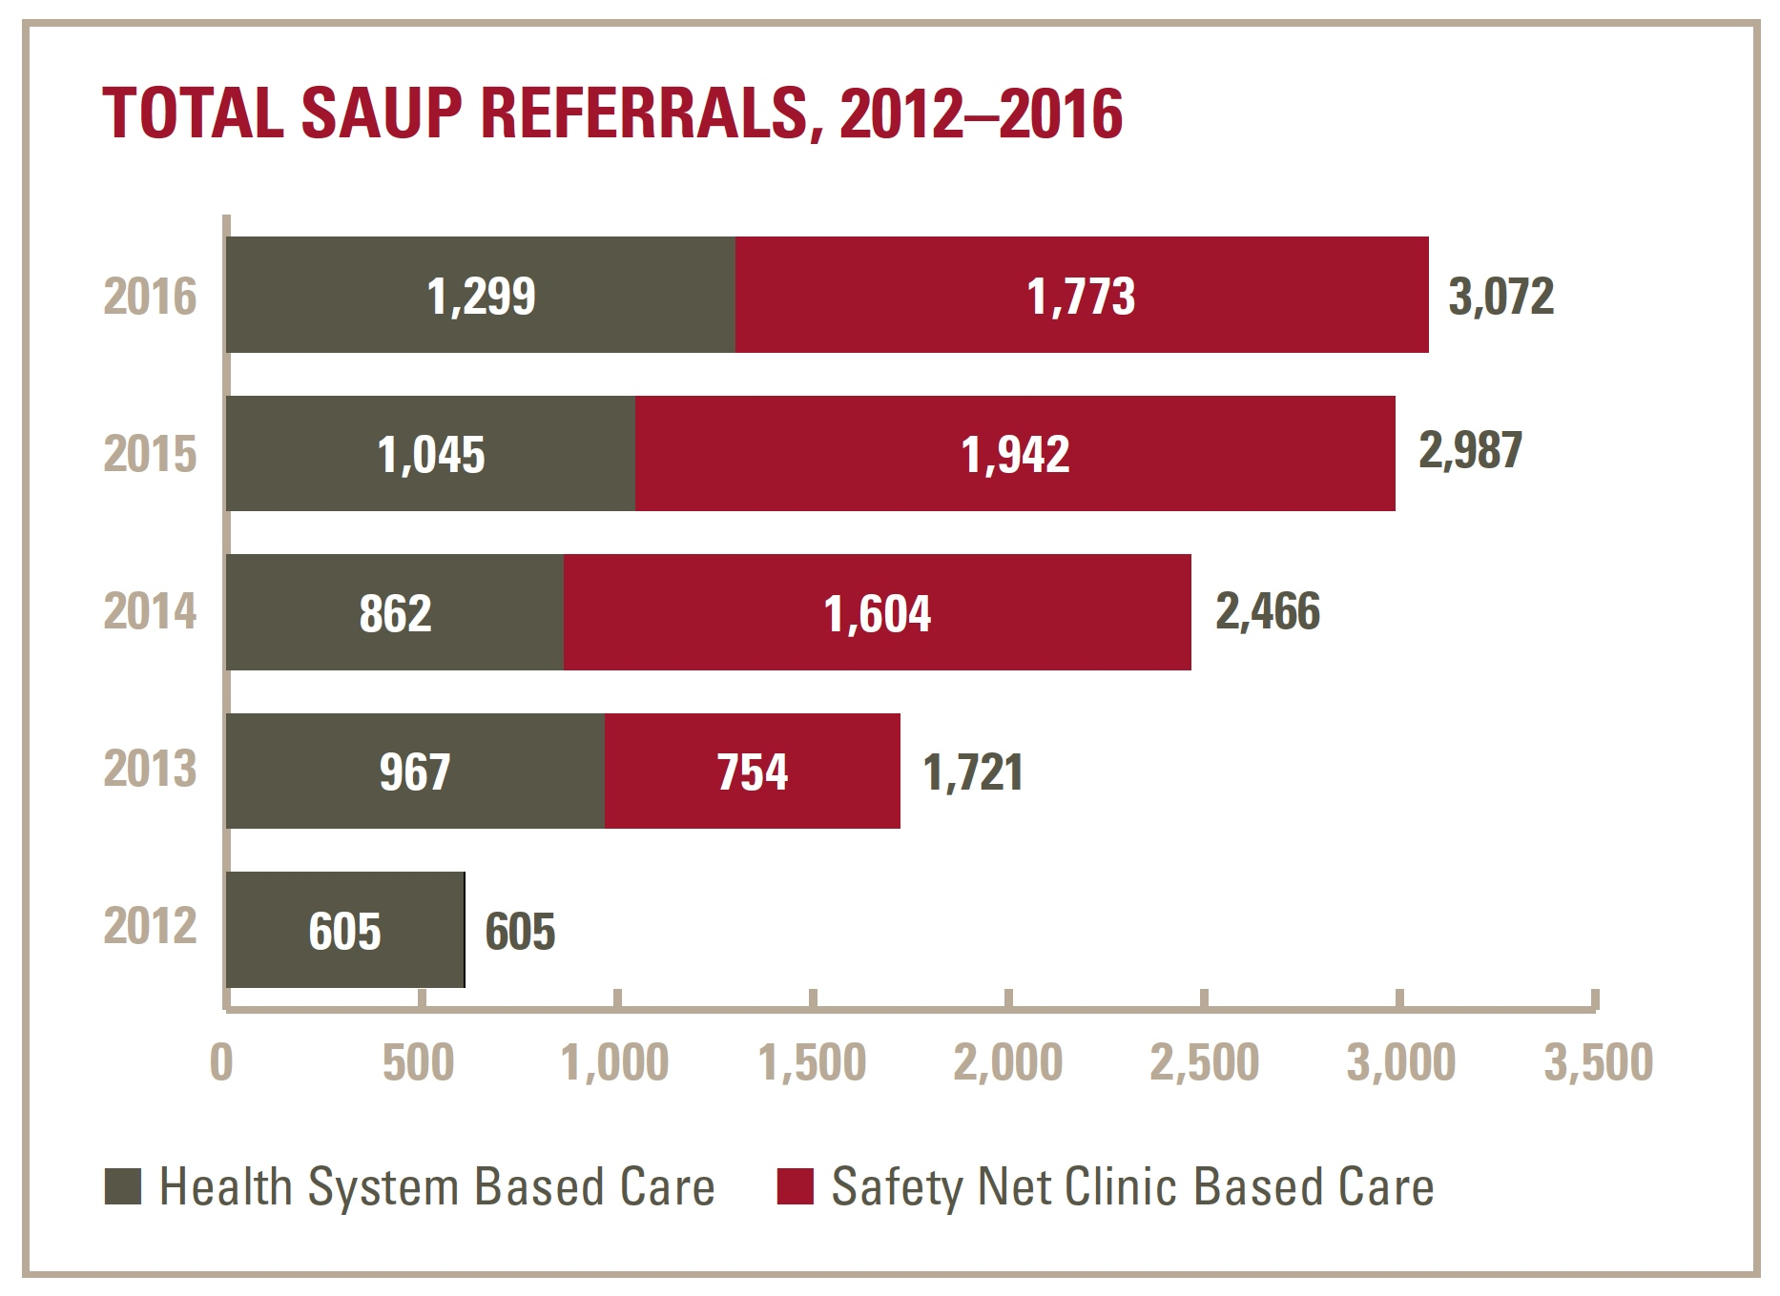
Outcomes
Notes:
58% safety net clinic based
42% health system referrals
6& had a referral to health system

Slide 13
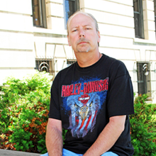
Anthony’s Story
Notes:
Dr. Tom Jackson of the Bread of Healing free clinic is a member of the Partnership’s Clinical Council and was instrumental in the design of SAUP.
Patient Story:
Being There – St. Ben's Clinic Helped Anthony Hannon Fight Cancer and Homelessness
When Anthony first discovered the lump in his neck, he faced the same decision that many people do when confronted with a strange, new ailment. Is it something that can be ignored until it just goes away on its own? Or is it something serious, requiring an immediate trip to the doctor?
That decision is that much harder, however, when you’re living in a homeless shelter.
At the time, Anthony was living at the Rescue Mission Shelter in downtown Milwaukee. Fortunately, he was there when Ellen Krueger, the Outreach Nurse for Columbia St. Mary’s St. Ben’s Clinic, was doing one of her bi-monthly screening and health counseling sessions.
After examining the lump on his neck, Ellen was concerned and asked Anthony to come to St. Ben’s Clinic for further evaluation. There, Anthony met with Sara Zirbel, a Nurse Practitioner, who was similarly worried and referred him to Dr. Gretchen Durkin, an Ear, Nose and Throat specialist.
Dr. Durkin returned with the diagnosis: cancer.
Although he was without financial support – diagnostic testing was funded through the Specialty Access for Uninsured Program (SAUP), a form of financial assistance charity care at Columbia St. Mary’s – Anthony had the courage to forge ahead through treatment planning and implementation.
The first step of his treatment was to visit a dentist to ensure his teeth and gums were healthy enough for the radiation treatment of his neck. It was at this time Anthony decided to call his father, from whom he had been estranged, and ask if he could stop by to tell him about his health problems. After hearing about Anthony’s cancer, his father did not want him going through treatment while living in a shelter and asked him to move in with him.
With the renewed support of his father, Anthony made his way through the 35 radiation treatments and two rounds of chemotherapy. His stress over treatment costs was relieved when the St. Ben’s Clinic social worker referred him to a Columbia St. Mary’s financial counselor for help in applying for Medical Assistance. They were successful in the application and Anthony did receive Medical Assistance for his ongoing care.
Today, Anthony feels blessed, not only for the life-saving care he received, but also for the reconciliation with his father.
“This was all through the grace of God. It was like a miracle,” Anthony says. “I haven’t earned any of this. It was all through God’s mercy.”
For their part, the St. Ben’s Clinic staff is thankful they could be there and be part of God’s plan for Anthony.

Slide 14
Lessons Learned
Efficiencies: Financial eligibility screening
Conservative – review by medical director
Care coordination
Care in the safety net clinic setting
Supports screening – telemedicine
Accountable care system for the uninsured
Notes:
Connect to objectives submitted to CJA here or other slides?
Presentation Objectives (2 minimum) (100 CHARACTERS)
How to collaborate across health systems and community clinics
Key factors for patient-centered results

Slide 15
Critical Success Factors
Sponsorship – The Partnership
Clinical leadership – clinical council
Project management and evaluation: grant funding, sustainability, board support
SAUP “coordinators” for each clinic and health system – single point of contact
“Improving transition care management is a critical success factor in patients being able to make their specialty appointments and receive high quality, timely health care services.”
John Fangman MD , Froedtert and the Medical College of Wisconsin
Notes:
Dr. Fangman Quote Source: SAUP HWPP Spotlight D5. From Clare 1-30-17
Recognition early on the need to streamline the access issue – they eventually arrived at a common threshold for charity care eligibility.
Language from the original CJA Proposal submission:
“Key success factors contributing to the SAUP have been the willingness of competing adult health systems to align and adopt the financial assistance screening processes implemented by safety net clinics, and the commitment to offering a network of specialists, for inpatient, outpatient and ancillary services. Also integral to SAUP’s success has been the medical-home capacity of the participating clinics in providing primary care, medication access, benefit counseling, enrollment assistance and navigation support. With strong commitment and collaboration across SAUP providers, care coordinators in all settings have built reliable relationships that have created a barrier-free experience and improved health outcomes for the uninsured patient.”

Slide 16
Looking Ahead
Adjusting to environmental changes with a nimble distributive methodology
Role of health information exchange in provider communication
“The Partnership, and especially the SAUP program, is a unique collaborative effort among traditional competitors who have worked together to improve care and reduce fragmentation. We have learned a great deal about process improvement and removing barriers to care, across the community.”
Tom Jackson MD, Bread of Healing free clinic
Notes:
Accountable care system = population health – this is a point the audience will be interested in

Slide 17
Questions?

Slide 18
Thank You
Milwaukee Health Care Partnership
(414) 585-4923
www.mkehcp.org
Betty Ragalie
bragalie@mkehcp.org

