Slide 1

Social Impact Bond 2.0
A New Way to Get Resources & Results
Bill Barberg, President & Founder, Insightformation, Inc.
Scott Cole, CEO & Co-Founder, Collectivity

Slide 2

The Typical Approach to Solve Community Problems Involves Seeking Resources to Scale Up Programs
Reduce Substance Misuse
Substance Misuse Rate
M
A program or PSE change with a strong evidence base
M
M
M
M
M
M
M
M
M
M
M
Notes:
Often there is a lot of emphasis on outcome measures and then individual organizations, programs or grant recipients need to come up with their own measures of performance. Each program or organization will tend to pick measures that make them look good. But, even though there are a lot of measures, they don’t really drive alignment around a strategy. This approach to measurement--even with a shared outcome measure—does not significantly improve alignment and teamwork.

Slide 3
Agenda
Embrace a “Bootstrap” Mindset
Social Impact Bonds 2.0
  Overview of SIBs
  Six Fundamental Shifts
  SIB 2.0 Techniques
Becoming an SIB 2.0 Pilot Community

Slide 4
Re-Engineer Your Coalition First…
…to reduce your dependence on investment dollars and grants by
Improving Community Teamwork, and
Shifting from Scarce to Abundant and Multiplying Resources

Slide 5
Fragmentation Undermines Success
Execution
Gap
Health Goals
No Strategic Alignment
Wasteful redundancy
Little sharing of information, ideas and resources
Frequent ramp-up and ramp-down of programs based on funding
Time spent chasing and competing for funding
Frustration among people committed to improving the environment
Notes:
This arrow at the top in the blue represents a community that might agree on some high level health goals, reducing obesity, reducing teenage pregnancy, things of that sort. The little black arrows represent all of the different efforts and programs and things that are in place to try and achieve that. And as you can see, because of the fragmentation and poor alignment, there is an execution gap. There’s also a lot of wasteful redundancy, a failure to share information, and ideas, and resources, in ways that would be ideal. You have different grants that would result in a ramping up and ramping down of programs based on funding. As well as, time spent chasing and competing for funding instead of working to actually address the social issues, which are difficult to address because they require many organizations working together.

Slide 6
No Strategic Alignment
Execution
Gap
Unmet
Health
Goals
Other Public Agencies & Officials
Health Depts
Medical Practices
Social Service Providers
Hospitals
Improve Community Health Outcomes
Schools
Community
groups
Faith Communities
Families
& individuals
Employers

Slide 7

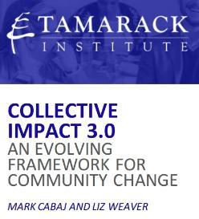
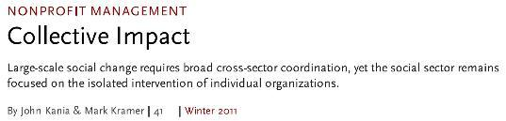
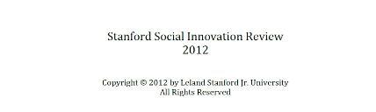
An Asset-Based Approach to “Collective Impact”
2011
Notes:
During the presentation you can type in questions. For those who may not be familiar with the term collective impact, we’re specifically referring to collective impact as it is described in a series of articles in the Stanford Social Innovation Review, one of which I have shown here on the screen. And if you fill out the survey at the end of the webinar, you’ll have the opportunity to request a copy of this article, which I think is an excellent summary of their research and the concepts behind collective impact and some good insights on getting started in that process.

Slide 8


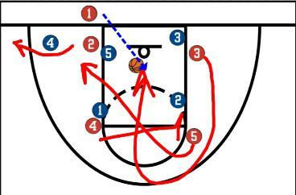
Learning a New Game

Slide 9
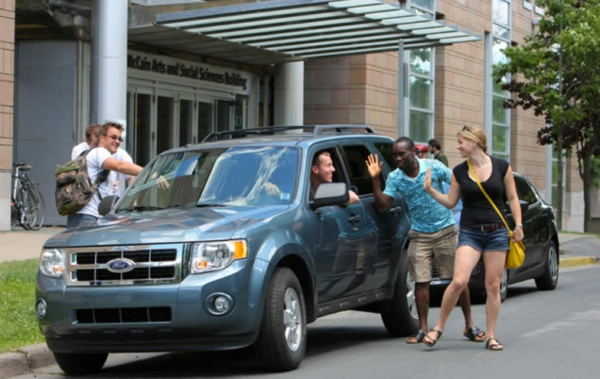

The Power Source for Sustainable Collective Impact
Condition Three: Mutually Reinforcing Activities
- Participant activities must be differentiated while still being coordinated through a mutually reinforcing plan of action
Upgrade to Mutually-Reinforcing and Mutually-Beneficial Activities

Slide 10

Who Scored More Career Points Than This Guy?
32,292 Points
Michael Jordan
Notes:
I’d like to start off with a poll so we can understand what exposure you have to the concept and understanding of collective impact. Whether is very little beyond hearing the term, limited exposure, it’s a concept you embrace, or very familiar with. So let’s put out the poll and encourage you to take and select which of these best describes your familiarity and understanding. Just a few more seconds, most of you have voted and we will close the polls here. And display the results. So in spite of the fact that the webinar’s talking about collective impact, most of you have little exposure beyond hearing the term, or perhaps have read the article. So this will be a good chance for you to learn more about this powerful concept and why its getting such positive press I guess and buzz. So I will start off with sharing a little bit more about this concept.

Slide 11
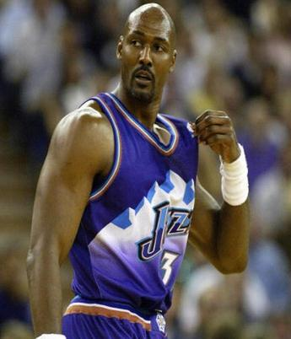
Who Is This Guy?
36,928 Points
Karl Malone
Notes:
I’d like to start off with a poll so we can understand what exposure you have to the concept and understanding of collective impact. Whether is very little beyond hearing the term, limited exposure, it’s a concept you embrace, or very familiar with. So let’s put out the poll and encourage you to take and select which of these best describes your familiarity and understanding. Just a few more seconds, most of you have voted and we will close the polls here. And display the results. So in spite of the fact that the webinar’s talking about collective impact, most of you have little exposure beyond hearing the term, or perhaps have read the article. So this will be a good chance for you to learn more about this powerful concept and why its getting such positive press I guess and buzz. So I will start off with sharing a little bit more about this concept.

Slide 12
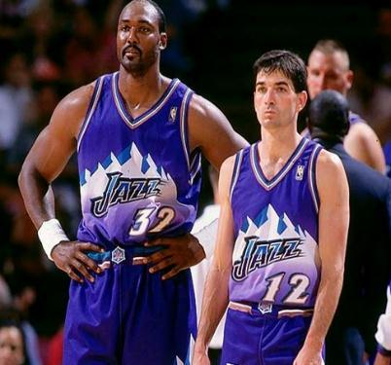
The Power of Teamwork!
36,928 Points
15,806 Assists
9x NBA Assists Leader
Karl Malone
John Stockton
Notes:
I’d like to start off with a poll so we can understand what exposure you have to the concept and understanding of collective impact. Whether is very little beyond hearing the term, limited exposure, it’s a concept you embrace, or very familiar with. So let’s put out the poll and encourage you to take and select which of these best describes your familiarity and understanding. Just a few more seconds, most of you have voted and we will close the polls here. And display the results. So in spite of the fact that the webinar’s talking about collective impact, most of you have little exposure beyond hearing the term, or perhaps have read the article. So this will be a good chance for you to learn more about this powerful concept and why its getting such positive press I guess and buzz. So I will start off with sharing a little bit more about this concept.

Slide 13

Recruiting Partners to Provide Assists
Focus on engaging the people you’re trying to help—not just as voices, but as key parts of the solution.
Other Non-Profits
Faith Communities
Universities and Colleges
Local Media
Social Entrepreneurs
Notes:
Today’s presentation will begin with a brief introduction and then we will talk the challenges in achieving collective impact. Then the majority of the presentation will focus on new techniques and tools that make collective impact more practical to accomplish and will summarize with some of the benefits, sharing some of the clients we have worked with, and a few concluding points.

Slide 14
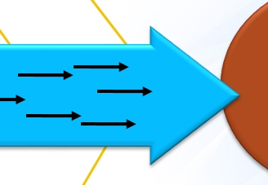
Improve Each Program or PSE Change with “Assists”
© 2015 All Rights Reserved by Insightformation, Inc.
Notes:
If you’re a funder or a grant giving organization, this well help you efficiently align the many different stakeholders in the community. Have them work together for collective impact. And have transparent engagement with the leading indicators, so you can make adjustments, not just wait. You have frequent communication of strategy, you can have infrastructure to be able to communicate and update what their planning on doing and what their actually doing. And all of this is ready in presentation-ready formats that reduces preparation times for meetings on the part of you and the grantees. And continuous evaluation and access to reports 24/7.

Slide 15
Re-Engineer Your Coalition First…
…to reduce your dependence on investment dollars and grants by
Improving Community Teamwork
Shifting from Scarce to Abundant and Multiplying Resources

Slide 16
Three Categories of Resources
Scarce,
Zero Sum
Dollars
Scarce Time
Abundant
Unemployed Youth
Church Facilities
Student Volunteers
Retirees
Cognitive Surplus
(Search for TED Talk)
Multiplying*
Ideas
Templates
On-line videos & toolkits
Shared digital assets
Relationships
Software*
* Or Near Zero Marginal Cost

Slide 17
Designing Strategies to be Scalable
The Need: 500 third-graders behind in reading proficiency
Option 1: Paid Tutors & Reading Specialists
  $2,000/child = $1 million + $200,000 to coordinate (per year)
Option 2: Volunteer Tutors
  250 to 500 skilled volunteers needed
  20 hours training per volunteer
  4 to 8 hours per week in volunteering
  $250,000 to coordinate

Slide 18

Using Abundant & Multiplying Resources
  Option 3: Scalable Innovations
$50 per child = $25,000 per year + $5,000 one-time cost
Volunteers need very little training or skills
2 volunteers / 25 kids (4 hours per month per volunteer)
$50,000 for coordination
Using software & singing to teach reading.
Proven Effectiveness to advance 1 year in 12-weeks

Slide 19
Combine Multiplying Resources & Assists
The Need: Help ex-convicts get connected with the resources to reduce recidivism in Arkansas
Multiplying Resource: Innovative Software: The Good Grid
  Technology to align & coordinate the efforts of existing organizations
  E-learning, care coordination, information sharing and much more
The Need: Updated, Detailed Information on Thousands of Organzations
  Services
  Capabilities
  Contacts
  Understanding of The Good Grid

Slide 20

Harnessing the Abundant Resources
The “John Stockton” Harding University in Searcy, Arkansas
1,200 Student
Volunteers
Impact: Updated, information on 6,000 Service Providers loaded into The Good Grid Software
“Impact Service Project”
Raised awareness and interest in doing more

Slide 21
Agenda
Embrace a “Bootstrap” Mindset
Social Impact Bonds 2.0
  Overview of SIBs
  Six Fundamental Shifts
  SIB 2.0 Techniques
Becoming an SIB 2.0 Pilot Community

Slide 22
The Appeal of Social Impact Bonds
Blends Pay for Success with financial investors who provide the up-front dollars
Addressing the “wrong pockets” problem
Addresses the time lag problem
Allow non-profit organizations to earn revenue
Provide pathways for mission-oriented or social impact investments
The potential to tap into vast financial resources

Slide 23
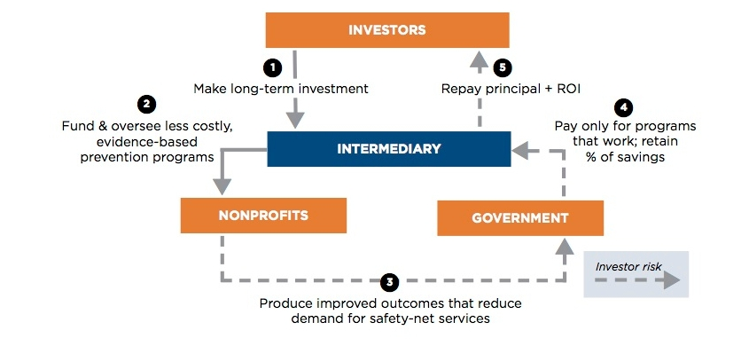
How SIBs Work (Version 1.0)
Source: Caffeinated Capital

Slide 24
The Gradual Traction and Struggles of SIBs
Lots of hype and interest
Many educational sessions
SIB Lab at Harvard (funded by the Rockefeller Foundation)
Only 12 active SIBs in the U.S. so far
  Recidivism
  Homelessness
  Early childhood / school readiness
  Average SIB investing about $1 million/year for 7 years.

Slide 25
The First SIB in the United States
Reduce youth recidivism at Riker’s Island jail in NYC
Funder: Goldman Sachs Urban Investment Group (UIG)
$7.2 million invested in Moral Reconation Therapy (MRT)
Ended with no success payment.
  Bloomberg Foundation paid $6 million to the funder
  Goldman Sachs UIG lost $1.2 million

Slide 26
Redesigning the SIB Model
Different purpose
  SIB 1.0 “Monetize future government savings”
  “An important business opportunity that can also do good for our society.”
  SIB 2.0 “Transform social finance to improve efficiency,
  collaboration and outcomes.”
Different set of assumptions
  Improving collaboration is the key to success
  Leverage unique local assets and help people help themselves
  Minimize money extracted from the community
  Technology & multiplying resources can be game-changers

Slide 27
Shift #1: Embrace Collective Impact
Isolated Impact
approach
Collective Impact approach

Slide 28
SIB 1.0 Funds Isolated Interventions
Priority Goal
Pick winners (and losers) and invest in the winners.
Outcome Measure
M
M
A program or PSE Change with a strong evidence base
M
M
M
M
M
M
M
M
M
M
Notes:
Often there is a lot of emphasis on outcome measures and then individual organizations, programs or grant recipients need to come up with their own measures of performance. Each program or organization will tend to pick measures that make them look good. But, even though there are a lot of measures, they don’t really drive alignment around a strategy. This approach to measurement--even with a shared outcome measure—does not significantly improve alignment and teamwork.

Slide 29
Shift #2: Different Way to Minimize Risks
Only fund interventions with a strong research base
Implement them "with fidelity"
Use community collaboration to enhance success
Use proven strategy management techniques to improve execution while allowing flexibility

Slide 30
Disadvantages of the SIB 1.0 Risk Mitigation
Interventions limited by evidence-based criteria
  Largely eliminates broad collaborative efforts
  Nearly always points to “isolated impact” interventions
Universe of Potentially Valuable Approaches
Interventions that have been tried
Interventions that have been researched

Slide 31

Moonshots are Not Achieved by Only Using “Evidence-based Interventions” or Process Improvement

Slide 32
Disadvantages of the SIB 1.0 Risk Mitigation
“Implementing with Fidelity” can be problematic or counter-productive
  Limits the listening to and engaging the locals
  Typically much more expensive to control variables
  Limits flexibility to make adjustments
  Limits the ability to benefit from “assists”

Slide 33
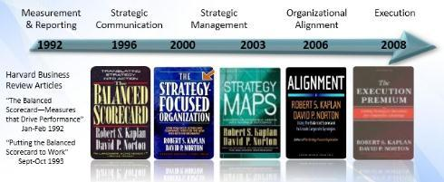
Reducing Risk with Strategy Management
Systematically Weave Many Actions Together
Anticipate Risks, Monitor Progress & Adjust
  A different approach to measurement
  Monitor Actions and “Drivers”
20 Years Track Record for Strategy Execution

Slide 34
Alignment Challenges without Strategy Measures
Outcome Objective
Evaluation Focused
Outcome Measure
M
M
M
M
M
M
M
M
M
M
M
M
Notes:
Often there is a lot of emphasis on outcome measures and then individual organizations, programs or grant recipients need to come up with their own measures of performance. Each program or organization will tend to pick measures that make them look good. But, even though there are a lot of measures, they don’t really drive alignment around a strategy. This approach to measurement--even with a shared outcome measure—does not significantly improve alignment and teamwork.

Slide 35
The Power of Community Strategy Measures
Outcomes
Outcome Objective
Outcome Measure
Strategies
Driver Objective
Driver Objective
Strategy Measure
Strategy Measure
Notes:
With strategy maps, we add at least one layer of detail below the Outcome Objectives and Measures that provides clarity to the strategy. As we have discussed, these strategy objectives are not the project or programs of individual organizations, but rather the changes, or the drivers of the outcomes, that will require collaboration among multiple organizations. Each of these Strategy Objectives also has one or two measures that are can be used to monitor if we as a community are making progress on our strategy. If we are making progress on our strategy, then we should see improvements in the Outcome Measure over time. Instead of selecting measures for each program, we select the programs and fund actions based on how they can support progress in the strategy—the driver Objectives. These are the types of measures that are often missing, and they are the ones that can allow for adjustments—such as pulling in additional “assists” by other organizations, represented by the red arrows here.
Instead of having the fragmented measures we saw in the previous slide, if the community can agree on the strategy map and then have measures for those objectives that will drive the outcomes, we can have far fewer measures to monitor and have more focus on working together to achieve those strategy objectives that will drive the success with the Outcome Objectives and the Outcome Measures.

Slide 36
Outcomes
Reducing Recidivism
Outcome Success Payments
Recidivism Rate
Strategies
Strategy Execution Payments
Increase Employment for Ex-Offenders
Individual Therapies
Strengthen Community Support & Mentoring
Employment Rate for Returning Citizens
# Completing Selected
Therapy Programs
% Participating in Mentoring
Notes:
With strategy maps, we add at least one layer of detail below the Outcome Objectives and Measures that provides clarity to the strategy. As we have discussed, these strategy objectives are not the project or programs of individual organizations, but rather the changes, or the drivers of the outcomes, that will require collaboration among multiple organizations. Each of these Strategy Objectives also has one or two measures that are can be used to monitor if we as a community are making progress on our strategy. If we are making progress on our strategy, then we should see improvements in the Outcome Measure over time. Instead of selecting measures for each program, we select the programs and fund actions based on how they can support progress in the strategy—the driver Objectives. These are the types of measures that are often missing, and they are the ones that can allow for adjustments—such as pulling in additional “assists” by other organizations, represented by the red arrows here.
Instead of having the fragmented measures we saw in the previous slide, if the community can agree on the strategy map and then have measures for those objectives that will drive the outcomes, we can have far fewer measures to monitor and have more focus on working together to achieve those strategy objectives that will drive the success with the Outcome Objectives and the Outcome Measures.

Slide 37
Strategy to Address Opioid & Heroin Abuse
Outcomes
Reduce Crime & Law Enforcement Costs due to Opioid Misuse
Decrease Health Costs & Employment Problems due to Opioid Misuse
Minimize Babies born with Opioid Addictions
Decrease Deaths due to Opioid Misuse
Strategies
Reduce Opioid Drug Misuse
Minimize People Starting to Misuse Opioid Drugs
Enable People Who Start Misusing Opioids to Quickly Quit
Improve Treatment of Addicted People & Enable Recovery
Prevent Overdose Deaths
Reduce Access to Opioids
Minimize Desire to Misuse Opioids
Improve & Expand Screening & Testing for Misuse
Improve Alignment & Teamwork Among Existing Programs & Opioid-Related Coalitions
Adopt Key Legislative & Policy Changes to Address the Opioid Crisis
Reduce Use of Gateway Drugs
Reduce Prescription of Opioids
Expand SBIRT Program
Reduce Stigma of Seeking Help with Substance Misuse
Increase Awareness of the Risks & the Crisis
Become a Trauma-Informed Community
Expand Access to (MAT) Medication-Assisted Treatment
Shift from Punishment to Treatment Approach for Opioid Users
Asset & Capacity Building
Strengthen the Coalition to Reduce Opioid Abuse
Engage Youth to Improve Communication & Prevention
Secure Funding for Expanding Addiction Treatment
Engage Healthcare Professionals to Address the Opioid Crisis
Increase Resources to Address the Opioid Crisis
Template Created by Insightformation, Inc.
www.Insightformation.com

Slide 38
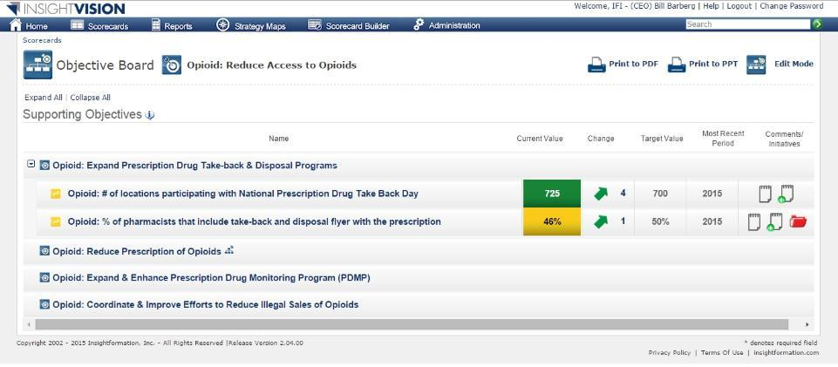
Scorecard Showing “Driver” Objectives & Measures
Click
Notes:
Often there is a lot of emphasis on outcome measures and then individual organizations, programs or grant recipients need to come up with their own measures of performance. Each program or organization will tend to pick measures that make them look good. But, even though there are a lot of measures, they don’t really drive alignment around a strategy. This approach to measurement--even with a shared outcome measure—does not significantly improve alignment and teamwork.

Slide 39
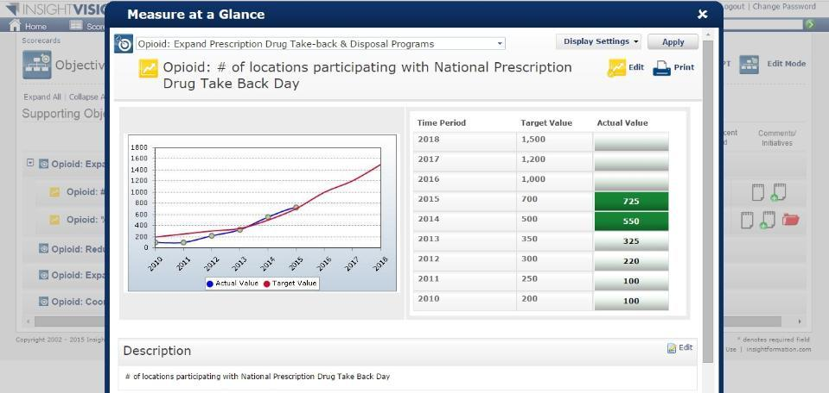
One-Click Access to Trend Data, Comments & More
Notes:
Often there is a lot of emphasis on outcome measures and then individual organizations, programs or grant recipients need to come up with their own measures of performance. Each program or organization will tend to pick measures that make them look good. But, even though there are a lot of measures, they don’t really drive alignment around a strategy. This approach to measurement--even with a shared outcome measure—does not significantly improve alignment and teamwork.

Slide 40
One Click to See the “Action Plans” for each Measure
Notes:
Often there is a lot of emphasis on outcome measures and then individual organizations, programs or grant recipients need to come up with their own measures of performance. Each program or organization will tend to pick measures that make them look good. But, even though there are a lot of measures, they don’t really drive alignment around a strategy. This approach to measurement--even with a shared outcome measure—does not significantly improve alignment and teamwork.

Slide 41
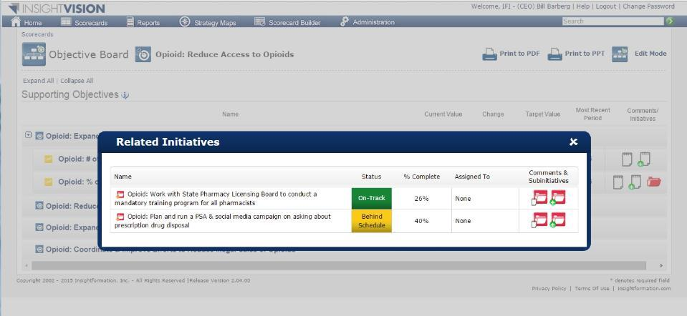
Show Many “Mutually-Reinforcing Activities” and “Assists”
Notes:
Often there is a lot of emphasis on outcome measures and then individual organizations, programs or grant recipients need to come up with their own measures of performance. Each program or organization will tend to pick measures that make them look good. But, even though there are a lot of measures, they don’t really drive alignment around a strategy. This approach to measurement--even with a shared outcome measure—does not significantly improve alignment and teamwork.

Slide 42
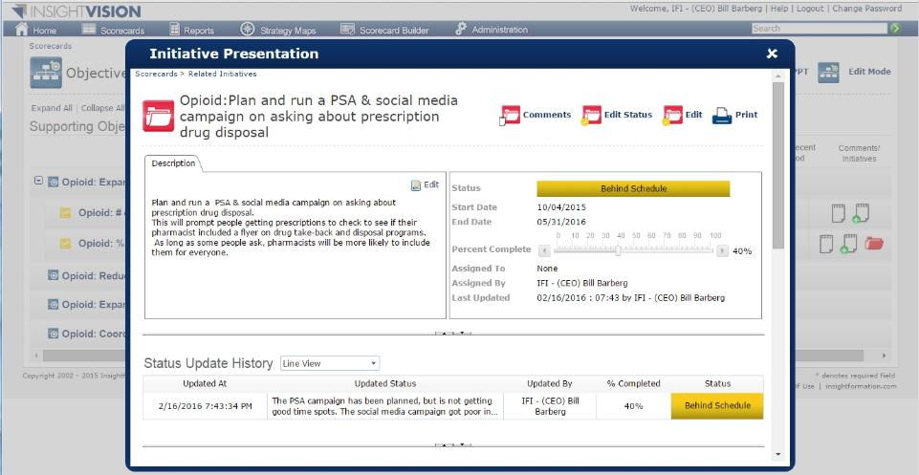
Powerful Transparency on How Actions are Progressing
Notes:
Often there is a lot of emphasis on outcome measures and then individual organizations, programs or grant recipients need to come up with their own measures of performance. Each program or organization will tend to pick measures that make them look good. But, even though there are a lot of measures, they don’t really drive alignment around a strategy. This approach to measurement--even with a shared outcome measure—does not significantly improve alignment and teamwork.

Slide 43
Shift #3: Different Designers and Investors
Shifting from extractive financial investors to local foundation PRIs.
Social Impact
Profit
Profit
Social Impact

Slide 44
Financial Industry is Good at Extracting Value
Financial investors are eager to find high returns
  Venture Capitalists as in “Shark Tank”
  Developing creative financial derivatives to “monetize” business profits
SIB 1.0 Investors want high returns
  Generally looking for 12% or more
  Seek to have philanthropists take much of the risk
  Capital costs can often exceed intervention costs
  SIB Service fees can be high (10-20%)

Slide 45
SIB 2.0 is Different
Concept Developers are Focused on Having Impact
SIB Funders are (Local) Foundation Investments
  Program Related Investments (PRI)
  Over $500,000,000,000 could be tapped.
Keep Money in the Community
Minimize Transaction Costs & Extracted Profits

Slide 46
Six Differences between SIB 1.0 & 2.0
SIB 1.0 | SIB 2.0
Isolated Impact approach | Collective Impact approach
Minimize risk by selecting evidence-based interventions and implementing with fidelity | Minimize risk by using system leadership, community input and assets, and rigorous strategy management practices & technology
Designed by the financial industry to (eventually) get funding from mainstream investors | Design by the social sector innovators to get funding from Foundation Program-Related Investments
Funding given to the organization delivering the specific program (and most of the success payment goes to the investors) | Funding goes into the StratEx budget for the topic (managed by the action team) and value is multiplied by using funding techniques that promote collaboration. Gainsharing Bonuses.
Long, complex documents | Much simpler documents
Philanthropy use to pay investors if success payment is not reached | Philanthropy used to overcome obstacles and to Pay for Success of driver Objectives.

Slide 47
SIB 1.0 Sources and Uses of Funding
Social Impact Investors
SIB 1.0
$$$$$
Isolated, Evidence-Based Programs
Mainstream Investors
Isolated, Evidence-Based Programs

Slide 48
Strategy to Address Opioid & Heroin Abuse
Outcomes
Reduce Crime & Law Enforcement Costs due to Opioid Misuse
Decrease Health Costs & Employment Problems due to Opioid Misuse
Minimize Babies born with Opioid Addictions
Decrease Deaths due to Opioid Misuse
Strategies
Reduce Opioid Drug Misuse
Minimize People Starting to Misuse Opioid Drugs
Enable People Who Start Misusing Opioids to Quickly Quit
Improve Treatment of Addicted People & Enable Recovery
Prevent Overdose Deaths
Reduce Access to Opioids
Minimize Desire to Misuse Opioids
Improve & Expand Screening & Testing for Misuse
Improve Alignment & Teamwork Among Existing Programs & Opioid-Related Coalitions
Adopt Key Legislative & Policy Changes to Address the Opioid Crisis
Reduce Use of Gateway Drugs
Reduce Prescription of Opioids
Expand SBIRT Program
Reduce Stigma of Seeking Help with Substance Misuse
Increase Awareness of the Risks & the Crisis
Become a Trauma-Informed Community
Expand Access to (MAT) Medication-Assisted Treatment
Shift from Punishment to Treatment Approach for Opioid Users
Asset & Capacity Building
Strengthen the Coalition to Reduce Opioid Abuse
Engage Youth to Improve Communication & Prevention
Secure Funding for Expanding Addiction Treatment
Engage Healthcare Professionals to Address the Opioid Crisis
Increase Resources to Address the Opioid Crisis
Template Created by Insightformation, Inc.
www.Insightformation.com
Notes:
Now minimizing childhood obesity is the desired outcome up on the top here and this would be measured. And at the top we’ve said this will be achieved if we can have the outcome of improving healthly eating for children as well as increasing age-appropriate activity. Now that’s not rocket science but if the community agrees on this framework, it’s a great way to start to bring consensus. Then the next set of objectives are what is the community going to do to achieve each of these. And in this case we have improve school nutrition and fitness programs and promote family nutrition and fitness to parents and kids. To increase age-appropriate activity besides the schools, we have increase biking and walking for recreation and transportation and increase neighborhood recreational activities to get kids off the computers and tv and out having fun, getting exercise. Well these would be good objectives and we can measure progress in these but their not just going to happen. They’re going to require the community doing things differently such as expanding and connecting and promoting trails and the built environment for active recreation. Or collaborating to leverage community assets for neighborhood fitness. This is describing a different way of working that can be focused on, measured, projects can be launched to accomplish this. As well as thing such as increase the monitoring of children’s BMI, nutrition, and fitness. And mobilizing assets in ways such as partnering with schools, parents, and community stakeholders or training public health staff in communication in asset based community development. So we have a story here of how this community can come together to minimize childhood obesity. But it’s not just a static document.

Slide 49
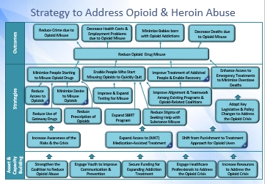
SIB 2.0 Sources and Uses of Funding
Existing Orgs & their $$
Increased Community “Assists”
Existing NPs & their Grant $$
Philanthropic PFS Funders
SIB 2.0
$$
Local Foundation PRI
StratEx
Budget

Slide 50
Six Differences between SIB 1.0 & 2.0
SIB 1.0 | SIB 2.0
Isolated Impact approach | Collective Impact approach
Minimize risk by selecting evidence-based interventions and implementing with fidelity | Minimize risk by using system leadership, community input and assets, and rigorous strategy management practices & technology
Designed by the financial industry to (eventually) get funding from mainstream investors | Design by the social sector innovators to get funding from Foundation Program-Related Investments
Funding given to the organization delivering the specific program (and most of the success payment goes to the investors) | Funding goes into the StratEx budget for the topic (managed by the action team) and value is multiplied by using funding techniques that promote collaboration. Gainsharing Bonuses.
Long, complex documents | Much simpler documents
Philanthropy use to pay investors if success payment is not reached | Philanthropy used to overcome obstacles and to Pay for Success of driver Objectives.

Slide 51
Agenda
Embrace a “Bootstrap” Mindset
Social Impact Bonds 2.0
    Overview of SIBs
    Six Fundamental Shifts
  SIB 2.0 Techniques
Becoming an SIB 2.0 Pilot Community

Slide 52
Seeking SIB 2.0 Pilot Communities
If you are interested…
  Indicate in the Survey
  Attend a Web-conference call discussion
  Seeking to find national funders to support a pilot
Innovative practices can be adopted even
without an SIB

Slide 53
Contact
Bill Barberg - bill.barberg@Insightformation.com
Scott Cole - Scott.Cole@Collectivity.coop
Web Address - www.Insightformation.com
QUESTIONS?

