Slide 1
What Communities Need to Know About the Evolving Health Reform Landscape
June 28, 2017 Karen Minyard, PhD Carla Willis, PhD Melissa Haberlen, JD MPH
Notes:
Karen

Slide 2
Survey
I am most worried about:
Medicaid expansion rollback
Medicaid funding changes
Individual / small group insurance market stability
Strained safety net
Having enough coffee
All of the above
What are doing to keep up with health reform?
Watching / listening to news
Reading the bills
Signing up for listservs
Following social media
All of the above
Do you know the difference between a block grant and per capita cap? (Y/N)

Slide 3
Health Reform 2017
Convened Interdisciplinary Work Group
Bi-weekly meetings
Live tracker
Policy Brief Package, Resources, and Tools
Published briefs – American Health Care Act, Market Stabilization Rule, Cost Sharing Reductions
Briefs currently in development – Alternatives to Medicaid Financing, Better Care Reconciliation Act
Presentations
State-Level Support
Medicaid, Behavioral Health, Legislature
Notes:
Karen

Slide 4
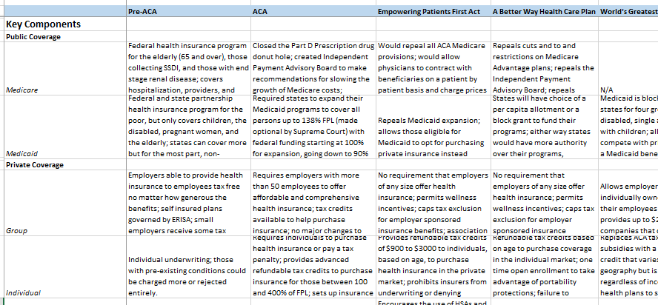
Health Reform 2017
Live Tracker Snapshot
Notes:
Karen

Slide 5
Three-Pronged Approach
3 R’s
Reconciliation
Regulation (and other administrative actions)
Regular order
Notes:
Karen
https://www.whitehouse.gov/sites/whitehouse.gov/files/images/20170308_HEA_obamacare_pdf_three-phases-3.pdf
AHCA is first part of a three part approach / 3 R’s
Use reconciliation to repeal key parts of ACA
Regulatory changes
Additional legislation
Reconciliation:
Republicans only have a simple majority in the Senate; thus, they have to use reconciliation to avoid a filibuster:
Can only make changes to money portions of a current bill or law
Requires a simple majority for passage
Cannot be used to fully repeal the ACA
Full repeal is not possible at this time
American Health Care Act (AHCA), as a reconciliation bill, passed the House on May 4, 2017

Slide 6
Medicaid Reforms
 | ACA | AHCA | BCRA
Medicaid funding | States retained Federal Medical Assistance Percentage (FMAP) for traditional populations. Enhanced FMAP for expansion population from 100% in 2014 to 90% in 2020 and subsequent years. | Changes Medicaid funding to per capita caps and optional block grants starting in fiscal year (FY) 2020. Growth rates based on variations of the medical care component of the Consumer Price Index for All Urban Consumers (CPI-U); FY 2016 state spending used as the base. States exceeding per capita caps required to repay overage. States using the block grants may retain unspent dollars. | Changes Medicaid funding to per capita caps and optional block grants starting in FY 2020. Per capita growth rates based on variations of the medical care component of the CPI-U. Block grants are based on CPI-U. State spending for eight consecutive quarters (chosen by state) from FYs 2014–2017 used as base. States that exceed their per capita caps required to repay the overage. States using the block grants may retain unspent dollars. Puts additional restrictions on states’ ability to use provider fees to draw down matching federal funds.
Notes:
Carla
Medicaid expansion
Grandfathers enhanced 90% match for those enrolled as of March 1, 2017 who maintain continuous coverage after 2019
States can expand thru end of 2017 but only at regular match
Supplemental safety net funding for non-expansion states FY 2018 through 2022
Other Medicaid changes
Per-capita caps on federal spending
Block grant option for non-elderly, non-disabled groups
Allow states to impose work requirements for non-elderly, non-disabled, non-pregnant adults starting in FY 2018
Restores pre-ACA DSH payments

Slide 7
Medicaid Reforms
 | ACA | AHCA | BCRA
Medicaid expansion | Expanded Medicaid to 138% of the federal poverty level (FPL) at state option; Required a single, streamlined application for tax credits, Medicaid, and CHIP. 100% FMAP for 2014-2016, phased down to 90% FMAP by 2020 on. | States that expanded as of March 1, 2017, will retain enhanced FMAP as long as enrollees have no more than a one-month break in coverage. Other states have until Dec. 31, 2017, to expand Medicaid, although they will only receive their state’s regular FMAP. | Three-year phase out of enhanced FMAP for expansion states (those expanding prior to March 1, 2017), starting in 2021.
Work requirements | Not addressed. | States will be able to institute work requirements for certain populations and receive 5% ↑ administrative FMAP. | States will be able to institute work requirements for certain populations and receive 5% ↑ administrative FMAP.
Notes:
Carla

Slide 8
Medicaid Reforms
 | ACA | AHCA | BCRA
Safety net funding | Reduced aggregate Medicaid DSH allotments. Required HHS to develop methodology to distribute the DSH reductions based on uninsured rates. Provided states with new options for offering home and community-based services. | Non-expansion states can apply for a portion of $2 billion each year for FYs 2018-2022. These allotments can be applied to the costs of providing health care services for Medicaid members, the uninsured, and the underinsured. Payments to states funded at 100% by the federal government in FYs 2018-2021 and at 95% in FY 2022. | Non-expansion states can apply for a portion of $2 billion each year for FYs 2018-2022. These allotments can be applied to the costs of providing health care services for Medicaid members, the uninsured, and the underinsured. Payments to states funded at 100% by the federal government in FYs 2018-2021 and at 95% in FY 2022.
Children’s Health Insurance Plan (CHIP) | Created a minimum eligibility level for all children of 138% FPL. Extended CHIP funding to 2015 and increased the FMAP up to 100%. | Reverts the mandatory Medicaid income eligibility level for poverty-related children back to 100% of FPL. States could cover this population in their CHIP. | Reverts the mandatory Medicaid income eligibility level for poverty-related children back to 100% of FPL. States could cover this population in their CHIP.
Notes:
Carla

Slide 9
Per Capita Caps & Block Grants
Per Capita Caps - Federal funding is capped on a per person basis; typically for each eligibility group
Funding is not adjusted based on health care costs but the states would receive more funding with more people served
Block Grants - National cap on federal Medicaid funding and a lump sum for each state;
Funding is not adjusted based on health care costs or the number of people served
Source: http://kff.org/medicaid/issue-brief/5-key-questions-medicaid-block-grants-per-capita-caps/
Notes:
Carla Additional characteristics of Block Grants
Block grants rarely require states to spend “own” funds to receive federal funds.
Maintenance of effort (MOE) clauses are generally included
Offer greater discretion than current funding arrangement
States are offered a “lump sum” with predetermined growth rate
State allocation of federal funds could be based on a state’s relative need, historical spending, or a national celling

Slide 10
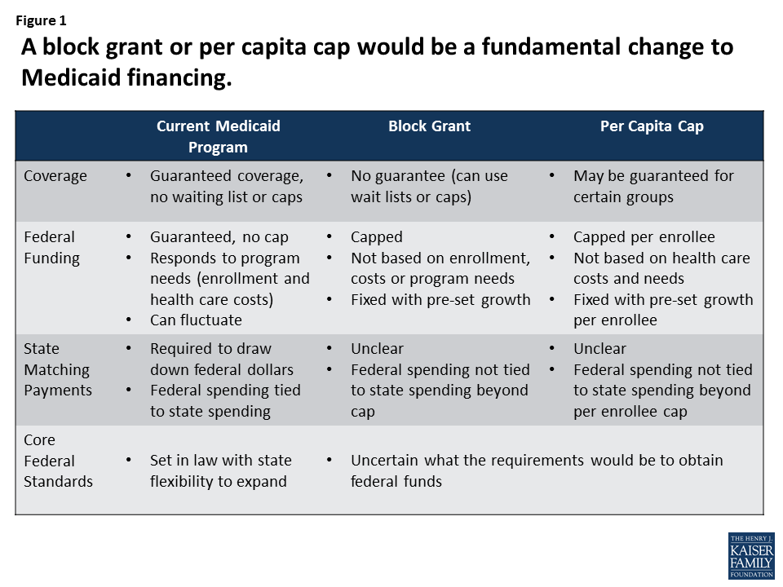
Per Capita Caps & Block Grants
Source: http://kff.org/medicaid/issue-brief/5-key-questions-medicaid-block-grants-per-capita-caps/
Notes:
Carla
Explain block grants in more detail

Slide 11
Per Capita Caps & Block Grants
Current law: Reflects increases in health care cost, changes in enrollment, and state policy choices
Current law
Federal Cap
Block grant: Does not account for changes in enrollment or changes in health care costs
Per capita cap: Does not account for changes in health care costs
Source: http://kff.org/medicaid/issue-brief/5-key-questions-medicaid-block-grants-per-capita-caps/
Notes:
Carla

Slide 12
Per Capita Caps & Block Grants
Pros:
Both allow states flexibility in program design, provide incentives for efficiencies, innovation, and promote federal budget stability
Per capita caps protect states against unexpected enrollment increases and start with the current federal/state share of funding per capita
Cons:
Both likely set spending growth lower than historical rates and may prevent programs from keeping up with need
Per Capita Caps likely ‘lock in’ historical spending when setting initial per-capita caps
Block Grants may favor high-income states when setting initial amount
Notes:
Carla
Explain block grants in more detail

Slide 13
Per Capita Caps & Block Grants
Had per capita caps been in place from 2001-2011,with a growth rate of medical CPI-U…
Total Medicaid spending would have been $195 billion lower over the entire period across all eligibility groups (~6.5% lower).
Thirty-eight states, including Georgia, would have experienced a reduction in federal funds in total. Twenty-five states, including Georgia, would have experienced at decline for each enrollee group.
The Georgia experience would have included…
$6.5 billion less (~14% ) in federal funding across all eligibility groups.
$2.3 billion less (-24%) for aged, $1.7 billion less (-10%) for persons with disabilities, $1.8 billion less (-28%) for adults, and $761 million less (-6%) for kids.
SOURCE: http://kff.org/report-section/what-if-per-enrollee-medicaid-spending-growth-had-been-limited-to-cpi-m-from-2001-2011-data-note/
Notes:
Carla Source: Garfield, R, et.al. 2017. “Data Note: What is Per Enrollee Medicaid Spending Growth Had Been Limited to CPI-M from 2001-2011. Kaiser Family Foundation.
Per Capita Caps would have functioning been limiting spending growth per enrollee to the consumer price index – medical for each enrollment group. Assumes that the baseline year is 2001.
Total Medicaid spending would have been $195 billion lower over the entire period across all eligibility groups (~ 6.5% lower than actual in 2011). Federal spending would have been $128 billion lower (~ 7.0% lower compared with the actual in 2011)
Declines would have impacts eligibility groups differently (KFF nearly three quarters would have been for spending for children and people with disabilities (each account for 37% of the change), with declines in spending for adults accounting for 22% of the change and declines for the aged accounting for 4% of the change.)
Most states (38) would have experienced a reduction in federal funds in total, and more than half the states (26) would have seen a drop in federal Medicaid funds of 10% or more. About half of states (25) would have experienced at decline for each enrollee group.
For children, Arizona would have faced a 38% drop in federal funds but Colorado a 24% gain; for adults, Pennsylvania would have seen a 45% loss versus a gain of 10% in Iowa; for people with disabilities, New Mexico would have lost 22% of federal funds versus +20% in Rhode Island; and among the aged, Alaska would have seen a 31% loss compared to a similar size gain in Michigan.

Slide 14
Per Capita Caps & Block Grants
Estimated Change in Federal Medicaid Spending if Per Enrollee Spending Growth by Group Was Limited to CPI-M, 2001-2011
SOURCE: http://kff.org/report-section/what-if-per-enrollee-medicaid-spending-growth-had-been-limited-to-cpi-m-from-2001-2011-data-note/
Notes:
Carla 18 state sample adapted from KFF and Urban Institute Analysis of 2001-2011 MSIS data.
In AHCA, CPI-M used to estimate growth for per capita caps and block grants:
CPI-M for growth in per capita cap per enrollee amounts, and
CPI-M + 1 for growth in block grants per enrollee, for elderly / disabled populations.
Kaiser estimates per enrollee spending for FFY 2001-2011 if spending growth starting in FFY 2001 had been limited to the medical care component of the CPI (CPI-M)
National average: -7% change in federal Medicaid spending from 2001 to 2011
GA : -14% change in federal Medicaid spending from 2001 to 2011

Slide 15
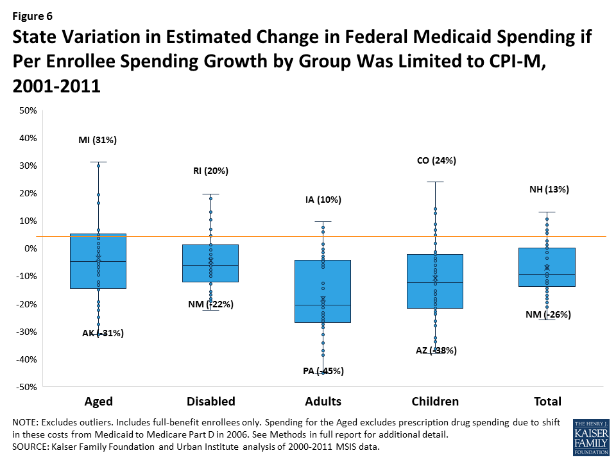
Per Capita Caps & Block Grants
GA (-6%)
GA (-10%)
GA (-14%)
GA (-24%)
GA (-28%)
Notes:
Carla Source: Garfield, R, et.al. 2017. “Data Note: What is Per Enrollee Medicaid Spending Growth Had Been Limited to CPI-M from 2001-2011. Kaiser Family Foundation.
Kaiser estimates per enrollee spending for FFY 2001-2011 if spending growth starting in FFY 2001 had been limited to the medical care component of the CPI (CPI-M)
GA : -14% change in federal Medicaid spending from 2001 to 2011
GA also experiences declines in federal funding for each enrollee group.
2.3 billion less (-24%) for aged,
1.7 billion less (-10%) for persons with disabilities,
1.8 billion less (-28%) for adults, and
761 million less (-6%) for kids

Slide 16
Individual Insurance Market Reforms
 | ACA | AHCA | BCRA
Individual mandate | Individual mandate to have health insurance or pay a fine. | Repeals individual mandate. Penalizes individuals for letting coverage lapse (30% surcharge when purchasing care). | Repeals individual mandate. Penalizes individuals for letting coverage lapse with 6 month waiting period.
Tax credits for purchasing insurance | Credits available for 100-400% FPL. Tax credits vary by age, income, and location; Based on cost of benchmark plan with 70% actuarial value (AV). | Flat tax credits based on age. For single incomes over $75,000 or couple incomes over $150,000, credit is reduced. | For 0-350% FPL. Tax credits vary by age, income, and where individuals live, but are less generous than ACA credits. Credits based on benchmark plan with 58% AV.
Cost-sharing reduction (CSR) subsidies | Provided subsidies to insurers for reduced out-of-pocket expenses for low-income individuals in the Marketplace. | Eliminates CSRs in 2020. | Eliminates CSRs in 2020.
Age rating bands | 3:1 | 5:1 | 5:1
Notes:
Melissa
Both AHCA and the BCRA would repeal the individual mandate,
The AHCA requires continuous coverage to avoid a 30% surcharge
The BHCA has a 6 month “lock-out” for coverage lapses, before you can join.
Instead of premium tax credits and cost-sharing reduction subsidies that are based on age, income, and location:
The AHCA would provide universal health care tax credits based on age:
The following tax credit amounts will be available to individuals earning up to $75,000 (or $150,000 for a couple filing jointly) beginning in 2020:
Age 29 and under: $2,000
Age 30 to 39: $2,500
Age 40 to 49: $3,000
Age 50 to 59: $3,500
Age 60 and over: $4,000
The BCRA gives tax credits that are varied by age, income, and location, but are less generous than ACA credits
The BCRA credits would be available for folks 0-350% FPL, while the ACA’s were available for 100-400% FPL (0-100% to be covered by Medicaid expansion)
The BCRA credits are based on a benchmark plan with 58% AV, while the ACA’s were based on a benchmark plan with a 70% AV.
Both the AHCA and BCRA would eliminate cost-sharing reduction subsidies in the Marketplace; these are the subsidies that the federal government pays insurers in order to reduce out-of-pocket costs (by bumping up the AV of their plan from 70% to 90%) for folks under 250% FPL
Additionally, both the AHCA and BCRA expand the age rating band that was set by the ACA from 3:1 to 5:1 (meaning, in the individual market, an older person can be charge 5 x as much as a younger person).

Slide 17
Individual Insurance Market Reforms
 | ACA | AHCA | BCRA
Dependent coverage | <26 years can stay on parents’ health plan. | Retains ACA provision. | Retains ACA provision.
Essential Health Benefits (EHBs) | Required insurers to cover a list of EHBs including Rx drugs, MH, & maternity. | States can define EHBs | States can define EHBs.
Community rating | Insurers cannot charge customers more or deny coverage based on pre-existing conditions. | Community rating state waiver; can include preexisting conditions. | Cannot waive preexisting conditions protections.
ACA § 1332 waivers | Created 1332 waiver program, starting in 2017, which allowed states to waive certain ACA provisions so long as coverage is at least as comprehensive, affordable, accessible, and budget neutral. | Not addressed. | Loosens 1332 waiver approval standards around cost-sharing and comprehensive coverage.
Notes:
Melissa
The AHCA and BCRA do allow the ACA’s increase in age for dependent coverage to remain (until age 26)
The AHCA and BCRA both allow states to define the list of EHBs that need to be covered by insurers in the individual market
The ACA required community rating in the individual market, and protected consumers from rating and exclusions based on preexisting conditions;
the AHCA would allow states apply for community rating waivers (i.e. ones that would allow pre-existing condition underwriting) if they have a high-risk pool program
The BCRA would keep the preexisting conditions protections from the ACA
- And instead of creating the community rating waivers that the AHCA does, the BCRA uses the ACA’s 1332 waivers (which allows states to waive certain ACA provisions in the individual market, so long as coverage is as comprehensive, affordable, accessible, and budget neutral) and loosens some of the restrictions around cost-sharing and how comprehensive the coverage is (richness of benefits).

Slide 18
Individual Insurance Market Reforms
 | ACA | AHCA | BCRA
Stability funding | Created risk adjustment, temporary reinsurance program (2014–2016), and temporary Marketplace risk corridors (2014–2016). | Creates fund to help states innovate ways to stabilize their individual markets including high-risk pools or premium subsidies. $130 billion over a decade. Establishes temporary federal invisible high-risk pool; funding for community rating waivers. | Establishes stability and innovation program to reimburse insurers bearing financial losses in the Marketplace $112 billion over a decade. Operated in short- term (until 2021) by Centers for Medicare and Medicaid Services, then by states.
Medical loss ratio (MLR) standards | Required insurance companies to spend 80% of premium income on health care claims and quality improvement. | Not addressed. | Sunsets ACA’s MLR standards starting in 2019 Allows states to set them going forward.
Notes:
Melissa
In order to stabilize the market, the ACA had temporary reinsurance program, risk corridors, and a few other mechanisms.
The AHCA creates a Patient and State Stability fund, of $130 billion over a decade, that would allow states to innovate ways to stabilize their individual markets (high-risk pools, reinsurance, etc.)
The fund also establishes a temporary federal invisible high-risk pool, to be taken over by states in 2020, and
Provides $8 billion for states that opt for the community rating waivers to fund high-risk pools, and provides some additional funding for maternity benefits, mental health services, and some other benefits that would have otherwise been covered as EHBs.
The BCRA establishes a Stability and Innovation fund to reimburse insurers bearing financial losses in the Marketplace
$112 billion over a decade.
Operated in short- term (until 2021) by Centers for Medicare and Medicaid Services, then by states.
The BCRA sunsets the ACA’s Medical Loss Ratio standards starting in 2019 (which said that insurance companies had to spend 80% of their premium income on health care claims and quality improvement (and only 20% for administration, marketing, and profit);
And instead allows states to set the standards going forward

Slide 19
Other Reforms
 | ACA | AHCA | BCRA
Employer mandate | Required employers with more than 50 employees to provide coverage that is affordable and comprehensive. | Repealed. | Repealed.
Taxes | Taxes on certain Medicare plans, health insurance, medical devices, and tanning beds. Increased medical deduction threshold to 10%. | Would repeal ACA taxes and restore medical deduction threshold to 7.5%. | Would repeal ACA taxes and restore medical deduction threshold to 7.5%.
Health savings accounts (HSAs) | Individuals can contribute up to $3,400 and families up to $6,750 per year. | Starting in 2018, individuals could contribute up to $6,550 and families could contribute up to $13,100 per year. | Starting in 2018, individuals could contribute up to $6,550 and families could contribute up to $13,100 per year.
Notes:
Melissa
Both the AHCA and BCRA repeal the employer mandate
And Both also repeal the majority of the ACA’s taxes on insurers, medical devices, etc. and restore the medical deduction threshold to 7.5% from 10%.
Both the AHCA and BCRA also make changes to rules around HSAs, in order to make that option more appealing; including allowing individuals and families to contribute almost twice as much, tax free, into HSA accounts, as well as a number of other changes around what would be considered reimbursable expenses under HSAs.

Slide 20
Other Reforms
 | ACA | AHCA | BCRA
Association health plans | Not addressed. | Not addressed. | Allows small businesses to purchase large group coverage together through associations (covered under ERISA instead of state law).
Public health/ community health centers | Created Prevention and Public Health (PPH) Fund (FY 2017 budget, $931 million). Created Community Health Center (CHC) Fund ($11 billion over 5 years). | Repeals funding for PPH Fund; Continues CHC Fund with $422 million for FY 2017. | Repeals funding for PPH Fund; Continues CHC Fund with $422 million for FY 2017.
Notes:
Melissa
Unlike the ACA or AHCA, the BCRA creates the option for small businesses to pool together in Association Health Plans, in order to purchase large group coverage together. This way they can self-insure, and are subject to ERISA, rather than state insurance law.
Both the AHCA and BCRA repeal funding for the Prevention and Public Health Fund (budget was $931 million in FY2017)
Repeal funding for Prevention and Public Health Fund (including its block grants) at the end of Fiscal Year 2018 and rescind any unobligated funds remaining at the end of FY 2018.
Takes away funding for a number of population health initiatives, including vaccinations, lead poisoning, https://www.cdc.gov/funding/documents/CDC-PPHF-Funding-Impact.pdf
local block grant funding may be more relevant for them.
But they do keep the funding for Community Health Centers (which includes 330 grant funding) for FY2017.

Slide 21
CBO Predictions: Budget
Estimated Costs – AHCA v. BCRA
Provision | Savings v. Spending / Revenue Reduction
 | AHCA | BCRA
Medicaid cuts | $834 billion | $772 billion
Insurance subsidy elimination / modification | $665 billion | $424 billion
Small employer tax credit elimination | $6 billion | $6 billion
New individual tax credits | -$375 billion | -
Employment-based health insurance coverage shifts | $23 billion | $21 billion
Individual / employer mandate penalty elimination | -$210 billion | -$210 billion
Individual market stabilization; state funds | -$117 billion | -$107 billion
Medicare DSH cuts elimination | -$43 billion | -$42 billion
Tax repeals | -$661 billion | -$541 billion
Other provisions | -$3 billion | -$2 billion
Net savings | $119 billion | $321 billion
SOURCE: Congressional Budget Office. (May 24, 2017). Cost estimate: H.R. 1628, American Health Care Act, as passed by the House of Representatives on May 4, 2017. Accessed from https://www.cbo.gov/system/files/115th-congress-2017-2018/costestimate/hr1628aspassed.pdf. Congressional Budget Office. (June 26, 2017). Cost estimate: H.R. 1628, Better Care Reconciliation Act. Accessed from https://www.cbo.gov/system/files/115th-congress-2017-2018/costestimate/52849-hr1628senate.pdf.
Notes:
Melissa
Over the next 10 years (2017-2026), the AHCA will reduce federal deficits by $119 billion by reducing spending by $1.11 trillion and revenues by $992 billion.
The BCRA would reduce deficits by $321 billion, by reducing spending by $1.022 trillion and revenues by $701 billion. That amount is $202 billion more than the estimated net savings for the AHCA.
The majority of the savings will come from the $834 billion reduction in Medicaid funding.
This reduction is achieved primarily through per capita caps and block grants, ending the Medicaid expansion enhanced federal match,
and through the $665 billion reduction in Marketplace insurance subsidies.
The majority of spending is due to:
the $375 billion in individual tax credits,
$117 billion for the Patient and State Stability Fund, and
$661 billion from the elimination of taxes and
$210 billion from the elimination of the individual mandate.

Slide 22
CBO Predictions: Uninsured
SOURCE: Congressional Budget Office. (May 24, 2017). Cost estimate: H.R. 1628, American Health Care Act, as passed by the House of Representatives on May 4, 2017. Accessed from https://www.cbo.gov/system/files/115th-congress-2017-2018/costestimate/hr1628aspassed.pdf. Congressional Budget Office. (June 26, 2017). Cost estimate: H.R. 1628, Better Care Reconciliation Act. Accessed from https://www.cbo.gov/system/files/115th-congress-2017-2018/costestimate/52849-hr1628senate.pdf.
Notes:
Melissa
The Senate bill would increase the number of people who are uninsured by 22 million in 2026 relative to the number under current law, slightly fewer than the increase in the number of uninsured estimated for the House-passed legislation. By 2026, an estimated 49 million people would be uninsured, compared with 28 million who would lack insurance that year under current law.
The CBO also estimates that by 2018, 41 million people will be uninsured under the AHCA, versus 26 million under current law — a net of 14 million more uninsured under the AHCA.
By 2026, an estimated 51 million people will be uninsured under the AHCA, versus 28 million under current law — a net of 23 million more uninsured under the AHCA).
The 2026 estimate of uninsured includes 14 million fewer covered by Medicaid, 6 million fewer covered in the individual marketplace, and 3 million fewer covered by employers under the AHCA.
****It should be noted that: CMS’s Office of the Actuary estimates that the AHCA would increase the number of uninsured relative to the ACA by 12.6 million and reduce the federal deficit by $328 billion by 2026.
The differences in estimates are driven by differences in assumptions about key features of the bill, such as the percentage of states that would choose to implement waivers of insurance regulations under the MacArthur Amendment, according to an analysis of the two reports published in Health Affairs. For example, the Office of the Actuary predicts 25% of states would waive community rating or essential health benefits, while the CBO expects 50% of states would implement such waivers.

Slide 23
CBO Predictions: Marketplace Premiums
In general, the market should be just as stable in many places under AHCA or BCRA, but
AHCA state waiver participation may destabilize for people with higher health care costs
BCRA may create even more certainty in the market after 2020
Both AHCA and BCRA would cause a temporary rise in premiums up until 2020, and then fall. By 2026:
-4% under AHCA no waiver, -20% under AHCA moderate waiver, -20% under BCRA (benchmark)
Decreases related to less benefits paid for by insurers
Notes:
Melissa
the CBO predicts that while the health insurance market will continue to be just as stable in many places under the AHCA as it currently is under the ACA,
state participation in EHB and community rating waivers may destabilize markets for people with higher health care costs.
Individual market single-policy premiums will temporarily rise prior to 2020 (by 20% in 2018 and another 5% in 2019).
Starting in 2020, the premiums will depend on the extent to which a state participates in AHCA EHB and community rating waivers.
In states with no waivers, premiums should decrease by 4% in 2026, versus the ACA, mainly due to a younger mix of enrollees in the market.
States making moderate market changes through waivers should see premium decreases of 20% in 2026, versus the ACA, primarily due to fewer benefits being paid for by insurers.
States making full market changes through AHCA waivers should also see decreases in premiums by 2026 due to a younger, healthier mix of enrollees (enrollees with costly health conditions are moved out of the market) and fewer benefits paid for by insurers.

Slide 24
ACA vs. AHCA Tax Credits
SOURCE: http://kff.org/interactive/tax-credits-under-the-affordable-care-act-vs-replacement-proposal-interactive-map/
Notes:
Melissa
This is a screen shot from a Kaiser tool that allows you to estimate changes in tax credits between the ACA and AHCA by age, income area, location (down to the county level)
This screen shot shows a 40 year old at $30,000 (250% FPL)
In the blue you see where the credit would be lower (50-75% lower in dark blue), and then higher in the orange (>75% higher in the dark orange)
This map really highlights the disparities between rural and urban, with 40 year olds making $30K in urban areas getting a whole lot more money under the AHCA than they did under the ACA, and rural 40 year olds getting a lot less.
There are higher costs in rural areas, and under the ACA subsidies were adjusted (increased) to account for the higher costs.
Under the AHCA the subsidy is a flat credit, adjusted only for age.

Slide 25
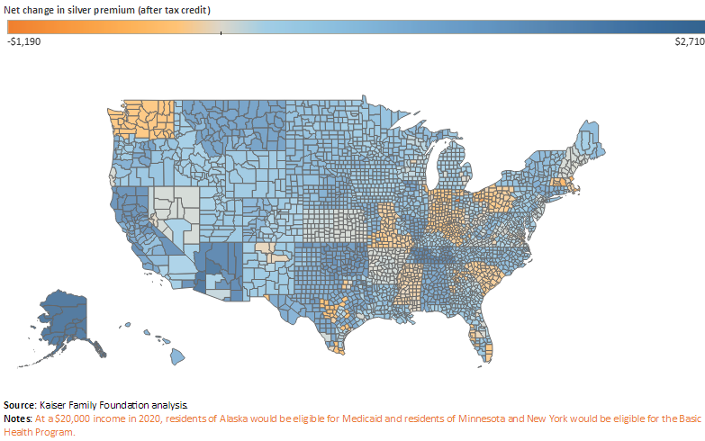
ACA vs. BCRA Net Premiums
SOURCE: http://www.kff.org/interactive/premiums-and-tax-credits-under-the-affordable-care-act-vs-the-senate-better-care-reconciliation-act-interactive-maps/
Notes:
Melissa
Kaiser also has a similar tool that allows you to estimate net changes in net premiums (after tax credits) between the ACA and BCRA by age, income area, location (down to the county level)
Again, we’re looking at a 40 year old at $30,000 (250% FPL)
Again, here in blue you see where the net premium would start costing more, and in the orange, you see where folks would have a drop in premium costs.
- Picture is a little different from the AHCA – for instance, in California there are no counties that have

Slide 26
What’s next?
More changes to BCRA?
No vote before July 4th recess
Negotiations to get >50 votes
All Democrats opposed
Push back from a few conservative and more middle-leaning Republicans
Bi-partisan opposition letter from governors
All major medical associations against
If passes Senate, must be reconciled in the House
Notes:
Karen - As of last week, the plan was to push for a vote before the July 4th recess
Democrats, all opposed, are trying to delay the vote
Some more conservative Republicans have come out against it because it doesn’t do enough to repeal Obamacare (i.e. Ted Cruz, R-TX, Rand Paul, R-KY), while other more moderate Republicans from expansion states (i.e. Dean Heller, R-NV) believe it needs changes
Bipartisan Group of Governors Pens Letter Opposing AHCA
A group of seven Republican and Democratic governors—John Kasich (R-OH), Steve Bullock (D-MT), Brian Sandoval (R-NV), John Bel Edwards (D-LA), John Hickenlooper (D-CO), Charles Baker (R-MA), and Tom Wolf (D-PA)—sent a letter to the Senate in opposition to the AHCA, saying that it “calls into question coverage for the vulnerable” and shifts “significant costs” to the states. The letter also calls the AHCA’s Medicaid provisions “particularly problematic” and suggests Congress should instead focus on improving the private health insurance system. Governor Kasich has separately stated that a gradual phase-out of the Medicaid expansion would be “acceptable” to him if Congress granted states additional funds and flexibility to manage their Medicaid programs.

Slide 27
Regulation & Administrative Action
Regulations
CMS Marketplace stabilization rule
HHS change to contraceptive mandate regulation?
Administrative Actions
HHS Marketplace advertising reductions
IRS statement on individual mandate penalty enforcement
FDA nutrition labeling compliance delayed
HHS/Treasury letter to governors on 1332 waivers
HHS/CMS letter to governors on Medicaid
HHS/CMS RFI – public input on regulatory reductions that would stabilize Marketplace
Cost-sharing reduction subsidies
Notes:
Karen Administration has been very active in this area:
CMS passed final marketplace stabilization rule in April that tightens enrollment periods, income verification process, and some other things in the Marketplace to stabilize it.
Sec. Price made a statement that he is revisiting the contraceptive mandate (which requires employers to cover contraceptives at 100%) in order to ”safeguard the deeply held religious beliefs of Americans who provide health insurance to their employees”
When Pres. Trump first went into office, HHS reduced Marketplace advertisement funding for that open enrollment period
IRS made the statement that they would not be enforcing the individual mandate penalty
The FDA has pushed the compliance date for the ACA restaurant Calorie / nutrition menu labeling requirement
Secretaries of HHS/ Treasury sent a letter to Governors in March encouraging applications for ACA 1332 waivers, and has provided additional application guidance since then for expedited “emergency” applications (such as Iowa’s application, due to the withdrawal of their last remaining carrier in the Marketplace)
Secretary Price and Administrator Verma sent a letter to Governors in March highlighting their understanding of the Medicaid program as one for the extremely vulnerable (not able-bodied adults), and encouraging flexibility and innovation in state administration of the programs
HHS solicited a RFI for organizations to comment on ACA-related regulatory reductions that could help to stabilize the Marketplace, reduce premiums, promote access, etc.
After months of back and forth and increased insecurity among carriers in the Marketplace, Sec. Price confirmed that President Trump’s budget request includes 2 years of cost-sharing reduction subsidies; also included in the BCRA

Slide 28
Regular Order
Purchase of health insurance across state lines
Association health plans
Streamline FDA approval for genetic drugs
More Medicaid flexibility / creativity
Medical malpractice reform
Alter administration of individual market subsidies
Notes:
Karen The following lists some health reform topics that are being pursued outside the reconciliation process
Most recent:
Medical malpractice bill recently introduced in the House:
Protecting Access to Care Act of 2017 (H.R. 1215), legislation sponsored by Rep. Steve King (R-IA) that would institute a three-year statute of limitations on medical malpractice claims from the date of an injury and cap noneconomic damages at $250,000. Conservatives raised concerns that the legislation would impose federal standards on states.
Last week, the House passed a couple of bills that alter the administration of subsidies in the individual market:
the Verify First Act (H.R. 2581), the
Broader Options for Americans Act (H.R. 2579), and the
Veterans Equal Treatment Ensures Relief and Access Now (VETERAN) Act (H.R. 2372).

Slide 29
Critical Activities to Build an Integrated & Sustainable Delivery System
1. Outreach and enroll into eligible programs
2. Provide culturally and linguistically competent medical
homes
3. Assure access to prevention and wellness services
4. Provide affordable prescription drugs
5. Assure access to specialty and hospital care
6. Manage chronic diseases
7. Coordinate comprehensive care
8. Develop strategies to cover low-wage workers
Notes:
Karen
Give background of 8 critical activities, and why we’re looking at health reform through this lense

Slide 30
Critical Activities to Build an Integrated & Sustainable Delivery System
Outreach and enroll into eligible programs
Medicaid covered populations and services
Market place plan design and affordability
What types of support will people need to determine eligibility and to enroll?
2. Provide culturally and linguistically competent medical
homes
Patient medical homes and other quality-improving, cost-saving efforts are not going away
Cultural and linguistic standards will still be important for new and existing populations
Notes:
Karen
1. Outreach & enrollment:
What will Medicaid cover and for whom?
- Depending on what happens in Congress, expansion populations may be dropped from Medicaid.
Will this group be able to afford buying in the Marketplace under the proposed tax credits / subsidies? Or will they become uninsured?
What types of plans will the Marketplace include?
Even for those remaining in the Marketplace, under the AHCA or BCRA, the type of insurance plan options will change (benefits covered may change, out-of-pocket costs, networks, etc.)
People will need help figuring out what they are eligible for and what to expect from coverage-wise and financially from those plans
Determining program eligibility, assistance with enrollment, attaining subsidies, understanding the impact of new Marketplace rules around EHBs & preexisting conditions, cost-sharing options, etc.
2. Provide culturally and linguistically competent medical homes
Patient medical homes and other quality-improving cost-saving efforts are not going away
However, understanding current cultural and linguistic standards both for the existing and incoming populations will be important

Slide 31
Critical Activities to Build an Integrated & Sustainable Delivery System
3. Assure access to prevention and wellness services
Volunteerism and practicing to scale of training
4. Provide affordable prescription drugs
Navigating access to free and reduced priced prescription drugs
5. Assure access to specialty and hospital care
Changes in EHB definitions may decrease benefits covered by plans and increase need for free or low-cost care
Identify opportunities to engage in state definition of EHBs
After defined, plan ways to bolster care for “benefit gaps”
Increases in uninsured status may increase the need for safety net providers, while also contributing to future hospital closures
Notes:
Karen
As far as assuring access to prevention and wellness services, affordable Rx drugs, and specialty and hospital care:
If ACA repeal / replace is successful, work in these three areas will be tied to two main scenarios:
Insurance status (insured v. uninsured)
Both bills are predicted to increase the number of uninsured.
Repeal of Medicaid expansion
Lower subsidies and lack of a mandate in the Marketplace
And for those who are insured, what type of benefits are covered, and what are their out-of-pocket costs
States will be allowed to define EHBs – insurers could sell plans with less-rich benefits
Under the AHCA, states may choose a community rating waiver, which could allow plans to rate based on preexisting conditions, widen age rating bands, or do other fixes that could make insurance less affordable
If passed, providers may want to get involved in state discussions around which EHBs to include
After defined, providers should be ready to help fill in benefit / care gaps

Slide 32
Critical Activities to Build an Integrated & Sustainable Delivery System
6. Manage chronic diseases
Look for upstream solutions and sustainable partners to help prevent the onset of certain chronic diseases
7. Coordinate comprehensive care
States, insurers, and providers may need partners for new “innovation” programs, particularly in an era of reduced federal funding
8. Develop strategies to cover low-wage workers
Partner with states to cover and scale-up programs like the “three-share” model for uninsured and underinsured workers
Focus on rural areas, which may be particularly vulnerable to Medicaid funding cuts, expansion cuts, and loss of Marketplace subsidies
Notes:
Karen
For manage chronic disease and coordinate comprehensive care:
If BCRA / AHCA are passed, per capita caps and block grant funding changes are going to force state Medicaid departments to look for even more innovative ways to save money, reduce waste, all while improving quality (at this time, quality measures aren’t being rolled back)
Main ways to do this are by better managing chronic conditions, and coordinating care
They will likely be looking for partners, so prepare to play this role, and look for opportunities to partner; many states Medicaid departments are already doing innovative work in these areas
Partner with MCOs – they will also be pursuing similar strategies
States that exclude certain services from EHBs, or allow insurers to rate based on preexisting conditions may need care coordination and DM partners in operating whatever innovative programs they put in place for their high-risk pool populations, in order to manage costs.
Hospitals still need partners on chronic care and care coordination
At this point, it seems that hospitals will still be held to readmissions standards; so they will continue to need help with care coordination and DM. Even if the penalties end, hospitals and payors who saw value in such programs (savings and increased quality of care) will continue to partner, as it’s in their own best interest.
Also, with folks losing insurance, hospitals will have work even harder to keep high-cost folks out of their Emergency Departments
For develop strategies to cover low-wage workers:
If the BCRA / AHCA passes, in Medicaid expansion states, the expansion populations will need coverage or care under a different program
The idea is likely to send them to the private marketplace, but may not be able to afford insurance there.
Innovative ways to cover / care for this population will need to be developed.
Rural areas will need particular attention
Rural areas (patients, hospitals, FQHCs, etc.) are particularly reliant on Medicaid as a payor
Many rural hospitals have already closed
https://www.ruralhealthweb.org/NRHA/media/Emerge_NRHA/GA/2017-Vote-No-American-Health-Care-Act.pdf;

Slide 33
Health Reform 2017
Questions?
Notes:
Karen

Slide 34
Survey
How do you feel now?
Better prepared
Optimistic
Excited
Scared
Which critical activities might you focus on?
1. Outreach and enroll into eligible programs
2. Provide culturally and linguistically competent medical
homes
3. Assure access to prevention and wellness services
4. Provide affordable prescription drugs
5. Assure access to specialty and hospital care
6. Manage chronic diseases
7. Coordinate comprehensive care
8. Develop strategies to cover low-wage workers

Slide 35
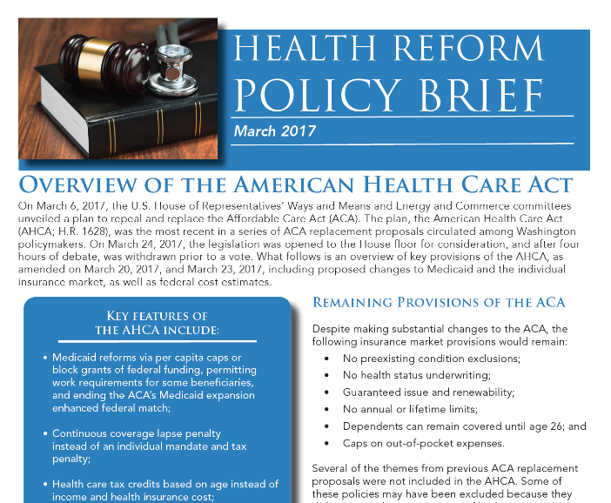
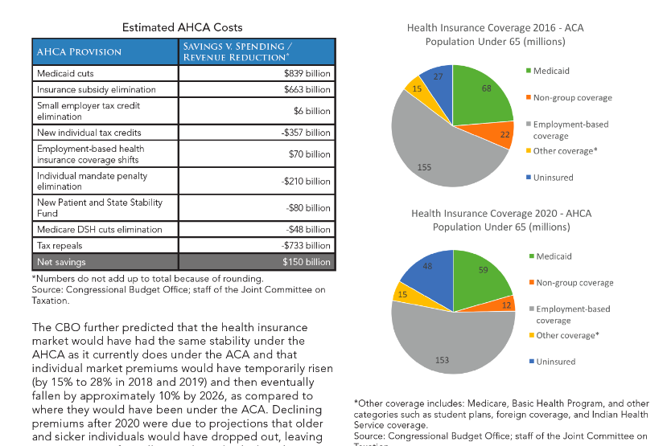
Health Reform 2017 – Materials
http://ghpc.gsu.edu/project/health-reform/
AHCA brief June
Comparison table: ACA, AHCA, BCRA
Notes:
Karen

Slide 36
About Communities Joined in Action
Communities Joined in Action (CJA) is a national, non-profit membership organization of local and regional community health collaboratives.
Mission: To mobilize and assist community health collaboratives to assure better health for all people at less cost
We support our members by facilitating the dissemination of innovations and community health models through peer-to-peer learning networks, webinars, and national conferences

Slide 37
About Communities Joined in Action
CJA depends on members to support its work. If you are not a member, please join at cjaonline.net/membership
Save the date for our national conference:
February 14-16, 2018
Atlanta, GA

