Slide 1

McDowell Access to Care & Health (MATCH)
An Initiative of the McDowell County
Health Coalition
Lanie Honeycutt
Program Manager, MATCH
Matthew Son
President, Son Information Systems

Slide 2

McDowell Access to Care & Health
A streamlined system of health that improves access to care, engages the patient in their physical, behavioral and social health and utilizes community resources in the best way possible.
Notes:
We are a streamlined, community referral network that improves access to physical, social, mental and behavioral health resources while providing participants with support and engagement for self-management of one’s comprehensive health. MATCH operates under the theory that in order for individuals to lift themselves out of the depths of poverty and poor health, they must have the tools and resources available to them to do so.

Slide 3
History & Timeline
Inception of McDowell Health Coalition’s Access to Care Workgroup (January 2013)
Facilitated by Care Share Health Alliance
MATCH Planning Period (2013-2015)
KBR Funding Awarded (May 2015)
Program Fully Staffed & Implemented (November 2015)
Notes:
In January 2013 the McDowell Health Coalition convened the Access to Care Workgroup composed of stakeholders from the mental, clinical, and public health entities in our county. The group met monthly to discuss the common issues, barriers, and needs that we repeatedly saw within the low income, uninsured, and underinsured populations that our agencies serve .
As we looked at the barriers to living a healthy lifestyle in McDowell county, we realized that there were already numerous programs and resources available in our community to help individuals access traditional health care-including a Project Access-like program provided by the local hospital system and low-cost mental/behavioral health services. However, despite the availability of these services, many individuals were unaware of their existence or how to access them, or are overwhelmed trying to navigate the healthcare and safety net systems on their own. Through our discussions we determined that in order to make long-term, systematic improvements in the health and wellbeing of those we served, we had to address root cause issues and socioeconomic barriers to care.
Over an 18-month period, the Access to Care workgroup received technical assistance from Care Share Alliance to develop the MATCH model of care. The workgroup completed an asset map of resources in the county and conducted site visits to similar networks including Rockingham Health Alliance. Through this work we developed a purpose and structure to a program that would decrease barriers to comprehensive care and improve the health of those served by creating a streamlined, traceable, and easily accessed referral network consisting of existing behavioral, clinical, and social health resources within the community.
Our proposal to implement the MATCH Program was funded by KBR in May 2015. Much of the programmatic planning and convening of key stakeholders and partners was done in advance through the Access to Care Workgroup, making it a fairly quick process to have the program fully operational and accepting clients by November 2015.

Slide 4
The MATCH Strategy
Community-based care coordination
Complete needs assessment and address physical, social, behavioral, economic, and environmental needs of all participants
Use existing community resources efficiently and effectively
“MATCH” needs with resources in the community and provide one-on-one assistance
Engage people in their own health
Use data to identify local gaps in services specific to our community’s needs & to capture impact
Notes:
Our strategy is to focus on “holistic” community-based care coordination by addressing physical, social, behavioral, and environmental needs of those we serve.
We want to use what already exists in the community both efficiently and effectively by “matching” the needs of those we serve with resources already available in the community and providing one-on-one assistance helping people access those resources.
We also hope to use the data gathered from MATCH to identify gaps in services where there are a surplus of needs that we are unable to identify a helpful resource for and hopefully use that data to bring about positive change the in the infrastructure of our community

Slide 5
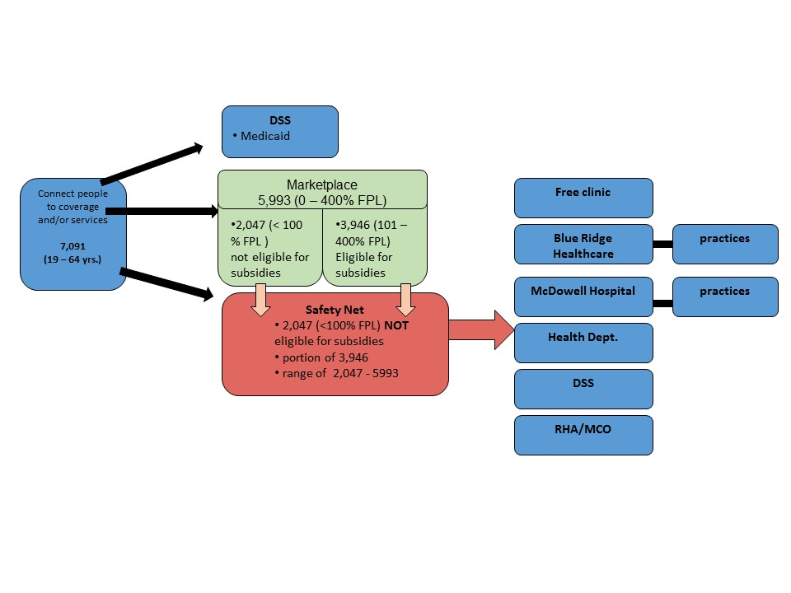
MATCH Structure:
Clinical Outreach Coordinator
Enrollment
Specialists
Notes:
This is a visual representation of how our structure works. As you can see, the enrollment specialists complete the first step by directing people either to DSS if they are possibly eligible for Medicaid, helping them enroll into private insurance through the health insurance marketplace, or by assisting with charity care applications for those who do not qualify for private insurance or Medicaid. Those who fall below 200% of the federal poverty line and qualify for MATCH are then fully enrolled into the program, receive a complete social, behavioral, and physical needs assessment, and are then referred on to our clinical outreach coordinator who then helps the participant access needed resources through appropriate agencies, programs, and services.

Slide 6
MATCH Partner Agencies
Community Care of WNC
RPM District Health Department**
The McDowell Hospital**
Carolinas HealthCare System Blue Ridge
Smoky Mountain LME/MCO & RHA Behavioral Health
McDowell County DSS**
Corpening Memorial YMCA
Buncombe County Council on Aging
McDowell County Public Library
McDowell Technical Community College
McDowell Cooperative Extension
Marion Tailgate Market**
**co-location site
FaithHealth
CareNet Counseling of Marion
NC Works Career Center**
McDowell EMS
Food Pantries**
McDowell Senior Center
McDowell Mission**
Rutherford Community Health Center
McDowell Tailgate Market**
McDowell School System
NC MedAssist
Legal Aid of Burke County
Notes:
We are able to accomplish this work through our partnerships with social service, behavioral health, and clinical service providers in our community. In our first year we created partnerships with over 20 agencies through BAAs and Data sharing agreements. Our staff also co-locates at 8 non-traditional community access points throughout the week, including our health department, hospital, DSS, CareerCenter, homeless shelter, 3 key food pantries, and our local tailgate market. These community-based access points facilitate non-traditional partnerships and act as a way for us to be a resource for social service agencies to integrate health care services into their work process and vice versa.

Slide 7
Primary Referral Sources
Social Service Agencies 30%
Word of Mouth 21%
Hospital/Practice 19%
Community Agency/Program 9%
Behavioral Health Provider 7%
Health Department 5%
Unknown 4%
Food Pantry 2%
Outreach Event 2%
Private Sector 1%
Notes:
These are the primary sources in which clients were referred to the MATCH Program in our first year. As you can see about a third of our clients are being referred to us from social service agencies, while almost one in five individuals hear about the program from friends, family, and acquaintances who are already enrolled in MATCH, About 20% of our clients also originate from the hospital or its practices, while almost 1 in 10 come from either a community partner or a behavioral health provider.
The data on where are referrals were coming from didn’t really surprise us much, except for the high number of referrals from word of mouth. When we started creating MATCH, the stakeholders said that one-to-one communication is the best way to get information out in our rural community. This came up in particular when we considered using 211 as a referral source. When we had discussions about using 211, people repeatedly said, we need local, person to person information, not a database or a phone call from a neighboring community. So, we designed MATCH to maximize the person to person interaction for the enrollment, and referring to resource. What we hadn’t really thought about or anticipated is that the person to person network would be one of our highest referrals sites into the program. So we not only have the wisdom of our stakeholders telling us how things work best I the community, we also have data that shows the power and importance of this person to person network.

Slide 8
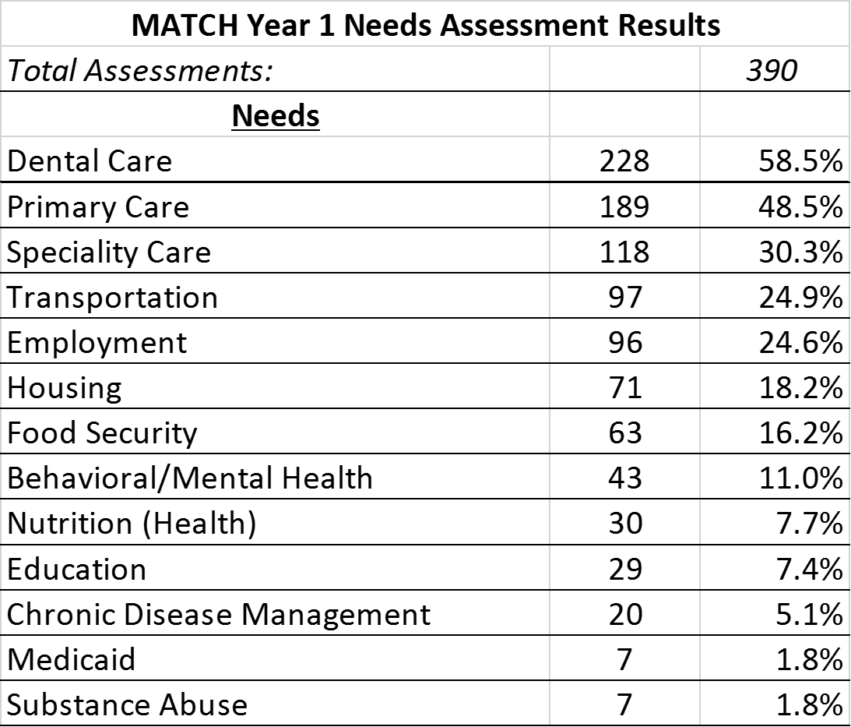
Notes:
Once clients are referred to us, we screen individuals for program eligibility and conduct a comprehensive needs assessment with each individual. Depicted here are the top needs of our clients. As we have a sample size of almost 400 individuals, we expect that these needs are similar to those experienced by the impoverished population of McDowell County as a whole. Almost 3 in 5 individuals reported a need for dental care, while almost half had no access to primary care. Many at risk individuals also need assistance with specialty care, transportation, gaining employment, suitable housing, and are living in a food insecure household.

Slide 9
Identifying and Addressing Gaps
Dental care presented as an immediate need
No resources available in the county for low cost or free dental services
FQHC in neighboring county offers low-cost services
Coordinated transportation with DSS to transport patients
We were able to:
Identify a need and gap in the county
Leverage available resources to add a resource and improve access
Secure needed services for our clients
Broadened our collaboration

Slide 10
Early Success - November 2015-June 2016
251 MATCH enrollees connected to and received at least 533 additional community resource via MATCH staff
$101,013.18 (417 encounters) of donated primary care
590 individuals served
376 individuals enrolled & linked to primary care
3,816 individual instances of community navigation
Notes:
Through our valuable partnerships we were able to serve 590 individuals in our first year, of which 376 qualified and were enrolled into the MATCH Program (meaning they had an income less than 200% of the FPL, did not qualify for insurance through the ACA and are uninsured, are between the age of 18-64, and live in McDowell County).
We provided 3,816 individual instances of community navigation which resulted in 533 completed referrals and 251 of our clients connecting to at least one additional service like transportation, dental care, education resources, job training, emergency assistance, smoking cessation, medication assistance, and behavioral or mental health resources.
Through donated care agreements with the McDowell Hospital and Carolinas Health Care System our clients also accessed $101,000 cost-free primary care in order to gain access to preventative care and chronic disease management.

Slide 11
Year 1 Outcomes
376 uninsured individuals below 200% of FPL [100% of enrollees] linked with a primary care medical home through commitments from McDowell Hospital practices and Blue Ridge Health practices. Target: 300
251 MATCH-enrolled patients [67% of enrollees] reported an additional referral to a partner agency resulting in a new service or benefit, such as Medicaid health coverage, Food Stamps, Social Security/Disability, Employment Services, Faith-Health support, Mental Health Services, Food Resources, Transportation, and Medication Assistance. Target: 225 individuals
MATCH enrolled diabetics utilized physician-led coordinated care teams and individualized self-management planning for improved indicators, resulting in 65% of individuals with diabetes who were enrolled in the program for at least 3 months being well-controlled (A1c values <9%). Target: 60%
Notes:
Through the MATCH team’s diligent work and valuable partnerships we not only met all but exceeded many of our targeted outcomes in our first year
***this slide feels redundant, maybe you use this time for examples I combined some of the info. on this slide with previous so you could take this out or use it for examples.

Slide 12
Year 1 Outcomes Continued
56% reduction in ED utilization, when comparing pre and post visits of those enrolled in the program for at least 6 months.
191 patients (51% of enrollees) improved in at least one specified, patient-determined goal (ex: keeping appointments, adhering to a care plan, or reduced # of days experiencing medical, social, or mental health crisis.)
64 uninsured individuals obtained ACA Health Insurance Marketplace coverage, education or assistance from MATCH enrollment specialists.
Notes:
***I just simplified the first bullet

Slide 13
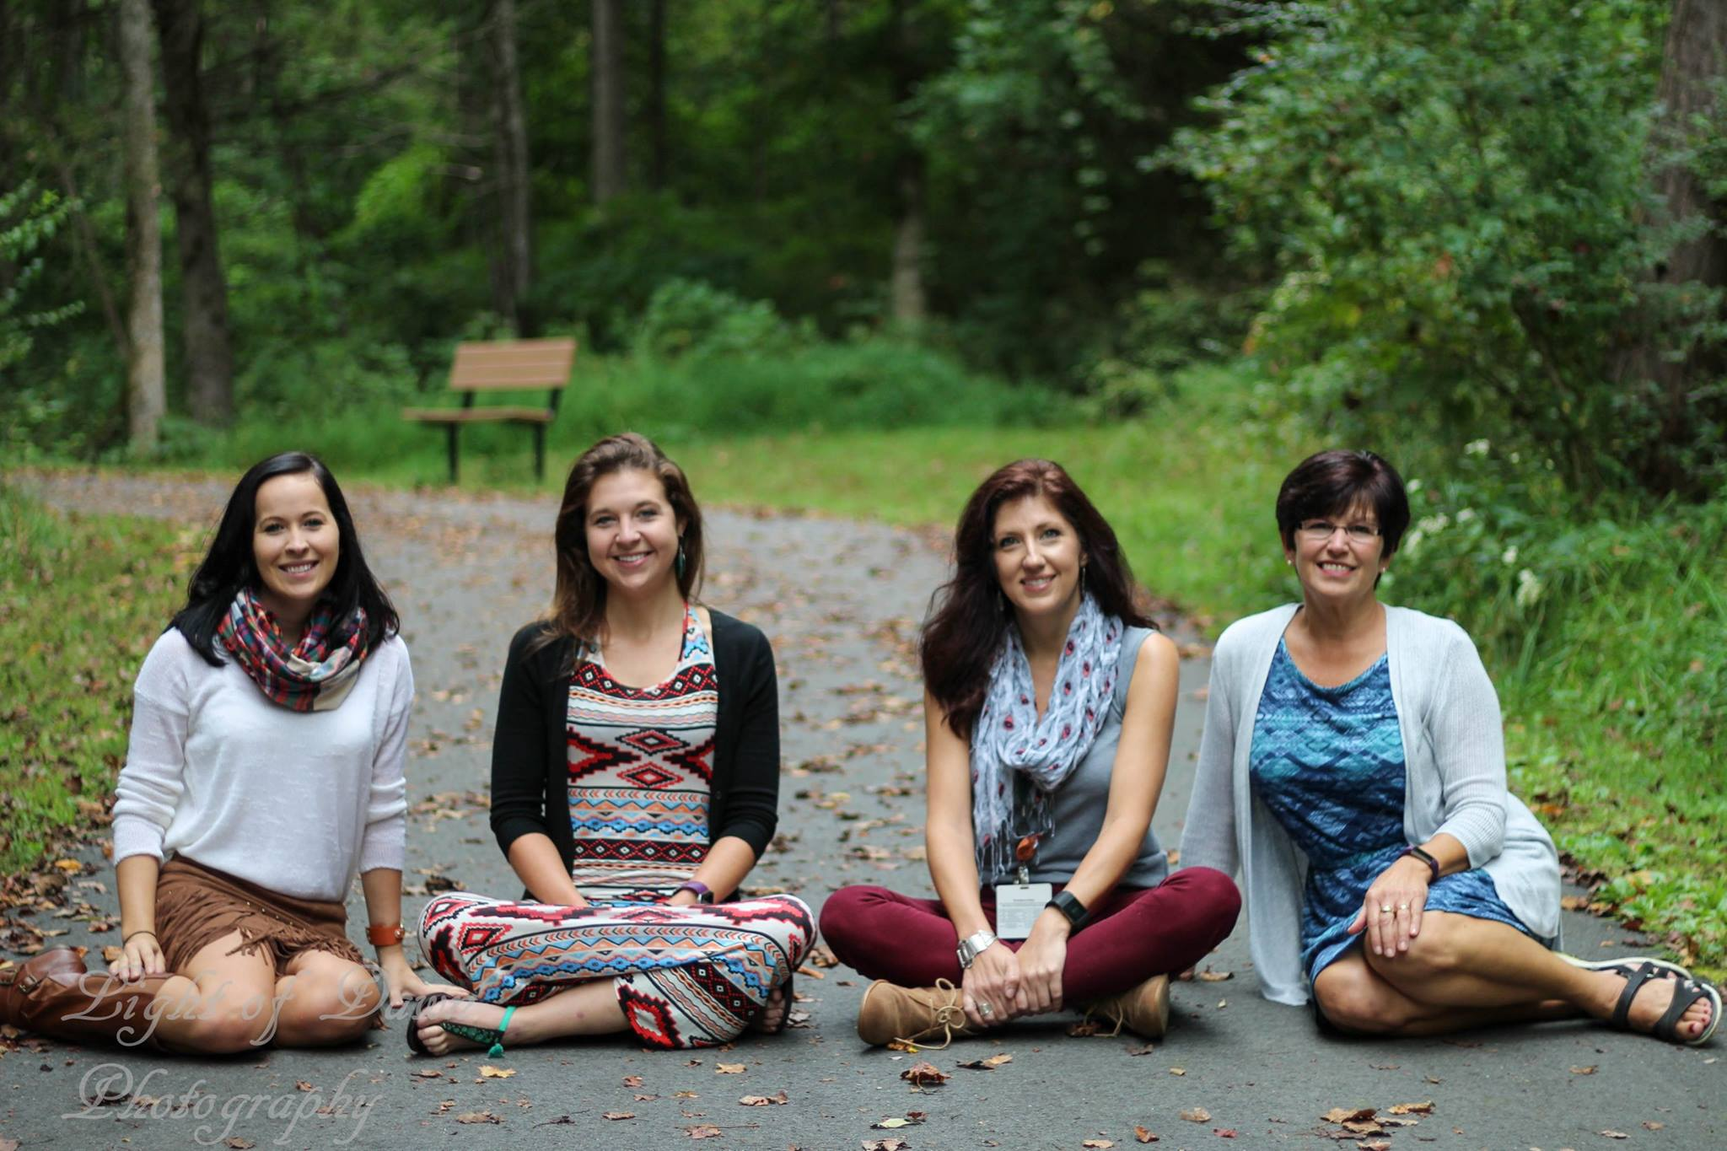
MATCH At Work
Notes:
Paul is a MATCH client our program was able to connect during one of our mobile health clinics at the local food pantry. Our local EMS was providing blood pressure checks and Paul’s blood pressure was found to be extremely high. Unfortunately he was out of work with a back injury, uninsured, and could not afford medical care. Before he left the food pantry, the MATCH team scheduled an appointment with one of our enrollment specialists for the following day. At his enrollment appointment, we learned Paul had worked as an over the road truck driver for most of his life until his back problems and COPD forced him into early retirement. He and his wife have also been trying to help several other family members with limited income and resources. Paul was enrolled into MATCH and scheduled to see his new primary care provider within a week. Our enrollment specialist helped Paul apply for financial aid programs to help cover the cost of blood work and any additional tests he may need. Since the MATCH program completes an in depth needs assessment with every client, we were also able to help Paul with access to affordable dental care for his ongoing dental problems. Our clinical care manager will be providing follow up care to ensure Paul is equipped with the resources he needs in his journey to better health
One of our clients came to the MATCH program in desperate need of a pair of new eyeglasses. Her were being held together with duct tape and she could barely see through them. After enrolling her into the MATCH program, we were able to understand her specific case and identify her needs. We realized that not only was she also living with diabetes, but she could not afford her medications to control her condition, vision care or dental services. Working with the client and MATCH was able to understand her health needs, as well as the social and financial barriers she faced in meeting them. The client and the MATCH program worked with her doctor, multiple charitable organizations, and other providers to bridge the gap in the client’s health needs. She now receives financial assistance for her medication, which allows her to control her diabetes.We were able connect her with a free eye exam and eyeglasses. Other community partners were able to provide free dental services to the client to alleviate her oral pain. The MATCH program checks in regularly
with the client to monitor any new gaps in care that may arise.

Slide 14
What we’ve learned
The trials and tribulations of integrating and tracking community referrals
The value of listening to those we serve
Social networks are critical to the success of the program
The importance of implementing a long screening process
The importance of having an IT system
It takes time to build the collaboration, but once it’s there and it works it can really bring a community together
Care Share is great!!!! <-seriously could not of done it without you guys ☺
Notes:
Facilitating and internally tracking community referrals is easy to implement but difficulty to engage community partners for follow-up can be difficult
The value of listening to those we serve and letting their needs guide our work
Social networks are critical to the success of the program and improving the community
A long screening process – people like it, creates greater connection and trust between clients and network staff, enhanced access to data
Healthcare works with referrals all of the time …. community based organizations don’t - this will impact how we work to improve social determinants of health
Having an IT system is a must, still deciding on the best ways to utilize our data
It takes time to build the collaboration, but once it’s there and it works it can really bring a community together
Care Share is great!!!! <-seriously could not of done it without you guys

Slide 15
Where do we go from here?
Better understand the health impact of connecting individuals to social, community, and behavioral resources, in addition to healthcare
Evaluate the economic impact and return on investment of MATCH. Partnering with WNC Healthy Impact, NC Center for Health and Wellness/UNCA, and Western Carolina University
Further utilize data to:
prioritize and address gaps
grow partnerships and communication
streamline services
improve access to healthcare and other needed resources
Improve health
Explore new models for sustainability
Notes:
The MATCH Program not only met but exceeded its targeted outcomes in its initial year of implementation. However, at close of the first year, 81% (305 individuals) of our enrolled population consisted of individuals enrolled in the program for 6 months or less. Due to the limited reporting time frame available for those enrolled less than one year, we feel as though we are unable to accurately document the comprehensive impact of our work. As we move into MATCH’s second year of implementation, we will focus our efforts on gathering data to understand our full impact on health outcomes as we continue to connect individuals with social, behavioral, and clinical resources as a means to improve socioeconomic determinants of health.
MATCH has identified UNC-Asheville, WNC Healthy Impact, and WCU as partners that will utilize the Results Based Accountability (RBA) Framework to evaluate the program’s success and economic value
We will also continue to utilize the data gathered through our program to identify and remedy gaps in resources through forming new partnerships, strengthening existing ones, improving cross-sector and cross-agency communication, streamlining services, and improving access to needed services and resources.

Slide 16
Contact Information
Find Us On The Web:
www.mcdowellhealthcoalition.org/match
www.facebook.com/mcdowellcountyhealthcoalition
Lanie Honeycutt MATCH Program Manager (828) 652-6811 Ext. 225 lhoneycutt@mcdowellhealthcoalition.org | Matthew Son President, Son Information Systems (919) 667 8307 matthew.son@son-is.com

