Slide 1
Grace E. Mandel, MPH
Baltimore City Department of Health
Thursday, February 16, 2017
CJA National Conference
Bringing Sectors Together To Improve Health Through Data Sharing: The Baltimore Experience
Tweet Us: @BMore_Healthy @DrLeanaWen

Slide 2
Outline
Falls as a public health problem
Developing falls surveillance infrastructure
Developing community relationships to utilize and improve a falls surveillance infrastructure
Future possibilities of data sharing

Slide 3
B’FRIEND
Baltimore Fall Reduction
Initiative Engaging Neighborhoods and Data

Slide 4



Purpose
Prevent hospital
admissions and
ER visits among adults 65 and older
Enable Baltimore residents to remain independent
Reduce the rate of injury and disability due to falls
Reduce the rate of injury and disability due to falls

Slide 5
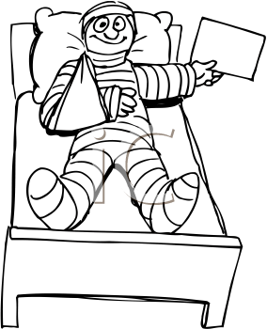


National Problem
20% Falls Leads to Serious Injury¹
3-Fold Higher Risk of Mortality compared with others in age cohort³
95% of Hip Fractures are the result of a fall²
1. Stevens JA, Ballesteros MF, Mack KA, Rudd RA, DeCaro E, Adler Gd. Gender ifferences in seeking care for falls in the aged Medicare Population. Am J Prev Med 2012;43:59–62. 2. O’Loughlin J et al. Incidence of and risk factors for falls and injurious falls among the community-dwelling elderly. American journal of epidemiology, 1993, 137:342-54. 3. Panula, J. et al. Mortality and cause of death in hip fracture patients aged 65 or older- a population based study. BMC Musculoskeletal Disorders, 2011. 12: 105.

Slide 6
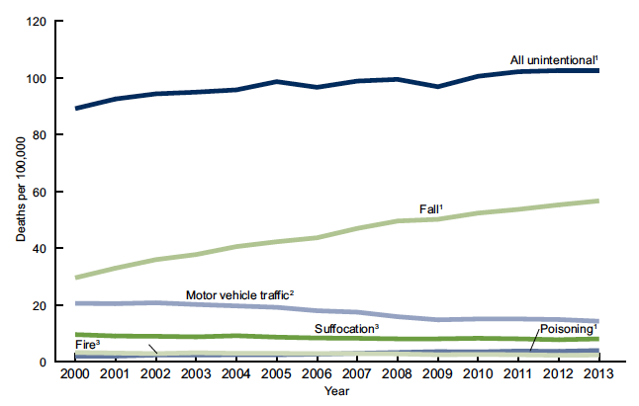
Figure: Age-adjusted death rates, by cause of death among adults aged 65 and over: US, 2000-2013
All unintentional
Fall
Motor vehicle traffic
Suffocation
Poisoning
Fire³
Source: CDC/NCHS, National Vital Statistics System, Mortality

Slide 7
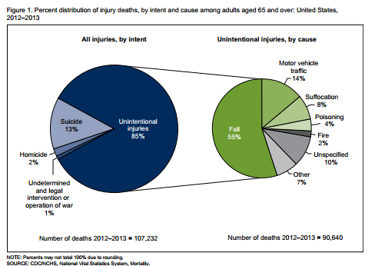
Lessons Learned
Figure 1. Percent distribution of injury deaths, by intent and cause among adults aged 65 and over: United States, 2012-2013
All injuries, by intent
Unintentional injuries, by cause
Motor vehicle
traffic
14%
Suffocation
8%
Unintentional
Injuries
85%
Poisoning
Suicide
13%
4%
Falls
55%
Fire
2%
Homicide
Unspecified
2%
10%
Other
Undetermined and legal intervention or operation of war 1%
7%
Number of deaths 2012-2013 = 107,232
Number of deaths 2012-2013 = 90,640
Number of deaths 2012-2013 = 107,232
Source: CDC/NCHS, National Vital Statistics System, Mortality

Slide 8

Falls in Baltimore
Baltimore’s rate of falls requiring ED visits or hospitalizations in 2014 was approximately 40% higher than the US National rate.

Slide 9
Framing Fall Reduction
What are you looking forward to in retirement?
Notes:
One-Stop Comprehensive Benefits – People deserve respectful assistance in accessing all the benefits they are eligible for… and entitled to
Citizen Education and Action Is Potent - a powerful and consistent component of all of our services. Citizens are our partners in green, healthy, and sustainable housing. The Baltimore Energy Challenge visits every house HCD serves thru CREATES and thousands that we cannot serve.
More families and households benefit from streamlined services – one application for all division services, one lending unit for various loan programs, one assessment of housing needs, one fiscal unit tracking various funding sources – for those served the process should be seamless.
Economies of scale make a difference – outreach to affordable housing rental projects, bulk buying of energy star gas furnaces, cool roofing whole rowhouse blocks, geographically concentrating services help more people more efficiently and at lower costs.
Housing is a health issue… and health is a housing issue – fall and injury prevention for seniors, reducing asthma-related emergency room visits, preventing the lifelong damage of lead paint poisoning, preventing fires and carbon monoxide poisoning, preventing hypothermia during “no heat” emergencies all reflect the symbiotic relationship between health and housing.
Technology in the 21st century needs to benefit agencies and the people we serve. Electronic storage and sharing of eligibility records, laptops and scanners for intake and benefits analysis, client tracking across City agency services, ipads for field services, accessing individual and composite utility accounts.
Evaluation is essential to prove our worth in saving energy, reducing health costs, preserving homeownership, and strengthening communities

Slide 10
Individual Experience
“ I lay there and I was just shook up. I was so shook up…”
- Baltimore Resident

Slide 11
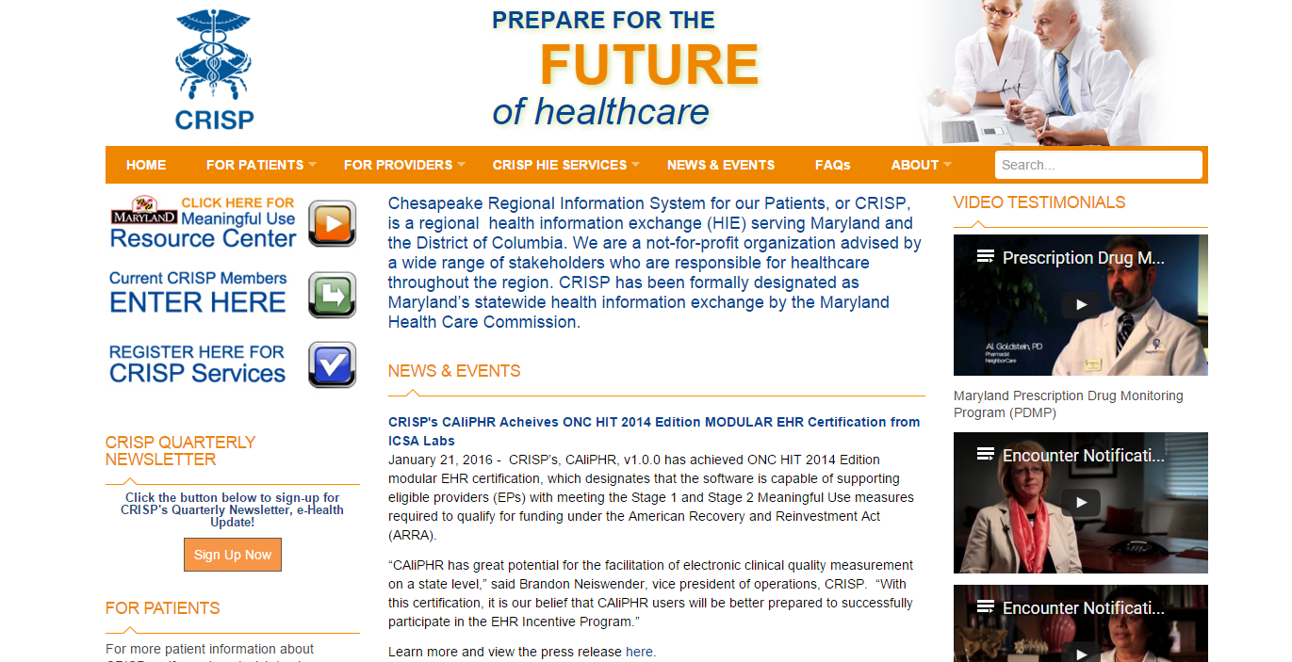
Using Data

Slide 12
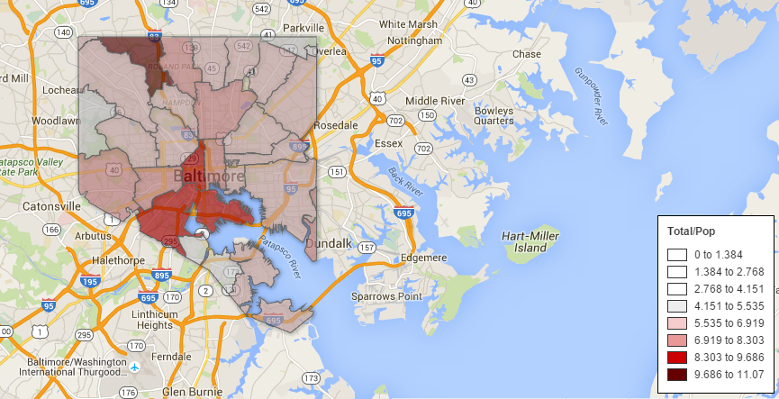
Mapping Falls
Rate of Falls by ZIP Code Requiring Hospital Care per 100 Baltimore City Residents over Age 65 years, 2014
(preliminary analysis of Maryland Health Services Cost Review Commission data)

Slide 13
Locate Community Interventions
Rate of Falls by ZIP Code Requiring Hospital Care per 100 Baltimore City Residents over Age 65 years, 2014
(preliminary analysis of Maryland Health Services Cost Review Commission data)

Slide 14







Community Partners
And More!!!!

Slide 15
Community Partner Goals
Evaluate effectiveness of interventions
Identify underserved areas and locate services
Greater integration with medical community, possibly be included under the clinical care Query Portal for notifications
Make Baltimore an aging friendly city

Slide 16




City Partners
Baltimore City Aging and Care Services
Baltimore City Fire and EMS

Slide 17
City Partner Goals
Make city housing safer for older adults
Improve public walkways that are utilized by older adults
Reduce ambulance usage
Improve access to exercise programs and senior center programs

Slide 18
Matching of Datasets
Possibilities Include:
  Ability to identify individuals at highest risk for individual outreach
  Ability to effectively evaluate a program

Slide 19


Individual Outreach

Slide 20
Further Resources

Slide 21



All In: Data for Community Health
Support a movement acknowledging the social determinants of health
Build an evidence base for the field of multi-sector data integration to improve health
Utilize the power of peer learning and collaboration

Slide 22
DASH and CHP are All In!
Community Health Peer Learning Program
NPO: AcademyHealth, Washington DC
Funded by the federal ONC
15 participant and subject matter expertise communities
Data Across Sectors for Health (DASH)
NPO: Illinois Public Health Institute in partnership with the Michigan Public Health Institute
Funded by the RWJF
10 grantee communities

Slide 23
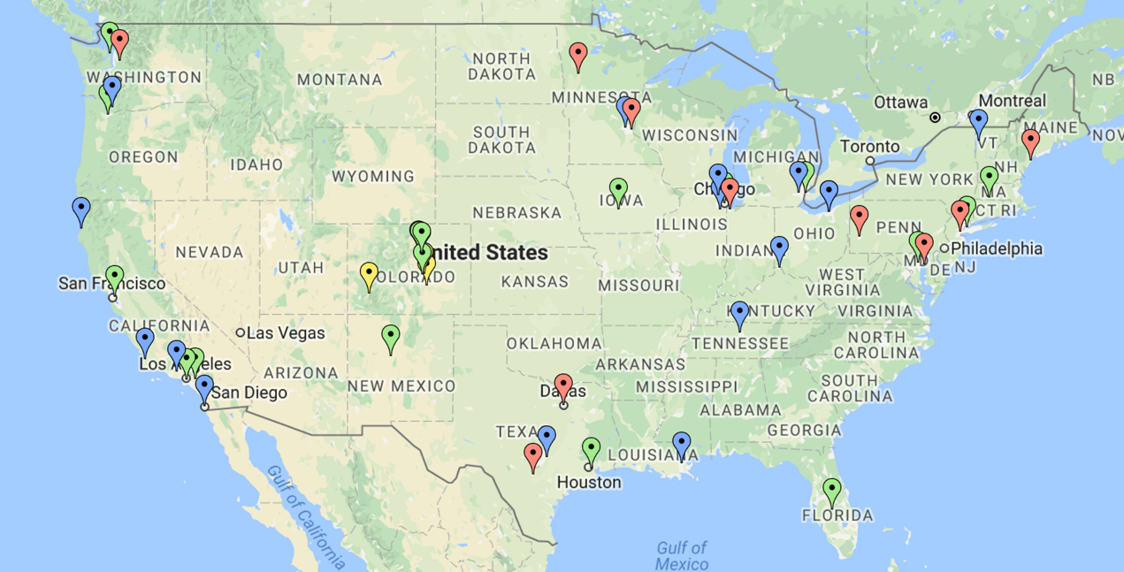

Projects in the Network
All In reflects the efforts and insights of 50 community collaborations
  10 Data Across Sectors for Health (DASH) projects
  15 Community Health Peer Learning Program (CHP) projects
  18 BUILD Health Challenge projects
  7 Connecting Communities and Care projects from the Colorado Health Foundation (TCHF)

Slide 24

Connect with Us!
Sign up for news at dashconnect.org/news
Follow us at
  @DASH_connect
  @AcademyHealth at #CHPHealthIT
  @BUILD_Health
  @COHealthFDN

Slide 25
Acknowledgements
A Sincere Thanks You to:
Data Across Sectors of Health
Robert Wood Johnson Foundation
CRISP and our Community Partners
Grace E. Mandel
1001 E. Fayette Street
Baltimore, MD 21202
grace.mandel@baltimorecity.gov
Notes:
Follow us on twitter and Instagram or like us on Facebook to stay informed about public health in Baltimore.

