Slide 1
Communities Leading from Abundance: Bright Spots from the Field
Lessons from the RWJF-funded SCALE Initiative
Spreading Community Accelerators through Learning and Evaluation
February 16, 2017
Communities Joined in Action Annual Meeting - San Antonio, TX

Slide 2
Leading from Abundance
Paul Howard & Niñon Lewis
Notes:
25 minutes total

Slide 3
What were the goals of SCALE?
Develop capability within communities to improve health and achieve a culture of health.
Learn what it takes to create effective teamwork and inter-community spread.
Develop a system for continuous learning and improvement, synthesis and dissemination (spread system).

Slide 4
Communities of Solution
How people relate to themselves, each other and people and places most affected by inequity
How the community creates change
How the community creates abundance

Slide 5
Leading from Abundance Framework
Leading from Within
Leading Together
Leading for Outcomes
Leading for Equity
Leading for Sustainability

Slide 6
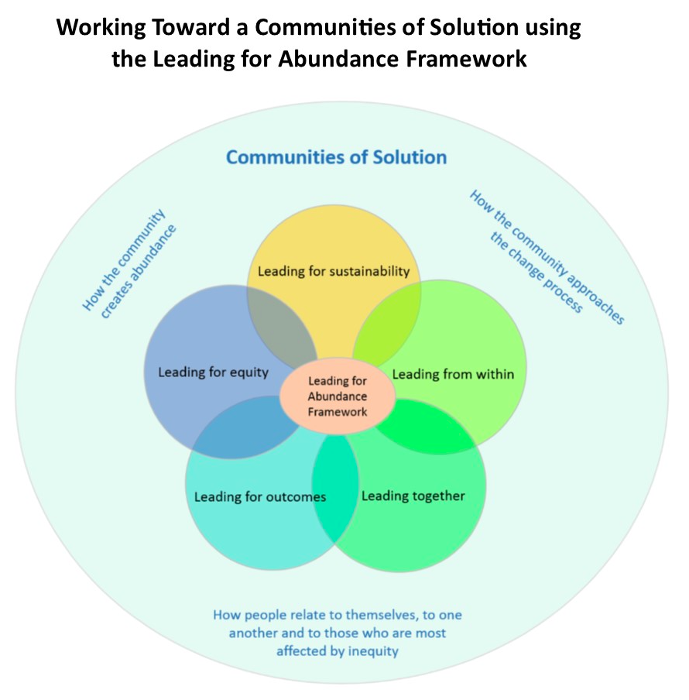
Co-designed in SCALE 1.0 by Implementation Team, Evaluation Team, SCALE Communities

Slide 7
Storytellers and Facilitators for Today’s Session
Sarah Callender, LCSW Director of Health and Wellness, Downtown Women’s Center
'Shemekka Ebony' Coleman, MS Steward of Community Champions, 100 Million Healthier Lives
Kate Ebersole CPCC Principal, KEE Concepts Consulting LIA: Cattaraugus County Healthy Livable Community
Seth Fritsch Strategic Initiatives Coordinator, Health Improvement Partnership of Maricopa County (HIPMC)
Andrew Martin Field Agent, 100 Million Healthier Lives
Esther N. Munene, MBA, Ph.D. Ethnic Community-based Organization for Refugees (ECOR)
Paul Howard, MPA Senior Director of Knowledge Sharing, Community Solutions, (Moderator)
Niñon Lewis, MS Executive Director, Institute for Healthcare Improvement, (Moderator)

Slide 8
Shemekka Ebony
Stories from the Field:
SE Raleigh Pacesetters Collaborative
Raleigh, North Carolina

Slide 9









Our Partner Organizations

Slide 10
Affordable Housing Education
Health & Wellness Economic Opportunity
Leadership Development
Leading for Equity
What is a Community Champion?
Any person with LIVED EXPERIENCE being Willing and Empowered to SHARE their Gifts and Skills in partnership with their Community, Neighborhood, and/or Block.

Slide 11
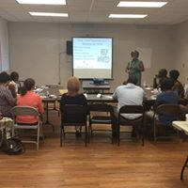
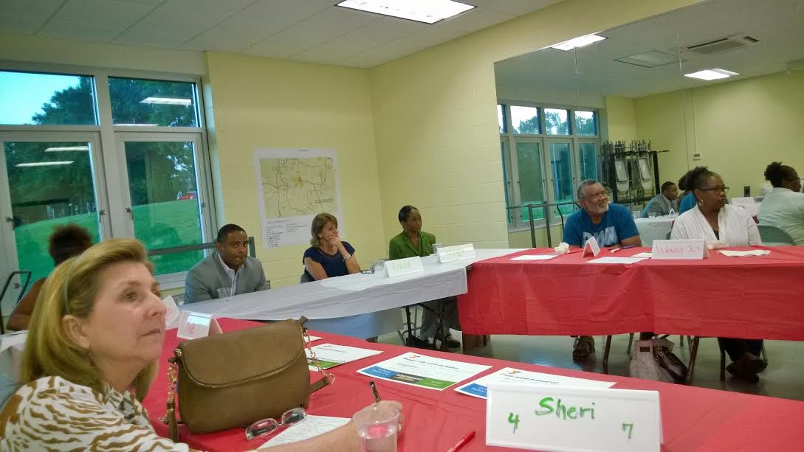
Leading from Within
PDSA Model-Improvement Science Tool
Plan Do Study Act
We were able to adapt presentations and layout based on rapid feedback from participants between trainings.
Our trainings improved and our presenters worked better together over time learning from our plans, actions, fail forwards, and revisions.

Slide 12
Learning
Leading with Equity can begin with involving community champions during initial planning of community engagement and health improvement initiatives.
Leading from Within helps us center our human connection to the work and not just an agenda for outcomes.
Engaging people with lived experience is invaluable in leading sustainable outcomes in community health & wellness and systemic change.

Slide 13
Drew Martin
Stories from the Field:
Proviso Partners for Health
Chicagoland, Illinois

Slide 14
Proviso Township, Illinois
The story of a small village under a circus tent

Slide 15
Leading Together
Establishing a Collective Impact system
  Shared agenda
  Common measurements
  Mutually reinforced activities
  Constant communication
  Backbone Organization*
Creating a culture of inclusiveness
Data sharing
Providing assistance to each other for funding purposes

Slide 16
Leading for Outcomes
Measure! Measure! Measure!
Tell the story in fun and inventive manner
Be prepared to spread both knowledge and techniques to the a broader and more diverse audience

Slide 17
Sarah Callendar
Stories from the Field:
Downtown Women’s Center
Los Angeles, CA

Slide 18
Our Project
Focus on diabetes management and prevention
Homeless and low-income women in the Skid Row Community
Diverse stakeholder group
  Health plan (L.A. Care)
  FQHC (Wesley Health Centers)
  Health advocacy group (UHHP)
  Non-profit (DWC)
  Community Champions (3)
  University (USC)

Slide 19
What Happened?
Everyone had fun coming together, developing doable goals and testing new SCALE tools
However, the main project ended up in the hands of one team at my agency
Other stakeholders came but did not provide much beyond input & ideas
My agency’s team lead got very frustrated but did not know how to communicate this to me

Slide 20
Failing Forward
I met with my agency’s lead to debrief what happened & address feelings of frustration
Discovered that I, our advisor to the project and my supervisor did not notice this was happening
Discovered that this happens often in stakeholder groups which can lead to coalition fatigue and disconnection
We brainstormed how to prevent this from occurring again in this project (new collaborative that she is leading)

Slide 21
Leading from Within & Together
Slow down and make sure people are taking equal responsibility before moving ahead.
Be brave! Speak up when we are uncomfortable with a project’s direction.
Be bold! Have tough conversations with people who want to be part of a collaborative but do not want to do the required work.
Allow space and time for people to express concerns and make sure you are approachable - ask open, honest questions.
How? Remember to be curious and turn to wonder when things get tough. We will make mistakes – we just have to learn from them so we can grow.
Spend time developing yourself as a leader (from within) so we can lead better together.

Slide 22
Questions?

Slide 23
Table Discussions

Slide 24
At your tables…
Take 2-3 minutes and silently reflect on the following:
  Which of these levels of leadership for abundance do you see present in your community? In what ways?
    Leading from Within, Leading Together, Leading for Outcomes, Leading for Equity, Leading for Sustainability
  Where are your areas for growth?
Share your reflections with your table mates

Slide 25
Large Group Report Out
What surprised you in your discussions?
Where do you feel we have the most growth and learning opportunities in our communities? Why?

Slide 26
At your tables…
Take 2 minutes and reflect on:
  What is a “Failing Forward” story from your work and/or community that led to breakthrough learning for you, your team, or your coalition?
Share your reflections with 1-2 people around you.

Slide 27
Large Group Report Out
Share a few Fail Forward stories from the room.
What is sticking with you from the stories shared today and from your table discussions?
  What has been the key take-away?
  What can you try when you get home?

Slide 28
Thank You!
#100MLives
http://www.100mlives.org/

