Slide 1

“A Community Model the World Will Follow”
Developing a Collective Impact from Grassroots.

Slide 2
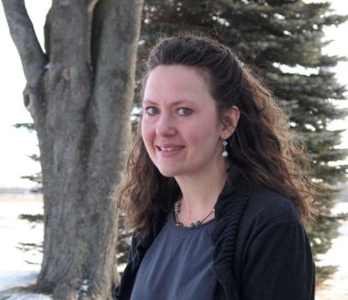
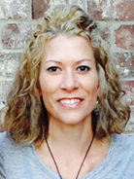
Presented by...
Claire Thompson
Associate Professor
Community Development Educator
UW- Cooperative Extension, Kewaunee County WI
Healthy Communities Activation Team Leader
Jody Anderson
RN, Health Coach
Community Nurse Activator
Bellin Health/ Live Algoma
Healthy Individuals Activation Team Leader

Slide 3
Breakout Session Objectives
Learn about the Live Algoma model
  How we do our work
  What we are working on
  Impact of our work
Building blocks for our work
  Activating community members with lived experience
  Building community partnerships
  Using the tools of Improvement Science
  The contribution of and give back to the Commons

Slide 4
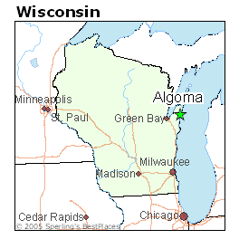

Algoma, WI

Slide 5
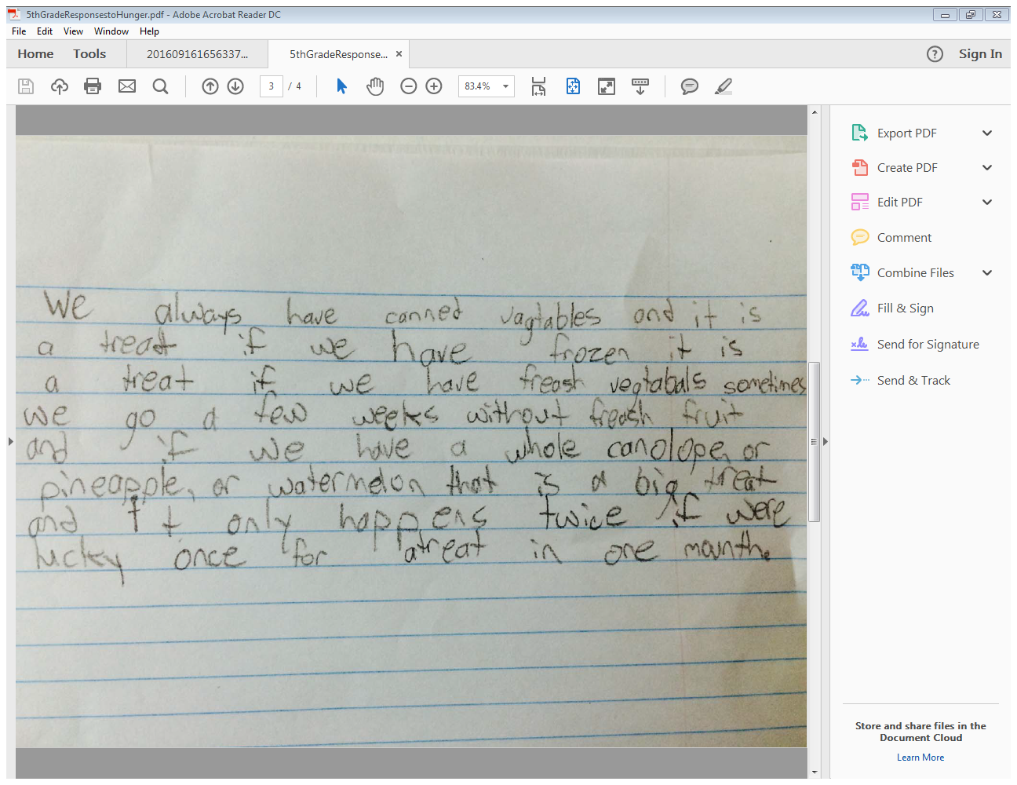
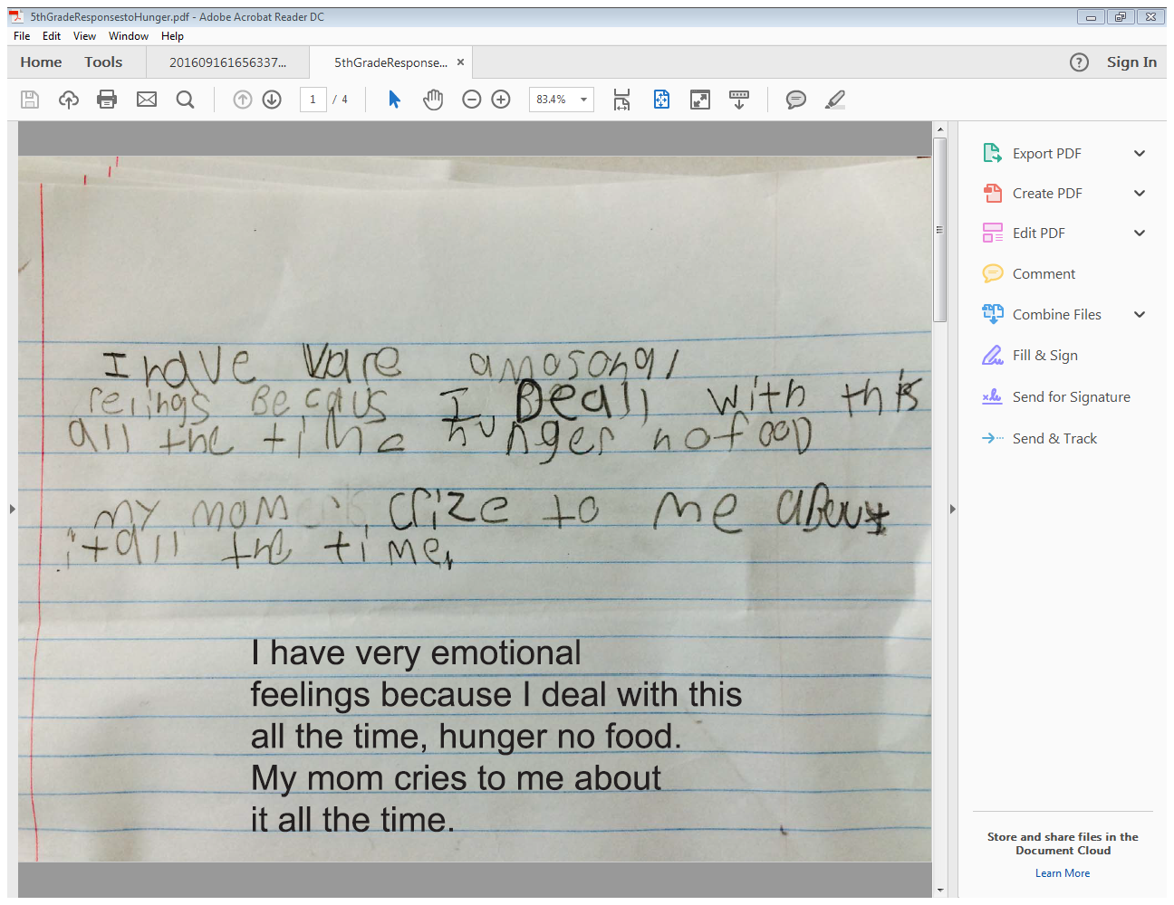
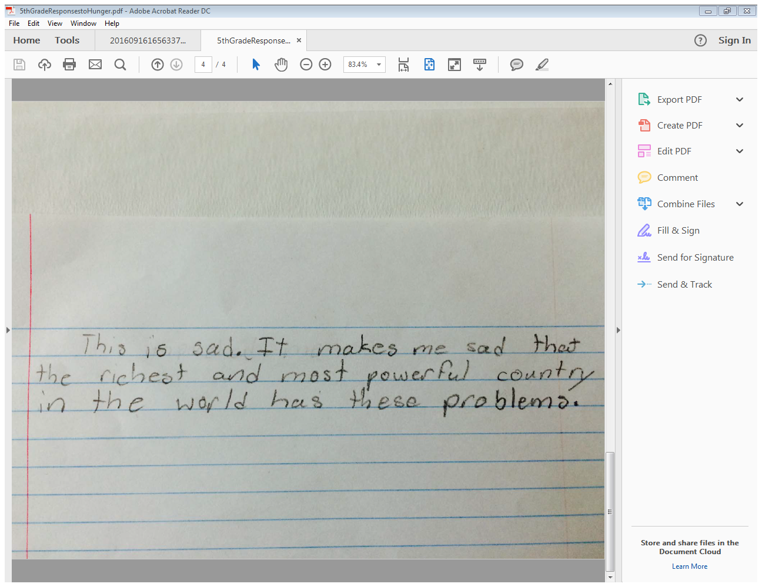
Children’s Reflections
Notes:
.

Slide 6
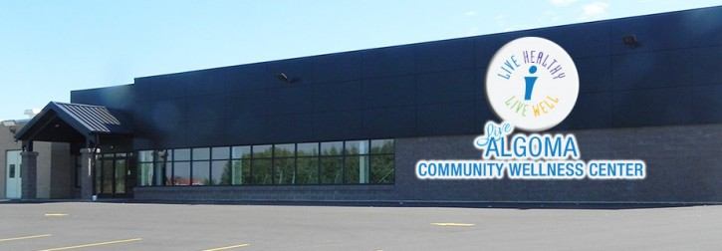
Live Algoma- the Beginning
School District needs are recognized
Building a fitness center for Student Athletes
Recognizing the need for entire community
Harnessed community enthusiasm
Ignited passion for getting things done

Slide 7
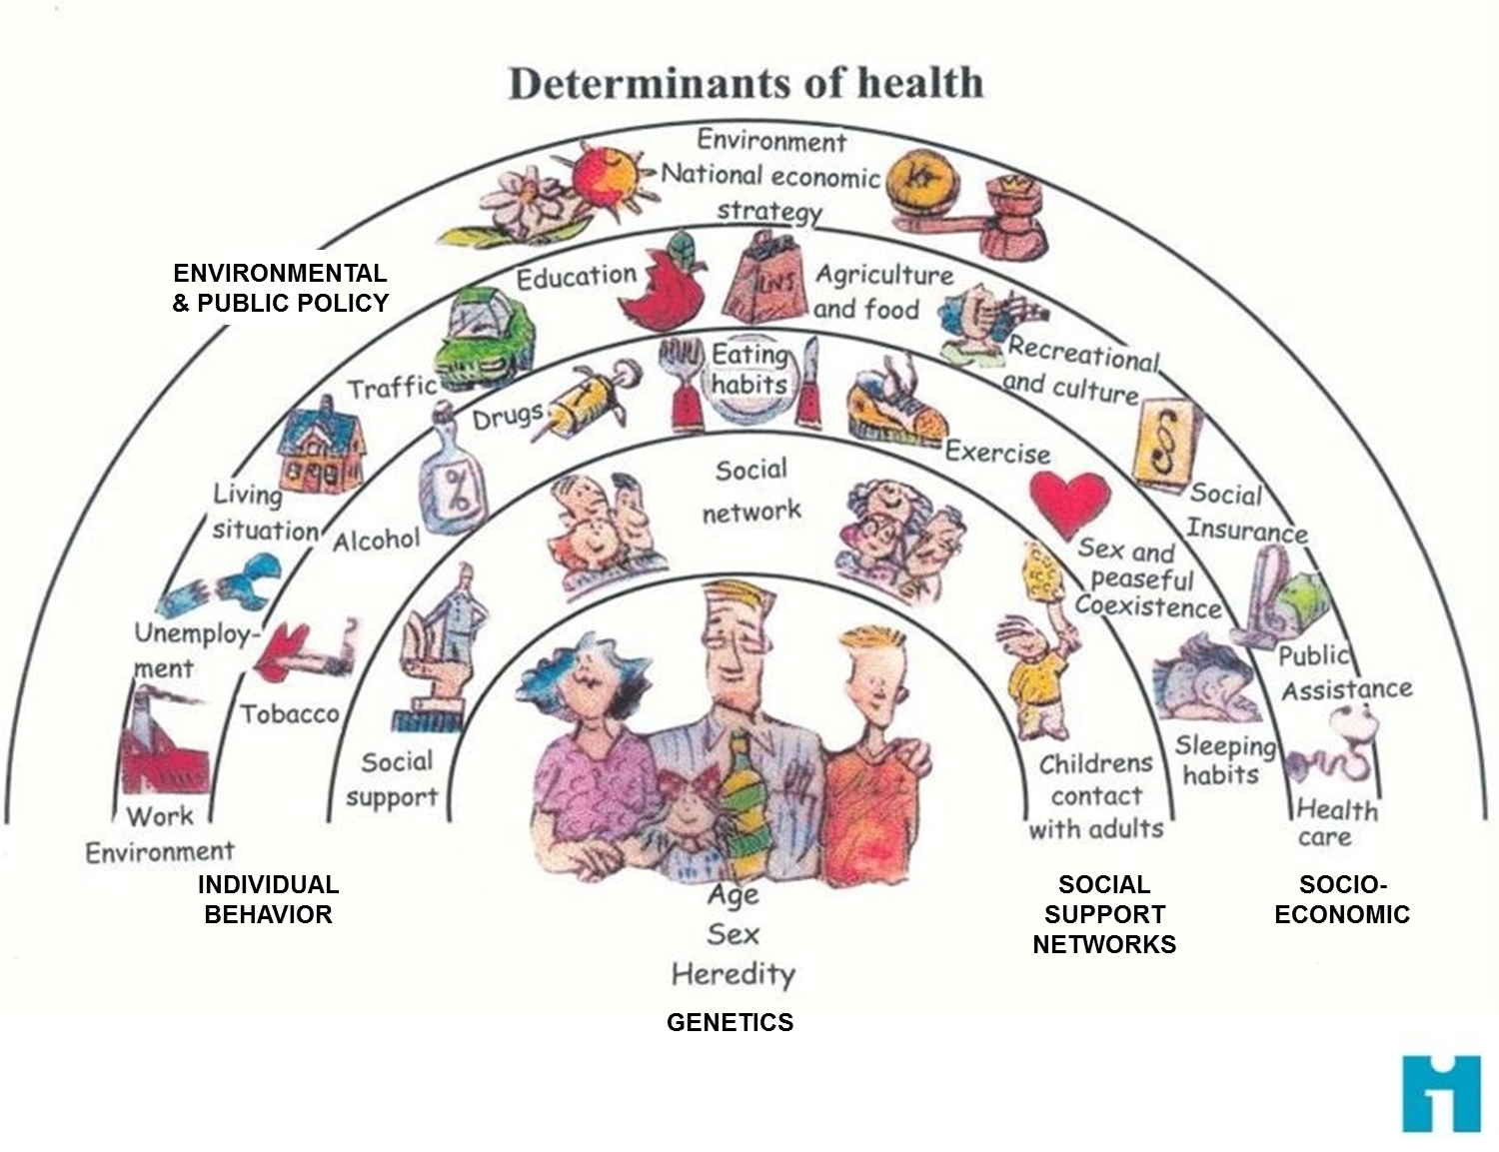
Notes:
.

Slide 8
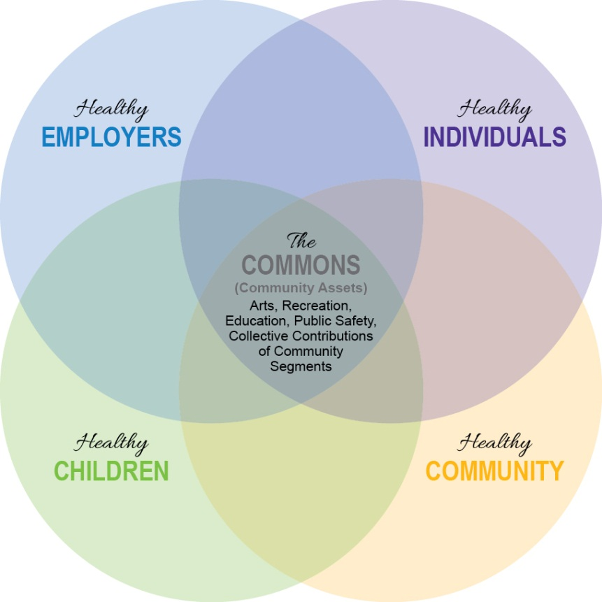
A Community Model the World Will Follow

Slide 9
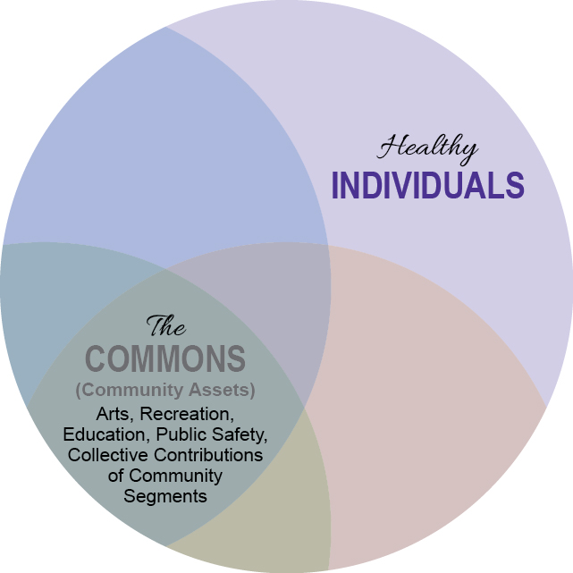

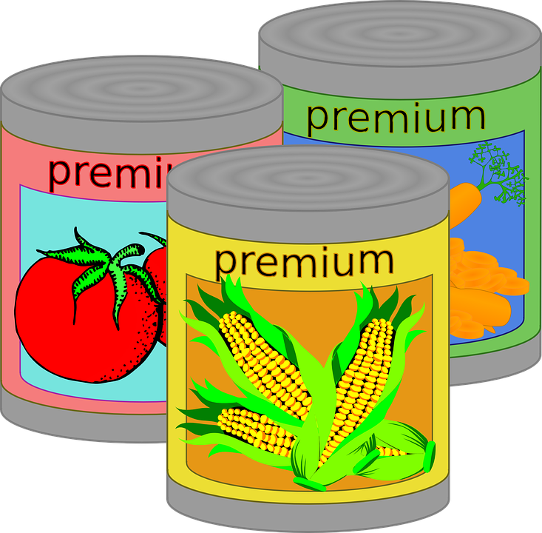

Healthy Individuals
Lens of Focus: adults, age 18 and older
You CAN make a DIFFERENCE
Challenge!

Slide 10
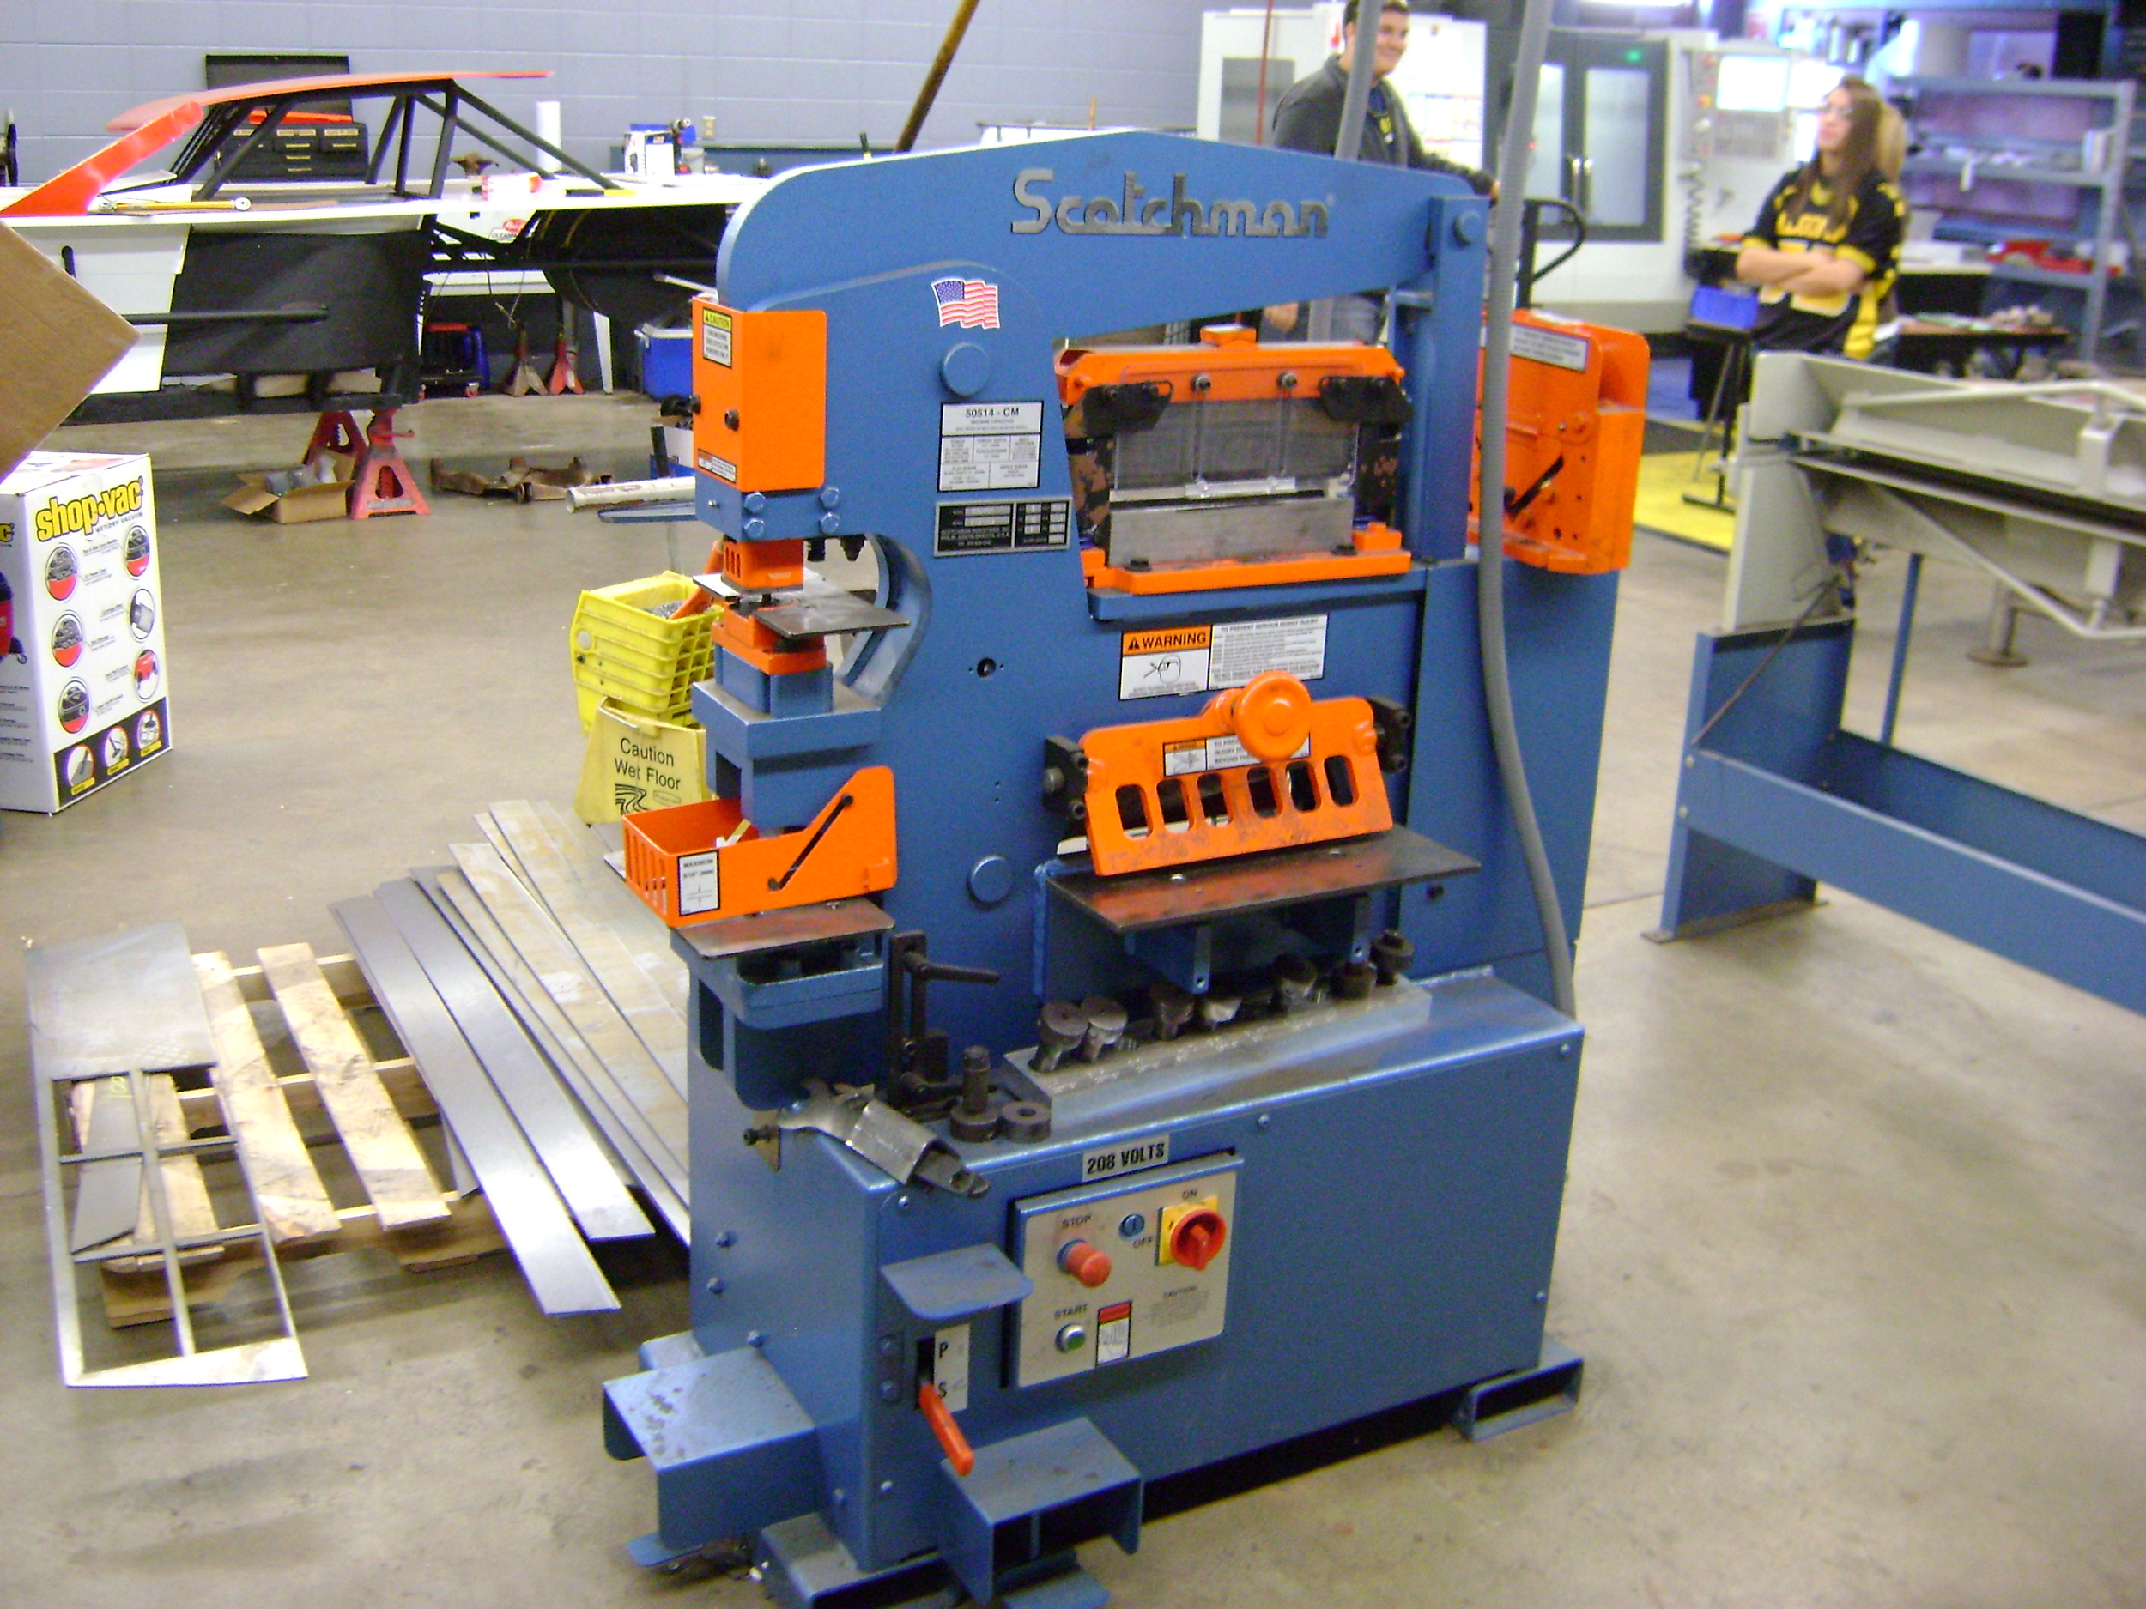
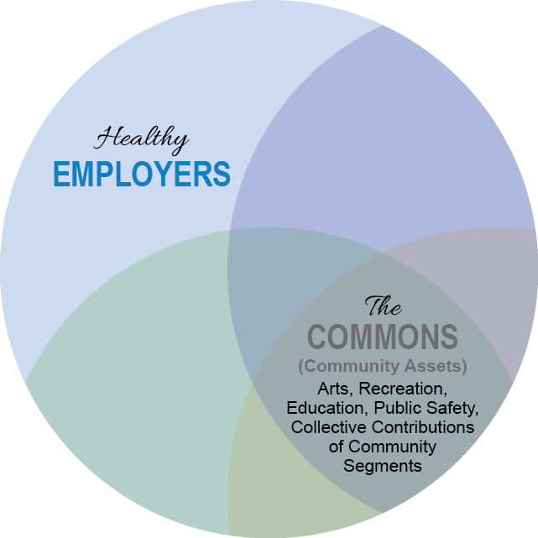
Healthy Employers
Lens of Focus: businesses and organizations
Example Contribution to the Commons: local manufacturing company places a press machine and their employee in the school

Slide 11
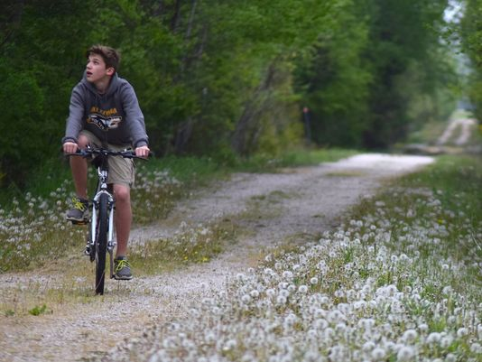
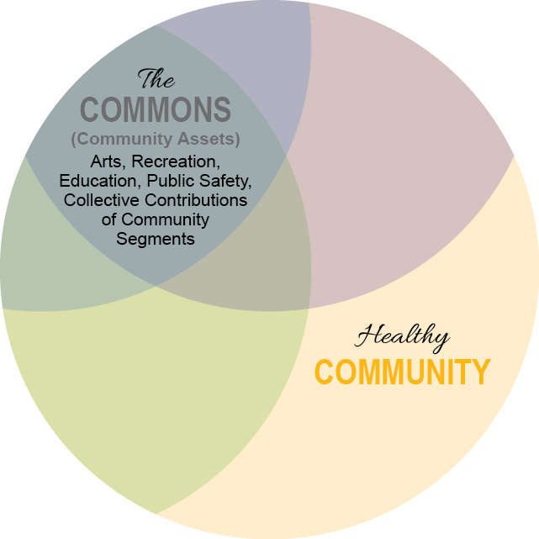
Healthy Community
Lens of Focus: systems and policies
Purpose: to implement systems and policy changes within the community that promote health and well-being
Notes:
.

Slide 12
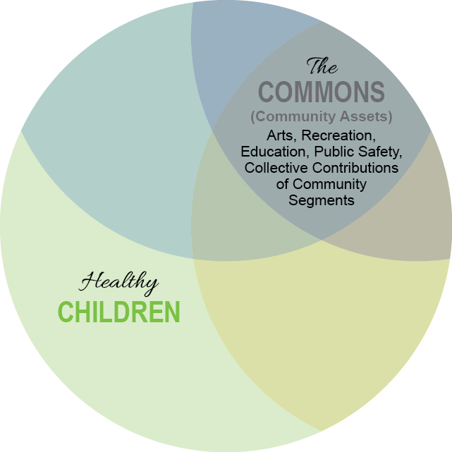
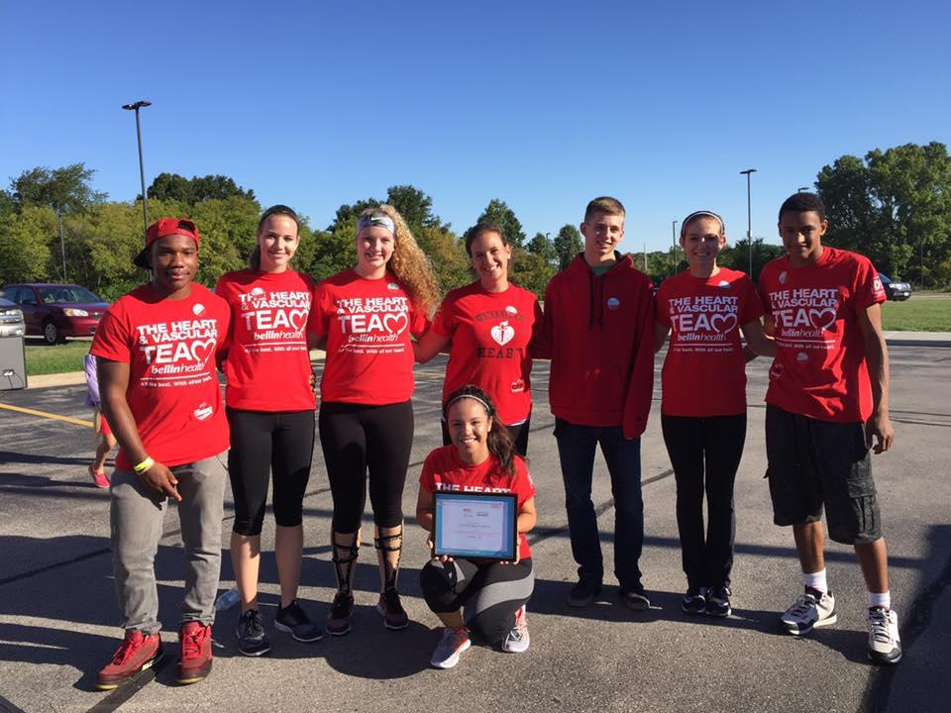
Healthy Children
Lens of Focus: pre-birth to age 18
Notes:
.

Slide 13
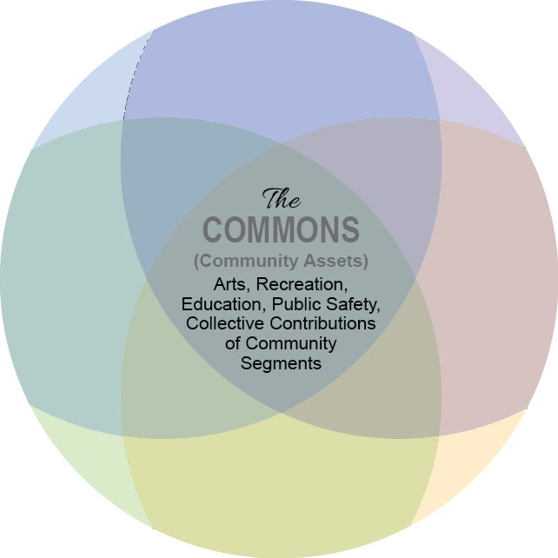

The Commons
Lens of Focus: community assets and resources

Slide 14
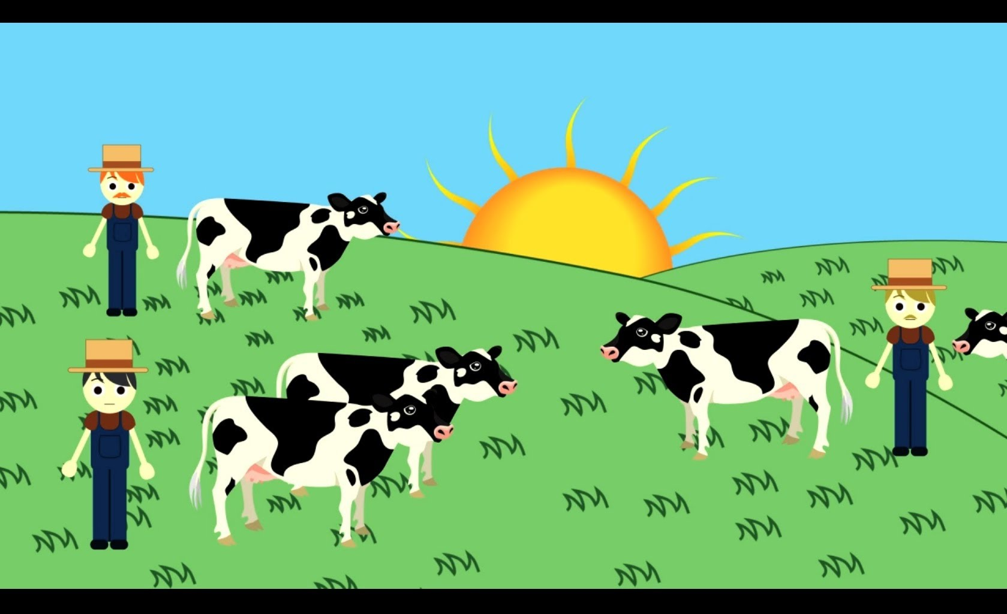
The Tragedy of the Commons
What we take, we must put back in

Slide 15


Slide 16

Building Momentum
IHI SCALE grant
Community Commitments Strengthened (School, Bellin Health, City, organizations)
CHILA - Community Health Improvement and Leadership Academy

Slide 17
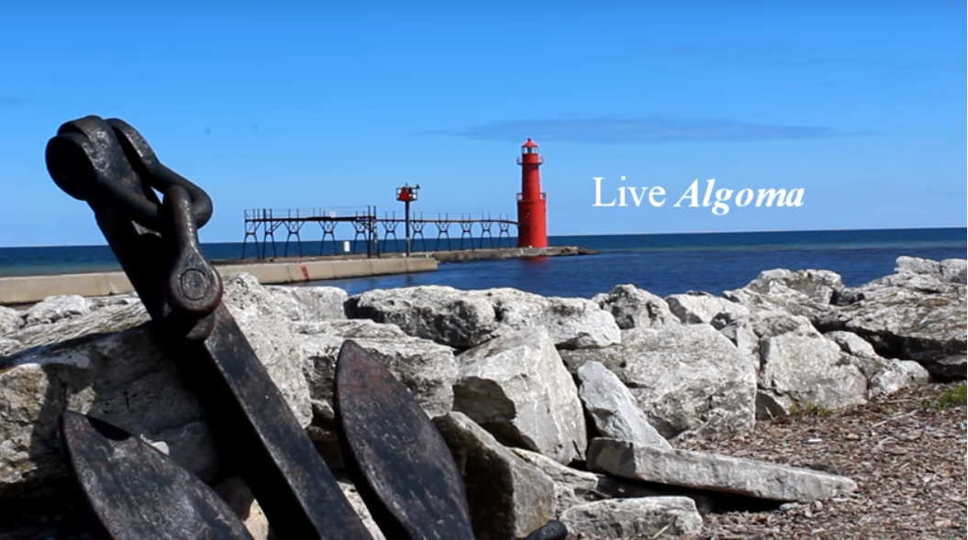
Wellbeing Wheel - Handout

Slide 18
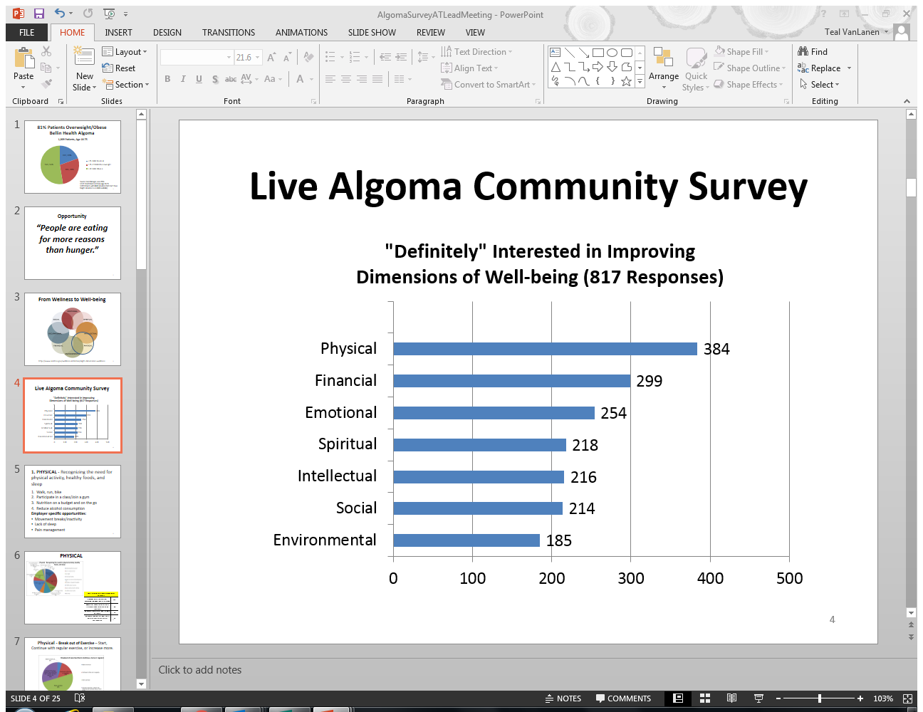
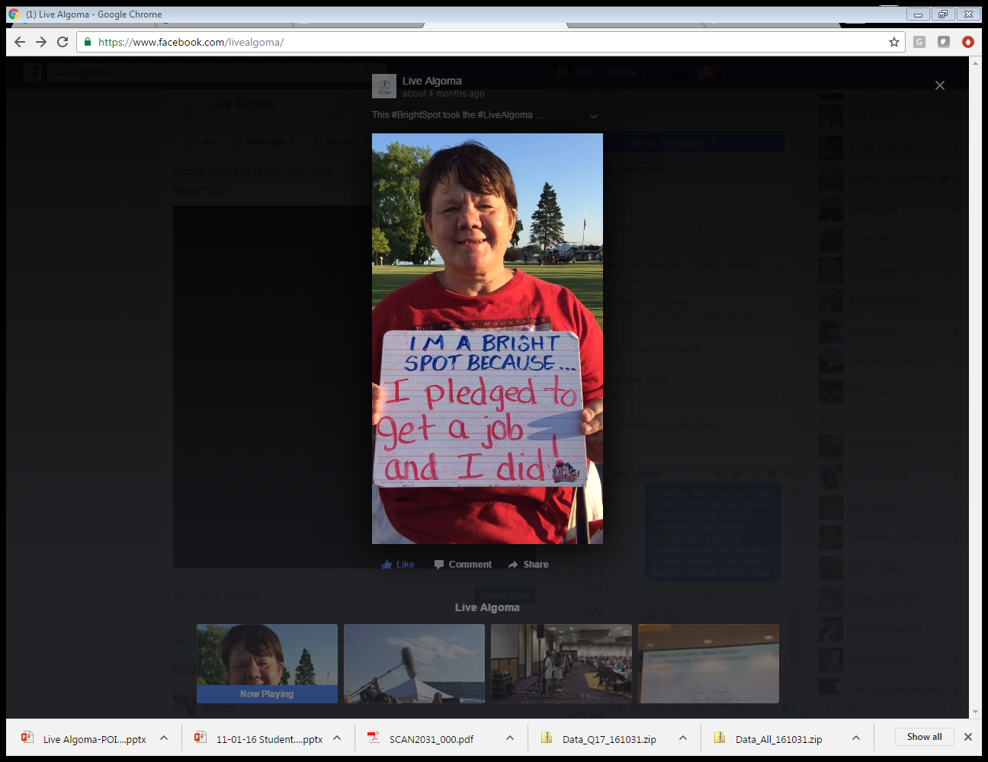

Slide 19

Our AIM
Together every person in the Algoma School District Community will improve one or more dimensions of their well-being, by September 1, 2018.
Emotional
Physical
Environmental
Social
Intellectual
Spiritual
Financial
Notes:
.

Slide 20
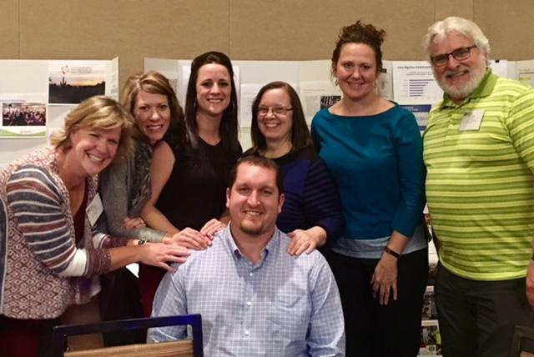
Activating Community Members with Lived Experience
Each team is made up of community members with strengths and lived experience
Conscious effort to not rely on “outside experts”
We know our community
We can see the impact of efforts first hand.

Slide 21
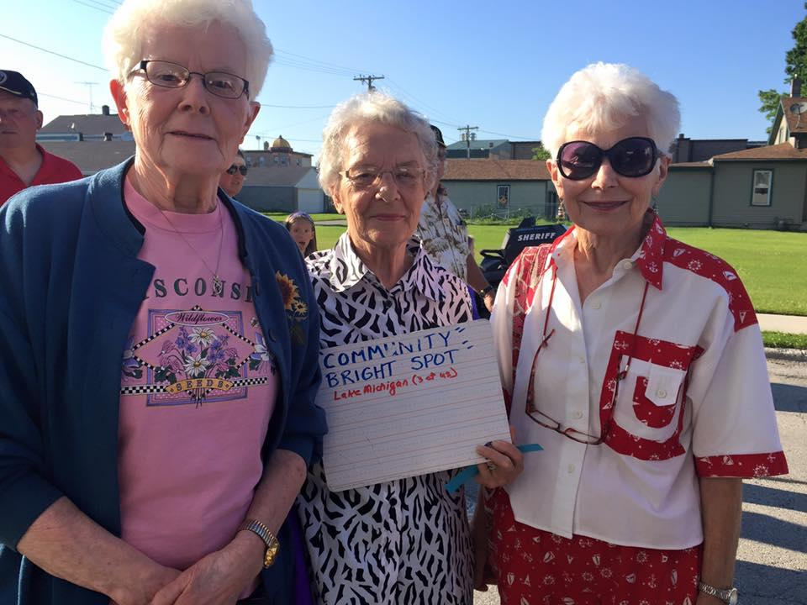
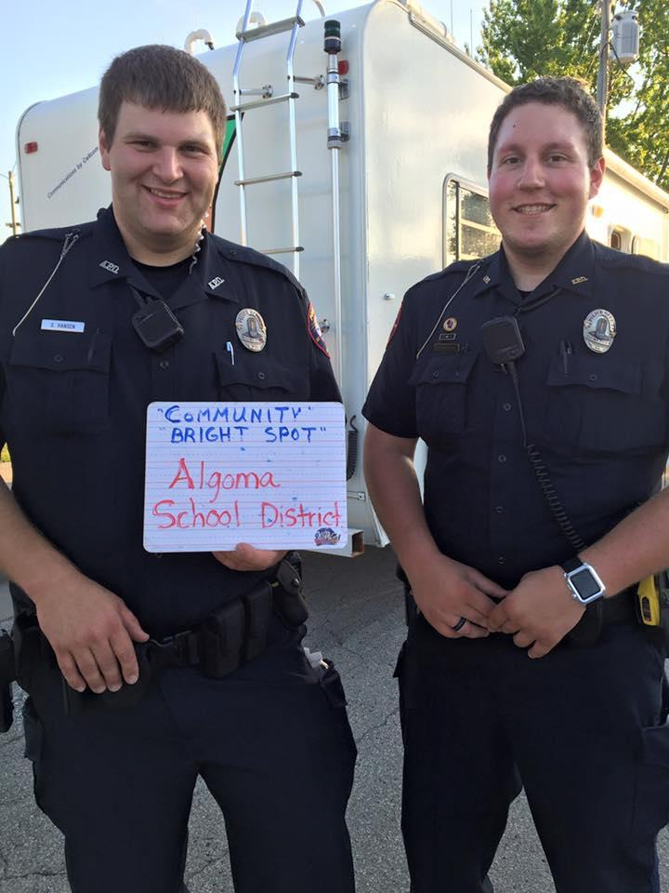
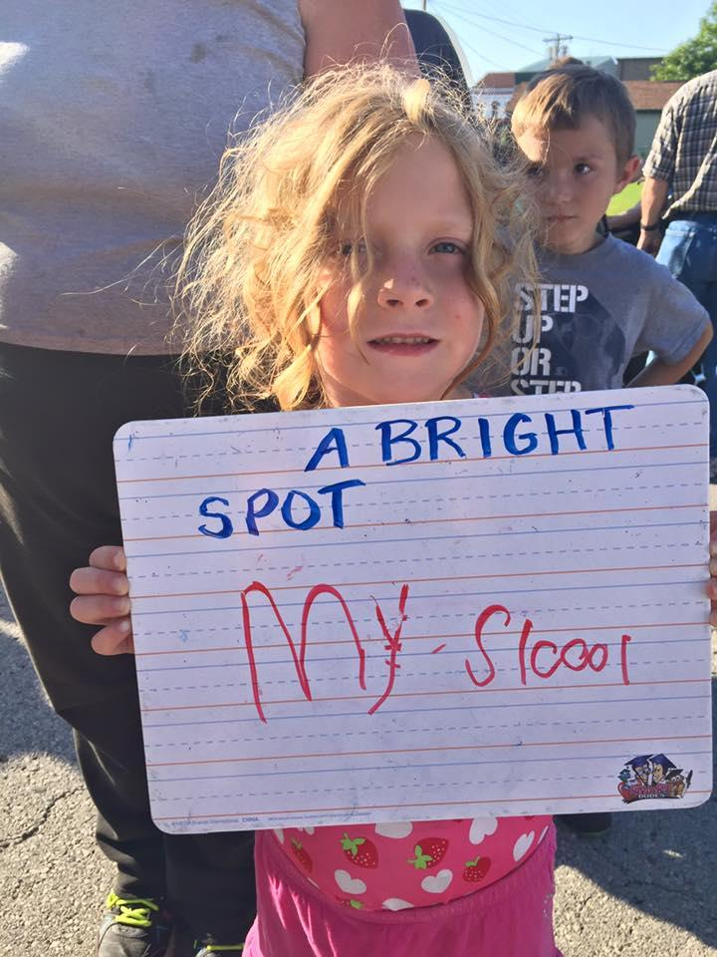
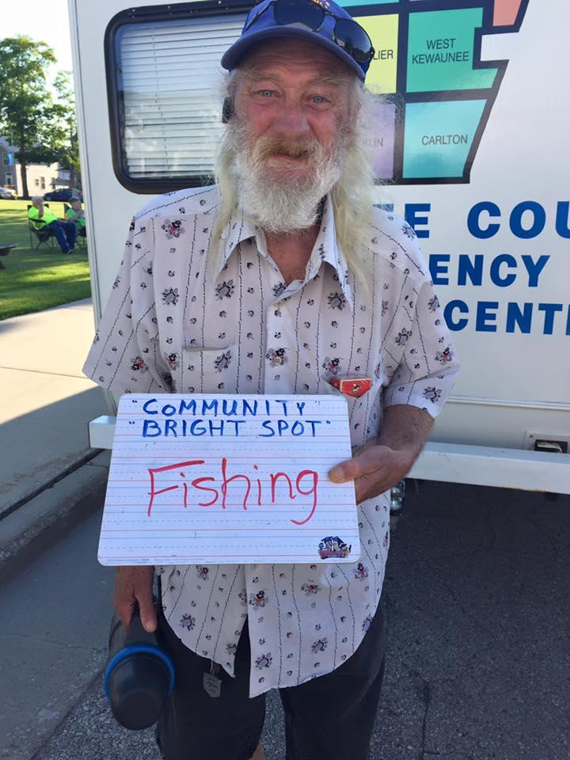
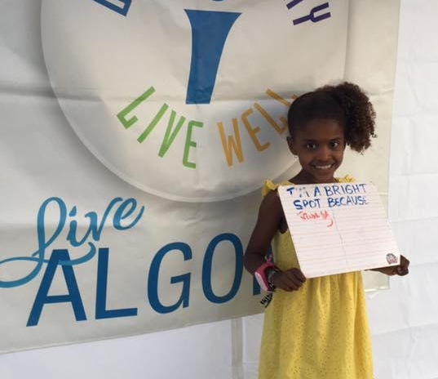
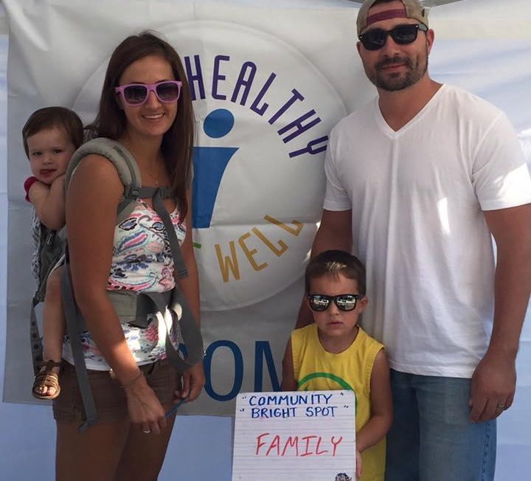
Bright Spots!
Activating those with Lived Experience

Slide 22
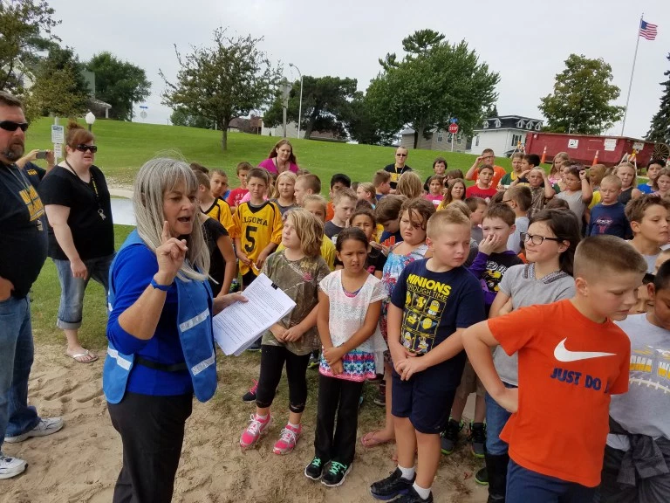
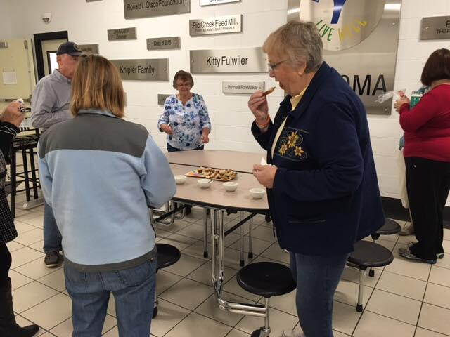
Bright Spots!
Building Community Partnerships
Physical Wellbeing- Eat Right for Life
Environmental - Beach Clean up
Notes:
.

Slide 23
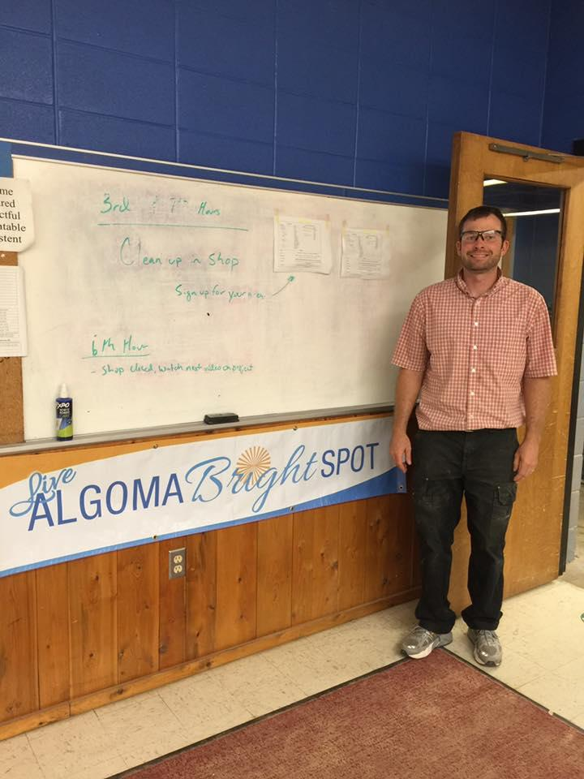
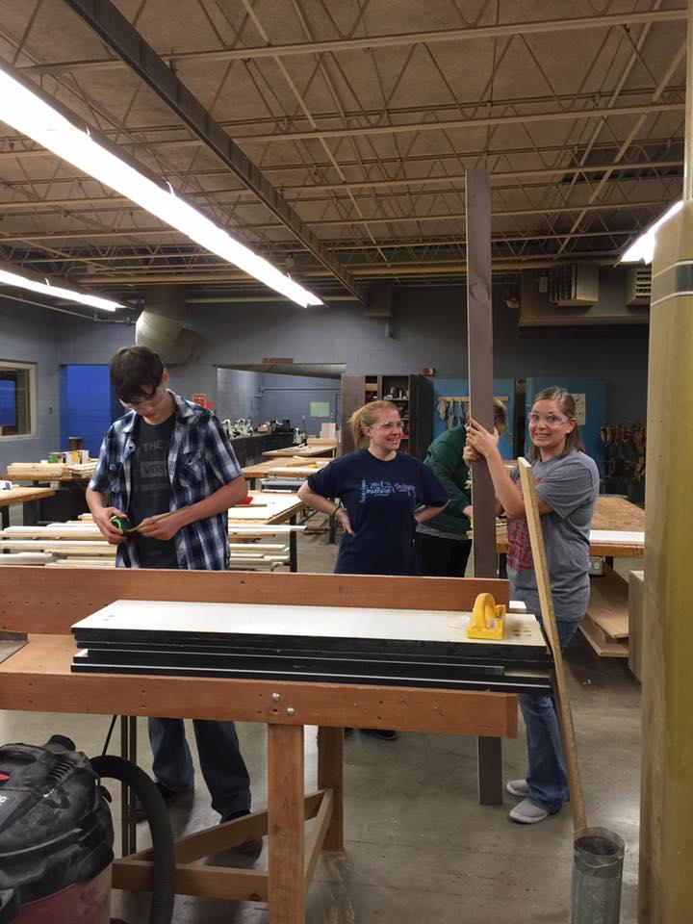
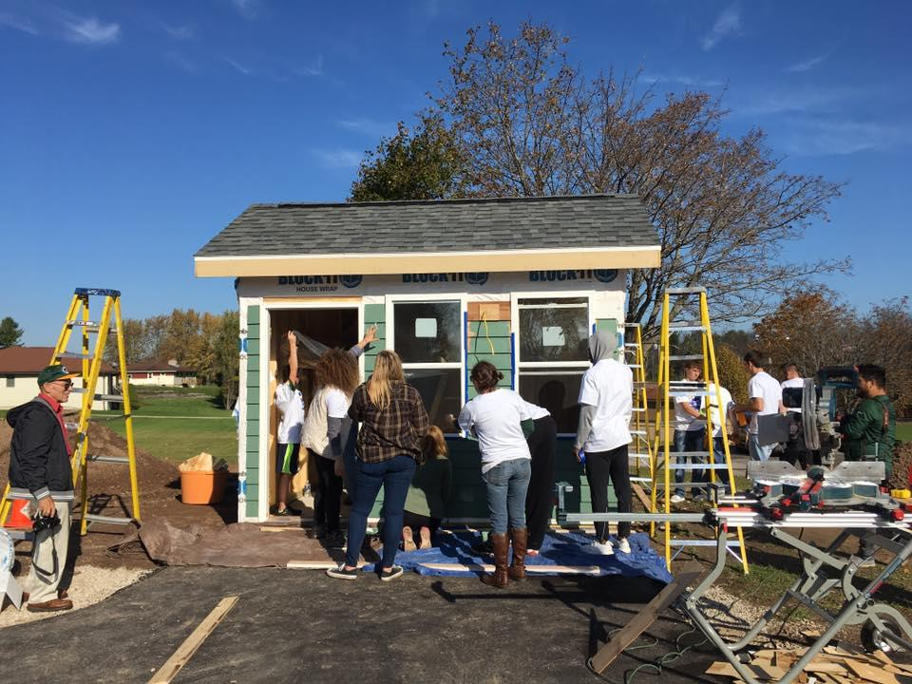
Bright Spots:
Building Community Partnerships
Community Fab Labs
Ice
Community Ice Rink
Notes:
.

Slide 24
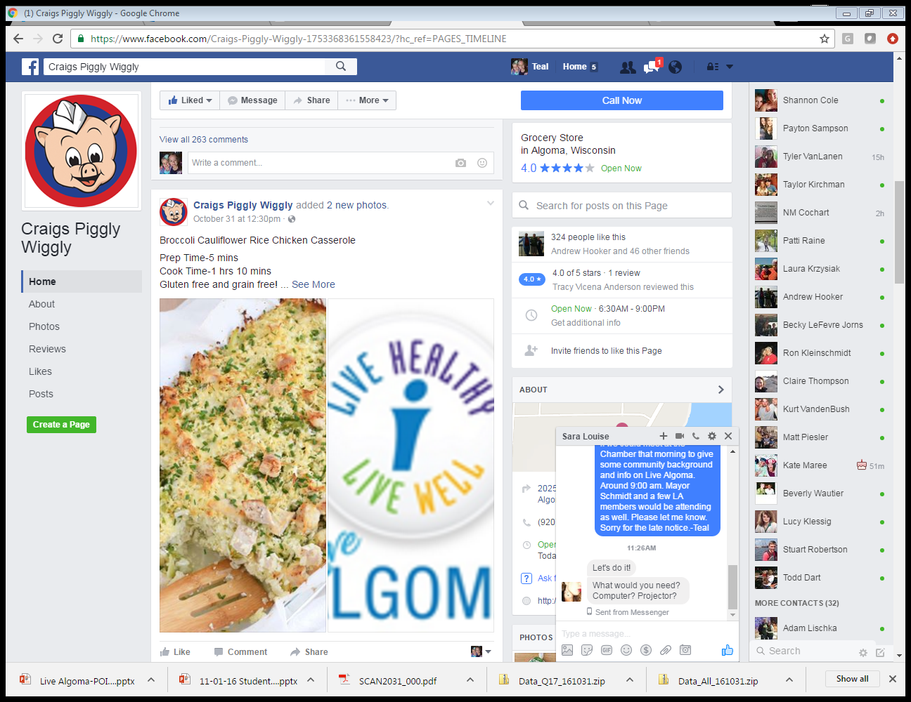
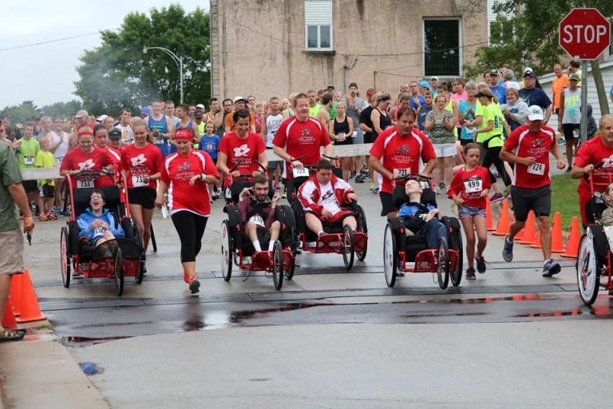
Bright Spots!
Building Community Partnerships
The Shanty Days 5K Run/Walk raised enough money to donate a wheeled racing stroller to the Algoma Community Wellness Center.
A local grocer- Piggly Wiggly,has created recipes highlighting nutrient dense foods that are on sale.

Slide 25
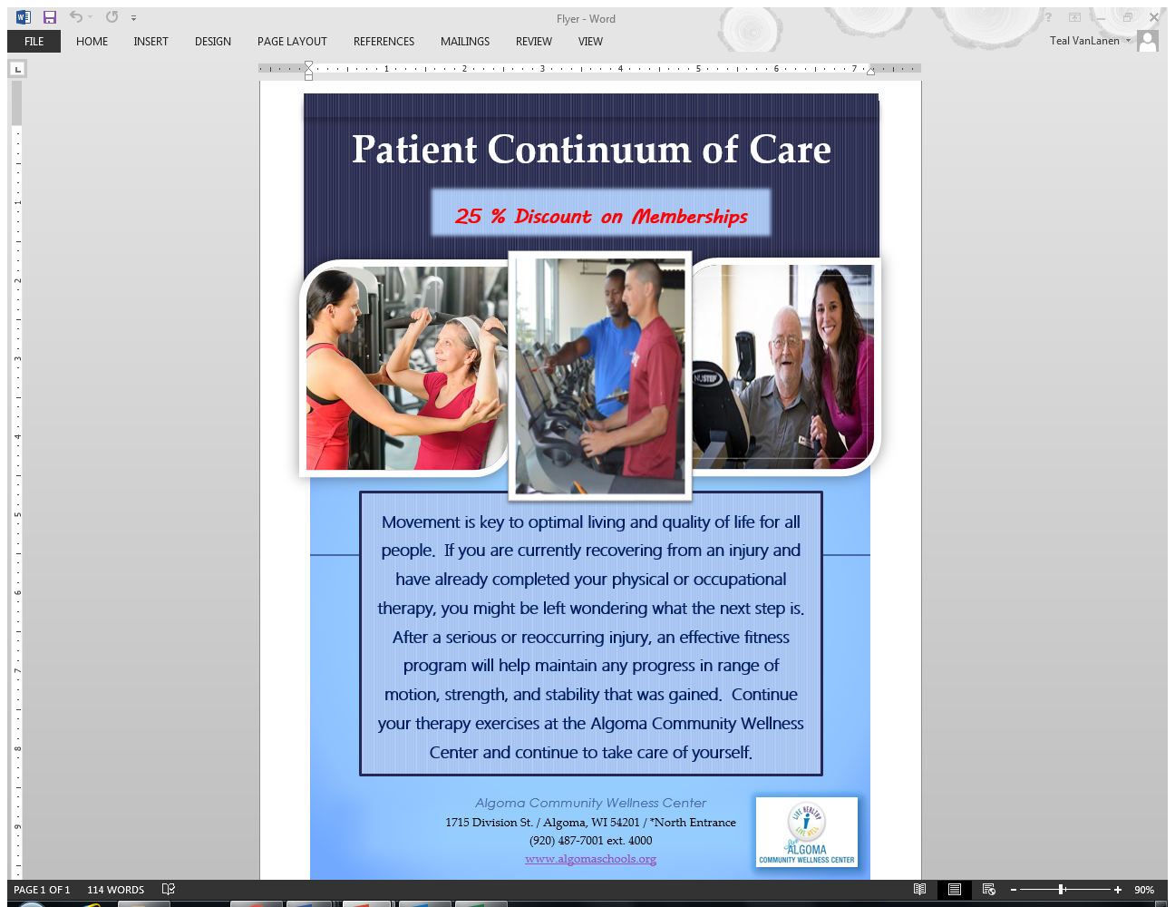
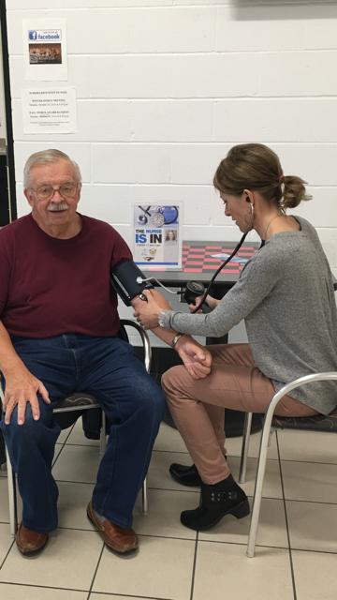
Bright Spots!
Giving back to the Commons
93% Utilization of our New Community Nurse Activator at the Algoma Community Wellness Center.
Physical Therapists from Door Ministry bring their patients to the Algoma Community Wellness Center for their last appointment. The PTs show them how to independently continue their care.

Slide 26
Leading for Results (handout of outcomes model)
Themes
Youth Leadership Development
Physical Activity and Nutrition
Mental Health

Slide 27
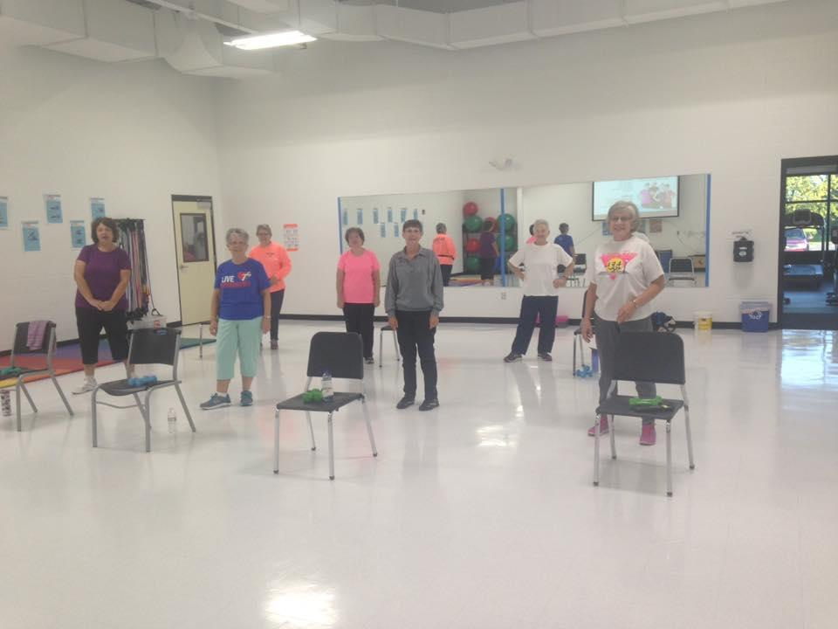
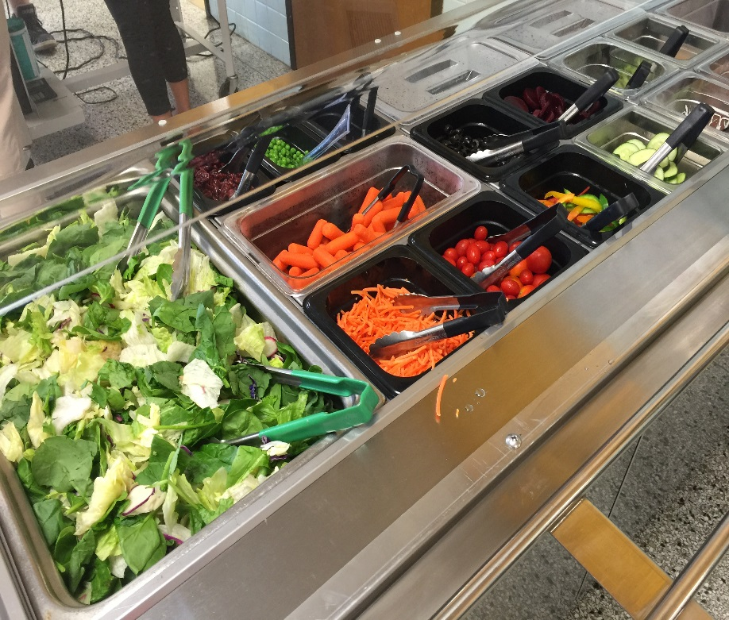
The Impact:
Physical Activity and Nutrition
Adding a new salad bar resulted in a 450% increase in weekly average vegetable consumption.
274 Active Community
Wellness Center Members

Slide 28
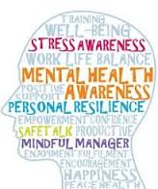
The Impact: Emotional Wellbeing
Trauma Informed School District
Mental Health Risk Assessment
Community Conversations Process
Upcoming challenges...

Slide 29
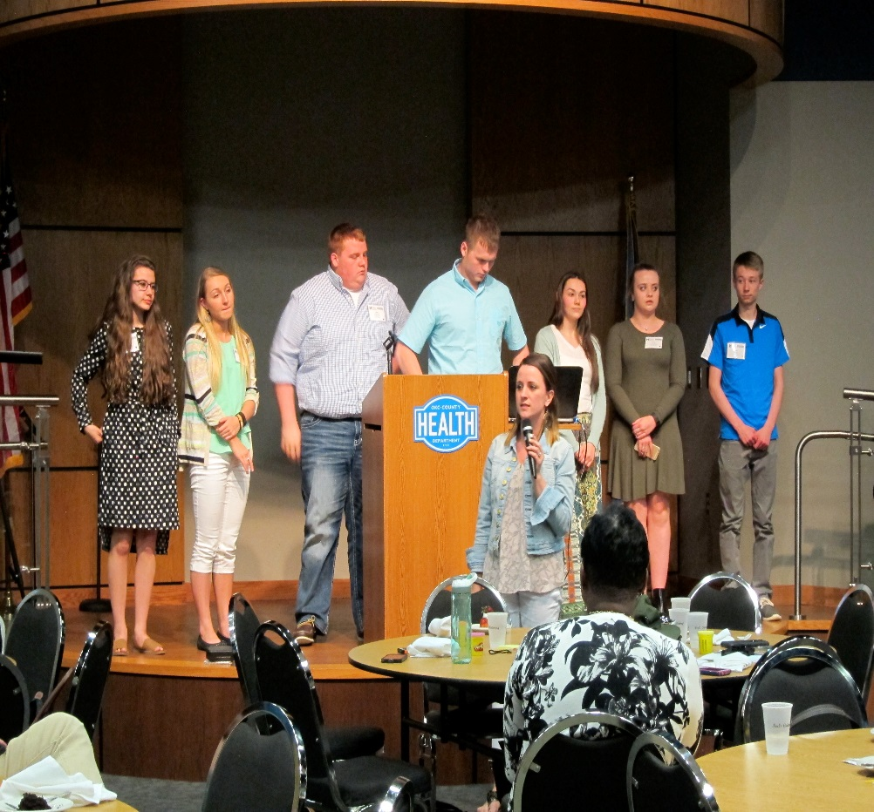
The Impact –
Youth Leadership Development.
Fourteen students developed a “Blueprint” for youth engagement.
Dream Big Start Small
Create a Shared Vision
Build Coalitions
Unity of Message
Moving Pillars of Power
Leave No One Behind
Develop Strategy & Tactics
Build Momentum
Finish What You Started

Slide 30
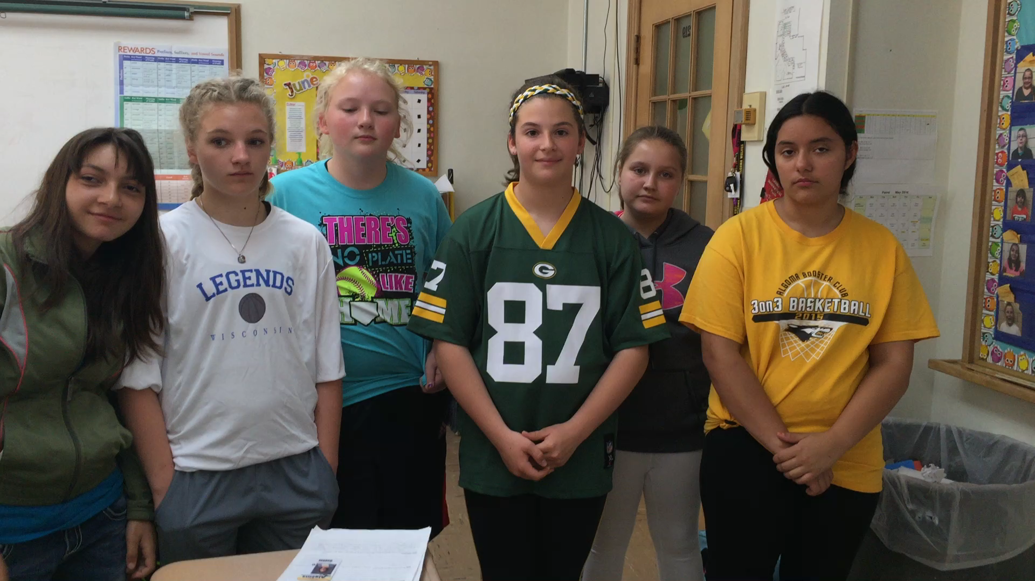
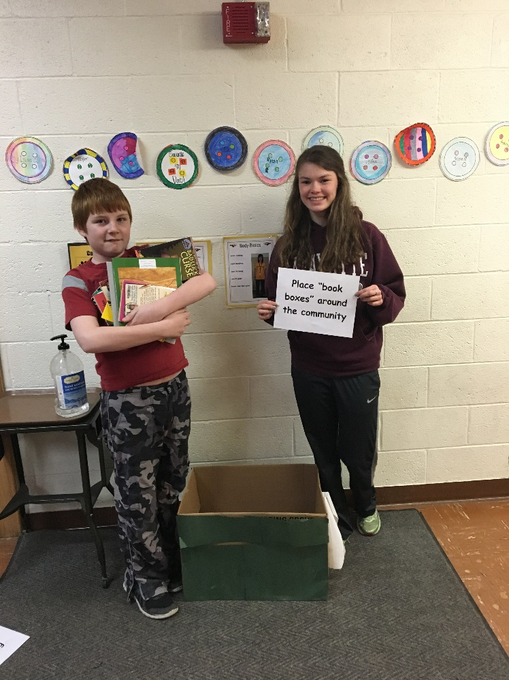
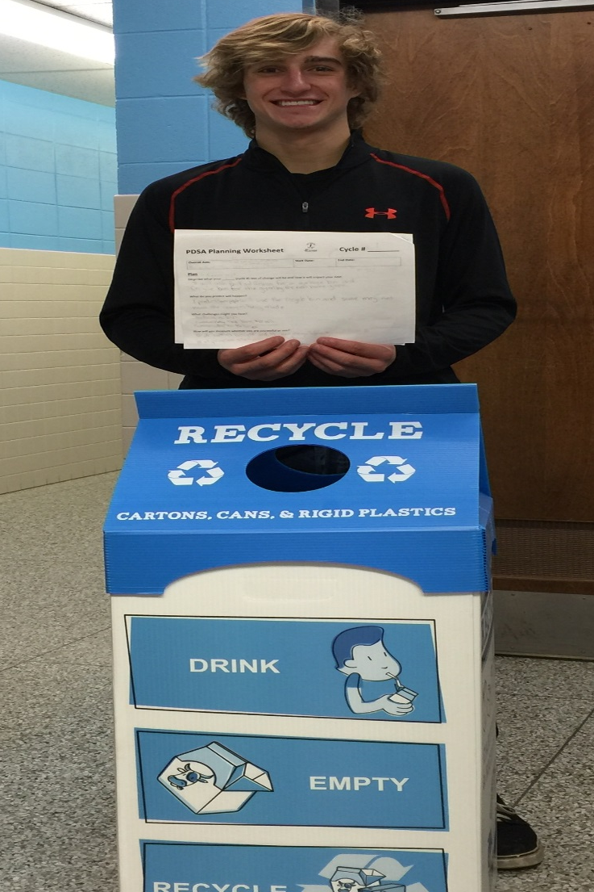
The Impact
Youth Leadership Development
Students and staff alike are learning the PDSA process to improve the world around them.

Slide 31
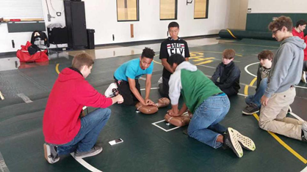
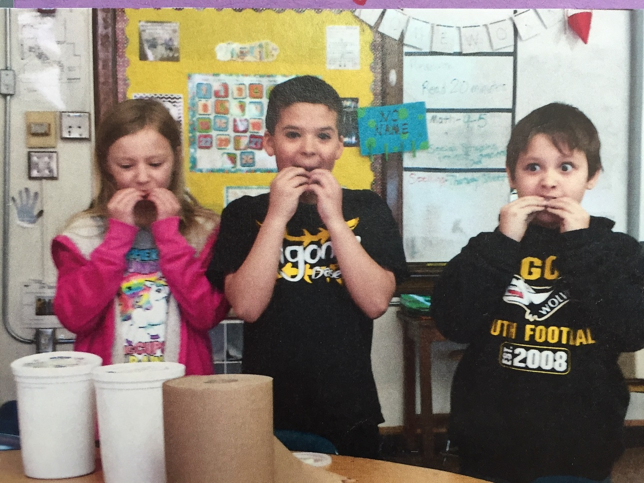
The Impact
Youth Leadership Development

Slide 32
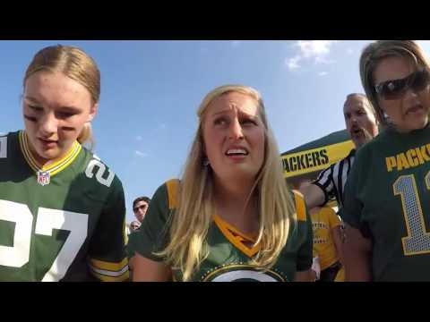

Slide 33
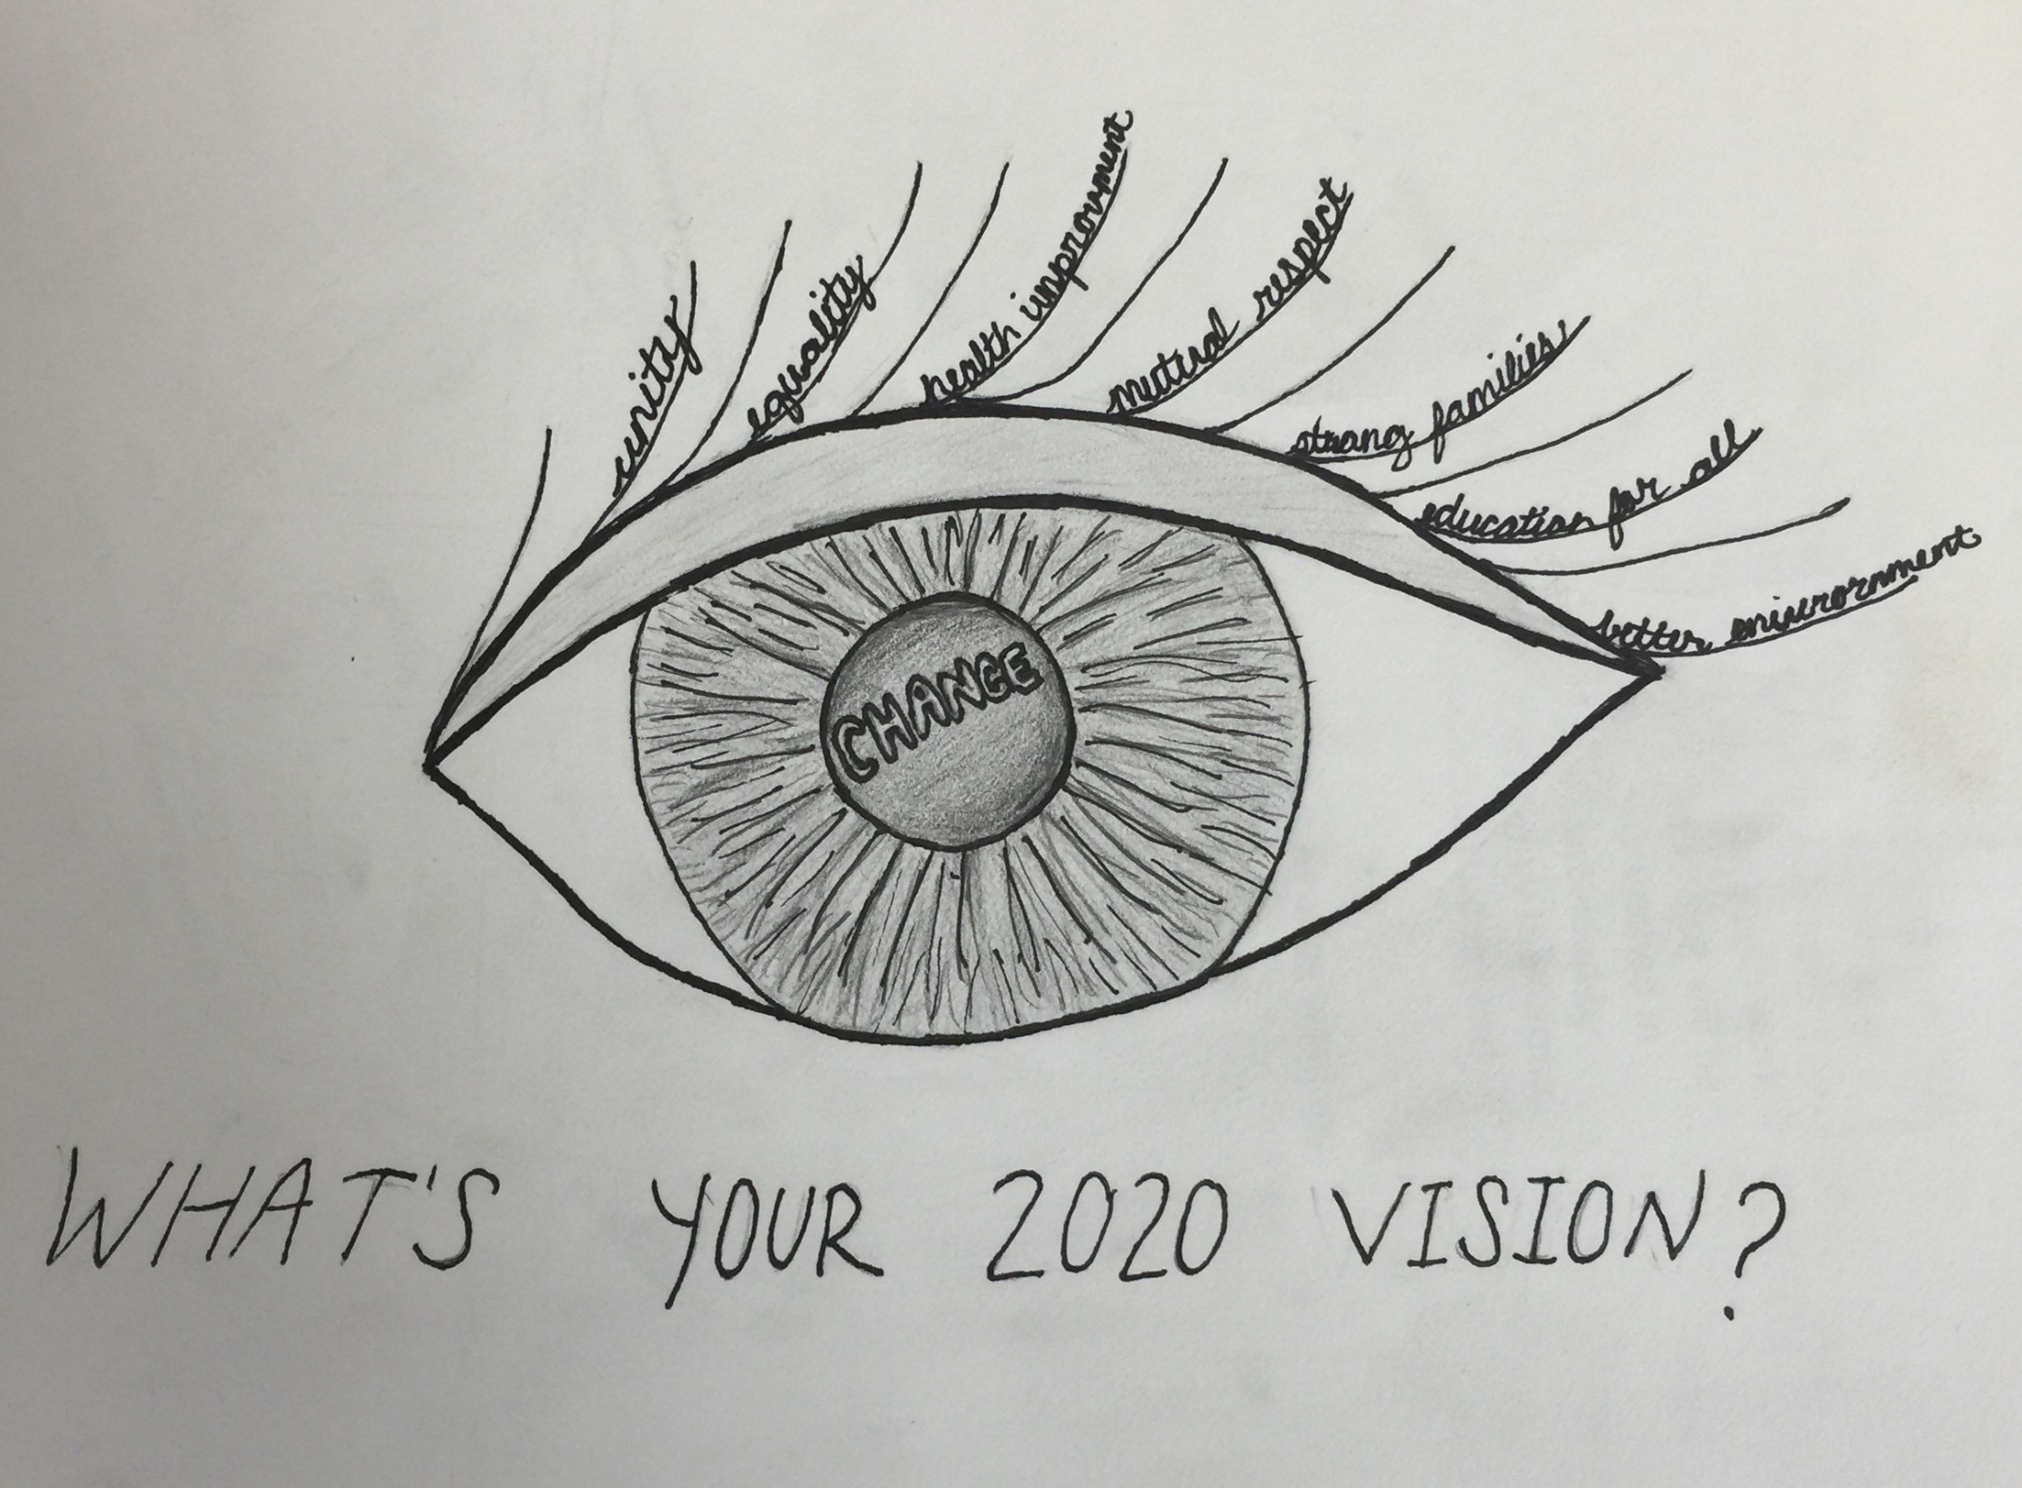

Slide 34
Thank you!

Slide 35
Sources
Social Determinants of Health- Institute for Healthcare Improvement
Be the MVP Hands Free CPR- The video was created in partnership with Live Algoma Community Members and Bellin Health using the creative mind of a very talented Algoma high school student John Holliday.
What’s Your 2020 Vision- Created by Algoma High School student Madison Robertson.
WELLBEING WHEEL- Color your World- Lifesaver Wellbeing Series by Bellin Health; www.bellin.org/lifesaver

