Slide 1
Developing a Community Health Worker Training Model for Latinos in Rural Texas
Katharine Nimmons & Angie Alaniz
Texas A&M School of Public Health
Center for Community Health Development
National CHW Training Center

Slide 2
Objectives
Describe the process of developing a community health worker curriculum
Discuss challenges in rural volunteer recruitment and training

Slide 3
Session Overview
Who are CHWs?
CHWs in Texas – history, numbers, certification
Who are we? CCHD & NCHWTC capacity
Madisonville, TX - demographics & background
Healthcare challenges in rural, underserved populations
CHWs as a potential solution in Madisonville
Development of CHW 101 curriculum
Future directions

Slide 4
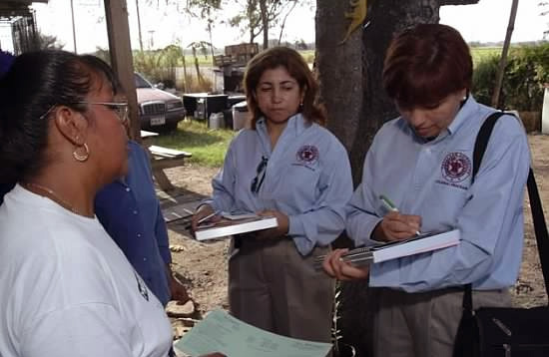
Definition of a CHW
A community health worker is a frontline public health worker who is a trusted member of and/or has an unusually close understanding of the community served.
Notes:
This definition was developed by the American Public Health Associations Community Health Worker Section
4

Slide 5
Definition of a CHW
The trusting relationship between the CHW and the community health worker enables the CHW to serve as a liaison/link/intermediary between health/social services and the community to facilitate access to services and improve the quality and cultural competence of service delivery.
A community health worker also builds individual and community capacity by increasing health knowledge and self-sufficiency through a range of activities such as outreach, community education, informal counseling, social support and advocacy.

Slide 6
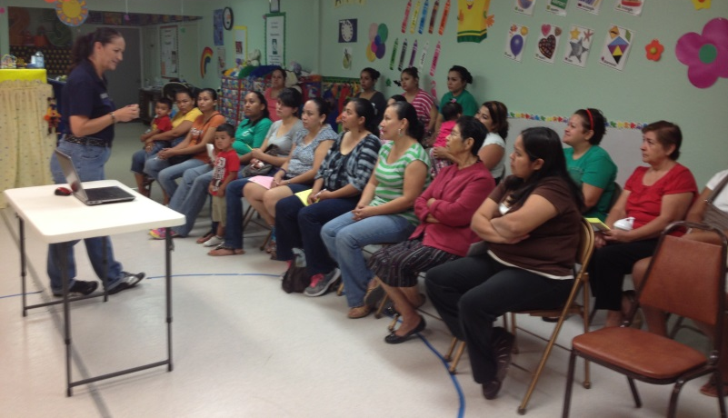
Qualities of a CHW
Relationship with the community
Honest & respectful
Personal strength & courage
Patient & kind
Not judgmental
Motivated & committed
Caring & empathetic
Notes:
Puede pensar en algunas cualidades o habilidades adicionales que serian útil?

Slide 7
CHW Roles
Interpretation & translation services
Culturally appropriate health education & information
Assess clients’ needs
Assist clients in accessing needed healthcare
Eligibility screenings
Informal counseling & guidance on health behaviors
Arrangement of transportation
Advocate for individual & community health needs
Provide some direct services (first aid, blood pressure checks)
Refer clients to health & social services
Conduct public health research
Provide of emotional support
Maintain client records
Notes:
La experiencia ha demostrado que el promotor de salud no es una
extensión de los servicios de atención de un departamento de Salud por ejemplo ; si no que es un recurso
de la comunidad y, por lo tanto, en su desempeño tiene que desarrollar
capacidades básicas que le permitan integrarse y liderar procesos dentro de
su comunidad:
La gama de servicios ofrecidos por los promotores incluyen:
Interpretación & servicios de traducción
Educación & información culturalmente apropiada
Evaluar necesidades del cliente
Ayudar a clientes en acceder atención medica necesaria
Determinar elegibilidad para exámenes
Asesoramiento informal y guía sobre comportamientos de salud
Arreglo de transporte
Abogar por las necesidades de salud individuales y comunitarios,
prestación de algunos servicios directos, tales como primeros auxilios y control de presión arterial
Prestación de apoyo emocional
Remisiones a servicios de salud y servicios sociales
Mantener registros de los clientes
Llevar a cabo la investigación en salud publica

Slide 8
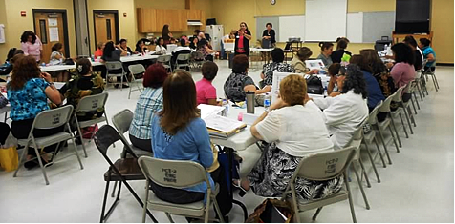
Research shows that CHWs:
Increase health-related knowledge
Increase self-care practices & health outcomes
Increase rates of health education course completion
Increase screening rates
Facilitate behavioral change by providing encouragement, support, and serving as role models.
Decrease high-risk behaviors in target population
Notes:
investigación descriptiva (poco empírica)

Slide 9
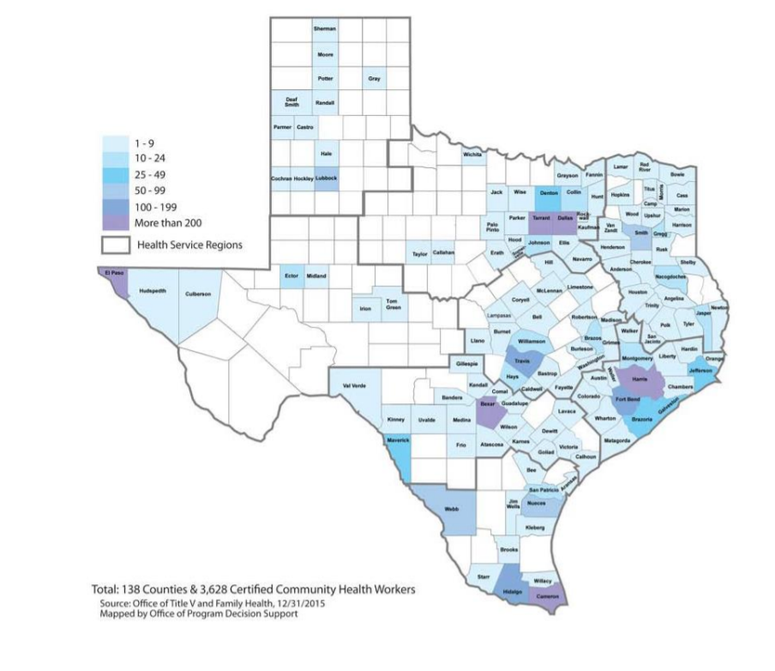
CHWs in Texas
1999 – Texas Legislature forms committee to look at certification
2001 – Senate Bill 1051 creates certification program
2003 – HRSA National Community Health Worker Study
2011-2012 - HB2610 Study
2015 Annual Report: 3800+ CHWs in Texas
Notes:
1999 – Legislatura de Texas forma comité para observar certificación
En 1999 la Legislatura de Texas aprobó una ley que creo un comité para observar la formación y certificación de promotoras en Texas. Este grupo evaluó los estudios disponibles y recomendó que las promotoras en Texas deberían ser certificados si trabajan como empleados/contratistas pagados.
2001 – Ley del Senado 1051 crea el programa de certificación
Como resultado, la Ley del Senado 1051- Aprobado por la Legislatura 77° de Texas en mayo de 2001, dirigió al Departamento de Salud de Texas (TDH) a desarrollar e implementar un programa de entrenamiento y certificación para promotoras (CHWs). Este programa asegurara que promotoras cumplan con las criterios mínimos y tener directrices adecuadas para llevar a cabo sus funciones. El programa será voluntario para los promotores(as) que no reciben compensación por sus servicios y obligatorio para los promotores(as) que son recompensados económicamente por los servicios que prestan. El Departamento de Salud tendrá en cuenta los informes, conclusiones y recomendaciones del Comité de Desarrollo del Programa de Promotora. Texas fue uno de los primeros estados en crear un proceso de certificación de todo el estado y uno de dos estados que tienen una certificación de todo el estado.
2003 - HRSA Estudio Nacional de Promotoras
En 2003 HRSA (Administración de Servicios de Recursos de Salud), financio un estudia para analizar el estado actual de las promotoras a nivel nacional. En este estudio se examinaron las cualidades o habilidades que hicieron exitosos a promotoras y que satisficieron las necesidades de sus empleadores. El estudio encontró que las promotoras tenían un conjunto de habilidades que les permitieron ser mas eficaz. Cuando miraron a las promotoras en la comunidad, encontraron que la mayoría tenían buenas habilidades en varias áreas, pero pocos tenían todas las habilidades identificadas. El programa de certificación miro a los resultados del estudio y crearon ocho competencias principales que se sentían que eran importantes que una promotora tuviera para ser exitoso.

Slide 10
DSHS CHW/Promotora Program
Promotor(a)/Community Health Worker Training
and Certification Program
Office of Title V and Family Health
Provides leadership to enhance the development and implementation of statewide training, certification standards, & administrative rules
http://www.dshs.state.tx.us/mch/chw.shtm
512-776-2208 or 512-776-3860, chw@dshs.state.tx.us

Slide 11
Certification Requirements
18 years of age
Reside in the state of Texas
Complete the 160 training requirement (must be taught by a certified Instructor who is working with a certified training institute with curriculum approved by the State) OR
Submit based on past experience (based on number of hours working in a CHW capacity within a specified time frame, must be verifiable)

Slide 12
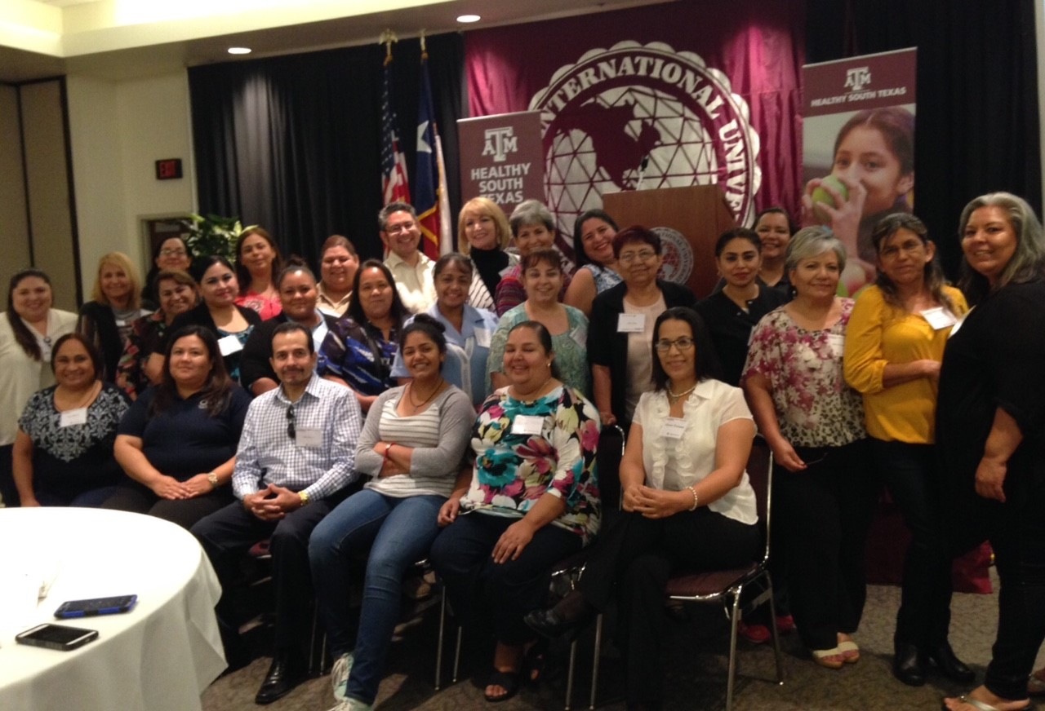
Core Competencies
Communication
Interpersonal skills
Teaching skills
Organization skills
Advocacy Skills
Capacity Building
Service Coordination
Knowledge Base
Notes:
Repasar hoja con la clase.

Slide 13
Center for Community Health Development
Center for Community Health Development
Research center established in 2001 under the Texas A&M School of Public Health
Working with Communities to Improve Health
CCHD partners with communities to identify health care priorities, develop and pilot strategies to address their priorities, and evaluate the effectiveness of these strategies when implemented.
Building SPH capacity to conduct prevention research
Provide infrastructure to expand the School of Public Health’s capacity to conduct prevention research in conjunction with key community stakeholders including health care providers, non-profit organizations, governmental entities, and community advocates.

Slide 14
Center for Community Health Development
Over $42 million in research funding
Centers for Disease Control and Prevention, American Heart Association, Health Resources and Services Administration, Office of Adolescent Health, Texas Department of State Health Services, Texas Health and Human Services Commission, Hospital and health care providers, non-profit agencies
The National Community Health Worker Training Center and the Texas A&M Telehealth Counseling Clinic operate under CCHD
Projects areas include community-based participatory research, population health assessments, and program evaluation.

Slide 15

National CHW Training Center
CHW & Instructor Certification
English/Spanish
In-person/Online
CHW & Instructor CEUs (40+)
English/Spanish
In-person/Online
Since 2001, the Center has provided over 89,000 hours of training to more than 2,770 CHWs, including 40,000+ DSHS-certified training hours to 2,300+ CHWs.

Slide 16
National CHW Training Center
CHW Training
Instructors in Dallas, College Station, Corpus Christi, McAllen, and Brownsville
CHW Curriculum Development
Research
Technical Assistance

Slide 17
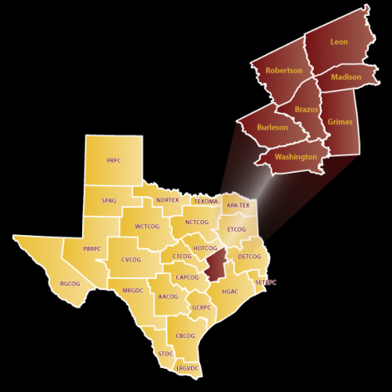
Madisonville, TX
City Population: 4,500+
County Population: 13,000+
Latino population: 22%
Mental Health & Primary Care Health Professional Shortage Area (HPSA)
40 miles from Bryan/College Station; 95 miles from Houston; 145 miles from Dallas
http://www.bvcog.org/about-us/

Slide 18
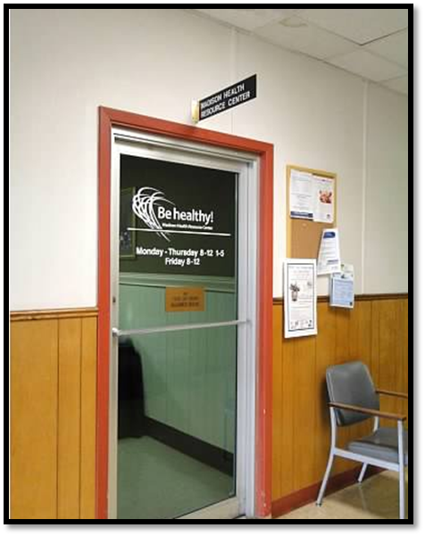
CCHD in Madisonville
Developed partnership with community in 2002
Focus - Extending access to care to the rural community
Madison Health Resource Center established in 2003
Audiology County Indigent Health Care Program Health Education Programs Hospice Brazos Valley Lone Star Legal Aid MHRC Transportation Madison Co. Senior Meals Program Medication Assistance Program Project Unity Scotty's House Sexual Assault Resource Center Telehealth Counseling Twin City Mission/STAR

Slide 19
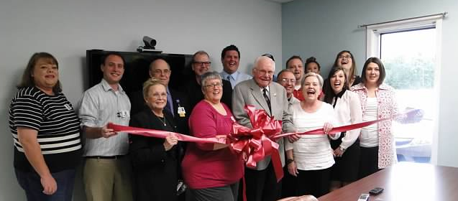
CCHD in Madisonville
Madison Outreach and Services through Telehealth (MOST) Network
Links behavioral and mental healthcare services in urban communities to rural residents
Provides telehealth mental health counseling
Trains community health workers (CHWs) to navigate Spanish-speaking residents to health and social services

Slide 20
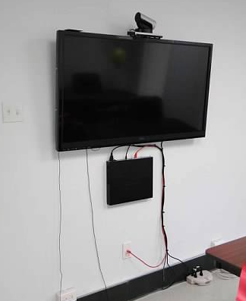
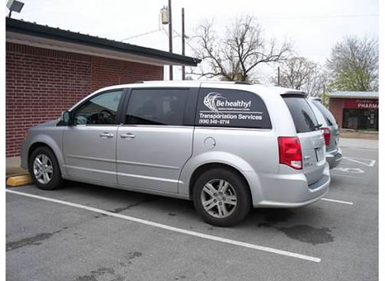
CCHD in Madisonville
MOST VIDEO:
https://www.youtube.com/watch?v=YzglCdDe5Ls

Slide 21
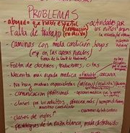
Healthcare Challenges
Rural communities experience disparities in access to health & social service providers
Latino populations face additional access disparities related to cultural and linguistic barriers
Rural Latinos in Madison County are disproportionally burdened by disparities in health care access and outcomes

Slide 22
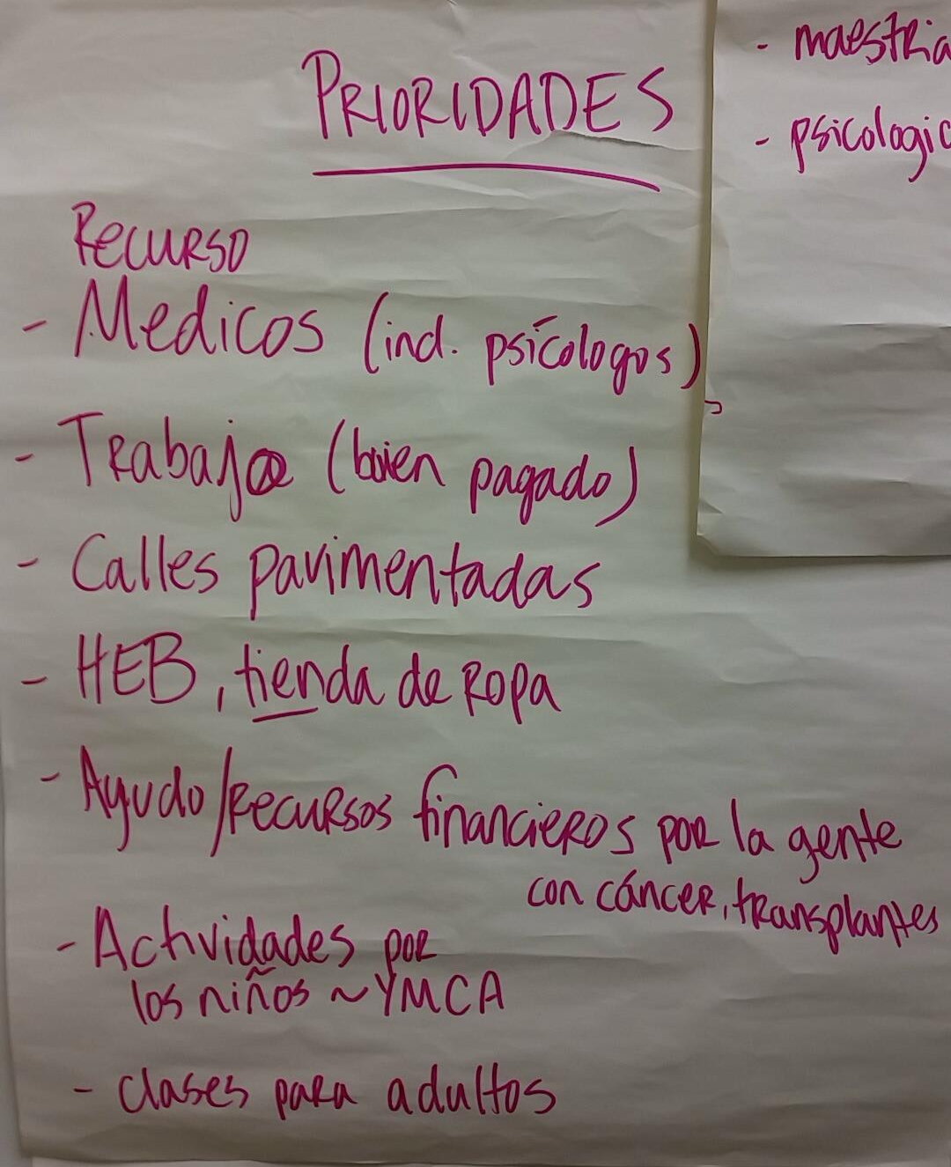
CHW 101: The Need in Madisonville
By connecting disadvantaged Latinos to available resources, culturally-competent CHWs can increase access to care and improve health outcomes.
In Madison County, creating a sustainable model for CHW engagement responds to community needs and strengthens local capacity.

Slide 23
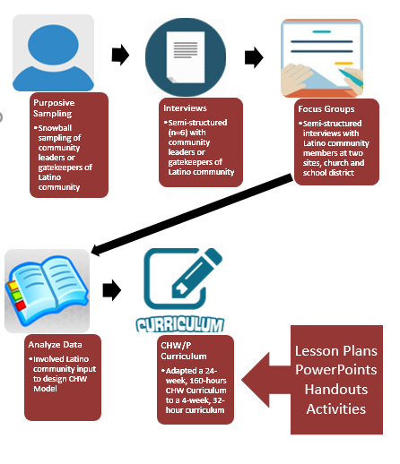
CHW 101: The Development
Consult stakeholders on community needs
Based on input, generate design for CHW 101 model
Adapt 160-hour certification class to 32-hour CHW 101 training

Slide 24
CHW 101: The Curriculum
8 classes
Each class includes 4 hours of presentations & hands-on activities
8 core competencies, one per class:
Communication
Interpersonal skills
Teaching skills
Organization skills
Advocacy Skills
Capacity Building
Service Coordination
Knowledge Base
Available in English or Spanish

Slide 25
CHW 101 vs CHW Certification
CHW 101
CHW Certification
32 total contact hours
8 classes (4 hours each)
No additional homework
Hands-on experience already completed
160 total contact hours
60 hours class instruction time
24 classes (2.5 hours each)
40 hours homework assignments
60 hours hands-on experience

Slide 26
Future Directions
In partnership with assessment stakeholders, recruit volunteers for the CHW program.
Deliver training in adapted CHW curriculum to volunteers.
Identify partner organizations to coordinate local management of the program.

Slide 27

Funding was made possible (in part) by the U.S. Department of Health and Human Services Health Resources and Services Administration (HRSA) Office of Rural Health Policy Rural Health Care Services Outreach Grant Program, award number D04RH23593-01-02.

Slide 28
Acknowledgements
Madison County
Madison Health Resource Center
Madison Health Resource Commission
CHI St. Joseph Madison Health Center
St. Elizabeth Ann Seton Catholic Church
Madisonville Consolidated Independent School District

Slide 29
Questions?

