Slide 1
Engaging Vulnerable Maternal and Child Health Populations: The Texas Healthy Start Alliance Experience
Misty Wilder
Kori Eberle

Slide 2
Objectives
Overview Texas Healthy Start Alliance
Understand conditions affecting Texas Maternal Child Health populations
Discuss implementation challenges
Discuss strategies used to overcoming barriers to engaging and serving women and their families
Leveraging partnerships

Slide 3

Mission: To collaborate with others to promote healthy families and communities in the State of Texas through education, advocacy, capacity building and research
Founded: August 28, 2009
Meet monthly via conference call first Tuesday
6 original sites: Dallas, Ft. Worth, San Antonio, Laredo, Houston & Brownsville

Slide 4
Texas Healthy Start Alliance
Laredo Healthy Start
  Araceli Flores- Program Manager
San Antonio Healthy Start
  Kori Eberle- Project Director
Dallas Healthy Start
  Karla McCoy- Project Director
  Kathy Chapman- Case Management Manager
Fort Worth Healthy Start
  Amy Raines-Milenkov- Project Director
  Misty Wilder- Program Manager

Slide 5
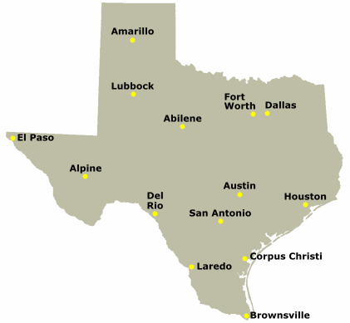
Vulnerable Populations
Refugee Communities
Minority women with low SES
Homeless
families
Living in colonias

Slide 6

Laredo, Webb County, TX- Colonias
Colonias are unincorporated neighborhoods or subdivisions that lack physical infrastructure, (water, power and sewer systems) that together with transportation challenges are responsible for extreme disparity in access to adequate health care and affecting the health and safety of residents.
Over 93% of Laredo Healthy Start clients live in these colonias and have incomes below 100% federal poverty level.

Slide 7
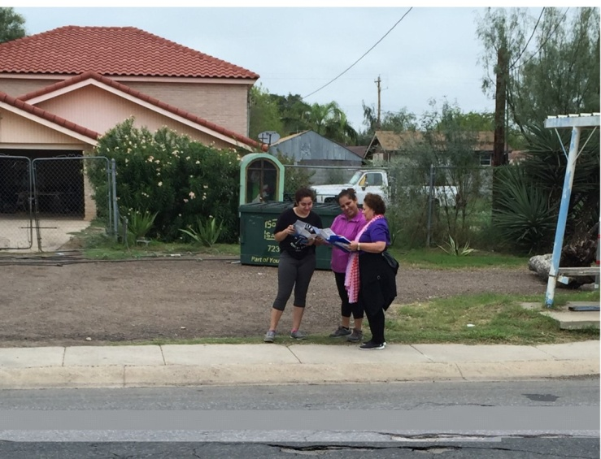
Challenges- Laredo
Clients are transient
Over half are immigrants with strong ties to Mexico
Cultural norms include unannounced, extended visits to family members across the border
Lack of means for communication, transience makes retention, care continuity, and client tracking more difficult
Notes:
One of the challenges we face is that our clients are transient since well over half are immigrants with strong ties to Mexico. Cultural norms include unannounced, extended visits to family members across the border. Combined with the lack of means for communication, transience makes retention, care continuity, and client tracking more difficult.

Slide 8
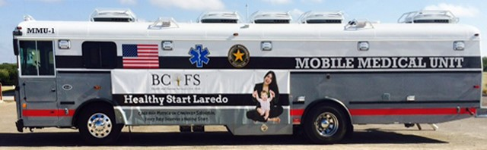
Strategies- Laredo
Community based services through the use of a mobile medical unit and home visiting program
The service team consists of a medical, case management, and outreach team (promotoras/community health workers).
Medical services consist of prenatal and postpartum care which include laboratory and referral services. Unit is equipped with NST (fetal non-stress test) and ultrasound machine.
Case management services focus on medical , social, financial, educational, legal, housing, parenting, and employment needs of its clients.
Certified community health workers provide outreach at community health centers, door to door, and in events
Transportation services are available for medical appointments for mothers and target children.
Notes:
Bullet 1- Community based services through the use of a mobile medical unit and home visiting program to address significant disparity in healthcare services and reluctance and/or inability of residents to leave their colonias for perinatal care.
Bullet 2-The service team consists of a medical, case management, and outreach team (promotoras/community health workers).
Bullet 3-Medical services consist of prenatal and postpartum care which include laboratory and referral services. Unit is equipped with NST (fetal non-stress test) and ultrasound machine. Pregnant women are encouraged to be seen in 1st trimester regardless if they have health care coverage in order to improve the health outcomes of pregnancy for mothers and infants.
Bullet 4-Case management services focus on medical , social, financial, educational, legal, housing, parenting, and employment needs of its clients.
Bullet 5-Certified community health workers provide outreach at community health centers, door to door, and in events. These workers are well trusted in the communities and are critical to the recruitment and engagement in these rural communities known as colonias.
Bullet 6-Transportation services are available for medical appointments for mothers and target children.

Slide 9
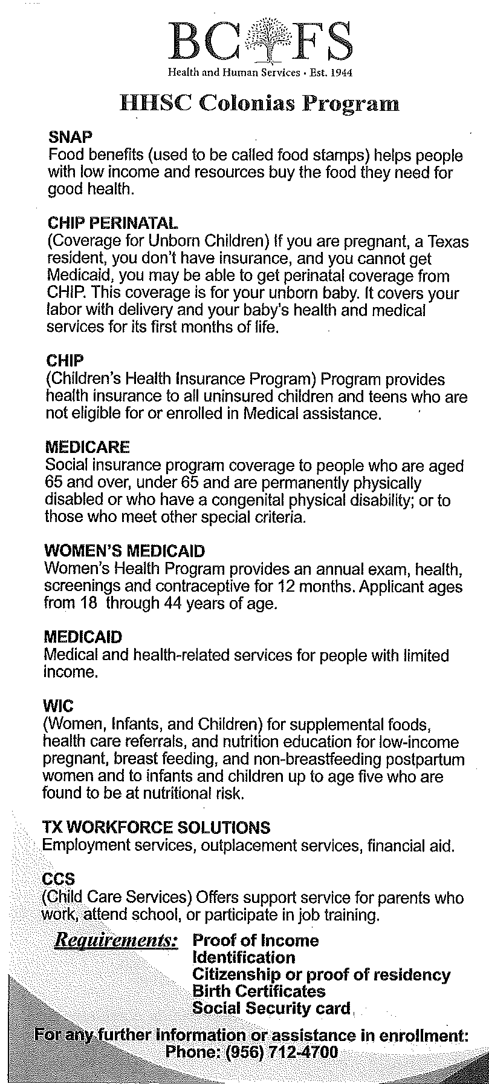
Leveraging Partnerships
Laredo
Partnerships with local hospital
Texas Health and Human Services Commission
Other agencies to provide counseling and educational services as well as other social needs.
TXHSA (Texas Healthy Start Alliance
HSBA (Healthy Start Border Alliance)
Notes:
Partnerships with local hospital system has enabled our program to provide the medical services to pregnant women and Texas Health and Human Services Commission to provide outreach and assistance with state benefit applications to ensure families get health care coverage and other benefits needed such as food assistance. Healthy Start Laredo partners with other agencies to provide counseling and educational services as well as other social needs. In addition, partnerships with TXHSA (Texas Healthy Start Alliance and HSBA (Healthy Start Border Alliance) has enable our program to collectively impact the disparities associated with maternal and child health among underserved communities.

Slide 10

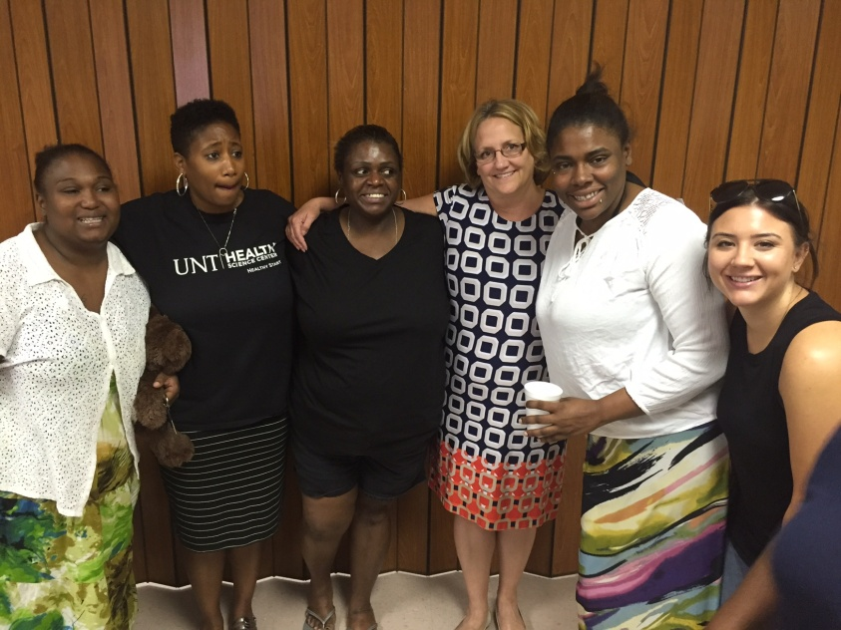
Ft. Worth, TX
Target population:
Refugee communities
  Provide services to refugees directly
    Bhutanese
    Nepali
    Karen-Burma
  Interpretation Services
    Arabic
    Afghani
    Somali
    And many others

Slide 11
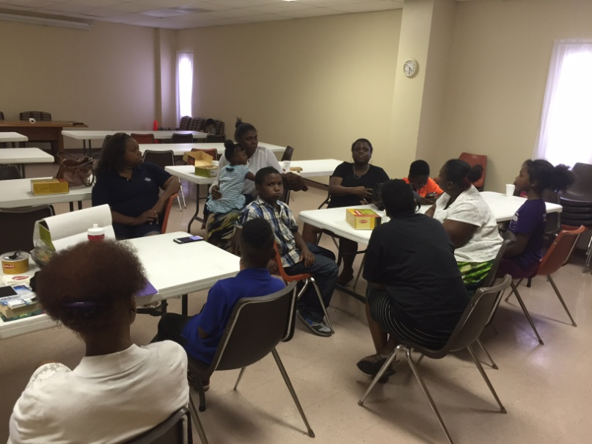
Challenges & Strategies - FW
All participants are high-risk
Staff recruitment and retention
Insufficient community resources
Staff burn-out
Mismatch between case-loads, funding and grant requirements
Strategies
Hire bilingual culturally
competent staff

Slide 12
Partnerships - FW
Tarrant County Jail
  In jail support, partnering with health providers in jail setting
  Family support in community
  Reentry support for mother and family
  Services to HS child (if born in custody)
Infant Health Network
  Existing collaboration of 15 years
  Annual Infant Health Summit
  Home Visitor Coordination Sub-Committee
Collective Impact Participation
  Focused on women’s health

Slide 13

Dallas, TX
Target population:
African American about 60% and
Latina women about 30-35%
Living in areas of high infant mortality rate
Low socioeconomic neighborhoods
Late seeking prenatal care
No insurance
Smokers
Substance users/ abusers
History of family violence
Mental health issues

Slide 14
Challenges & Strategies - Dallas
Recruiting & enrolling mandated number of clients
Limited Spanish speaking staff impacted number of Spanish speaking women women to be served
Limited ability to reach women serviced outside the Parkland Health & Hospital System
Community outreach
Build trusting relationships
Community Action Network coordinator is program “Ambassador”
Restructured staffing to hire more personnel
Include client participation in Community Action Network
Created partnerships

Slide 15
Partnerships - Dallas
Created MOU’s with programs/ agencies serving similar populations like WIC, Head Start and housing department
Changed from consortium (network based coalition) to community action network (action-based)
Strong collaborative relationships with network members for referrals.

Slide 16

San Antonio, TX
Target population:
Homeless or doubling up pregnant women living in shelters or transitional living facilities
Haven for Hope
Guadalupe Home
Fair Weather
SAMM Shelter
Project Precious- VOA Shelter
Couch surfing
Hotels/Motels
Homeless encampments

Slide 17
Challenges – San Antonio
Transient nature
Interrupted cell phone service
Mental health issues
Mistrust of “City”
Substance use/ abuse
Sex Work
Criminalized homelessness
History of violence

Slide 18
Strategies – San Antonio
HOPE Team police officers refer meet with case manager and women for first visit
Conduct classes within shelters to forge relationships
Incentive based program helps with necessities
Only case managers with proper experience, education and training work this critical cases
Meet participants where they are ie. McDonald’s, park, under a bridge, in the shelter
Meet participants where they are emotionally, never pass judgment, never impose. Guide.
Use motivational interviewing techniques

Slide 19
Partnerships – San Antonio
Healthy Families Network- coalition of 45 agencies all working on same goals
WIC
San Antonio Housing Authority
Homeless shelters
San Antonio Police Department
Bexar County Juvenile Justice
School Districts primarily SAISD and Edgewood
Pregnancy testing clinics

Slide 20
Conclusions

Slide 21

Contact Information

