Slide 1
Expanding the Reach and Success of Elder Abuse Prevention through Primary Care Partnerships
Communities Joined in Action
National Conference
February 16, 2017
Carol Zernial, MA
Ray Kirsch

Slide 2
Elder Justice Coalition –
An Overview of National Initiatives
Elder Justice Coalition
Washington, D.C.

Slide 3
Elder Justice Coalition
The Bipartisan Elder Justice Coalition seeks to:
  Increase public awareness of the tragedy of elder abuse, neglect and exploitation at the local, state and national levels and discuss solutions at the federal level.
  Increase awareness, support and funding for the Elder Justice Act in the Senate and House of Representatives as a comprehensive approach to addressing elder justice issues. Continue related advocacy work around funding for the Social Services Block Grant and the Older Americans Act.
  Continue to work collaboratively with the Administration on elder justice initiatives.
  Monitor and appropriately influence other relevant legislation and regulations that pertain to the prevention of elder abuse, neglect and financial exploitation.

Slide 4
Priorities for 2017
Ensure that FY 2017 funding includes at least $25 million for the Elder Justice Initiative. President Obama’s budget requested $10 million for the Initiative. Congress has not yet released their appropriations bills.
Include more money for Older Americans Act (OAA) elder justice programs, including LTC ombudsmen, in final FY 2017 funding bills. The President did not request increases for these programs.
Protect Social Services Block Grant from cuts.
Protect the Crime Victims Fund (VOCA) from cap reductions.

Slide 5
Priorities for 2017
Implement the rest of the Elder Justice Act.
Pass the Older Americans Act reauthorization.
Reauthorize the Elder Justice Act.
Ensure new Crime Victims Fund/VOCA funds go to underserved victims such as elder abuse crime victims.

Slide 6
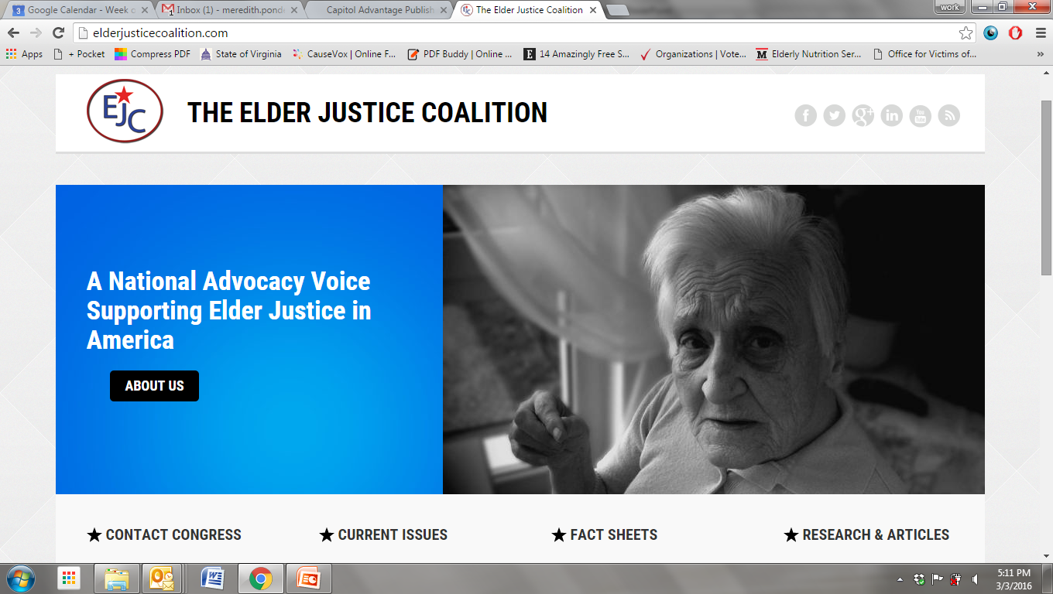
Visit the Elder Justice Coalition Website!
www.elderjusticecoalition.com

Slide 7
WellMed Medical Management, Inc.
Carol Zernial, MA
Executive Director
WellMed Charitable Foundation

Slide 8
Our Beginnings
Dr. George M. Rapier III founded WellMed in 1990 as a single clinic in the Medical Center area in San Antonio, Texas. He focused on preventive care and strong patient relationships instead of responding to the patient’s symptoms after they became ill.
Today, WellMed is a diversified healthcare company with clinics, medical management, Management Services Organization (MSO) operations, Quality and Risk Adjustment divisions, and an award-winning disease management program.

Slide 9

Vision & Mission
Vision
To change the face of healthcare delivery for seniors by providing quality, proactive patient care with a focus on prevention.
Mission
To help the sick become well and to help patients understand and control their health in a lifelong effort at wellness.

Slide 10
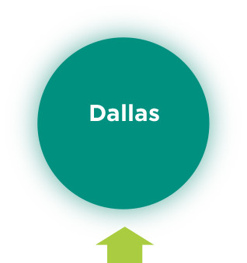

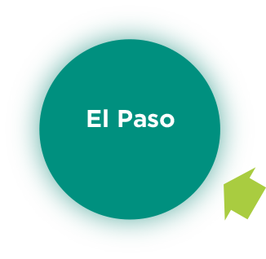
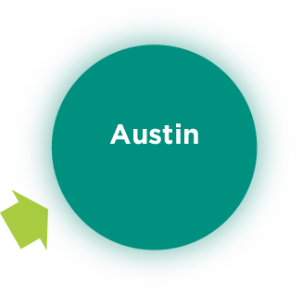
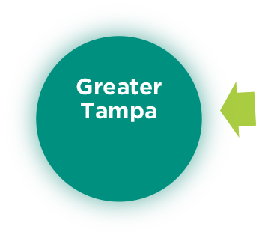





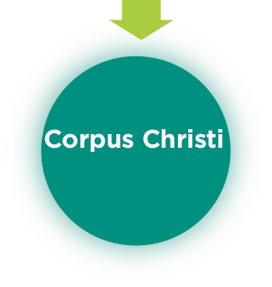
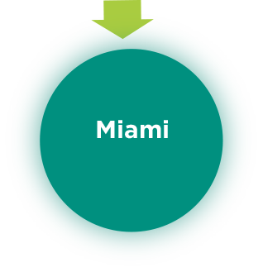
WellMed Owned PCP Locations
Total: 76
1
LOCATION
3
LOCATIONS
10
LOCATIONS
13
LOCATIONS
6
LOCATIONS
4
LOCATIONS
11
LOCATIONS
27
LOCATIONS
Total: 19
6
LOCATIONS
14
LOCATIONS
Texas - WellMed providers report under WellMed Medical Group, PA
Florida - WellMed providers report under WellMed Medical Management of Florida, Inc.

Slide 11
Organizational Overview
Primary Care Centric Medical Group (Family Practice, Internal Medicine + added Podiatry, Dermatology, Cardiology, Oncology, Pain Medicine, Palliative Care)
Manage Full-Risk Capitated Insurance Contracts
Specialize in Medicare-eligible Seniors – responsible for 238,000 lives
Contract for all Medical Services (Specialty, Hospital, Ancillary, Hospice)
  Fully functional primary care centric, patient centered medical home (PCMH) functioning as an accountable care organization (ACO)

Slide 12

Typical Patient Experience
EMR
Case Manager
PCP
Hospitalist
Other Services
Specialist
Disease Management
Social Programs
Notes:
12

Slide 13









Team Based Care Is Our Goal
Notes:
Diagram change – use the one from the website with honeycomb

Slide 14

“Stoplight” Stratification Process
Red
5 % of Panel: Highest Risk Patients
Yellow
10% of Panel: Elevated Risk Patients
Green
85% of Panel: Average Risk Patients
Approach for identifying the acuity level or
hospitalization risk of a patient
14
Notes:
14

Slide 15

The WellMed Business Model
Mutually beneficial relationships with PCPs
High quality medical care focusing on access, care coordination and care delivery resulting in lower health costs
Shifts away from traditional acute and episodic care to a chronic care delivery model
Notes:
Jazz up the boxes with color… change blue over the gray copy. Can redesign gray box…

Slide 16
Medicare FFS vs WellMed Model
Fee for Service
WellMed
Notes:
Key difference why patients would want to have a WM physician and Medical Home concept vs a typical FFS physician

Slide 17
ACL Grant Overview
Ray Kirsch
Texas Department of Family and Protective Services
Adult Protective Services

Slide 18
Elder Abuse Prevention Grants
Grants awarded by the Administration on Aging/Administration for Community Living (AoA/ACL)
Funds to be used to implement, test and measure performance of:
  New approaches to identify, intervene and prevent elder abuse, neglect and financial exploitation

Slide 19
Awards
5 grantees in the following states:
  Department of Health & Social Services – Alaska
  New York State Office of the Aging – New York
  University of Southern CA & CA Dept. of Aging – CA
  University of Texas Health Science Center at Houston – TX
  Texas Dept. of Adult Protective Services & WellMed Medical Management – Texas

Slide 20
Target Population for Intervention
Target Population for Intervention:
  Older patients of primary care clinics at WellMed
  5 regions of TX: San Antonio, Austin, Corpus Christi, El Paso, Lower Rio Grande Valley
  Largely Medicare
  Large Hispanic population
  Low Income
Target Population for Prevention:
    Clinicians working in WellMed clinics
Notes:
EASI tool is for cognitively intact patients

Slide 21
Intervention Components # 1 & 2:
Role of APS Staff & Clinician Training
  Embed 2 APS workers in WellMed Medical Management System to serve as a resource
  Train clinicians to identify, screen & report abuse
      Identification of types of elder abuse and risk factors
      APS referral mechanisms
      APS reporting requirements

Slide 22
Intervention Component # 3
Screening for Abuse
3. Implement the Elder Abuse Screening Index (EASI)
    Short 6-item screening tool to identify and prevent elder abuse in cognitively intact patients
    Incorporated clinical protocols
      High risk patients referred to APS
      Medium risk patients to complex care workers at WellMed
    Initially implemented as a paper-&-pencil document
    Later embedded in the electronic medical record (EMR) as part of the annual assessment & critical care assessment
    More on the EASI & protocols later in the presentation

Slide 23
Intervention Component # 4:
Delivery of Educational Materials
4. Educational materials on abuse, neglect & exploitation:
  Targeted information to patients at risk of abuse based on results of the EASI tool
  All patients & caregivers, irrespective of score on EASI receive -
    Educational materials
    Initially hard copies were distributed
    Now also available electronically (PDF files)

Slide 24
Intervention Component # 5:
Help for Stressed Caregivers
5. Caregivers of patients with dementia/Alzheimer’s
  Referred to Caregiver SOS program & Stress-Busting Program
    (EASI cannot be administered to people with dementia/Alzheimer’s)
    Caregiver SOS is available in San Antonio, Lower Rio Grande Valley and Corpus Christi
    Partner with the AAA’s in Austin and El Paso to offer Caregiver Services in those areas

Slide 25
Project Details and Case Examples
WellMed and Adult Protective Services
The road to culture change

Slide 26
Elder Abuse Suspicion Index – “EASI”
Developed in Montreal, Canada at McGill University and CSSS Cavendish to raise suspicion about elder abuse
Validated in ambulatory clinical settings in Canada with cognitively intact seniors
6 question survey administered by a clinician or trained staff
Adapted by the World Health Organization and currently used in several countries around the world

Slide 27
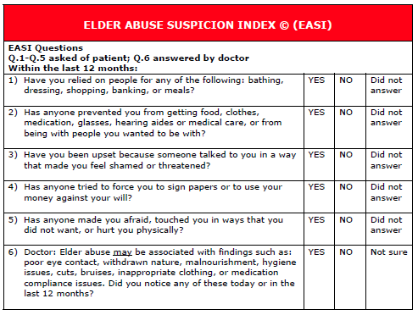

Slide 28
The EASI Tool Questions - Rationale
Remember that the EASI Tool is meant to raise suspicion about the presence of elder abuse-it is not intended to confirm the presence of abuse.
1) Have you relied on people for any of the following: bathing, dressing, shopping, banking, or meals?
  It is important to recognize that when an individual with any form of a disability and/or a need for assistance replies in the affirmative to this question, it increases his/her risk for abuse, neglect and/or exploitation.

Slide 29
The EASI Tool Questions - Rationale
2) Has anyone prevented you from getting food, clothes, medication, glasses, hearing aides or medical care, or from being with people you wanted to be with?
  This question is meant to explore the possibility of someone trying to isolate the individual as well as having control of his/her basic physical and emotional needs. This can signal possible neglect, lack of choice, economic vulnerability and/or isolation.

Slide 30
The EASI Tool Questions - Rationale
3) Have you been upset because someone talked to you in a way that made you feel shamed or threatened?
  Making someone feel ashamed is a way of degrading the individual and controlling them. Individuals are particularly vulnerable when they are not able to control some of their behaviors; i.e., bodily functions, speech, ability to hear, etc.
  Threatening someone is a form of control and can result in an individual’s increased dependence and vulnerability to manipulation.

Slide 31
The EASI Tool Questions - Rationale
4) Has anyone tried to force you to sign papers or to use your money against your will?
  A positive answer to this question raises suspicion of possible financial abuse, economic vulnerability as well as potential neglect, isolation and dependency.
5) Has anyone made you afraid, touched you in ways that you did not want, or hurt you physically?
  This question is intended to raise suspicion about the presence of any sexual or physical abuse, intimidation, isolation, and/or the possibility of family violence.

Slide 32
The EASI Tool Questions - Rationale
6) Elder abuse may be associated with findings such as: poor eye contact, withdrawn nature, malnourishment, hygiene issues, cuts, bruises, inappropriate clothing, or medication compliance issues. Did you notice any of these today or in the last 12 months?
  This question is specifically geared for the health care professional. If the findings described in this question are present, it may indicate the presence of abuse, even if the patient answered ‘no’ to all of the previous EASI questions.

Slide 33
The EASI Tool Questions - Rationale
RED = at least one “Yes” to questions 2-5 and “Yes” to question 6
YELLOW = at least one “Yes” to questions 2-5 and “No” to question 6
GREEN = “NO” no responses to questions 2-6

Slide 34
EASI Protocols for Texas WellMed Clinics
Score = “RED”
  Provide patient education materials related to the prevention of elder abuse
  Refer to WellMed Complex Care
  Report to APS and record reference number (tracking)
Score = “YELLOW”
  Provide patient education materials related to prevention of elder abuse
  Refer to WellMed Complex Care
Score = “GREEN”
  Provide patient education materials related to prevention of elder abuse (Abuse/Neglect/Financial Exploitation) to both patients and caregivers

Slide 35
Texas APS/WellMed Grant
Successes to Date
Goal was to implement 10,000 EASIs
  11,409 completed to date
  7,163 unduplicated patients
Misconceptions existed on both sides (WellMed/APS) of how the other entity operated
Have already intervened with multiple patients who were at high-risk that would have not been identified without this grant

Slide 36

LOCAL EVALUATION
Data Analysis from
Benjamin Rose Institute on Aging (BRIA)

Slide 37

Focus of Evaluation: Training Clinicians
Phase 1:
Pilot tested the training in 2013
  3 primary care clinics
  Invited to complete pre- & post-training surveys
  Modified training & surveys based on results
Phase 2:
Revised training implemented: 2/2014 - 2/2015
  63 primary care clinics across 5 TX regions
  Invited to complete pre- & post-training surveys
  Focus of presentation today

Slide 38
Clinicians Trained on Elder Abuse in the WellMed System
N = 826
Clinicians Not Invited to Participate in Phase II
N = 115
Clinicians Who Pilot-Tested Surveys in Phase I
N = 71
Clinicians Who Did Not Receive
Surveys After Training
N = 44
Clinicians Invited to Participate in Research
N = 711
Clinicians who refused to participate (did not complete Surveys)
N = 36
Clinicians who completed only pre-training Surveys
N = 72
Clinicians who completed only post-training Surveys
N = 71
Clinicians who completed both Pre- & Post-Training Surveys
N = 532

Slide 39

Phase II – Findings
Location of Participating Clinicians
(n = 411)

Slide 40
Clinician Demographics
Education Level
  44% “some college”
Gender
  85% female
Age
  Range:19-78
  Median: 40
Notes:
Others includes managers, supervisors, technicians, support staff

Slide 41
Profession of Clinicians
Notes:
Others includes managers, supervisors, technicians, support staff

Slide 42

APS Referrals Prior to Training
Question | Response | Prior to Training Percent (n)
Have you ever made a referral to APS (Adult Protective Services)? (N = 532) | Yes | 26% (136)
If yes, have you made a referral to APS in the last 12 months? (N = 136) | Yes | 53% (67)
 | # of cases | Percent (N)
If yes, how many cases did you refer to APS? (N = 67) | 1 | 41% (15)
 | 2 - 6 | 59% (52)
Question | Response | Prior to Training Percent (n)
Have you ever made a referral to APS (Adult Protective Services)? (N = 532) | Yes | 26% (136)
If yes, have you made a referral to APS in the last 12 months? (N = 136) | Yes | 53% (67)
 | # of cases | Percent (N)
If yes, how many cases did you refer to APS? (N = 67) | 1 | 41% (15)
 | 2 - 6 | 59% (52)
¼ trainees – ever made a referral to APS
½ of these made a referral in past 12 months

Slide 43
Familiarity with the EASI Tool
Prior to Training
Question | Response | Percent (n)
Are you familiar with the EASI tool? (N = 530) | Yes | 13% (60)
If yes, have you used the EASI tool in the past as a clinician? (N = 60) | Yes | 38% (22)
After Training
 | Response | Percent (n)
To what extent do you agree or disagree that the EASI tool is useful to identify elder abuse? (N = 60) | Strongly Agree/ Agree | 92% (55)
To what extent are you comfortable with using the EASI in a clinical setting? (N = 60) | Very Comfortable/ Comfortable | 90% (54)
Will you administer the EASI tool to a patient who has Dementia and/or Alzheimer’s Disease? (N = 506) | No | 84% (426)
Notes:
With respect to the EASI tool, only 13% of the sample were familiar with the EASI tool prior to receiving training. Of those who were familiar, more than a third had used the EASI in the past. However, after the training, the overwhelming majority of trainees indicated that they believed the EASI to be a useful tool to identify abuse. Nearly the same number responded that they were comfortable using it in a clinical setting and that, since the project’s intervention requires that a different protocol is followed for patients with dementia, they would not use the EASI with patients who had a diagnosis of dementia.

Slide 44
Recognizing Indicators of Abuse, Neglect & Exploitation
(n = 527)
Pre-training $\overline{x}$ = 3.6, Post-training $\overline{x }$= 4.2, t = 17.56, p < .001

Slide 45


Dept. of Aging & Disability Services – Responsible for Investigating Resident (NH & ALF) Abuse
(n = 464)
Test statistic = 156.28, p < .001

Slide 46

Correct Identification of Judges/Court as Making the Final Determination of Capacity to Consent
(N = 438)
Test statistic = 18.03, p < .001

Slide 47
Increased Familiarity with Clinical Protocols
Report Victims: test statistic = 228.15, p < .001
Refer Victims: test statistic = 219.42, p < .001

Slide 48

Familiarity with Selected Caregiver Programs
Caregiver SOS program test statistic = 216.02, p < .001
Caregiver Stress Busting Program test statistic = 204.02, p < .001

Slide 49

Some Other Significant Findings
Clinician responses also indicated significant improvements in knowledge from pre- to post-training that:
Alleged perpetrators of abuse can be an un-paid caretaker, a family member, and any person who has an ongoing relationship with the victim (test statistic = 7.35, p < .01).
The most likely perpetrator of financial exploitation is a family member or someone known to the individual (test statistic = 9.00, p < .01).

Slide 50

Other Significant Findings (continued)
APS provides all the following services: legal interventions, case management, guardianship referrals, referral to a nursing home, referral to home and community based services (test statistic = 24.24, p < .001).
APS investigates cases of reported abuse within 24 hours (test statistic = 189.68, p < .001).

Slide 51

Nonsignificant Finding
Clinicians’ knowledge that in Texas, reporting abuse, neglect, & exploitation is mandated for the following professionals:
  Social workers
  Nurses
  Providers (Physicians, Physician’s Assistants, & Nurse Practitioners)
  *98.5% of clinicians answered correctly before training vs. 98.3% after training

Slide 52

Conclusions
First project of its kind to train clinicians working in primary care clinics on abuse identification and reporting
Findings thus far indicate that training clinicians is an effective mechanism for increasing knowledge of abuse and reporting protocols

Slide 53

Implications
Short-Term:
  Clinicians are likely to report abuse in a timely manner
  Likely to prevent abuse from occurring or reoccurring
Long-Term:
Likely to save health care costs – victims experience negative and costly health outcomes

Slide 54
Follow Up Grant from ACL: Self-Neglect
The Benjamin Rose Institute will partner with Texas’ APS system and the WellMed Charitable Foundation to screen individuals in the community and identify individuals potentially at-risk of self-neglect. These individuals will be assigned a social worker to coordinate wrap-around supportive services with the goal of preventing self-neglect. The initiative will build on the successes and lessons learned from WellMed’s 2012-2015 Elder Abuse Prevention grant project.
Self-neglect is the most common type of non-financial elder abuse, neglect or exploitation.

Slide 55
Questions
?

Slide 56
Resources – Elder Justice
Elder Justice Roadmap: ncea.acl.gov/Library/Gov_Report/docs/EJRP_Roadmap.pdf
Recommendations of the EJCC: www.aoa.acl.gov/AoA_Programs/Elder_Rights/EJCC/docs/Eight_Recommendations_for_Increased_Federal_Involvement.pdf
Elder Justice Initiative: http://www.elderjusticecoalition.com/current-issues
Department of Justice Elder Justice website: www.justice.gov/elderjustice

Slide 57
Other Resources
Administration on Aging:
http://aoa.gov
Consumer Financial Protection Bureau: www.consumerfinance.gov/older-americans
National Center on Elder Abuse:
www.ncea.aoa.gov
Ageless Alliance:
www.agelessalliance.org
Center of Excellence on Elder Abuse and Neglect:
www.centeronelderabuse.org
National Committee for the Prevention of Elder Abuse: www.preventelderabuse.org
Texas Adult Protective Services:
https://www.dfps.state.tx.us/adult_protection/

Slide 58
Contact Information
Robert Blancato, M.P.A.
Elder Justice Coalition
Rblancato@matzblancato.com
Carol Zernial, M.A.
WellMed Charitable Foundation
Czernial@wellmed.net
Ann Cortez
Texas Department of Family and Protective Services
Ann.Cortez@dfps.state.tx.us
Raymond Kirsch
Texas Adult Protective Services
Raymond.Kirsch@dfps.state.tx.us
Farida K. Ejaz, Ph.D, LISW-S
Benjamin Rose Institute on Aging
Fejaz@benrose.org

