Slide 1
Forming Partnerships to Address Obesity in Texas Border Rural School Districts
OFFICE OF BORDER SERVICES
Rosy de los Santos, B.S., B.A., CHWI

Slide 2
LEARNING OBJECTIVES
Learn how to establish partnerships with rural border school districts and community leaders to increase awareness on the benefits of healthy eating and active living.
Learn how to develop programs to address obesity and inactivity among children in rural school districts.
Learn how to evaluate school interventions regarding nutrition and physical activity.
Learn about sustaining a nutrition and physical activity intervention in the school setting.

Slide 3
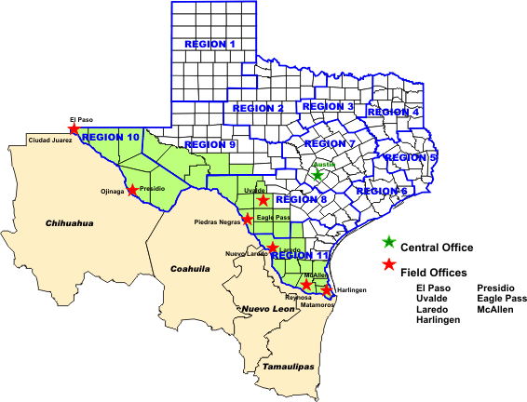
TEXAS-MEXICO BORDER
Notes:
Area 100 kilometers (62.5 miles) north and south of the international boundary (La Paz Agreement).
Comprised of 32 counties and stretches 1,254 miles from the Gulf of México to El Paso, Texas
Population of 2.9 million residents.
Considered to be one of the busiest international boundaries in the world.

Slide 4
BORDER HEALTH ISSUES
High rates of poverty
30.0% of border residents below poverty level, compared to only 16.2% of Texas non-border residents. American Community Survey, computed from 5-year estimates, based on 2009-2013 data
Lack of health insurance
46.1% of Texas border residents ages 18-64 lacked health insurance, compared to only 28.3% in the non-border counties of Texas. 2014 Texas Behavioral Risk Factor Surveillance Survey (BRFSS) age-adjusted estimates
Higher rates of obesity
39.17% among Texas border counties, compared to 32.0% of Texas non-border counties. 2014 BRFSS

Slide 5
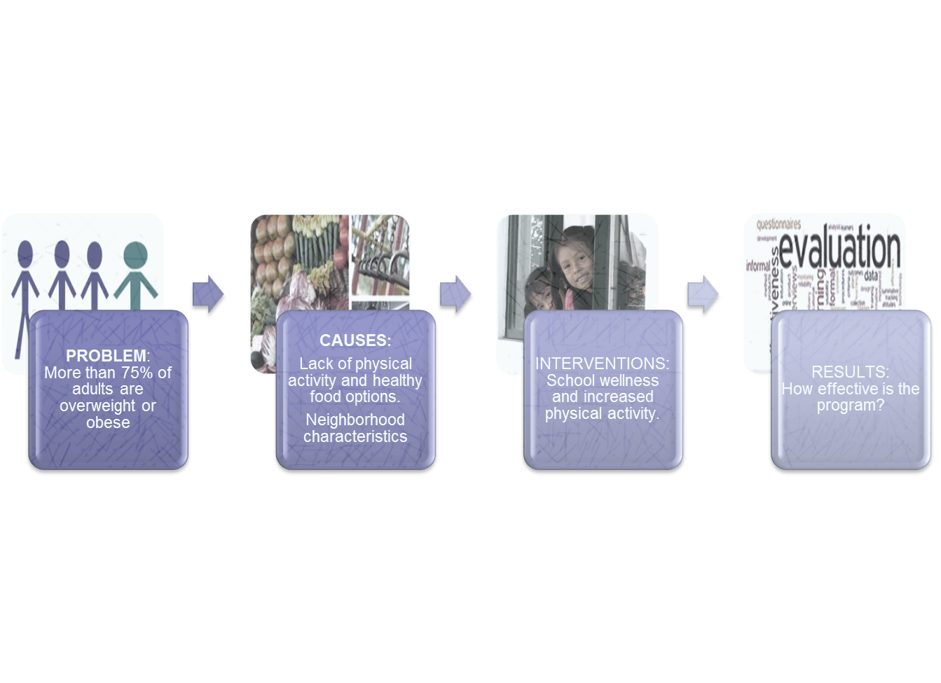
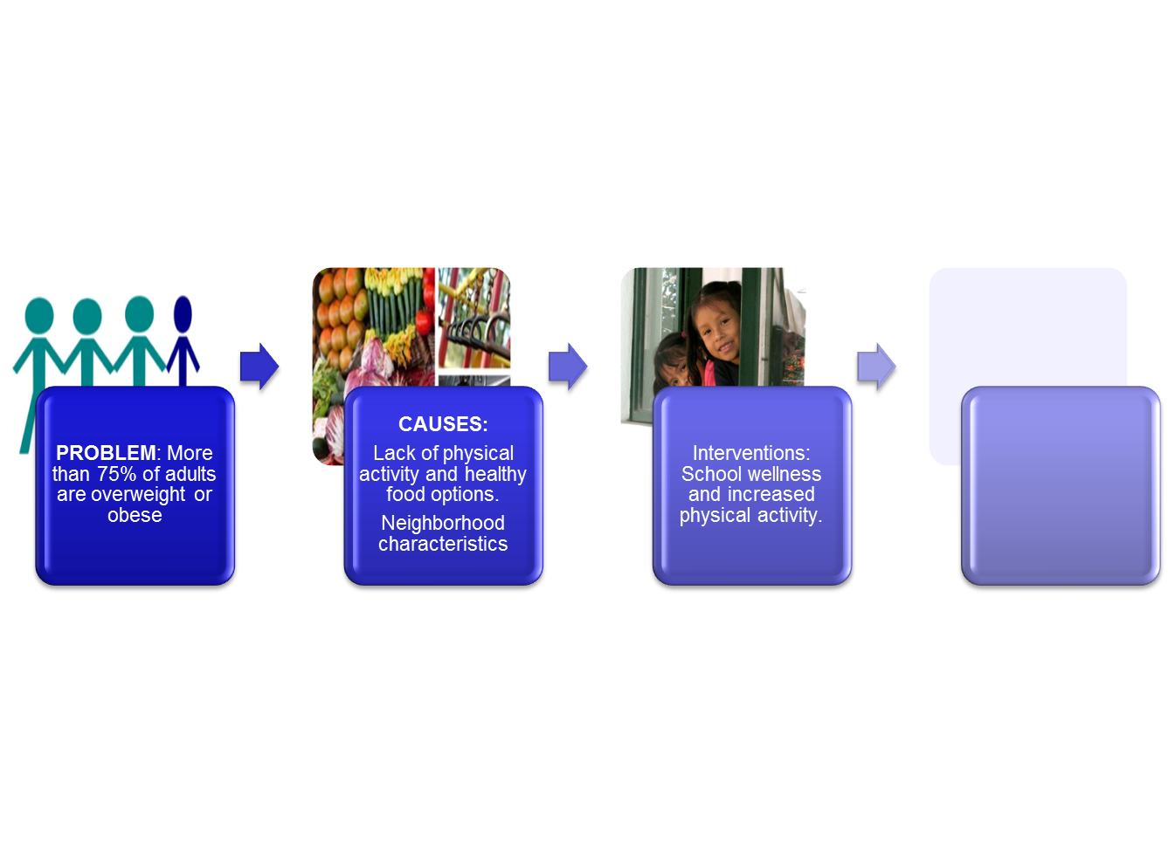
MAVERICK COUNTY

Slide 6
ESTABLISHING PARTNERSHIPS
Active participation in the community
Meetings
SHAC (School Health Advisory Council)
Binational Council Meetings
Presentations
Wellness Works presentations at schools
100 Mile Club
Walk/Bike to School Initiative

Slide 7
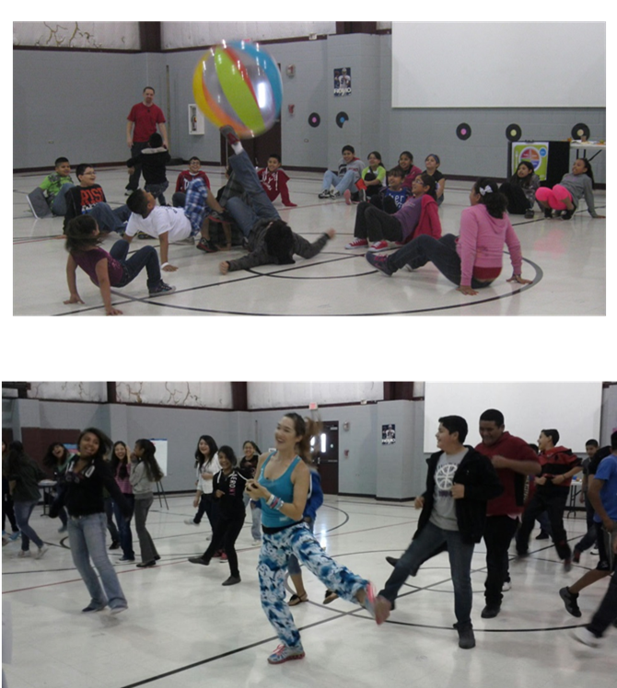
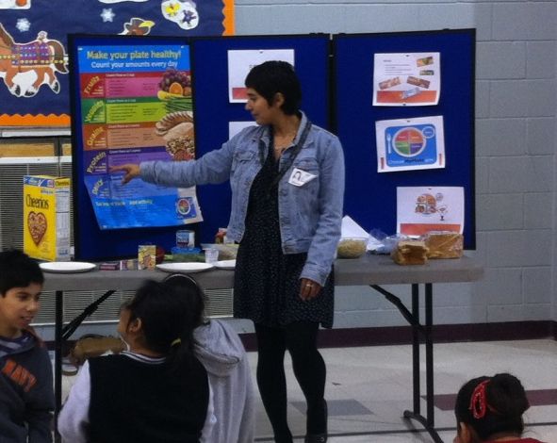
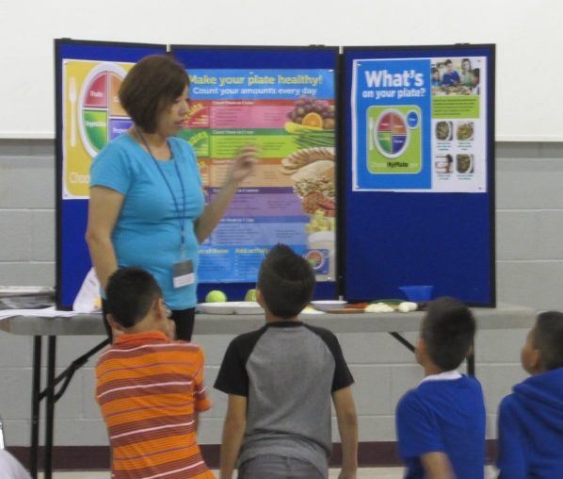
WELLNESS WORKS PROGRAM AT BENAVIDES ELEMENTARY

Slide 8
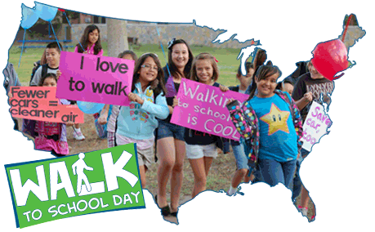


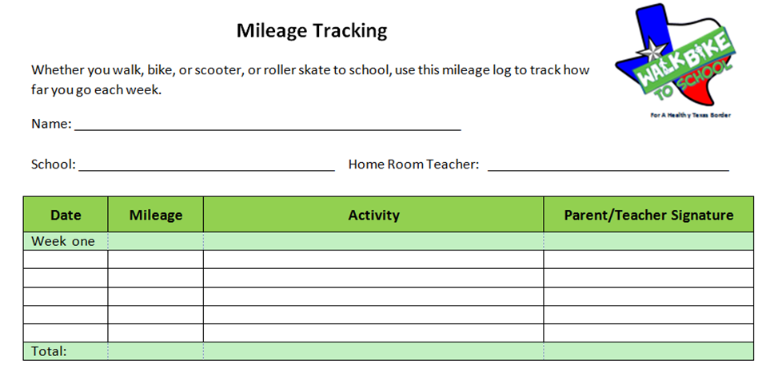
WALK/BIKE TO SCHOOL AND 100 MILE CLUBS
For A Healthy Texas Border

Slide 9
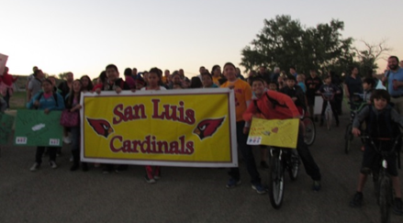


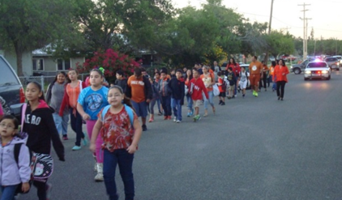
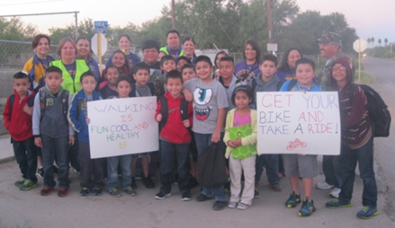
WALK/BIKE TO SCHOOL DAY
OCTOBER
San Luis students Walk to School
Glass Elementary students Walk to School
Students at Ray H Darr Walk to School

Slide 10
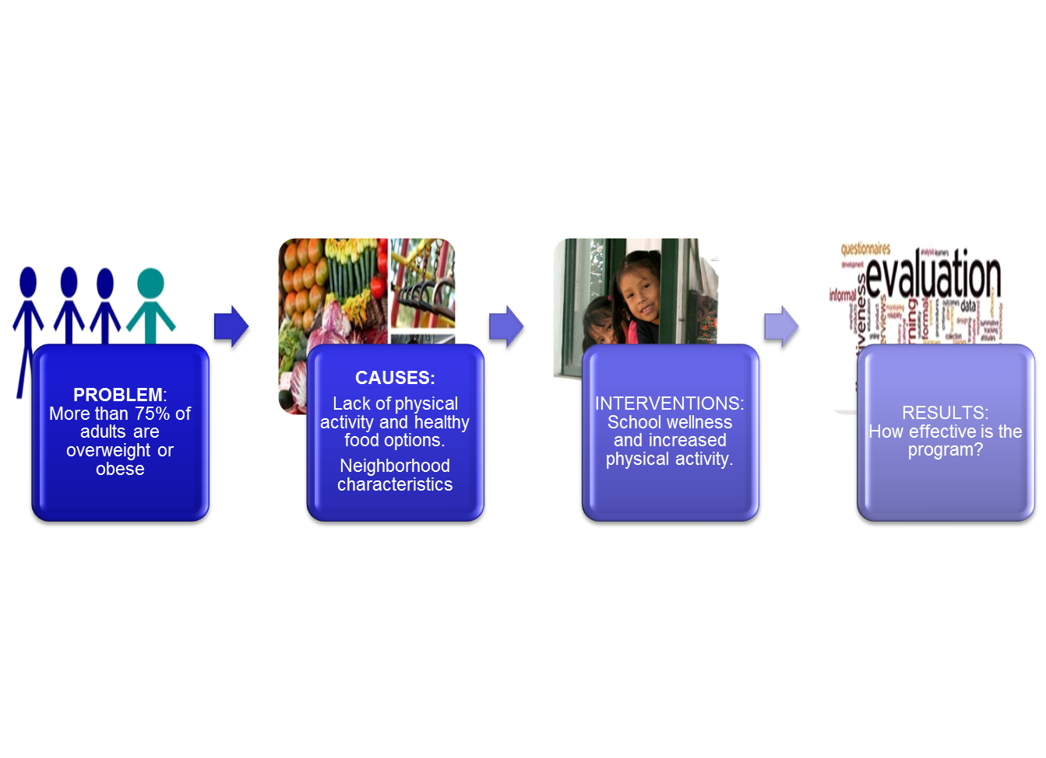
MAVERICK COUNTY

Slide 11
Facilitators
Parents walk with children to school, walking clubs
Physical activity benefits
Recommendations
Barriers
Dogs, distance, fear of crossing highway, cars, weather
Convenience for parent, apathy of child
Talk and spend time with friends
Street signs, fix streets
Playground equipment, track, incentives
More time for recess, different types of activities
Parks (proximity, safety, maintenance)
Spend time outdoors
Children Focus Groups

Slide 12
Facilitators
Parents walk with children to school, walking clubs
Physical activity benefits
Recommendations
Barriers
Dogs, distance, safety
Convenience (time)
Less screen time
Street signs, fix streets
Playground equipment, track, incentives
Parks (proximity, safety, maintenance)
Spend time outdoors
More time for recess, different types of activities
Parent Focus Groups

Slide 13
NUTRITION AMBASSADORS
Healthy Buddies Initiative
Office of Women’s Health Bodyworks
Veggies for Kids Curriculum
Let’s Move Health Initiative
Nutrition Council’s 5-2-1-0 Prevention Message
USDA’s MyPlate

Slide 14
MAVERICK COUNTY

Slide 15


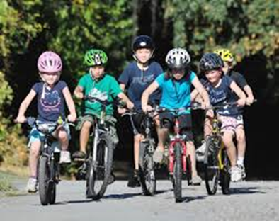


NUTRITION AMBASSADORS

Slide 16










NUTRITON AMBASSADORS

Slide 17

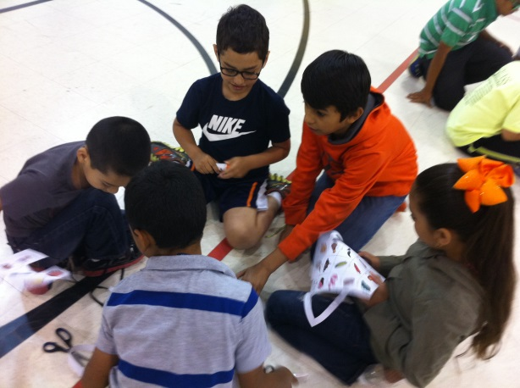
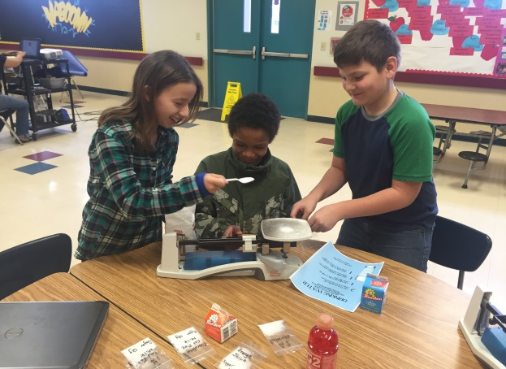
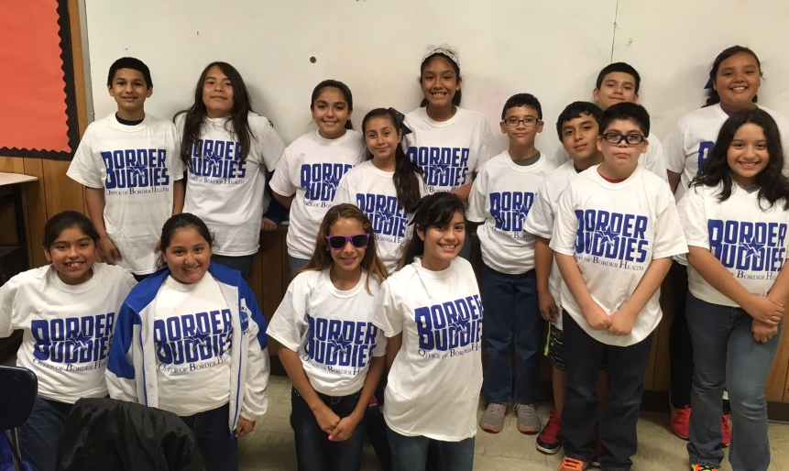
NUTRITION AMBASSADORS
Eagle Pass ISD
San Felipe Del Rio CISD
Rocksprings ISD

Slide 18
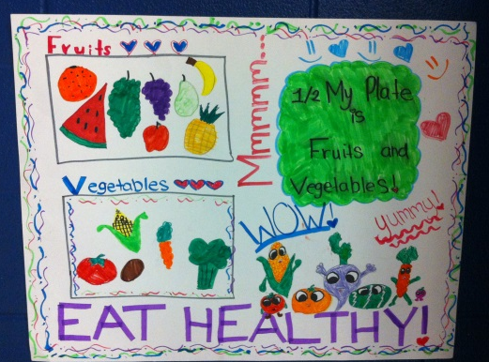
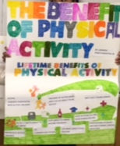
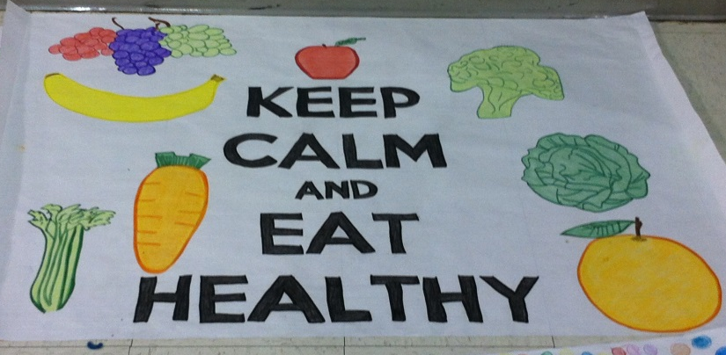
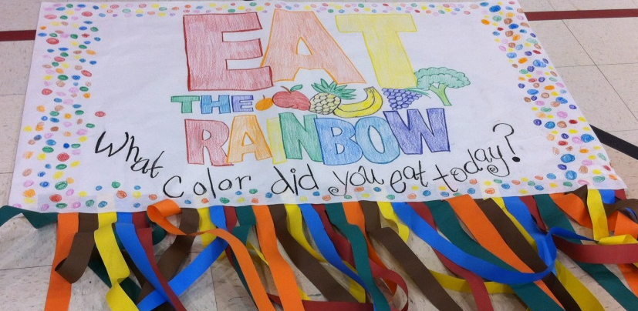
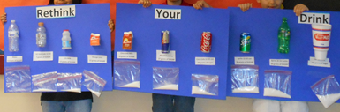
NUTITION AMBASSADOR SCHOOL POSTERS

Slide 19
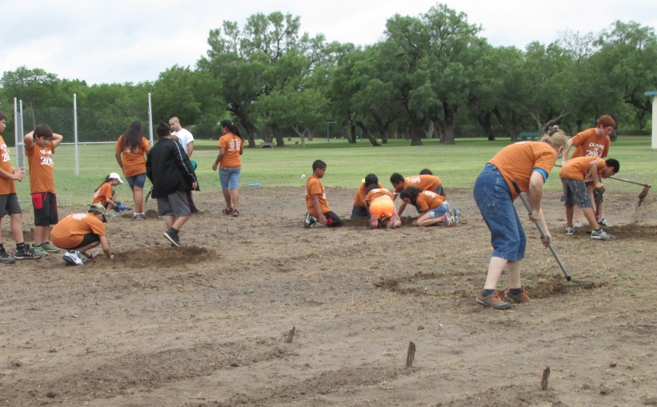
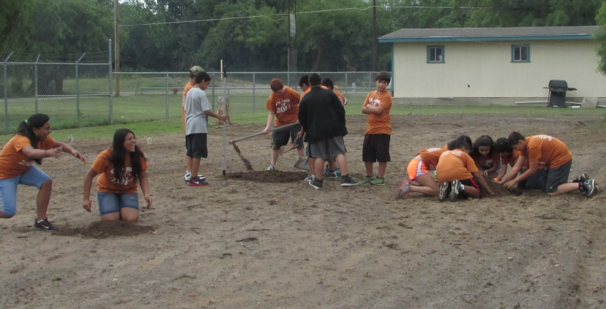
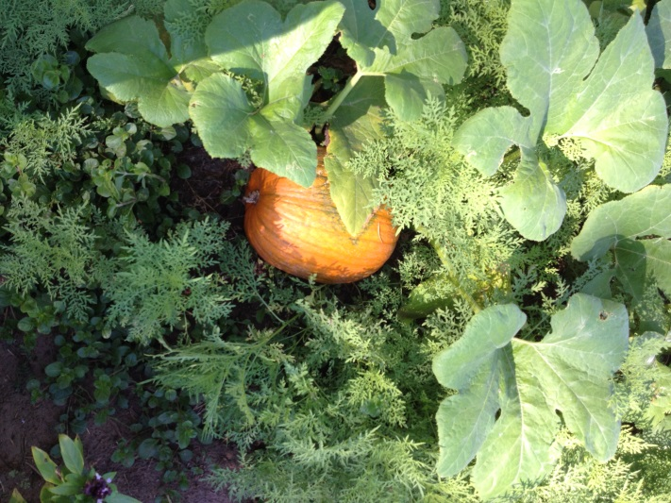
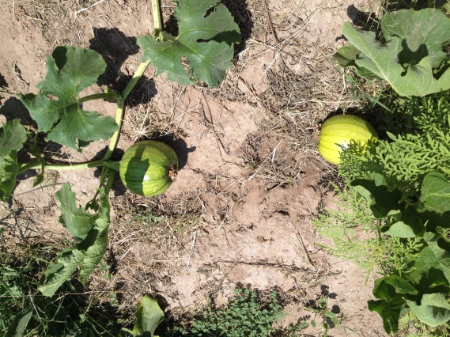
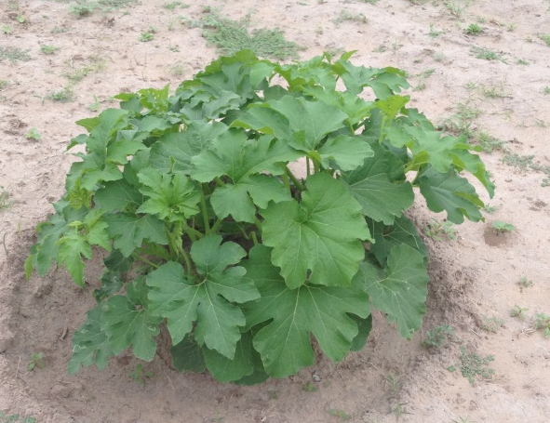
COMMUNITY GARDENS

Slide 20
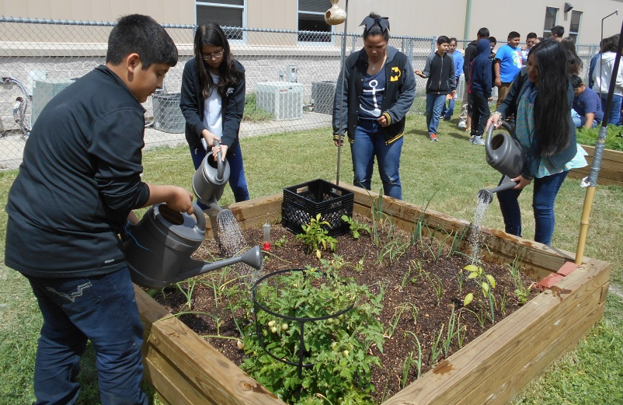
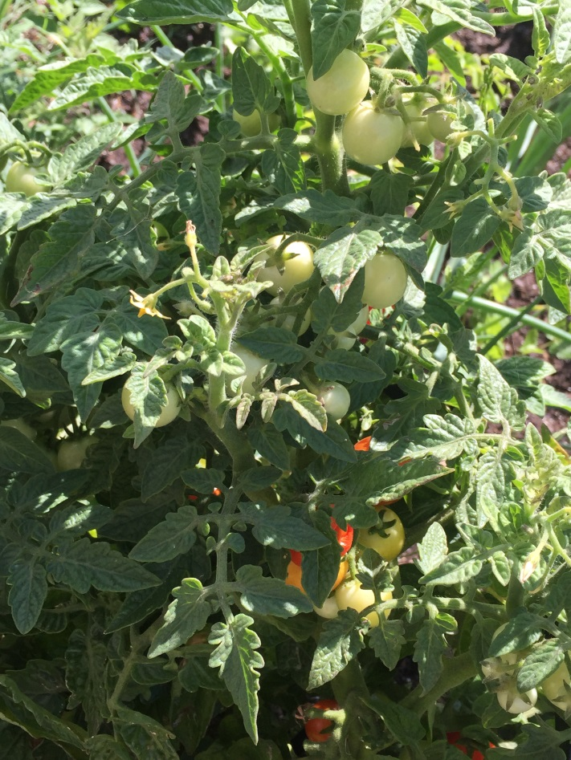
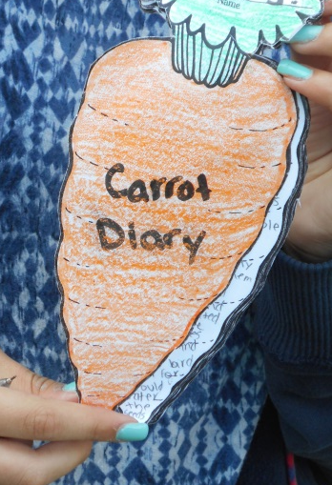
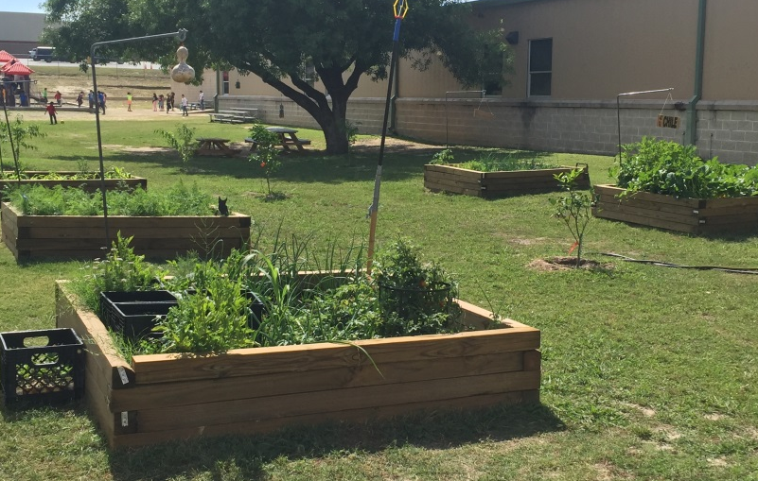
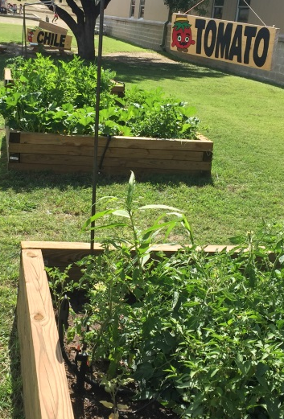
COMMUNITY GARDENS

Slide 21
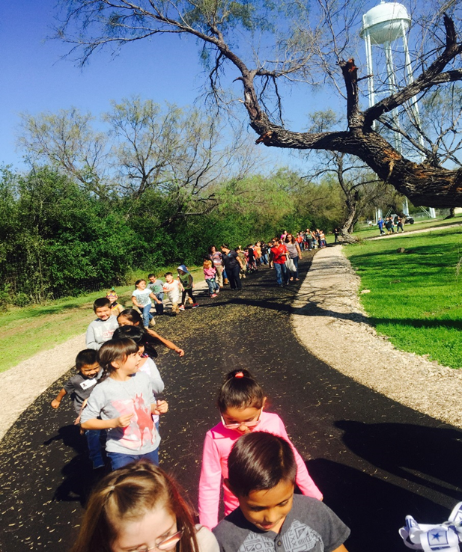
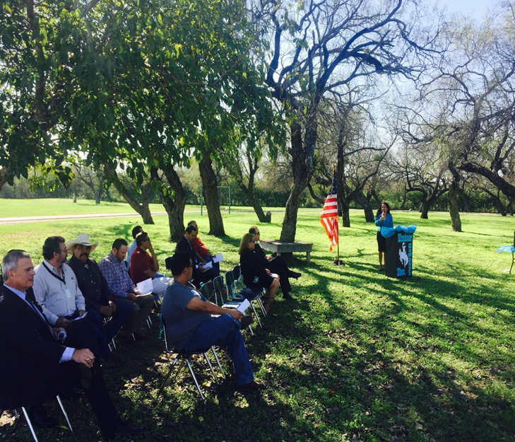
WALKING TRAIL

Slide 22
MAVERICK COUNTY

Slide 23
NUTRITION AMBASSADOR AND 100 MC PARTICIPATION
Participation | Totals
School Districts | 3
Schools | 9
Trained Nutrition Ambassadors | 302
Nutrition Ambassador Participants | 4196
100 Mile Club Participants | 5193

Slide 24
CHANGES REPORTED BY STUDENTS

Slide 25
STUDENT KNOWLEDGE
OF USDA’S MYPLATE GUIDELINES

Slide 26
STUDENT, PARENT, AND TEACHER RESPONSES
“These tomatoes are better than the one’s from the store.”
1st grader, San Luis Elementary
“I like being a Nutrition Ambassador, the presentations are fun.”
5th grader, Kirchner Elementary
“My daughter doesn’t let us drink cokes at home anymore.”
Parent to 2nd grader, Ray H. Darr Elementary
“My students have really enjoyed participating in this program. Most of them are really shy, but they have embraced the project and made it their own. They have already started talking about how they are going to make it better next year.”
Family & Consumer Science Teacher, Rocksprings Middle School

Slide 27
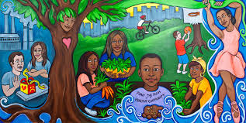
SUMMARY
Continued Need to Improve Health
Build and sustain a culture of health among our schools

Slide 28




GRANT OPPORTUNITIES
School Community Gardens

Slide 29
REFERENCES
http://www.countyhealthrankings.org/app/texas/2013/measure/factors/45/map
http://www.dshs.state.tx.us/chs/brfss/
http://www.census.gov/acs/www/
http://www.tasanet.org/domain/124
http://www.nutritioncouncil.org/programs/healthy-kids/5-2-1-0/
http://www.choosemyplate.gov/

Slide 30
Thank You!
Rosy De Los Santos
rosy.delossantos@dshs.state.tx.us
830-758-4241

