Slide 1

Greater with wic: moving beyond the clinic walls to bridge the rural food access gap
Quinney Harris, MPH
National WIC Association
February 17, 2017

Slide 2

Disclaimer
This presentation was supported by the Cooperative Agreement Number, U58 DP005645-03, funded by the Centers for Disease Control and Prevention. Its contents are solely the responsibility of the authors and do not necessarily represent the official views of the Centers for Disease Control and Prevention or the Department of Health and Human Services.

Slide 3
What do you know about the WIC Program?

Slide 4
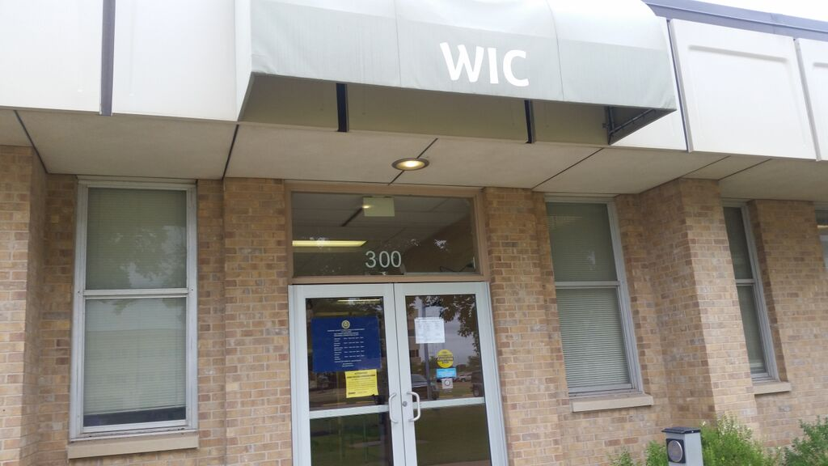

Special Supplemental Nutrition Program for Women, Infants, and Children (WIC)
Federally funded, state run
4 pillars of service
Nutritious food package
Nutrition education
Breastfeeding promotion and support
Referrals to health care and social services

Slide 5
WIC Serves…
Pregnant, breastfeeding, and post-partum women
Infants and children up to age 5
Who meet income requirements
Document income at or below 185% of poverty
Demonstrate enrollment in SNAP, TANF, or Medicaid
Who demonstrate nutrition risk
About 8 million clients per month in 90 state agencies through 10,000 clinics across the country

Slide 6
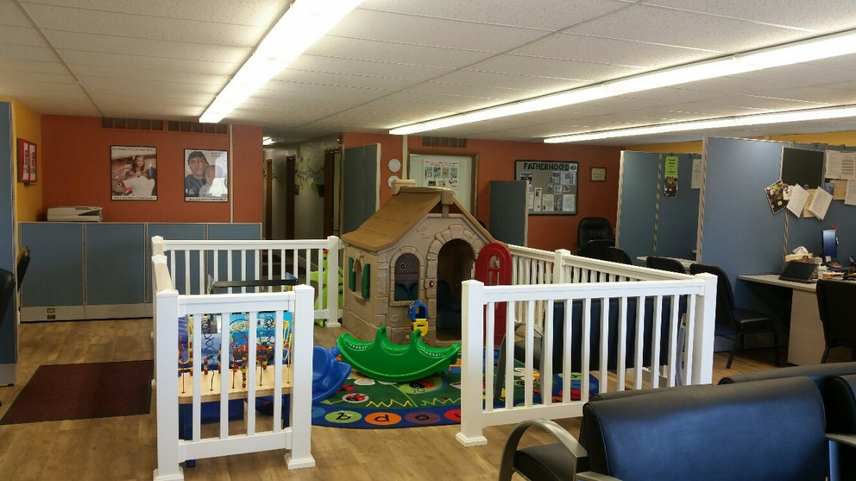
WIC Goals
Reduce nutrition-related illness and give children a healthy start in life
Children arrive at school ready-to-learn

Slide 7
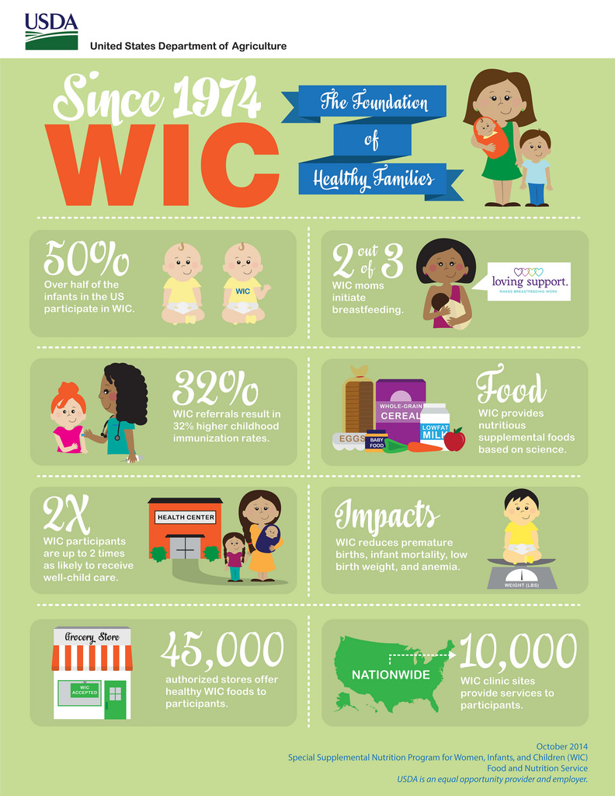
Notes:
Improved health behaviors and health outcomes
Program Impact…
Health care cost savings

Slide 8
NWA’s Role with WIC
The National WIC Association (NWA):
is the non-profit education arm and advocacy voice of WIC
is a membership association, with WIC agencies comprising most of its membership
does not administer the WIC Program and is independent of the U.S. Department of Agriculture (USDA), Food and Nutrition Service (FNS), which provides funding and policy guidance, and creates regulations for the Program.
NWA Represents WIC Agencies
Founded in 1983, the National WIC Association (NWA) represents 90 Geographic, Territorial, Indian and Native American State Agencies and more than 2,000 Local Agencies that together provide quality nutrition education, breastfeeding support, health care and other referral services to nearly 9 million at-risk women, infants and children through 10,000 WIC clinics nationwide

Slide 9
NWA’s Community Partnerships for Healthy Mothers and Children Project

Slide 10
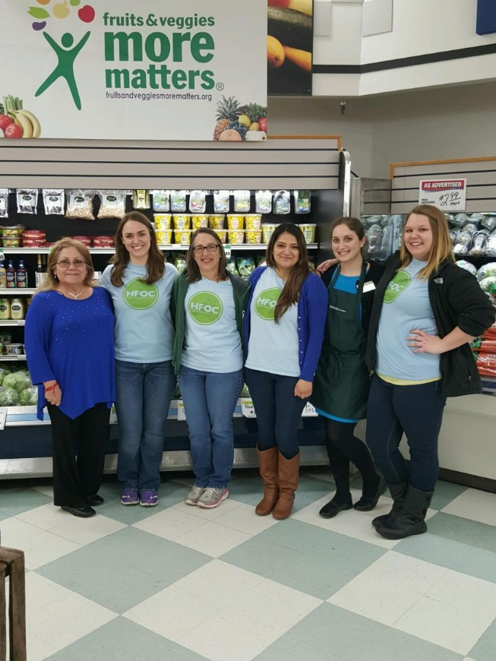
WIC Community Health Leadership
NWA’s Community Partnerships for Healthy Mothers and Children Project
3-year cooperative agreement with CDC
30 local WIC agencies in 2 cohorts
Project partners include:
ACOG, Altarum Institute
Other National Organization Awardees: AHA, APA, SOPHE, and DHPE
Requirements: Coalition, leadership team, needs assessment, CAP, and implementation
WIC Agencies working on policy, systems, and environmental change with community partners to
Improve access to healthy food and beverage options (including breastmilk)
Improve access to chronic disease prevention and management services

Slide 11
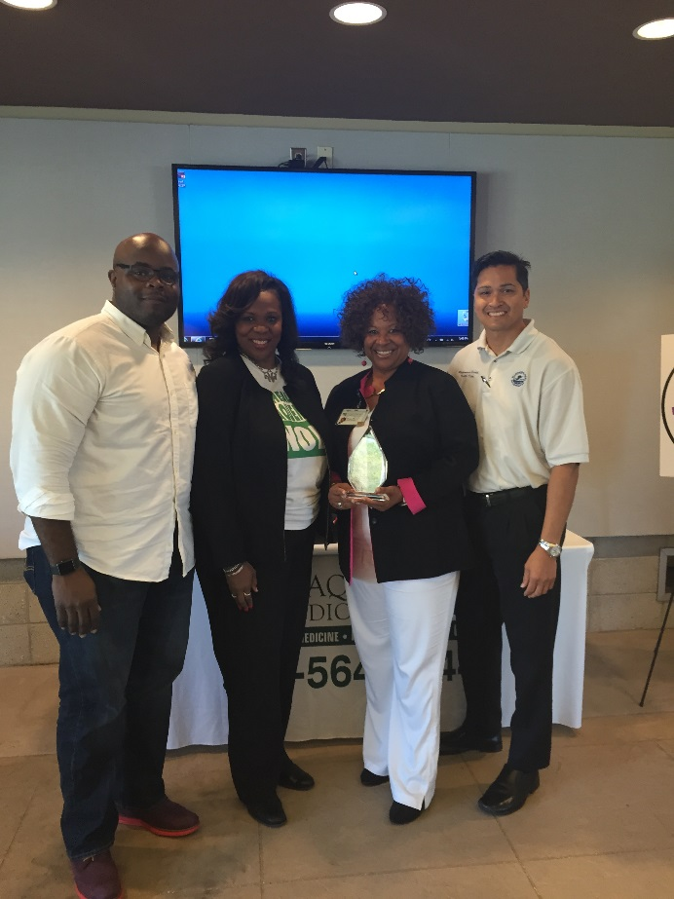
NWA’s Vision
Promoting WIC Assets
Trusted community resource
Insights on client and community needs
Knowledgeable staff
Established community relationships
Serving clients beyond the clinic walls
Empowering WIC staff and clients to be engaged in a leadership role
Notes:
Leveraging WIC strengths in a larger public health context
Consider the external and home environment
Programming based on the identified needs of the target population
Community partnerships
Consistent messaging with other stakeholders
Evaluation

Slide 12
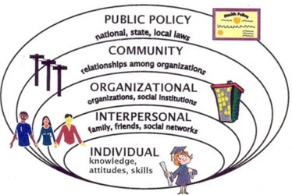
WIC Working With Community Partners Can Help Provide the Full Spectrum of Support for WIC Clients
Policy, Systems, and Environmental Change Strategies Target the Organizational, Community, and Public Policy Levels (Potential for additional support for clients)
WIC Program: Direct Services

Slide 13
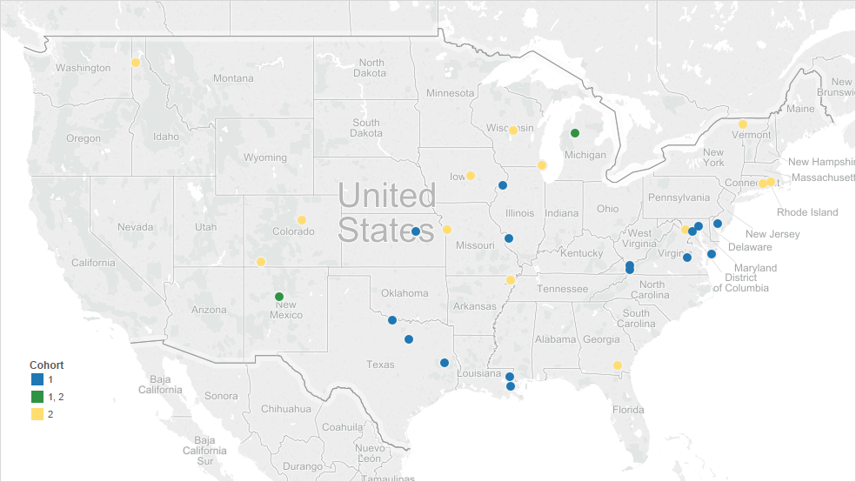
CPHMC Projects
Notes:
To accomplish our goals, NWA funded 31 communities in 18 different states to implement policy, systems, and environmental change interventions in their local communities.

Slide 14
Why is rural health important to you?

Slide 15
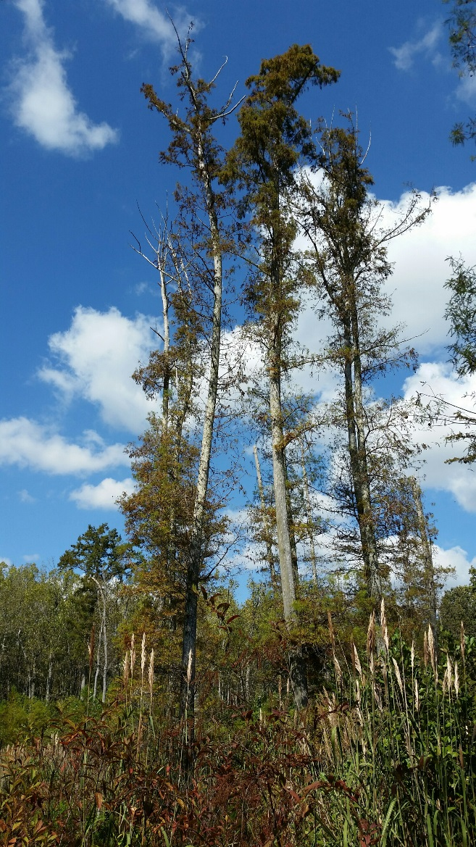
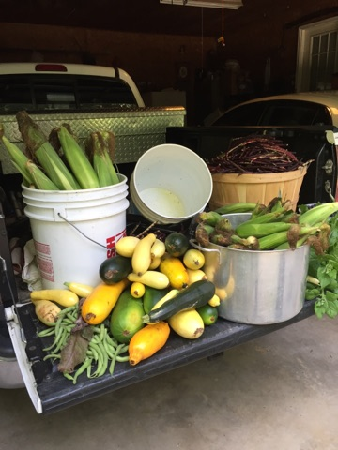
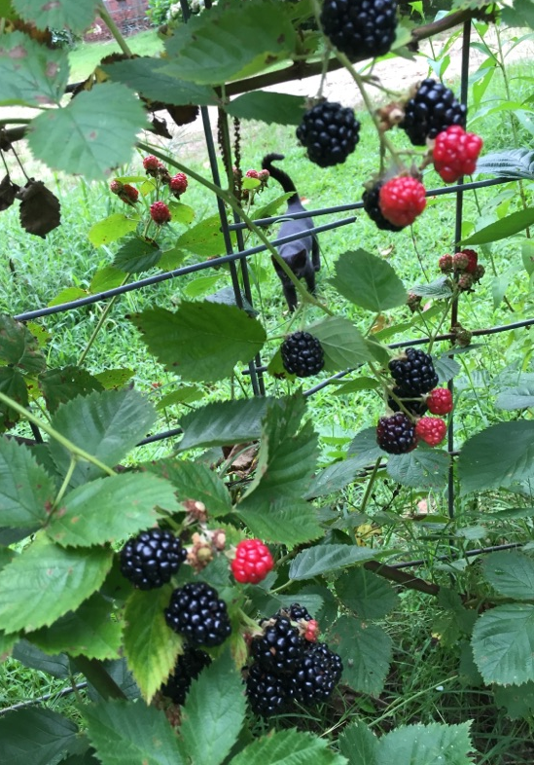
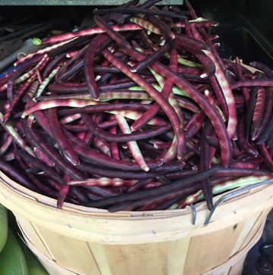

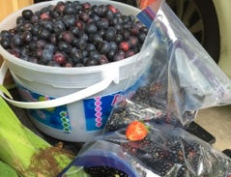
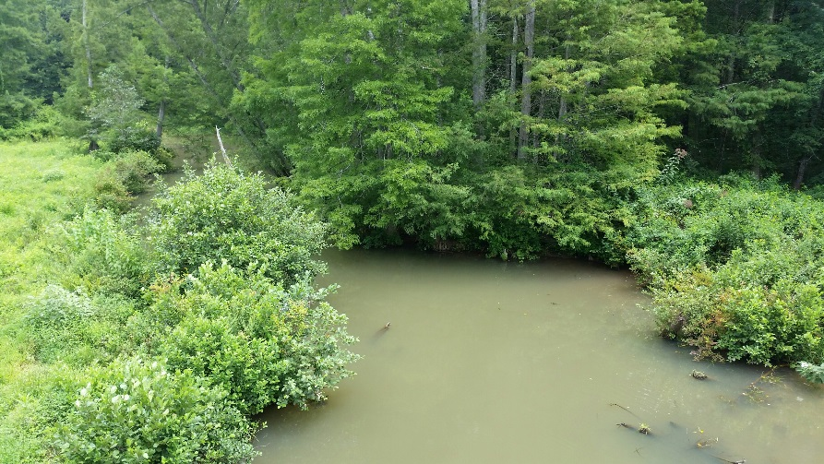

Slide 16
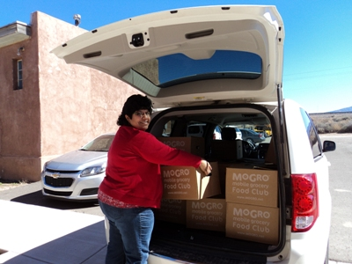
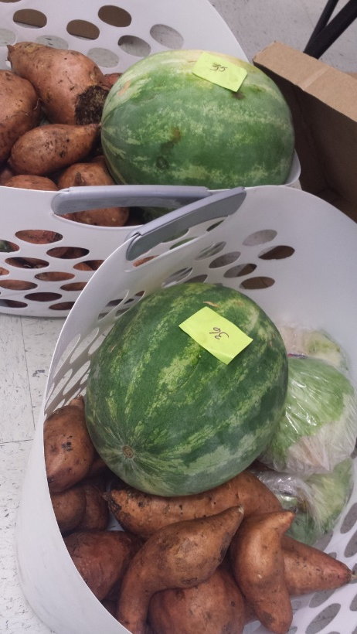
CPHMC Cohort 1 Rural Food Access Achievements

Slide 17
Rural Coalitions
Angelina County & Cities Health District (Angelina County, TX)
Cumberland Plateau Health District (Tazewell County, VA)
Mount Rogers Health District (Carroll and Grayson Counties; City of Galax, VA)
Crescent City WIC Services, Inc. (Plaquemines Parish, LA)
District Health Department #10 (Oceana County, MI)
Five Sandoval Indian Pueblos, Inc. (Cochiti Pueblo, Jemez Pueblo, Sandia Pueblo, Santa Ana Pueblo, and Zia Pueblo, NM)

Slide 18
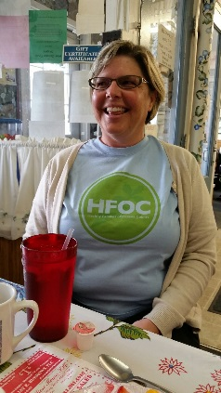
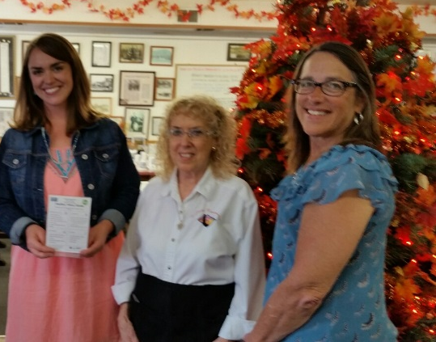
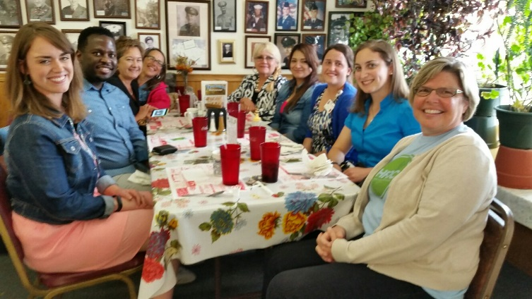
Project leadership team
Project Coordinator from local WIC agency
WIC client
Women’s health service provider like an OB/GYN or nurse practitioner

Slide 19
 | Mount Rogers Virginia | Crescent City WIC Louisiana | Angelina County & Cities Texas | Cumberland Plateau Virginia | Five Sandoval Indian Pueblos, Inc. New Mexico | District Health Department #10 Michigan
Income – Per capita | $20,057 | $25,747 | $20,982 | $20,723 | $9,814.20 | $18,985
Food insecurity | 12.81% | 11.28% | 19.11% | 12.56% |  | 14.12%
Child poverty | 31.5% | 17.2% | 28.7% | 24.7% | 19.56% | 30.7%
Grocery store access | 17.1 per 100,000 | 13.2 per 100,000 | 11.52 per 100,000 | 17.57 per 100,000 |  | 26.35 per 100,000
Low income pop. w/low food access | 2.96% | 13.6% | 13.2% | 6.9% |  | 2.1%
Inadequate F/V consumption | No data | No data | 78.8% | 83% |  | No data
Obesity | 31.66% | 34.7% | 33.6% | 29.6% |  | 33.8%
Notes:
Have US averages on hand for comparison
These numbers reflect persons living on the specified land only. Tribal governments typically count registered tribal members including those living off the reservation

Slide 20
 | Santa Ana Pueblo (Urban) | Sandia Pueblo (Urban) | Jemez Pueblo (Rural/Isolated) | Cochiti Pueblo (Rural/Near Santa Fe) | Zia Pueblo (Rural/Near Rio Rancho)
Income – Per capita | $9,857 | $11,240 | $8,045 | $11,240 | $8,689
Median Household Income | $45,179 | $31,000 | $28,889 | $31,000 | $34,583
Poverty Rate | 4.1% | 19.8% | 25.5% | 19.8% | 15.4%
Child poverty | 4.1% | 24% | 27.1% | 24% | 18.6%
Tribal owned businesses | Casino & Hyatt Regency Resort and Spa (luxury) | Casino | Convenience store & visitor center | Golf course & visitor center

Slide 21
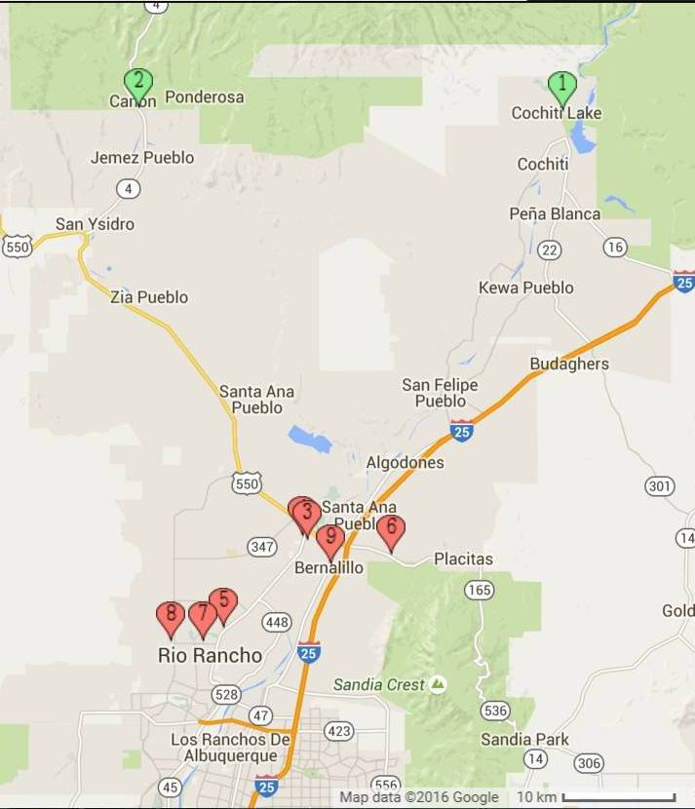
Geography and transportation
WIC Vendors
Albertson’s in Rio Rancho
T&T Supermarket in Bernalillo
Walatowa Convenience Store in Jemez Pueblo
Distance to Nearest Grocery Store
Cochiti Pueblo – 6.5 to food market/33.5 miles to nearest WIC approved store
Jemez Pueblo – 27.3 miles
Notes:
New Mexico is the fifth-largest state, 36th-most populous (total population) and 45th in population density (pop per sq mi) Any inferences or comparisons to US as a whole or to particular states should take this geographic variation into consideration.

Slide 22
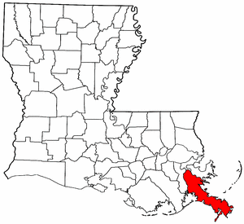
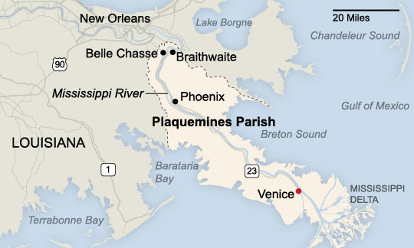

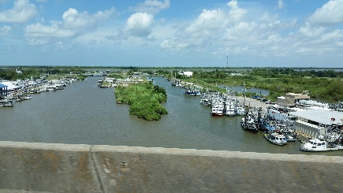
Geography and Transportation
Notes:
· 2- grocery stores in the parish are on the West Bank. In Belle Chase and Port Sulphur.
· No grocery stores on the East Bank and there is only 2 convenience store.
No really healthy food. One has gas station on East bank
· The farmer’s markets and farm stands located in 3 Belle Chasse and 2 Port Sulphur
· How reliable is the ferry?
Okay
Does it ever shut down for long periods of time? yes, once for an extended time in lower Plaquemines. About a Month
· When there are hurricanes or flooding, are there mandatory evaluations or do people generally stay in their homes?
Mandatory for lower and Partial for upper.
Are there food access problems during these times?
Yes, Due to families overstocking and food items run out.

Slide 23
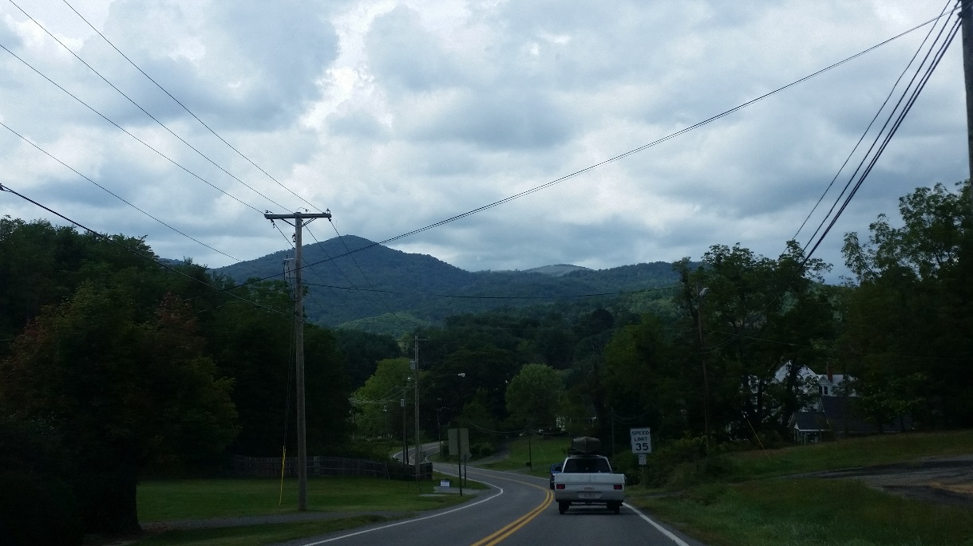
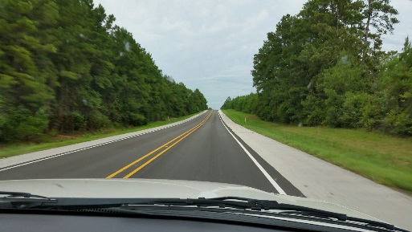
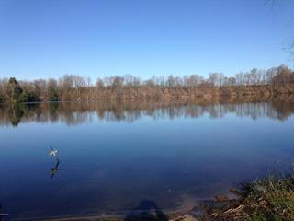
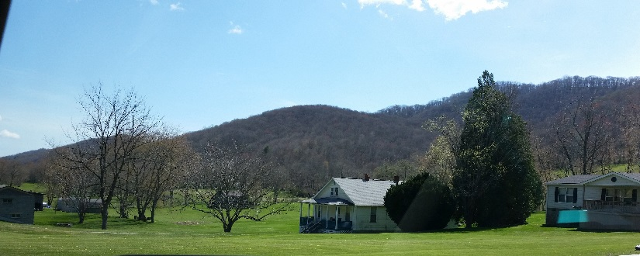
Geography and transportation
Notes:
While not county wide concerns, several coalitions had isolated communities within their county

Slide 24
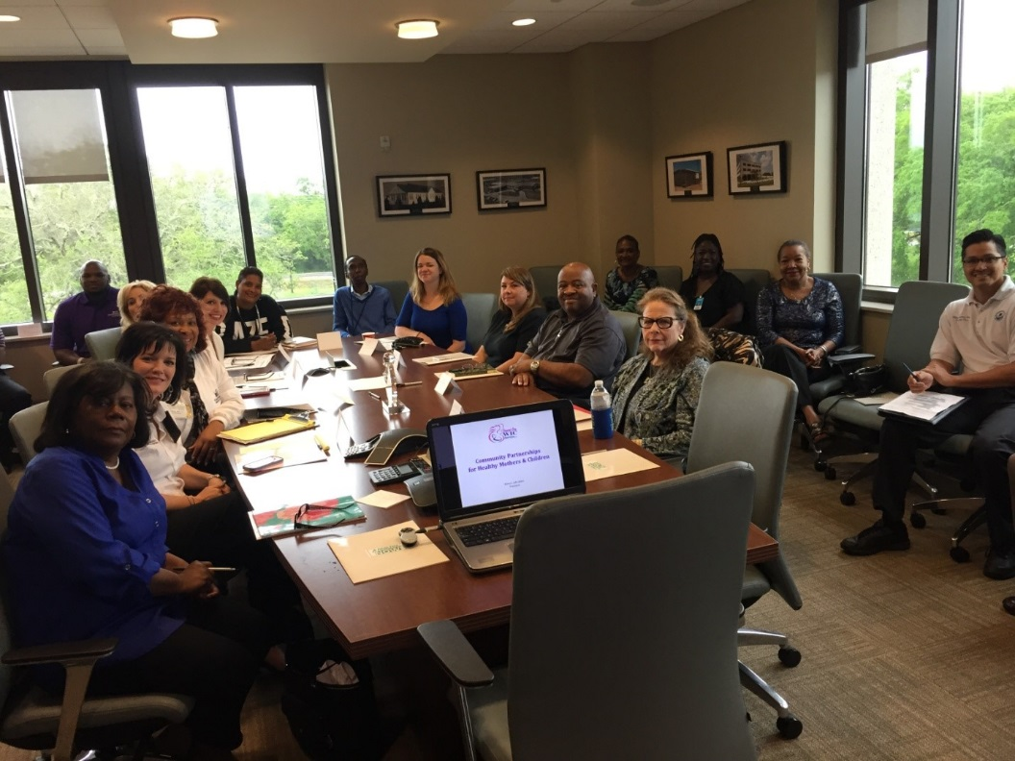
Community Assets
Willingness to partner and help those in need
Close-knit relationships
Local culture (Native American, Louisiana/New Orleans, Appalachian, Great Lakes)
Embraced the coalition and PSE work
Working relationships with farmers, Cooperative Extension, and ag stakeholders

Slide 25
Common goal with different approaches
Primary Objective: Improve access to environments with healthy food and beverage options
Targeted Approaches
Food Banks
School Gardens
Green Prescription Pads
Healthy Food Retail
Farmer’s Markets
Breastfeeding

Slide 26
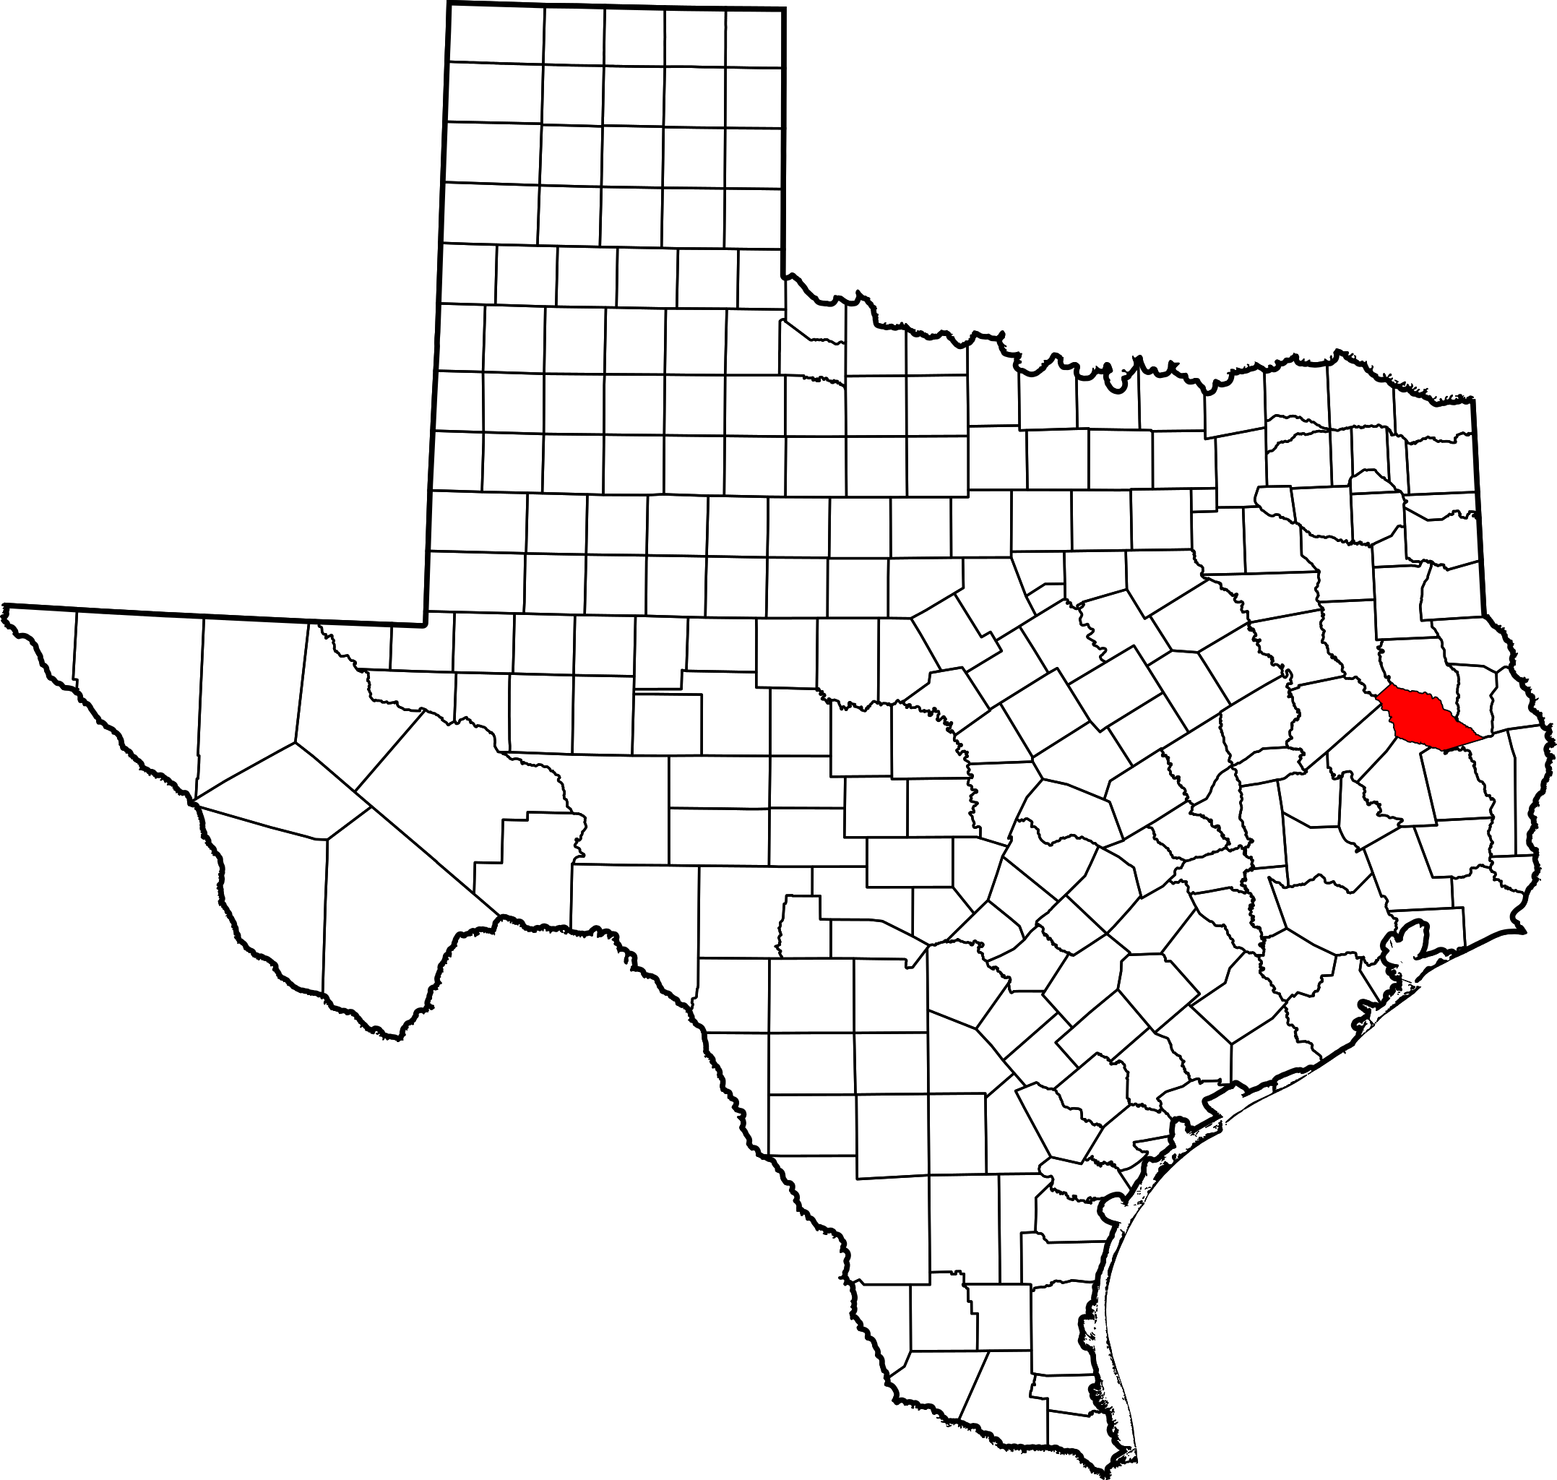
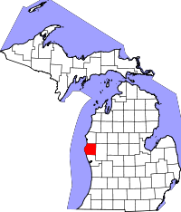
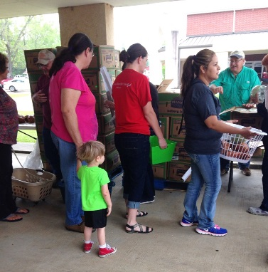
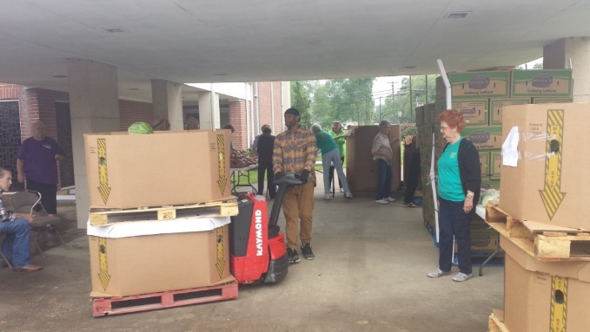
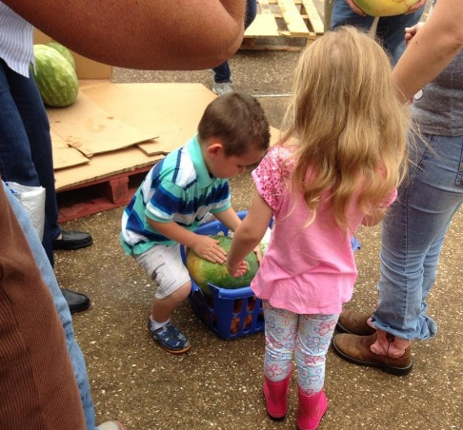
Food Banks
New food drop location in Angelina County that will increase food produce offerings at two food banks serving rural communities in the county.
“Pick Me- I am a Healthy Item!” shelf labels and signage at local grocery stores and a local food pantry (English and Spanish)

Slide 27
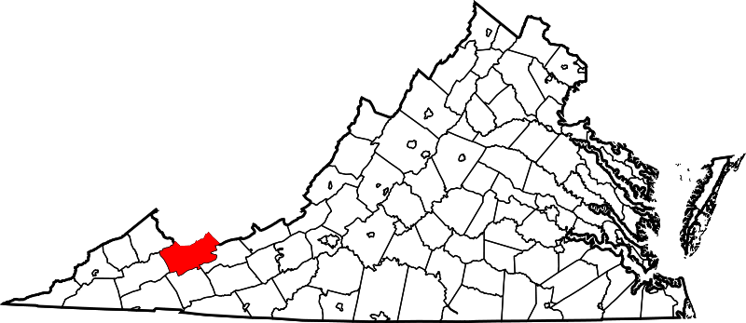
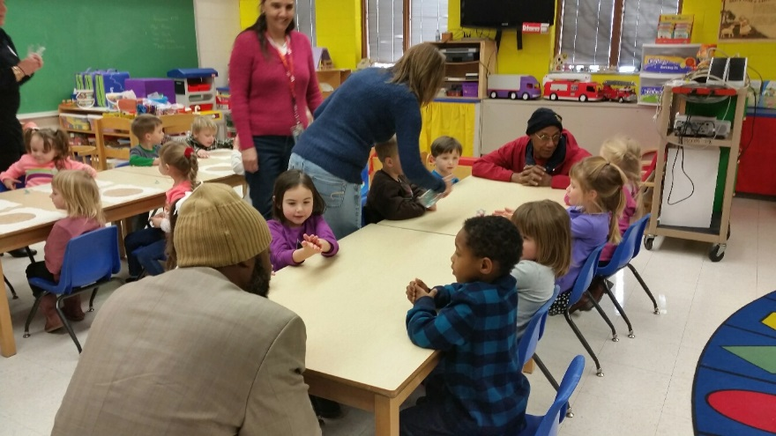

School Gardens
Growing Healthy Habits gardening curriculum in elementary schools and a daycare center taught by local farmers
Coalition Website: http://growswva.wixsite.com/growswva
Curriculum Website: https://www.eatsmart.umd.edu/resources/curricula/growing-healthy-habits
Notes:
Cumberland Plateau Health District established a coalition website to share resources and break down silos in their community. Coalition members were trained to use the website as a referral tool and it was promoted in their local community using billboards and physical reminders. They are currently working with a software company to develop a mobile app for the coalition website. http://growswva.wix.com/growswva

Slide 28
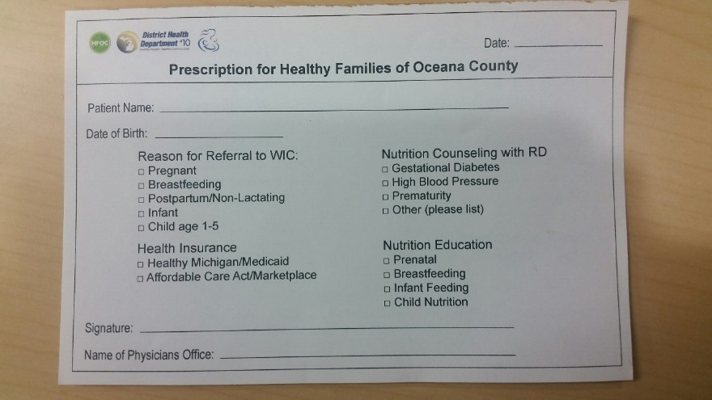
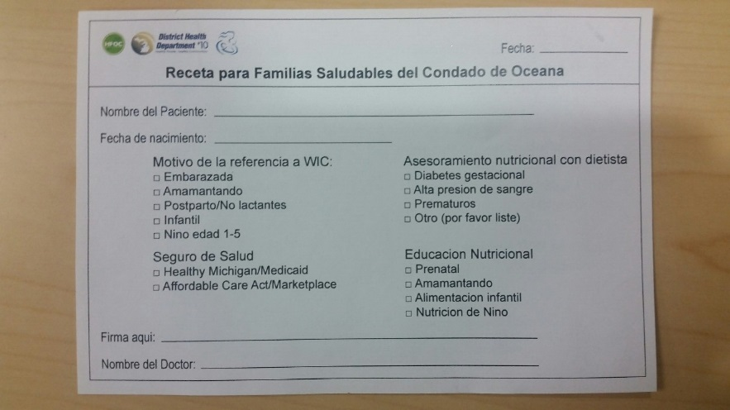
Green Prescription pads
“Rx for Healthy Families” prescription pads used to refer women and children to the WIC program, provided to four local healthcare agencies (English and Spanish)
Conducted a WIC in-service training for four local healthcare agencies

Slide 29
Green prescription pads
The “Choose Fresh” Rx Program
Screened patients for chronic disease risk and food access and provided patients with a prescription to purchase fresh produce from the local grocer.

Slide 30
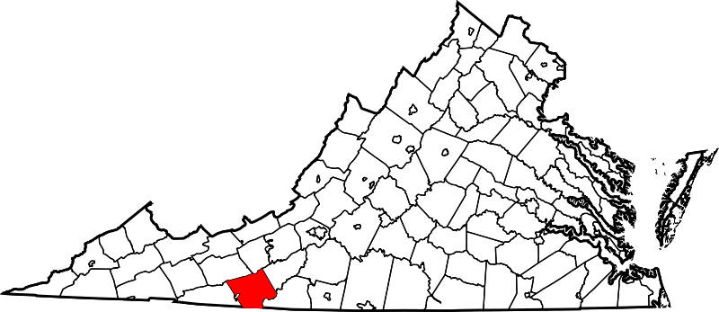
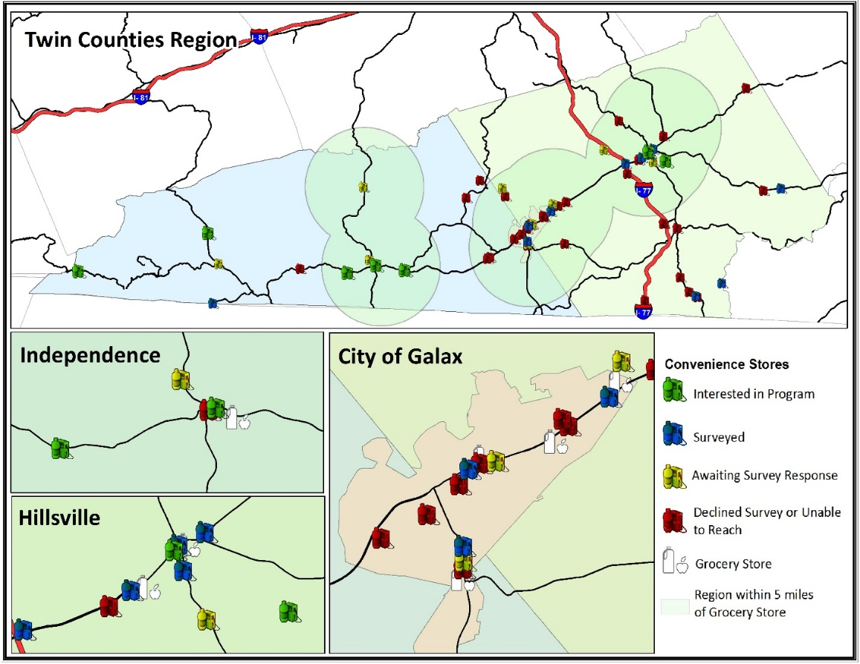
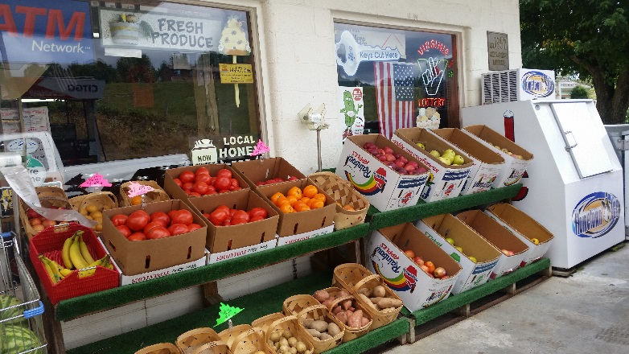
Healthy Food Retail
Feasibility study to assess local convenience stores

Slide 31
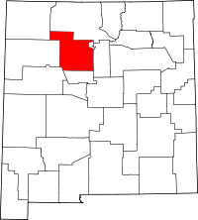
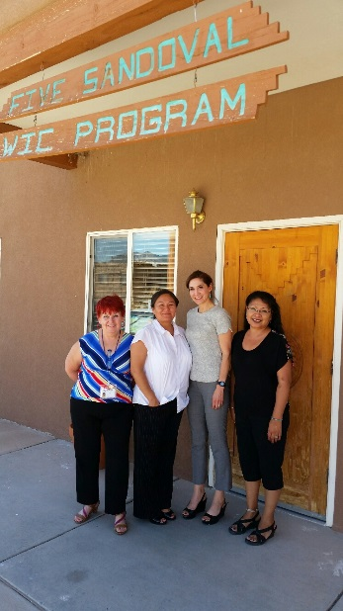
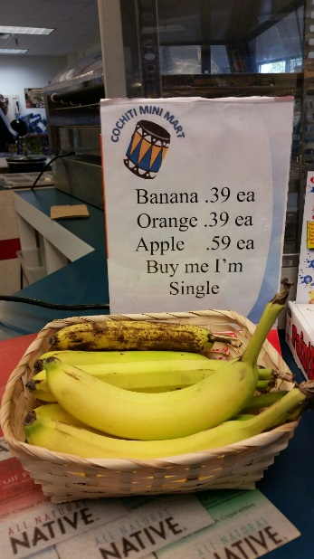
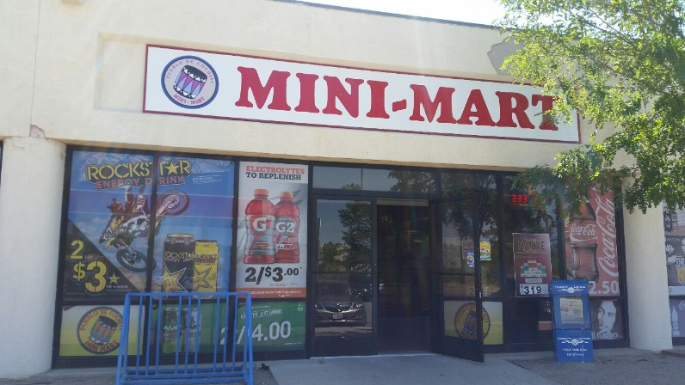
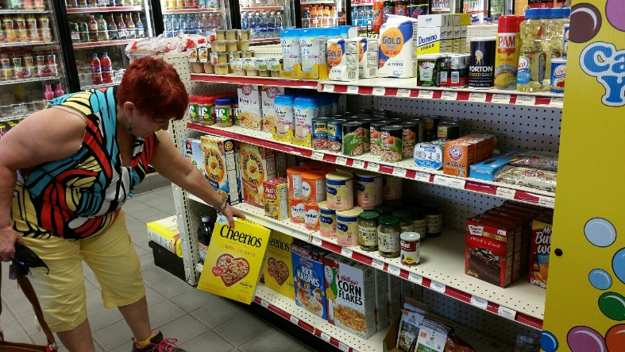
Healthy Food Retail
Fresh produce & WIC approved items in convenience stores at Cochiti and Jemez pueblos

Slide 32

Healthy Food Retail
MoGro food box program at Jemez Pueblo

Slide 33
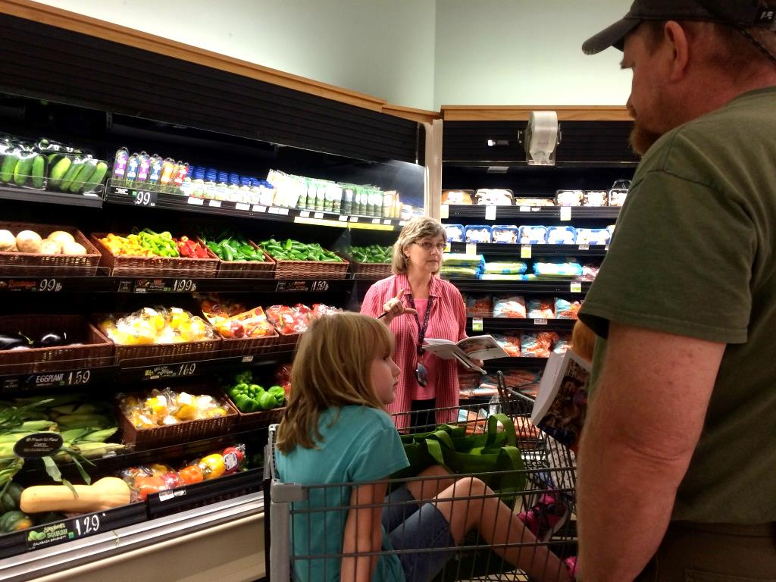
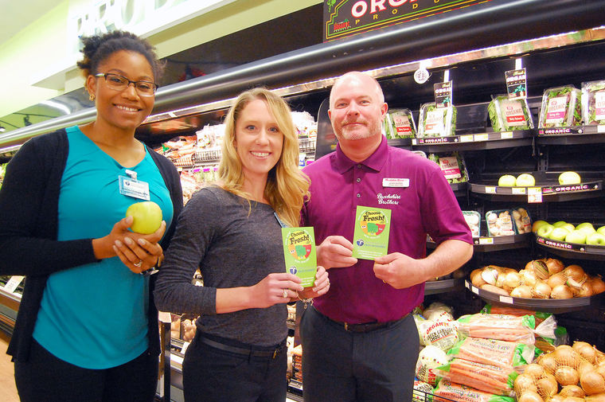
Healthy food retail
Grocery store tours and training grocery store employees

Slide 34
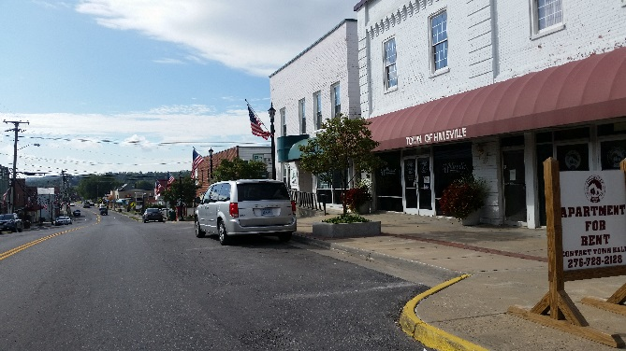
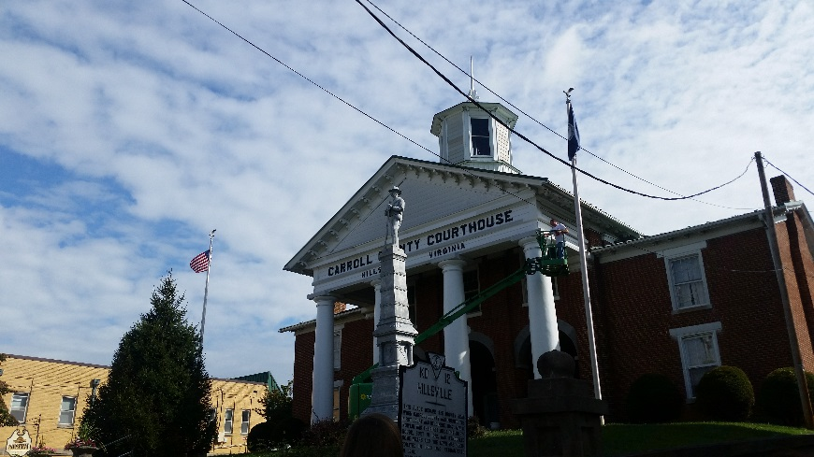
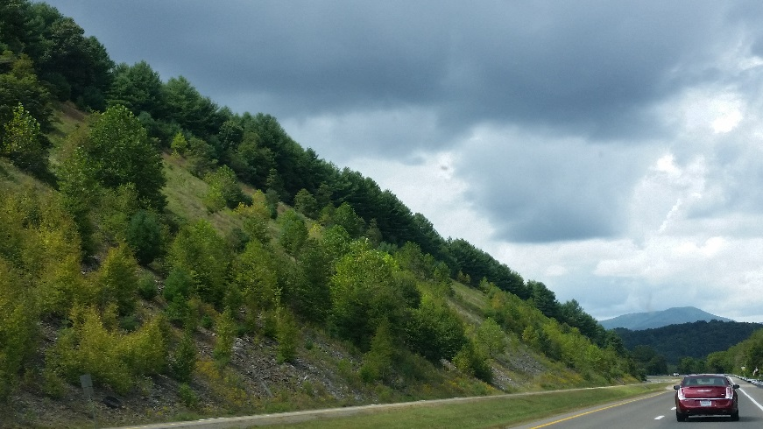
Farmer’s Market
Feasibility study for the town of Hillsville
Funded secured; new market opening in May

Slide 35

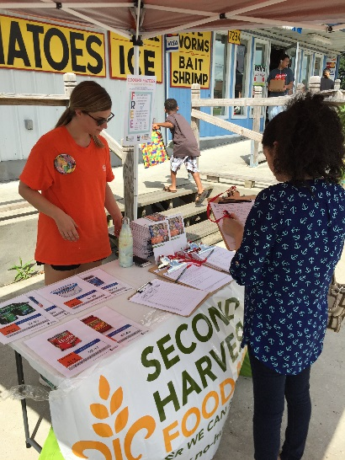


Farmer’s Market
Four (4) farmers markets certified to accept WIC and senior farmer’s market vouchers; one (1) accepts SNAP

Slide 36


Breastfeeding
Breastfeeding friendly workplaces
Business case for breastfeeding
Jingles
CLC training
Nursing rooms

Slide 37

H.A.N.D.S. Commercial

Slide 38
Major outcomes
Improved access to healthy foods in geographically underserved areas, including the New Mexico desert, Appalachian Mountains, frontier areas, and a peninsula served by two ferries
Increased collaboration and communication among local partners
Increased referrals to WIC, food banks, and other community services
Improved access to farmer’s markets for seniors, WIC, and SNAP recipients
Increased awareness of WIC assets

Slide 39
Major outcomes
Enhanced nutrition education and grocery shopping skills
Increased awareness of where to access healthy foods
Improved community acceptance of the practice of breastfeeding
Increased awareness of the benefits of breast milk
Increased employer support for breastfeeding

Slide 40

To Learn More…
Please visit our website: www.greaterwithwic.org

