Slide 1

Healthy communities: facilitating cross-sector collaboration in a rural setting
Elisabeth Altazan, LSU AgCenter
Denise Holston-West, LSU AgCenter

Slide 2
"If you want to go fast, go alone. If you want to go far, go together."
African Proverb

Slide 3
Outline
Background information
Phases of Healthy Communities
Lessons Learned/Best Practices
Successes
Q&A

Slide 4
Background

Slide 5
Context
CDC 1416 Grant funds to increase access to healthy foods and physical activity through community coalitions in counties with obesity rates over 40%
Socio-Ecological model is used to address policy, systems, and environmental changes (PSE)
Community-Participatory
Formal Partners include:
  LSU & Southern University AgCenters
  Louisiana Department of Health
  Pennington Biomedical Research Center (evaluation)

Slide 6
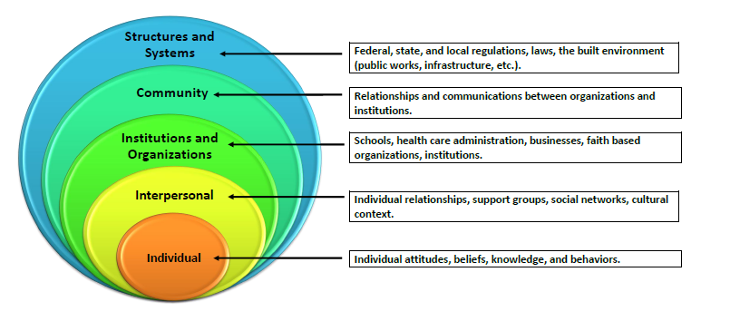
Socio-Ecological Model

Slide 7

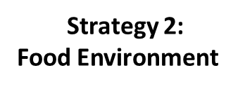



Slide 8
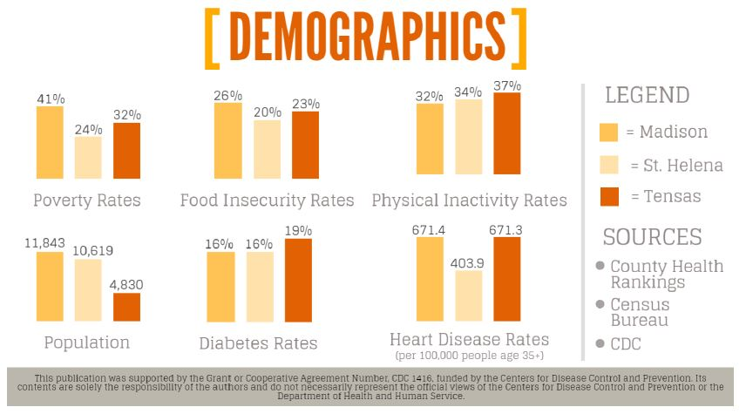
Parish Demographics

Slide 9
Phases of Healthy communities

Slide 10
Needs Assessment
Coalition Building
Action Planning
Implementation
Evaluation

Slide 11
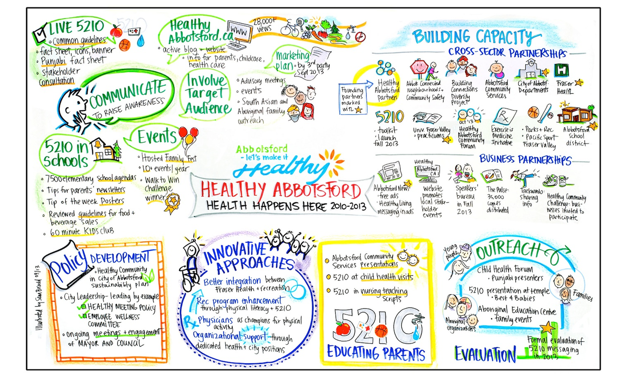
Moving Parts of Healthy Communities

Slide 12
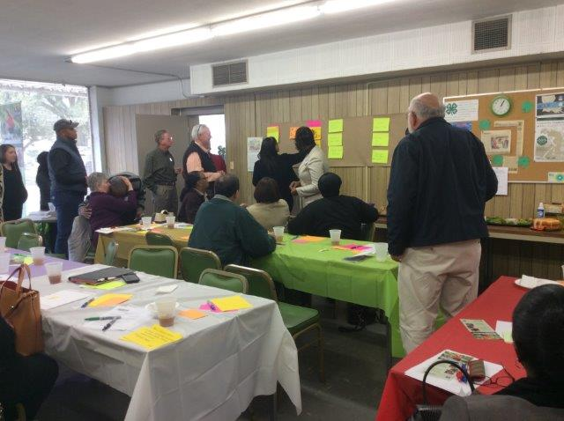
Needs Assessment
Collect baseline data
  NEMS and PARA surveys
Host community forums
Discuss community specific needs
Map assets
Ideal timeline: 1 year

Slide 13
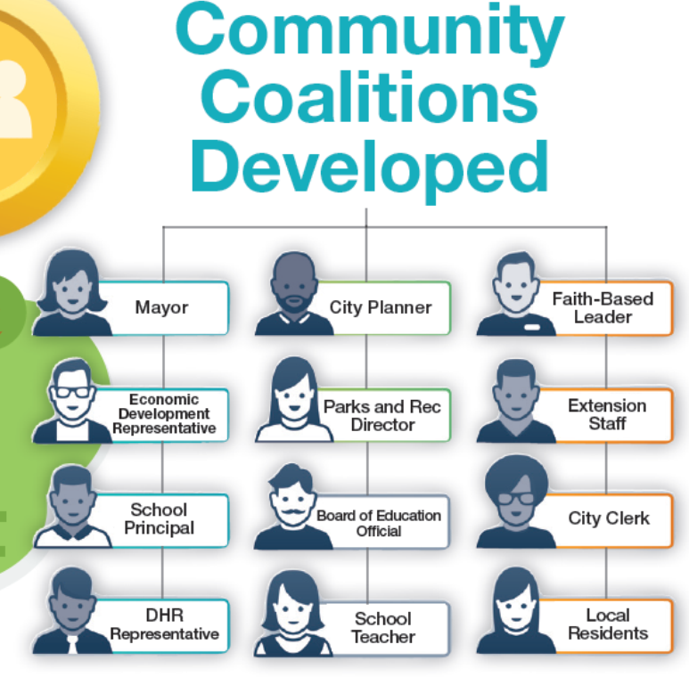
Coalition Building
“Stealth Group” of multiple sectors
Maybe starting from existing group
Identifying “movers and shakers”—not just in title
Capacity Building and Technical Assistance

Slide 14
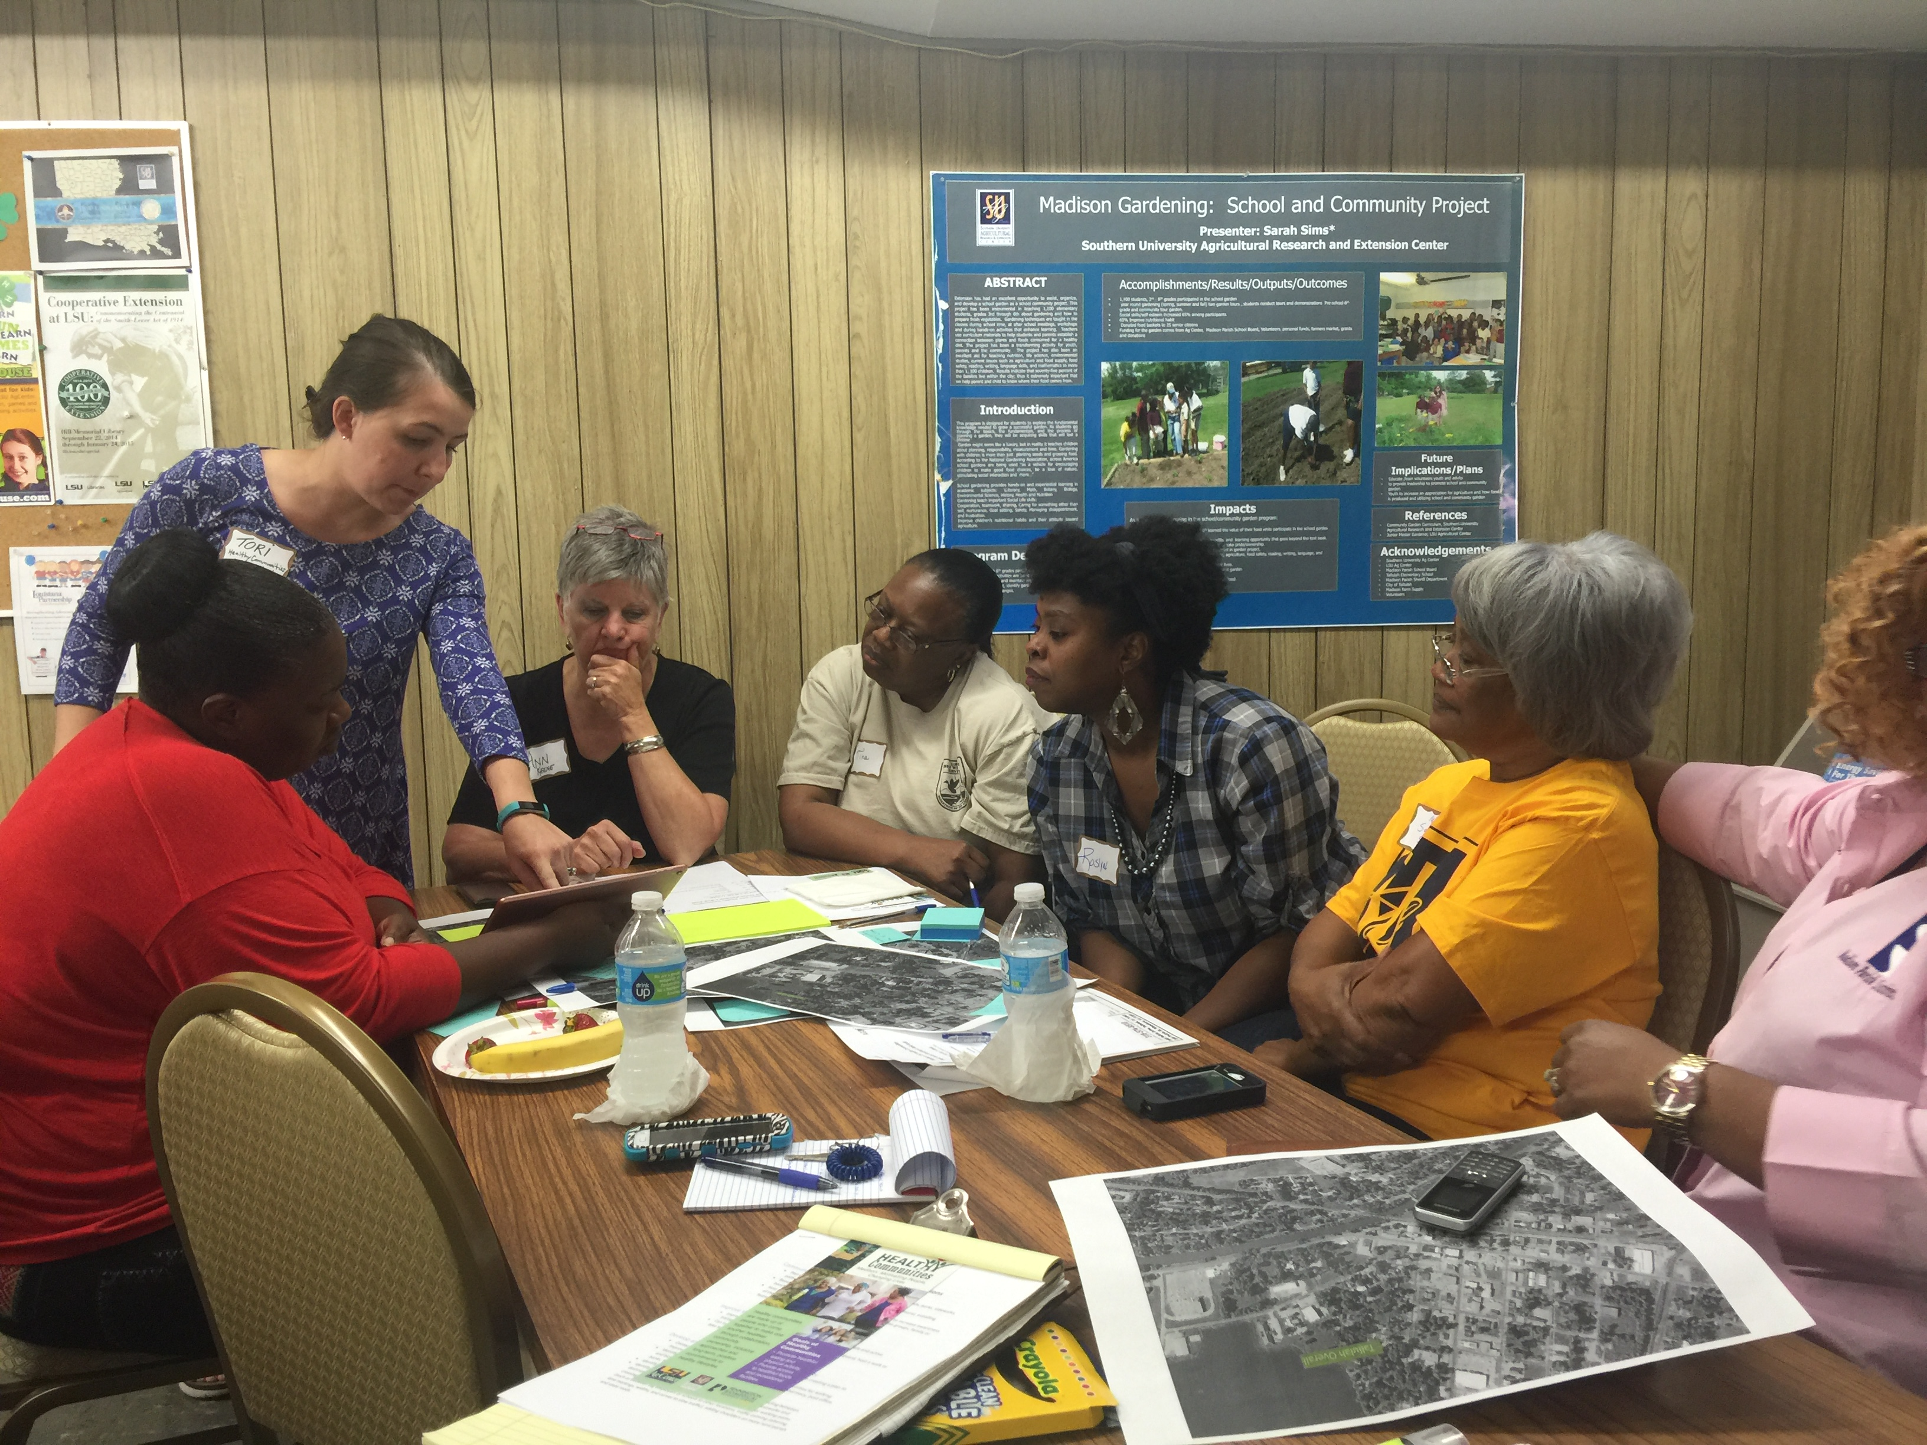
Action Planning
Coalitions identify and prioritize interventions
Develop comprehensive plan and consider long-term effects
Develop budget proposal and action-plan
Evaluation Designed

Slide 15

Implementation
The big goal!
Programs delivered, events hosted, environmental changes begin, etc.
Needs are have been matched with an intervention

Slide 16
Evaluation
Evaluate interventions using qualitative and quantitative data

Slide 17
Best Practices and Lessons learned

Slide 18
Needs Assessment: Community Forum
Lessons Learned
Best Practice
It’s difficult to get the right people to show up to 1 meeting in a rural area
Identifying the “movers and shakers” can be difficult; titles are not as telling in rural settings
In addition to hosting a Community Forum, meet the community where they already are. Ex.: Host “community conversations” at the Council on Aging, 4-H Club Meeting, City Council meeting, etc.
Work with Extension or community “veterans” to identify leaders

Slide 19
Needs Assessment: Collecting Baseline Data
Lessons Learned
Best Practice
You will be noticed in stores in small towns, may be met with suspicion (especially in C-stores)
Using coalitions members to collect data was a challenge to getting consistent data; required additional data cleaning.
Develop relationship with store management- call ahead or ask permission immediately when entering store
Using the same person, or 2-3 people to collect data will save time/ensure data is consistent. If you use community members, ensure they are fully trained on the surveys.

Slide 20
Needs Assessment: Asset Mapping
Lessons Learned
Best Practice
Asset-Mapping is a long process, coalitions members found places missing on several drafts
Facilitated asset-mapping meetings are helpful in facilitating discussion around who considers what an asset/non-asset and why
Before addressing the coalition, develop a resource list, or ask existing Extension staff if one exists already
After getting feedback from coalition on list, develop a draft and again get feedback from coalition before making a final version
Use a facilitated asset-mapping toolkit

Slide 21
Coalition Building: The Hard Part
Lessons Learned
Best Practice
Getting started, many come to the table with their own ideas/seeking a way to benefit their organization
The beginning group is not what your core group ends up looking like
Local government is key!!
  Caveat: We’ve also found political unrest/issues pretty common in small towns—in this case figure out who the decision makers are.
Ensure from the beginning you focus on the “community-minded” nature, and decisions will be made in a group setting
Find the “stealth” group. You really only need 5-6 core members, others can be invited as needed.
Pursue local government from the beginning, let them know how important their support is.

Slide 22
Coalition Building: Capacity Building and Technical Assistance
Lessons Learned
Best Practice
Once you’ve accomplished getting the right people to the table, training and capacity building is the next hurdle
  The Policy, Systems, and Environment (PSE) change model was new to all of our coalitions, and takes a good bit of training
Use an expert if possible!
  Mark Fenton
  The Food Trust
  Local consultants

Slide 23
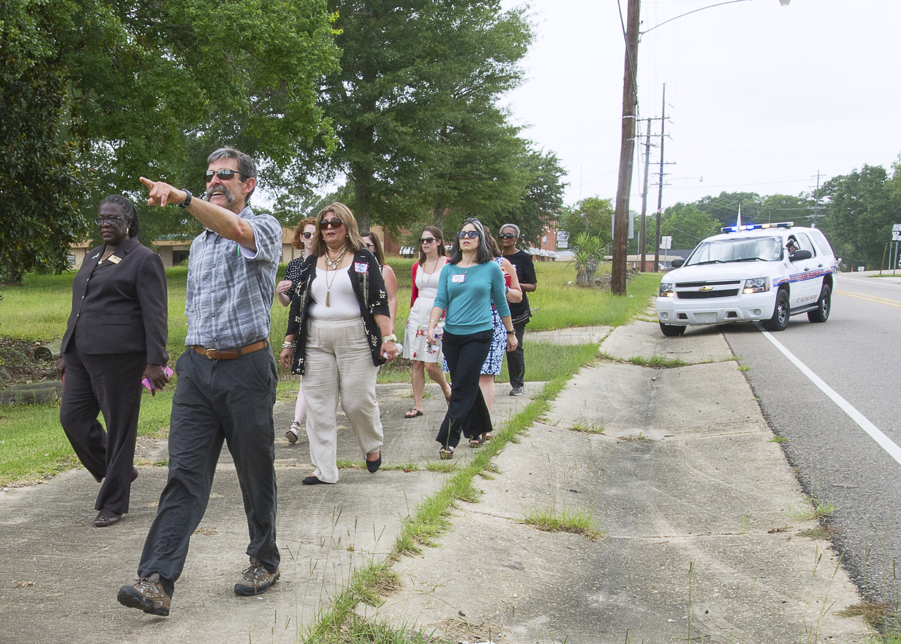
Coalition Building: Capacity Building and Technical Assistance
TA Needs
What is the PSE model/approach
Walkabillity
Planning+Public Health Importance
Healthy Food Access
Policy Work**

Slide 24
Action Planning
Lessons Learned
Best Practice
Having coalition members take ownership of plan-making is a challenge—they will rely on the agent to
Ensure coalition members understand their role in the plan-making and implementation process from the beginning
Provide coalitions with templates for action-steps and have them volunteer for specific tasks
Ensure the agent can provide guidance/support without creating the plans/taking full responsibility

Slide 25
Action Planning
Lessons Learned
Best Practice
A starting point is necessary- coalitions need to decide as a group what top interventions will be priority in a given timeline
Coalitions struggled to come up with “big picture” ideas that were outside of educational programming and one time projects and events (**This is where PSE training is imperative!!**)
Record ideas coalition has discussed throughout the process, and provide them with tools to vote on these
Provide a “menu” of additional options for interventions that are practice/evidence based, or have been done in a similar area and been successful

Slide 26
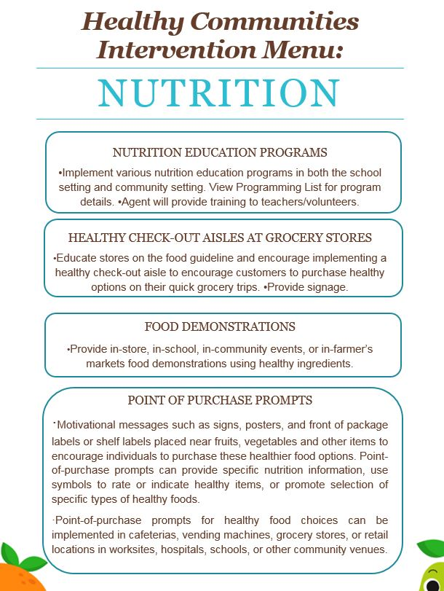
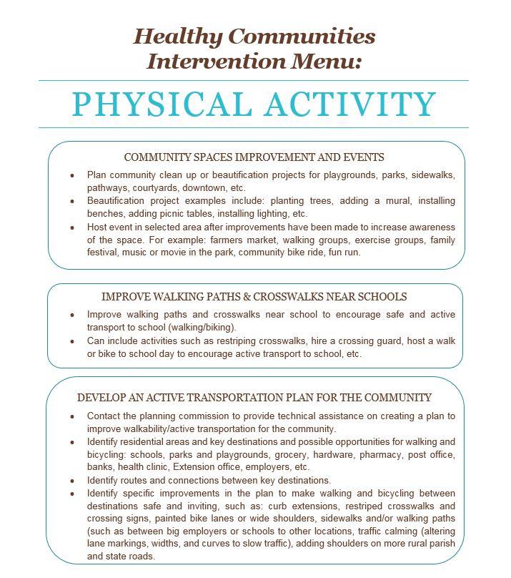
Menu of Interventions

Slide 27
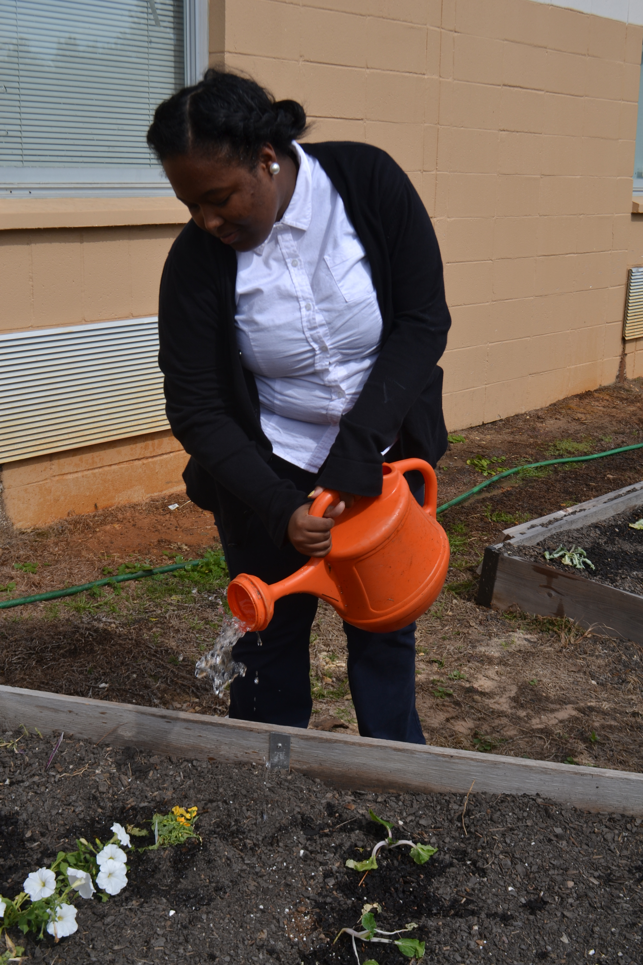
General Lessons Learned
Conduct community readiness assessments
Community-Driven work is slow
Agents facilitating the work must understand their role and end goals

Slide 28
Successes

Slide 29
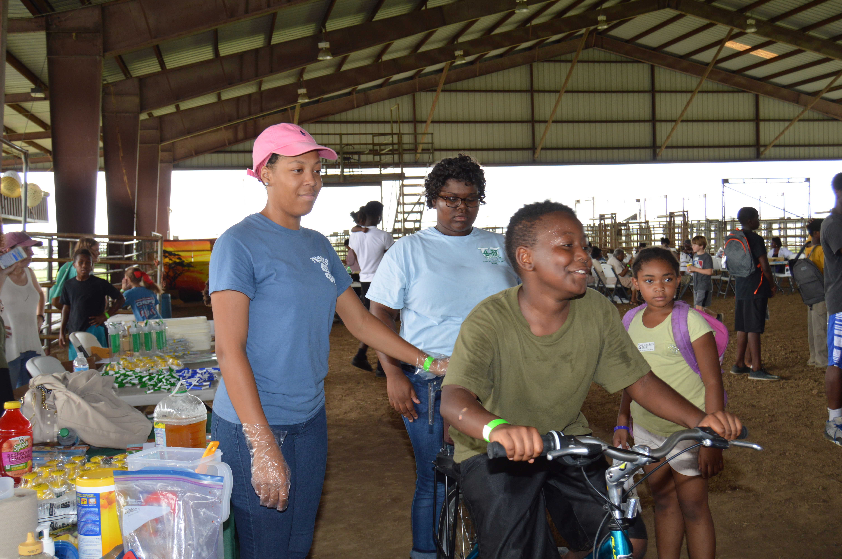
Cross-Sector Collaboration
A success in itself!
For communities “moving slower”, facilitating partnerships between entities that don’t otherwise cross paths has been most impactful result
Has resulted in state level partnerships with : Dept. of Transportation, non-profit planning agency, MPO’s, LA Public Health Institute, State Obesity Commission
The Tensas Community Health Center hosted a community event and partnered with Coalition

Slide 30
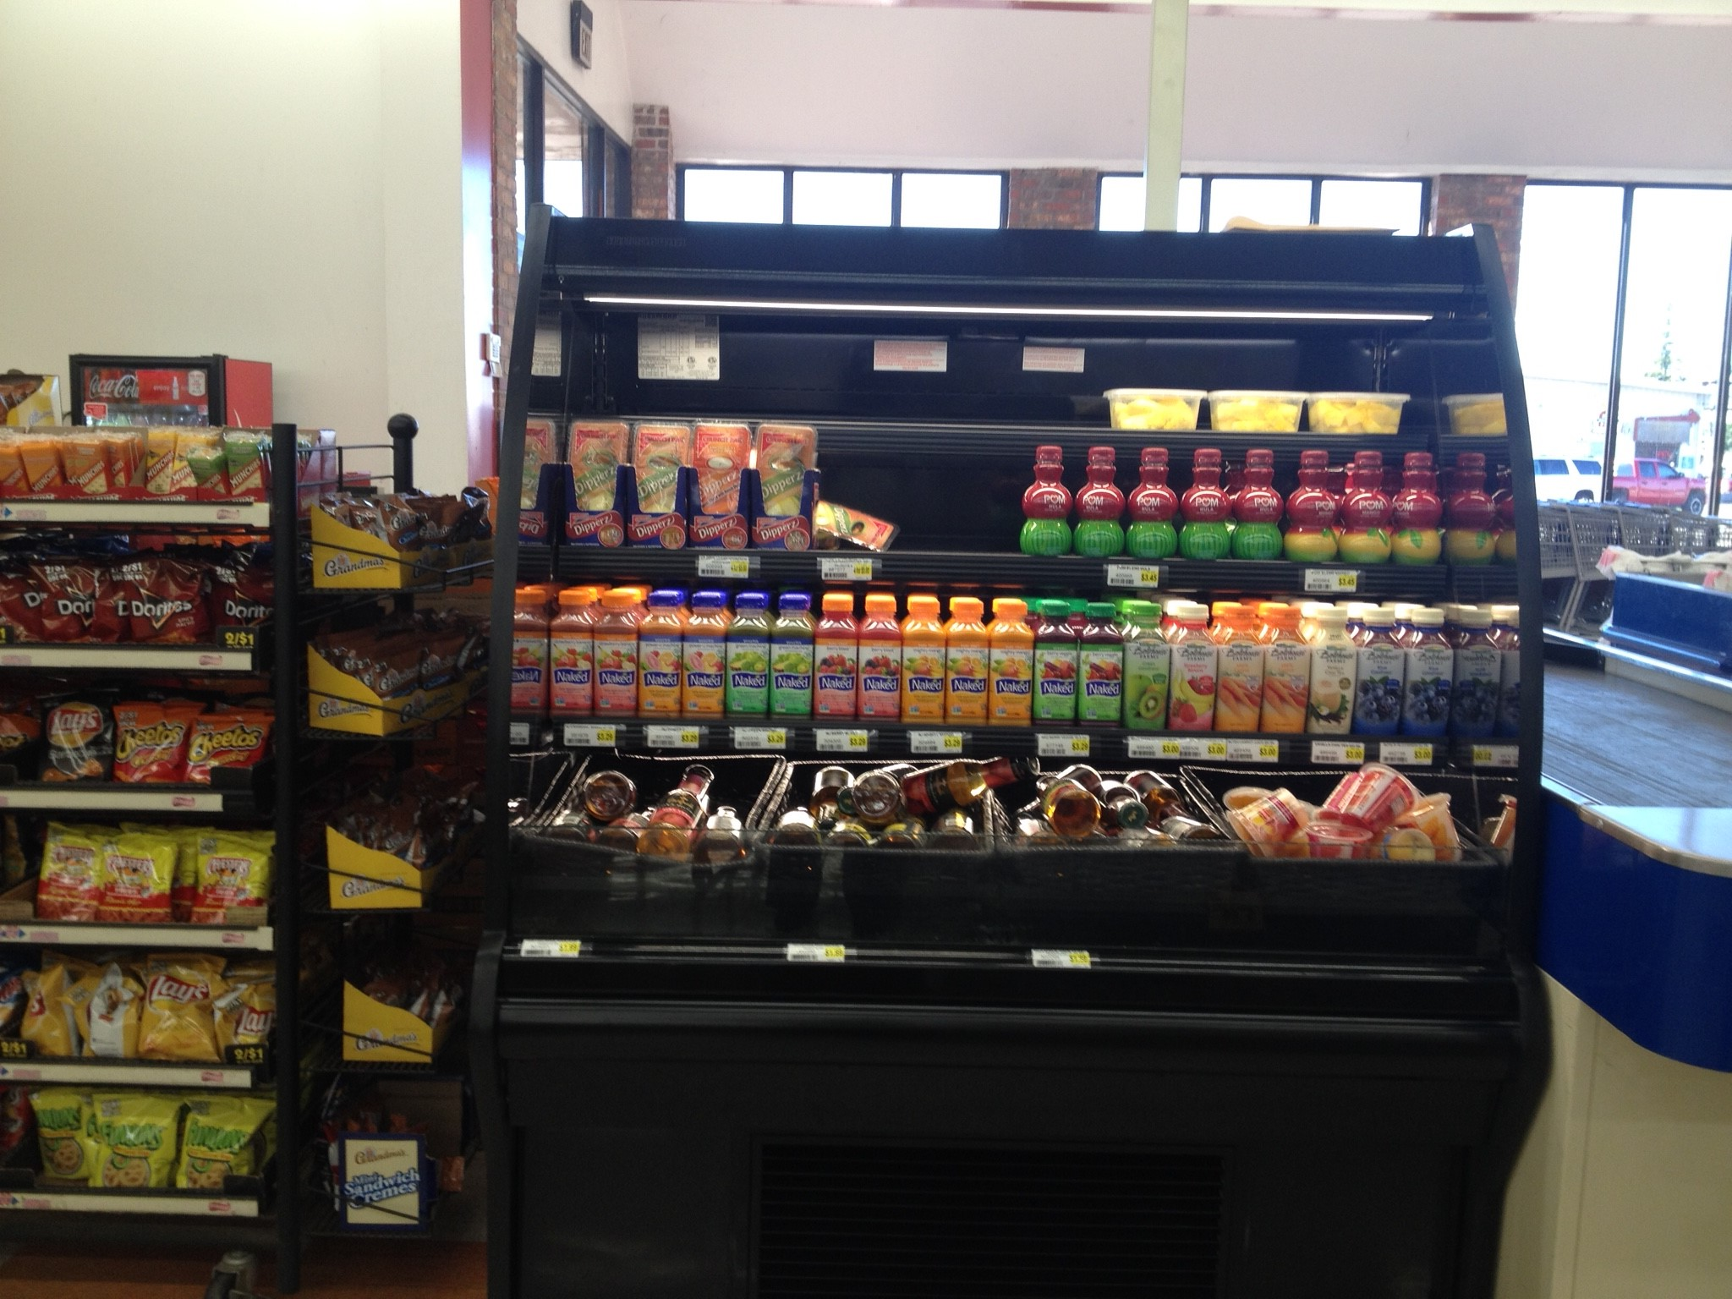
Madison Parish Interventions
Private Grocery store added a “grab and go” section, and will implement healthy marketing. Invested $5,000 in refrigeration for healthy items
Local DOTD approved two crosswalks near downtown area
Planning crime prevention training for parks in the Spring

Slide 31
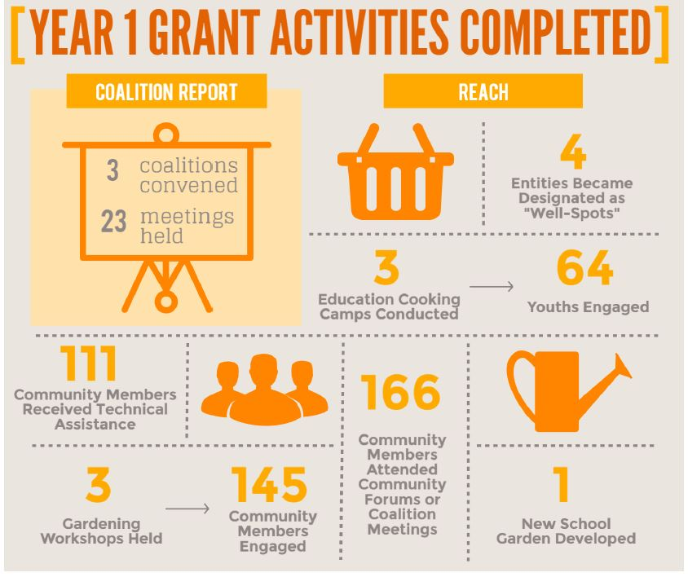

Slide 32
Q&A
Elisabeth Altazan: ealtazan@agcenter.lsu.edu
Denise Holston-West: dholston@agcenter.lsu.edu

Slide 33
Thank you

