Slide 1
Healthy Start Border Alliance: Aligning for Maximum Impact
along the US/Mexico Border
Communities Joined in Action National Conference
San Antonio, Texas February 15-17, 2017
Presenter: Maria Lourdes F. Reyes, MD, MPH
Director, PCI US & Border Programs
mreyes@pciglobal.org
www.pciglobal.org

Slide 2
PCI’S MISSION IS TO EMPOWER PEOPLE TO ENHANCE HEALTH, END HUNGER AND OVERCOME HARDSHIP.
Our vision
Motivated by our concern for the world’s most vulnerable children, families and communities, PCI envisions a world where abundant resources are shared, communities are able to provide for the health and well-being of their members, and children and families can achieve lives of hope, good health and self-sufficiency.

Slide 3
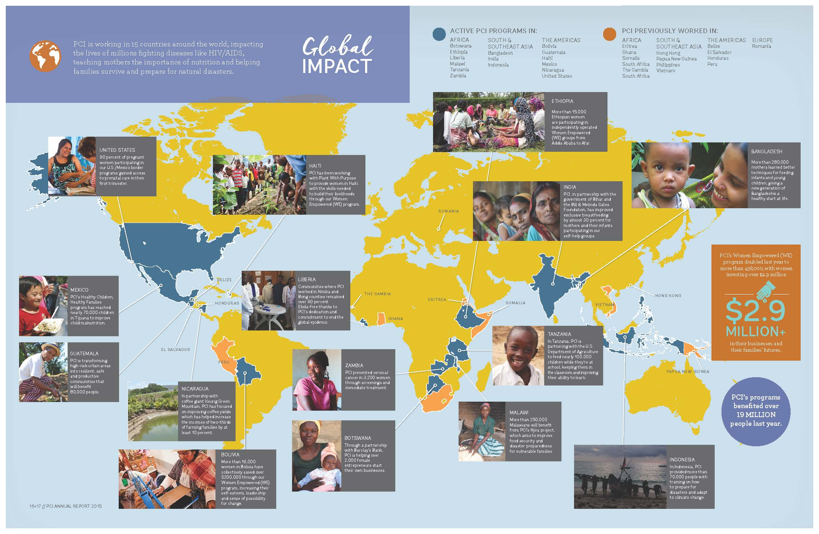

Slide 4
Healthy Start is a national initiative, funded by HRSA, mandated to reduce disparities in infant mortality and other perinatal outcomes
Usually African American communities; we have a Latino, border focus
100 Healthy Start programs working nationally

Slide 5
Healthy Start Objectives
Improve Women's Health
Health insurance (Goal: 90%)
Reproductive life plan (Goal: 90%)
Postpartum visit (Goal: 80%)
Medical home (Goal: 80%)
Well women visits (Goal: 80%)
Strengthen Family Resilience
Perinatal depression screening and referral (Goal: 100%)
Follow up services for perinatal depression (Goal: 90%)
IPV screening (Goal: 100%)
Father involvement (Goal: 80%)
Daily reading to children (Goal: 50%)
Promote Quality Services
First trimester prenatal care (Goal: Increase)
Infants ever breastfed (Goal: 82%)
Infants breastfed at 6 months (Goal: 61%)
Abstinence from smoking (Goal: 90%)
Short Interval Pregnancies (Goal: <30%)
Well child visits (Goal: 90%)
Elective delivery <39 weeks (Goal: <10%)
Achieve Collective impact
% of HS grantees with a fully implemented Community Action Network (CAN) (Goal:100%)
% of HS grantees with at least 25% HS participant membership on their Community Action Network (CAN) membership (Goal: 100%)
Increase accountability through quality improvement and performance M&E
↑ % of HS grantees who establish a quality improvement and performance monitoring process to 100%
↑ % of HS grantees that have a fully implemented CoIIN process to 90%

Slide 6
Health Disparities: Interrelated Factors
diet & physical activity
environment
poverty
social support
women’s health
access to care
Notes:
Health disparities are preventable differences in the burden of disease, injury, violence, or opportunities to achieve optimal health that are experienced by socially disadvantaged populations.
Health disparities are influenced by various factors, such as socioeconomic status (SES), educational attainment, discrimination, biologic and genetic characteristics, behavior, environment, and quality of care.

Slide 7
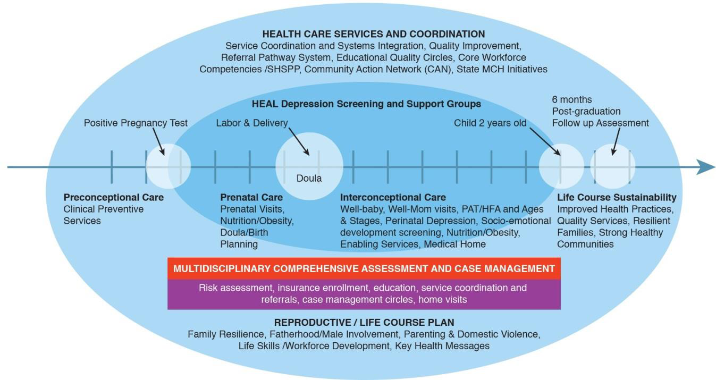

Slide 8
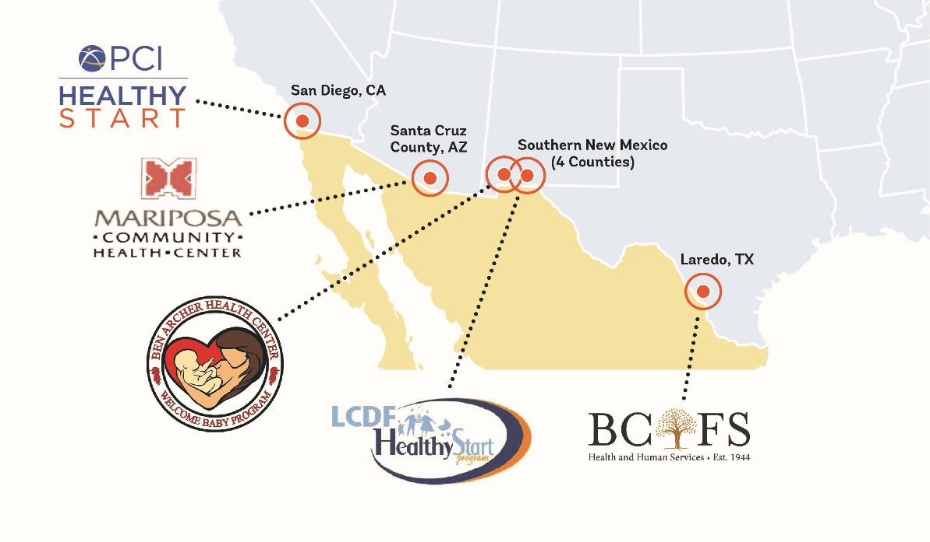
Healthy Start Border Alliance
Healthy Start is a national initiative, funded by DHHS HRSA, mandated to reduce the rate of infant mortality and improve perinatal outcomes
100+ working nationally
HSBA Goals:
Improve Women’s Health
Promote Quality Services
Strengthen Family Resilience
Achieve Collective Impact
Notes:
Community health worker model at the border

Slide 9
Border Challenges
Poverty at 25% vs 13% US
Without Health insurance 23% vs. 15% US
Last in education attainment at age 25
Depression 1:7 adults vs 1:10 US
DV- 42% are abused while pregnant
73% are medically underserved and 63% are Health Professional shortage areas for primary medical care

Slide 10
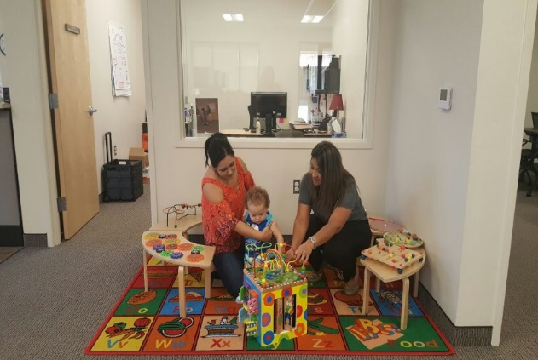
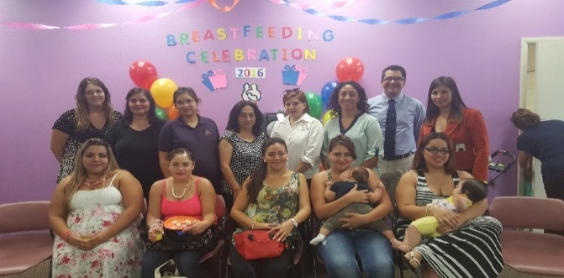
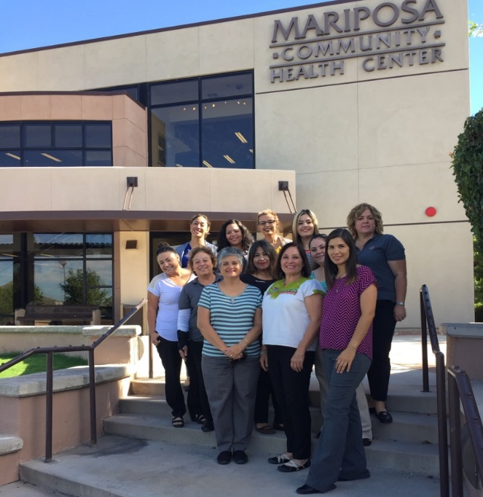
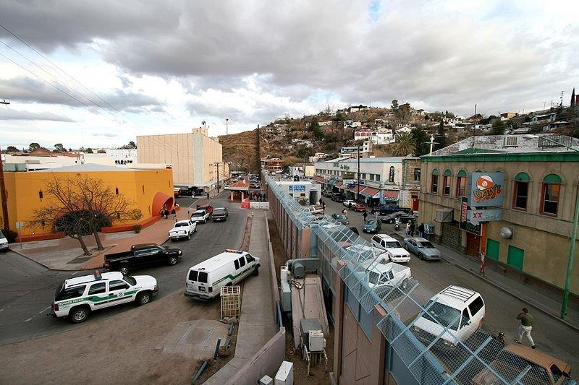
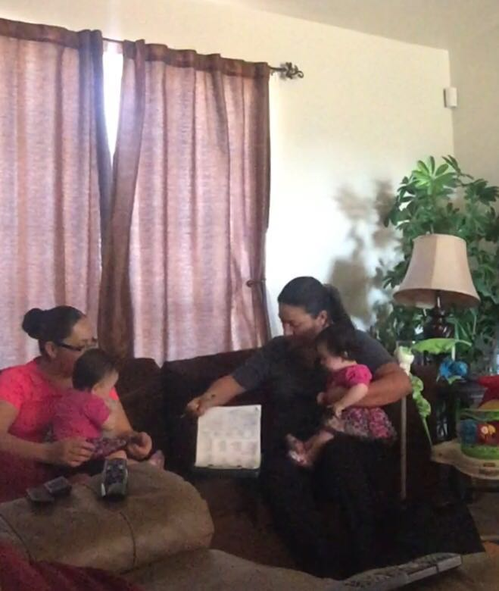
Santa Cruz County
Healthy Start

Slide 11
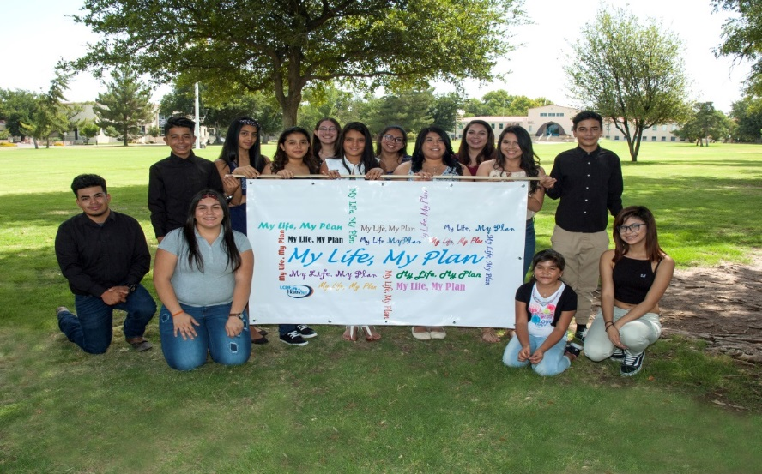
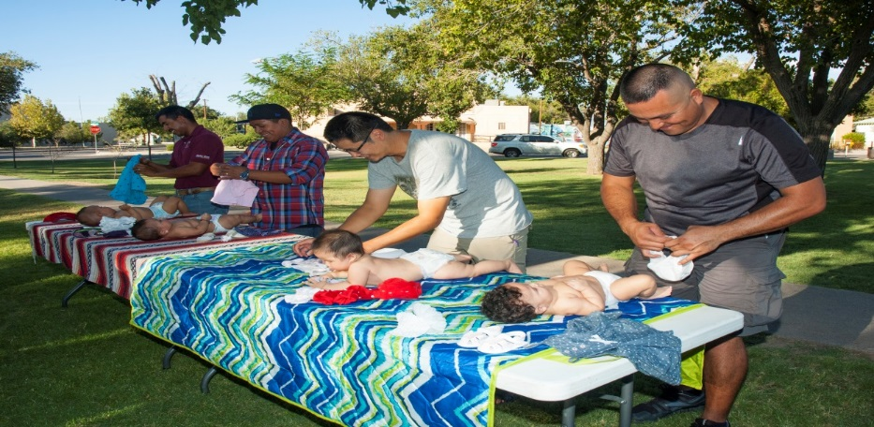

Slide 12
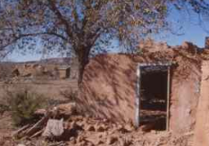
Ben Archer Health Center Welcome Baby Healthy Start Program

Slide 13
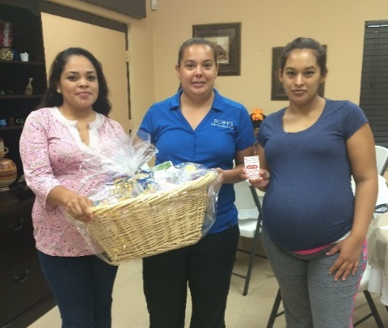
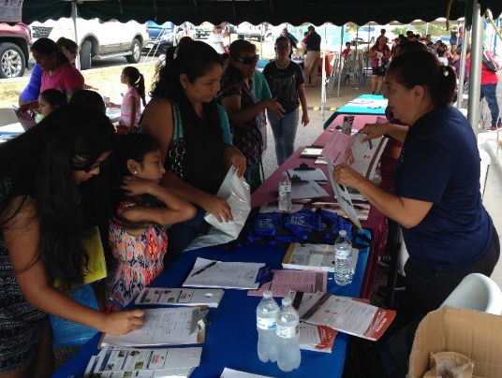
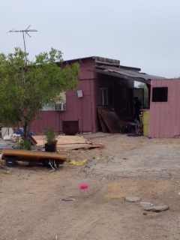
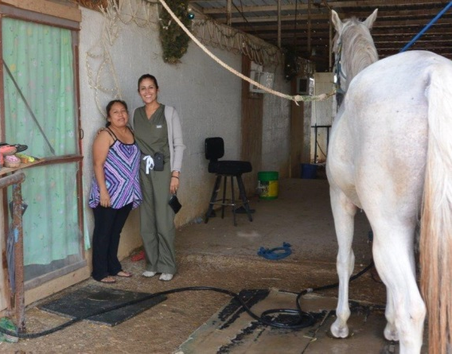
Healthy Start Laredo
Notes:
Laredo is the county seat of Webb County, Texas. It is located on the north bank of the Rio Grande in South TX across from Nuevo Laredo, Tamaulipas, Mexico. According to the 2010 Census, the city population was 236,191.
It is the 10th most populous city in the State of Texas and 3rd most populated on the Mexican Border after San Diego, California and El Paso, Texas.
95.6% are Hispanic and Latino.
Our target population are the families living out in the colonias of Webb County. Colonias are unincorporated neighborhoods or subdivisions that lack physical infrastructure, such as running water, power, and sewer systems.

Slide 14
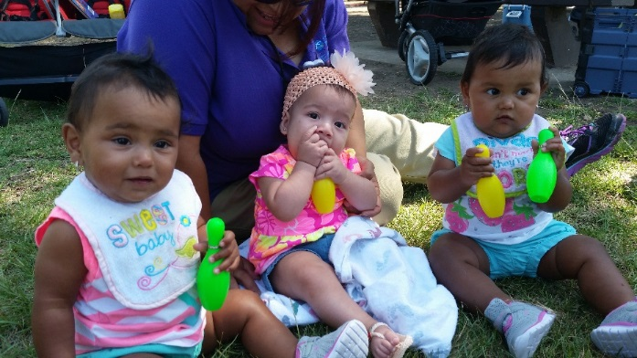
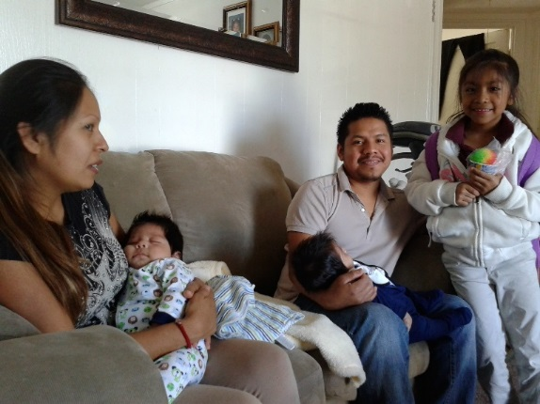
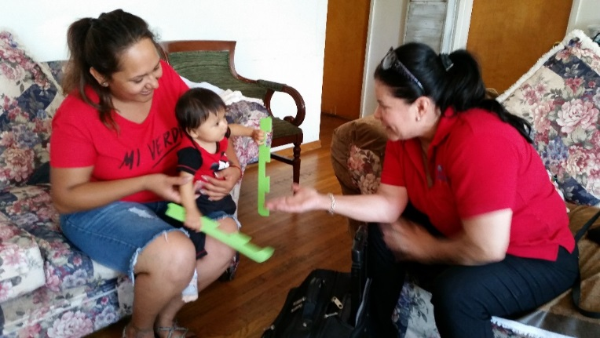
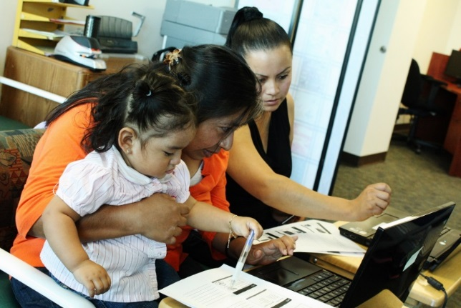
California Border Healthy Start: San Diego, CA
Notes:
San Diego is the 2nd most populated county in California (2010 Population of 3.2 million) and 8th most populated county in the US.
CBHS+ serves densely populated 12 zip code area in Central and East San Diego with 20,000 births per year, all within 15 miles of the US/Mexico Border
Large immigrant and military populations
Our target population is primarily (85%) Latina immigrant

Slide 15
Healthy Start Border Alliance Priorities
Relationship strengthening
Cross-training
Border-wide collective impact strategies
Joint branding/visibility
Position for additional border partnerships and funding

Slide 16
Mentoring & Peer Learning Network
With Border Alliance
Trainings in TX, NM (Grand Rapids)
Trainings in AZ in May and Fresno
Collective Impact process
Research – early entry into prenatal care; Zika
Manuscripts- pending publication
Nationwide conferences presentations

Slide 20
Health Education Action for Living (HEAL) Mental Health and Resilience
Facilitation Guide and 6 week Curriculum based on the book “Is it difficult being a woman?”
Reduced depression by 40% among Hispanic immigrant women and 55% among pregnant women in San Diego (PCI)
Implemented by 5 Healthy Starts, Texas A&M Colonias program, and several community health centers along the border.
Developing joint evaluation strategies
Notes:
PHQ-9 PRE- POST screening results from our 2007-2012 project showed:
Average reduction rate of depression by 55% of pregnant women
Average reduction rate of depression by 40% among non-pregnant women
Average 55% improvement in women’s post test evaluation of the reduction of stigma, increase self-efficacy, empowerment, self care, and general well-being.

Slide 21
Women Empowered Micro-savings groups

Slide 22
Prioritizing First Trimester Prenatal Care (FTPNC)
Systematic examination of individual program data
Early access to prenatal care has significant impacts on mothers and infants
Ability to impact many of the Healthy Start benchmarks
Commonly accepted measure and comparison data is available
Notes:
How the Border Healthy Start Alliance identified early access to prenatal care as a priority:
In May 2015, all of the Border Healthy Start projects came together to form the Border Healthy Start Alliance. Our first meeting took place in Fort Worth, Texas. Over the course of two full days each of the Border Healthy Start programs discussed individual program struggles, baseline measures, barriers to care and Healthy Start benchmarks. A systematic examination of data from each of our programs was completed to identify trends and establish a shared measure and common agenda to focus on as the Border Healthy Start Alliance. Each program was asked to complete an extensive survey prior to the meeting, which was compiled for use during the meeting. Through this analysis of data; lack of early access of prenatal care was identified as a common struggle for women along the US/Mexico border.
Why is early access to prenatal care important?
Early and regular prenatal care leads to improve health outcomes of pregnancy for mothers and infants. Two of the most significant benefits of early and ongoing prenatal care are improved birth weight and decreased risk of preterm delivery. Infants born to mothers who received no prenatal care have an infant mortality rate five times that of mothers who received appropriate prenatal care in the first trimester of pregnancy (March of Dimes, 2009). Additionally, women who engage in first trimester prenatal care have more time to make positive changes to behaviors, environments, insurance, medical home, etc.
Improving early access to prenatal care along the US/Mexico border has the ability to impact many of the Healthy Start benchmarks; and is an accepted measure for which there is comparison data available. For all of these reasons the Border Healthy Start Alliance chose to focus on early access to prenatal care.

Slide 23
Early Prenatal Care: Why it Matters
Infants born to mothers who received no prenatal care have an infant mortality rate five times that of mothers who received appropriate prenatal care in the first trimester of pregnancy (March of Dimes, 2009)
Pregnant women who do not receive adequate prenatal care run the risk that complications will go undetected or may not be managed in a timely manner, which increases the possibility of poor outcomes for the mother and baby.
Early prenatal care is essential for screening for maternal issues (e.g., maternal depression, alcohol use, intimate partner violence) that can impact maternal health and affect fetal development and infant health.
American Academy of Pediatrics recommends initiation of prenatal care in the first trimester (12 weeks)
Healthy People 2020 goal: 77.9% of women receive first trimester prenatal care by 2020

Slide 24
Rates of First Trimester Prenatal Care
Nationally, 74% of women giving birth in the US receive early prenatal care in the first trimester (Child Health USA, 2013)
77.5 % of all Latinas delivering in the US initiated prenatal care in the first trimester, compared with 89 % of non-Hispanic whites (Luecken et al, 2009)
Hispanic women giving birth in border counties (14%) are nearly twice as likely as women in nonborder region (7.7%) to begin prenatal care in the third trimester or not at all (McDonald et al, 2013)
Women in US border counties have higher rates of preterm birth (12.8%) than women in Mexican border counties (6.2%) (Ibid)
Notes:
In 2011, among the 36 states and District of Columbia that had implemented the 2003 revision to the standard birth certificate as of January 1st and collected prenatal care information in the same format, 73.7 percent of women giving birth received early prenatal care in the first trimester, while 6.0 percent of women began prenatal care in the third trimester or did not receive any prenatal care. http://mchb.hrsa.gov/chusa13/health-services-utilization/p/prenatal-care-utilization.html
Luecken, L. J., Purdom, C., & Howe, R. (2009). Prenatal care
initiation in low-income Hispanic women: Risk and protective
factors. American Journal of Health Behavior, 33, 264–275
n 2013, American Indian and Alaska Native women were the most likely to receive late or no prenatal care (11 percent of births), followed by black (10 percent) and Hispanic women (eight percent). In contrast, only five percent of 2013 births among Asian or Pacific Islander women, and four percent of births among white women, were births where the mother received late or no prenatal care. (Figure 2) - See more at: http://www.childtrends.org/?indicators=late-or-no-prenatal-care#sthash.6EynRDPj.dpuf
Among Hispanics in 2013, the percentage of women receiving late or no prenatal care ranged between four percent for mothers of Cuban origin, to six percent for mothers of Puerto Rican origin, and eight percent for mothers of Mexican, Central or South American origin. - See more at: http://www.childtrends.org/?indicators=late-or-no-prenatal-care#sthash.6EynRDPj.dpuf
These rates are higher than corresponding rates for Mexican women (10.1% vs 5.7%) (rates of low or no prenatal care) than nonborder counties.
McDonald, J. , Mojarro, O. , Sutton, P. , & Ventura, S. (2013). A binational overview of reproductive health outcomes among us hispanic and mexican women in the border region. Preventing Chronic Disease, 10, E137-E111

Slide 25
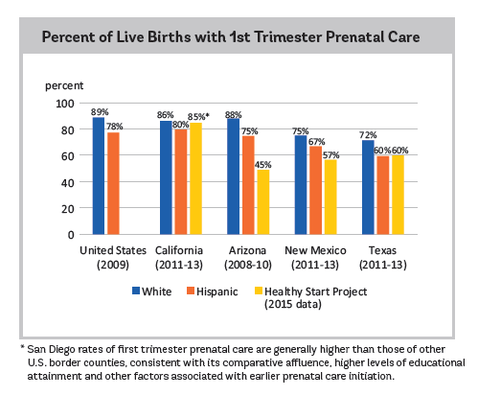
Notes:
This chart illustrates the struggle we were having as border Healthy Start programs in impacting early access to prenatal care. In the majority of the states; 1st trimester care was accessed at a higher rate by white non-Hispanic women, followed by Hispanic women, then the Border Healthy Start projects. Because of these disparities, we as the Border Healthy Start Alliance wanted to dive further into what barriers are impacting women along the border’s ability to access early prenatal care.
Data comes from National Center for Health Statistics Natality files, retrieved from the March of Dimes Peristats

Slide 26
What Data Show…
Factors associated with early prenatal care
Factors associated with late prenatal care
Hispanic, Black, Native American
No High School Diploma
Teenage mom (under 20 years)
Uninsured or Medicaid/Medi-Cal
Unintended pregnancy
Single or uninvolved partner
Foreign born
Living in a small city
White, Asian
High School Graduate
Over 25 years
Private Insurance
Planned pregnancy
Married, partner involved in pregnancy
Born in the US
Living in a large city
Notes:
Rates of first-trimester prenatal care increased greatly with educational attainment, from 58.5 percent of mothers with less than a high school diploma to 86.1 percent of mothers with a bachelor’s degree or higher - Data Source: U.S. Department of Health and Human Services, Centers for Disease Control and Prevention, National Center for Health Statistics. 2012 Natality File. (http://mchb.hrsa.gov/chusa14/health-services-financing-utilization/prenatal-care.html)
Age is a major factor associated with prenatal care entry for moms under 20 years old, with only 58% of pregnant women under 20 receiving early PNC, compared to an average of 76% of women over 20. Data Source: U.S. Department of Health and Human Services, Centers for Disease Control and Prevention, National Center for Health Statistics. 2012 Natality File. (http://mchb.hrsa.gov/chusa14/health-services-financing-utilization/prenatal-care.html)
Payer: 2012, in the District of Columbia and the 38-state reporting area, privately insured women were most likely to have received first trimester prenatal care (85.0 percent), followed by those with Medicaid (65.2 percent) and those whose care was self-paid (51.4%). Data Source: U.S. Department of Health and Human Services, Centers for Disease Control and Prevention, National Center for Health Statistics. 2012 Natality File. (http://mchb.hrsa.gov/chusa14/health-services-financing-utilization/prenatal-care.html)
Wantedness of pregnancy has been correlated to PNC initiation in some studies as the psychosocial factor with the largest impact on timing – women with unwanted pregnancy were 63% less likely than those whose pregnancy was wanted to get ePNC → importance of preconception family planning and preventing unwanted pregnancies. Data Source: Pagnini, D., & Reichman, N. (2000). Psychosocial factors and the timing of prenatal care among women in New Jersey's Healthy Start program. Family Planning Perspectives, 32(2), 56.
Paternal Involvement: In a large general population sample, Martin and colleagues recently reported that when the baby's father was actively involved in the pregnancy, women were 1.5 times more likely to receive PNC in the first trimester. Support from the baby's father is particularly important when the pregnancy was unintended by the mother and may increase pregnancy desirability, a variable known to improve PNC utilization. Data source: Martin LT, McNamara MJ, Milot AS, et al. The effects of father involvement during pregnancy on receipt of prenatal care and maternal smoking. Mater Child Health J. 2007;ll{6):595-602
City size: 74.5% of women in metropolitan areas initiated early prenatal care vs. 71.5% of women in non metropolitan areas. Data Source: Pagnini, D., & Reichman, N. (2000). Psychosocial factors and the timing of prenatal care among women in New Jersey's Healthy Start program. Family Planning Perspectives, 32(2), 56.
Other factors discussed
(+) depression, involvement with MH services or social services systems
(-) witnessed, experienced or initiated DV or abuse

Slide 27
Other factors identified
Provider scheduling delays
Insurance enrollment challenges or misunderstanding of benefits
Public Charge issue for immigrants
Preventive care poorly valued or understood
Ambivalence or fear about pregnancy – “wait and see…”
Social support (child care, family influences)
Language
Cultural factors?
Notes:
Identified through Focus group and lit review (in process)
- Clinics wont schedule appointments before 8 weeks
- Immigration lawyers misinforming women about public charge issue
Cultural factors?
lack of time for doctor-patient interaction is especially unsettling for Hispanic patients, who tend to have expectations of a more personal and warm relationship with the provider
concerns about the medical examination, the gender of their potential clinician or distrust of medical providers.
- Distrust of healthcare system - Lay or midwifery services more common among foreign immigrant populations

Slide 28
Research on Prenatal Care along the Border 2015-2016
Analyze barriers to early prenatal care entry among low income Hispanic women along the US/Mexico border, as well as best / promising practices in the region.
Support coordinated implementation and evaluation of best/promising practices to increase early prenatal care entry at 5 Healthy Start sites along the US/Mexico border.
Research Questions
What factors affect our participants obtaining prenatal care in the first trimester?
How can we fine tune our programs to mitigate risk factors and enhance protective factors related to prenatal care initiation in the first trimester?

Slide 29
Survey Data Collection
Target population was Hispanic women who were current or potential HS participants along the U.S.-Mexico border that lived in the area served by each of the HS project sites and of reproductive age (15 to 44 years).
Each project site surveyed eligible women based on the standardized protocol with the goal of reaching at least of 60% of women from the outside the HS program or related clinic settings.
A 12-question survey was utilized to assess key factors related to prenatal care seeking.
Survey questions obtained demographic information, parity, pregnancy practices, access and barriers to care, and sources of reproductive health information.
Across the five project sites, case managers, outreach workers and other staff conducted 536 surveys of which 133 were eliminated as not satisfying study protocol.
Notes:
Survey questions were available in both English and Spanish.
Some women did not qualify due to ethnicity and age.

Slide 30
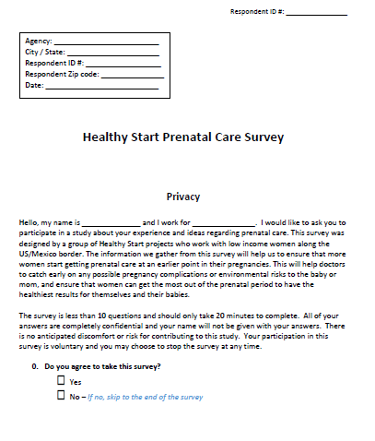
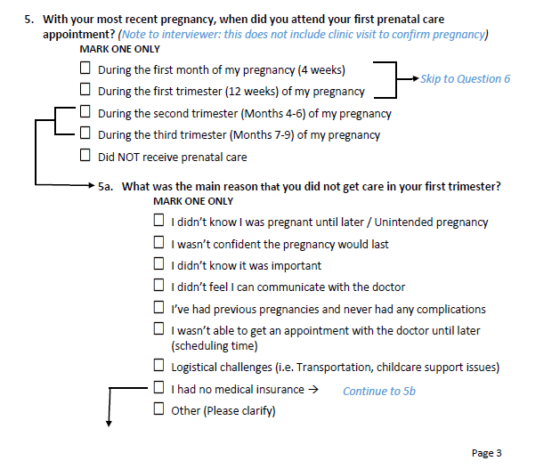
Notes:
This is the draft we field tested in hard copy – you can see the skip counting

Slide 31
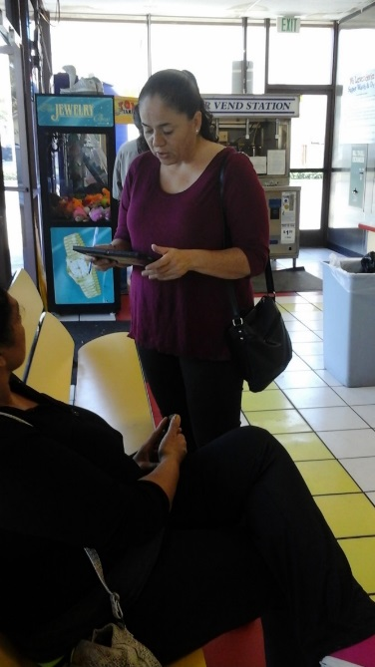

Slide 32
Survey Responses: Sample of surveyed Hispanic respondents (n=403)
 | San Diego County, CA | Santa Cruz County, AZ | Doña Ana County, NM | 4-County Area, Southern NM | Webb County, TX
Respondents Total (n) | 65 | 56 | 134 | 96 | 52
White Race (%) | 82% | 100% | 85% | 95% | 100%
Mean Age (yrs) | 31 | 29 | 29 | 28 | 29
Healthy Start Participants | 26% | 27% | 28% | 36% | 33%
Went to doctor w/in last 1 year | 83% | 91% | 87% | 90% | 63%
Notes:
Survey Sample
100% Hispanic
Small % non white races in San Diego and New Mexico
Average ages slightly older in San Diego
Aim was to limit to 25% HS PP but varied across sites – some sites are more HS ‘saturated’
We wanted to know how recently women had been to the doctor in the last year for reasons other than PNC so we could cross tabulate it with FTPNC and this also varied, but was lowest in Texas and San Diego
Interesting – 33% of women from Laredo had not been to the doctor for nonPNC in more than 2 years or couldn’t remember, but that group also had the highest rates of FTPNC among Texas

Slide 33
Notes:
very high rates of FTPNC across all sites – ranged from 98% in AZ to 82% in TX.
8% of women across all sites had non FTPNC – from 18% of women in TX to 7% in SD
We were surprised at these levels which were so much higher than official records
Thought about them in a few ways
We looked at sampling methods – if we are getting a representative population
Survey questions not clear enough for respondents who don’t understand what PNC is (vs. just taking your prenatal vitamins or appointment to confirm pregnancy) but we addressed this in the survey questions (using ‘prenatal care appointment’) and training of interviewers
Possibility that we are doing a good job in our areas
Official data is somehow not capturing accurately FTPNC rates for women in the region – which we will come back to later
DATA GAPS
Small eligible sample size may not be representative of the respective target areas.
Potentially important sociodemographic variables were also not assessed by the survey, e.g., education, income, and time in the U.S., nor was adequacy or continuity of PNC, which limits our ability to assess important confounding variables
The recruitment strategy at several sites may have favored respondents who were already connected with the health care system.
When comparing to regional statistics, need to better understand accuracy of PNC data in border region where medical records are incomplete among border crossers

Slide 34
Times Pregnant
Sample of Pregnant Respondents
(n=353)
p-value = 0.0089
Notes:
We also looked at parity / # of pregnancies and found that women who were pregnant for the first time, which was about 30% of women, were significantly less likely to start FTPNC than women with multiple pregnancies (87% vs. 95%)
FTPNC was lowest for the youngest (19-24) and oldest (35-44) groups, following a similar curve as for parity, but this was not deemed significant.
Age group: 1st trimester PNC
16-18 years 100%
19-24 years 90%
25-34 years 95%
35-44 years 88%
-

Slide 35
US Only - 93% FTPNC
Both US-Mex - 89% FTPNC
Mexico Only - 90% FTPNC
Notes:
Approximately 14% of women accessed all or some of their PNC in Mexico, ranging from 29% of respondents in Arizona to 7-9% in New Mexico.
Reported FTPNC did not significantly vary for those who accessed any care in Mexico on an individual level – though it is noteworthy that the state with the highest utilization of PNC in Mexico also had the highest rates of FTPNC surveyed compared to the official records
Among those first time pregnant women, only 15% of them got some or all of their PNC in Mexico compared to 30% of those with 2-3 pregnancies – so location of care did not seem to be a factor

Slide 36
Survey Results: Information Sources about PNC
(n=403)
Notes:
From where have you received information about when to start prenatal care? Select all that apply.
Nearly 25% had not received information from any sources regarding when to start PNC, regardless of whether they had been to the doctor at any point.
In particular, the youngest women (16-18 and 19-24) had the fewest information sources and most had no sources of information
Top source of information was clinicians (64% of respondents); Internet and TV/Radio were not a significant source of information in any location, and HS as a source of information varied by site
Most also confirmed pregnancy at a clinic (60% vs. 30% with a home pregnancy test)

Slide 37
Healthy Start vs. Non-Healthy Start Respondents
 | Healthy Start (n=118) | Non-Healthy Start (n=403 / 353 pregnant)
FTPNC | 95% | 91%
Doctor w/in last 6 months for non-PNC care | 65% | 54%
PNC in US only | 91% | 84%
2+ source of information on PNC | 50% | 35%
Notes:
HSPP – number
Slightly higher FTPNC
More likely to have been to the dr in last 6 mons for non PNC (65% vs 54%)
more likely to have PNC exclusively in the US (91% vs 84% for non PP); 9% of hS PP got some or all of their care in Mexico vs. 16% of non HS PP
more likely to have access to 2 or more sources of information on PNC (50% vs 35%)

Slide 38
Reasons for non-FTPNC (Surveys; n=27)
Barriers to Early Initiation of Prenatal Care
Notes:
Survey & FG findings here
Surveys: The most significant reason women gave for late PNC was not knowing they were pregnant (70%) - (across all sites)
Did simple coding and frequency analysis with FGs comprised of women who had non FTPNC – majority reflected the same barrier
Subthemes within ‘didn’t know pregnant’ included: felt fine, normally irregular period, or they thought they couldn't get pregnant.
The most significant reasons for delayed PNC among women who found out they were pregnant in the first trimester were fear or shame related to an unintended pregnancy; and lack of support among family or partners.
Many "lack of support" codes are related to fear/stigma themes, as they discuss fear or not having supportive families. Fear or stigma of being pregnant was only really a topic in Arizona, but was echoed across all three groups held there and was largely centered around shame and fear of family/parents finding out about an unplanned pregnancy (i.e. that a woman is having unprotected sex or sex outside of marriage).
Financial hardship or lack of insurance was not a significant factor in any site though more of a topic in Texas and Arizona. Women said they didn't know where to go, and didnt have supportive family around them.
Neither fear or mistrust of the healthcare system nor lack of medical insurance were a significant reason for late initiation of PNC – lack of insurance was biggest problem in Texas (3/9 women)
We also looked separately at ease of accessing PNC (data not shown) – Top coded themes were financial challenges - coded most often in Arizona and in Texas, and transportation, coded most often in New Mexico, followed by Arizona and Texas.
Focus group participants talked about ways to increase early PNC included more routine wellness checks, regular pregnancy monitoring, more public education and awareness raising measures appealing to the sense of vigilance and responsibility to another life.
We came together and looked at what the priority Opportunity Areas that could be identified:
Pregnancy / Reproductive Life Planning
Opportunity: Education for the youngest but also the oldest women around reproductive health and planning
Cross-border prenatal care utilization
Systems Approaches
Visibility / Marketing Campaign
Our first step together was to dive a bit deeper into those opportunity areas to really understand what information women are getting when they go to the doctor in the areas we serve

Slide 39
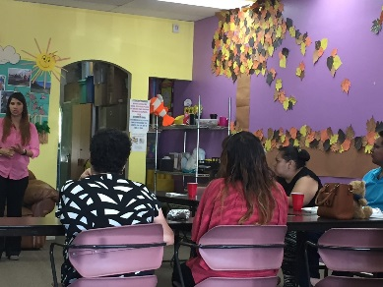
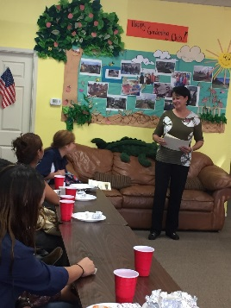
Focus Groups
Inclusion criteria same as surveys, PLUS
Currently or recently pregnant (up to 6 months postpartum)
Initiated prenatal care after the first trimester
Questions covered barriers and reasons for delayed entry to care
Understanding of what PNC includes
Information sources on PNC
Ease/difficulty of access to PNC and reasons (general)
Experiences in accessing PNC (specific)
Reasons for late PNC
Differences with prenatal care or delivery in Mexico vs. the US
Ideas for how to improve early PNC
Notes:
Inclusion criteria
Lives at least a majority of the time in the area served by the border organization
Is a Hispanic female 18-44 years old
Currently or recently pregnant (up to 6 months postpartum)
Initiated prenatal care after the first trimester
If utilizing Healthy Start participants, limited to only those who were recently enrolled (i.e. within last 1-2 months)
Those who may have participated in the previous survey study will not be excluded.
Facilitator Training by PCI in protocol and Guiding Principles and Best Practices for focus group discussions
Target participation was 50 (10 per site); only recruited 38
All but 1 group were conducted in Spanish (participant preference)
Women identified through:
Prenatal nurses working in clinics
Review of Healthy Start participant data to identify women with non-FTPNC
Partner programs reviewed their participants’ data for eligible women and obtained consent for Healthy Start to contact them.
Incentives offered such as gift cards, transportation/tokens, childcare, and nutritional supplement provided (varied by site)
Each of 5 sites received uniform guidance and focus group guide in both English and Spanish
Facilitators were identified who had experience facilitating focus groups, knowledgeable in the topic and bilingual
Study managers ensured facilitators were trained on how to manage challenging emotional responses to the questions – though these were not anticipated
Facilitators and note-takers from each site were trained by PCI in best practices for focus groups and facilitation skills / expectations, as well as adequately informed about the protocol, the research procedures, and their duties and functions in this study

Slide 40
I had nothing and knew nothing… nobody told me anything, no information at all, nothing, nothing.
– Texas participant
“We all know it is important to go to the doctor but there are so many things in our lives that discourage us, that keep us from getting ahead.”
– Arizona focus group participant
My mother is very religious and my whole family, and they don’t want me to mess up. I’m scared.
– California participant

Slide 41
We have to pay half the contract up front, $500, and we didn’t have the money for the first few months – New Mexico participant
It used to be you paid what you could, but now there is a price on everything, even at the clinics where they are supposed to help everyone – Texas participant
I knew I was pregnant but every appointment is so expensive and I don’t have money. I took vitamins and prayed for the best
– Arizona participant
Notes:
costs

Slide 42
I looked at options on both sides of the border, but it was cheaper in Mexico so I went with the economical choice
– Arizona participant
I was just scared to find out the truth.
- New Mexico participant
I am really irregular, and forgetful. When they sked me when was my last period I said ‘I don’t remember’. ‘You don’t remember?’ ‘No, I don’t remember the last time. – California participant
They told me here I wouldn’t get an ultrasound until week 20. Imagine all that time… so I went to Mexico for an ultrasound. As a mom I wanted to know.”
– California participant
Notes:
Clinic experiences

Slide 43
Key Informant Interviews
18 KIIs across all sites
OBGYN, Mid-wives, lead nurse/nurse practitioner, midwife, etc. and office staff (ideally managers or directors)
Minimum of 1 Yr. Experience in relevant position
Questions covered how PNC is scheduled, tracked (staff), incentivized and promoted (providers)

Slide 44
Key Informant Interviews Learnings
Language does not appear to be a barrier however communication may be
Reproductive Life Planning – It is not clear that providers truly understand RLP & Preconception Health
Date used to document prenatal care entry is often unclear (Especially when a patient is transferred from one provider to another)
Need to find out how hospitals are documenting entry into prenatal care
Records provided from Mexico are not frequently used
Standards (ACOG, HRSA) are a reason for not considering care provided from other entities
There is a distinct difference in opinion between OB and Midwifes regarding Pregnancy Planning
Notes:
Some women are entering care early but because of the standard that they must be seen by an MD to be counted as prenatal care initiation
First joint strategy
Will expand to Mexican key informants in next phase

Slide 45
Next Phases: Translating learnings to action
Align our CANs / community collaborations around defined FTPNC goal (three CANs already do)
KII Interviews with providers in Mexico -- talk to providers in Mexico about their perceptions of quality, explore differences in guidelines
Trainings in reproductive life planning
Borderwide campaign – importance of preconception / reproductive life planning and prenatal care
Use data/presentation to educate State MCH and community health care providers
Increase information sources on preconception and prenatal care
Notes:
Share how we are taking the data back to the community and the questions they are asking about
Teen reproductive life planning – LCDF Example
Community wide RLP trainings in San Diego and New Mexico
Pregnancy Testing Services – Welcome Baby CAN mapping process example
Potential to align messages around PNC on both sides of the border – BorderMACH Sister Cities example (JuaPasAna in New Mexico)

Slide 46
Research on Zika 2016
In 2016, the threat of the Zika virus emerged.
High rates of cross-border traffic across the US-Mexico border, and the high patterns of international travel to areas with ongoing outbreaks of Zika on the part of many border region residents, pregnant women in the US-Mexico border region can be considered at an elevated risk.
HSBA quickly began coordinating to share resources and materials for educating participants.
Notes:
Given high rates of cross-border traffic across the US-Mexico border, and the high patterns of international travel to areas with ongoing outbreaks of Zika on the part of many border region residents, pregnant women in the US-Mexico border region can be considered at an elevated risk.
In addition, women in the border region have higher rates of late prenatal care and unplanned pregnancies than non-border states, as well as higher rates of uninsured women of reproductive age than non-border states.

Slide 47
Zika Study
OBJECTIVES:
To examine Zika virus related knowledge, perceived susceptibility/risk and preventive measures being taken among pregnant and reproductive age women served by our programs
To inform strategies to impact Zika prevention among these communities.
RESULTS: Study completed in October, 2016:
HSBA programs conducted over 350 surveys of pregnant and interconceptional participants across the five sites
Work continues with a researcher from New Mexico State University to analyze and publish results

