Slide 1
Implementation of ELECTRONIC CONSULTS (eConsults) with Patient navigation at a FEDERALLY-QUALIFIED Community Health Center
February 17, 2017
Lauren Kelley, MSW, MPA
Sanket Dhruva, MD

Slide 2
Community-Based Participatory Research
Partners in eConsult initiative
  Project Access-New Haven (PA-NH)
  Fair Haven Community Health Center (FHCHC)
  Community Health Center Association of Connecticut (CHCACT)
  Yale-New Haven Health
  Yale Medicine Technology
  Yale Medicine Cardiology, Adult & Pediatric Dermatology, Rheumatology, Nephrology
  Robert Wood Johnson Foundation Clinical Scholars at Yale School of Medicine

Slide 3
Background
Medicaid patients have limited specialty care access
  Long wait times
  Sometimes unable to receive appointments
  Some patients may not need a face-to-face specialist visit
    Significant inconvenience and stress
  Poor coordination of services
    May not have necessary testing or information for a helpful specialty visit
  Urgent visits are often not prioritized
PCPs have limited access to specialists
    May lack sufficient expertise to optimally manage a given patient’s health concerns

Slide 4
eConsults
Prior studies of eConsults have demonstrated
  Decreased wait times for specialty consultations
  Decreased need for face-to-face visits with specialists by enabling PCPs to manage medical issues (building capacity)
  Over time, a decrease in the number of specialist referrals because of increased primary care expertise

Slide 5
Our Team’s Solution
  eConsult system: electronic communication between a PCP and a specialist to answer a specific clinical question; documented in the patient’s electronic medical record (Epic)
    Fair Haven Community Health Center and Yale New Haven Health have a shared electronic medical record system
    Project Access-New Haven has access to the electronic medical record
  Patient navigation is provided by Project Access – New Haven using a care model proven to support timely, efficient patient care through an episode of illness

Slide 6
Funding
Community Health Center Association of Connecticut awarded a $17 million Transforming Clinical Practice Initiative grant
  Included funding for PA-NH to navigate Medicaid-insured patients
Separately, a Connecticut State Plan Amendment provides reimbursement for Medicaid patients at federally qualified health centers who receive care through eConsults

Slide 7
eConsult
For Non-urgent Medicaid patients
eConsult Workflow
Outcome #1
Question Answered w/o Additional Testing or Face-to-Face Visits
PCP informs pt of eConsult using PANH brochure
PCP sends eConsult to PANH Pool via Epic
Outcome: question answered
No enrollment in PANH – No Navigation
Continue care w/PCP (no tests/F2F needed)
Follow up Survey
No Navigation
PANH forwards eConsult to Specialist
PANH send closing letter to PCP
eConsult Closed in Clara
Specialist responds to eConsult within 48 hours
PANH f/u w/specialist (72hrs)

Slide 8
eConsult
For Non-urgent Medicaid patients
eConsult Workflow
Outcome #2
Face to Face w/Specialist Needed
PCP informs pt of eConsult using PANH brochure
Navigation Offered
Outcome: Face to Face w/Specialist
Decline
PCP sends eConsult to PANH Pool via Epic
PCP enters test/referral order in Epic
No enrollment in PANH – No Navigation
OR
PANH notifies PCP pt decline/ not able to contact
PCP schedules F2F
Follow up Survey
No Navigation
PANH forwards eConsult to Specialist (?)
No Contact
CLARA
PANH mail initial contact letter after
3 missed consecutive calls
Specialist responds to eConsult within 48 hours
OR
Enrolled in PANH -Navigation as needed
Accepts
Past 48 hours, PANH f/u w/specialist on progress
Baseline Survey
Screening
PANH schedules F2F w/Specialist
PANH informs enrollment status/appt back to PCP
F2F
Follow up Survey
5 per month/Navigated pt
Pt discharged from PANH per specialist discretion
eConsult Closed

Slide 9
eConsult
For Non-urgent Medicaid patients
eConsult Workflow
Outcome #3
Additional Tests Needed
PCP informs pt of eConsult using PANH brochure
Outcome: Additional tests
Navigation Offered
PCP enters test order(s) in Epic
Decline
PCP sends eConsult to PANH Pool via Epic
No enrollment in PANH – No Navigation
OR
PANH notifies PCP pt decline/not able to contact
PCP schedules additional test
Follow up Survey
No Navigation
PANH PC forwards eConsult to Specialist (?)
No Contact
Close in Clara
PANH mail initial contact letter after
3 missed consecutive calls
OR
Enrolled in PANH -Navigation as needed
Specialist responds to eConsult within 48 hours
Accept
PANH schedules required tests
PANH informs enrollment status/ appt back to PCP
Tests
PCP reviews f/u test results w/pt
Past 48 hours, PANH PC f/u w/specialist on progress
Normal test results
Abnormal test results
Baseline Survey
Screening
PANH Patient Navigation
Or
Follow up Survey
5 per month/Navigated pt
No need for F2F/testing continue care w/PCP
Discharged from PANH per provider
Additional testing/F2F appt. needed
eConsult Closed

Slide 10
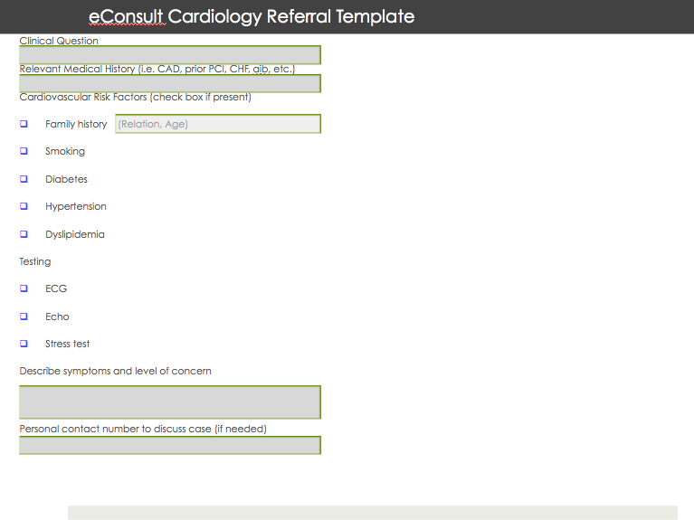

Slide 11
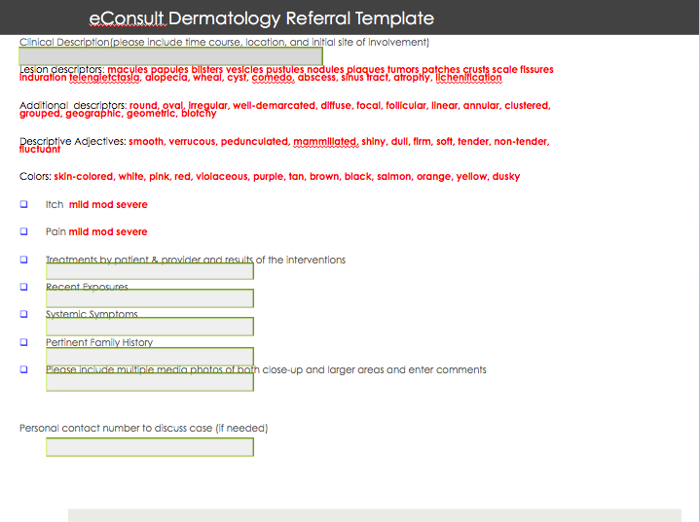

Slide 12
Implementation
July 2016
Cardiology Pediatric Dermatology
Aug 2016
Rheumatology
Feb 2017
Nephrology
Adult Dermatology
Ongoing discussions with additional specialties

Slide 13
Project Access-New Haven’s Role
  Necessary “glue” that allows this eConsult system to function
  Navigate patients to follow-up testing or specialist office visits
  Remove barriers to care
  Help provide an understanding of the social and economic characteristics of Medicaid beneficiaries who are receiving eConsults

Slide 14
Notes:
Patient Brochure

Slide 15

Notes:
Patient Brochure in Spanish

Slide 16
Progress To Date (as of January 2017)
23 eConsults accepted thus far (17 closed)
-16 pediatric dermatology
-5 rheumatology
-2 cardiology
4 navigation eligible (3 accepted)
  -1 active

Slide 17
Timeliness of eConsults
1.0 days (mean) from eConsult creation to first specialist response
2.7 days (mean) from eConsult creation to eConsult completion (including responses to follow-up questions from PCP if applicable)
20.5 days (mean) from enrollment in navigation to first medical appointment (physician office visit or test)
Notes:
(mean)

Slide 18
Evaluation – Patient Feedback
Surveys conducted by Project Access - New Haven
  Baseline for all navigated patients at PA-NH enrollment
  Up to 10 randomly selected patients/month who complete the eConsult process, but do not require follow-up testing or a face-to-face visit
  Survey focus: experience with eConsult process, self-reported health and quality of life, utilization of care, access/barriers to care, social determinants of health
  Follow-up survey for patients who enroll in and complete PA-NH navigation in development

Slide 19
Evaluation – Patient Feedback (n=16)

Slide 20
Evaluation – Patient Feedback

Slide 21
Evaluation – Patient Feedback

Slide 22
Evaluation – Patient Feedback

Slide 23
Evaluation – Patient Feedback
69% very satisfied with eConsult process
75% very satisfied with time waited to hear back from PCP about specialist recommendations
High level of provider (PCP) trust
  Scale of 0-10 (0=do not trust at all; 10=completely trust)
  Mean score: 8
Preferred to see specialist in person?
  19% would have preferred in-person visit
  38% would not have preferred in-person visit
  44% not sure

Slide 24
Evaluation – Clinician Feedback
PCPs who have requested eConsults
Brief, structured interviews via phone
PCPs request eConsults to expedite care and try to manage some medical issues in primary care
Found the process slightly more time-consuming (2-3 minutes longer) than a traditional face-to-face consult because they had to communicate more information (specialist is not performing a primary patient evaluation)

Slide 25
Evaluation – Clinician Feedback
Universally positive feedback on communication from specialists
Universally positive feedback on communication from Project Access – New Haven
Patients were glad to know they would receive a quicker response
Most PCPs wanted additional specialties

Slide 26
Evaluation – Clinician Feedback
PCPs who had not requested eConsults:
Online survey
Identified need for ongoing clinician outreach and training and broader specialty coverage

Slide 27
Dissemination
Qualitative methods paper on our collaboration and lessons learned
Feedback to FHCHC providers and patients

Slide 28
Successes & Challenges
Successes
Reduction of unnecessary tests and office visits (most eConsults resolved without visits/tests)
PCPs have timely and efficient access to specialty expertise/clinical recommendations
PCPs are better equipped to manage care in the primary care setting
More appropriate use/timing of diagnostic testing

Slide 29
Successes & Challenges
Challenges
Provider education
Patient education
Patient engagement in navigation
Scope of navigation – limited to medical care associated with eConsult

Slide 30
Thank You!
Lauren Kelley, MSW, MPA
lauren.kelley@ynhh.org
Sanket Dhruva, MD
sanket.dhruva@yale.edu

