Slide 1
Communities Joined in Action 2017
Texas 1115 Healthcare Transformation Waiver
Keeping Them Ambulatory:
Care Navigation for the At-Risk Population
Katrina Lambrecht, JD, MBA
Vice President Institution Strategic Initiatives and
Administrator, Angleton Danbury Campus
Craig Kovacevich, MA
Associate Vice President, Waiver Operations & Community Health Plans
Office of the President
University of Texas Medical Branch at Galveston
February 17, 2017

Slide 2
Presentation Objectives
Overview of the Texas 1115 Healthcare Transformation Waiver
Community Health Program/Chronic Disease Education Project Information
Review the role of data collection and analytics in measuring the impact to changes in health outcomes and community impact including, access, quality, and financial viability
Discuss feasibility for project replication in other communities that have identified the need to better navigate patients with Chronic Disease and/or multiple co-morbidities
Showcase best practices in patient navigation and care coordination through discussion of work that has proven to be successful in helping a variety of populations, including those most vulnerable in the community.
Question and Answer

Slide 3
Texas 1115 Transformation Waiver Overview

Slide 4
Background: 1115 Healthcare Transformation Waiver
Five-year demonstration waiver approved by CMS in December 2011; expired September 2016
  Approximately $29 billion value inclusive of Uncompensated Care (UC) and Delivery System Reform Incentive Payment (DSRIP)
  Currently in a 15 month extension period ending December 2017
Purpose:
  Preserve supplemental funding under a new methodology
  Expand Medicaid managed care statewide (transition from fee-for-service payment model)
  Transform patient care delivery through innovative projects designed to improve quality and patient care coordination
  Advance the Triple Aim of Healthcare as defined by the Institute of Healthcare Improvement (IHI)

Slide 5
Delivery System Reform Incentive Payment (DSRIP)
DSRIP is an incentive program to:
  Support coordinated care and quality improvement through 20 Regional Healthcare Partnerships
  Transform delivery systems through infrastructure development and testing innovative care models
DSRIP targets Medicaid recipients and low-income uninsured individuals
Projects are funded at the Medicaid federal match rate with the non-federal share of funds coming from a local or state public entity (Intergovernmental Transfers, or IGT)
DSRIP funds are earned based on achievement of project-specific metrics each year
Approximately $7.1B in total DSRIP payments to date (as of July 2016)

Slide 6
Delivery System Reform Incentive Payment (DSRIP)
20 Regional Healthcare Partnerships (RHPs) covering Texas’ 254 counties; each coordinated by a public Anchoring Entity
Each RHP plan is based on a community needs assessment of healthcare needs for the region
Over 300 DSRIP performing providers – hospitals (public and private), physician groups, community mental health centers, and local health departments
Intergovernmental transfers (IGT) from governmental entities – largely local public hospital districts – are the non-federal share for DSRIP incentive payments
1,342 active DSRIP projects statewide (as of November 2016)

Slide 7
UTMB 1115 DSRIP Overview
UTMB has 29 active DSRIP projects with a combined valuation of approximately $250 million
Projects are aimed at enhancing patient care through increased access, better coordination, and improved quality outcomes
Many DSRIP projects have created new opportunities for cross-entity collaboration to support achievement of project goals and expansion of innovative patient care programs in the communities we serve
In its role as Anchor for Region 2, UTMB has been able to strengthen and build upon existing relationships and cultivate new partnerships
UTMB has been sought out by regional partners and statewide colleagues for guidance on best practices in areas that our faculty and staff are subject-matter experts (use of community health workers, telemedicine, population health research)

Slide 8
Opportunities: Enhanced Collaboration
Continuation of transformational region-wide projects, with additional focus on cross-regional efforts
  Strong desire by providers to build on individual work with more robust collaboration
  Continue to build on existing relationships and develop new opportunities to expand
Greater partnership with Medicaid Managed Care Organizations to enhance:
  Exploration of alternative payment models, such as “bundled payments” and “shared savings arrangements”
  Quality reporting
  Better, coordinated care management for shared chronic disease and/or complex patient populations
  Development of “systems of care”

Slide 9
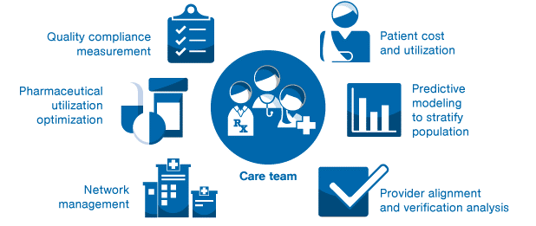
Opportunities: Population Health Management
DSRIP projects are “incubators” for population health
Outcome metrics are tied to target populations, based on community needs and project scope

Slide 10
UTMB’s Community Health Program/Chronic Disease Education Project

Slide 11
Community Health Program/Chronic Disease Education Project
Provides care management and disease management services in Galveston and Brazoria counties to:
  Adult Medicaid
  Dual eligible (Medicare/Medicaid)
  Uninsured patients who have chronic disease (i.e. diabetes, hypertension, heart disease, COPD)
Community Health Workers (CHWs) and Case Managers (CMs) provide enhanced social support and culturally competent care to this patient population
The CHWs and CMs serve as navigators for the patients as they traverse through the continuum of health care services and ensure that patients receive coordinated, timely, and site‐appropriate health care services.
The navigators in this program assist in connecting patients to primary care physicians and/or medical home sites as well as providing expanded care management services and education to patients with chronic disease.

Slide 12
Community Health Program/Chronic Disease Education Project
Hypertension is the pay-for-performance measure attached to the project in order to demonstrate the projects impact.
  The percentage of patients 18 to 85 years of age who had a diagnosis of hypertension (HTN) and whose blood pressure (BP) was adequately controlled (<140/90) during the measurement year.
Readmissions are not a pay-for-performance metric that is associated with this Texas 1115 project but UTMB does count the Community Health Program/Chronic Disease Education project as a large piece of our overall readmission reduction work.

Slide 13
The Role of Data Collection and Analytics
Patient data extraction is key to proper reporting to all project stakeholders
  Electronic Medical Record (EMR) patient data extraction must be optimized to handle large and varied requests
  Stakeholders will require varied reports in order to demonstrate the impact of the project as the project meets significant timeline milestones
  Approach every reporting deliverable as if it is a performance review of the reporting systems you are using or an audit of the methodologies you are employing
Second stage analysis once the data is extracted is key to final numbers.
  Setting correct methodologies for data extraction is not enough before final number reporting.
  Three stage data analysis is used at UTMB in order to ensure correct reporting to the information's final destination.

Slide 14
Project Replication
UTMB was able to align the project with the organizations overall care management strategy
  Project successes and best practices are reviewed and reinforced at monthly readmission reduction meetings (CARE Team)
  The RN Case Managers, Community Health Workers, and Team Leads and Analysts are also all part of the care management improvement teams
  UTMB recently realigned the Care Management structure to better include the DSRIP projects that work towards the Care Management of the many different patient populations that UTMB serves, including the Community Health Program/Chronic Disease Education Program.

Slide 15
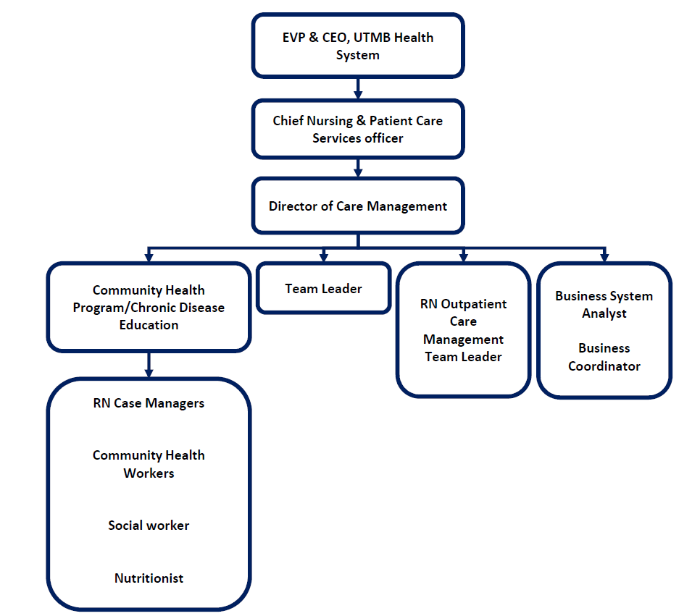
Project Replication: Staffing

Slide 16
Best Practices in Patient Navigation and Care Coordination
Hypertension impact:
  Numerator: The number of patients in the denominator whose most recent BP is adequately controlled during the measurement year. For a patient’s BP to be controlled, both the systolic and diastolic BP must be <140/90 (adequate control). To determine if a patient’s BP is adequately controlled, the representative BP must be identified.
  Denominator: Patients 18 to 85 years of age by the end of the measurement year who had at least one outpatient encounter with a diagnosis of hypertension (HTN) during the first six months of the measurement year.
The above numerator and denominator definitions are used to guide the data pulls for the baseline year and all subsequent performance years. The resulting performance year ratios are then pitted against the baseline ratio, informing the project team on the impact seen in the patient population.

Slide 17
Best Practices in Patient Navigation and Care Coordination
Hypertension outcome measure impact:
Goals role over into a “carryforward year” if not met during the first performance year period allowing for achievement of previous goals
Goals are also subject to partial achievement with gap closures of 25%, 50%, and 75% paid with dollars at the same percentage of the total metric’s valuation respectively
Measurement Period | Goal | Actual
Baseline Year | N/A | .5800
PY (Performance Year) 1 | .5911 | .5217
PY 2 | .6022 | .5948 (Achievement of PY1 goal!)
PY 3 | .6430 | Not reported yet

Slide 18
In Summary
The Texas 1115 Transformation Waiver has created opportunity for Texas Healthcare Service Organizations to start projects such as UTMB’s Community Health Program/Chronic Disease Education Project.
UTMB has streamlined data reporting in order to meet DSRIP reporting needs
UTMB’s Community Health Program/Chronic Disease Education Project can be easily duplicated at other Healthcare Service organizations across Texas and the Nation to address readmissions and hypertension in a patient population as well as provide care for the Low-income/Uninsured population
Best Practices in Hypertension have shown a positive variance over the 5 year project timeline and the 3 year outcome measure performance year periods.

Slide 19

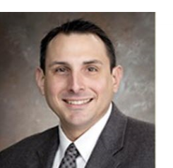
Want to Know More?
VP Institution Strategic Initiatives and Administrator, Angleton Danbury Campus
409.772.1909
kmlambre@utmb.edu
www.utmb.edu/1115
Associate VP, Waiver Operations & Community Health Plans
409.766.4047
cskovace@utmb.edu
www.utmb.edu/1115

