Slide 1
Effective Prescription Safety Net Programs in Action
Communities Joined in Action 2017 Conference

Slide 2



Why Does Trinity Health Need a Safety Net Strategy for Prescriptions?
Facilitates sharing of information and availability of programs
Expands access to programs for our facilities
Makes free medication and prescription assistance programs more readily available to patients who need them
Notes:
You may be wondering why we have taken the time to put together a prescription safety net program when we operate in such a large geographic area? Many programs are available across our geographic area. In many cases, usage of these programs are based on a staff member knowing about the availability of the free or low cost medications. The Trinity Health prescription safety net programs allows all locations what programs are available in their regions. We have also started automating a few of these processes for Trinity prescribers and staff.

Slide 3


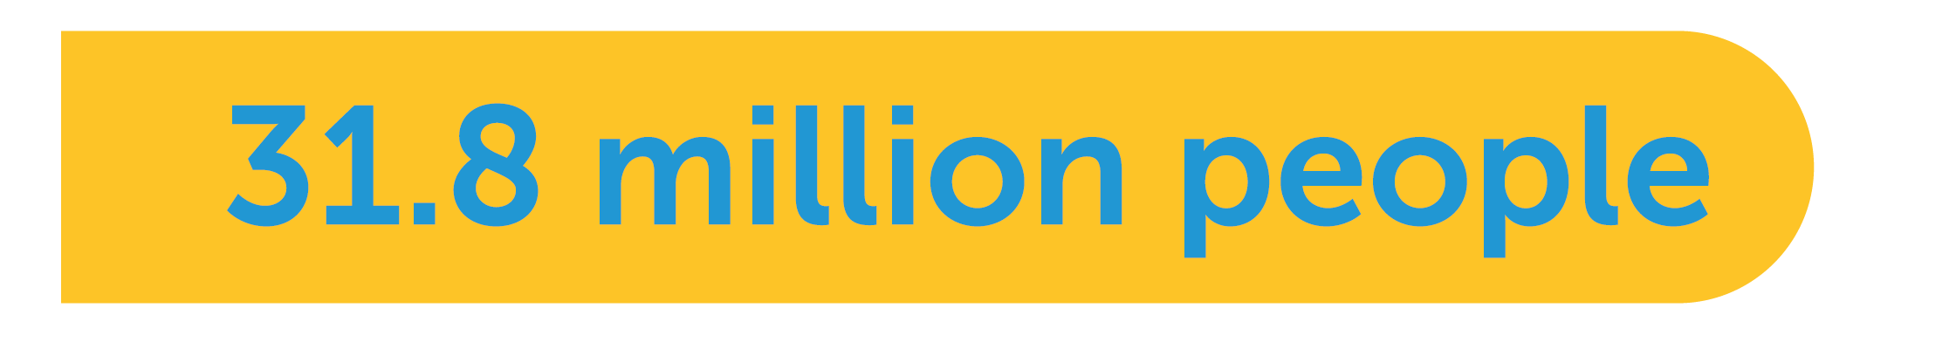
Need for Prescription Assistance is Growing
Large Base of Uninsured & Underinsured
(25% of the workforce) are underinsured
have no health insurance
The Henry J. Kaiser Family Foundation
Notes:
The need for prescription assistance –no cost and reduced cost medications is growing. 25% of the workforce is underinsured-this means they have a co-pay of $2,000 or more. 35 Million patients did not a prescription in 2014 due to cost. 19% of Medicare beneficiares enter the donut hole but only 3% come out.

Slide 4



Need for Prescription Assistance is Growing
High Costs of Meds Impacts Compliance
did not fill a needed prescription in 2014 because of cost
reported taking potentially dangerous steps to curb high medication costs
The Commonwealth Fund, Consumer Reports
Notes:
The need for prescription assistance –no cost and reduced cost medications is growing. 25% of the workforce is underinsured-this means they have a co-pay of $2,000 or more. 35 Million patients did not a prescription in 2014 due to cost. 19% of Medicare beneficiares enter the donut hole but only 3% come out.

Slide 5


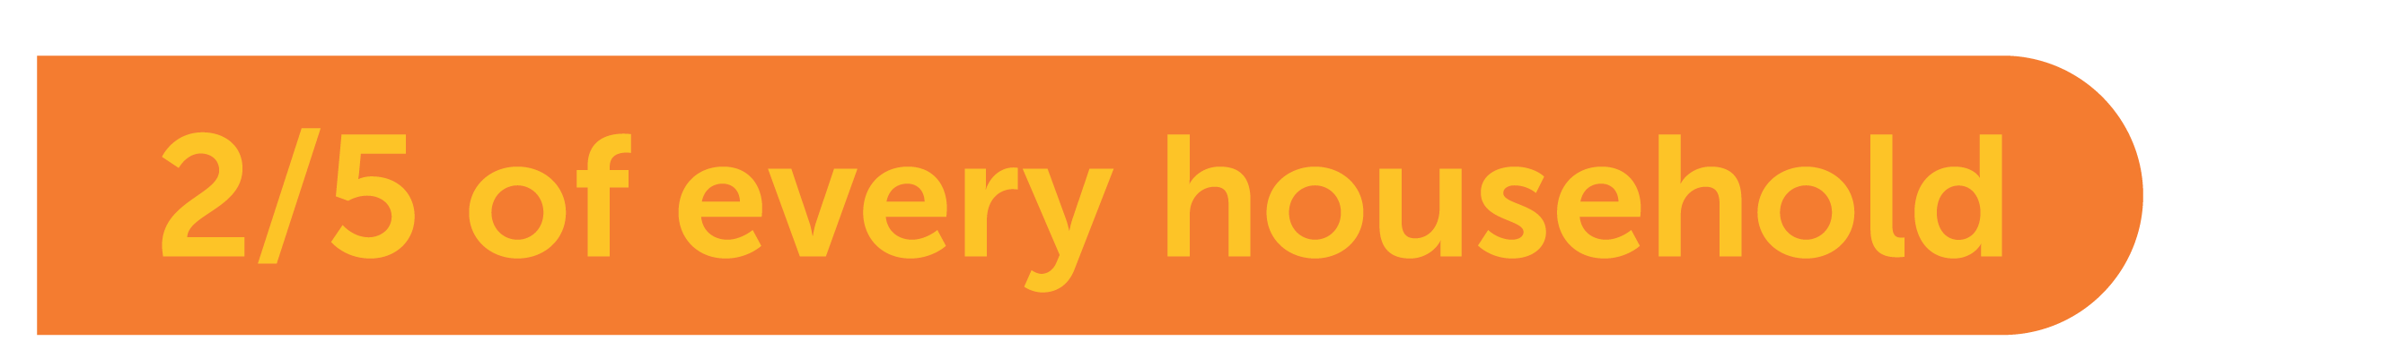
Need for Prescription Assistance is Growing
Growing Underinsured Population
purchased insurance with a high deductible from an Exchange
cannot afford their mid-level deductible
The Henry J. Kaiser Family Foundation
Notes:
The need for prescription assistance –no cost and reduced cost medications is growing. 25% of the workforce is underinsured-this means they have a co-pay of $2,000 or more. 35 Million patients did not a prescription in 2014 due to cost. 19% of Medicare beneficiares enter the donut hole but only 3% come out.

Slide 6

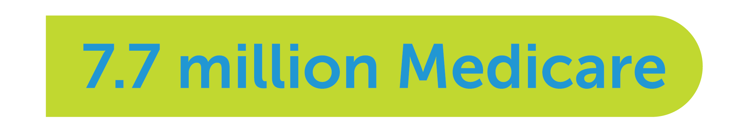

Need for Prescription Assistance is Growing
Medicare Doesn’t Meet Patient Drug Needs
eligible beneficiaries have no drug plan
enter the donut hole but only 3% come out
The Henry J. Kaiser Family Foundation
Notes:
The need for prescription assistance –no cost and reduced cost medications is growing. 25% of the workforce is underinsured-this means they have a co-pay of $2,000 or more. 35 Million patients did not a prescription in 2014 due to cost. 19% of Medicare beneficiares enter the donut hole but only 3% come out.

Slide 7
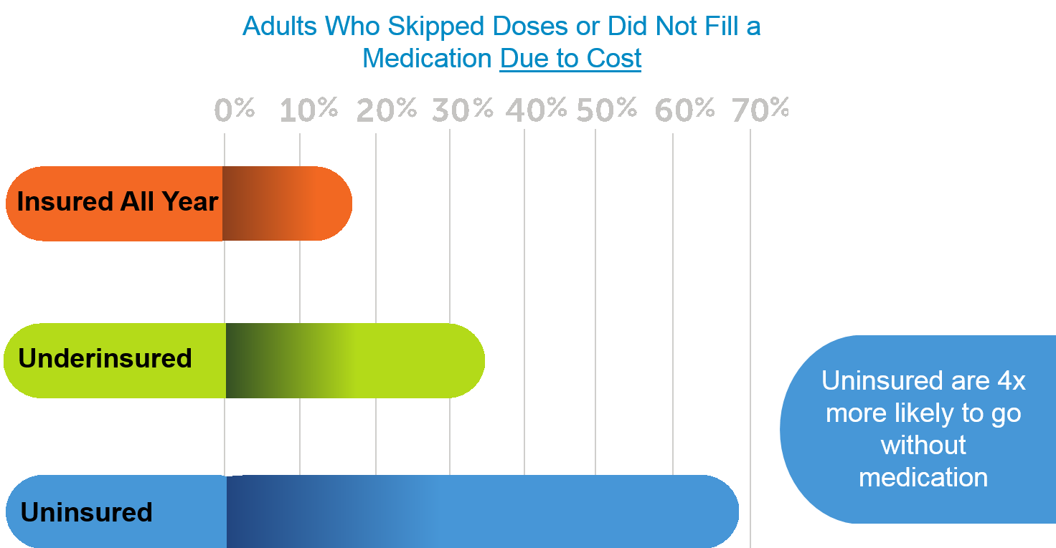
The High Cost of Rx Medications Today
Insured
Under Insured
Not Insured

Slide 8
Streamlining the Process
Option
Description
Cost
Immediate/ In-Office
Uninsured and under 200-300% FPL
Samples, AmeriCares, Dispensary of Hope
Free
2. Regional/ Local Price List
Is medication on $4/Free list?
Fill at local chain offering $4/Free list
$4/30 days
$9/90 days
Is there a 340B program?
Fill at outpatient/
contracted pharmacy
Significantly reduced prices
3. Federal Program

Slide 9
Streamlining the Process
Option
Description
Cost
4. Prescription Assistance Programs
Able to complete paperwork?
Apply for manufacturer prescription assistance program (PAP) and NeedyMeds
Free but not timely, use samples and FamilyWize Program
Manufacturer co-pay coupon available?
Reduces out of pocket spending
Brand name only, savings limits apply, compare to FamilyWize pricing
5. Co Pay Coupons
6. Automated in EMR
No Other Options, FamilyWize Program
Automated in EMR
Reduced price equal to what insurance company pays

Slide 10




Who is FamilyWize?
Helping millions of people nationwide
United Way partner
More than 10 million patients served
More than $1 billion saved for patients
Innovation for healthcare organizations and patients
EMR integration allows FamilyWize information to be transmitted automatically to any pharmacy
Mobile app provides price lookup tool for patients
Notes:
Who is FamilyWize? We have been helping patients afford their prescription medications for over 10 years. What started as a small, local program grew out the need to reduce the cost of prescription medications for the uninsured. Ten years later, with high deductible plans becoming the norm, we are needed more than ever. FamilyWize is an important layer in your prescription assistance safety net program.

Slide 11
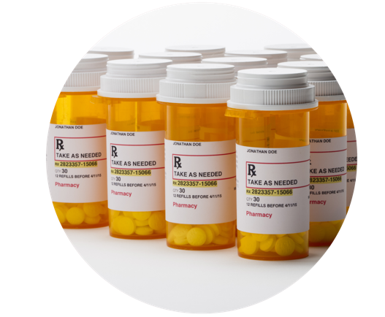

How Does FamilyWize Integrate with Your Prescription Safety Net?
Increased access to no-cost and $4 prescription medications from local retail pharmacies
FamilyWize program info delivered directly to the pharmacy via your EMR

Slide 12
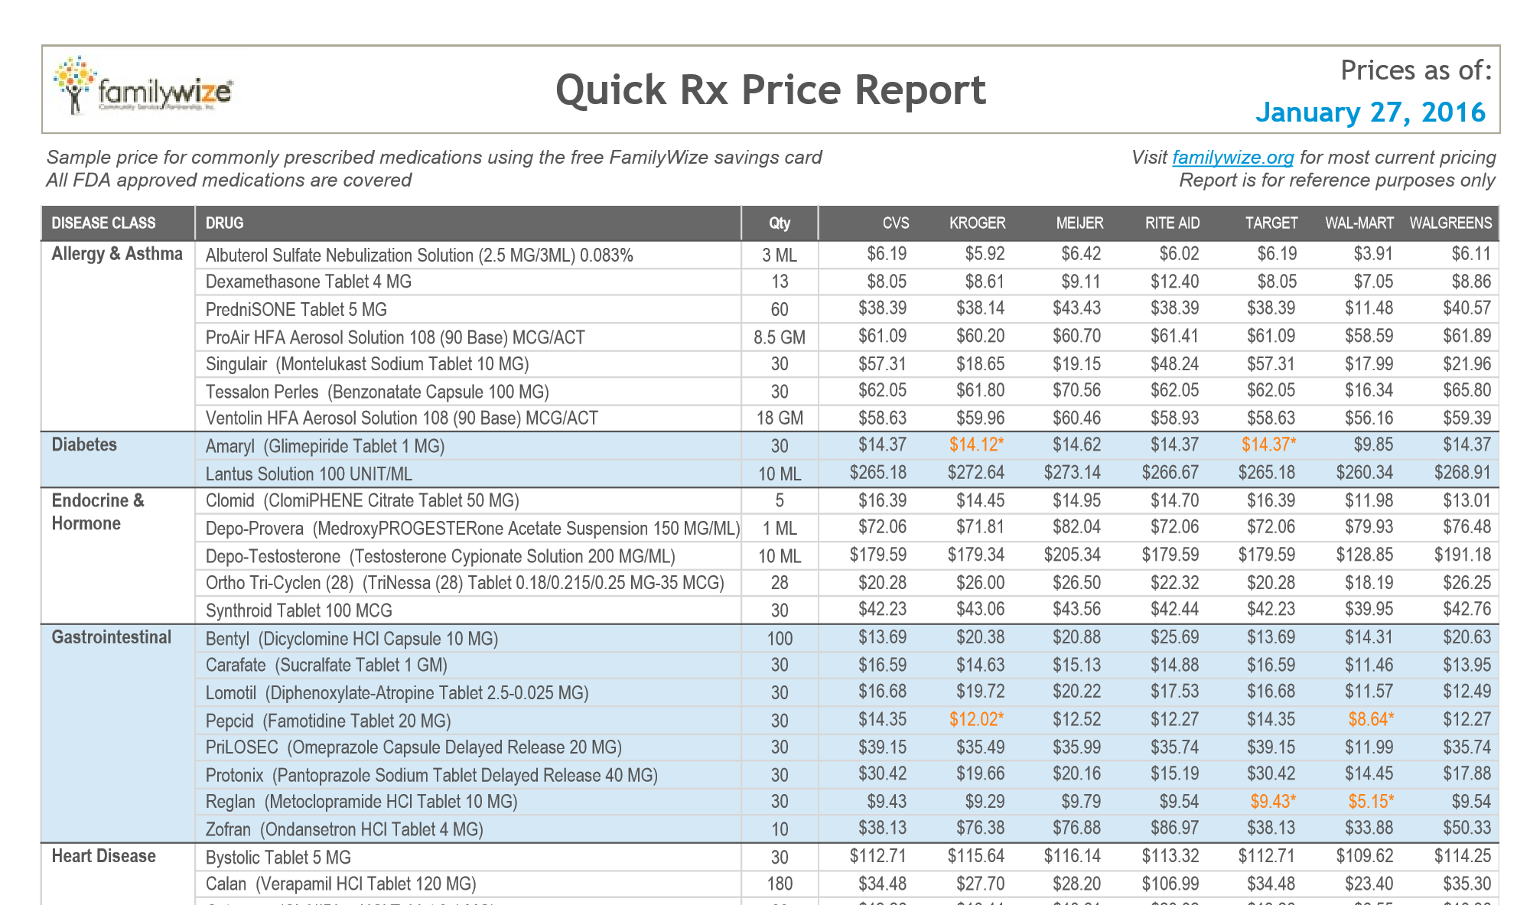
Quick Rx Guide is Integrated with the $4.00 Lists
$4.00
$4.00
$4.00
$4.00
$4.00
$4.00
Notes:
FamilyWize automatically integrates the $4.00 lists into the Quick Rx Price Report. Your office will receive this list of frequently prescribed medication and prices in your location's zip codes. This is a quick reference guide for use in the clinics and doctor’s office. It is sent to your office manager every two weeks for distribution. When a medication is prices in orange, that medication is on the $4.00 list at the pharmacy chain.

Slide 13
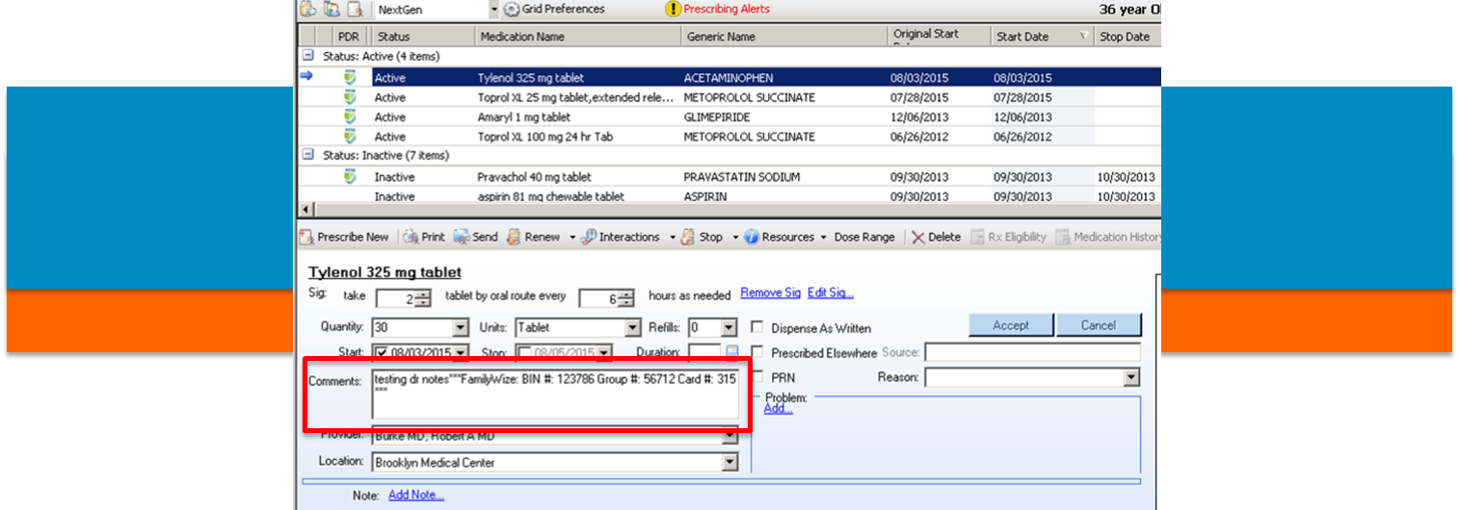
How Automation Helps
Program is completely automated.
Paper-based → electronic system
Assures patients are getting the lowest price
Moving with industry to electronic platform provides significant benefits to all parties
Notes:
FamilyWize has been assisting uninsured and underinsured patients for over 10 years. Originally, patients needed to remember to hand carry a document or card to obtain the FamilyWize discount. (Gen 1 image) Over the past year we have been able to automate this process-allowing the program information to automatically transmit with the prescription. As you can see in the image labeled Gen 2, the FamilyWize program information transmits in the comments section of the e-prescribed transmission. The program also attaches to the script if it is faxed or printed. This takes the burden off the patient –the pharmacist sees the patient is eligible for the FamilyWize program and applies the discount. In a case where the patient has both insurance and FamilyWize, the lower price is charged.

Slide 14






Best Practices for Staff Training
FamilyWize helps train your staff, saving your team time.
Live webinar session to learn process and ask questions
Recorded webinar session available for on-demand use
Signage in staff breakrooms to serve as reminder of emRxcelTM integration and FamilyWize partnership
Dedicated website with educational tools about emRxcelTM, a list of current prices of popular medications (Quick Rx Guide), and general information about the FamilyWize Prescription Safety Net program
Routine emails from Community Benefit Director with training information, success metrics, and other program features
Routine emails with updated Quick Rx Guide, featuring the latest prices of popular medications

Slide 15
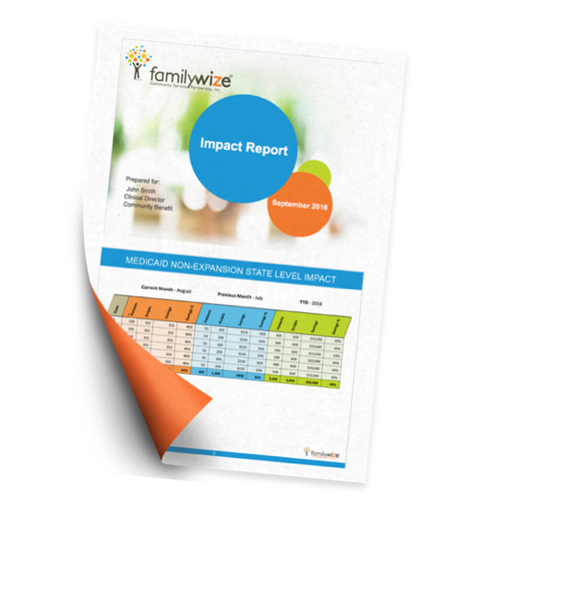
Customized Impact Report Shows Monthly and Yearly Trends
See results at the corporate level, including:
Number of patients
Number of scripts
Medication prices and patient savings
Increased access to $4 medications
Data reported on expansion vs non-expansion states

Slide 16
Success Metrics from emRxcelTM at Trinity Health
Nationwide | Program to Date
Number of Patients | 10,551
Number of Scripts Filled | 13,536
Trinity Patient Savings | $412,664
% Savings | 43%

Slide 17
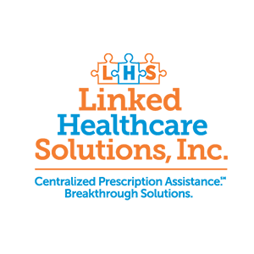
Introducing Linked Healthcare Solutions
FamilyWize created Linked Healthcare Solutions to streamline and expand access to automation and education tools.
Linked Healthcare Solutions is dedicated to providing automated solutions to healthcare providers and patients in the medication access space.

