Slide 1

The ANCHOR National Implementation Model: Engaging Communities for
Sustainable Policy, Systems, and Environment Change
Laura King Hahn
Sr. Program Manager
ANCHOR Partnerships Program

Slide 2
Presenter Disclosures
Laura King Hahn
(1) The following personal financial relationships with commercial interests relevant to this presentation existed during the past 12 months:
No relationships to disclose

Slide 3
What is ANCHOR?
Accelerating National Community Health Outcomes through Reinforcing Partnerships Program
Otherwise known as by CDC and our public health partners…
Category “A”

Slide 4
National Organizations That Were Funded
Awardee
Category A:
National WIC Association
American Planning Association
American Heart Association
Category B:
Society for Public Health Education
Directors of Health Promotion and Education

Slide 5
Role of Category As: National Project Scope
National awardees (American Heart Association, National WIC Association, American Planning Association) will use their annual award to identify, fund, monitor, and support two cohorts of 15 sub-recipients from among their chapters/affiliates.
Selected locations (chapters/affiliates) will develop or strengthen their local coalition(s) and examine community needs assessment data.
Then implement a locally-driven community action plan that addresses one or more of the following chronic disease risk factors selected by their national organization: tobacco use and exposure, poor nutrition, physical inactivity.
Sub-recipients implementation timeline:
  Cohort one: March 2015 – April 2016
  Cohort two: Feb 2016 – July 2017

Slide 6
Role of Sub-recipients: Local Project Scope
Increase collaboration between local community partners
Build a local community action plan (CAP), a work plan, that outlines that activities and tactics that will be undertaken to build policy, systems and environmental (PSE) changes.
Increase the community’s capacity by:
  Build or leverage an existing multi-sectorial coalition
  Identify community priorities by reviewing local data and conducting a situational assessment
  Identify the settings that this effort would occur
  Identify the audience who would be benefit from by the PSE change
  Project the number of people who will benefit (reach)

Slide 7
Additional CDC Deliverables
Communication Deliverables:
Communicate to the public about the importance of PSE improvements and the activities underway to build PSE changes within the selected local communities;
Communicate to partners about the project and engage them on PSE improvements; and
Develop success stories

Slide 8
Alignment with AHA Priorities
Reasons for pursuing the National Implementation for Chronic Disease Prevention funding:
  To accelerate the AHA’s 2020 goal:
    To improve cardiovascular health by 20%
    To reduce deaths from cardiovascular diseases and stroke by 20%
  To build policy, systems and environmental improvements at the local level
AHA’s Approach to Sustainability:
  Fits within AHA’s pre-existing goals
  Accelerated and expanded on AHA’s existing priorities
Notes:
Reasons for pursuing the project
Support 2020 Goal
Improve cardiovascular health by 20%
Reduce deaths from cardiovascular diseases and stroke by 20%
Focus policy priorities at the local level
Sustainability
Fits within AHA’s preexisting goals
Accelerate and expand current work

Slide 9
ANCHOR’s unique niche…
Accelerating National Community Health Outcomes through Reinforcing (ANCHOR) Partnerships program provides the following value add:
Facilitates multi-sectoral collaboration with stakeholders, partners, volunteers and community members on community-identified priorities
Accelerates the momentum to build policy, systems or environmental changes
                or
Support the implementation in the wake of policy adoption.

Slide 10
Accelerating Change in Communities:
The Policy, Systems and Environmental (PSE) Campaign Pendulum
Building Momentum
Supporting Implementation
Momentum for Change
Support the Change
ANCHOR
ANCHOR
PSE
Change Occurs
Implementation Approach:
Defining the Problem
Identify Solutions
Plan Strategies
Implementation
Sustainability
Implementation Approach:
Defining the Problem
Identify Solutions
Plan Strategies
Implementation
Sustainability
Notes:
Policy, Systems and Environmental changes is the ultimate goal based on AHA’s priorities. Approach is the same, activities different on “front end” vs. “back end”. Just because a PSE is complete doesn’t mean ANCHOR has no role to play. ANCHOR is here to accelerate on both ends of the pendulum.

Slide 11
Designing a Policy, Systems and Environmental Changes (PSE) Continuum Model
Defining the Problem
Identify Solutions
Planning Strategies
Implementation
Sustainability
Community needs assessment
Resources and barriers identified
Strategies tailored for sites
Potential stakeholders convened
Develop leadership team
CAP developed, modified
Promotion of new PSE change
Institutionalized PSE change
Strategy identified
PSE strategy carried out
Organization adoption
Sites identified
An issue is identified as a policy, systems, or environmental change is needed to improve local health status
AHA staff convene statewide and/or local stakeholders vested in the issues identified
If identified, decision is made to explore potential PSE changes
AHA staff convene stakeholders to identify resources and barriers to address the issue.
AHA staff convene leadership group of stakeholders to help in the planning and implementation of PSE changes
Decision is made to conduct a PSE intervention
Leadership group identifies sites that are willing to implement PSE changes
Leadership group tailors PSE change strategy to be site specific
AHA staff develop and/or modify the community action plan to incorporate new PSE activities.
AHA staff and/or leadership team work with sites to carry out PSE changes
AHA staff, setting, and/or leadership team promotes new PSE changes
Site adopts organizational procedures to continue the PSE change
Once implemented, site staff embed the PSE change in to organizational budget, practice and policy
AHA staff helps to promote PSE changes, so community support influences sustainability

Slide 12
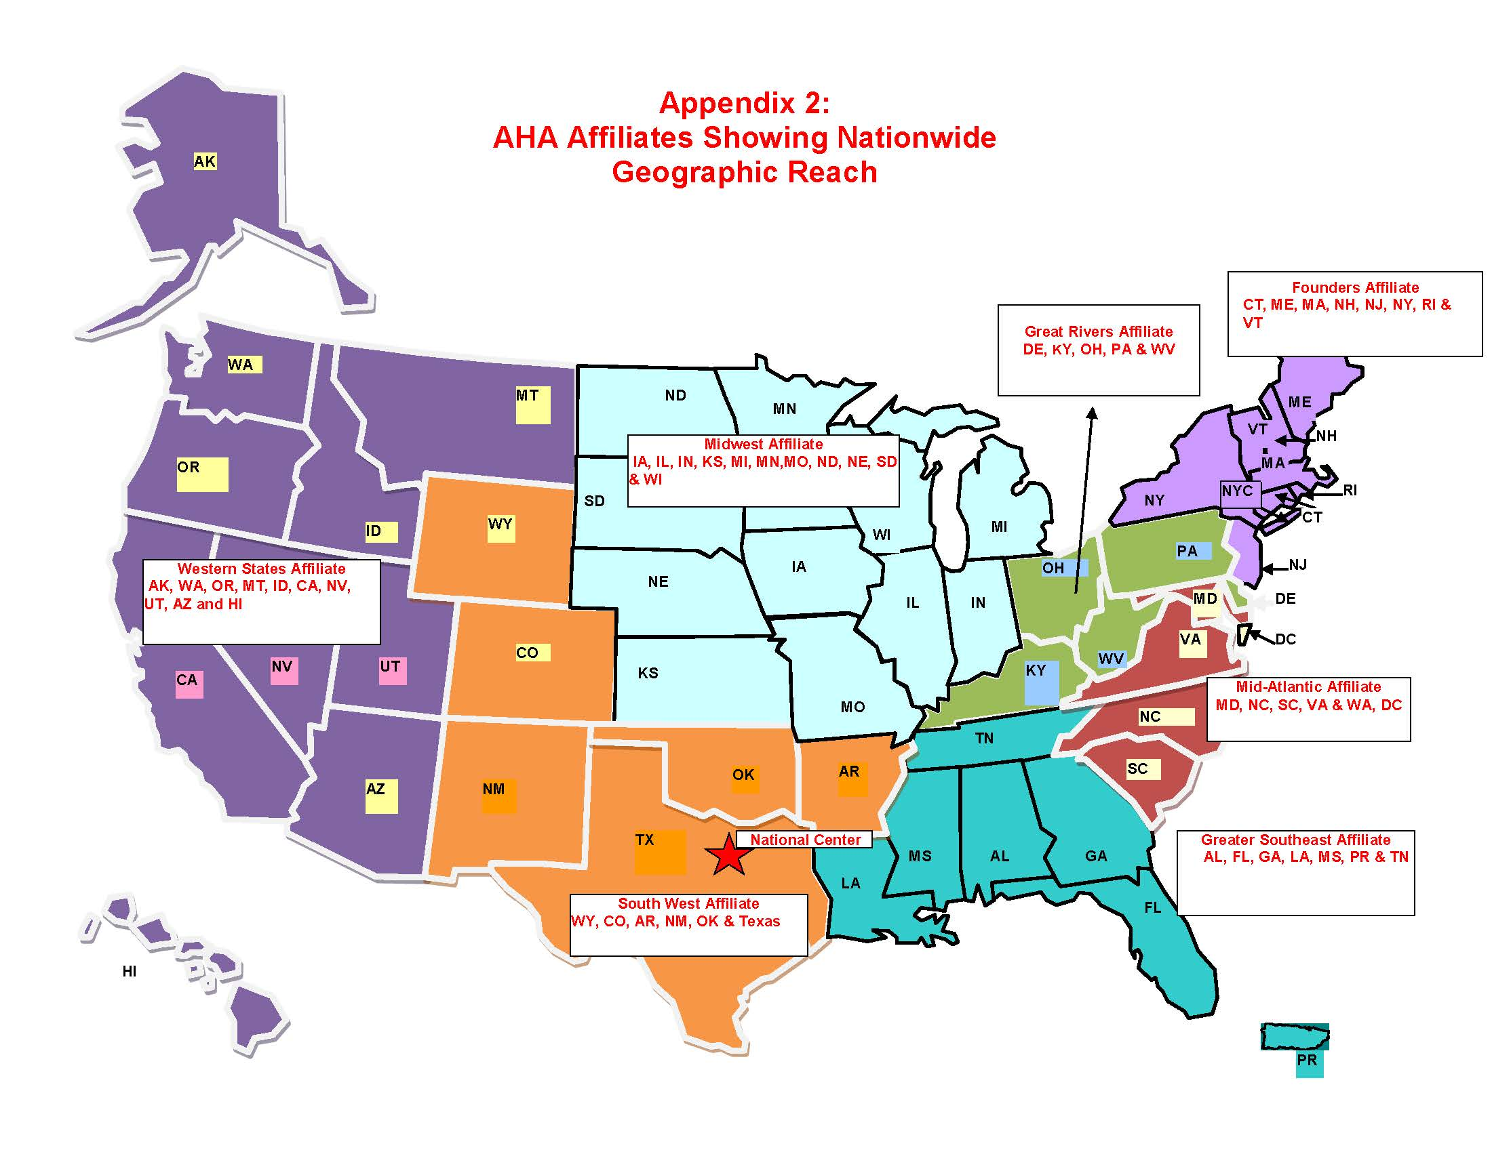

Slide 13
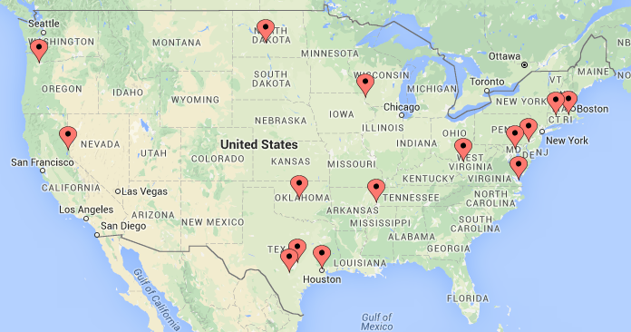
As a result, ANCHOR Cohort One…
15 Locations Across 13 States
Notes:
15 sub-recipients across 13 States
11 – led by advocacy
3 – led by multicultural
1 – led by community health
Strategic Areas of Focus per ANCHOR Market:
Nutrition:
Procurement - 8 sites
Healthy Food Financing Initiatives (HFFI) - 4 sites
Farmers Markets - 5 sites
Physical Activity:
Shared Use - 2 sites
Physical Education (PE) - 3 sites
Tobacco:
Smoke-free Environments - 3 sites

Slide 14
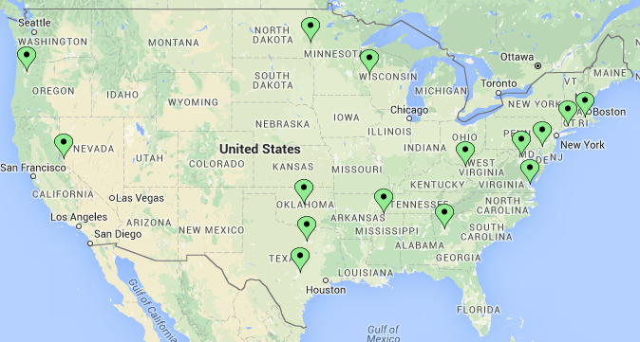
As a result, ANCHOR Cohort Two…
15 Locations Across 14 States
Notes:
15 sub-receipients across 14 states:
13 led by advocacy
2 led by multicultural
0 led by community health
Strategic Areas of Focus per ANCHOR Market:
Nutrition:
Procurement – 10 sites
Healthy Food Financing Initiatives (HFFI) – 1 sites
Farmers Markets – 3 sites
Physical Activity:
Shared Use – 1 sites
Physical Education (PE) – 3 sites
Community Physical Activity – 2 sites
Tobacco:
Smoke-free Environments – 3 sites

Slide 15

Ensuring We All Spoke the Same Language
We needed to ensure we were all speaking the same language to avoid anyone getting lost in terminology.
We had to understand the goal and the metrics that could or could not be measured.
Policy, Systems, and Environment changes were the metric of success. Once complete, PSE changes were used to attain reach numbers towards ANCHOR’s CAP reach goal.
Notes:
We needed to ensure we were all speaking the same language and did not get lost in terminology. We had to understood the goal and the metrics that could or could not be measured.
Policy, Systems, and Environment changes were the metric of success. Once complete, PSE changes were used to attain reach numbers towards ANCHOR’s CAP reach goal.

Slide 16
Building a Comprehensive Community Action Plan (CAP)
CAP Development Approach – “Being of the Community”:
Assess and understand the needs of the community in relation to reaching your end goal – the PSE change.
    What activities are partners already undertaking?
    Can ANCHOR serve as a maximizer?
    What gaps are there which are unmet?
Select effective support activities.
    What support activities will best position your setting(s) for change?
Utilize the CAP as a roadmap to PSE change.
    Are some support activities dependent on one another or on efforts of partners?
    What timing is best suited for each support activity?
    How can they work cohesively to build momentum?
Notes:
Guidance was provided to determine how each RCM was planning to reach their ANCHOR reach number. This was a critical in CAP the planning process. The RCM needed to consider and articulate the settings, sites and opportunities and how these aligned with their campaign goals.
Multi-pronged approach to build PSE changes included engaging internal and external partners, key stakeholders, community members, AHA volunteers. The CAP then was to reflect the collaborative action plan on how to move the priority forward based on identified needs.

Slide 17
Campaign Planning for PSE Changes
PSE Change
Smoke-free Environments
PSE Changes within the following settings
Businesses
Restaurants and Bars
Colleges and Universities
Public Spaces (Parks, trails, beaches, etc.)
ANCHOR
Businesses go smoke-free
Restaurants and bars go smoke-free
Campuses adopt smoke-free policy
Departments adopt smoke-free for public spaces
PSE Changes
Educational presentations and materials provided to community
Assessments to inform change and community
Letters of support and/or pledges drafted
Communications to celebrate and publicize changes
Signage to promote change and informs community
Support Activities

Slide 18
Campaign Planning for PSE Changes Cont.
PSE Change
Healthy Food Financing Initiatives (HFFI)
PSE Changes within the following Settings
Farmers markets
Grocery stores
Mobile markets
Corner stores
ANCHOR
PSE Changes
Increased number of markets
Increased acceptance of SNAP and WIC
Addition and promotion of healthier food and beverage offerings
Increased acceptance of SNAP and WIC
Addition and promotion of healthier food and beverage offerings
Increased acceptance of SNAP and WIC
Support
Activities
Educational presentations and materials provided to community
Assessments to inform change and community
Letters of support and/or pledges drafted
Communications to celebrate and publicize changes
Signage and guides to promote change and inform community
Notes:
The actions that ANCHOR was conducting are based on AHA advocacy best practices and could be led by other sections within the organization. Meaning when the federal funds supporting this initiative go away the approach does not need to end. Advocacy, community health and multicultural initiatives could collaborate and lead on the multi-prong approach to support changes that lead to “Little p” and “Big P” policy levels
Policy, Systems, and Environment changes are the metric of success in ANCHOR’s work. I would argue this is where being “of the community fits” and multicultural initiatives and community health have a role to play in the same sphere that ANCHOR played.

Slide 19
CAP Implementation: Training and Technical Assistance
Community Action Plan (CAP) planning:
  Including a detailed work plan and a RASCI (to ensure internal and external partners were appropriately engaged)
Program management training
Additional Technical Assistance Offerings:
1:1 CAP review calls (CAPs to be updated quarterly)
Face-to-face team mtgs
Affinity (peer) calls
Coaching calls (campaign planning, PSE changes, messages research results, evaluation tools/resources etc.)
Monthly calls between Affiliate supervisor and the Sr. Program Manager
Monthly dashboards reports
Consultation services provided by Sr. Program Manager, Program Performance Improvement Specialist and Texas A&M (ANCHOR evaluators)

Slide 20


Leveraging AHA Assets
AHA internal partners:
  Local Board of Directors
  Government Relations
  Volunteers (including grassroots and grass top)
  Community Health Multicultural Initiatives
  Communications
  Science and Legal
  Youth Market
  Market Quality & Systems Improvement
AHA resources and materials:
  Healthy food and beverage toolkit
  Tobacco control resources
  Voices for Healthy Kids toolkits (e.g. shared use)
  Healthy Ways to Grow materials
  NEMS assessment tools
  Sodium reduction materials

Slide 21
Sustainability Planning
ANCHOR sub-recipients developed sustainability plans that addressed:
What does success look like?
What potential barriers could hinder progress?
What campaign components/activities/projects should continue in the future?
How do these support AHA priorities and/or the communities’ priorities?
Who needs to be responsible and what resources will be required for sustaining the campaign components in the future (i.e. partner/ community organization, AHA staff, monetary resources, institution contacts or supports, individual contacts or support, tools, communications, data, and other materials).
What are considerations for organizational and community capacity?
What significant milestones or deliverables are required for these efforts to be successful?
What are the dependencies for the milestones/deliverables?
Notes:
Note: On-going technical assistance and training will address these items with staff from both local and organizational perspectives, leveraging all assets and opportunities.

Slide 22
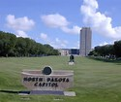
Highlights from Cohort One
Bismarck, Mandan, ND:
The Capitol Café stocks beverage machines on the capitol grounds. A policy was developed for all beverage machines to offer plain water and a minimum of 50% healthy beverages.
Healthy box lunch project provided healthy options for meetings and caterings and the addition of a healthy entrée salad to the daily cafeteria menu.
Sanford Health-Bismarck increased healthy food and beverage in their employee/visitor cafeteria and vending which resulted in increased revenue. The Sanford Health Enterprise worksite wellness leadership is interested in to additional sites within the hospital system.
The Sanford Health Healthy Food and Beverage Task Force was awarded the HERO team award.

Slide 23
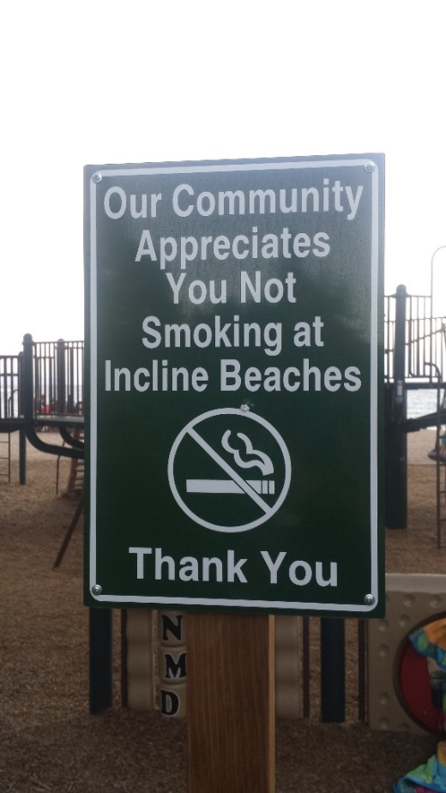
Highlights from Cohort One Cont.
Providence, RI:
AHA partnered with the RI Department of Health (RIDOH) to increase healthy food and beverage selections at the Dunkin Donuts Center concessions (entertainment and sports arena).
Incline Village, NV:
Incline Village Parks & Recreation pilot tested smoke-free signs at outdoor events, beaches and playgrounds.
Decided to make their parks, beaches and trails smoke-free. Permanent signs installed (Fall 2016).

Slide 24
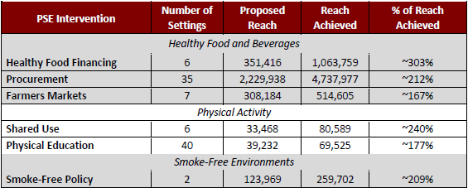
Potential Reach* and Settings (Cohort One)
Settings included: hospitals, schools, colleges/universities, early childcare centers and home care centers, workplaces, government buildings/property, parks/beaches/trails, and more.
Cohort Two potential reach will be available at the end of the cohort (July 2017).
*Potential Reach – Not referring to actual population reached but rather those who have the opportunity to benefit from the change.
Notes:
Table developed by Texas A&M University Evaluation team

Slide 25
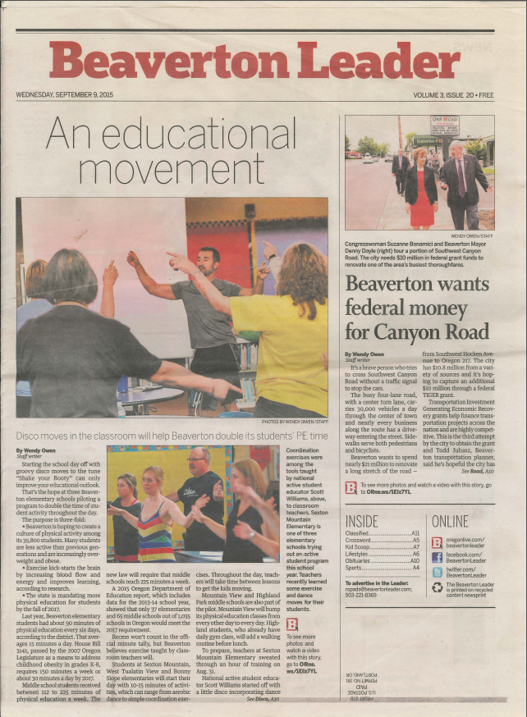
Highlights from Cohort One Cont.
Southern Chester County, PA:
The Nourish Mobile Market obtained a USDA license to accept SNAP but they were not processing SNAP transactions as they were unsure of how to obtain EBT equipment. The AHA identified a vendor that provides free EBT equipment to farmers markets and provided TA to the employees to set up the equipment and process transactions.
The Nourish Mobile Market and the YMCA partnership resulted in expanding the mobile markets to seven new locations (YMCA branches).
Beaverton, OR:
The Beaverton School District Oregon Kids Move with Heart pilot (occurred in 16 schools) each elementary school began the school day with 10 minutes of physical activity (Brain Boosts), have recess before lunch, and incorporate Brain Boosts activities throughout the school day.
Decided to expand the across all 33 elementary schools beginning September 2016.

Slide 26

Cohort One Momentum (Sustainability) Continues…
Providence, Rhode Island:
The Providence Public School District has trained 7 more schools to implement the Comprehensive School Physical Activity Program (CSPAP) which provides guidance to develop, implement, and evaluate comprehensive school physical activity programs.
18 schools (of 39 in the district) have signed up as an Active School on the “Let's Move! Active Schools” website.
Bismarck/Mandan, North Dakota:
The Bismarck Event Center adopted healthy choices on their standard catering menu offerings. The concession stands has added a select number of healthy items including fresh fruit and low sugar beverages.
Notes:
Image copyright American Heart Association

Slide 27

Cohort One Momentum (Sustainability) Continues…
Kanawha County, West Virginia:
The Kanawha County Coalition for Community Health Improvement is utilizing AHA’s Healthy Food and Beverage Toolkit for their “Wellness at Work” initiative.
Oklahoma City, Oklahoma:
The Oklahoma City Council unanimously passed a resolution implementing a healthy vending policy to ensure that local officials, staff, and visitors to city property have access to healthier food and beverages. ANCHOR provided critical education outreach in advance of this decision.

Slide 28
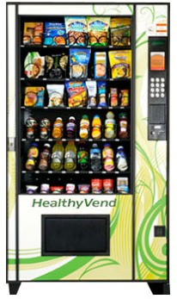
Cohort Two Progress
Pawtucket, Central Falls, RI:
The RI Department of Health has adopted AHA’s nutrition guidelines as their standard for providing support to government and outside organizations.
In collaboration with the RI Department of Health, the McCoy Stadium agreed to increase healthy food and beverage options. Technical assistance is being delivered to meet the AHA guidelines.
The RI Department of Health (DOH) requested local ANCHOR collaboration to deliver a healthy food and beverage policy training for all Health Equity Zones (HEZ) in RI in addition to a training already planned for the Pawtucket/Central Falls HEZ. It is an opportunity for DOH to announce the adoption of the AHA nutrition guidelines. All HEZ members have been asked to adopt healthy food and beverage policies.

Slide 29

Cohort Two Progress Cont.
Austin, TX:
Collaborating with the local Good Food Purchasing, the University of Texas Department of Housing (UT-Housing) and Austin Independent School District (AISD) on a pilot to improve food procurement standards.
Led to a national opportunity whereby the AHA is advising on the Center for Good Food Purchasing national nutrition procurement standards.
Developed a public education campaign to educate the public on the issue of access to healthy food in collaboration with AHA’s Voices for Healthy Kids team.
The City of Austin recently allocated resources for food access initiatives including $300K to SNAP double dollar programming and $400K for grocery incubator grants.

Slide 30

Cohort Two Progress Cont.
Chesapeake, Newport News, Suffolk, VA:
ANCHOR collaborated to bring in the Virginia Department of Agriculture's Mobile Lab to sign up farmers participating in farmers markets to be able to accept Supplemental Nutrition Assistance Program (SNAP) payments.
Four farms were set up; these farmers were equipped with free terminals for processing the payments. The AHA goal is to encourage other farmers/farmers markets to increase SNAP acceptance.
Notes:
Image copyright American Heart Association - http://newsroom.heart.org/news/addressing-social-factors-critical-for-continued-fight-against-heart-disease-and-stroke-in-america

Slide 31
Lessons Learned: Reflections from AHA Sub-recipients
Begin by creating a relationship - POWER of Connection
AWARENESS, TRUST, and ACTION
PAINT A PICTURE of a different way
Stepping stones build confidence
Engage grassroots and grass top champions
There is more than one way to . . . Have a Plan B…plus a Plan C …
It won’t be perfect but it will be better.
Start communications activities early and keep it consistent (i.e. public education and partner messaging)
Paperwork
Timelines

Slide 32
Ask the Audience
What questions do you have about…
  Pursuing PSE Changes?
  Building or strengthening coalitions?
  Community Action Plans?
  Planning for sustainability?
  Other items?

Slide 33

Interested in learning more?
ANCHOR success stories are online! Please visit www.heart.org/anchor
Laura King Hahn, Sr. Program Manager
ANCHOR Partnership Program
laura.king.hahn@heart.org

