Slide 1
The Role of a Health Foundation in
Developing HealthNotJustHealthcare Strategies to Assist Communities and Community Clinics
Shao-Chee Sim
February 17, 2017

Slide 2
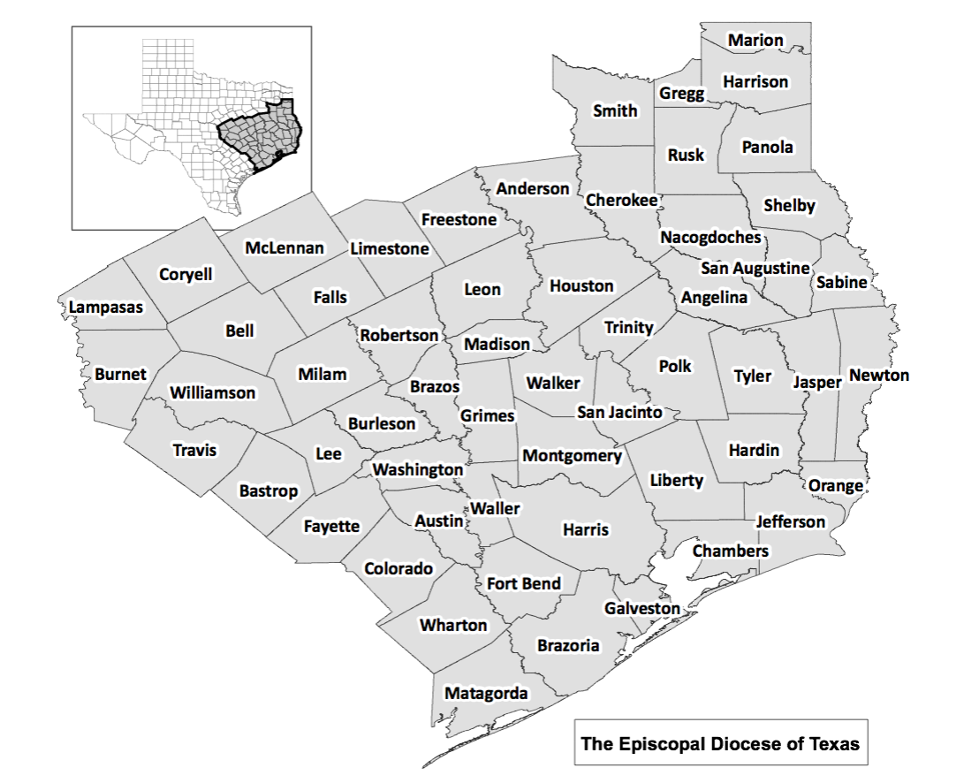
Episcopal Health Foundation
Service Area
Geographic service area:
57 counties in SE Texas
10 million people
153 Churches

Slide 3
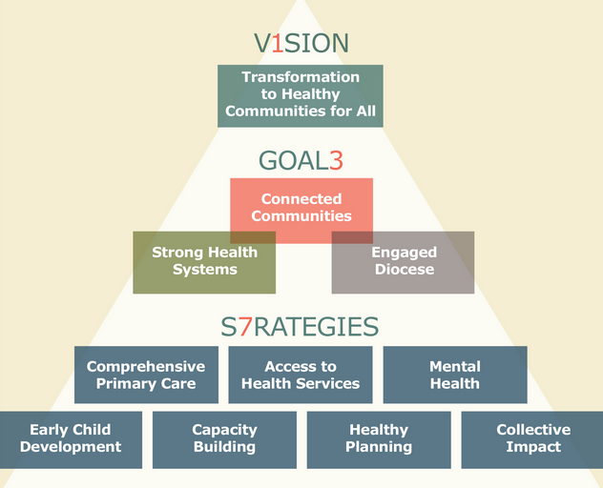

Slide 4
Community Engagement Efforts
Convene Organizations to Accomplish A Goal
Beaumont Health Coalition
Health & Wellness Planning Committees in Madison, Grimes and Robertson Counties
Build capacity of organizations to engage their communities to appreciate grassroots voices
Prosper Waco (Collective Impact Initiative)
Early Matters in Houston (Collective Impact Initiative)
Community Engagement Workshops (targeting grantees and congregations)
Provide grants to support community engagement work
Engage congregations in health-focused outreach

Slide 5
Rural Health Efforts
Stakeholder Engagement
State Associations (Texas Organization of Rural & Community Hospitals & Texas Assoc of Rural Health Clinics
State Agencies (Texas State Office of Rural Health & Texas Office of Primary Care)
Funding Partners (St. David’s Foundation, Methodist Healthcare Ministries & T.L.L. Temple Foundation)
Research Projects
State of rural hospitals in Texas (TORCH)
In-depth analysis of rural health clinics (TORCH and TARHC)
Development of community options to address rural hospital closures (TAMU College of Medicine)
Community Convening
Madison, Grimes and Robertson Counties (TAMU Southwest Rural Health Research Center)
11 rural counties in Northeast Texas (UT Northeast Health Science)

Slide 6


Community Centered Health Homes (CCHH)

Slide 7
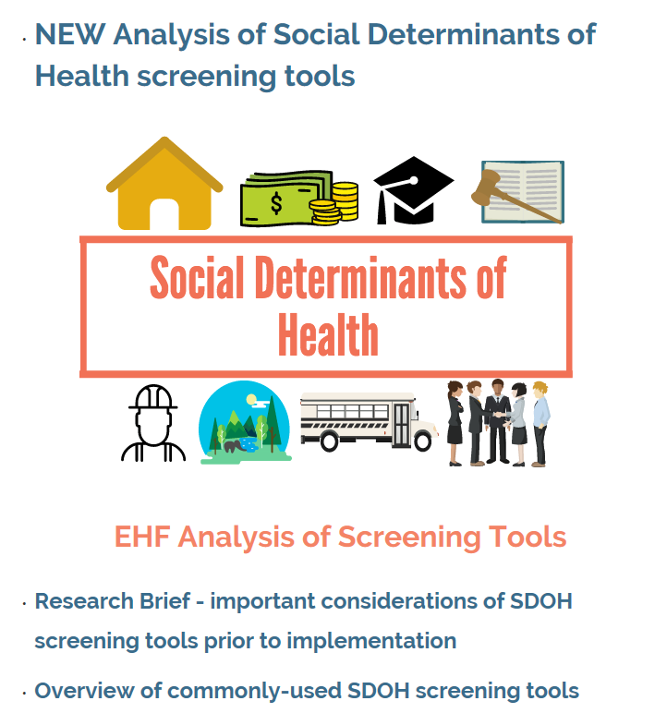
SDOH Screening Tools
Many SDOH tools being used and/or piloted throughout the country. EHF is currently supporting the pilot initiative of PRAPARE, national standardized protocol to identify and address SDOH in a clinical setting, in 3 FQHCs in Texas. The project is led by NACHC.
Important factors to consider when adopting a tool include the target population, ease of integration in clinical practice, sustainability of screening, actionability of questions and provider obligations.
Healthcare clinics have been identified as the ideal setting for SDOH screening, with little evidence that integration of SDOH screening in healthcare is superior to an alternative environment.
We-Care, SEEK, PRAPARE, Roots to Health, Health Leads

Slide 8
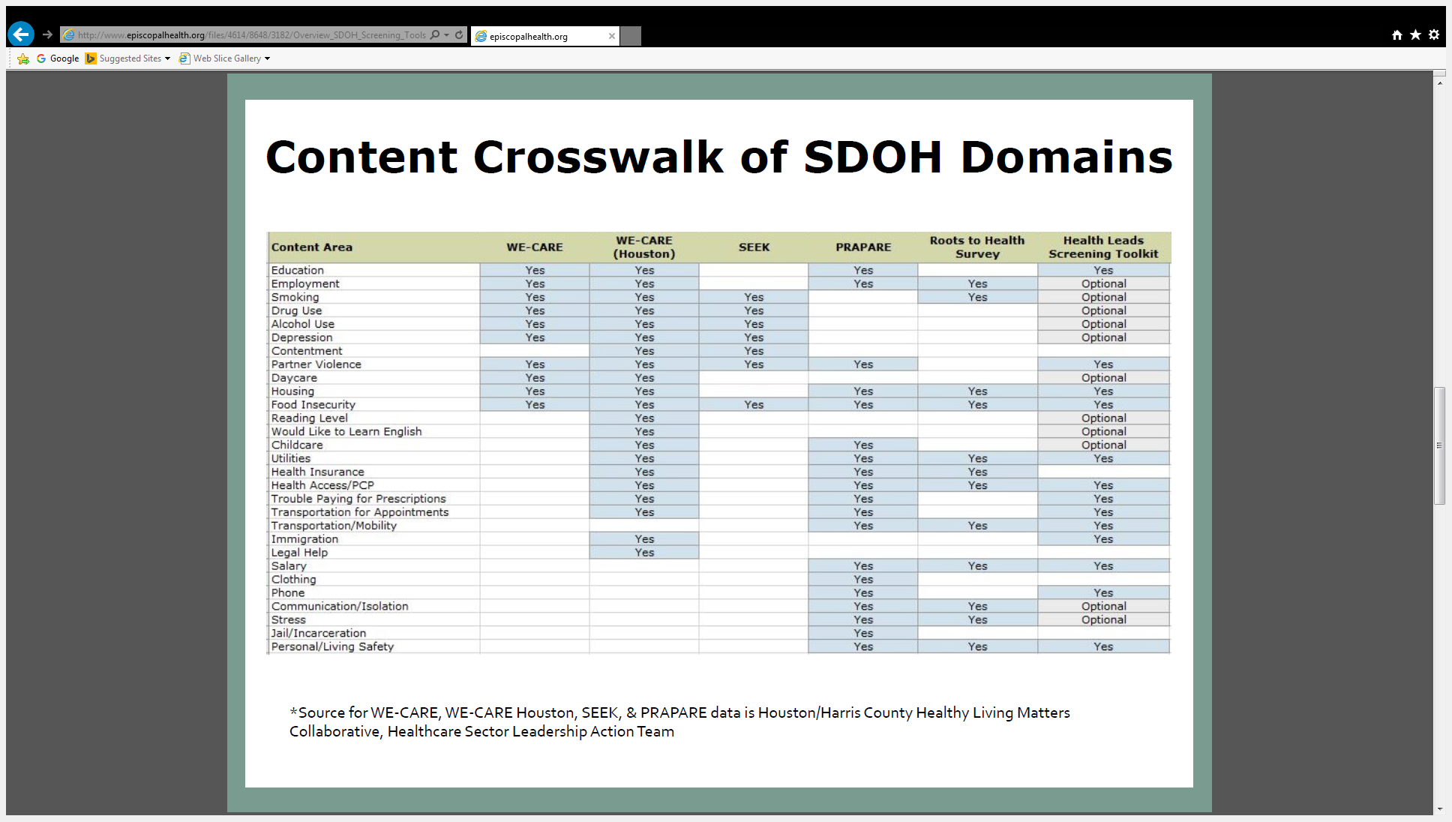
SDOH Screening Tools

Slide 9
PAYMENT REFORM LEARNING COLLABORATIVE
Currently working with HealthCare Quality Institute in partnership with Robert Wood Johnson Foundation and St. David’s Foundation to conduct a feasibility analysis and to develop a plan for creating a FQHC payment reform learning collaborative
Other stakeholders include the State Medicaid Office, Texas Association of Health Plans and Texas Association of Community Health Plans
Payment Reform readiness assessment survey will be administered to 35 FQHCs in our service area
Identify and leverage existing national and state resources on payment reform (i.e., Safety Net Advancement Center)
The first FQHC Payment Reform Learning event scheduled for March 2017 in Houston

Slide 10
SOME EARLY LESSONS LEARNED
EHF service area covers 57 counties and 10.7 million population. Given this complexity, EHF is experimenting with a number of different approaches:
Invest in research, asset maps and social network analysis
Deploying staff to support existing health coalition work
Rely on the knowledge of local universities in communities to help us identify community stakeholders and organizations
Community engagement is often messy, time and resource intensive, and leaders usually look for a quick solution without including community voices.
EHF is in the midst of developing a community engagement strategy – more intentional, focused and outcome-oriented.
Given the larger health policy trends, EHF has and continues to work to address patients’ social determinants of health issues via community prevention initiative, social determinants of health screening tools and financial sustainability of the community clinics to address upstream issue. (HealthNotJustHealthcare!)

Slide 11
Shao-Chee Sim, PhD
Vice President for Applied Research
Ssim@episcopalhealth.org

