Slide 1
Community Health Worker Core Consensus (C3) Project: Addressing health equity
Lex Hurley, Student, MPH Program, Texas Tech University Health Sciences Center
Carl Rush, Project on CHW Policy & Practice, University of Texas Institute for Health Policy
Julie St. John, DrPh, MA, CHWI, Associate Chair, MPH Program Abilene, GSBS, TTUHSC

Slide 2



Funding Disclosures
Phase 2 of the C3 Project has been funded by Sanofi-US to the Paul L. Foster School of Medicine at Texas Tech Health Sciences Center El Paso
This Project has been designated as “Exempt” by the TTUHSC Institutional Review Board for the protection of human subjects (FWA # 00020736 EL PASO IRB #00009945) 10-24-16
PI: Dr. E. Lee. Rosenthal, Co-PI: Dr. Julie St. John

Slide 3
The C3 Project Team
Outreach
Carl Rush
Settings*
Lee Rosenthal
(clinical)
Assessment**
Caitlin Allen
Nell Brownstein
Project Director
L. Rosenthal
Jorge Ibarra
Project Directors Team
Julie St. John
(community)
Durrell Fox
Lisa Renee Fox
(Advisor liaison)
Admin/IRB Team
B. Sanchez &
J. Ibarra & C. Palmer
Coordinating Organizations:
Texas Tech University Health Sciences Center El Paso – lead
UT Project on CHW Policy & Practice
Mesa Public Health Associates
Community Resources, LLC
Supported by Sanofi-US
Students:
*Colton Palmer
*Lex Hurley
**Maria Cole

Slide 4
Welcome!
Introduction
Origins of the C3 Project
Early Work
Current Work
Future Work
Goals of the C3 Project & Future Directions

Slide 5
C3 Project Purpose
Develop national consensus around “contemporary” recommendations for:
CHW Core Roles (Scope of Practice)
CHW Core Skills
…affirm existing knowledge about CHW Core Qualities

Slide 6
Why C3 Now?
National Community Health Advisor Study (NCHAS, 1998) – has served CHW education programs & state standards…
Times have changed – >CHWs working “inside” healthcare
More states developing official role definitions & skill requirements
Pressure to create national standards; agreement among states is not clear
“What’s a good training program?”

Slide 7
C3 Project Timeline
Precursor activity in 2013: analysis of 40+ CHW training programs
Fall 2014 - Spring 2015: Roles & Competencies Crosswalk against NCHAS baseline & review by Advisory Committee
Summer 2015: CHW Networks Review & consensus building
Spring 2016: release of 2015 recommendations
Notes:
Precursor activity in 2013: analysis of 40+ CHW training programs descriptions by Coastal AHEC (TX)
Fall 2014 - Spring 2015: Roles and Competencies Crosswalk against NCHAS baseline, and Review by Advisory Committee including a majority CHWs
Summer 2015: CHW Networks Review and consensus building
Spring 2016: release of 2015 recommendations
Also to promote CHW self-determination
A core value of the C3 Project’s implementing team is promoting CHW self-determination supporting CHWs to define their own practice and polices that influence that practice. CHWs and other stakeholders provide leadership to the C3 Project through a range of approaches including:
A majority-CHW national Advisory Committee that provides a critical feedback and creative input to the process CHW key consultants and C3 CHW Fellows who are members of the core implementation team; CHW Fellows chaired the Advisory Committee
Feedback sessions at APHA annual meetings and the annual Unity Conference to share findings and gather input from CHWs and other stakeholders
A Reader’s Panel made up of individuals from the CHW field, allies, and other decision makers
Solicitation of feedback on C3 Project findings from the nation’s CHW leaders, especially leaders of state and local CHW networks

Slide 8
C3 Benchmark Documents cross-walked with NCHAS
State | Role (Scope of Practice) | Training Standards (Curricula
California | California Health Workforce Alliance State Conference Study (2014) | City College of San Francisco CHW Curriculum
Massachusetts | State Scope of Practice (2015) | State Board of Certification Core Competencies
Minnesota | Minnesota Community Health Worker Alliance (2012) | Standard State Curriculum Required for Medicaid
New York | New York State CHW Initiative Guidance to State (2011) | New York State CHW Initiative
Oregon | State Traditional Health Worker Commission (2014) | Scope of Practice Committee, State Traditional Health Worker Commission
Texas | State Definition of CHWs (2010) | State Curriculum Standards
IHS Community Health Representatives Program | Indian Health Service Scope of Practice (2014) | [postponed]
Notes:
In order to conduct a more modern assessment of CHWs and the work they do, the C3 Project conducted a crosswalk analysis of select benchmark documents from California, Massachusetts, Minnesota, New York, Oregon, Texas, the Indian Health Service Community Health Representatives Program, and the NCHAS for common threads regarding CHW roles, skills, scopes of practice, and qualities.

Slide 9
Roles
Cultural Mediation
Providing Culturally Appropriate Health Education & Information
Care Coordination, Case Management, & System Navigation
Providing Coaching & Social Support
Advocating for Individuals & Communities
Building Individual & Community Capacity
Providing Direct Service
Implementing Individual & Community Assessments
Conducting Outreach
Participating in Evaluation & Research
Notes:
Cultural Mediation among Individuals, Communities, and Health and Social Service Systems
Providing Culturally Appropriate Health Education and Information
Care Coordination, Case Management, and System Navigation
Providing Coaching and Social Support
Advocating for Individuals and Communities
Building Individual and Community Capacity
Providing Direct Service
Implementing Individual and Community Assessments
Conducting Outreach
Participating in Evaluation and
Each of these specified Roles also have many sub-roles which we identify in our 4 page summary document on our website. For example, the Role “Care Coordination, Case Management, and System Navigation” will also include necessary sub-roles such as
Participating in care coordination and/or case management
Making referrals and providing follow-up
Facilitating transportation to services and helping to address other barriers to services
Documenting and tracking individual and population level data
Informing people and systems about community assets and challenges

Slide 10
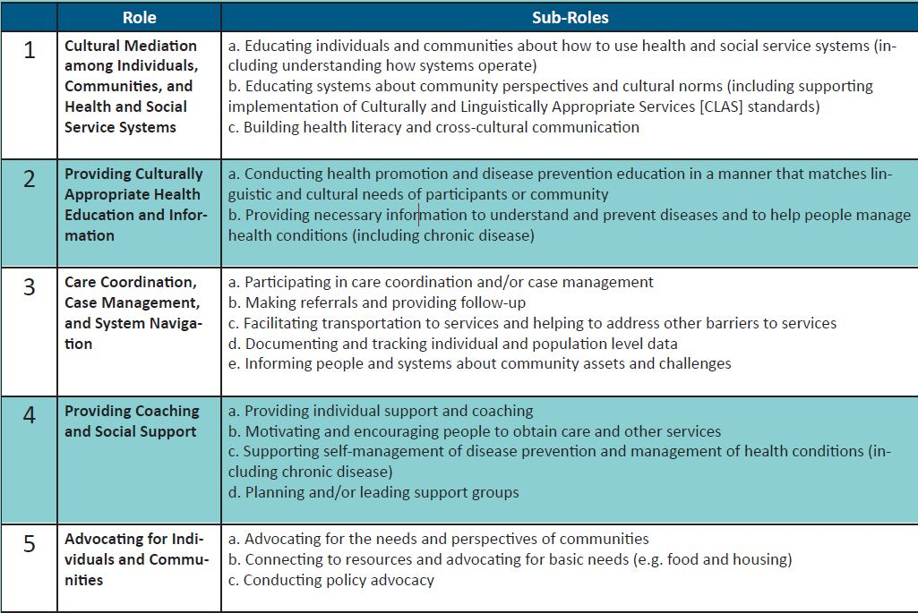
Sub-Roles
Notes:
Within each identified Role, there were many different types of “sub-roles” which are still unique and important to CHWs. For example, the Role “Care Coordination, Case Management, and System Navigation” will also include necessary sub-roles such as
Participating in care coordination and/or case management
Making referrals and providing follow-up
Facilitating transportation to services and helping to address other barriers to services
Documenting and tracking individual and population level data
Informing people and systems about community assets and challenges
A complete – and much easier to read – table of these Roles, Skills, and their respective sub-roles and sub-skills is freely available within our full report and four page summary from our website.

Slide 11
Skills
Communication
Interpersonal & Relationship-Building
Service Coordination & Navigation
Capacity Building
Advocacy
Education & Facilitation
Individual & Community Assessment
Outreach
Professional Skills & Conduct
Evaluation & Research
Knowledge Base

Slide 12
Current Work: Outreach Core
Individualized follow-up with CHW networks to define concerns & areas of interest
Network with other Stakeholders in addition to CHWs:
Current/Potential Employers
Medical
Public Health
Social Services
Health Insurers
State/Federal Policy Makers
Notes:
This consensus building process would present a greater opportunity for refinement and potential endorsement of proposed CHW roles, skills, and qualities. It can also serve as part of an awareness and education strategy for these non-CHW stakeholders: despite growing interest, many of them still know little or nothing about CHWs.

Slide 13
Current Work: Settings Core
The Community Health Worker Core Consensus Project Survey 2016
Sent to members & organizations identified in the Outreach Core
Evaluate which Roles & Skills are needed for CHWs in Community-Based as compared to Clinical settings.
Over 500 responses at survey’s close in December 2016.

Slide 14
Current Work: Assessment Core
Creating recommendations to assess skill proficiency
Challenge to create appropriate employee/participant assessment tools
Capture state of the art in techniques
Use of modified community-based participatory research approaches
Includes interviews & survey
Advisory Committee
Interviews
Results and Toolkit

Slide 15
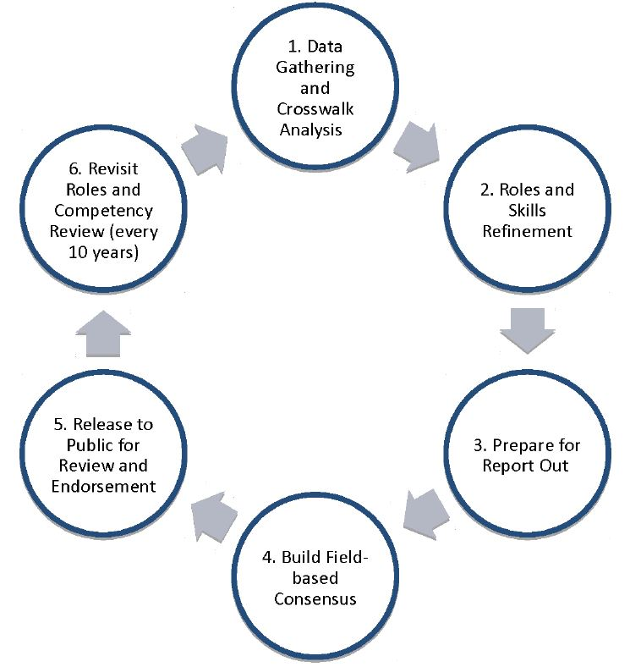
Proposed CHW C3 Review Cycle
Notes:
It is also worth mentioning that our step 6 “Revisit Roles and Competency Review” can reoccur up to every 10 years.

Slide 16
Future Direction of the C3 Project
Medium Term: National consensus on & wide distribution of C3 Project recommendations on roles & competencies & their proposed use
Recommendations for CHW roles in varied settings (community-based vs. clinically-based)
Recommendations on appropriate methods for assessment of CHW proficiency in core skills
Long Term: Utilization & endorsement of C3 Project recommendations by local, state, & national organizations
Strengthen CHW education, practice, & policies nationwide
Notes:
We hope that the new national CHW association will consider the C3 Recommendations if national standards are proposed.

Slide 17
How can C3 impact health equity?
Health equity: study & causes of differences in quality of health & healthcare across different populations
“Attainment of the highest level of
health for ALL people.” (HP 2020)
Notes:
So, what do we mean by health equity? Essentially, health equity refers to the study & causes of differences in quality of health & healthcare across different populations.
Healthy People 2020 defines health equity as the "attainment of the highest level of health for all people." Watch our 'What is Health Equity' video for more information.
With that said, after hearing about the C3 project, we’d like to hear YOUR thoughts and ideas about how C3 project outcomes can be used to positively impact health equity?

Slide 18

Activity
Notes:
CHWs = can fill the gap or serve as the missing “piece” in the problem of health inequities and striving for health equity.

Slide 19
Summary
C3 is a national CHW project that continues to seek to build consensus among the CHW profession
Given CHWs unique characteristics, there is great potential within the project findings for dissemination among populations served by CHWs—which often face the gravest health inequities

Slide 20
Questions?

Slide 21
Contact Information
Download 2016 Report: c3report.chwsurvey.com
Join mailing list: c3mailing.chwsurvey.com
Send us an email: info@c3project.org

Slide 22
Thank You!

