Slide 1
Primary Health Solutions Fairfield and Hamilton School-Based Health Centers
Presenter:
Stephen Roller, COO & Chief Clinical Officer, Primary Health Solutions

Slide 2
Partnership and Mission
A. Partnership Formed
Administration, Board Members of Fairfield City Schools, Hamilton City Schools and PHS began to discuss the possibility of a school-based health center (2015).
Due to the visionary efforts of the Fairfield and Hamilton City Schools and the ability to collaborate with multiple private organizations that were all passionate about this project, we were able to open the largest, and most comprehensive SBHC in a suburban school district the United States in January 2016 in Fairfield, Ohio.
B. Mission/Vision
Improve community wellness through access to quality, affordable healthcare
Increase utilization of primary care
Ensure the students of Fairfield and Hamilton City Schools are in school, healthy, and ready to learn.
Provide access to primary medical, dental, behavioral health, and optical care.
Remove financial and logistical barriers that stall access to healthcare.

Slide 3
Need in Fairfield
Overview
Over 40% of FCSD students are on Free and Reduced Lunch.
62% of parents surveyed would allow students to utilize the medical center. 51% would use it personally.
44% of students reported they either had no insurance or Medicaid as their insurance.
30% of students reported no primary care provider, using the ER or Urgent Care as needed.

Slide 4
Primary Health Solutions: Overview of their Services
Only Federally-Qualified Health Center (FQHC) in Butler County.
Provide adult medicine, pediatrics, women’s health, dental, vision, pharmacy, dietetics, and behavioral health services in six convenient locations.
We provide care to all patients whether they have insurance or not.
Patients that don’t have insurance are seen on a sliding-fee scale based on the Federal Poverty Guidelines.
We have 3 locations throughout Hamilton: Downtown, on the West side, and now in Garfield Middle School.
Other locations include Middletown, and our offices in Oxford and Fairfield.
Opening a 3rd school-based health center in Middletown, Ohio in September 2018.

Slide 5
Primary Health Solutions: Rapid Growth of Services
Currently have 30,000 patients and continue to see 400-600 new patients per month.
As an organization, we have provided over 100,000 encounters to patients in 2017.
Expanded Women’s Health to include two locations and 4 providers. Currently delivering 60% of all of the babies at Fort Hamilton hospital on a monthly basis and provided access to patients at Mercy Fairfield as well.
Opening a dental center in the Bever Center in Hamilton that will open in December 2017. This will bring our dental chair total to 21 throughout Butler County. This expanded access was helped greatly by a partnership with Mercy Hospital.

Slide 7
Health Center Operations
Hours and Contact Information
Open Year Round
8:30-5:00 (Monday-Friday)
Appointments: 513-454-1111
Bilingual staff (Spanish/English) and access to other languages
Who has Access to Health Center?
Any student at Fairfield and Hamilton City Schools and private schools in these districts.
Family members of students
Staff and their families
C. Insurance and Sliding Scale Fee
Primary Health Solutions will manage business aspect of the Health Center: Hiring staff, billing, and all business operations of Health Center fall under their responsibility.
Patients without insurance will be seen o a sliding scale fee based on income.
Primary accepts all forms of Medical Insurance like any other heath care provider.

Slide 8
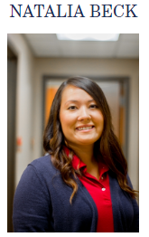
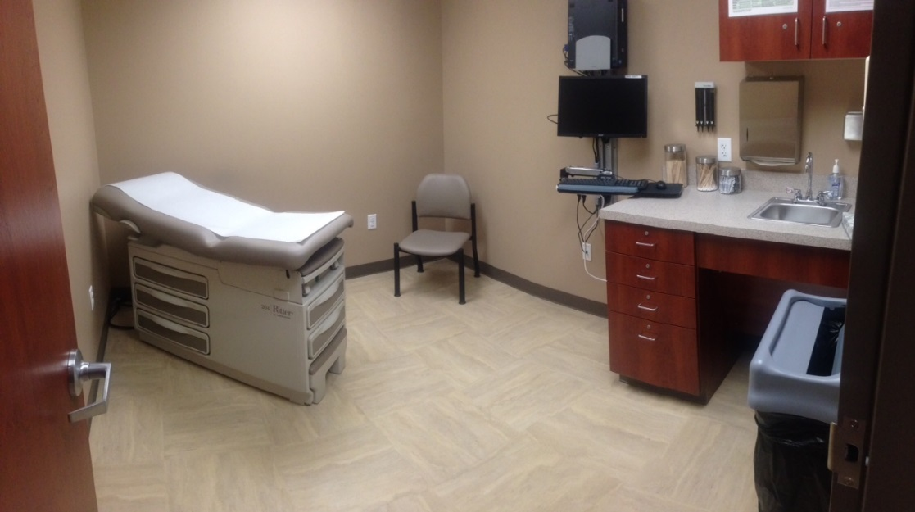
Medical
A. Overview
Nurse Practitioner: Natalia Beck
Medical Assistant: Jessica Alvarado
Collaborating Physician: provides ongoing medical consultation to Nurse Practitioner
3 exam rooms

Slide 9
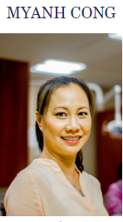
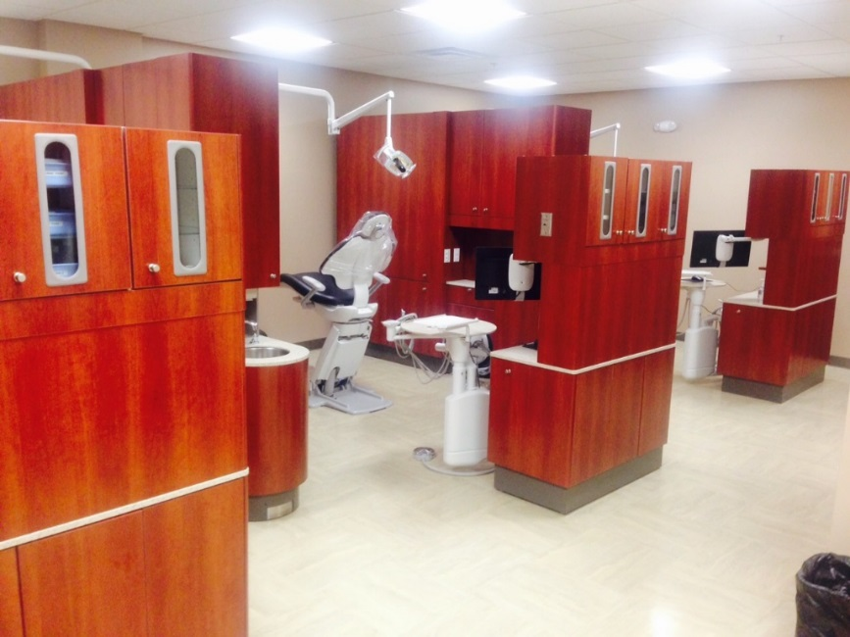
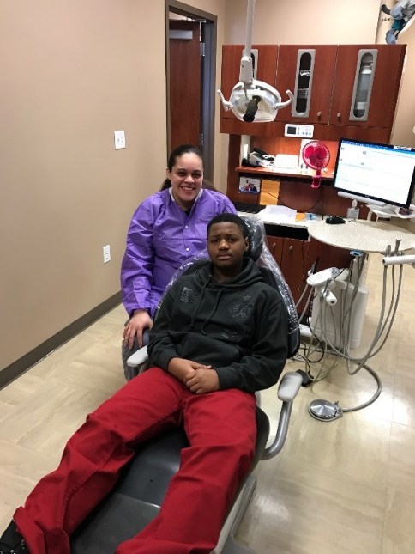
Dental
A. Overview
Dentist: Dr. Myanh Cong
Dental Assistant: Malika Porter
Dental Hygienist: Rachel Ludd
3 Dental chairs
Provide comprehensive dental services

Slide 10
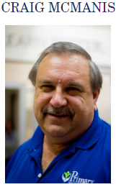
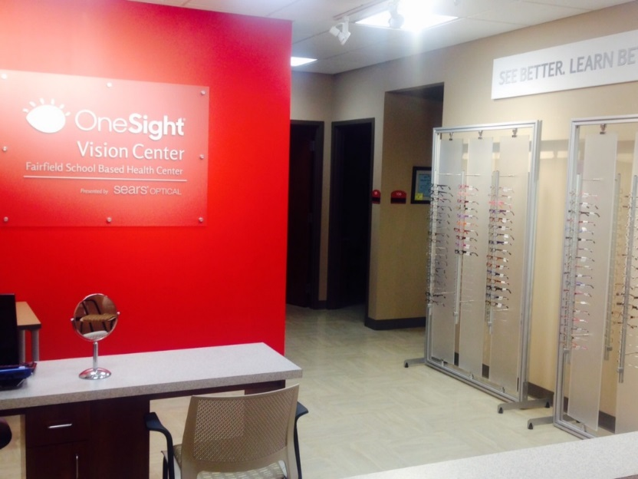
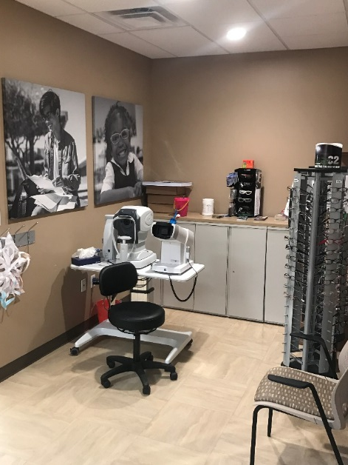
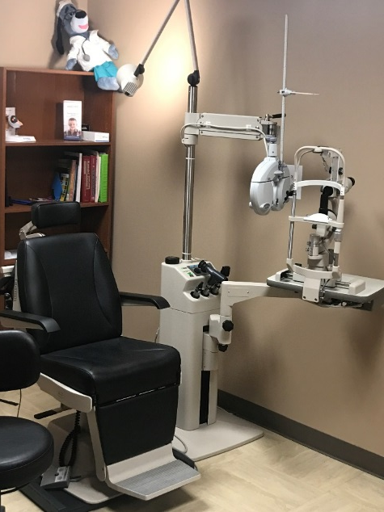
Vision Services
A. Overview
Optometrist: Dr. Craig McManis
Optometric Tech: Allison Mitchell
Optician: Dana Meeks
2 exam rooms, prescreening area, and selection/fitting area.

Slide 11
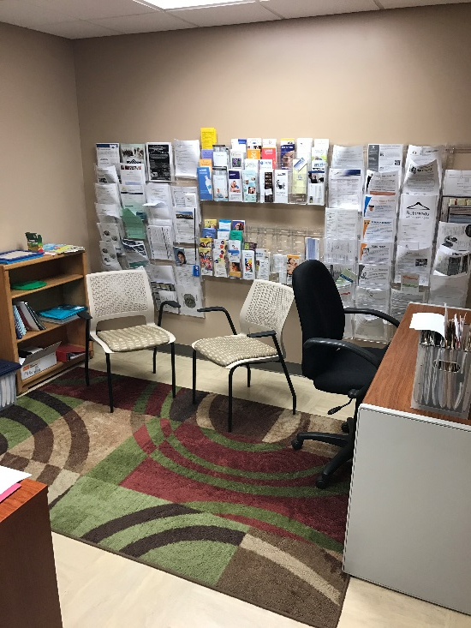
Behavioral Health
Overview
Behaviorist: Margie Braunstein, LISW
Helps identify students and family members with mental health needs, resulting in referrals for ongoing care.
Screening will be in collaboration with Nurse Practitioner

Slide 12
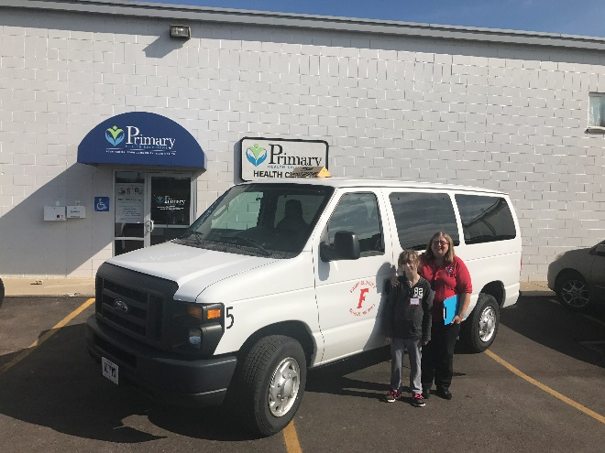
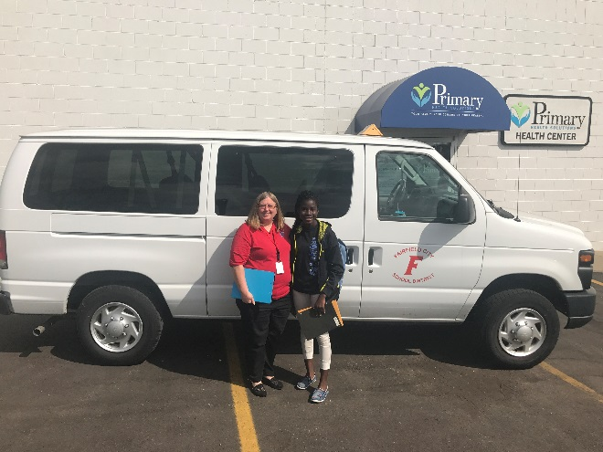
Transportation
A. Overview
Logistics/Transporter: Kay Carran
Students who attended Fairfield City Schools can be transported during their school day by our school staff.
Parents call Primary Health Solutions to make appointment during day, or school nurse does this on behalf of parent.
No additional cost for this service.

Slide 13
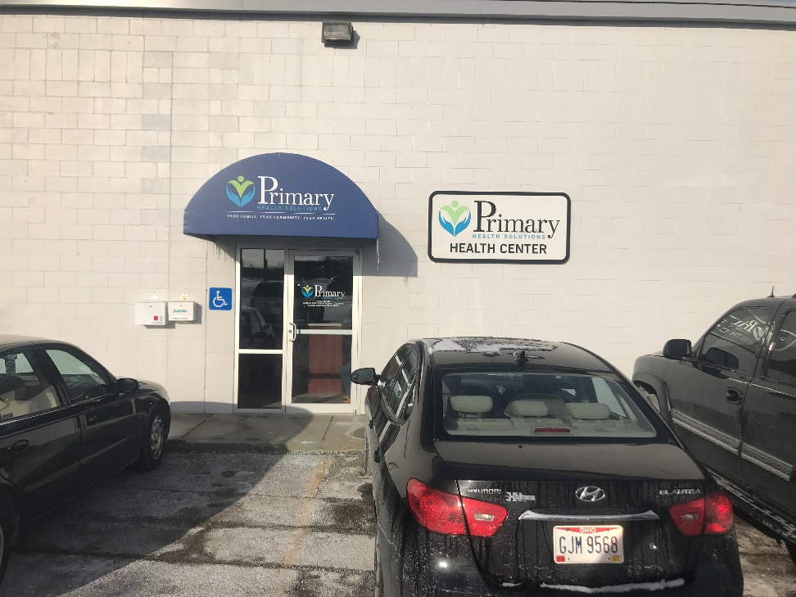
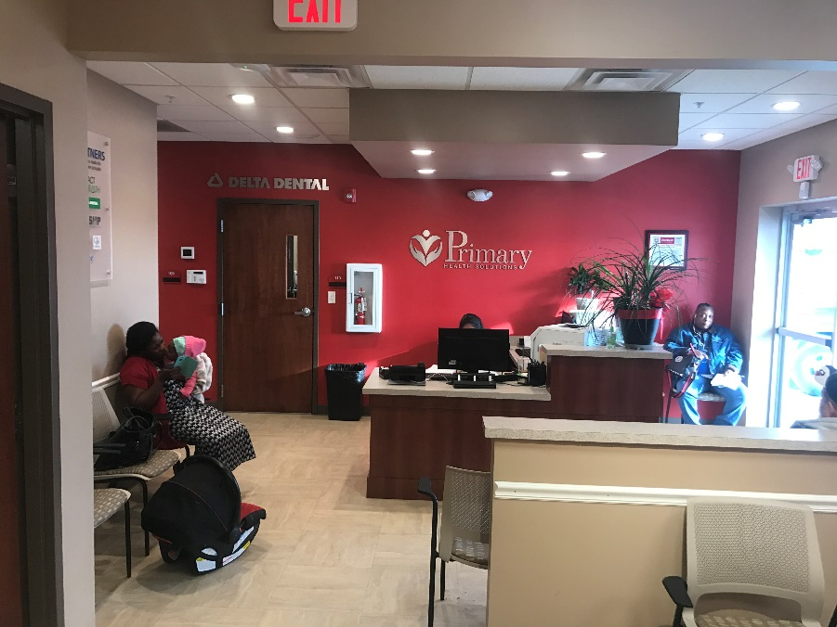
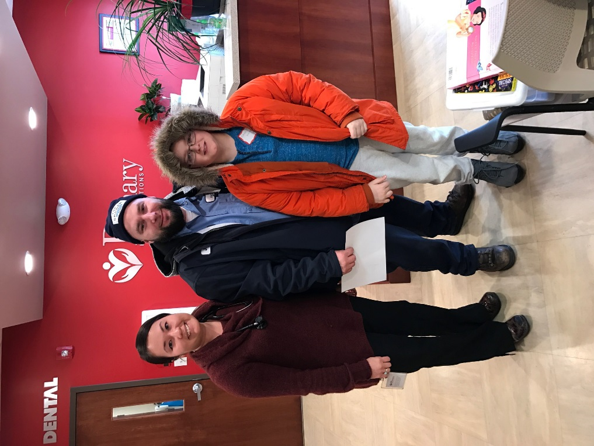
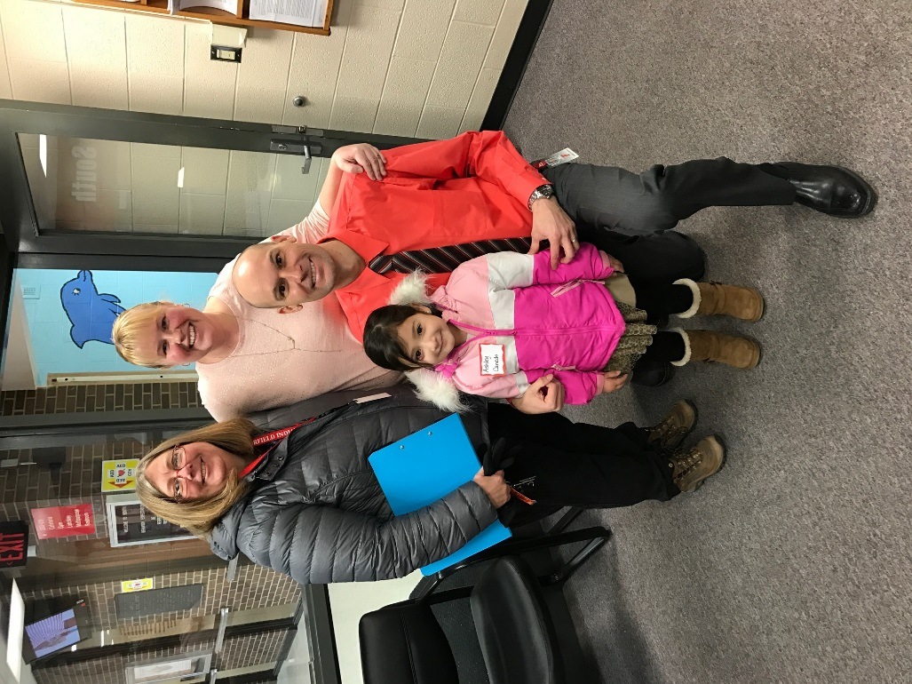
How Far Have We Come in 2 Years?

Slide 14
Dental
Month | 0-5 | 6-10 | 11-15 | 16-18 | 19-24 | 25-50 | 51+ | Total 18< | 19+ | Total Patients
January (2017) | 30 | 53 | 28 | 17 | 12 | 118 | 18 | 128 | 148 | 276
February | 33 | 42 | 36 | 19 | 17 | 93 | 27 | 130 | 137 | 267
March | 19 | 33 | 23 | 10 | 10 | 127 | 38 | 85 | 175 | 260
April | 19 | 55 | 33 | 26 | 13 | 102 | 39 | 133 | 154 | 287
May | 40 | 68 | 28 | 16 | 7 | 111 | 51 | 152 | 169 | 321
June | 40 | 53 | 39 | 11 | 13 | 127 | 51 | 143 | 191 | 334
July | 19 | 31 | 26 | 14 | 18 | 78 | 56 | 90 | 152 | 242
August | 28 | 42 | 41 | 13 | 12 | 95 | 44 | 124 | 151 | 275
September | 43 | 55 | 33 | 7 | 9 | 75 | 44 | 138 | 128 | 266
October | 37 | 60 | 53 | 18 | 8 | 110 | 54 | 168 | 172 | 340
November |  |  |  |  |  |  |  | 0 | 0 | 0
December |  |  |  |  |  |  |  | 0 | 0 | 0
Total | 308 | 492 | 340 | 151 | 119 | 1036 | 422 | 1291 | 1577 | 2868
 |  | 45.01% | of patients 18 and below
 |  | 54.99% | of patients 19 and above
 |  | 13.22 | Average Patients Per Day

Slide 16
Vision
 | 0-5 | 6-10 | 11-15 | 16-18 | 19-24 | 25-50 | 51+ | 19+ | Total 18< | Total Patients
January (2017) | 10 | 21 | 12 | 7 | 8 | 26 | 11 | 45 | 50 | 95
February | 3 | 24 | 22 | 3 | 5 | 33 | 13 | 51 | 52 | 103
March | 8 | 47 | 30 | 21 | 10 | 51 | 25 | 86 | 106 | 192
April | 12 | 44 | 35 | 8 | 13 | 45 | 37 | 95 | 99 | 194
May | 3 | 36 | 30 | 23 | 7 | 63 | 90 | 160 | 92 | 252
June | 13 | 15 | 18 | 8 | 13 | 47 | 29 | 89 | 54 | 143
July | 8 | 29 | 22 | 5 | 2 | 59 | 39 | 100 | 64 | 164
August | 8 | 54 | 39 | 8 | 3 | 67 | 42 | 112 | 109 | 221
September | 22 | 38 | 35 | 14 | 4 | 35 | 20 | 59 | 109 | 168
October | 14 | 42 | 28 | 3 | 8 | 33 | 22 | 63 | 87 | 150
November |  |  |  |  |  |  |  | 0 | 0 | 0
December |  |  |  |  |  |  |  | 0 | 0 | 0
Total | 101 | 350 | 271 | 100 | 73 | 459 | 328 | 860 | 822 | 1682
 |  |  | 48.87% | of patients 18 and below
 |  |  | 51.13% | of patients 19 and above
 |  |  | 7.75 | Average Patients Per Day

Slide 18
Behavioral Health
 | 0-5 | 6-10 | 11-15 | 16-18 | 19-24 | 25-50 | 51+ | 19+ | Total 18< | Total Patients
January (2017) | 6 | 6 | 7 | 3 | 7 | 17 | 19 | 43 | 22 | 65
February | 8 | 9 | 10 | 4 | 3 | 20 | 6 | 29 | 31 | 60
March | 9 | 19 | 8 | 8 | 5 | 11 | 8 | 24 | 44 | 68
April | 1 | 11 | 11 | 8 | 2 | 23 | 6 | 31 | 31 | 62
May | 1 | 7 | 13 | 7 | 2 | 21 | 9 | 32 | 28 | 60
June | 4 | 5 | 4 | 4 | 4 | 17 | 11 | 32 | 17 | 49
July | 6 | 3 | 9 | 0 | 6 | 17 | 9 | 32 | 18 | 50
August | 3 | 3 | 11 | 4 | 3 | 6 | 8 | 17 | 21 | 38
September | 4 | 8 | 15 | 5 | 1 | 16 | 9 | 26 | 32 | 58
October | 2 | 13 | 12 | 8 | 1 | 7 | 2 | 10 | 35 | 45
November |  |  |  |  |  |  |  | 0 | 0 | 0
December |  |  |  |  |  |  |  | 0 | 0 | 0
YTD Total | 44 | 84 | 100 | 51 | 34 | 155 | 87 | 276 | 279 | 555
 |  |  | 50.27% | of patients 18 and below
 |  |  | 49.73% | of patients 19 and above
 |  |  | 2.56 | Average Patients Per Day

Slide 20
Medical
 | 0-5 | 6-10 | 11-15 | 16-18 | 19-24 | 25-50 | 51+ | 19+ | Total 18< | Total
January (2017) | 77 | 40 | 30 | 10 | 17 | 97 | 26 | 140 | 157 | 297
February | 112 | 55 | 44 | 18 | 10 | 96 | 44 | 150 | 229 | 379
March | 101 | 66 | 58 | 30 | 9 | 96 | 52 | 157 | 255 | 412
April | 79 | 42 | 38 | 28 | 10 | 112 | 63 | 185 | 187 | 372
May | 80 | 33 | 38 | 21 | 7 | 106 | 41 | 154 | 172 | 326
June | 57 | 30 | 28 | 17 | 12 | 72 | 35 | 119 | 132 | 251
July | 81 | 37 | 26 | 14 | 20 | 87 | 54 | 161 | 158 | 319
August | 97 | 54 | 65 | 22 | 9 | 82 | 63 | 154 | 238 | 392
September | 78 | 42 | 54 | 26 | 4 | 69 | 49 | 122 | 200 | 322
October | 99 | 59 | 59 | 34 | 17 | 103 | 48 | 168 | 251 | 419
November |  |  |  |  |  |  |  | 0 | 0 | 0
December |  |  |  |  |  |  |  | 0 | 0 | 0
Total | 861 | 458 | 440 | 220 | 115 | 920 | 475 | 1510 | 1979 | 3489
 |  | 56.72% | of patients 18 and below
 |  | 43.28% | of patients 19 and above
 |  | 16.08 | Average Patients Per Day

Slide 22
Summary
Overview of Patients Seen: 2016 vs. 2017
 | 2016: 18< | 2017: 18< | 2016: 19+ | 2017: 19+ | % Increase | Total
Medical | 1326 | 1979 | 792 | 1510 | 64.73% | 5607
Dental | 985 | 1291 | 1004 | 1577 | 44.19% | 4857
Vision | 285 | 822 | 216 | 860 | 235.73% | 2183
Behaviorial Health | 212 | 279 | 253 | 276 | 19.35% | 1020
Total | 2808 | 4371 | 2265 | 4223 | 69.41% | 13,667
52.53% | are patients 18 and below
47.47% | are patients 19 and above
13,667 | Patients seen since opening on January 14, 2016
Original Goal Projected by Primary Health Solutions
Medical | 2631 annual patients | 11.96 patients per day
Dental | 2027 annual patients | 9.21 patients per day
Vision | 4113 annual patients | 18.7 patients per day
Total | 8771 annual patients | 39.87 patients per day
Total Patients Seen by November 2017: | 8594 annual patients

Slide 23
Transportation

Slide 24
Consent Paperwork
Health Center: Consent Paperwork
2016-2017
Number of Student With Consent Paperwork |  | North | South | East | West | Comp | central | FIS | FMS | FFS | FHS
Medical | 1001 | 37 | 124 | 77 | 88 |  | 183 | 188 | 101 | 60 | 143
Dental | 1022 | 38 | 138 | 82 | 88 |  | 182 | 198 | 104 | 57 | 135
Vision | 1026 | 37 | 136 | 79 | 89 |  | 184 | 192 | 107 | 60 | 142
Transportation | 868 | 32 | 121 | 71 | 84 |  | 176 | 177 | 101 | 51 | 124
Total | 3917
2017-2018
Number of Student With Consent Paperwork |  | North | South | East | West | Comp | central | CX | CS | FFS | FHS
Medical | 1294 | 57 | 92 | 116 | 112 | 140 | 163 | 148 | 202 | 33 | 231
Dental | 1292 | 56 | 102 | 116 | 111 | 140 | 167 | 153 | 203 | 34 | 210
Vision | 1314 | 54 | 101 | 118 | 120 | 145 | 161 | 154 | 207 | 36 | 218
Transportation | 1219 | 51 | 91 | 116 | 100 | 130 | 158 | 147 | 191 | 34 | 201
Total | 5119
30.69% increase in students who have consented to 1 or more services.

Slide 25
Community Engagement
Representatives at all of our schools open houses
Booth at our staff vendor expo
Booth at the Butler County Resource Expo
Attended opening events at Rethreads
Sponsored ads for the High School newspaper, and Crystal Classic
Sponsored the Christmas luncheon at the Academy
Preventive education (vision and dental) at North Elementary
Participated in the Freshman reality check, giving out promo info at each
Sponsored the Football and Basketball broadcasts on WMOH – entire seasons
Sponsored 1600 water bottles for the Intermediate School field Day
Held Luncheon for principals, administrators & nurses
Numerous (at least 20+) community events, including the Butler Co. Fair last year
Promoted through Fairfield Chamber and Leadership Fairfield activities
Held a “Party in the Parking Lot” last summer
Promote through Social Media – Facebook, LinkedIn, Instagram, Twitter

Slide 26
Testimonials
“I have used the Health Center not only for students here at school, but my own children. My boys used the dental services and got their teeth cleaned a few months ago. It is very difficult for me to find a sub to cover the clinic in order to take my sons to health appointments. I was able to schedule their appointments very easily, and then Mrs. Carran transported them to and from the Health Center. The boys were taken care of, and I didn't even have to leave my office! The Health Center is a wonderful resource, and I plan to continue to use their services.”
-Kelly Moorman, South School Nurse and Parent
“The health center has been such a positive resource to the students here at the Middle School. I have recommended it to parents who do not have a regular doctor for their children and the parents have been grateful for this resource. Students have been able to receive glasses, updated immunizations and dental care. Bonus about this is students can receive services and return to school the same day. There is little interruption of their school day.”
-Lynn King, FMS School Nurse
“We have had several students who came to Central from extremely impoverished countries (specifically from areas of Guatemala and Ghana) who have never gotten medical or dental attention prior to coming to the US. Rosina Philpot and Lindsey Hersha have been able to get the families the support and health care they needed.”
-Karrie Gallo, Principal Central Elementary
“The health center worked with us and provided the opportunity for our most at-risk HS students to obtain the required immunizations so students could continue to attend school. Teachers and administrators were presented with resources by the behavior consultant from PHS in order to ask the right questions and know how to react with students in crisis.”
-Kari Franchini, Director Fairfield Academy

Slide 27
Testimonials
“The ability to have students seen throughout their school day is invaluable to those parents who are unable to leave work and it benefits the students by getting them early care so that their illness is not prolonged and they are able to return to school more quickly. As the school nurse, I find it very helpful to give the clinic as a viable option for those families who may not have an established health care provider or our having difficulty finding care due to their insurance or lack there of.” -Pamela Buehler, FIS School Nurse
“Anyone who has never had to use public insurance does not understand the challenges that families face when trying to find a provider who accepts Medicaid and its HMOs. It is truly a frustrating experience. For our families to be able to access medical, dental and vision care all in one place that accepts their insurance has made such an amazing impact for those families. And for them to be able to offer a sliding fee scale for uninsured patients is something that no other area medical provider can do. I do not know what we ever did without them.”
-Rosina Philpot, Butler County Success Community Liaison
“I had a student come in with excruciating tooth pain, he looked absolutely miserable. I took a look and he had severe tooth decay and said that his tooth had been hurting for a very long time. I talked to his mom and she said they were new to the area and they could not find a dentist. So I called over to PHS and they were able to get the student in for an emergency visit forty minutes later. Mom was so appreciative when I called her back, as was the student. PHS really pulled through in this family’s time of need. I was very impressed and grateful for being able to work with PHS. -Katrina McVey, Central School Nurse
“I like coming here. Its (Health Center) Fun!”
-2nd Grader, South Elementary

Slide 28
More Information
www.fairfieldcityschools.com
Click on “about us” tab
Click on “School Based Health Center Info”
B. http://www.myprimaryhealthsolutions.org
Consent forms available
Available in Spanish and English

Slide 29
Questions?

