Slide 1


Health in All Policies as a Collaborative Approach
to Address Community Health
Communities Joined in Action February 14, 2018 | Atlanta, GA

Slide 2

YOUR PRESENTERS
Jimmy Dills, MUP MPH Health Integration Associate
jdills@gsu.edu
Michelle Rushing, MPH Policy Impact Specialist
mmarcus2@gsu.edu
Notes:
Jimmy

Slide 3

SESSION OVERVIEW
Intros & Images of Impacts
Health in All Policies
Housing in GA & AL
Community Redevelopment in WI
Comprehensive Planning in KY
Resources and Q&A
Notes:
Beth

Slide 4

YES, AND…INTROS
Pair up
Partner A & B
2 Minutes
Yes, and…
Notes:
Beth

Slide 5

IMAGES OF IMPACTS

Slide 6
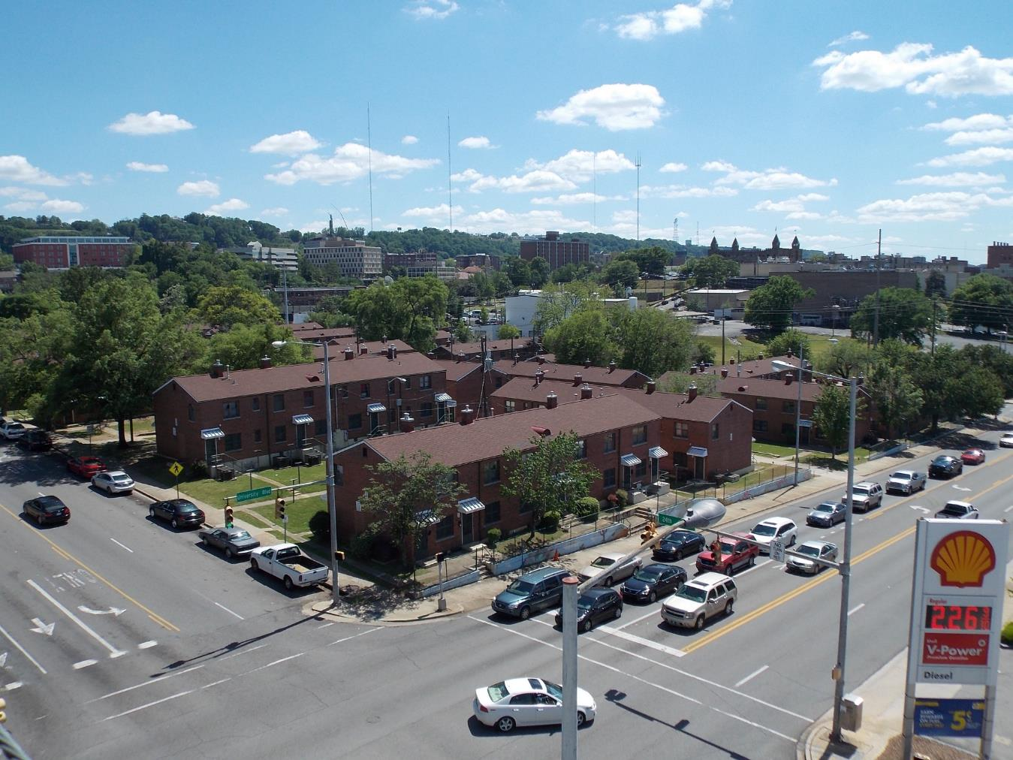

Slide 7
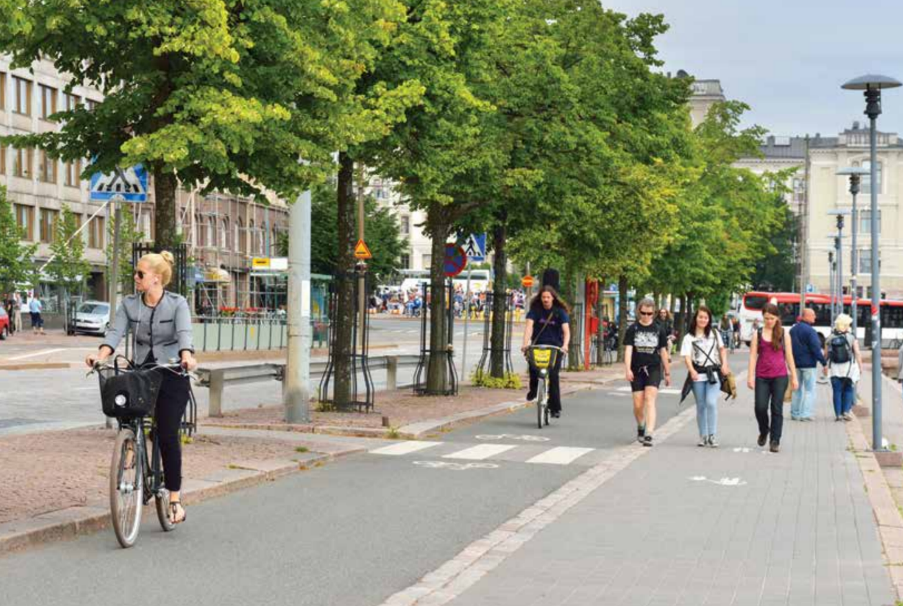

Slide 8
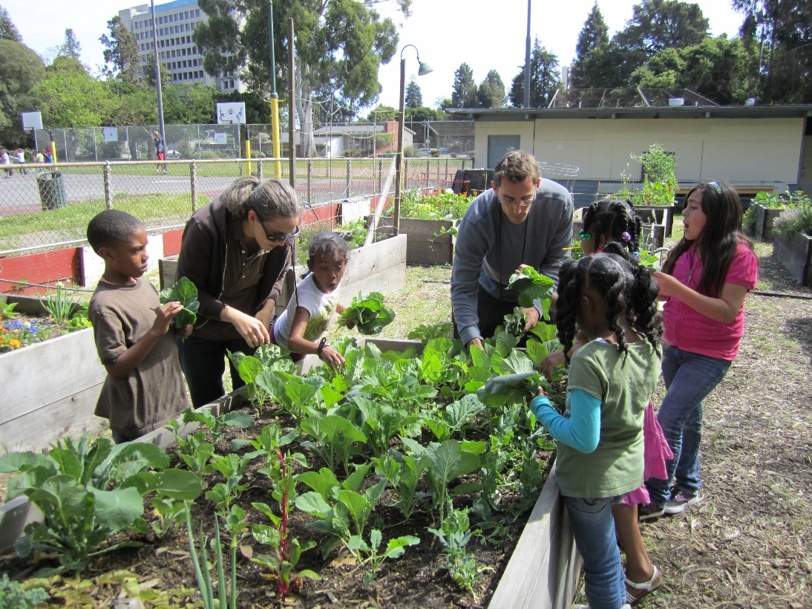

Slide 9

Health in All Policies: An Introduction

Slide 10

What is Health?
Health is “a state of complete physical, social and mental well-being, and not merely the absence of disease or infirmity.”
Furthermore, health is the ability of an individual or group “to identify and to realize aspirations, to satisfy needs, and to change or cope with the environment.”
1948 World Health Organization Constitution and the 1986 Ottawa Charter for Health Promotion
Notes:
10

Slide 11
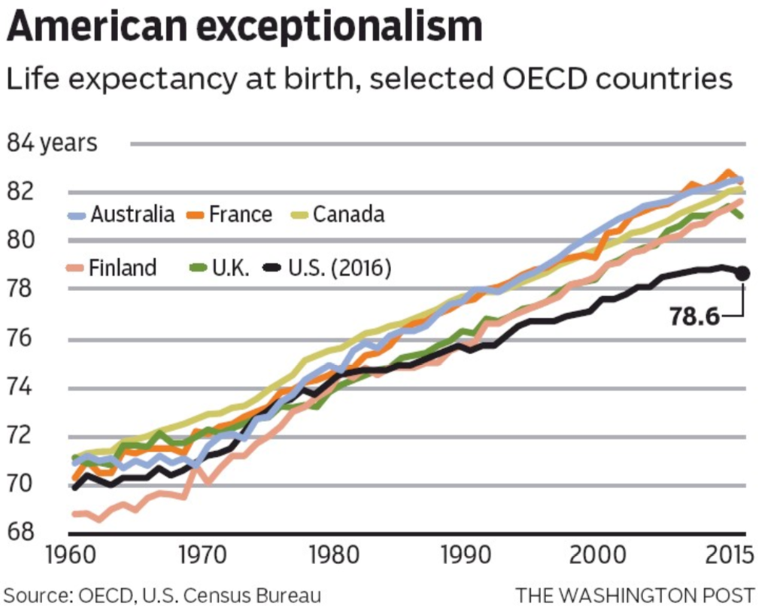
Source: https://www.pressreader.com/usa/the-atlanta-journal-constitution/20171228/281616715742663

Slide 12
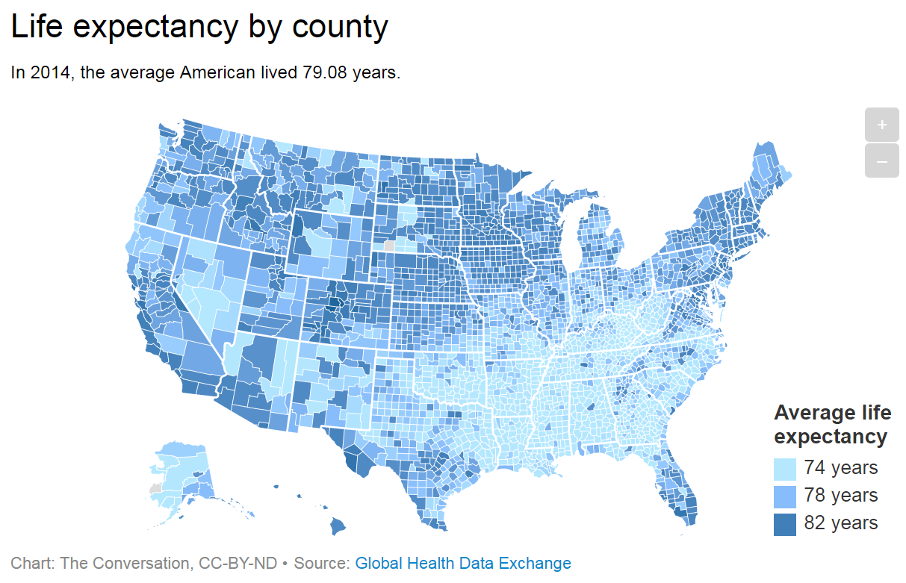
Source: ‘5 charts show why the South is the least healthy region in the US’ by Jay Maddock in The Conversation, February 5, 2018. Link

Slide 13
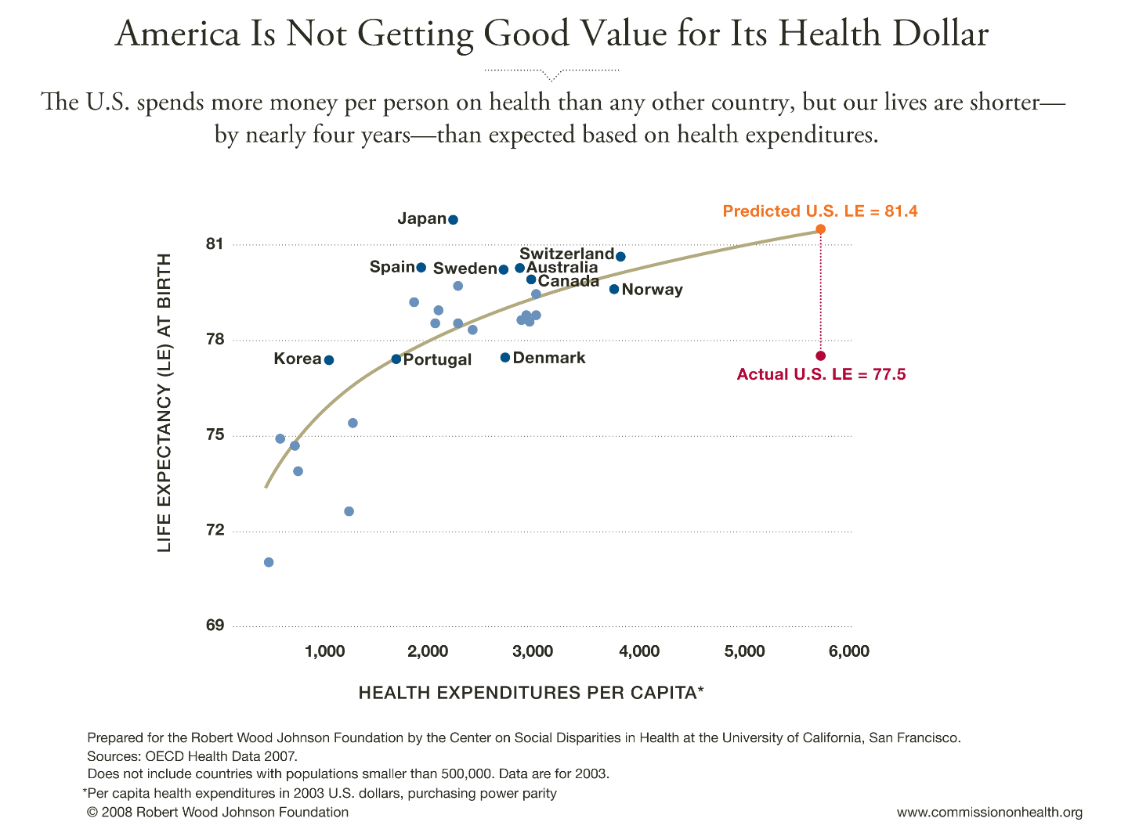

Notes:
The US leads the world in quality of medical services and spending on medical services. Yet we are far behind other developed countries in life expectancy, not even in the top 25. Why aren’t we getting more for our money?

Slide 14
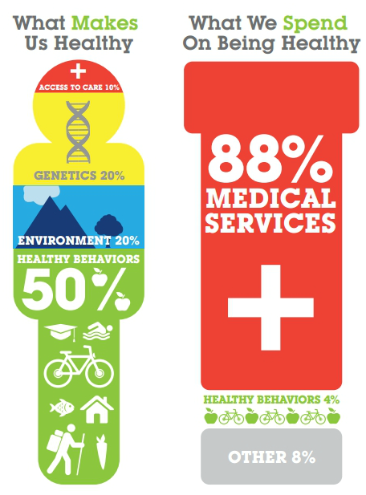
Source: The Bipartisan Policy Center
Notes:
Most of our investment is in health care. However, science has revealed that medical care only accounts for about 10% of physical and mental wellness. Where we live and the ways that we live contribute the majority of our health status. With that information, we also make small investments in healthy behaviors.

Slide 15
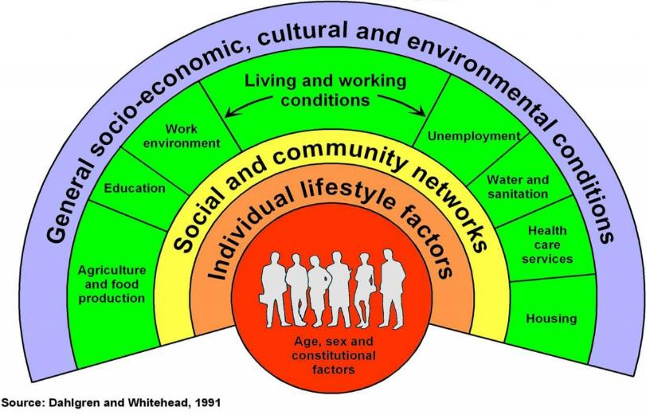
HEALTH DETERMINANTS
Notes:
And there are great disparities among subpopulations. Expected life of african american man vs. white man etc…

Slide 16
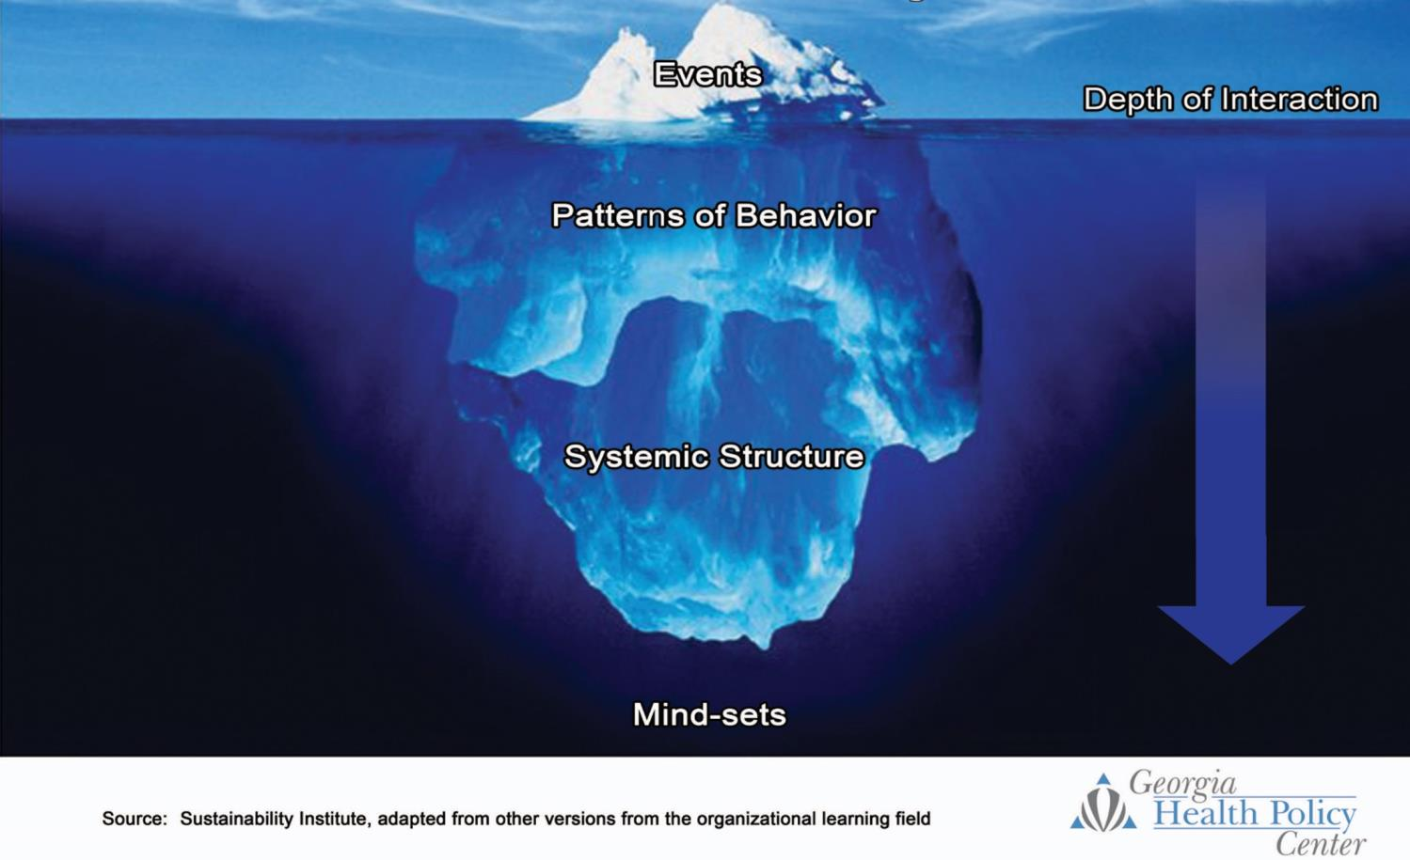
The Iceberg: A Metaphor for the Level at Which We Interact With a System
Heart disease, obesity, hypertension
Increasing Leverage
Fruit and vegetable consumption
Access to grocery stores
Should all neighborhoods have easy access to healthy foods?
Notes:
16

Slide 17

How Do We Increase Leverage?
One way is to develop a
Health in All Policies mindset…

Slide 18
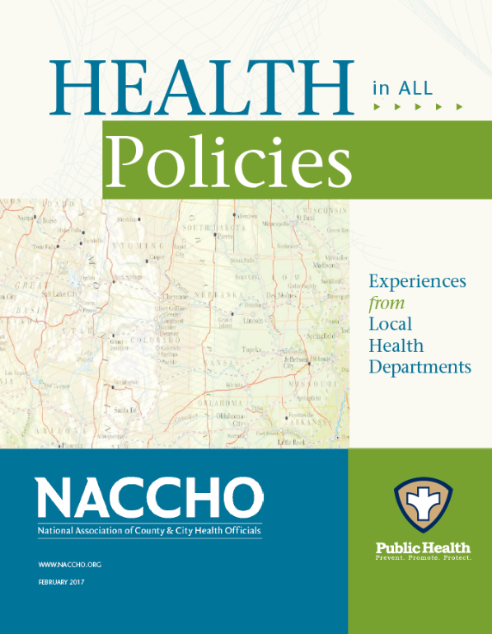
Health in All Policies (HiAP)
A “change in systems that determine how decisions are made and implemented by local, state, and federal governments to ensure that policy decisions have neutral or beneficial impacts on health determinants.”
Focuses on changing systems of decision-making, rather than changing a single decision.
http://www.naccho.org/uploads/downloadable-resources/NACCHO-HiAP-Report_Experiences-from-Local-Health-Departments-Feb-2017.pdf

Slide 19

Five HiAP Themes from NACCHO
Partnerships and Collaborations
Windows of Opportunity
Building Capacity
Embedding & Sustaining a Framework for Change
Challenges

Slide 20
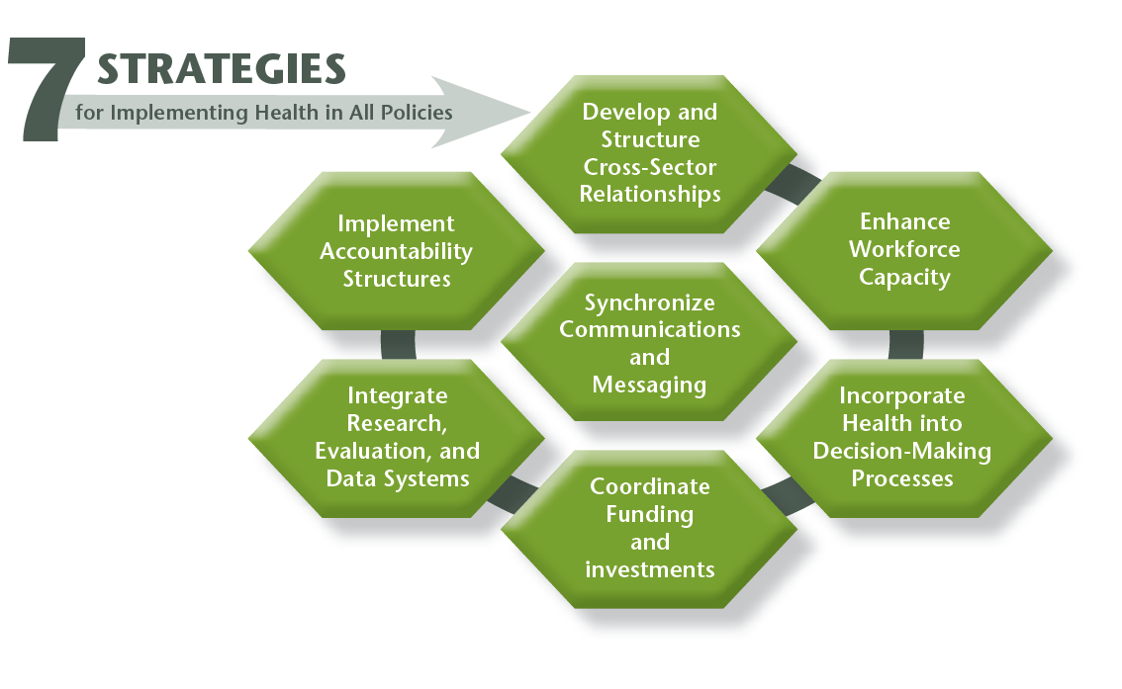
http://www.naccho.org/uploads/downloadable-resources/Programs/Community-Health/factsheet_hiap_dec2014-1.pdf

Slide 21

Importance of Context
HiAP driven heavily by local context
Successful initiatives in one place may not work in another
Absence of step-by-step process creates ambiguity for implementation
Difficulty in communicating outcomes or justifying resources

Slide 22

Health Impact Assessment (HIA) is a springboard for HiAP
For more on HIA visit hiasociety.org
Image: http://www.cincoanillos.com.ar/saltos-ornamentales/
Notes:
Beth

Slide 23


HIA DEFINED
A systematic process that uses an array of data sources and analytic methods and considers input from stakeholders to determine the potential effects of a proposed policy, plan, program, or project on the health of a population and the distribution of those effects within the population. HIA provides recommendations on monitoring and managing those effects.
Source: “Improving Health in the United States: The Role of Health Impact Assessments” by the National Research Council, September 2011
Notes:
Definition is from “Improving Health in the United States: The Role of Health Impact Assessments” by the National Research Council, September 2011.
Let’s break it down to clarify what the definition means.

Slide 24

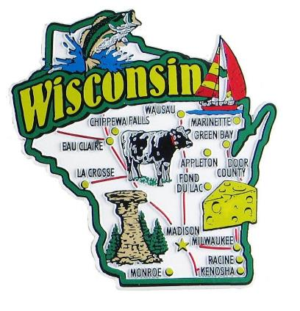
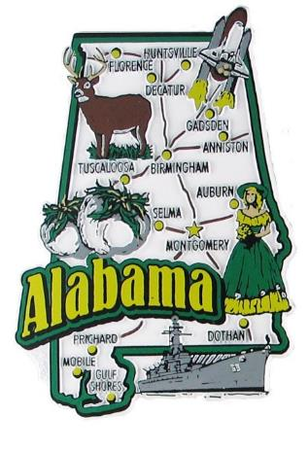
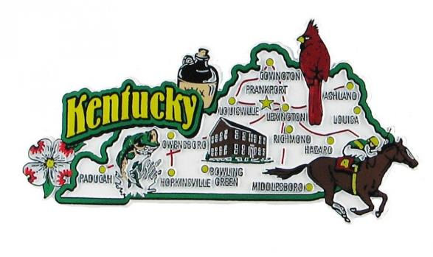
HiAP in Action: Experience from Georgia, Alabama, Wisconsin, & Kentucky

Slide 25




QUICK DESCRIPTION OF THE WORK
Notes:
Beth

Slide 26
QUICK DESCRIPTION OF THE WORK
The Geography
Notes:
Beth

Slide 27
QUICK DESCRIPTION OF THE WORK
The Geography
The Window of Opportunity
Notes:
Beth

Slide 28
QUICK DESCRIPTION OF THE WORK
The Geography
The Window of Opportunity
Key Stakeholders
Notes:
Beth

Slide 29
QUICK DESCRIPTION OF THE WORK
The Geography
The Window of Opportunity
Key Stakeholders
GHPC’s Role: Which Hat Did We Wear?
Notes:
Beth

Slide 30
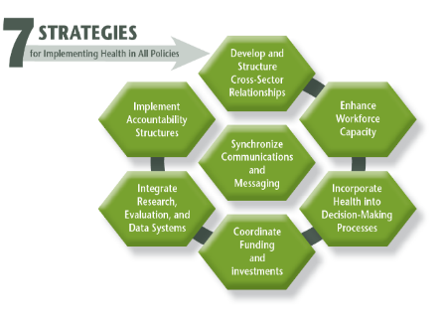


HiAP STRATEGY / CONCEPT EXAMPLES
Develop & Structure Cross-Sector Relationships
Enhance Capacity
Incorporate Health into Decision-Making
Coordinate Funding & Investment
Integrate Research, Evaluation, & Data
Implement Accountability
Synch Communication & Messaging
HIA Springboard
Context Factors
Notes:
Beth

Slide 31
AFFORDABLE HOUSING IN GA
Notes:
Beth

Slide 32
AFFORDABLE HOUSING IN GA
The Geography
Statewide policy
&
Local-level follow-up in 10+ communities around GA
Notes:
Beth

Slide 33
AFFORDABLE HOUSING IN GA
The Geography
Statewide policy
&
Local-level follow-up in 10+ communities around GA
The Window
HIA grant opportunity
&
Annual policy update for critical health determinant
Notes:
Beth

Slide 34
AFFORDABLE HOUSING IN GA
The Geography
Statewide policy
&
Local-level follow-up in 10+ communities around GA
The Window
HIA grant opportunity
&
Annual policy update for critical health determinant
Key Stakeholders
GA Dept. of Community Affairs
GA Dept. of Public Health
Housing Developers
Local Housing Authorities
Advocate Organizations
Residents
Notes:
Beth

Slide 35
AFFORDABLE HOUSING IN GA
The Geography
Statewide policy
&
Local-level follow-up in 10+ communities around GA
The Window
HIA grant opportunity
&
Annual policy update for critical health determinant
Key Stakeholders
GA Dept. of Community Affairs
GA Dept. of Public Health
Housing Developers
Local Housing Authorities
Advocate Organizations
Residents
GHPC’s Roles
Partner
Facilitator
Consultant
Evaluator
Notes:
JD

Slide 36
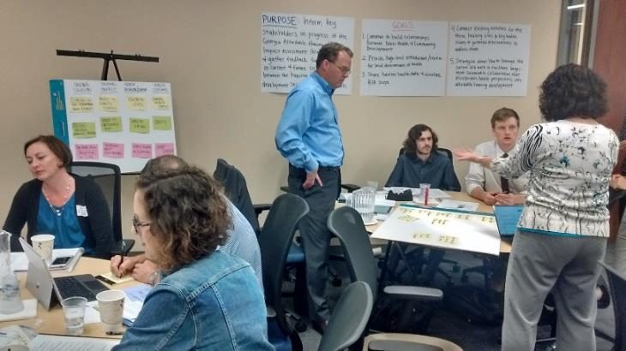
AFFORDABLE HOUSING IN GA
Develop & Structure Cross-Sector Relationships
Integrate Research, Evaluation, & Data
Incorporate Health into Decision-Making
Coordinate Funding & Investment
Implement Accountability
HIA Springboard
Collaborative workshops led to policy change incentivizing community partnerships between housing management & health service providers
Notes:
MR:
Cross-sector: Collaborative workshop during site-level HIA brought affordable housing experts together with public health experts from chronic disease, environmental health, and behavioral health to understand how housing can be more intentionally used as a platform for health promotion. One result was a policy change to reward demonstrated community level partnerships between housing managers and health service providers.

Slide 37

AFFORDABLE HOUSING IN GA
Develop & Structure Cross-Sector Relationships
Integrate Research, Evaluation, & Data
Incorporate Health into Decision-Making
Coordinate Funding & Investment
Implement Accountability
HIA Springboard
Readily available Dept. of Education data used to incentivize affordable units near higher quality schools, linking two critical health determinants
Notes:
MR:
Integrate data: QAP HIA led to streamlined use of DOE data to build incentive structure for locating affordable housing near higher quality schools. This connection to an existing and easy-to-use data source for school quality led to a three-fold increase in proposals where families are more likely to have access to better schools. This leverages the nexus between two important health determinants: affordable housing and education.

Slide 38

AFFORDABLE HOUSING IN GA
Develop & Structure Cross-Sector Relationships
Integrate Research, Evaluation, & Data
Incorporate Health into Decision-Making
Coordinate Funding & Investment
Implement Accountability
HIA Springboard
Health outcomes for residents now included as a ‘State Priority’ for housing, emphasizing “site selection, site design, community partnerships, and focused services”
Notes:
MR: Health into decision-making: promoting health added as a state priority for housing in 2017, which provides strong justification for future involvement of public health perspectives in affordable housing development in Georgia.

Slide 39

AFFORDABLE HOUSING IN GA
Develop & Structure Cross-Sector Relationships
Integrate Research, Evaluation, & Data
Incorporate Health into Decision-Making
Coordinate Funding & Investment
Implement Accountability
HIA Springboard
DCA & GHPC collaborating on funding proposals, with Kresge-funded GA Homes for Healthy Futures focused on collecting cost-related data
Notes:
MR:
Coordinate funding: DCA has collaborated with GHPC on health-based funding proposals, most significantly the Kresge-funded GA Homes for Healthy Futures project that aims to evaluate changes in healthcare costs and utilization for residents of housing units redeveloped under a healthy and green model. This type of evaluation should help monetize health benefits of public investments in affordable housing, in turn leading to opportunities for better coordination between state agencies that pay for health care and those that fund health determinants (like housing).

Slide 40
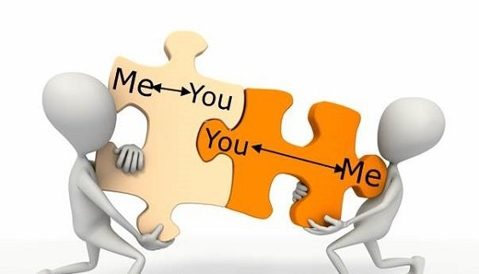
AFFORDABLE HOUSING IN GA
Develop & Structure Cross-Sector Relationships
Integrate Research, Evaluation, & Data
Incorporate Health into Decision-Making
Coordinate Funding & Investment
Implement Accountability
HIA Springboard
Not fully realized yet, but continued refinement of evaluation requirements for housing-based health promotion efforts moves toward a true accountability structure
Notes:
MR: Implement Accountability: This is one of the most challenging HiAP strategies to fully realize. The GA QAP comes close by requiring developers to evaluate effectiveness of their on-site Healthy Housing Initiatives for residents. This is an initial step for defining a full accountability structure wherein health promotion activities are required to demonstrate a certain level of success or face some consequence.

Slide 41
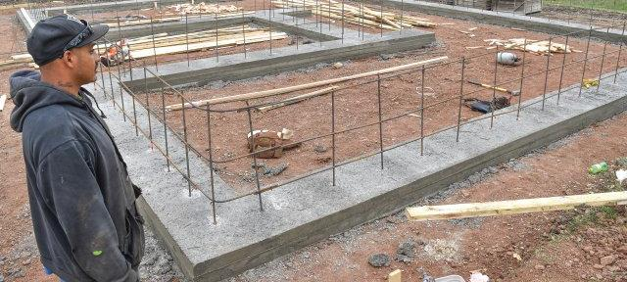
AFFORDABLE HOUSING IN GA
Develop & Structure Cross-Sector Relationships
Integrate Research, Evaluation, & Data
Incorporate Health into Decision-Making
Coordinate Funding & Investment
Implement Accountability
HIA Springboard
HIA work started in 2013 is the foundation for an ongoing relationship between DCA and GHPC that has received national recognition for innovation in HiAP
Notes:
MR:
HIA springboard: Initial comprehensive HIA work began in 2013 and informed the 2015 policy. This was followed by a rapid HIA in 2016 that examined site-level implications of the 2015 policy. These two HIAs allowed GHPC to develop a deeper understanding of DCA policy-making and implementation around a specific affordable housing funding mechanism. We have become a trusted partner on subsequent policy updates, as well as collaborate on new projects like the GA Homes for Healthy Futures project that are all built on the relationships and stakeholder alignment that began with HIA.

Slide 42
AFFORDABLE HOUSING IN AL
Notes:
MR:
Based on our work with state housing policy in Georgia, we were invited to help start a similar conversation in Alabama.

Slide 43
AFFORDABLE HOUSING IN AL
The Geography
Statewide policies
Notes:
MR:
Alabama stakeholders wanted to learn from our work ing Georgia and apply it to similar state-level policies in their state.

Slide 44
AFFORDABLE HOUSING IN AL
The Geography
Statewide policies
The Window
Annual policy update for critical health determinant
&
Limited funding for HiAP
Notes:
MR:
Therefore the policy window was similar in that they were also considering annual updates to affordable housing policies like the QAP, providing a reoccurring decision-point on which to focus.
They also had some limited funding from the Health Impact Project to implement a HiAP project. This funding allowed them to lay the groundwork for a more sustained collaboration around housing and health.

Slide 45
AFFORDABLE HOUSING IN AL
The Geography
Statewide policies
The Window
Annual policy update for critical health determinant
&
Limited funding for HiAP
Key Stakeholders
Collaborative Solutions
&
Alabama Healthy Homes Initiative
Notes:
MR:
Collaborative Solutions is a state-wide non-profit focused on affordable housing and ending homelessness. They were the lead for the Alabama Healthy Homes Initiative, which included representation from state and local health departments, housing and social justice advocates, housing developers, academia, and rural health systems – among others.

Slide 46
AFFORDABLE HOUSING IN AL
The Geography
Statewide policies
The Window
Annual policy update for critical health determinant
&
Limited funding for HiAP
Key Stakeholders
Collaborative Solutions
&
Alabama Healthy Homes Initiative
GHPC’s Roles
Consultant
&
Facilitator
Notes:
MR:
GHPC helped with this HiAP initiative in two ways: first, we provided a rapid health review of Alabama’s 2015 QAP based on our experience with Georgia’s. Based on this review, we consulted with Collaborative Solutions on policy opportunities and recommendations for next steps in their state. Second, we were hired to design and facilitate the first convening of the Healthy Homes Initiative, which was a day-long workshop in Montgomery where Alabama stakeholders laid out their perspectives on housing and health concerns in their state. The purpose of the workshop was to collaboratively develop a work plan for the Initiative going forward.

Slide 47
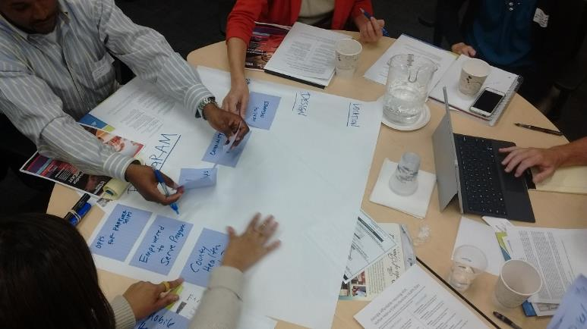
AFFORDABLE HOUSING IN AL
Develop & Structure Cross-Sector Relationships
Context Factors
Mix of perspectives at AHHI convening leading to collaborative priority-setting
Notes:
MR:
The biggest success from the AHHI convening was simply having the mix of perspectives in the room, where housing-focused stakeholders learned that they had allies in the public health world. Even for-profit housing developers, who were initially skeptical of new policy innovations, identified the face-to-face learning opportunity as beneficial. Health-focused stakeholders walked away with a better understanding of housing policies and programs. Housing-stakeholders walked away with new ideas about cross-sector partnerships.

Slide 48
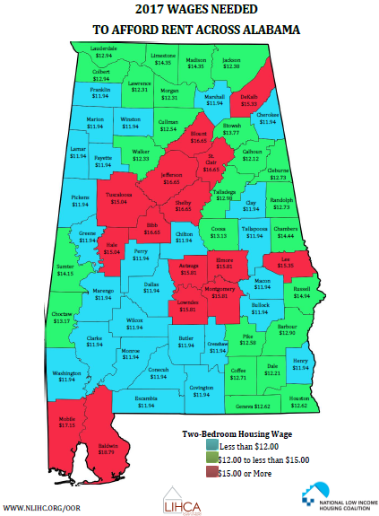
AFFORDABLE HOUSING IN AL
Develop & Structure Cross-Sector Relationships
Context Factors
Clear that Alabama wanted a solution derived from their perspective, learning from GA experience – not replicating it
Notes:
MR:
The work in Alabama is a great example of context determining the character of a HiAP approach. They recognized that, although broad policy contexts were fairly similar to Georgia (and other states), the state of readiness in Alabama was different. There was a clear mindset that Alabama needed to figure it out for themselves and not simply replicate Georgia’s work. It was also an opportunity for us as the facilitators to use our success and experience as guidance, but not as a ready-made solution.

Slide 49
COMMUNITY REDEVLOPMENT IN WI
Notes:
MR:
In Wisconsin, we have an example of HiAP in action at local-level.

Slide 50
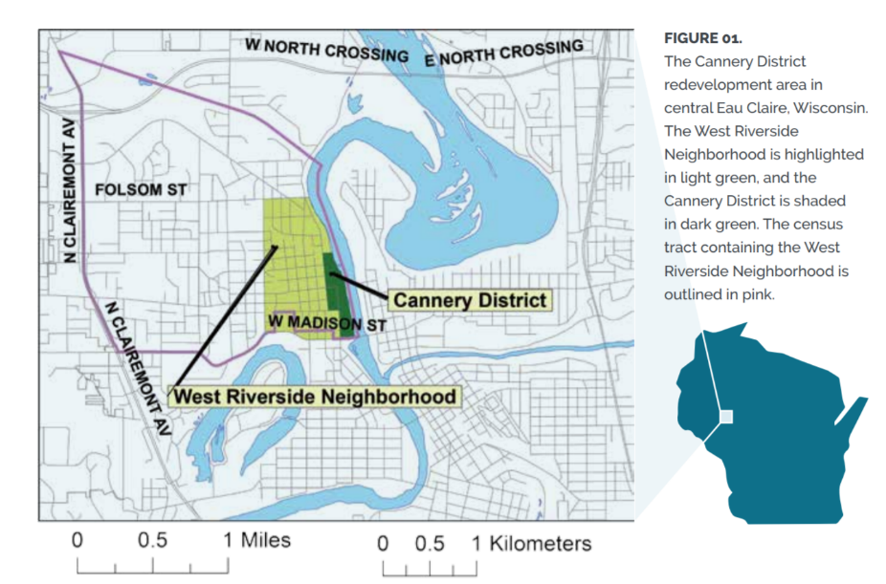
COMMUNITY REDEVLOPMENT IN WI
The Geography
Cannery District in Eau Claire, Wisconsin
Notes:
MR:
Here, the focus was on a specific area in the city of Eau Claire, a mid-size city in a rural part of the state. The area was called the Cannery District, a riverfront location that was being considered significant redevelopment.
[will pull a context map from report]

Slide 51
COMMUNITY REDEVLOPMENT IN WI
The Geography
Cannery District in Eau Claire, Wisconsin
The Window
Grant funding
HIA/HiAP language in both health & planning
Early stage of redevelopment
Notes:
MR:
The policy window in this case was the confluence of several factors. First: the health department had received grant funding from the Medical College of Wisconsin to conduct an HIA. Second, the local comprehensive plan had a Health chapter that includes language about piloting HIA as an approach; while the local Health Department had been exploring broader HiAP approaches to community health. Third, the Cannery Redevelopment was in it’s very early stages, which allowed room for health perspectives to be integrated in a wide range of decisions that had yet to be made.

Slide 52
COMMUNITY REDEVLOPMENT IN WI
The Geography
Cannery District in Eau Claire, Wisconsin
The Window
Grant funding
HIA/HiAP language in both health & planning
Early stage of redevelopment
Key Stakeholders
City-County Health Department
City Planning Department
Eau Claire Healthy Communities
Joining Our Neighbors Advancing Hope (JONAH)
Mayo Clinic Health System
Medical College of Wisconsin
Notes:
MR:
The project was led by the Eau Claire City-County Health Department, who assembled a diverse set of perspectives into the Cannery District HIA Project Team. This team included the planning department, a local health system, neighborhood-based organizations, universities, and others.

Slide 53
COMMUNITY REDEVLOPMENT IN WI
The Geography
Cannery District in Eau Claire, Wisconsin
The Window
Grant funding
HIA/HiAP language in both health & planning
Early stage of redevelopment
Key Stakeholders
City-County Health Department
City Planning Department
Eau Claire Healthy Communities
Joining Our Neighbors Advancing Hope (JONAH)
Mayo Clinic Health System
Medical College of Wisconsin
GHPC’s Role
Training, Mentoring & Technical Assistance
Notes:
MR:
GHPC’s role was to lean on our experience with HIA to provide training, mentoring, and technical assistance to the Eau Claire team. This included several in-person workshops and meetings, strategic thinking about the role of this HIA in the community’s broader vision for HiAP, along with regular consultation throughout the project.

Slide 54

COMMUNITY REDEVLOPMENT IN WI
Develop & Structure Cross-Sector Relationships
Integrate Research, Evaluation, & Data
Enhance Capacity
Synch Communication & Messaging
HIA Springboard
HIA team provided collaborative structure where strong relationships internally allowed for leverage of relationships external to core team
Notes:
MR:
As noted previously, the Eau Claire project team included a good variety of local perspectives on planning, development, and health. This HIA gave them a structure for collaboration focused on a specific project, leading to better understanding of how each group approaches their work. Having a close-knit project team also allowed them to leverage their relationships outside the core team to advance the goals of the HIA and HiAP generally.
An example of this was the planning department representative, who conveyed both a deep understanding of decision structures around a redevelopment of this scale – things the health stakeholders would have been unlikely to uncover alone – as well as inroads with the larger development community, with whom he could act as a trusted ambassador for the project.

Slide 55
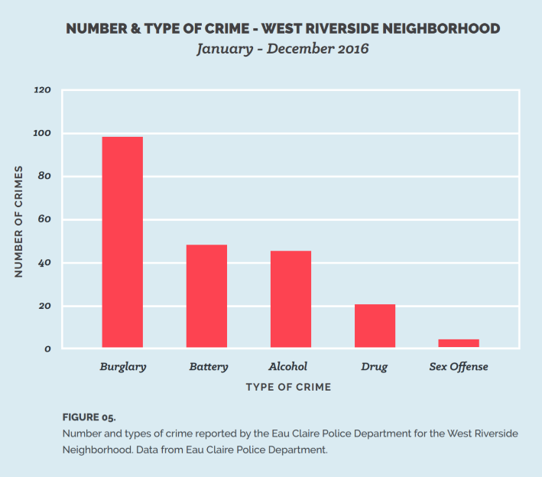
COMMUNITY REDEVLOPMENT IN WI
Develop & Structure Cross-Sector Relationships
Integrate Research, Evaluation, & Data
Enhance Capacity
Synch Communication & Messaging
HIA Springboard
HIA scope informed by Community Health Assessment (CHA) data and included new data from the affected communities
Notes:
MR:
This HIA provided a clear way to address priorities identified in the local Community Health Assessment (like obesity and mental health) through influence on non-health decisions that influence the broader social and environmental determinant of health – in this case the built environment. The HIA also integrated survey data from existing residents near the Cannery District redevelopment site; data on perspectives that otherwise would have been unlikely to be included in deliberations about the redevelopment.

Slide 56
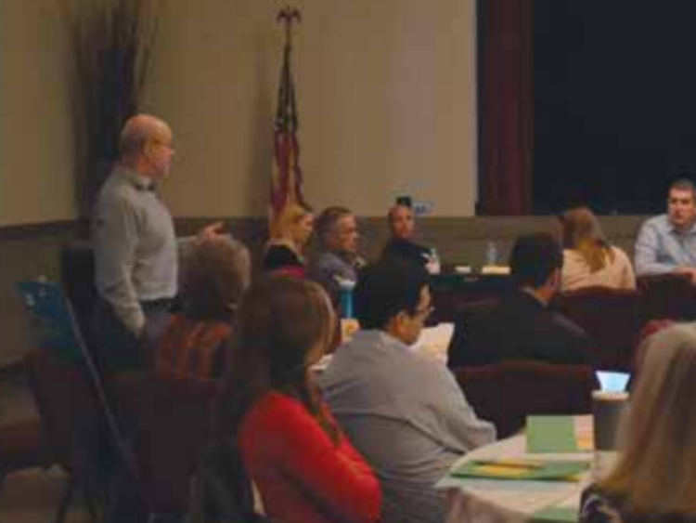
COMMUNITY REDEVLOPMENT IN WI
Develop & Structure Cross-Sector Relationships
Integrate Research, Evaluation, & Data
Enhance Capacity
Synch Communication & Messaging
HIA Springboard
Large community kick-off training on HIA process built capacity and strengthened relationships
Notes:
MR:
One of the first steps for GHPC once we were brought on board was to lead a community training on the HIA process. This day-long workshop included over 50 participants from across the Eau Claire community, many of whom would become intimately involved in the HIA as it progressed. In addition to strengthening cross-sector and community relationships, this was also an opportunity to build HiAP capacity for the health department and their stakeholders.

Slide 57
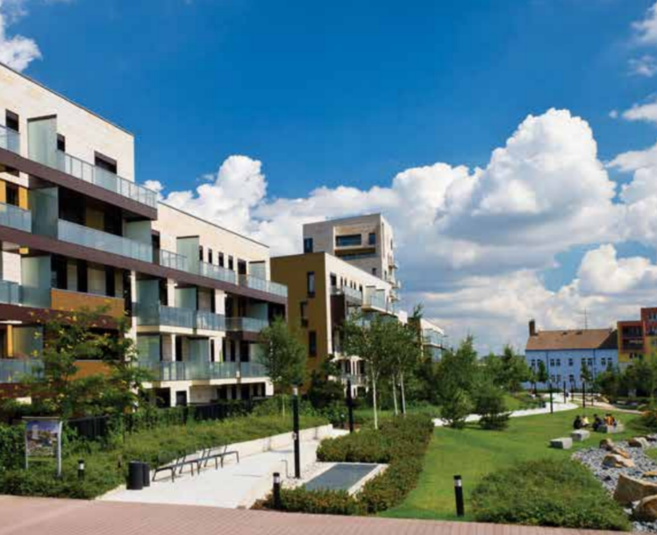
COMMUNITY REDEVLOPMENT IN WI
Develop & Structure Cross-Sector Relationships
Integrate Research, Evaluation, & Data
Enhance Capacity
Synch Communication & Messaging
HIA Springboard
Emphasizing role of HIA as an enhancement of not an impediment to development process led to more buy-in over time
Notes:
MR:
Clearly communicating the purpose of the HIA was important. There were initial perspectives among some on the development side that the health department was getting out of their lane and trying to interfere with economic development opportunities. Early messaging around the purpose of HIA as a tool to enhance the process, not to impede it, were critical in gaining tentative support from the development community. Through the course of the project, aligning health and planning messages led to better understanding by and eventually buy-in from skeptical stakeholders. By the end of the project, there had been a clear advancement toward broader community understanding of how built environment decision-making can be supported by intentionally integrating health perspectives.

Slide 58
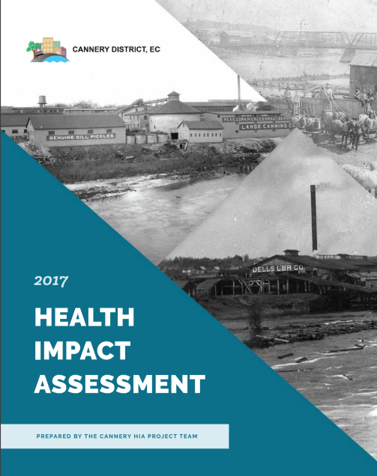
COMMUNITY REDEVLOPMENT IN WI
Develop & Structure Cross-Sector Relationships
Integrate Research, Evaluation, & Data
Enhance Capacity
Synch Communication & Messaging
HIA Springboard
Cannery HIA as a practical culmination of health-focused stakeholders’ work to get health concepts into comprehensive plan
Notes:
MR:
The Cannery HIA is a clear example of using HIA to advance broader HiAP perspectives. The health department and other local health-focused stakeholders had been working for some time to broaden the scope of their health promotion work to include more intentional involvement in decisions impacting social and environmental determinants of health. This is how they were able to collaborate on a health chapter in the local comprehensive plan. The HIA helped move this HiAP work from theoretical policy language to real-world community action.

Slide 59
COMPREHENSIVE PLANNING IN KY
Notes:
Beth

Slide 60
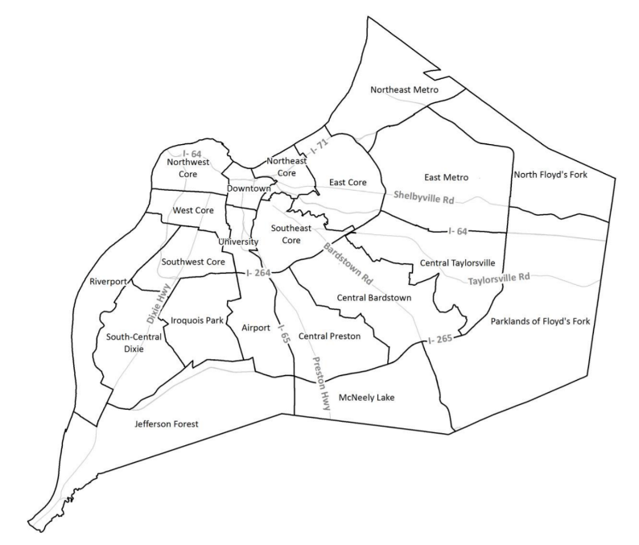
COMPREHENSIVE PLANNING IN KY
The Geography
Louisville-Jefferson County, KY
Notes:
Beth

Slide 61
COMPREHENSIVE PLANNING IN KY
The Geography
Louisville-Jefferson County, KY
The Window
Culture of Health Visibility
Comprehensive Plan Update with Work Group focused on Health
Notes:
Beth

Slide 62
COMPREHENSIVE PLANNING IN KY
The Geography
Louisville-Jefferson County, KY
The Window
Culture of Health Visibility
Comprehensive Plan Update with Work Group focused on Health
Key Stakeholders
Louisville Health Advisory Board
Metro Department of Public Health & Wellness
Develop Louisville
Institute for Health Air Water & Soil
Louisville HiAP Ambassadors
Notes:
Beth

Slide 63
COMPREHENSIVE PLANNING IN KY
The Geography
Louisville-Jefferson County, KY
The Window
Culture of Health Visibility
Comprehensive Plan Update with Work Group focused on Health
Key Stakeholders
Louisville Health Advisory Board
Metro Department of Public Health & Wellness
Develop Louisville
Institute for Health Air Water & Soil
Louisville HiAP Ambassadors
GHPC’s Role
Consultant
Notes:
Beth

Slide 64
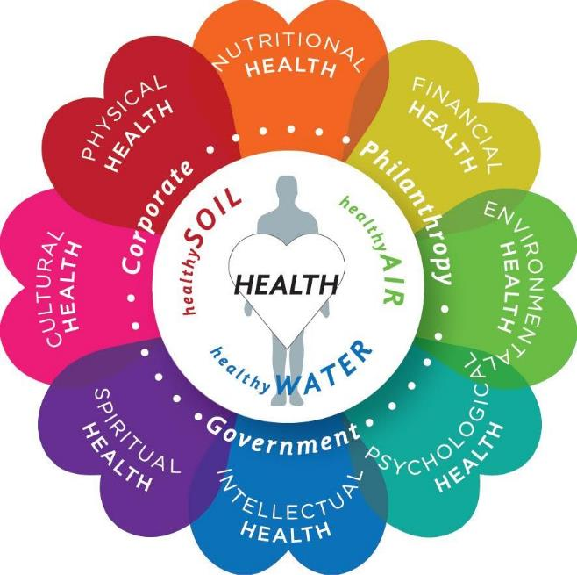
COMPREHENSIVE PLANNING IN KY
Develop & Structure Cross-Sector Relationships
Integrate Research, Evaluation, & Data
Enhance Capacity
Incorporate Health into Decision-Making
Context Factors
Broadening perspectives included in built environment planning and in health promotion
Notes:
JD

Slide 65
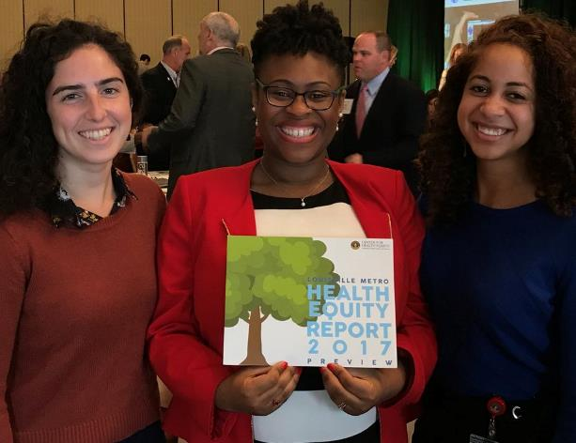
COMPREHENSIVE PLANNING IN KY
Develop & Structure Cross-Sector Relationships
Integrate Research, Evaluation, & Data
Enhance Capacity
Incorporate Health into Decision-Making
Context Factors
Alignment with CHA/CHIP process & Health Equity Report; better understanding of how data inform planning decisions
Notes:
Beth

Slide 66
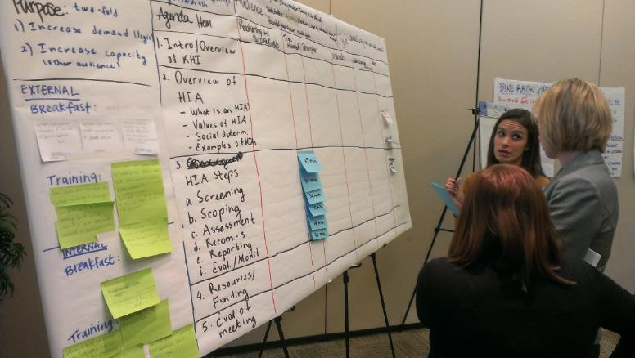
COMPREHENSIVE PLANNING IN KY
Community ‘CHASE Integration Workshops’ to drive holistic perspective and broaden participation – not just from the health perspective
Develop & Structure Cross-Sector Relationships
Integrate Research, Evaluation, & Data
Enhance Capacity
Incorporate Health into Decision-Making
Context Factors
Notes:
JD

Slide 67
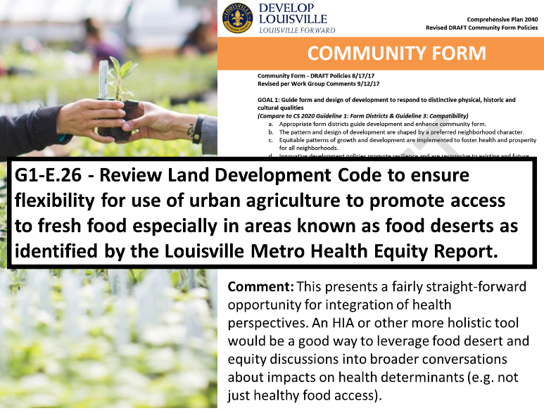
COMPREHENSIVE PLANNING IN KY
Develop & Structure Cross-Sector Relationships
Integrate Research, Evaluation, & Data
Enhance Capacity
Incorporate Health into Decision-Making
Context Factors
While health is part of guiding principles for the plan, we are still figuring out what that really looks like in practice
Notes:
JD

Slide 68
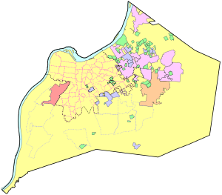
COMPREHENSIVE PLANNING IN KY
Challenging: comprehensive plan not as ‘high leverage’ as initially perceived. Real policy change requires sustained involvement, leading to focus on HiAP Ambassadors
Develop & Structure Cross-Sector Relationships
Integrate Research, Evaluation, & Data
Enhance Capacity
Incorporate Health into Decision-Making
Context Factors
Notes:
Beth

Slide 69


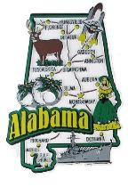
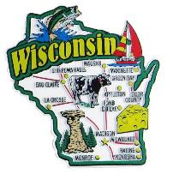

Project Resources
GHPC HiAP Page: http://ghpc.gsu.edu/areas-of-expertise/health-in-all-policies/
2015 GA QAP HIA: http://ghpc.gsu.edu/project/qap-qualified-allocation-plan/
2016 Site-level Affordable Housing HIA: http://ghpc.gsu.edu/project/georgia-affordable-housing-hia/
GA Homes for Healthy Futures: http://ghpc.gsu.edu/project/healthy-homes-for-healthy-futures/
Collaborative Solutions: https://collaborative-solutions.net/
Eau Claire Dept. of Health HIA Page: http://www.ci.eau-claire.wi.us/departments/health-impact-assessment
Louisville Comprehensive Plan: https://louisvilleky.gov/government/planning-design/comprehensive-plan

Slide 70

Thank You
Jimmy Dills, MUP MPH jdills@gsu.edu
Michelle Rushing, MPH mmarcus2@gsu.edu

