Slide 1
Introduction to 100MLives and 100MLives Members
Shemekka Ebony
Laura Brennan

Slide 2
100 Million Healthier Lives www.100mlives.org
Identity: An unprecedented collaboration of change agents pursuing an unprecedented result:
100 million people living healthier lives by 2020
Vision: to fundamentally transform the way we think and act to improve health, wellbeing and equity.

Slide 3
Theory of change – 100 Million Healthier Lives
Unprecedented collaboration
100 Million People Living Healthier Lives by 2020
Innovative improvement
System transformation

Slide 4
100 Million Healthier Lives Core Principles
Create equity, justice, strength and wholeness in the process of creating health.
Partner deeply and respectfully with people, especially those with lived experience.
Adopt a humble posture of learning and improvement.
Intentionally work to remove barriers in critical areas such as payment reform and policy through intentional collaboration with traditional and nontraditional partners.
Make our collaboration an example of what is possible.

Slide 5
Core Approach (Community of Solutions Skills)
Leading from within
Leading together
Leading for outcomes
Leading for equity
Leading for sustainability

Slide 6
100 Million Healthier Lives - Numbers
1,200 + members and partners
Reach >200 health systems and >200 communities
Reach to >300 million people in the US alone
Geographic hubs
People in 20+ other countries are joining the movement
Brazil, UK, Sweden, Scotland, Australia, Uganda, Canada, New Zealand, India, UAE, England, Afghanistan, Qatar, Ireland, Mexico, Tunisia, Guyana

Slide 7
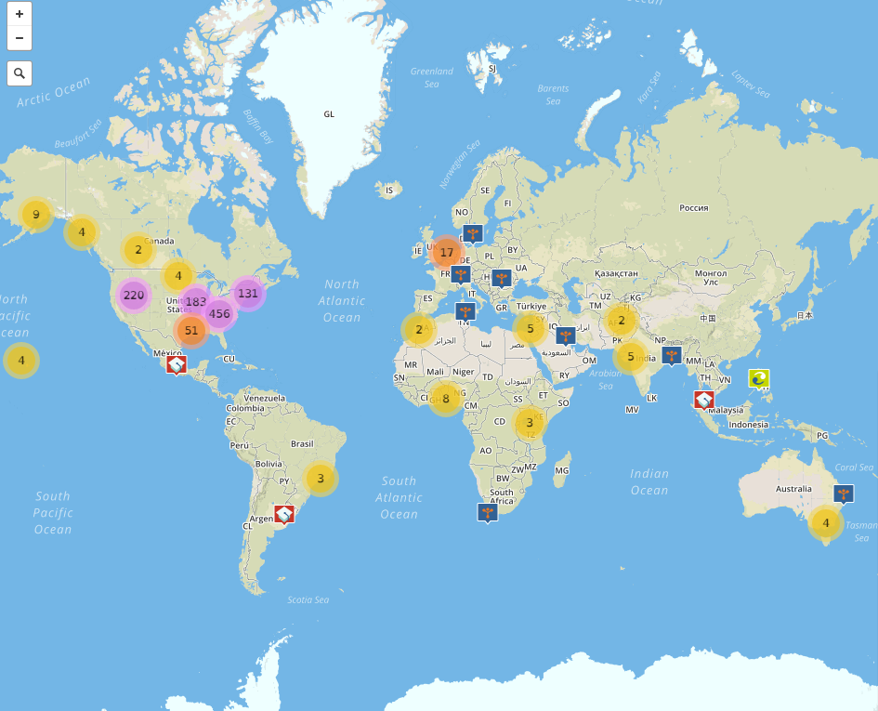
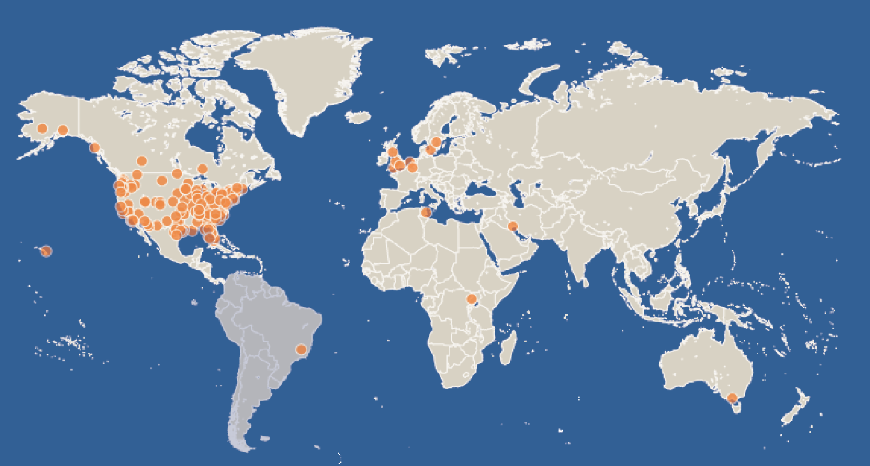
100 Million Healthier Lives Spread www.100mlives.org/map

Slide 8
Join: Membership & Engagement www.100mlives.org/join
If you haven’t already, we invite you to join us as a member, partner, or sponsor!
Members: Individuals and organizations working on the ground to improve health and who want to be part of a community working together to create the change that is needed.
Partners: Individuals and organizations who are ready and willing to play a leadership role in 100 Million Healthier Lives.
Sponsors: Individuals and organizations who can financially support 100 Million Healthier Lives.

