Slide 1
Communities Joined in Action 2018
Community Health and the Texas 1115 Healthcare Transformation Waiver
The Three Legs of Community Health: Public, Behavioral, and Safety Net Hospital
Craig Kovacevich, MA
Associate Vice President, Waiver Operations & Community Health Plans
University of Texas Medical Branch
Melissa Tucker, LCSW
Chief Executive Officer
Gulf Coast Behavioral Health
Kathy Barroso
Chief Executive Officer
Galveston County Health District
February 16, 2018

Slide 2
Presentation Objectives
Review the role of communication and collaboration in bringing community stakeholders and health care providers across care sectors together to improve community care
Discuss feasibility for replication in other communities that have identified the need to better their community’s health through the partnering of health care organizations
Showcase best practices in public health, behavioral health and safety net hospitals that has allowed these providers in the community to leverage their collaboration to maximize the effect of their work
Question and Answer

Slide 3
The Three Legs of Community Health
University of Texas Medical Branch (UTMB) – State Owned Safety Net Hospital
Gulf Coast Center (GCC) – Local Mental Health Authority, Local Intellectual & Developmental Disability Authority, Out Reach Screening & Referral (OSAR), and substance use provider for Brazoria and Galveston Counties.
Galveston County Health District (GCHD) – Galveston County’s Local Public Health Agency

Slide 4
Background
Initially a five-year demonstration waiver approved by CMS in December 2011; expired September 2016
  Approximately $29 billion value inclusive of Uncompensated Care (UC) and Delivery System Reform Incentive Payment (DSRIP)
  A transition year was approved for 15 months; began October 2016 and expired December 2017
  Currently in a 21 month extension period ending October 2019
Purpose:
  Preserve supplemental funding under a new methodology
  Expand Medicaid managed care statewide (transition from fee-for-service payment model)
  Transform patient care delivery through innovative initiatives designed to improve quality and patient care coordination
  Advance the Triple Aim of Healthcare as defined by the Institute of Healthcare Improvement (IHI)

Slide 5
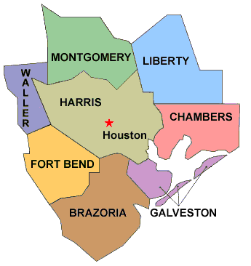
Geographical Reach
Galveston and Brazoria counties are considered part of the Houston Metropolitan Area
Mixed urban and rural with Brazoria being the more rural of the two
GCC serves as the Local MH and IDD Authority for both Galveston and Brazoria Counties, and serves as the OSAR for Austin, Brazoria, Chambers, Colorado, Fort Bend, Galveston, Matagorda, Waller and Wharton Counties.
UTMB operates their Angleton Campus in Brazoria county
GCHD provides services primarily in Galveston County, but is also responsible for providing HIV/STD outreach and testing in Brazoria and Chambers counties.

Slide 6
The DSRIP Opportunity—Transforming the Payment System
2012 2013 2014 2015 2016 2017 2018 2019 2020 2021 2022
OLD WORLD:
Medicaid Fee-for-Service (FFS) payment
Individual provider was anchor for financing and quality measurement
Volume over Value
NEW WORLD:
Value-Based payment (VBP) arrangements
Integrated care services for patients are anchor for financing and quality measurement
Value over Volume
Transition Period:
DSRIP allows providers to restructure themselves so as to succeed in new financial & regulatory environment

Slide 7
The DSRIP Opportunity—Transforming the Payment System
Gulf Coast Center Transition
Ambulatory Detox Clinic
Crisis Respite IDD
Integrated Healthcare
Peer Support
Safe Harbor
SELECT
Smoking Cessation
Telemedicine Access
Transitions
Wellness & Recovery Clinic
Screening & Referral for Substance Use / Co-Occurring Psychiatric and Substance Use Disorder Services—Integration MHA & SUD
Maintain services focused on need and funding available.
Primarily funded by Stephen F Austin – Federally Qualified Health Center.
Continued expansion through collaboration with Substance Use Recovery Services.
Screening & Referral for Substance Use / Co-Occurring Psychiatric and Substance Use Disorder Services- Case Management Services
Embedded within Youth Behavioral Health Services.
Screening and education will be integrated into the physician appointment.
Physician time will be integrated into clinics.
Intake Qualified Mental Health Professionals—Decentralization of Centralized Intake—All 4 Adult Clinics opposed to 1 location
Physician and therapist time transitioned into youth clinics.

Slide 8
Gulf Coast Center – 1115 At-A-Glance
Year(s) | Years 1-5 2012 through 2016 | Year 6 2017 | Years 7& 8 2018 & 2019 | Years 9-11 2020 - 2022
Focus | Planning and Implementation Development of Innovative projects | Transition Sustainable Projects | System-Wide/CCBHC Health Outcomes – Service Focus | (Unofficial – Funding Ramp Down)
Reporting | Individualized Project Number Served Individualized Project Metrics Individualized Implementation & Project Performance | Individualized Project Number Served Standardized Project Metrics Individualized Project Performance | Medicaid Low-income/Uninsured Percentage Contract Performance Metrics Selected Metrics – System Wide Core Activity – Integrated MH/SUD | Unknown
Payment | 2012 - $0 2013 - $397,550 2014 - $2,391, 556 2015 - $4,365,644 2016 - $5,129,376 | 2017 - $4,854,519 | 2018 - $3,600.000 – estimated low 2019 - $3,600,000 – estimated low | 2020 – less than 2019 2021 – less than 2020 2022 - Zero
Structure | Ambulatory Detox CAT, WRAP, CET Crisis Respite – IDD Crisis Respite – MHA Integrated Health Care Peer support* Safe Harbor* School, Law Enforcement Crisis Team (SLECT) Smoking Cessation* Telemedicine Access Transitions Wellness and Recovery for Youth Bold = Discontinued Project for Year 6 * = Three Year Project | Ambulatory Detox Crisis Respite – IDD Integrated Healthcare – FQHC Peer Support Safe Harbor School, Law Enforcement Crisis Team (SLECT) Smoking Cessation Telemedicine Transitions Wellness & Recovery for Youth | System Defined – Adults & Youth diagnosed with IDD and MI, SUD, SUD and MI, or MI only. System Metrics – 15 points Required Body Mass Index (BMI) Screening Major Depression Follow-up Plan Care Planning – COPSD Assessment – COPSD Psychiatric Hospitalization Follow-up Substance Use Screening Opioid Education Services funded through 1115 Dollars COPSD Services – Integration Certified Peer – MH Crisis Respite/BCBA – IDD IHC – One Position SLECT Screening – BMI, Alcohol, Substances, Opioid, Depression Hospital Follow-up Italics = Unofficial | Italics = Unofficial

Slide 9
The DSRIP Opportunity—Transforming the Payment System
University of Texas Medical Branch Transition
Expand Primary Care
Expand Urgent Care
Disease Registries
Readmissions
Interpretation
Expand Specialty Care
Expand OB/GYN Services
Patient Centered Medical Home
Care Navigation
Palliative Care
The additional providers are needed and can be supported by patient revenue.
Clinic is self-sustaining without DSRIP and can be supported by patient revenue.
The staff can be supported with non-DSRIP funds.
Project will continue, anchor will have learning collaborative requirements in DY7-8.
Interpretation is needed, and can be supported without DSRIP funds.
The additional specialty providers are needed and can be supported by patient revenue.
Clinic staff can be supported without DSRIP funds and by clinic revenue.
Clinic staff/supplies can be supported without DSRIP funds and by clinic revenue.
Services are needed and staff/supplies can be supported without DSRIP funds.
Established and enhanced palliative care services at UTMB; this new service will continue

Slide 10
UTMB – 1115 At-A-Glance
Year(s) | Years 1-5 2012 through 2016 | Year 6 2017 | Years 7& 8 2018 & 2019 | Years 9-11 2020 - 2022
Focus | Writing projects and implementing them | Project transitions Sustainability | System-Wide Health Outcomes – Service Focus | (Unofficial – Funding Ramp Down)
Reporting | Individuals served Encounters served Clinics built Staff hired | Standardized metrics Individuals served Encounters served | Medicaid Low-income/Uninsured Percentage Contract Performance Metrics Selected Metrics – System Wide Core Activity – Unknown | Unknown
Payment | 2013 - $4,697,495 2014 - $20,902,796 2015 - $39,142,910 2016 - $26,326,301 | 2017 - $24,585,267 | 2018 - $25,952,649 – estimated 2019 - $16,957,323– estimated | 2020 – less than 2019 2021 – less than 2020 2022 - Zero
Structure | Expand Primary Care Expand Urgent Care Disease Registries Readmissions Interpretation Expand Specialty Care Expand OB/GYN Services Patient Centered Medical Home Care Navigation Palliative Care | Expand Primary Care Expand Urgent Care Disease Registries Readmissions Interpretation Expand Specialty Care Expand OB/GYN Services Patient Centered Medical Home Care Navigation Palliative Care | System defined: 3 full service inpatient hospitals, 1 academic medical center, community clinic system, and level 1 trauma emergency department and 2 other EDs. System Metrics- 75 Points Required A1 – Improved Chronic Disease Management: Diabetes Care C1 – Primary Care Prevention-Healthy Texans C2 – Primary Care Prevention-Cancer Screening D1 - Pediatric Primary Care E1 – Improved Maternal Care E2 - Maternal Safety | Italics = Unofficial

Slide 11
The DSRIP Opportunity—Transforming the Payment System
Galveston County Health District Transition
Expand Primary Care
Mobile Clinic
Galveston County Health District will keep the newly expanded primary care services
This includes the operation of their mobile clinic on a scheduled basis in the community
The clinic space, access, and providers will be brought into their operational budget

Slide 12
GCHD – 1115 At-A-Glance
Year(s) | Years 1-5 2012 through 2016 | Year 6 2017 | Years 7& 8 2018 & 2019 | Years 9-11 2020 - 2022
Focus | Writing project and purchasing mobile clinic | Transition Sustainable Project | System-Wide Health Outcomes – Service Focus | (Unofficial – Funding Ramp Down)
Reporting | Individualized Project Number Served Individualized Project Metrics Individualized Implementation & Project Performance | Individualized Project Number Served Standardized Project Metrics Individualized Project Performance | Medicaid Low-income/Uninsured Percentage Contract Performance Metrics Selected Metrics – System Wide Core Activity – Primary Care Services | Unknown
Payment | 2013 - $237,200 2014 - $469,520 2015 - $551,475 2016 - $542,735 | 2017 - $533,710 | 2018 - $500,000– estimated low 2019 - $500,000– estimated low | 2020 – less than 2019 2021 – less than 2020 2022 - Zero
Structure | Expand primary care | 1. Expand Primary Care | System Defined – Galveston County Residents Receiving at Least one Service as GCHD 1 point required Blood pressure Control | Italics = Unofficial

Slide 13
Communication and Collaboration
Continuation of transformational region-wide projects, with additional focus on cross-regional efforts
  Strong desire by providers to build on individual work with more robust collaboration
  Continue to build on existing relationships and develop new opportunities to expand
Regional Learning Collaborative
  Behavioral Health Learning Collaborative
  Readmissions Learning Collaborative
  Care Transitions Collaboration Going Forward

Slide 14

Opportunities: Community Health
DSRIP projects are “incubators” for population health
Outcome metrics are tied to target populations, based on community needs and project scope

Slide 15
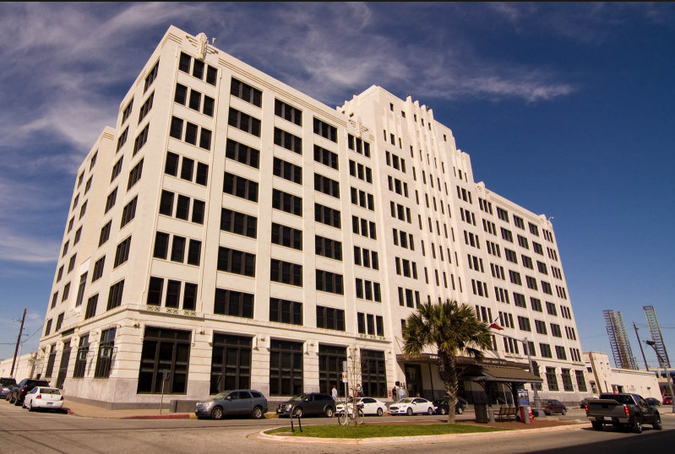
Lessons Learned for Better Health Care Outcomes
Collaboration…
strengthens and supports the IHI triple aim of healthcare.
  Improving the patient experience of care
  Improving the health of populations
  Reducing the per capita cost of health care
decreases silos in health care, allowing for improved continuity of care for all patients/clients.
allows community partners to better understand each others roles to more successfully handle both planned and unexpected needs.
Shearn-Moody Plaza, Galveston TX

Slide 16
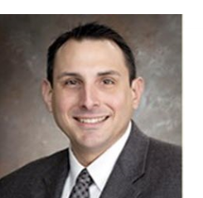
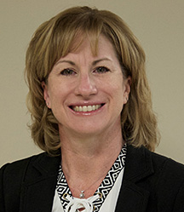
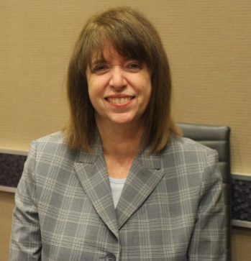
Want to Know More?
Presenters:
Craig Kovacevich
Associate VP, Waiver Operations & Community Health Plans - UTMB
409.766.4047
cskovace@utmb.edu
www.utmb.edu/1115
Melissa Tucker
CEO - GCC
409.944.4337
melissat@gulfcoastcenter.org
https://gulfcoastcenter.org/
Collaborator:
Kathy Barroso
CEO - GCHD
409.938.7221
kbarroso@gchd.org
www.gchd.org

