Slide 1
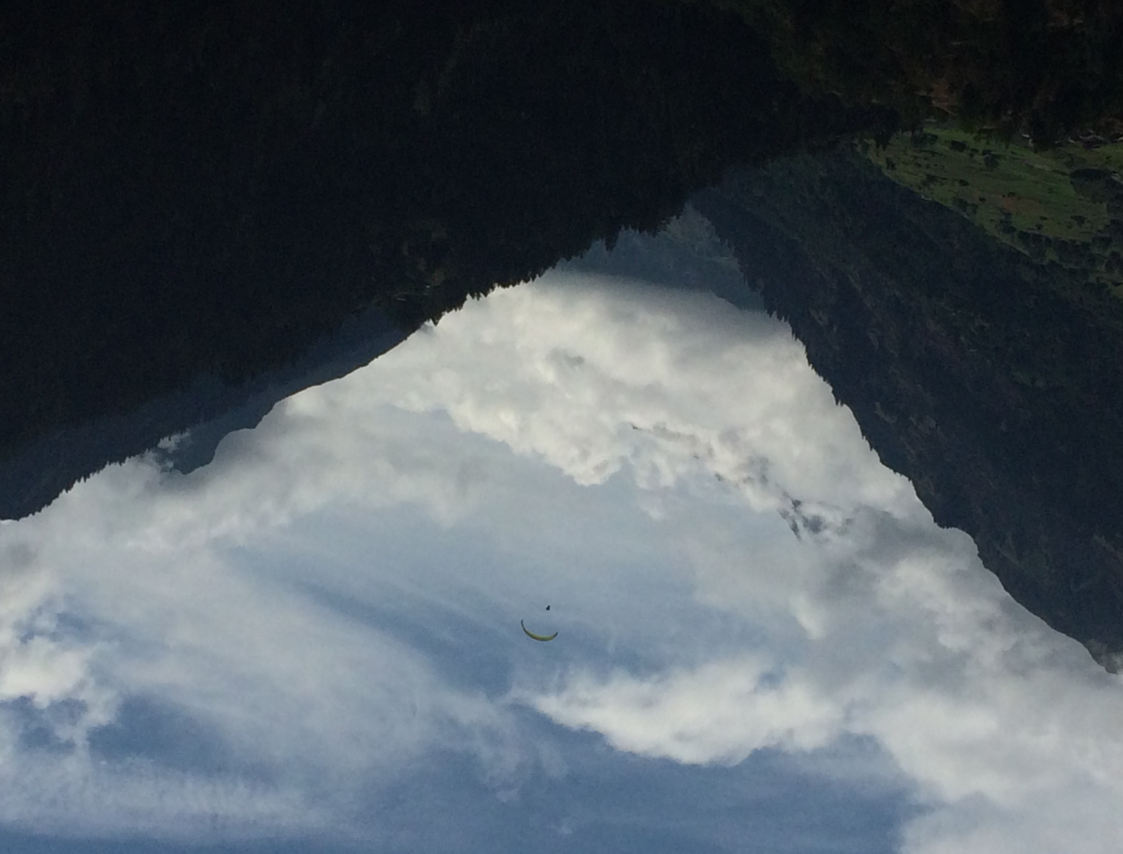
All Mountains Are Different
Multiple Trails to the Top of Community Health Improvement

Slide 2
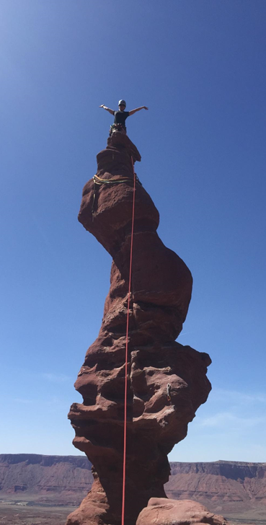
Introductions
Leigh Caswell
Director, Center for Community Health
Presbyterian Healthcare Services
Albuquerque, NM
Trail running and my new puppy!
I volunteer for mountain rescue
Notes:
Both

Slide 3
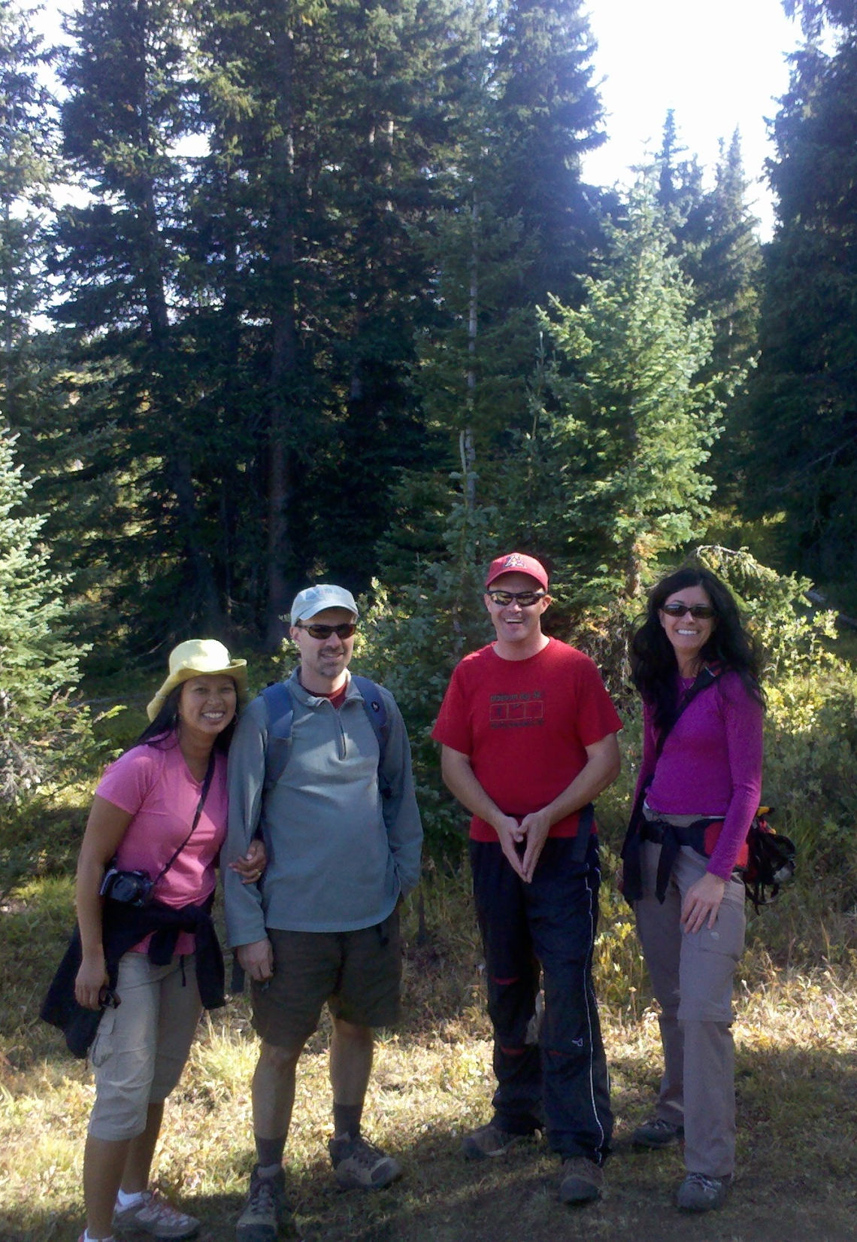
Introductions
Matt Guy
Owner, Accelerated Transformation Associates
Pueblo West, CO
Doctor Who, X Files, Premier League Football (soccer to the rest you), my family, being outside
I am part Choctaw

Slide 4
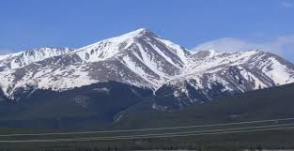
No One Size Fits All
“If you only go up this one trail…”
No one thing will get you to improved community wellness:
Improvement Methods
Action Models
System Theory
Leadership Design
Programs and Initiatives
Notes:
Matt

Slide 5
More Than One Trail to the Top
It takes more than just one idea/theory/process to help move a community from point A to point B
Multiple methods are needed to move the community “mountain”
There’s more than one way to the top…you have to discover what is the best way for your community to get there
And you will fail trying to reach the summit…possibly many times
Notes:
Leigh

Slide 6
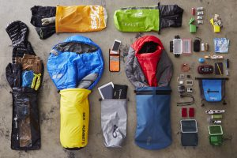
Basic Hiking Needs
Pick a summit:
Goals/aims/purpose and relevance
A trail:
Theory of change and equity
Your gear:
Resources, programs and initiatives
Topo maps and hiker’s guides:
Data
Engaging those who come with you or those you encounter:
Leadership and community engagement
Notes:
Matt

Slide 7
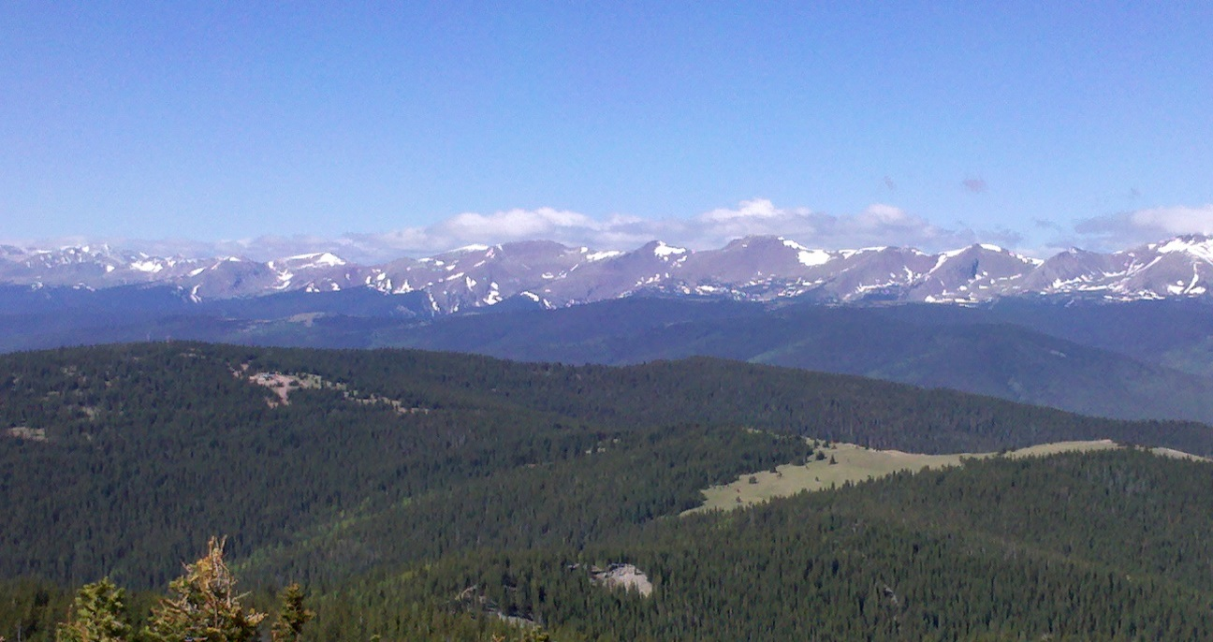
Basic Hiking Needs
Pace and patience on the hike:
Time/opportunity horizons and keeping the long view in mind
Anticipated view from the top:
Seeing the whole picture (system thinking)
Notes:
Matt

Slide 8
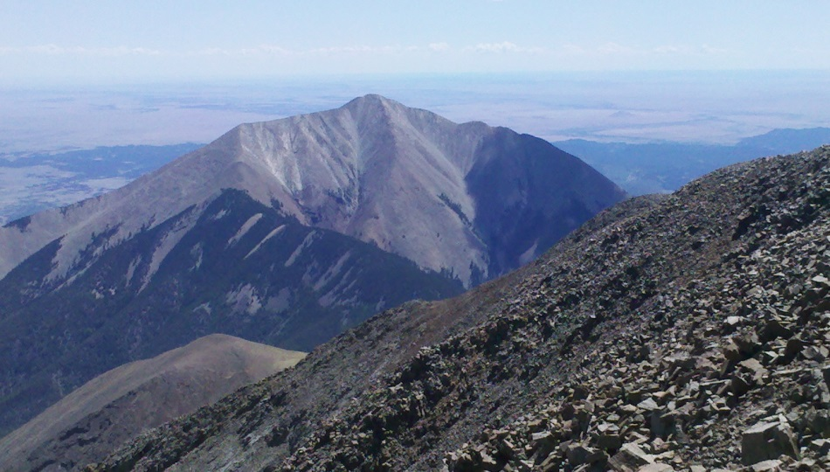
What Summit to Conquer?
Aim
Purpose
Value Statement
Relevance
CHNAs
True community conversations
Community assets
Different methods to pick a goal…
Aim statements
SMART Goals
Value proposition development
Notes:
Leigh

Slide 9
What Trail Do We Take?
Not all trails are the same!
Steep vs easy climb, short vs long, etc.
Some are more equitable than others
What’s your theory for getting there (what are you trying to change)?
Driver diagrams
Causal loops
LEAN
Triple Aim
ReThink Health (Stewardship, Strategy, Financing)
Notes:
Matt

Slide 10
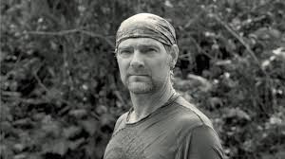
What Do You Take With You?
What do you already have
Les Stroud’s Zones of Assessment (yes, Survivorman)
On you, next to you, in the vicinity
Asset mapping
What gaps do you have in your gear?
Program and initiative development
Driver diagrams
Cost/benefit resources
Modeling
Notes:
Matt

Slide 11
Do I Trust This Map?
Data
How to choose data points that will show movement
Verifying sources
Collection and presentation
Does it show how all of our community is being impacted?
Checking data for equity
Stories from other hikers
Real time impacts of the work done and the work ahead
Notes:
Matt

Slide 12
Who Is With Us? Who Will We Meet?
Who you go with and what you encounter are important
Identification of people and things you engage is key
Who blazes the trail?
Leadership and governance ideas
Identifying leaders
What did you encounter?
Community engagement
Collective Impact
Notes:
Leigh

Slide 13
Is This a Race?
Pace
Tools for pacing
Short, medium, and long term view (horizon development)
Sunrise and Sunset-picking a time horizon that fits the trail and summit
Weather
Being able to spot potential hazards on the time line
Analysis tools to avoid pitfalls
Notes:
Matt

Slide 14
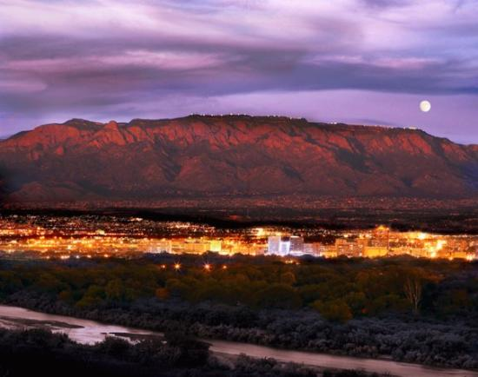
What’s the View From the Top?
Seeing the whole picture
Thinking in terms of connections
Developing system thinking
Do others see something else in their view?
Policy level thinking
What you see
What you can control in what you see
Notes:
Matt

Slide 15
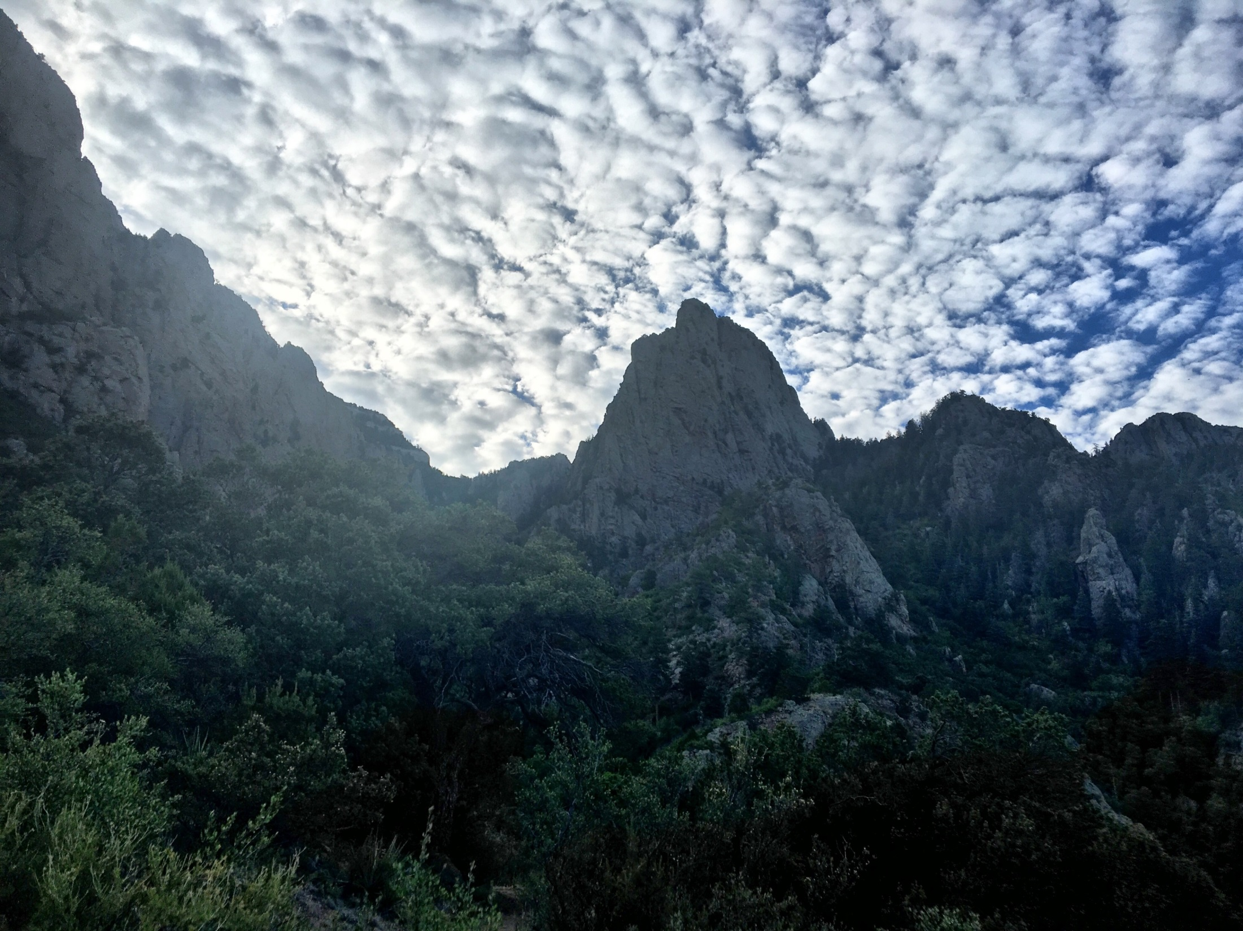
New Mexico Examples

Slide 17


Slide 18
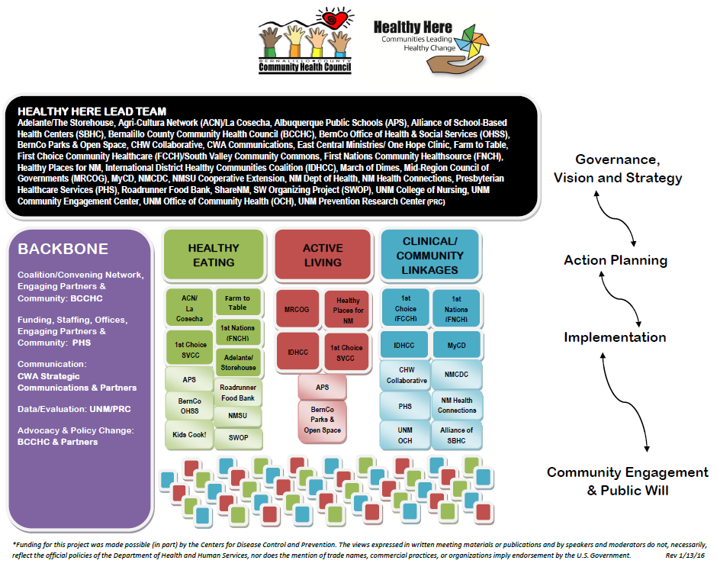

Slide 19




Funded in part by a Center for Disease Prevention and Control
Cooperative Agreement for Racial and Ethnic Approaches to Community Health

Slide 20
Accountable Health Communities
Addressing the social determinants of health
New 5-year, $4.5 million cooperative agreement through CMS
Screen and refer Medicaid and Medicare beneficiaries
Housing
Food insecurity
Utility assistance
Transportation
Safety
Examine the impact on cost and quality of care
75,000 people screened a year at multiple health care locations (hospitals, FQHCs, community dental)
The contents provided are solely the responsibility of the authors and do not necessarily represent the official views of HHS or any of its agencies. The project described was supported by Funding Opportunity Number CMS-1P1-17-001 from the U.S. Department of Health & Human Services, Centers for Medicare & Medicaid Services.

Slide 21
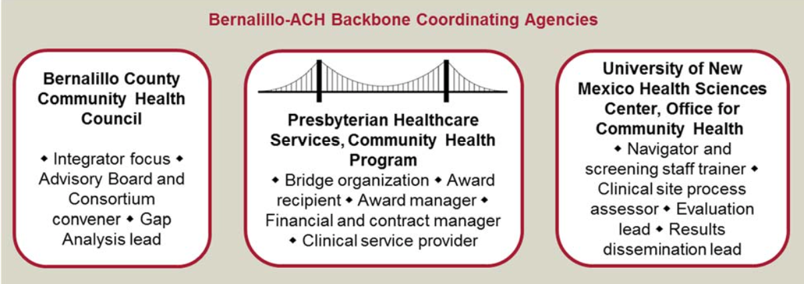
Accountable Health Communities
Shared leadership model
Goal of systems change

Slide 22

ReThink Ventures
Developing a vision for a health ecosystem
2 year project, focused on Bernalillo County
Partnership with UNM HSC, Health Insight, Bernalillo County Government, and Bernalillo County Community Health Council
One of 6 communities across the country chosen to participate
Focus on reinvestment and new payment models

Slide 23
ReThink Health’s integrated approach
Broad-based Stewardship
Sound Strategy
Sustainable Financing
Stewardship: Leaders in regions who work together as stewards of a common system, across boundaries and vested interests, to foster greater health, equity, and economic well-being
Sustainable Financing: Identifying and allocating a broad range of resources to match priorities and fulfill long-term health and economic potential
Strategy: Agreement on a clear course of action for the region, with priorities that deliver intended results over time, avoiding significant pitfalls or unacceptable tradeoffs

Slide 24
Anchor Institutions
“A commitment to consciously apply the long-term, place-based economic power of the institution, in combination with its human and intellectual resources, to better the long-term welfare of the community in which the institution is anchored.”
Can Hospitals Heal America’s Communities?
“All in for Mission” is the Emerging Model for Impact
Tyler Norris and Ted Howard
Can Hospitals Heal America’s Communities?
“All in for Mission” is the Emerging Model for Impact
Tyler Norris and Ted Howard

Slide 25
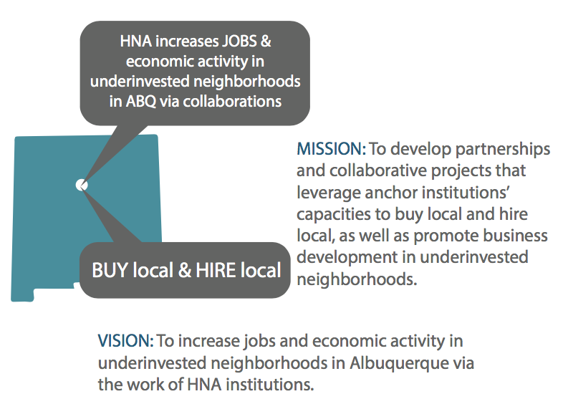
Healthy Neighborhoods Albuquerque

Slide 26

Notes:
The partners are…

Slide 27


Slide 28
Pueblo Triple Aim Making Pueblo Colorado’s Healthiest County

Slide 29
The Good News
Teen pregnancy rate is down by nearly 60%!
Fewer seniors are going are being readmitted to the hospital for avoidable situations (nearly 50% reduction)!
Fewer Puebloans are overweight!

Slide 30
The Not So Good News
Over $1 Billon spent annually on healthcare in Pueblo County
61% of Pueblo adults are overweight or obese
Nearly 30% of all local hospital patients have a diabetes diagnosis
Higher smoking rate than the state average

Slide 31
Purpose Statement
Ever-rising healthcare spending weakens Pueblo’s local economy, threatens jobs, and has failed to deliver improved health of Pueblo County citizens. This combination of increased costs and poor results threatens Pueblo’s future by diverting resources from investment in education and growth.
The Pueblo Triple Aim Corporation (PTAC) formed to respond to these issues.

Slide 32
PTAC’s Three Pillars
Triple Aim
Collective Impact
ReThink Health

Slide 33
Pueblo Triple Aim Coalition
High Level Policy and Governing Board: Pueblo Triple Aim Corporation
High Level Community Support
Advisory Council: Pueblo Triple Aim Steering Committee
“Boots on the Ground”
Ad-Hoc Committees: Area Specific
Deal with shorter-term, single issue needs

Slide 34
Focus Areas
Area of Emphasis (Portfolio) | Sub Areas
Obesity Goal: Reduce rate of adult obesity by 2017 from 29.76 to 23.7% | Food Systems Physical Activity Build Environment
Teen/Unintended Pregnancy Goals: Maintain reduced teen pregnancy rate from 51/1000 in 2009 to 30/1000 in 2014; reduce rate to state average of 19/1000 by 2020. | Mentoring Long Acting Reversible Contraceptives
Smoking Goal: Reduce adult smoking rate from 24% to the state average of 17% by 2020. | Safety Net Population Youth (14-24) In Person Cessation Assistance
Readmissions/ED Use Goal: Reduce avoidable Medicare readmissions from 35/1000 enrollees to 33/1000 enrollees by 2020. | Frail Elders/Dual Eligibles Detox

Slide 35

Come Hiking With Us
Matt Guy
President and Owner
Accelerated Transformation Associates
719.248.7010
atapuebl@gmail.com
Leigh Caswell
Director, Center for Community Health
Presbyterian Healthcare Services
505.724.8865
lcaswell@phs.org

