Slide 1
Exercise is Medicine:
Clinical-Community Collaboration in Catawba County, NC
Zack King, MPH, CHES
Public Health Strategist
zking@catawbacountync.gov | 828.695.6683

Slide 2
Creating and supporting a culture of wellness for all of Catawba County.
Notes:
LiveWell Catawba fosters partnerships aimed at sustainably improving Catawba County’s health priorities: healthy eating, active living, and preventing chronic disease.
Our vision is a healthier community and enhanced quality of life for all people in Catawba County.
Coalition collective impact model

Slide 3

Supporting Partners

Slide 4
Healthy Eating | Active Living
Preventing Chronic Disease

Slide 5
Resources
Community push toward equitable access for active living
Leadership motivation to create stronger clinical-community connectivity
Well-placed board members and relationships
Staffing and funding made possible by support from the Duke Endowment’s Healthy People, Healthy Carolinas initiative

Slide 6


Slide 7
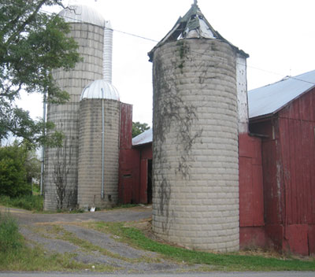

Slide 8
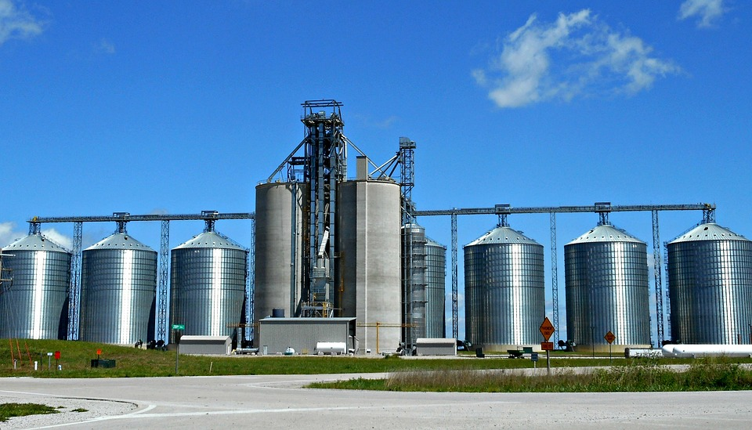

Slide 9
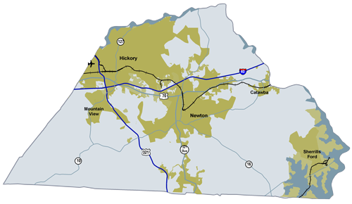

Slide 10
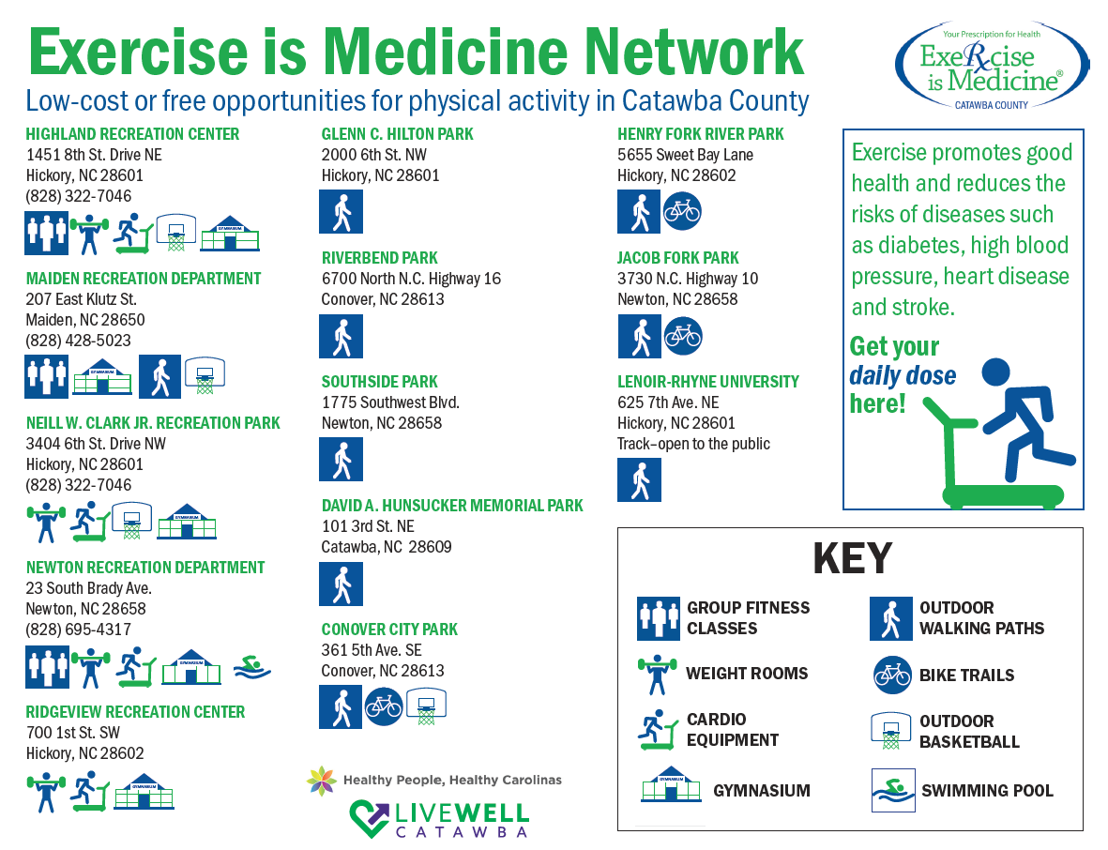

Slide 11
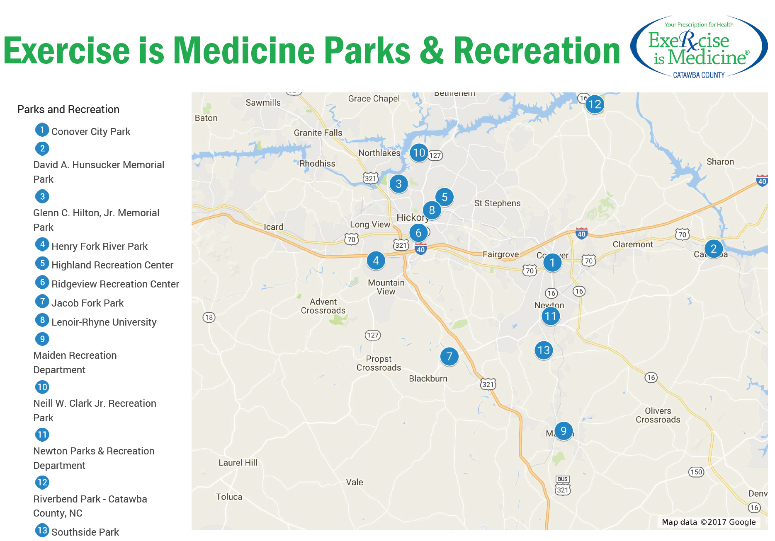

Slide 12
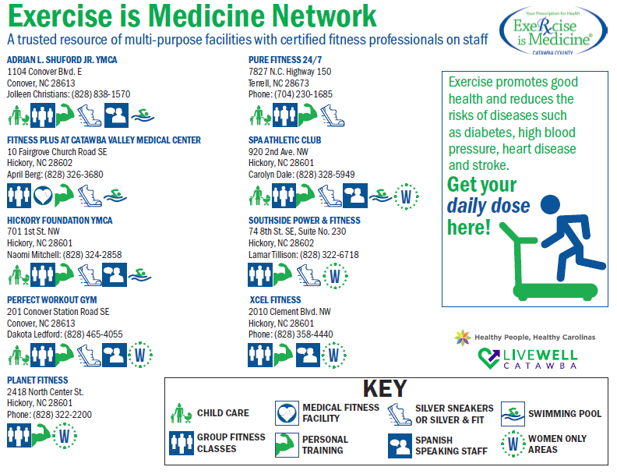

Slide 13
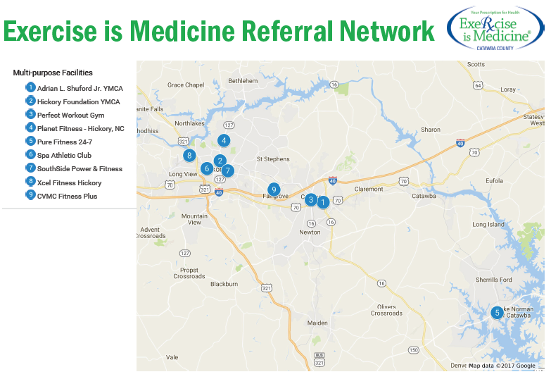

Slide 14
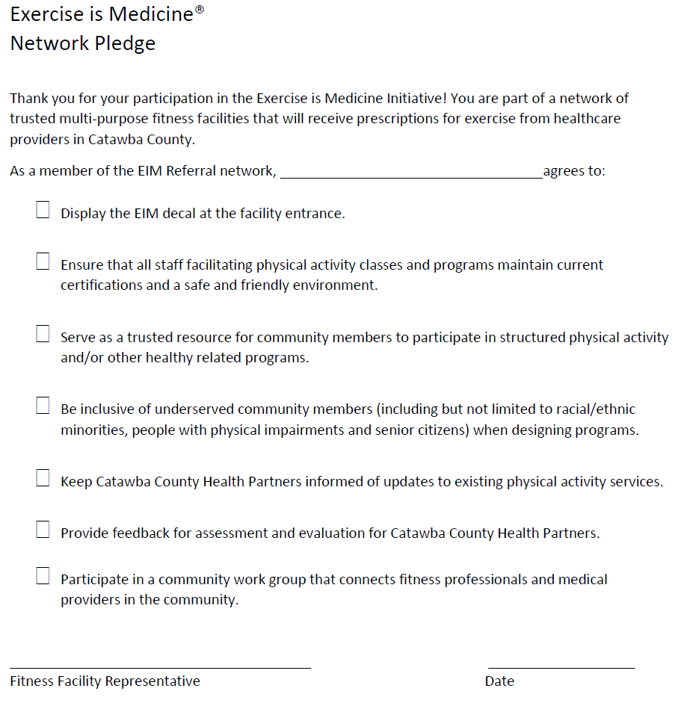
Building our Network
Site assessment
EIM coordinator at each site
Collaborative-based expectations
Pledge process
Patience, patience, patience

Slide 15
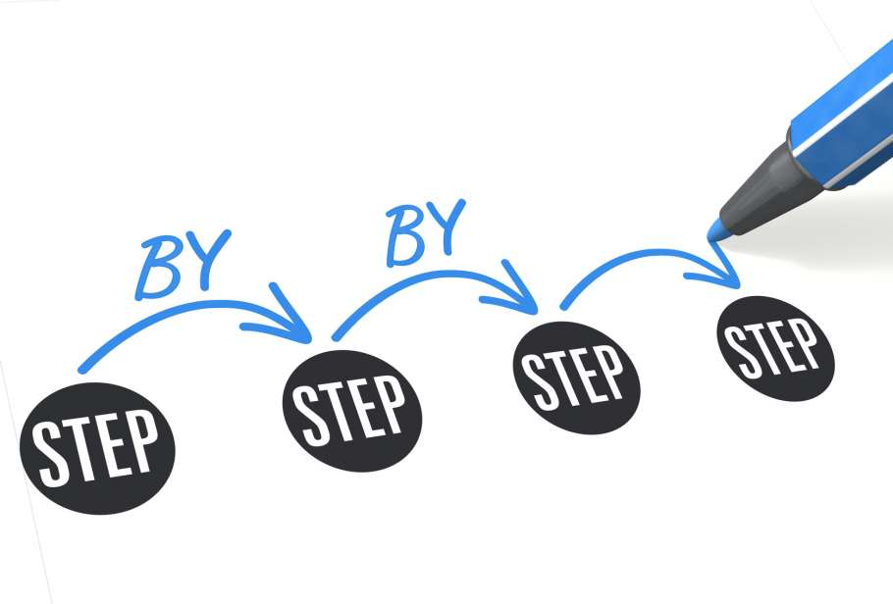
First Steps
Heavy “medical fitness” emphasis
Multi-purpose facility focus
“Come see us” paradigm
Balancing business
“Community-based” doesn’t always mean “community representation”

Slide 16
Health Equity Shift
Catawba County Public Health and Catawba Family Care (FQHC) roll out this year
How does our network need to shift to be more equitably accessible?
  What about rural?
  Training for network leadership and staff
  “Find a Park” free work out and motivation building initiative
  Leveraging sustainable municipal recreation center resources
  Growing the network: faith-based relationships and open use at schools
  Growing low/no cost opportunities for expertise and social support
Notes:
Open Use, Faith Based

Slide 17
Ultimate Connectivity
Clinic-based opportunities for physical activity
  “Walk with a Doc” strategies led by clinical staff
  Place-based environmental strategies on site: walking trail, fitness room
  Bringing our network on-site for classes and patient support
  Facilitates relationship-building and patient inclusivity

Slide 18
Lessons Learned
Consistent face-face communication and relationship building
Provide opportunities for professional development and training for referral sites
Resources vs. Partners
Plan with access and equity in mind
Don’t reinvent the wheel, find the spokes
Leverage EIM as a support and driver of broader community environmental change
TIME!

Slide 19
Thank you!
Zack King, MPH, CHES
828.695.6683 | 803.984.4158 zking@catawbacountync.gov

