Slide 1
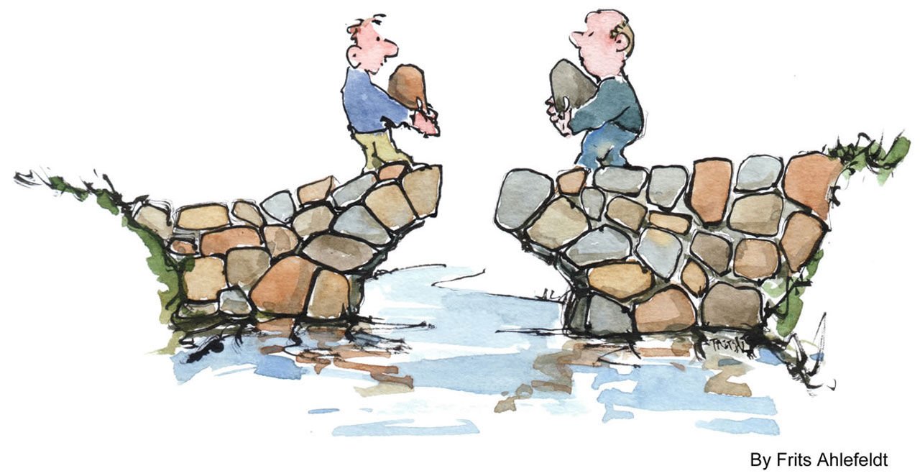
Harnessing Clinical-Community Partnerships to Increase Patient Physical Activity:
Implementing Exercise is Medicine in Two North Carolina Communities
Mark Stoutenberg, PhD, MSPH
Associate Professor, University of Tennessee Chattanooga
Program Officer, Exercise is Medicine®

Slide 2

The PROBLEM for Healthcare
More individuals are entering healthcare systems sedentary, obese, becoming frail and requiring chronic disease prevention and management care

Slide 3
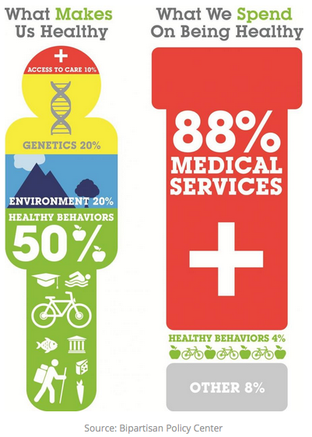
Healthcare only spends 4% of the nation’s total healthcare bill each year on promoting healthy behaviors
Why?
LACK OF PATIENT ENGAGEMENT!
The clinical care setting is not well trained in behavioral health, and they do not have the skills to engage patients in lifestyle changes!

Slide 4
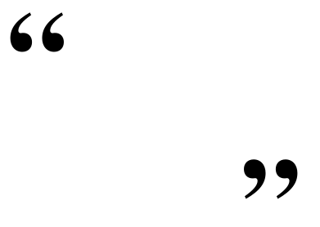

What if there was
one prescription
that could
prevent and treat
dozens of diseases,
such as diabetes, hypertension and obesity?
Would you prescribe it to your patients?
Certainly.
Robert E. Sallis, MD, FACSM,
Exercise is Medicine® Chairman

Slide 5
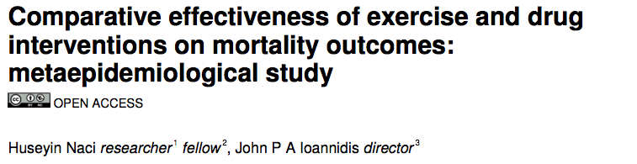
Meta-analysis of 16 studies (4 exercise and 12 drug)
Compared the effectiveness of exercise vs. drug therapy
Examined:
Mortality outcomes
Secondary prevention of coronary heart disease, rehabilitation of stroke, treatment of heart failure, prevention of diabetes
Naci H et al. BMJ. 2013; 347.
Notes:
In discussing how an exercising prescription can be viewed similarly to a drug prescription, we feel this is a good place to briefly describe this important meta-analysis by Naci and colleagues
They looked at the effectiveness of exercise interventions on health outcomes compared to the effectiveness of drug therapy

Slide 6
Results
Exercise and drug interventions did not differ in terms of their mortality benefits or in the:
Secondary prevention of coronary heart disease,
Rehabilitation after stroke,
Treatment of heart failure, and
Prevention of diabetes
In some cases, such as with stroke rehabilitation, the exercise intervention was more effective!
Naci H et al. BMJ. 2013; 347.

Slide 7
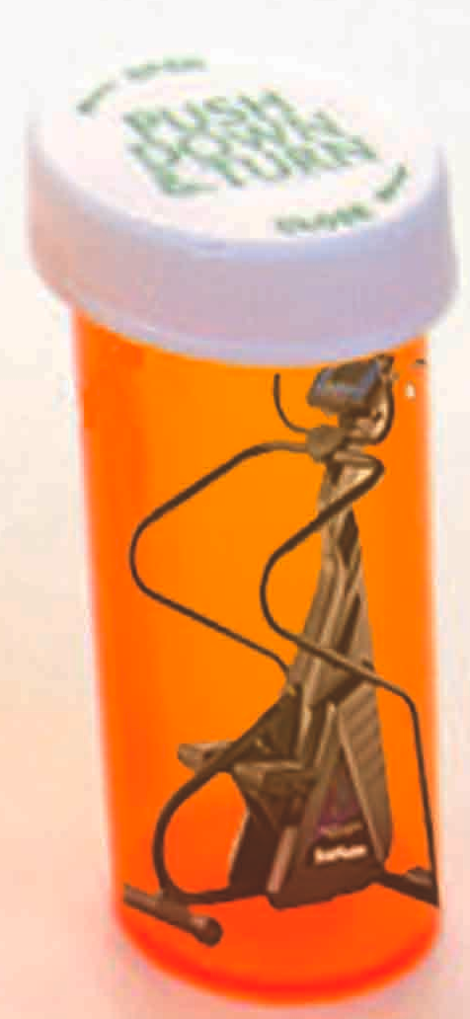
Their Conclusion
Exercise and many drugs are similar in terms of their benefits
Exercise interventions SHOULD be considered as a viable alternative to, or alongside, drug therapy
Physical Activity needs to become the prescribed “PILL” of the FUTURE!!
Naci H et al. BMJ. 2013; 347.

Slide 8
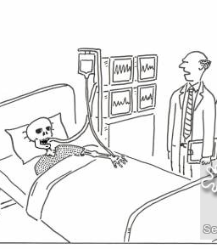
Exercise is a Medicine… Physicians should prescribe it, Patients should take it!
Are we reaching a point where NOT prescribing physical activity should be consider patient neglect?
“The readings look good, but just in case, when was the last time the system was checked for bugs?”

Slide 9


Exercise is Medicine (EIM) is a global initiative to establish physical activity as a standard in healthcare
The goal of EIM is transformational change – to institutionalize physical activity assessment & prescription in healthcare systems

Slide 10
Inputs
Activities
Outputs
Outcomes
Advocate/lobby for PA in healthcare policies and reimbursement schemes
Presence in national PA plan/prevention strategies
# PA items in healthcare systems
Surveillance systems, monitoring & policies
PA counseling recommended and by government, healthcare systems and HCP professional organizations
EIM
Global Center
Policy &
Surveillance
Develop national surveillance systems for PA in healthcare
# medical schools with PA in curriculum
EIM
Research
Center
Education & Certification
HCPs become PA role models for patients and community
PA in medical school curricula
CME training,
Exercise professional
# training course delivered
HCPs and fitness professionals trained
EIM presence at major medical conferences
Conducting EIM leadership training courses
HCPs have knowledge & skill to provide PA counseling & referral
EIM
Regional Centers
# EIM presentations & leadership training courses delivered
Clinical
Integration
# medical systems with PAVS in EMR
PA levels assessed at every patient visit to clinic
Integrate PAVS in EMRs
Support HCPs PA assessment, behavioral counseling & referral via CDSS and clinical workflow integration
# HCPs routinely giving PA assessment, counseling & referral
HCPs routinely provide PA prescriptions and referrals
Community Integration
Develop and integrate a network of EIM programs & credentialed professionals
Develop web-based and self-management resources
# EIM communities
# of EIM programs and professionals in network
Use of web-based and self-managed programs
Communities have network of PA resources to help patients meet national PA guidelines
EIM
National
Centers
Evaluation
Develop and implement evaluation framework for the EIM solution
# EIM process and outcome milestones met
Develop an evidence-based EIM efficacy and cost-effectiveness
Media
Develop standardized, simple messages through print, electronic & radio/TV media
Greater awareness and promotion of EIM and the role of PA in healthcare
# media activities
Industry
Build coalition of industry partners
# industry coalition partners
Private sector funding
Coalition of broad industry support for EIM
Lobelo et al. BJSM. 2014; 48(2).

Slide 11
Exercise is Medicine® (EIM) Solution
The implementation of EIM across three key domains to establish physical activity as a standard in patient care
EIM Solution
Healthcare Systems
Community Resources
Active Health Technology

Slide 12

Healthcare Systems adopt the EIM Solution by integrating and implementing physical activity in their patient care model.
EIM Solution
Healthcare Systems
Community Resources
Active Health Technology

Slide 13

Healthcare Systems
The healthcare module is a sequence of three steps to engage providers in promoting physical activity to their patients
1. Physical Activity Assessment
Providers assess physical activity during patient visits using assessment tools embedded in the “vital sign” section of electronic medical records (EMR)
2. Physical Activity Prescription
Using available tools, providers prescribe PA in the right “dose” for the prevention, treatment, and management of an identified chronic condition
3. Referral to a Physical Activity Network
Utilizing referral tools, patients are provided with a list of programs, professionals and places that offer physical activity programs that meet their individual needs

Slide 14


Healthcare Providers
Physical Activity Assessment
Ensuring that a member of the healthcare team assesses and records patient physical activity levels at every clinic visit
The Physical Activity Vital Sign (PAVS) is a simple 2-question set determines weekly frequency, duration and intensity of physical activity
Integration of the PAVS into the EMR ensures that the assessment of patient physical activity levels will occur at every patient visit
The EMR software can then use the two self-reported responses to calculate physical activity levels in minutes per week
Can determine individuals meeting national physical activity recommendations (150 minutes per week of moderate intensity PA)

Slide 15
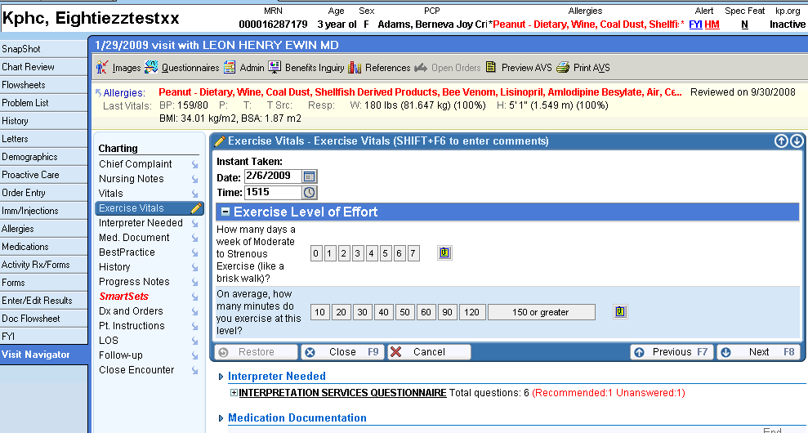
Example of the PAVS in an EMR
Clicking on the “Exercise Vitals” section opens up to display the two exercise intake questions that can be efficiently completed
The date and time the PA Vital Sign data was captured and stored

Slide 16

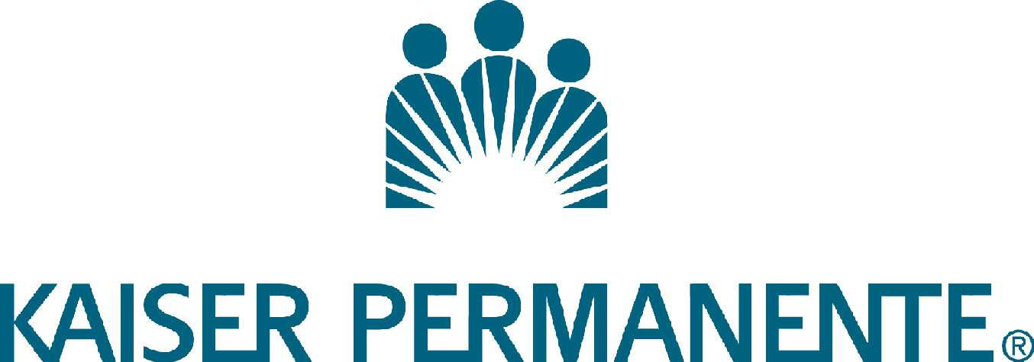
Integration of PAVS into EMRs
Several large healthcare systems in the U.S. have integrated the PAVS into their electronic medical records
Kaiser Permanente in California integrated the PAVS in their EMR in 2010
Intermountain Healthcare (one of the largest providers in Utah) integrated the PAVS into their EMR in 2013

Slide 17
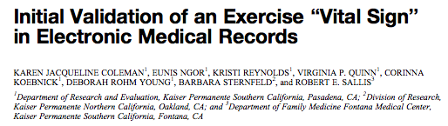
Integration of PAVS at Kaiser Permanente
Implemented in the Kaiser Permanent healthcare system in California in 2010
After 1.5 years of implementation, 86% (1,537,798) of all eligible patients had record of the PAVS completed in their EMR
Coleman et al. Med Sci Sports Exerc. Nov 2012
Notes:
This slide provides a quick example of the implementation of the PAVS in the EMR of the Kaiser Permanente Health System in California. With the integration of the PAVS into the EMR, a high percentage of all patients are now being asked about the current PA levels at every healthcare visit.
The example of the Kaiser Permanente system highlights the success of integrating the PAVS into an EMR to ensure that it becomes a systematic part of the workflow with each patient at every visit with every healthcare team in that health system!

Slide 18
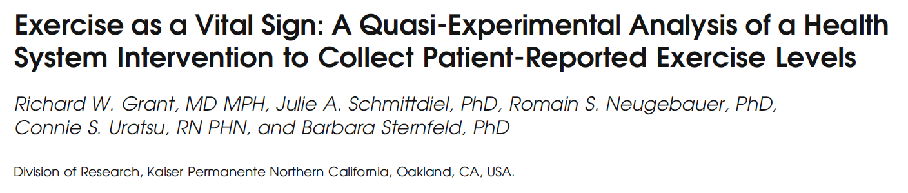
Effectiveness of the PAVS
Kaiser Permanente hospitals in Northern California that had integrated the PAVS in the EMR
Examined 1,569,324 visits by more than 690,000 patients seen by 1,196 different primary care physicians
Compared patient outcomes to hospitals that had not yet implemented the PAVS in their EMR
Grant et al. J Gen Intern Med. 2014; 29(2).
Notes:
This slide introduces a study released in 2014 examining the impact of the PAVS in the hospitals where it was integrated as a part of the EMR. This study examined the health outcomes of patients in hospitals that had introduced PAVS into their EMR compared to hospitals that were not using the PAVS.

Slide 19

Benefits of the PAVS
Use of the PAVS was associated with:
More weight loss in overweight and obese patients in hospitals that used the PAVS
Greater reduction in HbA1c levels in diabetic patients
Patients were 14% more likely to report having discussed exercise with their primary care physician
Physicians were also more likely to document exercise in their progress notes during visits after using the PAVS
An increase of 12% of documentation of PA habits
14% increase in providing exercise referrals to patients
Grant et al. J Gen Intern Med. 2014; 29(2).
Notes:
The authors found that by simply asking patients about their PA levels, small but significant improvements were seen in several patient outcomes. A key point to emphasize here is that even though the improvements were not huge, these changes were a result of asking each patient 2 questions that took a member of the healthcare team less than 30 seconds to do!

Slide 20
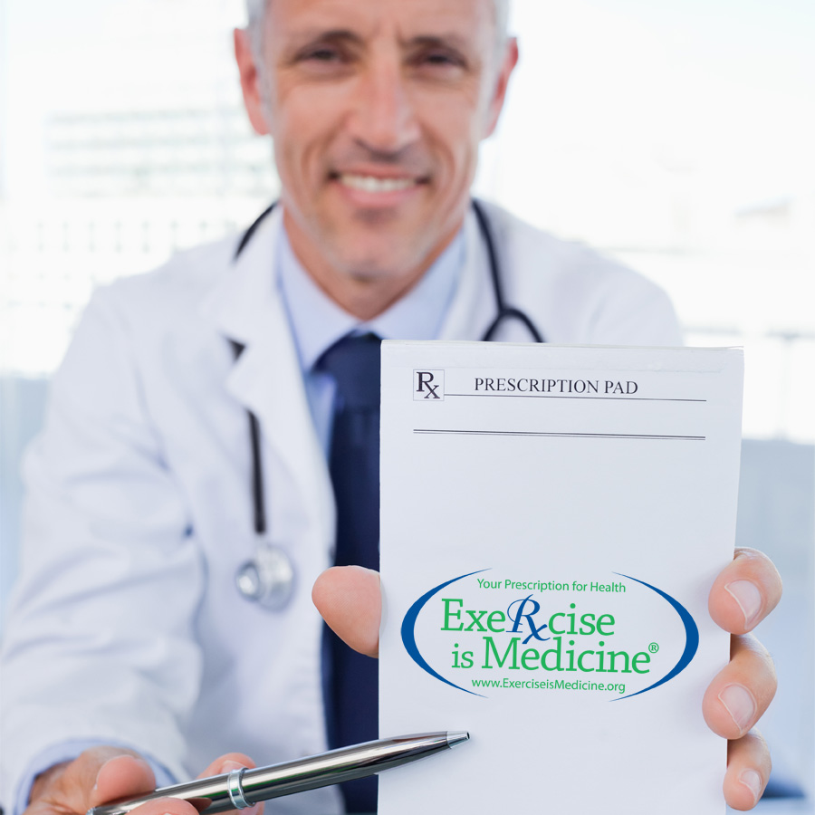
Healthcare Providers
Physical Activity Prescription
Providing patients with a prescription as a first step in becoming more physical activity
Based on the results from the PAVS, healthcare providers give patients an appropriate physical activity prescription
Physical activity prescriptions are based on identified health risks and American College of Sports Medicine (ACSM) guidelines
Prescriptions can be provided to each patient through the use of EIM prescription pads, web-based tools, or order sets in the EMR

Slide 21

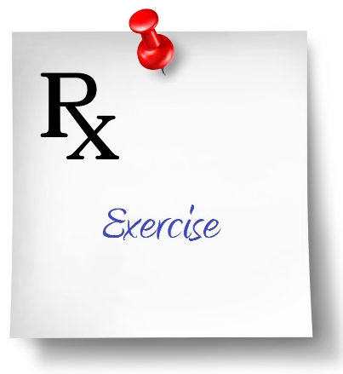
The Power of Prescribing PA
In New Zealand, prescribing physical activity is an integrated part of their national health system
As part of the “Green Prescription”, physicians provide written PA prescriptions to their patients
Written prescriptions increased the # of people exercising over verbal advice/counseling¹
Written prescriptions also increased PA levels (+32%) to a greater extent than verbal advice/counseling (+17%)
In another study, providing an exercise prescription increased the level of patients engaging in 150 minutes of weekly PA by nearly 10% over the control group²
1- Swinburn et al. Am J Public Health. 1998; 88.
2- Elley et al. BMJ. 2003; April 12, vol 326.
Notes:
The most “advanced” physical activity prescription schemes has evolved in New Zealand under the guise of the “Green Prescription”
The Green Prescription is a program advocated by the New Zealand Ministry of Health, whereby physicians are encouraged to provide their patients with exercise prescriptions to local community programs
The Green Prescription system involves physicians, nurses, PA experts, regional sports trust and many more!
http://www.health.govt.nz/our-work/preventative-health-wellness/physical-activity/green-prescriptions

Slide 22
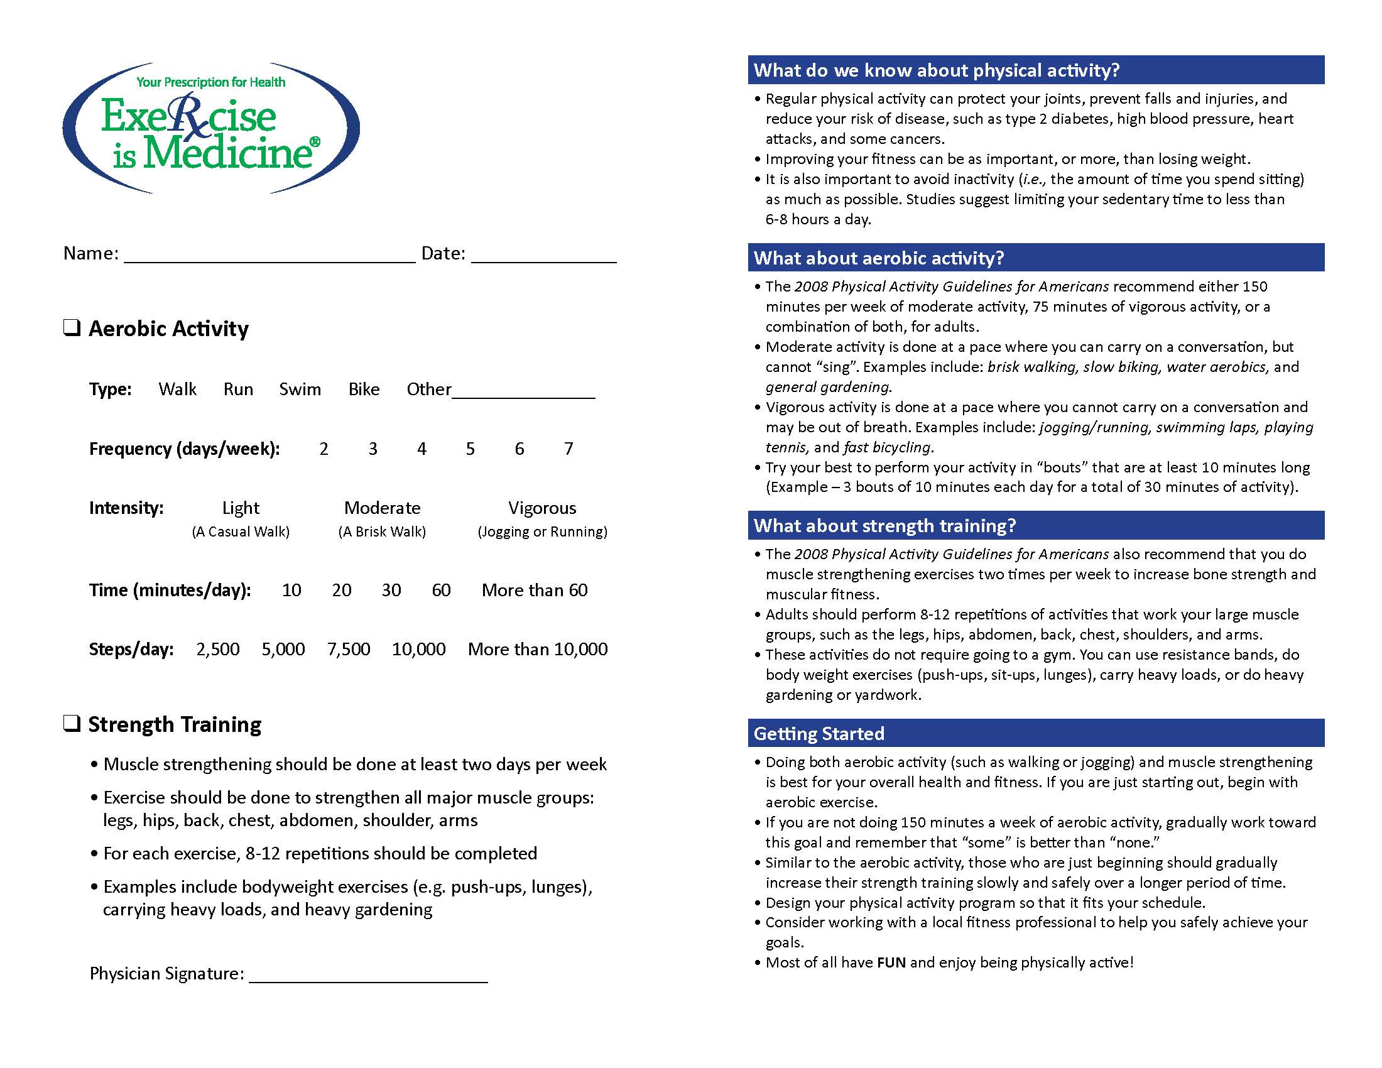

The EIM Prescription Pad

Slide 23
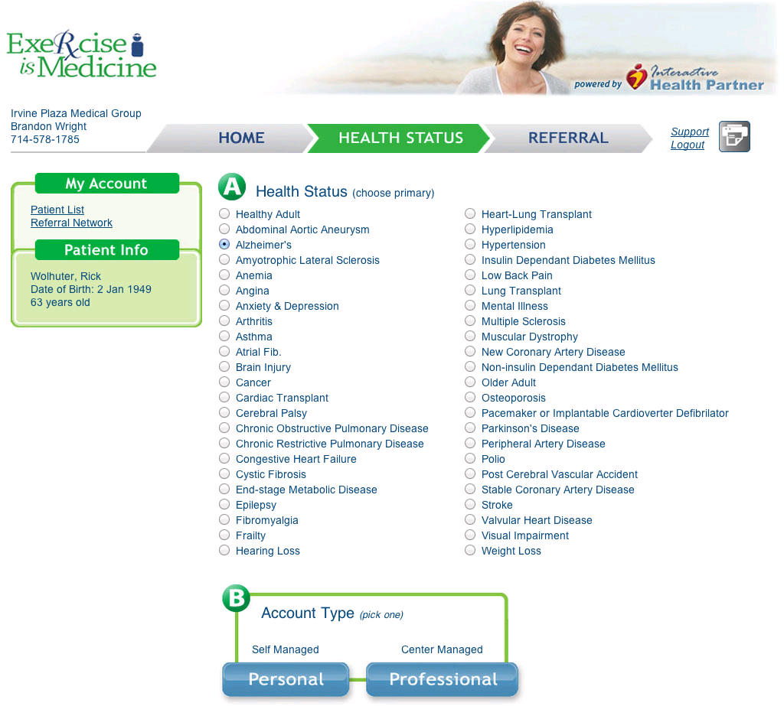

Select Primary Health Risk

Slide 24
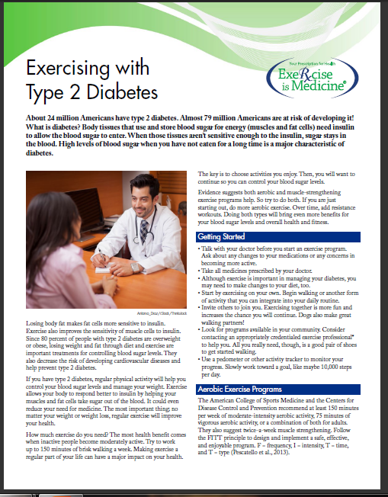
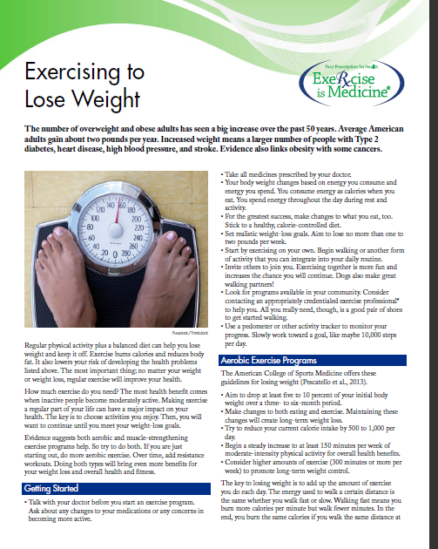
Your Prescription for Health Series
Notes:
Shown above are examples of 2 exercise prescriptions for different medical conditions (Type 2 Diabetes and Weight Loss). EIM has created multiple different patient education handouts that discuss exercise with various health conditions – we are currently updating them and have 16 currently updated versions on the EIM website.

Slide 25




Park Prescription Programs
"Park prescriptions" is a concept that links healthcare systems and public lands, such as local parks, to create healthier people
The program is a collaboration between the U.S. National Park System, local parks and their health systems
Successful initiatives have been started in Baltimore, MD (Docs in the Park), Greenville, SC (LiveWell Greenville), Washington, DC (DC Park Rx), and Portland, OR (Rx Play)
http://www.nrpa.org/Grants-and-Partners/Recreation-and-Health/Park-Prescriptions/
Notes:
This is another example in cities around the United States of the linkage between healthcare and the local park systems
HCPs in these healthcare systems are referring their patients to existing community resources (the local parks) where daily walks and activities are being hosted by park staff for community members
Can the attendees brainstorm any ways to link their patients to external resources? What resources exist in their community that they might be able to tap into?

Slide 26
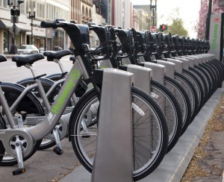
Bike Prescription Program
In the Spring 2014, Boston announced a program to subsidize bike-sharing memberships for low-income residents, in partnership with Boston Medical Center.
The “Prescribe-a-Bike” program allows doctors at Boston Medical Center to prescribe low-income patients with a yearlong membership to Hubway, a bike-share program, for only $5.
Plans are to initially enroll 100 low-income residents
http://www.bostonglobe.com/metro/2014/03/27/new-program-will-allow-boston-medical-center-doctors-prescribe-bike-sharing-program/zjwfLfCEtAEGfWYxVn4CiN/story.html

Slide 27
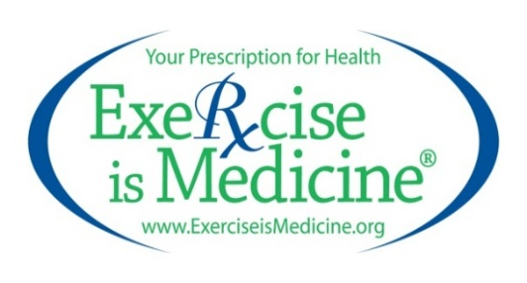

Healthcare Providers
Referral to Community Physical Activity Resources Providing patients with referrals to local community resources to assist them in “filling” their physical activity prescription
Healthcare providers help their patients fill their physical activity prescription by referring them to existing community resources
This may include self-directed physical activity programs that can be performed independently
Other patients may need more structured programs that meet their individual health risks, needs and abilities
Existing community resources, such as certified programs, conducted at recognized places, hosted by credentialed professionals, may be help engage patients in sustained lifestyle modification change

Slide 28
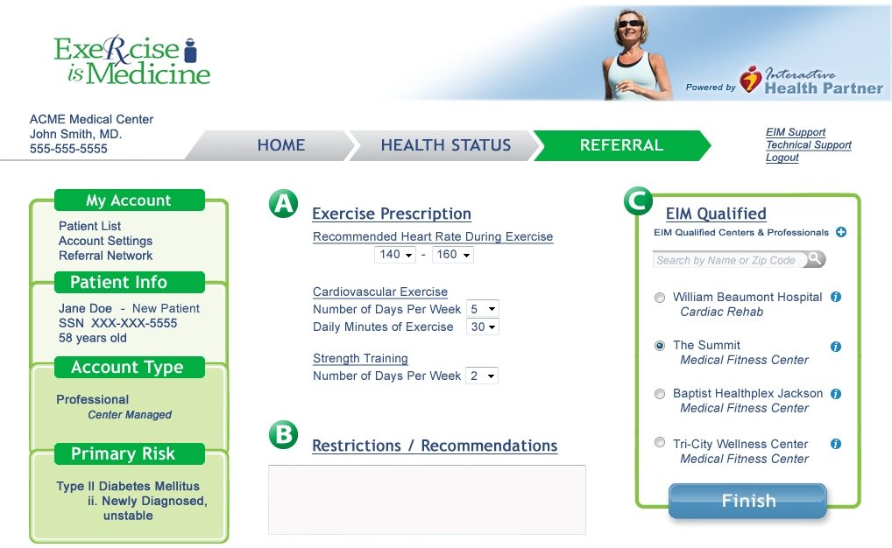

Referrals to certified physical activity programs delivered by credentialed EIM Professionals at EIM recognized places

Slide 29

Exercise Referral Schemes in the UK
Under the National Heath Service (NHS) there has been a proliferation of ERS in the United Kingdom since the 1990’s
They have become an integrated part of their health system
Over 800 in existence in 2003
Government endorsement was a major factor in the rapid increase in the # of ERS implemented across the UK
NHS works with local programs to effectively increase physical activity and reduce obesity levels
Evaluation of these ERS have demonstrated an increase of 27 and 21 minutes of PA at the end of a 12-week intervention and 1 year later, respectively¹
1 - Dugdill et al. Ergonomics. 2005: 48.
Notes:
In the UK, exercise referral schemes were very popular in the early part of the 21st century and were widely promoted by the national government!
There were some drawbacks of the ERS in the UK such as:
Practitioners largely designed ERSs in an ‘off-the-shelf’ fashion instead of doing it in a systematic, evidence-based manner
Many operational ERSs in the UK were never evaluated or gathered data which limited usefulness and improvements
Overall, there is a lack of critical awareness of what really works (i.e. what it is about a scheme that leads to sustained behavior change) making it necessary that we also try to evaluate what is working and what is not (if possible)

Slide 30

Clinic - END GOAL
No patient should leave a physician’s practice without:
An assessment of his/her physical activity
- and -
An exercise prescription and/or a referral to a qualified exercise professional for further guidance
Notes:
Suggested Talking Points

Slide 31
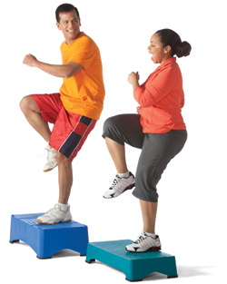
Existing Community Resources are utilized to support patients in increasing their physical activity levels
EIM Solution
Healthcare Systems
Community Resources
Active Health Technology

Slide 32
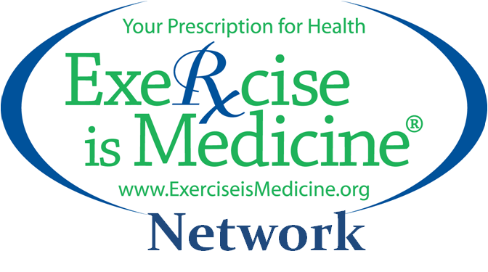

Community Resources
Establishing a Physical Activity Network Developing and utilizing a network of professionals to support patients in filling their exercise prescriptions
The EIM Network consists of certified programs offered in recognized places by credentialed professionals
The EIM Network may consist of resources both in-house (within the healthcare system) or in the local community
The EIM Network should also consist of evidence-based, self-directed programs via online resources and mobile technologies

Slide 33


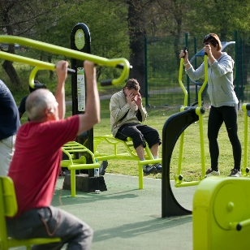

Creating a Physical Activity Network…
…to serve all patients at-risk for obesity, sedentary lifestyles, and chronic diseases and conditions, particularly in underserved populations
Exercise Professionals
PA Intervention Programs
Local PA Resources
Professionals
Programs
Places
Self-Directed Programs

Slide 34

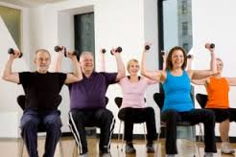
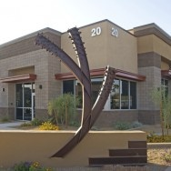
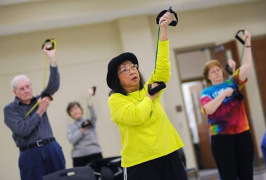
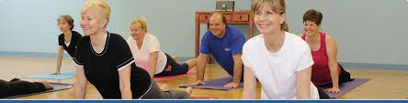
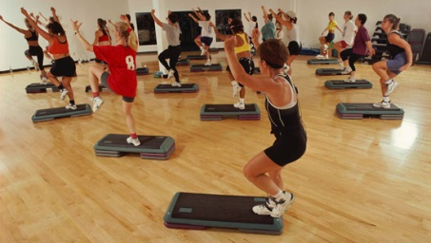

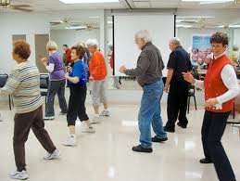
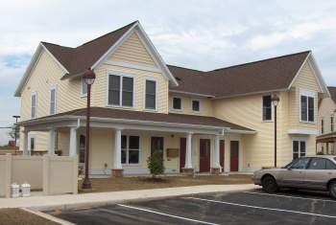
Recognized EIM Places
Safe and convenient locations in the community for at-risk population groups to participate in PA programs
Municipal Community Centers
Commercial Health Clubs
School System Facilities
Corporate Health Centers
YMCA Facility Locations
Hospital Wellness Centers
Medical Fitness Facilities
Physical Therapy Clinics
Park & Recreational Facilities
Notes:
A community-based network featuring a variety of places to experience PA Intervention Programs provide access to meet all preferences and help lower barriers to sustained participation.

Slide 35

Certified Physical Activity Programs
Programs with structured physical activity, health education, and lifestyle modification strategies designed to:
Prevent and manage non-communicable chronic diseases
Combat obesity and sedentary lifestyles
Extend therapeutic and rehabilitative care
PA Intervention Programs
“move and learn”
Structured Physical Activity
Patient Health Education
Lifestyle Change Strategies
Notes:
Engaging muscle and mind in a group and/or self-directed PA Intervention Programs.

Slide 36

Credentialed Professionals
Certification of exercise and fitness professionals trained to work with at-risk populations
Deliver multi-faceted physical activity programs that include structured physical activity and lifestyle modification strategies
May also support self-management programs
Credentialed to work with either low, moderate, or high risk patients to meet the high standards required by healthcare providers and payers

Slide 37


Building an EIM Solution Bridge of Trust between Healthcare Systems & Community Resources
Community Resources
Healthcare Systems
Notes:
Building a bridge of Trust by applying the EIM Solution to Healthcare Stakeholders and Community Resources for Referrals to experience a seamless patient-centered care transition from the Clinical Care Team to the Community Care Team.

Slide 38

Engagement starts with Healthcare Providers referring their at-risk population groups to an EIM Network for participation in programs for low- to high-risk individuals that:
Prevent and manage chronic diseases
Combat obesity and sedentary lifestyles
Extend therapeutic and rehabilitative care
The EIM Solution
Notes:
The EIM Solution establishes physical activity as a standard in healthcare as a cost containment strategy by providing PA Intervention Program access as an extension to healthcare through a shared delivery network.

