Slide 1



Chatham Health Alliance &
Exercise is Medicine
Sarah Weller Pegna, MPH, CHES
Alliance Coordinator
Chatham Health Alliance
sarah.weller@chathamnc.org
919-545-8443

Slide 2
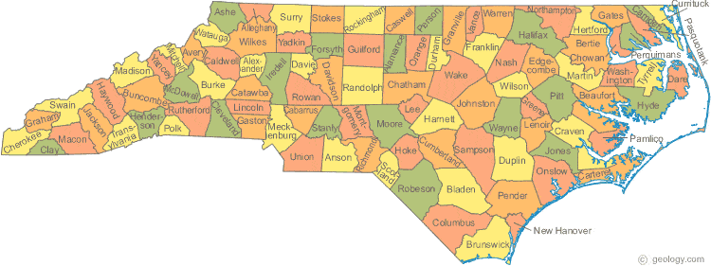
Chatham County, NC
Population: 72,243 (2017 estimates)
Area: 710m² (~hr from corner to corner)
https://www.census.gov/quickfacts/fact/table/chathamcountynorthcarolina/PST045217

Slide 3

The Chatham Health Alliance
“To bring organizations and residents together to work on issues affecting health
in Chatham County, with a focus on
the health priorities identified in the Community Health Assessment.”
http://www.chathamhealthalliancenc.org/

Slide 4
Our Resources
Identified need through Community Assessment
List of community-based resources
Funding
  The Duke Endowment, Healthy People Healthy Carolinas Program
Person-power
  Alliance Obesity Subcommittee
  Alliance Coordinator
  Support from local FQHC

Slide 5
EIM Chatham Vision
To increase the number of people with access to opportunities for chronic disease prevention, risk reduction, or management through clinical and community linkages by:
  Establishing an EIM Referral Network
  Training healthcare teams in the EIM model and encouraging PA promotion in the clinic
  Training community agencies in encouraging PA and providing PA referrals

Slide 6



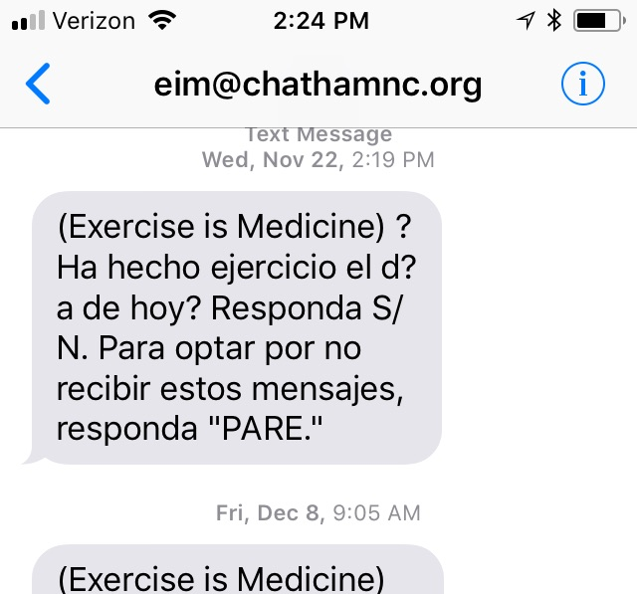

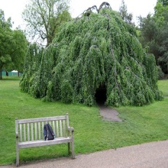

Chatham’s Program
NEW!
Assessment
Prescription
Referral Network
Follow-Up

Slide 7
EIM Chatham Pilot
23 total patients enrolled
Average PAVS increased from 37.5 to 61.8
60% went to their referral site at least once
53% exercised with someone else
73% would recommend EIM to a friend
73% reported health improvement
70% of our referrals were to community parks and other free outdoor locations

Slide 8
Text and Email Messages
71% of pilot participants said that text or email messages would help them
Developed text and email messaging component
Developed based on feedback and research
  Message types: Tips, motivational, gain framed, check-in/accountability
1 message/week, 6 months (26 total)

Slide 9
Clinical Partnership
Partnered with local FQHC
  Existing partner in Alliance & participant in Obesity Subcommittee
  Located in priority area of county

Slide 10
Clinical Partnership
Worked with clinic staff to:
  Integrate into EMR
  Determine data access
  Determine how to transfer information
  Who was going to implement each step

Slide 11
Clinical Partnership
Step 1: When checking in a patient, the MA uses the quick-text .eim which will print out the following questions:
On average, how many days per week do you engage in moderate or greater physical activity (like a brisk walk) lasting at least 10 minutes?
On those days, how many minutes do you engage in activity at this level?
Physical Activity Score (AxB):
If answer is Physical Activity Score is <150 minutes per week, provider will write EIM on the Pre-visit Planning form.
Step 2: Provider discusses exercise with patient and fills out prescription in appropriate language [Rx pads in English and Spanish will be in drawers in all exam rooms] and refers patient to Care Manager. Additional pads will be kept in the nursing station.
Provider refers to the patient to the Care Manager.
Step 3: Care Manager counsels the patient on available resources to assist him or her in exercising and has patient sign consent form. She enrolls patient in the Exercise is Medicine Program and FAXES the form to the Chatham County EIM program.
Step 4: The Chatham County Health Department is then responsible for carrying
out the EIM protocol and completing the program assessment.

Slide 12
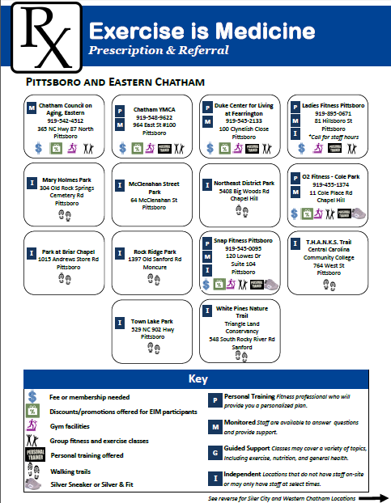
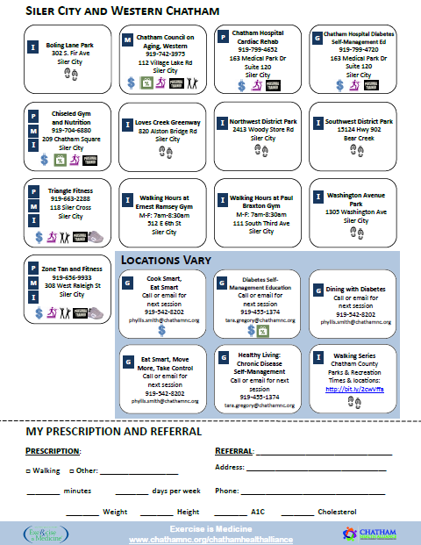
Prescription & Referral

Slide 13
Prescription & Referral

Slide 14
Lesson Learned:
Identifying your First Site
Start with low-hanging fruit
    - “Get ” the why for exercise and prevention
    - Already existing partner
Helpful if autonomous over own site or impacting whole system
Stable staffing

Slide 15
Lesson Learned:
Clinic Flow
Have structure in initial approach
Plan for turn-over in program champion
- Embed staff at the beginning
- Ensure early institutionalization
Outcome AND process measures
- Walk through

Slide 16
Lesson Learned:
Demonstrating Impacts & Value
In our Pilot while overall PAVS increased…
Baseline | 6-week | 18-week
35.7 | 61.8 ↑ | 55.2 ↓

Slide 17
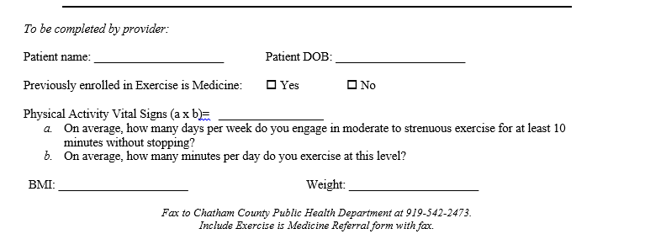
Lesson Learned:
Demonstrating Impacts & Value
Self-report vs. actual measures

Slide 18
Lesson Learned:
Cost
Scalable based on resources
Current costs to date:
  Referral network lunch
  Printed materials (RX pads, referral sheets)
Most significant cost = staff time

Slide 19
Lesson Learned:
Time
Time to:
Thoughtfully plan materials needed
  Prescription and referral form; Processes and procedures
Develop and sustain partnerships
  Referral Network members; Clinic partners
Patient Follow-up
Evaluate

Slide 20
Our Next Steps
Finish standardizing processes
  Standard agreement
  Clinic flow
  Enrollment Form
  Prescription “formula”
  Staff training
Begin recruiting and expanding providers
  Develop a “business case”
Incorporate feedback that more
support is needed

Slide 21
Contact Information:
Sarah Weller Pegna
Alliance Coordinator
Chatham Health Alliance
sarah.weller@chathamnc.org
919-545-8443

