Slide 1
Engaging Communities To Collect and Disseminate Data
Presented by
Donyel Barber, Community Centered Health Coordinator-Gaston Family Health Services
Abigail Newton, Special Projects Manager-Department of Health and Human Services Public Health Division

Slide 2
Unique Data Collection Methods
Developing creative ways to engage the community and collect data is a great way to gather authentic community feedback and determine the community’s health status and their barriers to good health

Slide 3
Community Centered Health
Gaston Family Health Services led a collaborative of community partners to build upon the foundation of Healthier Highland Coalition using the Community Centered Health (CCH) Model to reduce barriers to healthy living. Health Center and Medicaid data show that residents of Highland experience significant health disparities compared to other city and county residents. CCH uses a community-driven approaches to identify strategies and goals to make systems level change. Sometimes called “upstreamism,” this approach engages neighbors with stakeholders from multiple sectors to seek policy, systems, and environmental changes to improve conditions at the population level.

Slide 4
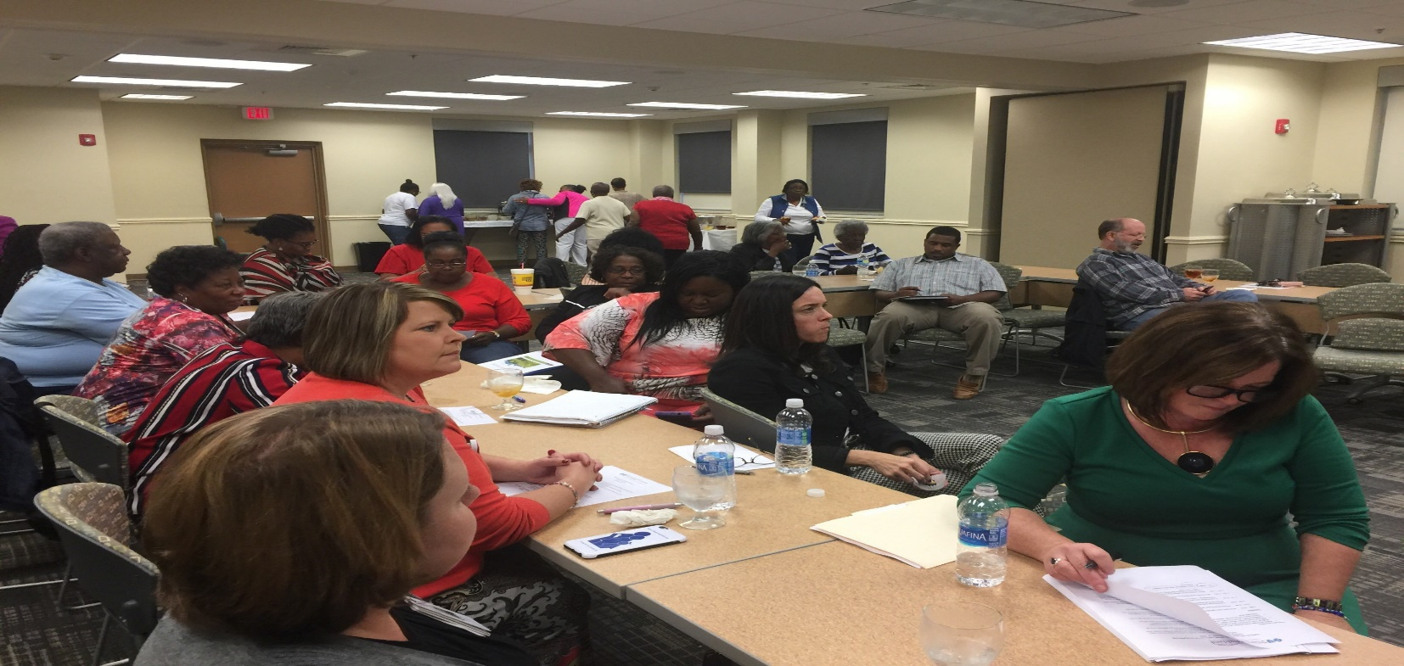
Focus Groups
Engage those you serve to participate in Focus Groups

Slide 5
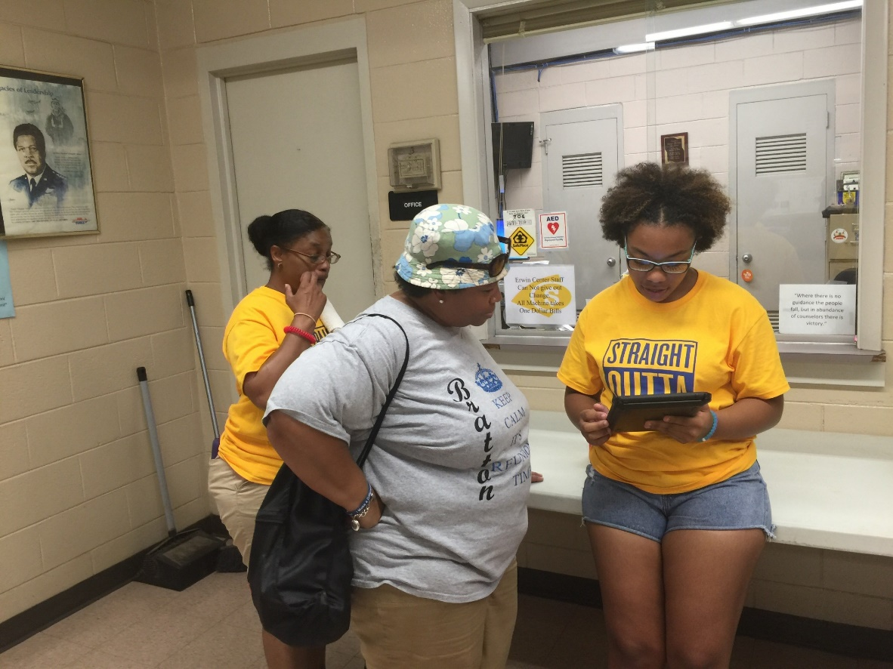
Surveys With A Twist
Move away from the usual paper or email surveys, reach people where they are and get creative with conducting surveys. Incorporate methods that appeal to the community you are serving.

Slide 6
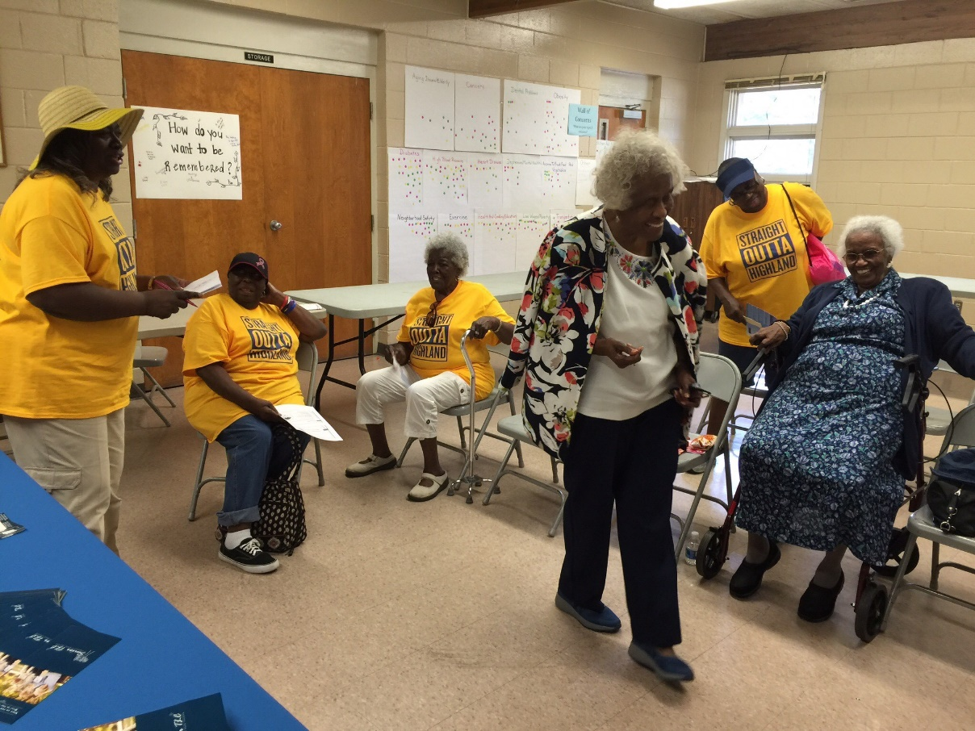
Dot Voting
Utilize information provided directly from the community to develop a list of priorities or concerns, then allow the community to rank those concerns.

Slide 7
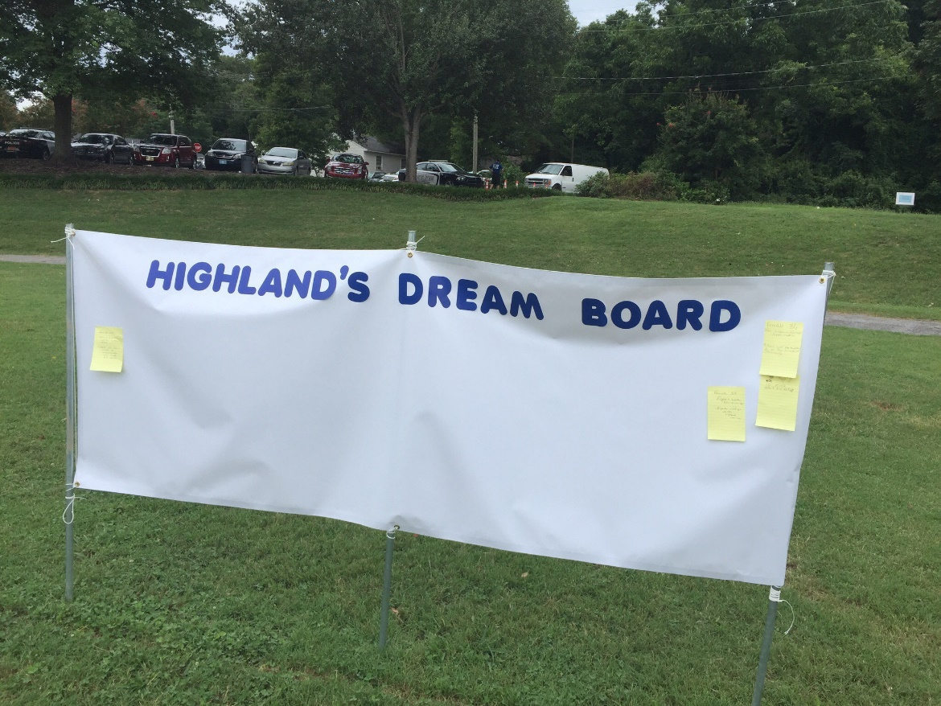
Dream Boards
Members of the community will offer very good ideas, if we would only ask them for their input.

Slide 8
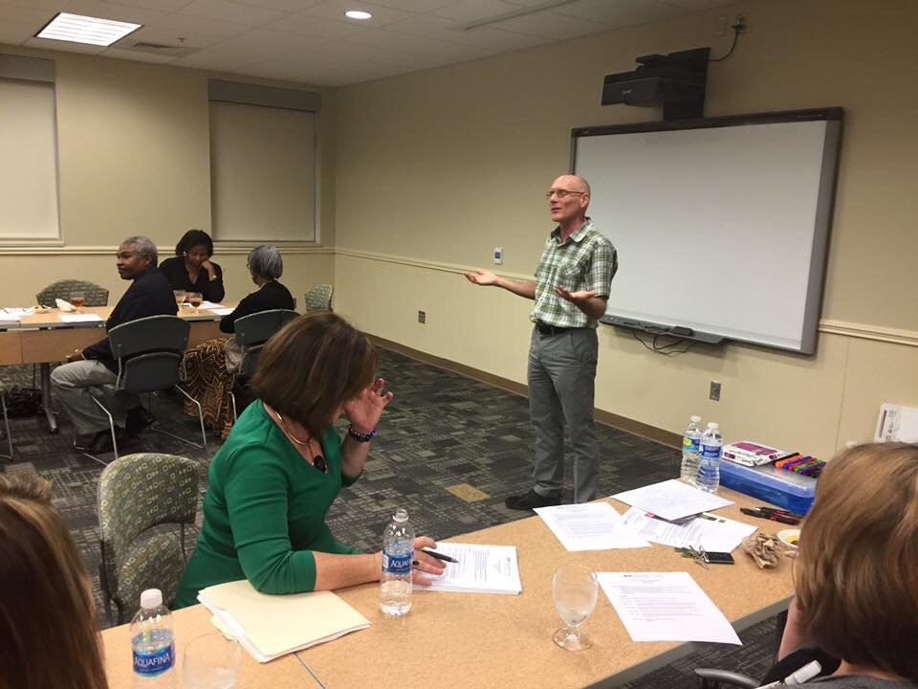
Root Cause Analysis
Just ask why?

Slide 9
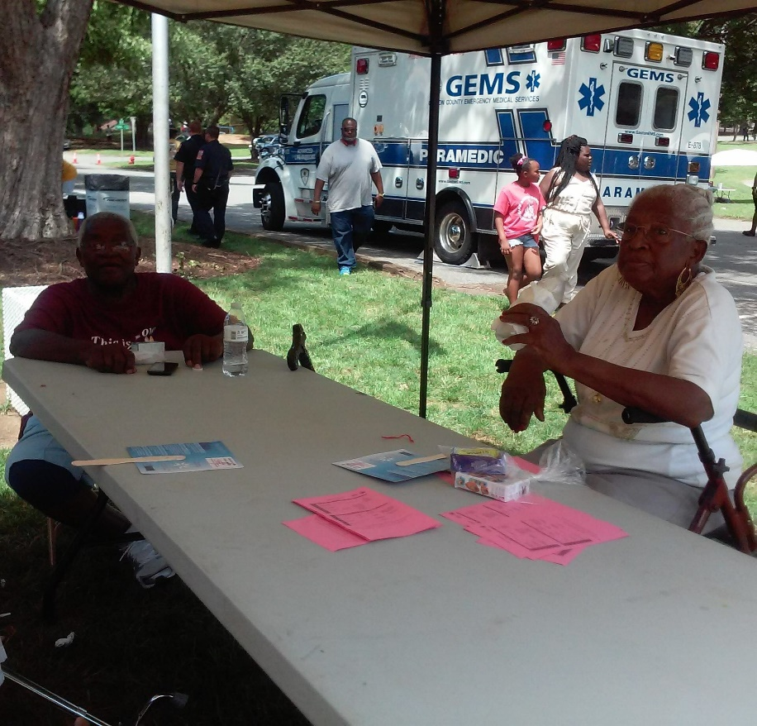
Intergenerational Interviews
Generations engaging one another can be a powerful tool for collecting data!

Slide 10
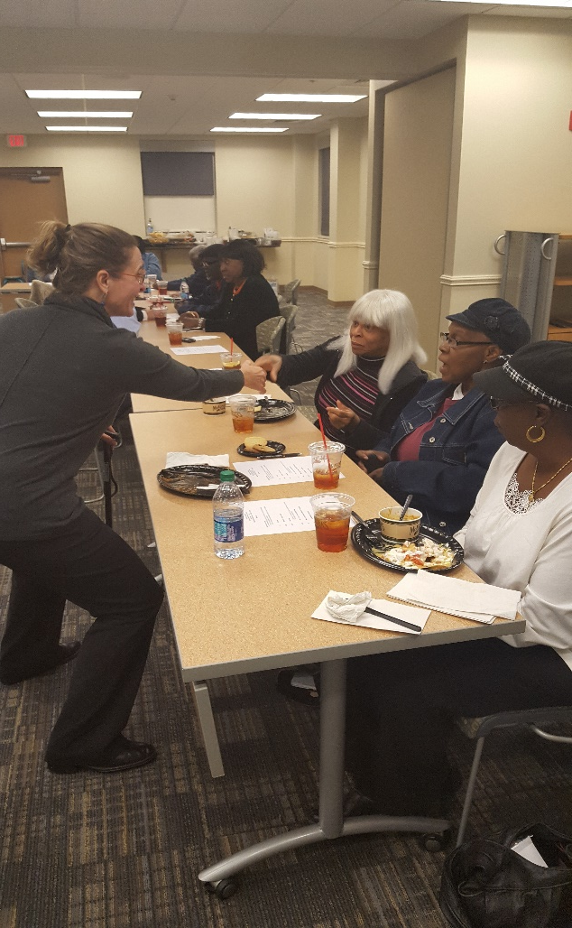
Information Sharing
Don’t just collect data and not be seen till the next time information is needed! Report Back!

Slide 11
Data Activities
It’s time for role play!

Slide 12
Future Work in the Neighborhood
Community Health Needs Assessment
Data collection at a local elementary school from teachers, parents, and students.

Slide 13
Questions and Answers
Thank You!

