Slide 1
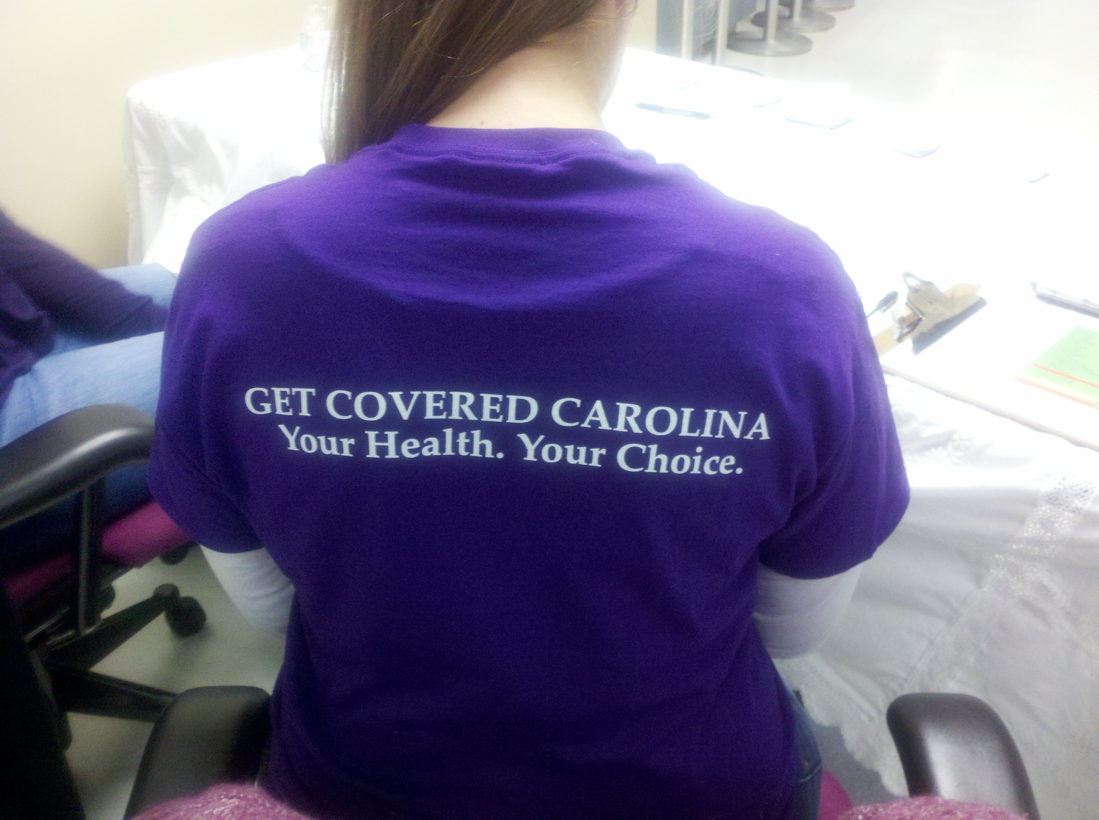
“Get Covered Carolina”: A Partnership to Navigate Change in HealthCare Law
Communities Joined in Action Annual Conference February 2018
Sherry S. Hay, MPA UNC Department of Family Medicine Director of Community Health Initiatives Adjunct Assistant Professor Shay@med.unc.edu 919-649-5423
Tim Smith, MPA Carolina HealthNet UNC Department of Family Medicine tismith@email.unc.edu 984-974-4996

Slide 2

“Life isn’t about waiting for the Storm to Pass.
It’s about learning how to dance in the rain” Vivian Greene

Slide 3
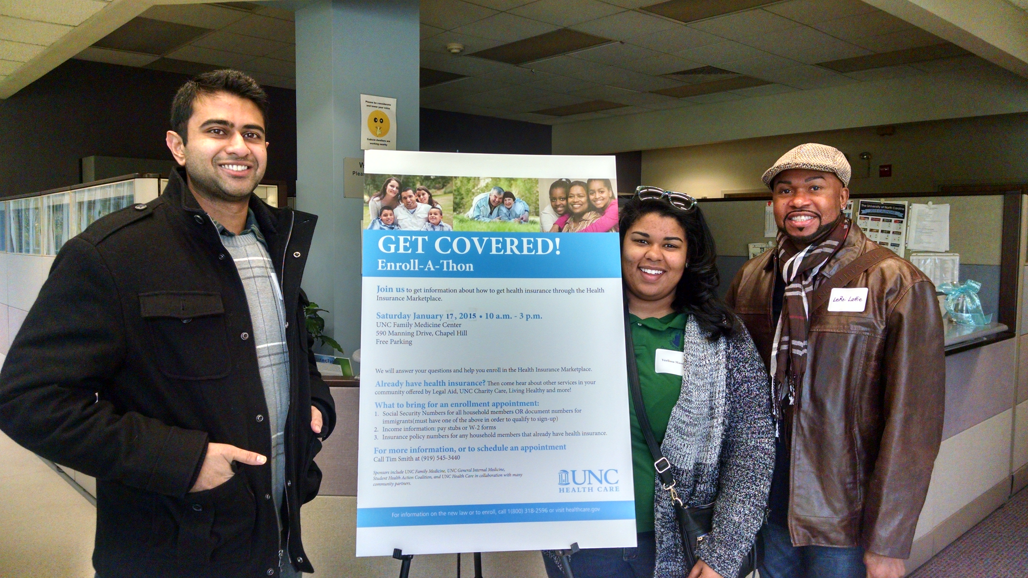
Objectives
To learn who in the community has an investment in the change and how objectives may align
To learn how to engage leaders and learners in the community work
To practice “putting the pieces together” for moving the community through healthcare change(s)

Slide 4
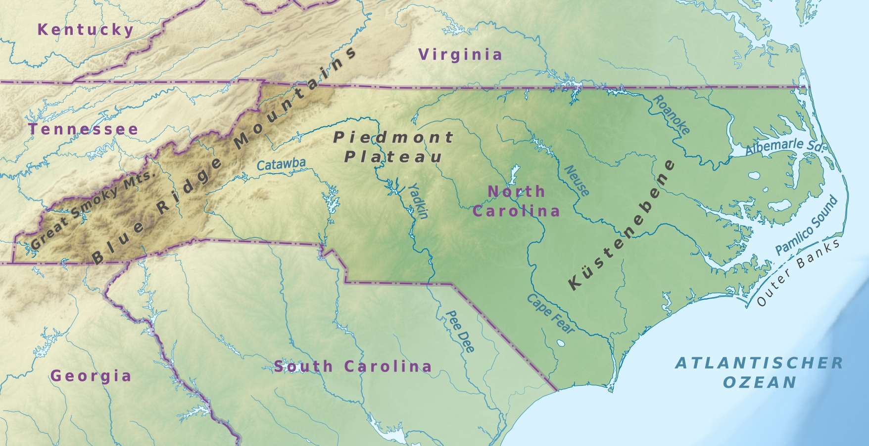
The Setting……….
North Carolina (Prior to first open enrollment in 2013/14)
-1.5 million uninsured (19% of the nonelderly population).
-87% of NC uninsured below 400% of FPL
-77% of the uninsured hade been uninsured for more than one year Our Region
- Regional Data-4 counties-more than 25,000 marketplace eligible
-Chose not to expand Medicaid (Supreme Court Ruling)
-Opted to use the federally facilitated marketplace
-State leaders told state agencies not to be actively involved with ACA activities
UNC Department of FM/UNC Family Medicine Center
-An academic medical center - over 16,500 patients and 54,000 outpatient visits
-Approximately 13% of patients Medicaid and 13% are uninsured.
-40 faculty and 26 resident physicians.
-Community Health (CH) central to the vision and mission of FM and our local work
of the uninsured, Carolina HealthNet. CH is robust – over thirty activities.

Slide 5

More Questions than Answers……..
More than 950 page law - What does it mean?
Where do we start and what is our role?
How do we do our work within NC’s political environment?
What about funding?
---------------------------------------------------------------------------------------------------------
Quickly realized, we needed to figure out how to help people in our community. We will be stronger through partnership!

Slide 6

Jumping in the Deep End…….
Don’t wait until you have all the answers but be strategic in your planning
Convene a regional meeting- Invite “old” partners & new partners
Our Aims for the meeting:
(1)Understanding more about the law;
(2)Networking between individuals;
(3)Discussing what people are thinking they may do within their respective organizations;
(4)Discuss what we may do as a regional group;
(5)Identify missing stakeholders for future meetings.
Plan well - engaging people in the meeting* (Identify individuals who can help with facilitation of the meeting and small group discussion) Organize the time using tools that help your process…

Slide 7
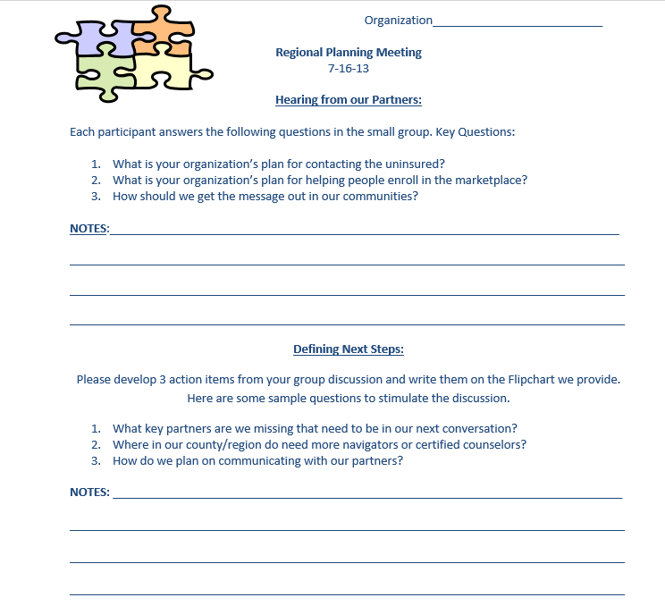

Slide 8
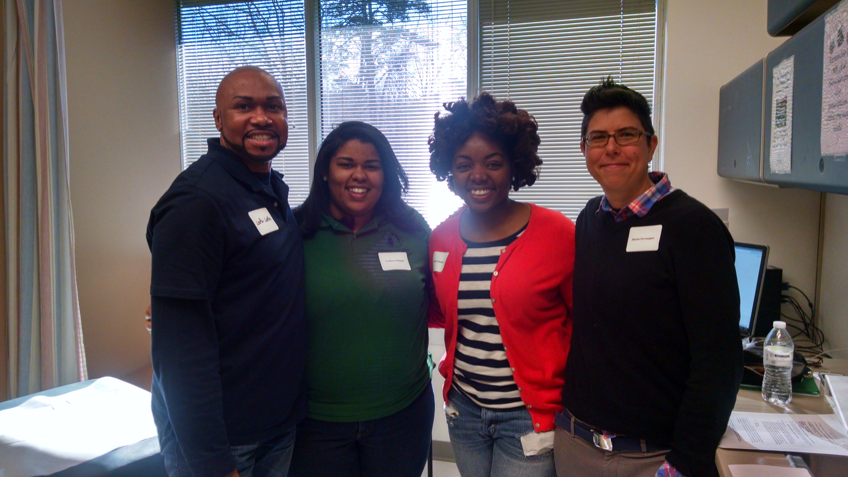
Our Partnerships..
NC Institute of Medicine
Hospital Systems
Area Health Education Centers (AHECs)
Legal Aid
Enroll America
League of Women Voters
Health Departments
United Way
Safety Net Providers
Free Clinics
Students (Medical, Public Health, Social Work)
Library
Media

Slide 9
Our Work Together…
Outreach and Education
Agreed to do inward outreach through their respective organization which ultimately led to people getting assistance who are otherwise served by other organizations
Developed a regional community resource sheet with hours of operation, phone numbers, and whether bilingual assistance was available. This was made available within and across the region.
Sponsored a Community Open House for questions to be answered about the ACA and how it may affect individuals. Partners offered different resources to make this happen
Leveraged existing partnerships to benefit collaborative efforts across region, e.g. FM has an existing contract with a local radio station. They agreed to provide information about the changes and resources at all partner organizations.

Slide 10
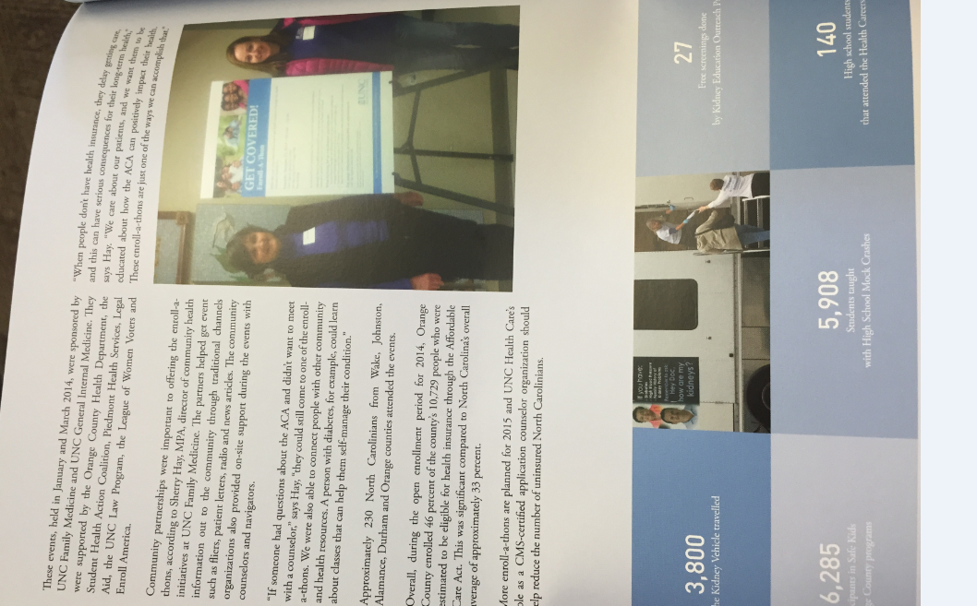

Our Work Together…
Outreach and Education (cont.)
Ensured our community relations department at the local health system was involved as they are responsible for their annual community benefit plans. Our local system provided dollars for newspaper ads, food for events, and space for educational seminars while other partners agreed to provide counselors, appointments and the administrative organization for these activities.
Provided small group educational opportunities at our enrollment events. League of Women Voters agreed to lead the discussions on the ACA.
Designed buttons for partners to wear in the office and/or community.
Partnership group met to share “lessons learned” to develop best practices.

Slide 11
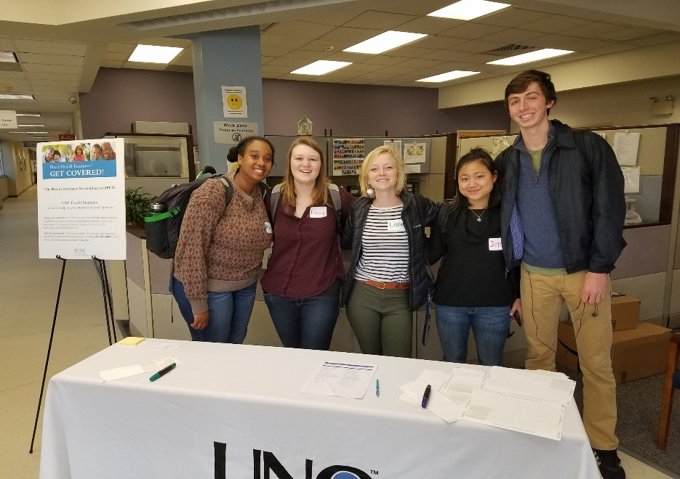
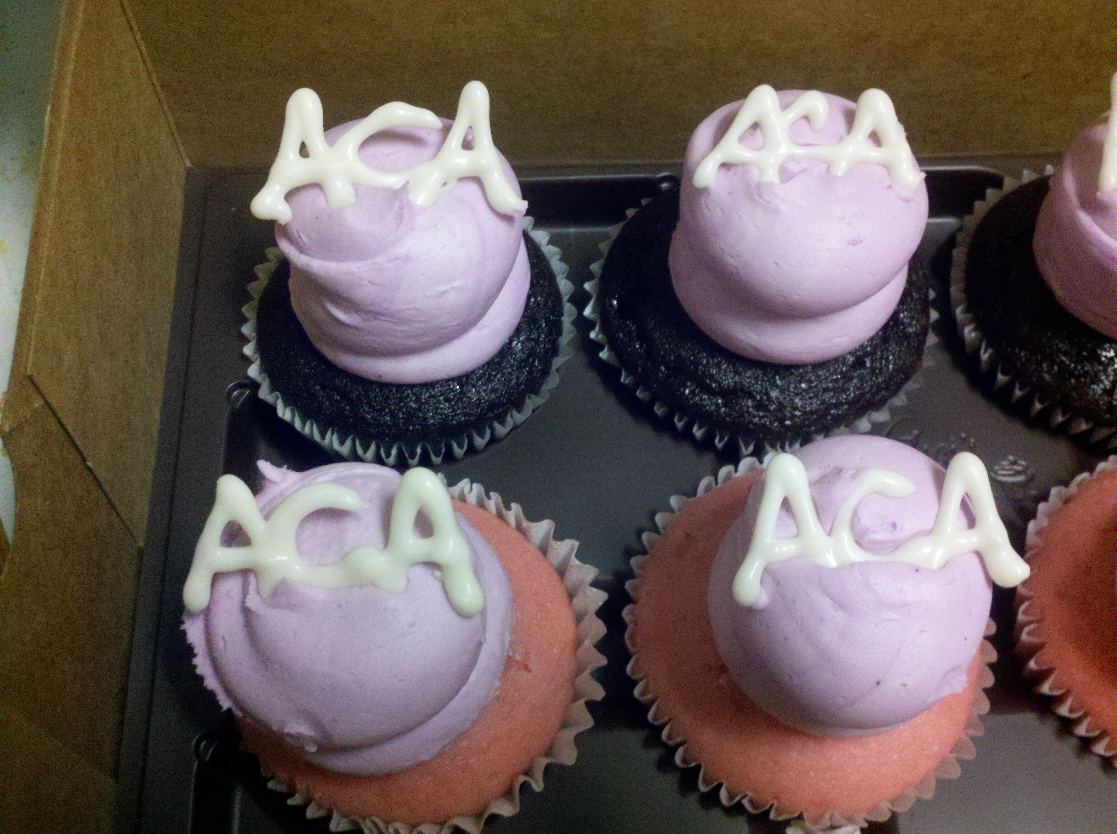
Our Work Together…
Enrollment
Shared Certified counselors and other volunteers
Worked to ensure support service agencies were involved, e.g. Medicare and Charity Care
Shared Space and Technology
Offered on-site and enrollment events together
Evaluated data and celebrated efforts!

Slide 12
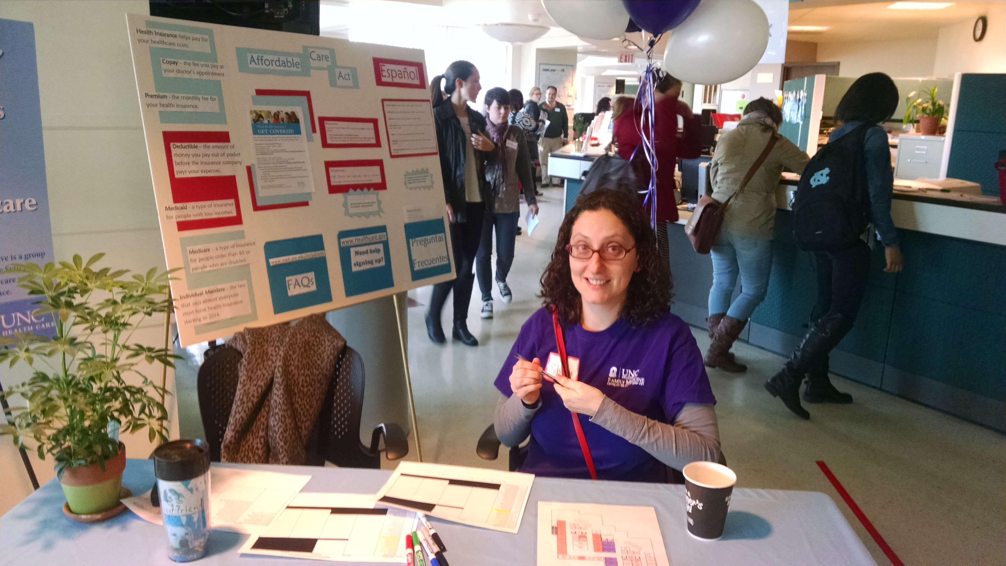
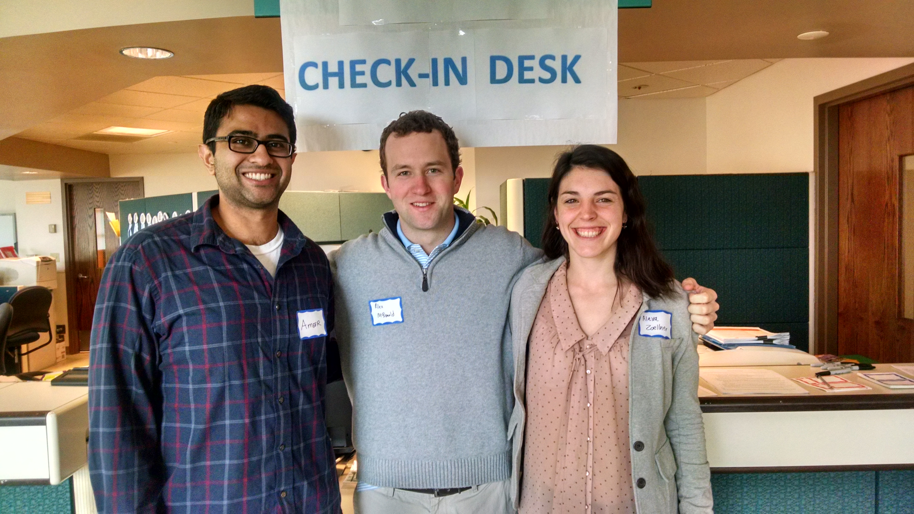
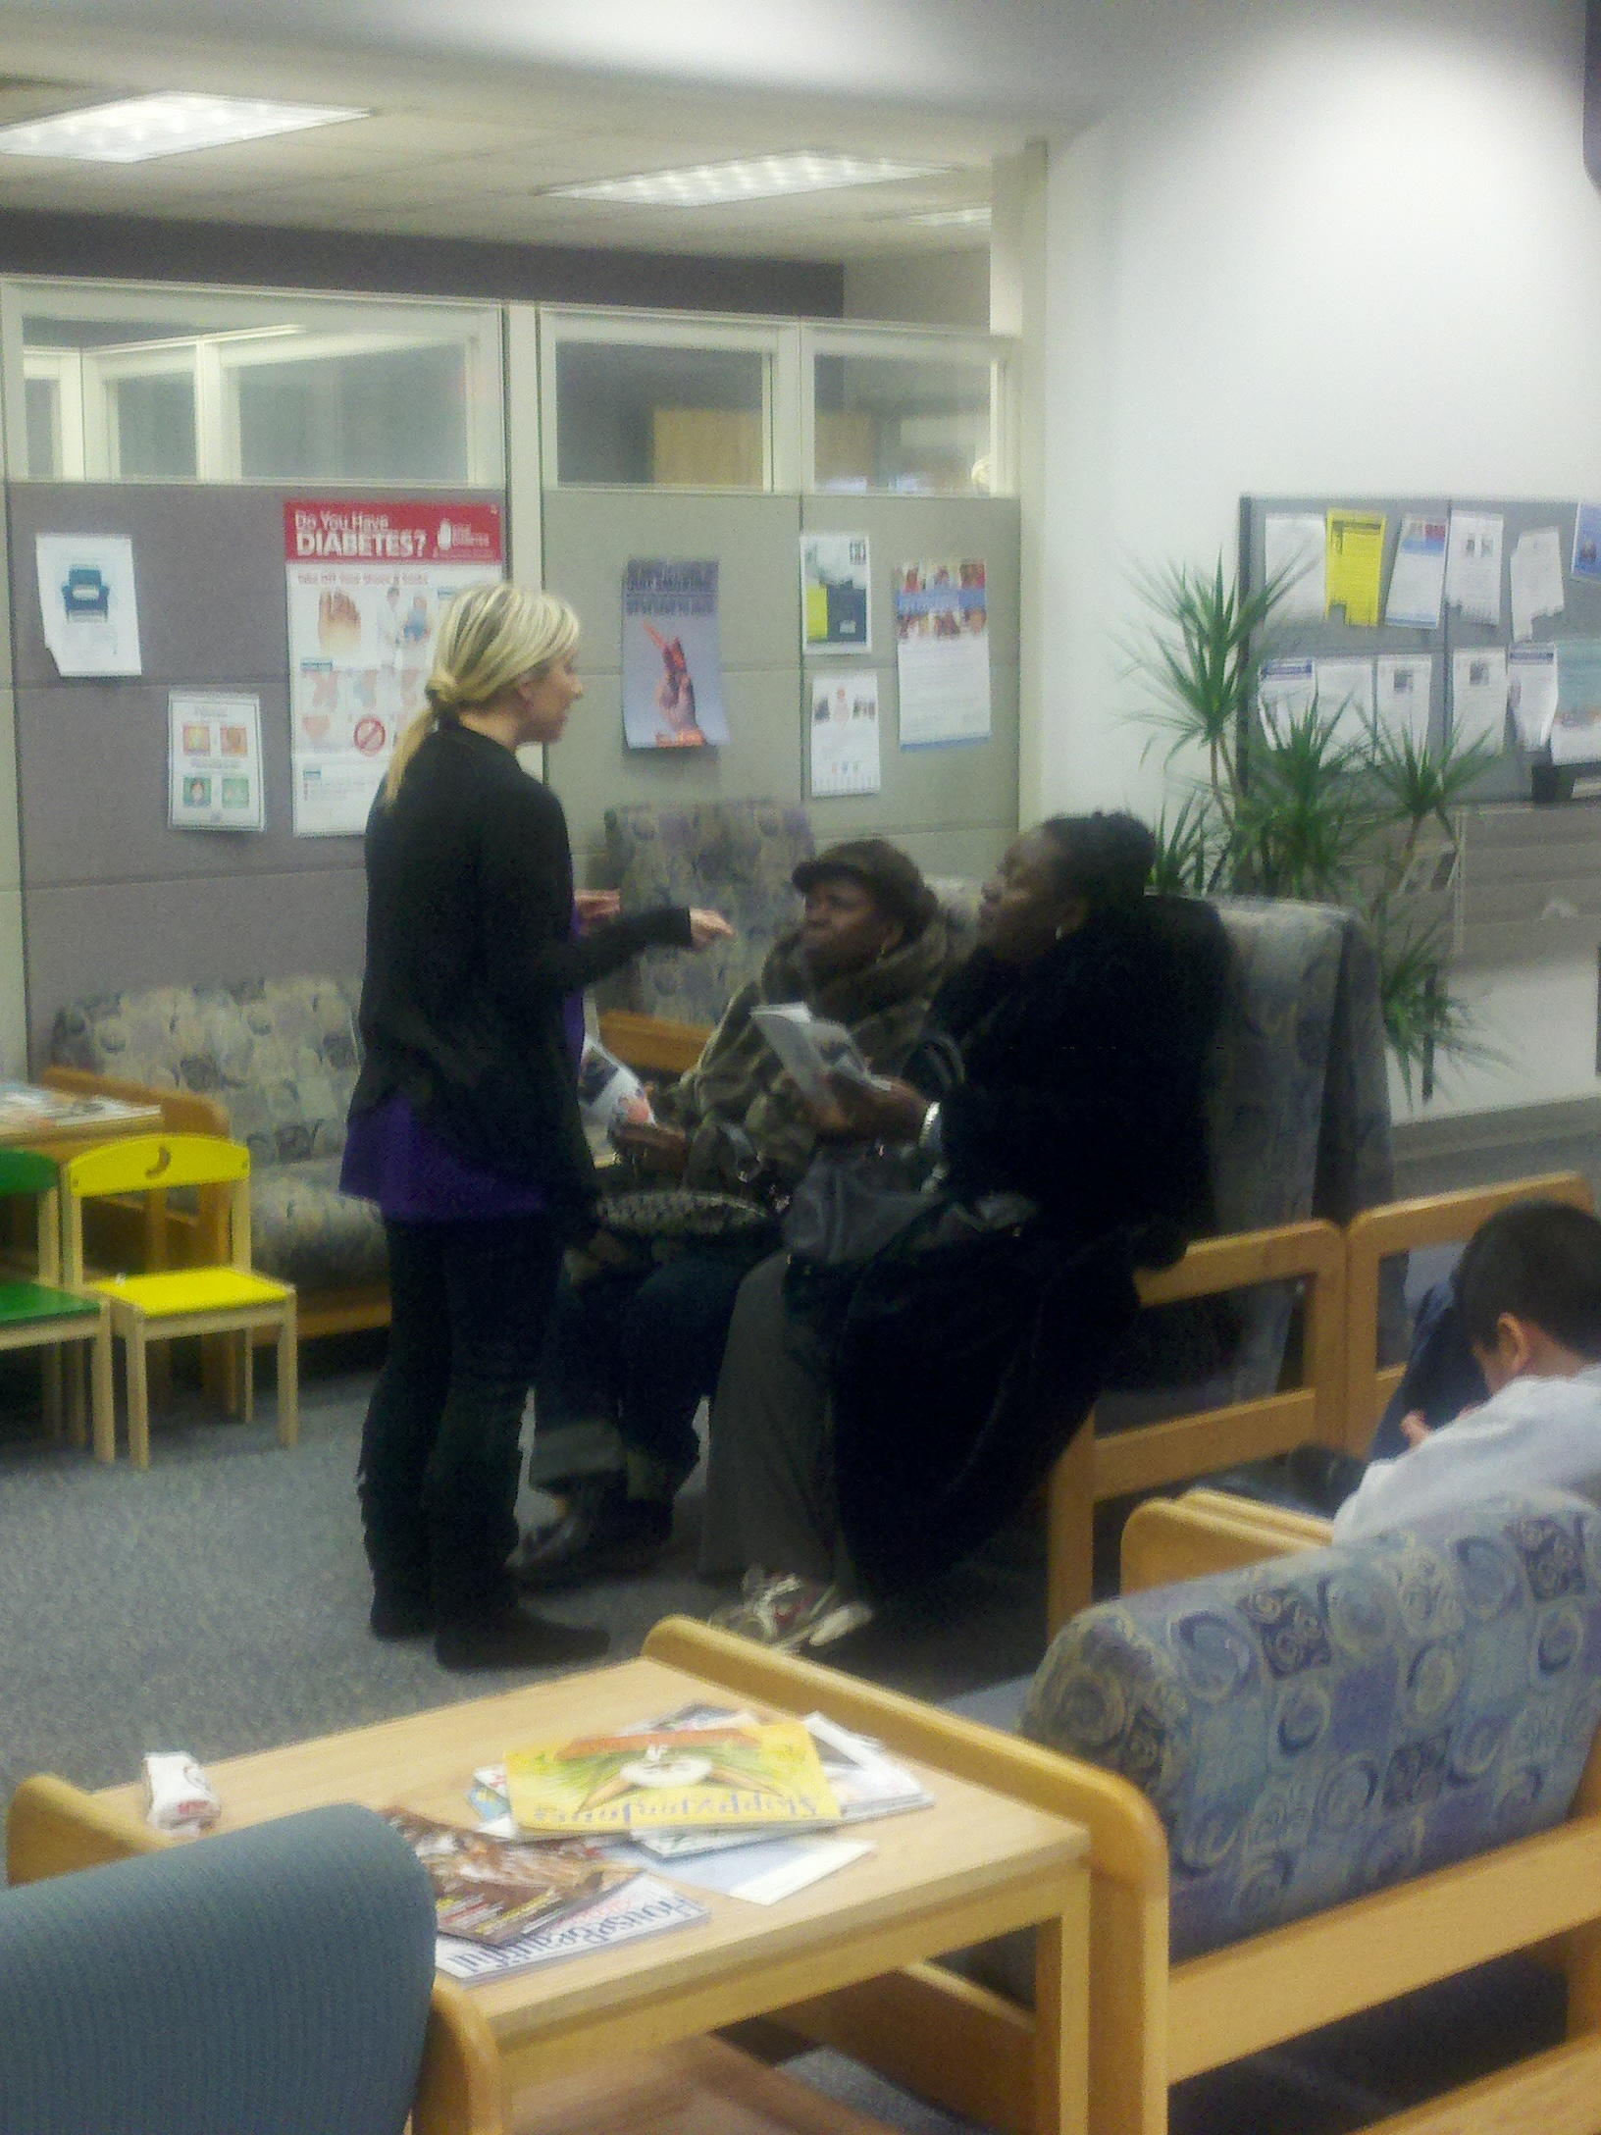
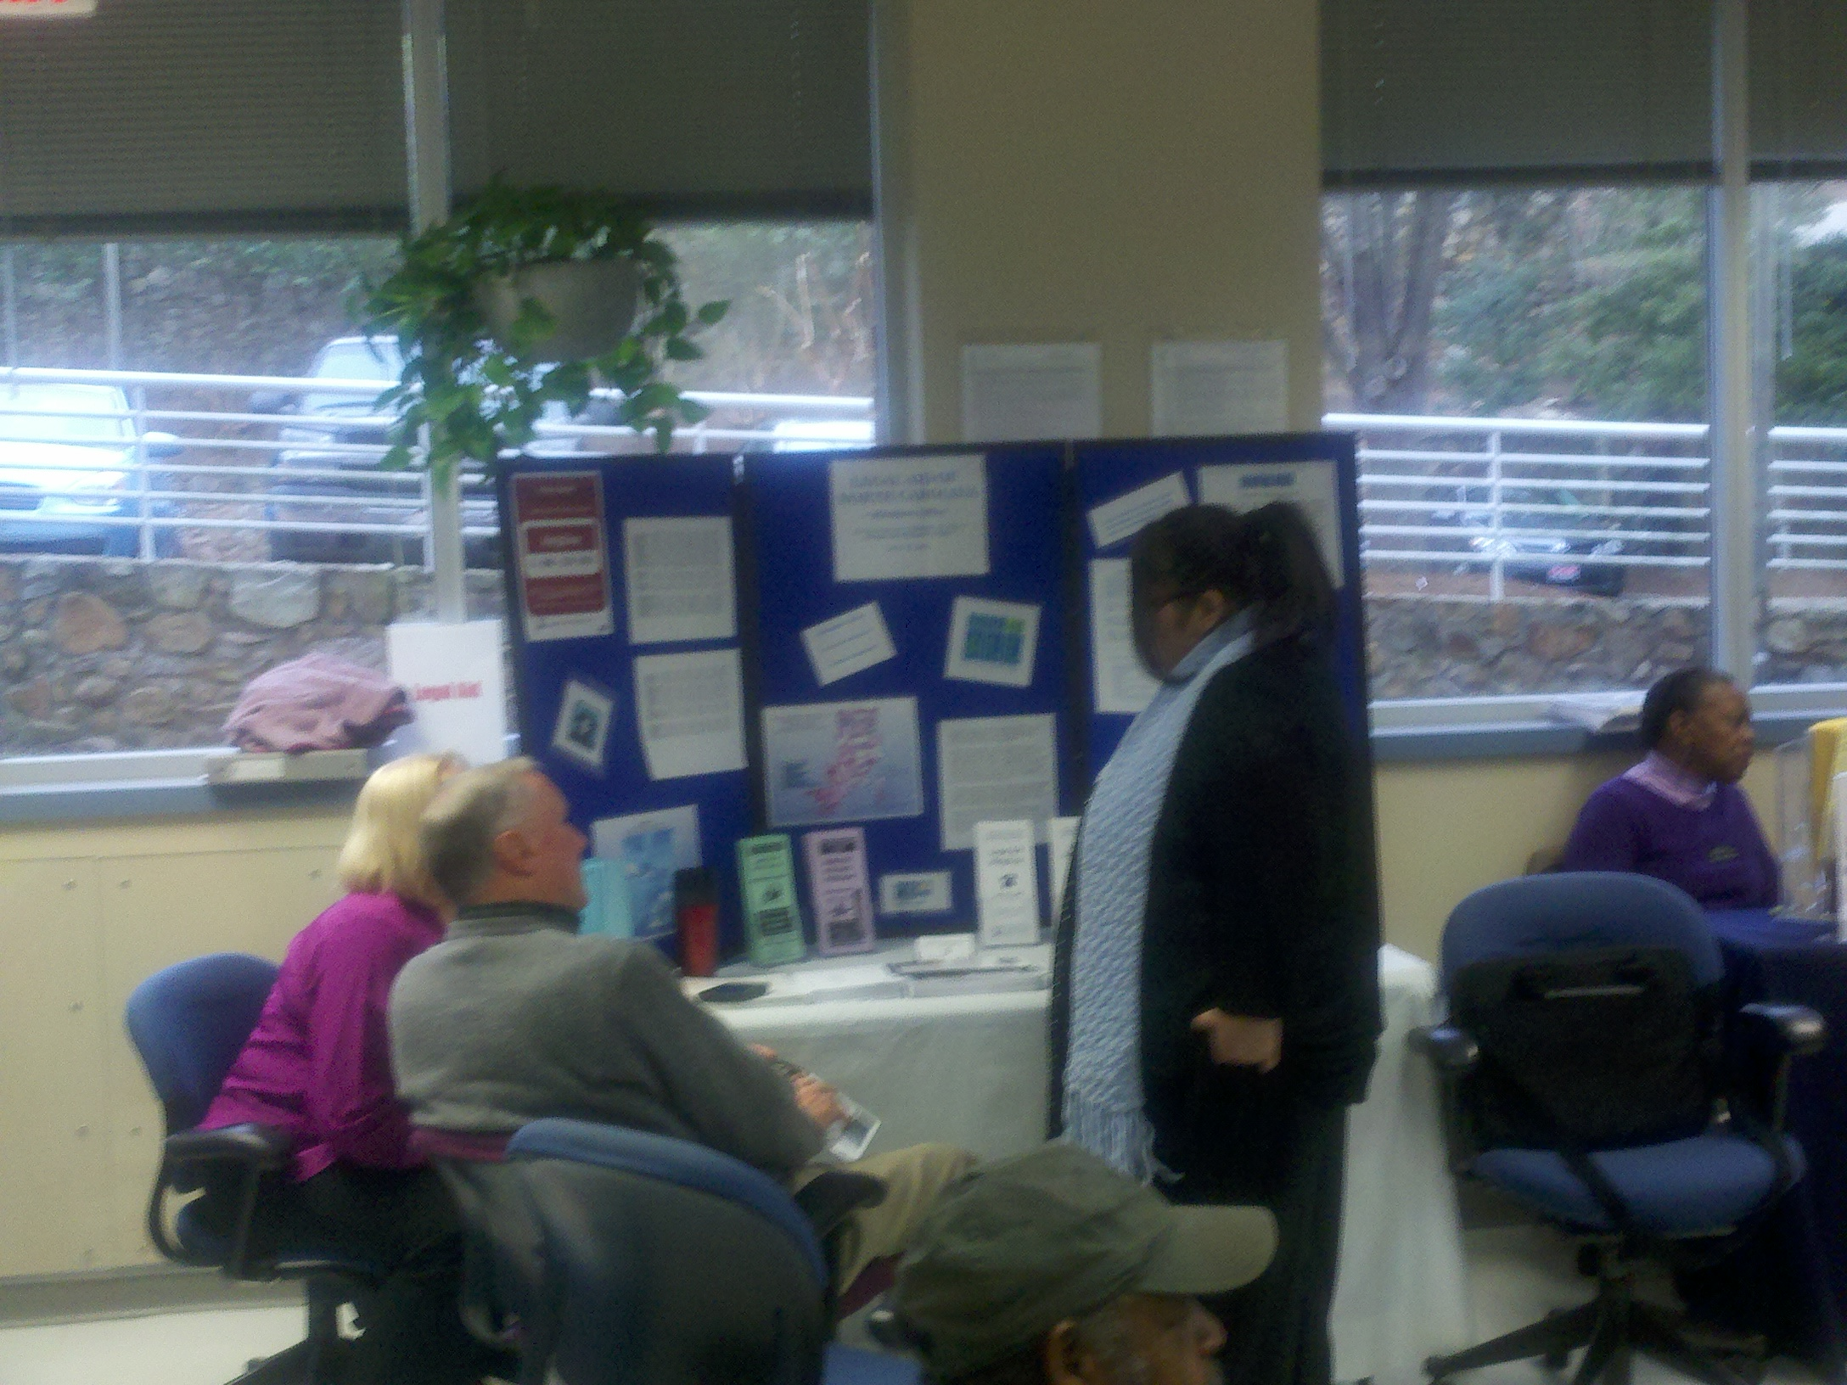
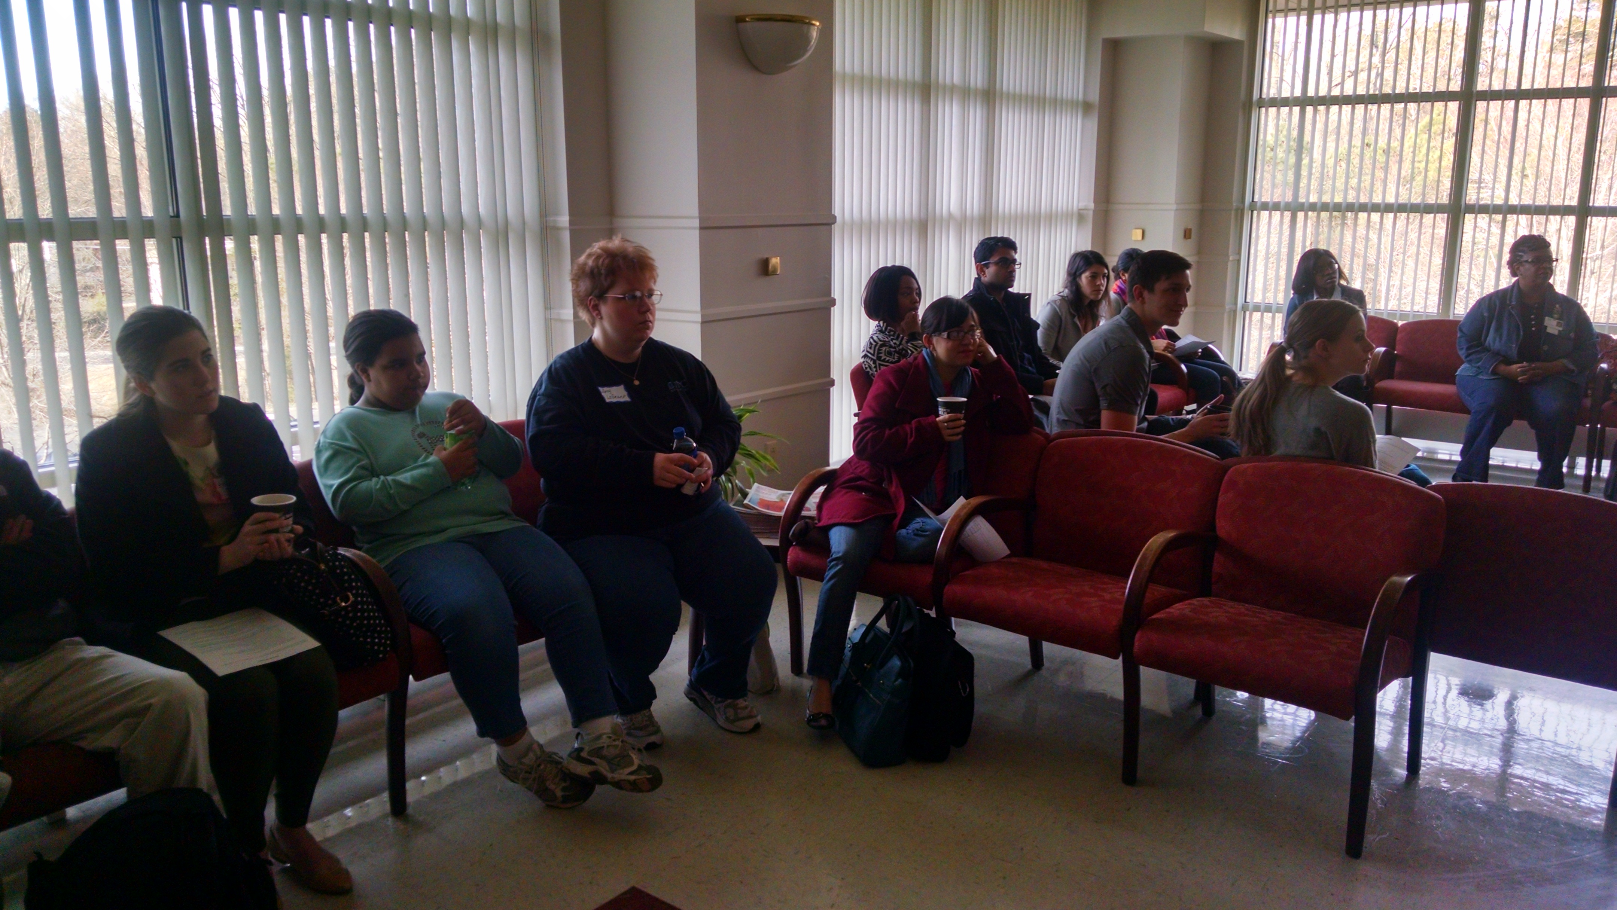
Enrollment Events……

Slide 13
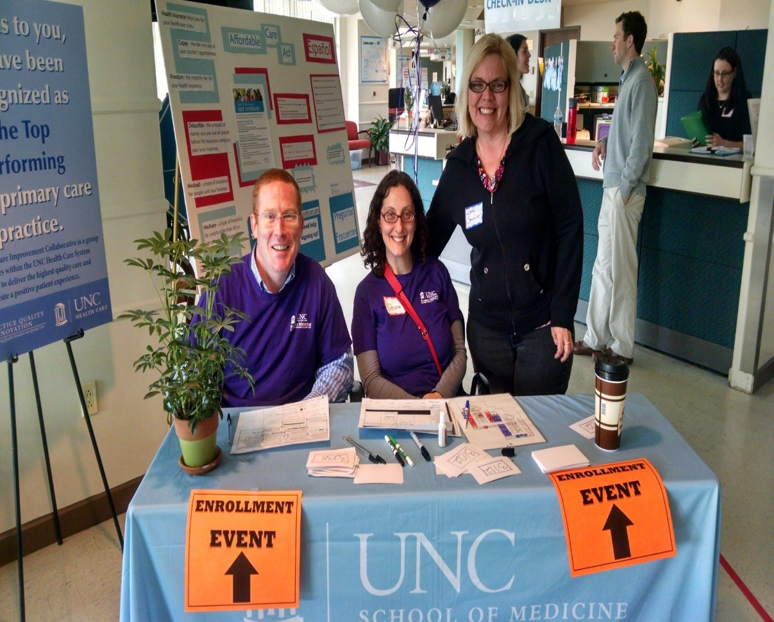
Results…
3rd highest enrollment nationally among states who used the FFM
Regionally our % enrolled slightly higher as compared to % enrolled by state
Informed other local coalitions in NC on the process of successful partnership which led to helping to develop a toolkit - www.ncgetcovered.org
Work of “Get Covered Carolina” has paved the way for other community collaborations, e.g. regional health advisory council

Slide 14
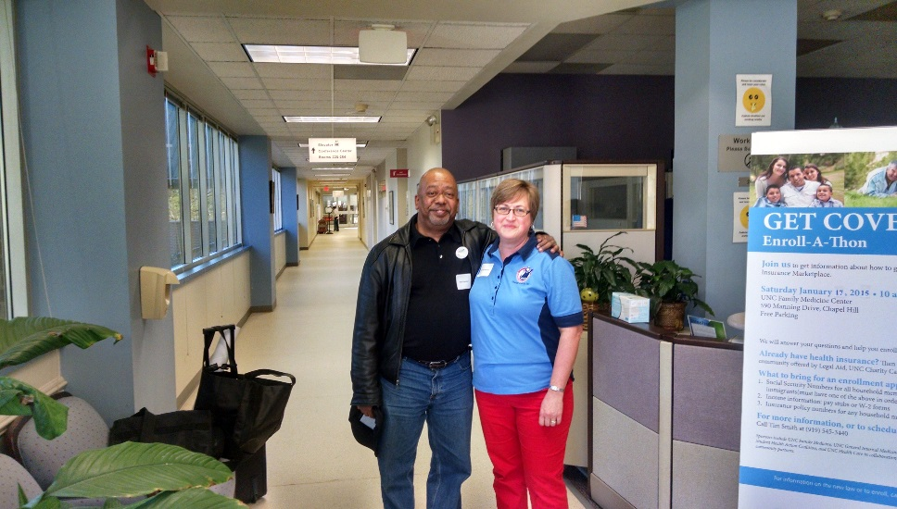
Can I Make this Work in my Community?
Yes, jump in with both feet while looking around at who is there to support you! Dancing in the rain can be fun!
Find your champions-knowledge and process champions. This could be the same people or different people
Plan well and be persistent
Be adaptable and flexible
Connect with an academic medical center/community college
Decide on how to measure your success & celebrate often
Healthcare systems have community relations departments who are often responsible for annual community benefit plans. Ensure they are involved as they have funding and this these types of efforts align with their mission.

Slide 15
Small Group Exercise: Your Community navigating a change in healthcare law
Wear a different hat, i.e. pick a role from those listed on your sheet. It should be something other than your current role. What are your interests with the change in law in this new role and how would you help?
Everyone has a role, read the challenge
Discuss the questions
Report out to the larger group

Slide 16
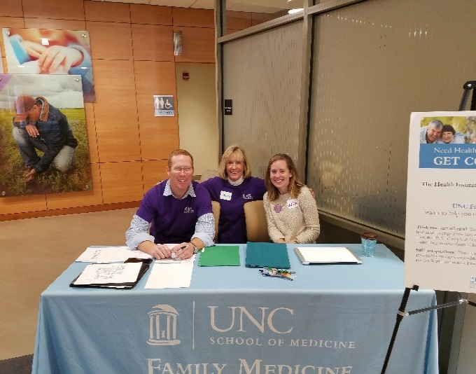
Thank you!
Sherry S. Hay, MPA UNC Department of Family Medicine Director of Community Health Initiatives Adjunct Assistant Professor Shay@med.unc.edu 919-649-5423
Tim Smith, MPA Carolina HealthNet UNC Department of Family Medicine tismith@email.unc.edu 984-974-4996

