Slide 1
From Grass Roots to Statewide Change:
A Collective Impact Approach to Addressing Childhood Obesity
Multi Sector Partnerships
Presenters:
Emily Anne Vall, PhD, GA Shape Program Manager, GA Dept of Public Health
Debra Kibbe, MS, Sr Research Associate, GA Health Policy Center
Date / Time:
February 15, 2018 ▪ 10:00 a.m.-11:00 a.m.
For:
2018 Communities Joined in Action National Conference
Notes:
CJA - send your power point presentations by February 1, 2018.
2.7 From Grass Roots to Statewide Change: A Collective Impact Approach to Addressing Childhood Obesity
This session will review:
Participating stakeholders and their roles in addressing childhood obesity will be described including state departments of public health, education and early care along with public, private, county and district public health partners.
A systems modeling tool used to educate legislators about childhood obesity will provide audience interaction.
Successes and challenges experienced when implementing a childhood obesity effort at the local, regional and state level.
a discussion of how partnerships, professional development, technical assistance, and community interventions have been applied in targeted geographic locations to build capacity throughout the state in addressing childhood obesity.

Slide 2
In your opinion, what have been the biggest contributors to the increase in childhood obesity in the past 20 years?
Vote with your feet!

Slide 3

Stand if you think it’s…
Fast Food
Sugary Beverages
Video Games
Lack of Outdoor Play
Less PE & Recess
Excess Snacking
Temperature Regulation-Homes/Schools
Safety Concerns
Computer/Smart Phones
Marketing to Children

Slide 4
OBJECTIVE #1
Stakeholders and their Roles in Addressing Childhood Obesity in Georgia
Emily Anne Vall, PhD, Georgia Shape, Georgia Department of Public Health
EmilyAnne.Vall@dph.ga.gov
Notes:
This session will review successes and challenges experienced when implementing a childhood obesity effort at the local, regional and state level. Participating stakeholders and their roles in addressing childhood obesity will be described including state departments of public health, education and early care along with public, private, county and district public health partners. A systems modeling tool used to educate legislators about childhood obesity will provide audience interaction. Finally, a discussion of how partnerships, professional development, technical assistance, and community interventions have been applied in targeted geographic locations to build capacity throughout the state in addressing childhood obesity.

Slide 5
Georgia Shape Overview
A Statewide, Collective Impact Framework to Reduce Childhood Obesity
Notes:
This session will review successes and challenges experienced when implementing a childhood obesity effort at the local, regional and state level. Participating stakeholders and their roles in addressing childhood obesity will be described including state departments of public health, education and early care along with public, private, county and district public health partners. A systems modeling tool used to educate legislators about childhood obesity will provide audience interaction. Finally, a discussion of how partnerships, professional development, technical assistance, and community interventions have been applied in targeted geographic locations to build capacity throughout the state in addressing childhood obesity.

Slide 6

Framework for Change: Collective Impact
Government
Philanthropy
Academia
Business
Georgia Department of Public Health: “Backbone Organization”
Notes:
Collective Impact – to date approx. 129 partners actively working on Shape sub groups and Council

Slide 7
Collective Impact (CI) Steps
Engage Partners (120+)
  Formal and Informal; Share Resources & Data
Define SMART Goal(s) & Objectives
  “What’s in it for me?”
Develop Evaluation Design
Implement and Share Interventions
Collect and Report Evidence
Share Lessons Learned
Revise CI Plan
If you are using CI, raise a hand!
Notes:
GEORGIA SHAPE
DOE
DPH
DECAL
DFACS
HIGHER ED – UNIV W. GA, GSU, EMORY
GEORGIA HEALTH POLICY CENTER
NON-PROFITS - CHILDREN’S HEALTHCARE OF ATL and HEALTHMPOWERS
129 different partners
Committee structure includes
Nutrition
PA
Data and Evaluation
Communications and Marketing

Slide 8

S.M.A.R.T. GOAL
By 2023,
69% of GA Students will be in the Healthy Fitness Zone for BMI
How do we achieve this goal?
Notes:
EMILY
Over the next ten years Georgia Shape will work towards increasing the number of students in the Healthy Fitness Zone for Body Mass index by 10%. Other objectives set forth by the Governor and Georgia Shape include reaching disparate populations, increasing the aerobic capacity measure of Georgia’s youth, increasing the breast feeding rate across Georgia, and increasing the number of early care centers that excel in nutrition and physical activity measures.

Slide 9
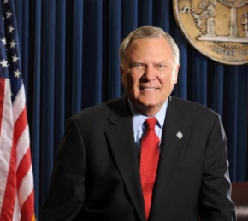

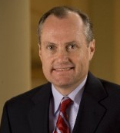

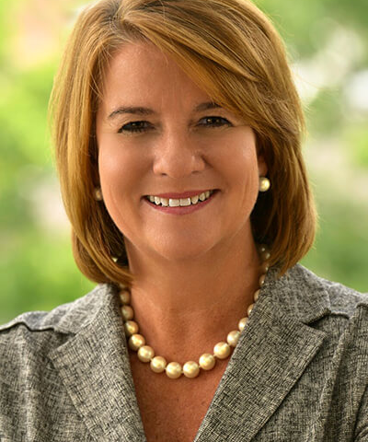
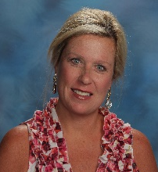


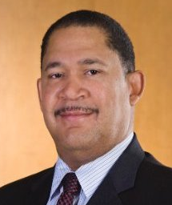

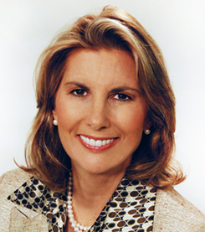
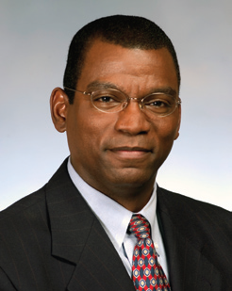


ENGAGED LEADERSHIP:
Members of the Governor’s Advisory Council on Childhood Obesity
Nathan Deal
Council Co-Chair
Governor,
State of Georgia
John Bare
Council Co-Chair
Vice President,
Arthur M. Blank Foundation
J. Patrick O’Neal, MD
Commissioner,
Georgia DPH
Casey Cagle
Lieutenant Governor,
State of Georgia
Missy Dugan
President and Chief Executive Officer, Boys & Girls Clubs of Metro Atlanta
Jennifer Glover, PhD
Asst Principal at White County Intermediate School,
Owner Glo Crest Dairy
Evelyn Johnson, MD
Vice President, Georgia Chapter, American Academy of Pediatrics
Melvin Lindsey
Senior Government Relations Director, Amerigroup Georgia
Linda Matzigkeit
Chief Administrative Officer,
Children’s Healthcare of Atlanta
Teya Ryan
President and Executive Director, Georgia Public Broadcasting
Ron Shipman
Vice President. Environmental Affairs, Georgia Power
David Satcher, MD, PhD
Director, Satcher Health Leadership Institute; Director, Center of Excellence on Health Disparities, Morehouse School of Medicine
Phillip Williams, PhD
Dean, College of Public Health, University of Georgia

Slide 10
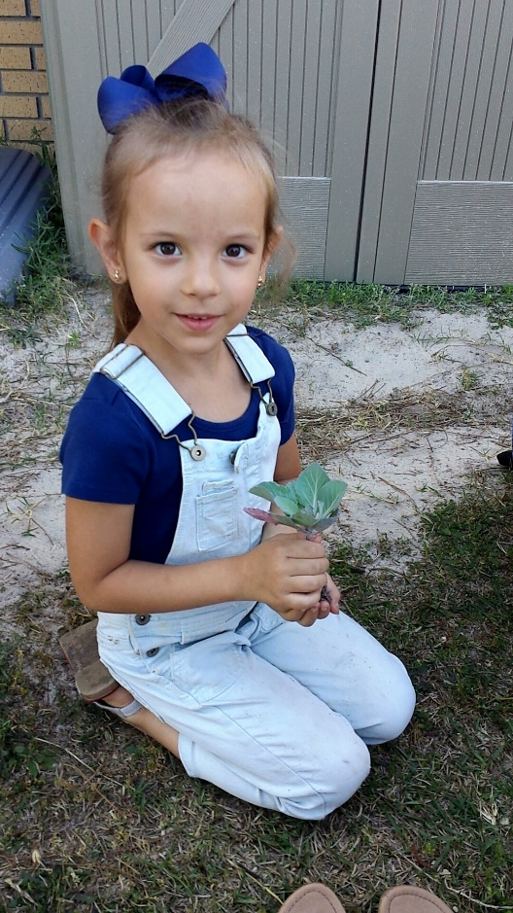
Engaged Partners:
Committee Framework
Nutrition
Physical Activity
Data and Evaluation
Communications and Marketing
Healthcare
When: Quarterly Meetings/Conf Calls
Focus: Partner Reports on Progress & Future Efforts

Slide 11
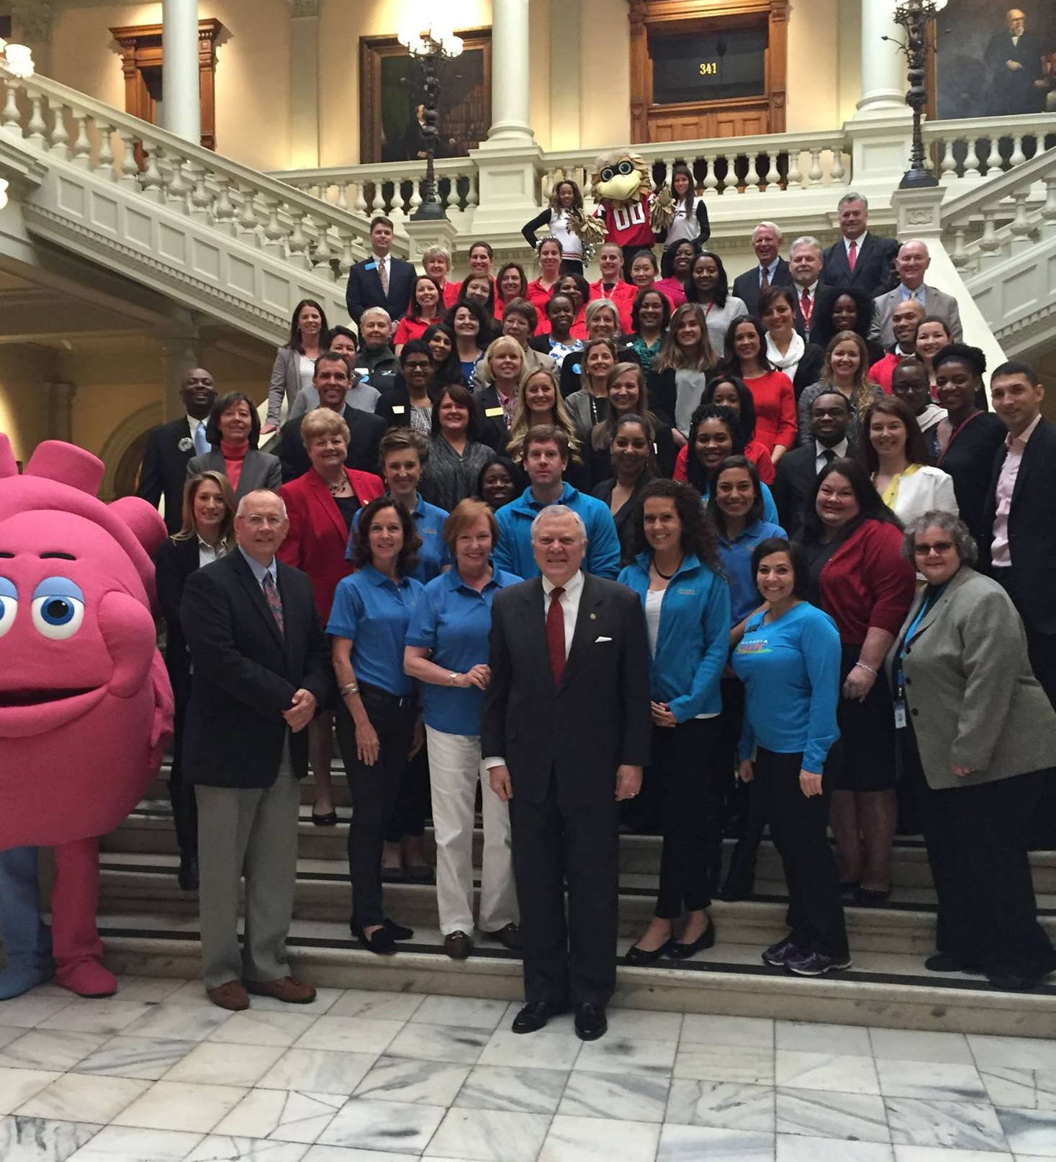
State Agency Partners
Georgia Departments of….
  Public Health
  Education
  Early Care and Learning
  Agriculture
  Human Services, Division of Family and Children Services

Slide 12

Engaged Partners
Universities
Non-profits
Health systems
Private industry
Local health districts
Partners: ≈ 129
Notes:
Our partners ensure, Georgia Shape is:
Better Connected to the Communities throughout GA
Establishing diverse relationships
Has “Boots on the Ground”
Maximizing the Sharing of Resources
Able to expand its Efforts/Reach/Outcomes
Translating Public Health Concepts to real life application

Slide 13
Partnership: Early Care
Growing Fit
EAT MOVE TALK
University of Georgia
Georgia Organics
Common Market GA
SHAPE Awards: DECAL
GDPH
Quality Care for Children
Strong4Life
Voices for GA’s Children
Farm to Preschool Coalition
WIC
HealthMPowers

Slide 14

Results: Early Care
259 centers assessed using common assessment tool
1181 center staff trained
115 written wellness policies
34,822 students impacted

Slide 15
Partnership: Schools
Alliance for a Healthier Generation
Children’s Healthcare of Atlanta
Fuel Up to Play 60
HealthWays
Captain Planet
GA Health Policy Center
Georgia Organics
GDPH / GDOE HealthMPowers
Action for Healthy Kids
Team Nutrition
Voices for GA’s Children
American Heart Association
Presidential Youth Fitness Program
Atlanta Falcon’s Youth Foundation
Power Up for 30
Professional Development
Grants Programs
Farm to School
School Grants
Shape Award
Technical Asst.
Capacity-building workshops

Slide 16
Pilot Intervention Model
Notes:
Grew Out of a pilot in 2013
39 schools
Partners (DPH, DOE, BCBS, HMP GaShape GSU – Evaluator

Slide 17
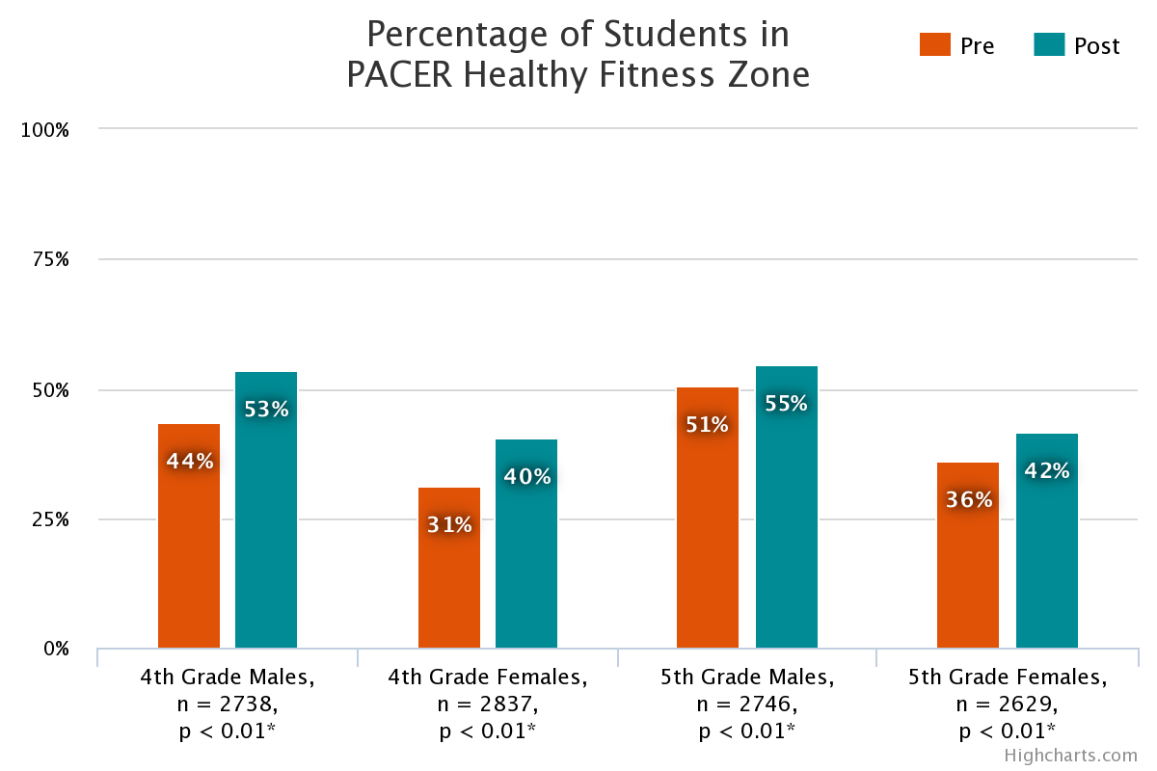

Slide 18
Partnership: Universities
Program Evaluation, Partnership Evaluation, Research,
Student Thesis Work, Internships
Emory
``
Georgia State
GDPH / HealthMPowers
University of Georgia
University of West Georgia

Slide 19
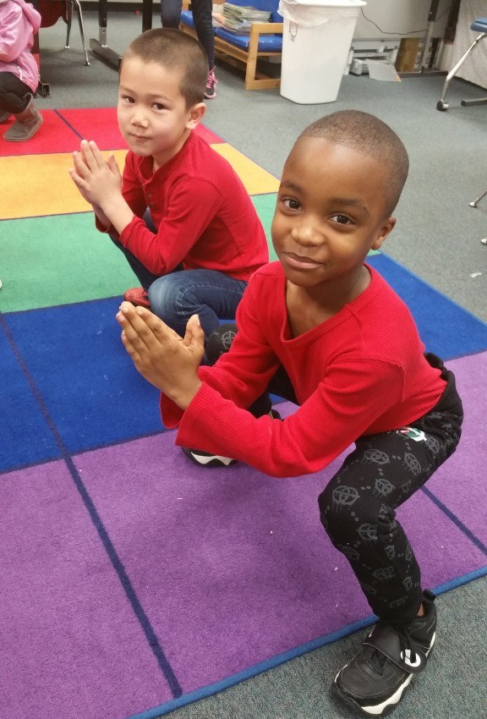
Results: Higher Education
Robert Wood Johnson Foundation – Emory
  DOE, DPH, HealthMPowers, Boise State, GSU
  Randomized control trial; 40 schools – 1 district
  Physical Activity and Academic Achievement
  Results 2020
NIH RO1 – UGA
  DPH, HealthMPowers
  Shape Implementation
  Results 2018

Slide 20
OBJECTIVE #2
Systems Modeling to Inform Policy and Practice for Addressing Childhood Obesity in Georgia
Debra Kibbe, Georgia Health Policy Center, AYSPS, Georgia State University
dkibbe@gsu.edu 404-413-0287

Slide 21
Obesity Model Tabletop Activity
Evidence-based Strategies (those that change BMI):
  School Physical Education,
  Classroom-based Physical Activity,
  Afterschool Physical Activity and Nutrition,
  Preschool Physical Activity and Nutrition
  Competitive Foods in School Nutrition Program,
  Medical Nutrition Therapy
  Breastfeeding
  Safe Routes to Schools
Handout

Slide 22
Background: Childhood
Obesity Systems Model
Focus is on systems funded by GA Legislature
Education:
  Public Schools
  Georgia Pre-K (Lottery $)
  Afterschool Programs
Healthcare:
  Medicaid
  MCH/WIC
Transportation:
  Safe Routes to Schools
Notes:
Schoolwide Title I programs. Local education agencies (LEAs) can consolidate and use Title I and other federal, state, and local funds for schoolwide Title I programs in schools where at least 40 percent of the students are from low-income families. Schools can use this funding to develop schoolwide health programs, such as hiring a school nurse, implementing nutrition programs, schoolwide positive behavior and social-emotional support strategies, bullying prevention programs, or a strong physical education program. These are programs that can benefit all students, in addition to providing targeted support to those who are struggling.

Slide 23
Background: Childhood
Obesity Systems Model
2007: $ from the Healthcare GA Fdn to build upon the work of the Legislative Health Policy Certificate Program (LHPCP)
LHPCP participants chose childhood obesity as an “issue of interest”
Team of 12 (mostly volunteers) worked for 5 months on developing the model & supporting materials
Childhood Obesity Systems Model project provided:
  A tool for legislators to be trained in basic systems
  An opportunity for more rigorous discussion about an important policy issue

Slide 24
Background: Childhood Obesity Model
2014: GHPC received grants from Woodruff Fdn & GDPH to update the model
  Updated literature reviews for “assumptions documents” for all levers/interventions
  Fitness assessment data collected on GA students 2011 to 2014 informs the model
  New Levers Added: Breastfeeding, Classroom-based physical activity, Recess
Notes:
AR data in last model!

Slide 25
Activity
Choose a preferred policy
Graph what you think will happen to Childhood Obesity Prevalence over 20 years
    Starting = 18%
    Ending = ? ? %
Combine policies to come up with a “preferred set” of recommendations

Slide 26
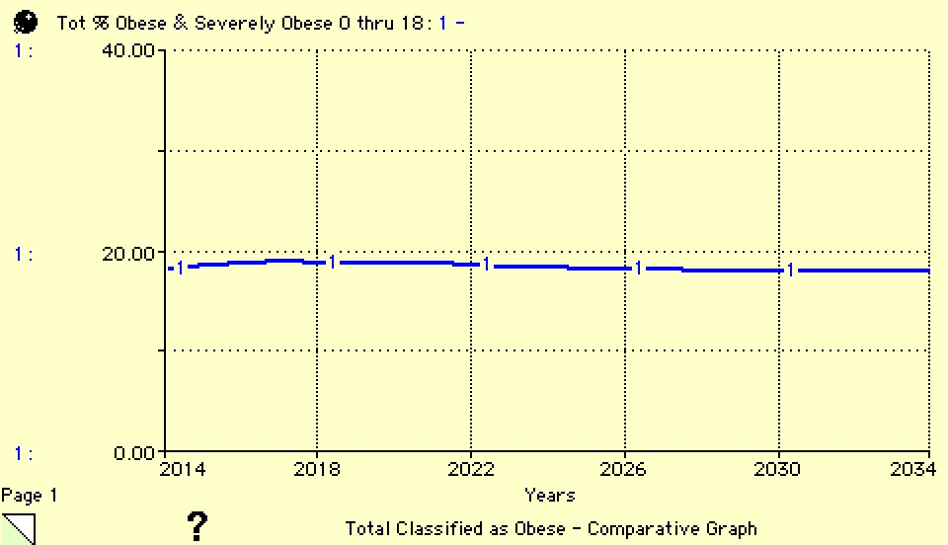
Preferred “only one” policy
Preferred Policy_________________
In your small groups…
Write down your preferred policy
On the graph, sketch your prediction on how the obesity % will change over the next 10 years, compared to the baseline (blue line).
Obesity % of Population (Ages 0-18)
Why do you expect this change? ____________________________________________________________________________________________________________________________________________________
What are the financial implications of this policy? ____________________________________________________________________________________________________________________________________________________
Now test it and record your observations in the first row on the following page

Slide 27
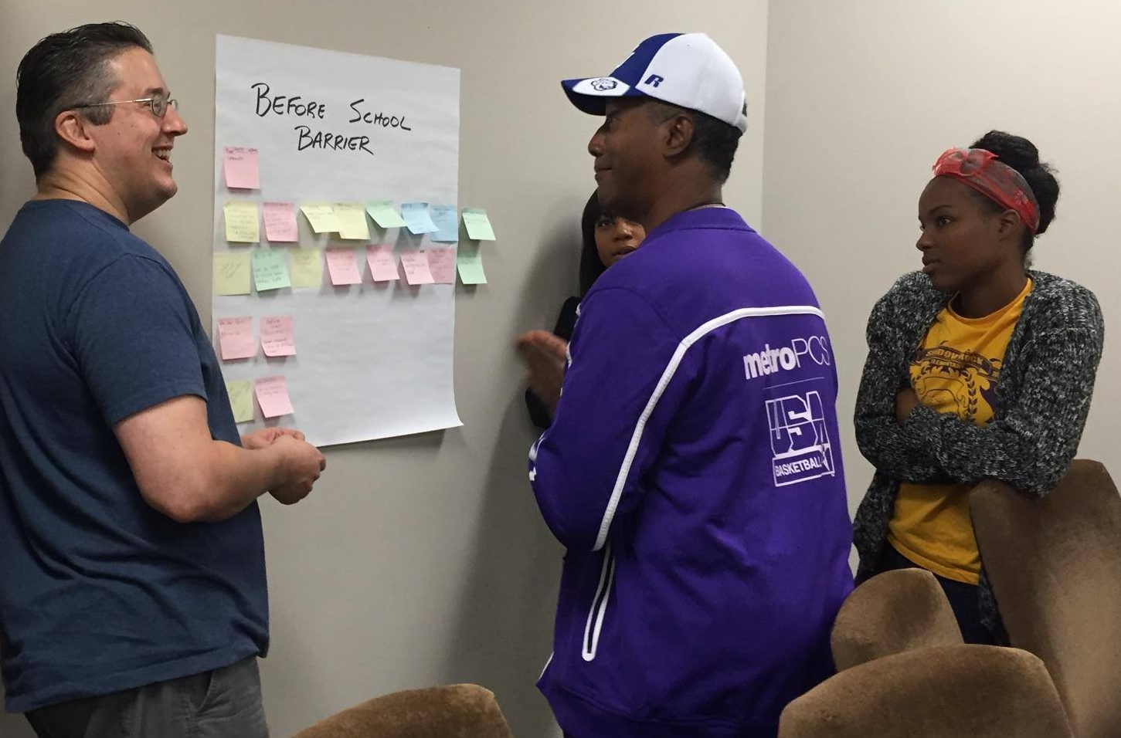
Who wants to test their policy in the model?!

Slide 28
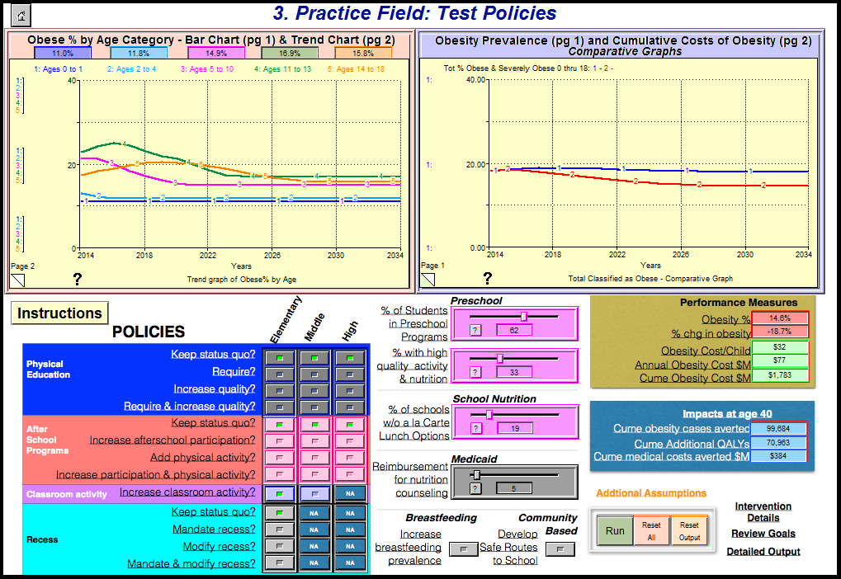
EXAMPLE: Georgia Childhood Obesity Systems Model
Single Intervention: 50% of GA Elementary Classrooms Integrate PA
Courtesy of Georgia Health Policy Center
Notes:
Obesity Prevalence in Georgia 18% Baseline
Single Intervention: 50% of elementary school students experience classroom based physical activity
In 2034, obesity prevalence estimates are 14.6%
As a reminder, we are not "predicting the future" with the model; the model features interventions that are funded by legislative decision and we use the best available evidence about daily caloric change resulting from the intervention to model the impact of different interventions individually or in combination.

Slide 29
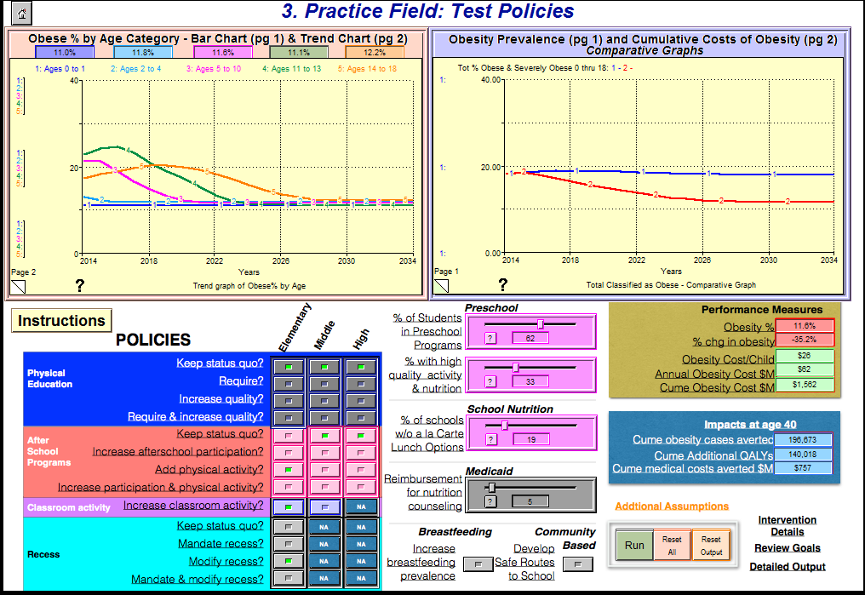
EXAMPLE: Childhood Obesity Systems Model “Power Up for 30” Interventions: 50% of GA ES Classrooms Integrate PA, 95% of ES students get mandated PE time, Afterschool PA in 30% of students, Recess MVPA time enhanced
Notes:
Obesity Prevalence in Georgia 18% Baseline
Multiple Interventions – like in Power Up for 30 Schools: 50% of elementary school students experience classroom based physical activity, 95% of students are experiencing the PE mandate of 90 contact hours per year, recess MVPA time is enhanced, 30% of afterschool programs increase PA quality.
In 2034, obesity prevalence estimates are 11.6%

Slide 30

Acknowledgements
Childhood Obesity Systems Model Project Team
Chris Soderquist, Modeler
Debra Kibbe, GA Health Policy Center
Emily Anne Vall, GA Dept of Public Health
Karen Minyard, GA Health Policy Center
Ken Powell, Public Health Consultant
Rachel Ferencik, Banyan Communications
Questions? Debra Kibbe, GHPC
dkibbe@gsu.edu 404-413-0287

Slide 31

OBJECTIVE #3
Georgia Shape
Successes and Challenges
Notes:
This session will review successes and challenges experienced when implementing a childhood obesity effort at the local, regional and state level. Participating stakeholders and their roles in addressing childhood obesity will be described including state departments of public health, education and early care along with public, private, county and district public health partners. A systems modeling tool used to educate legislators about childhood obesity will provide audience interaction. Finally, a discussion of how partnerships, professional development, technical assistance, and community interventions have been applied in targeted geographic locations to build capacity throughout the state in addressing childhood obesity.

Slide 32
Georgia Shape’s 10-year goal: increase the % of Fitnessgram-assessed students that fall in the Healthy Fitness Zone for BMI by 1% each year 2013-2023
Improve BMI & Aerobic Capacity
Increase Populations Assessed
Improve Breastfeeding Duration Rate
Increase Shape Early Care Centers
Objectives
Physical Activity
Nutrition
Healthcare
Data & Evaluation
Marketing & Communications
Success #1:
Layering Various Evidence-Informed Strategies
SME Sub Groups

Slide 33

Success #1 (cont.)
Evidence-Informed Strategies
Early Childcare Environments
K-12 Schools
Healthcare
  Women Infants and Children (WIC)
  Pediatricians
  Birthing Hospitals
Out of school time
Notes:
What are the six core groups that you would be needed to pull

Slide 34
Success #1 (cont.)
E-B Strategies
Systems Change – (organizational decisions/procedures)
Environmental Change – (setting)
Policy Change – (written rules)
Healthier Children and Adults
Evidence-based/informed Strategies

Slide 35

Success #2:
Working to Address Equity and Disparity
Title 1 Schools
SNAP Ed
WIC Participants
Low SES Communities
  Urban
  Rural
Female Adolescent Populations

Slide 36
Success #3: Tracking Collective & Diverse Investment
Working under the Georgia Shape umbrella, partners can use information / data shared for grants, contributions, fund raising, etc.
Georgia Shape can use the partners’ grants received / investments for their “collective impact” tracking
Total estimated collective investment among all GA Shape partners since 2012: Over $60m

Slide 37
Success #4:
Statewide Reach
True population health reach and impact have been achieved
  1.1 million students assessed annually for BMI and Fitness
  Professional development among 100% of WIC RD staff
  Professional development for Healthcare Providers (3,669)
  Power Up for 30 impacting 2/3 of all elementary schools and 7 middle schools (470,000 kids)
  Power Up for 30 Out of School time in 275 sites (50,000 kids)
  37 Georgia 5 Star Baby-friendly hospitals across the state

Slide 38
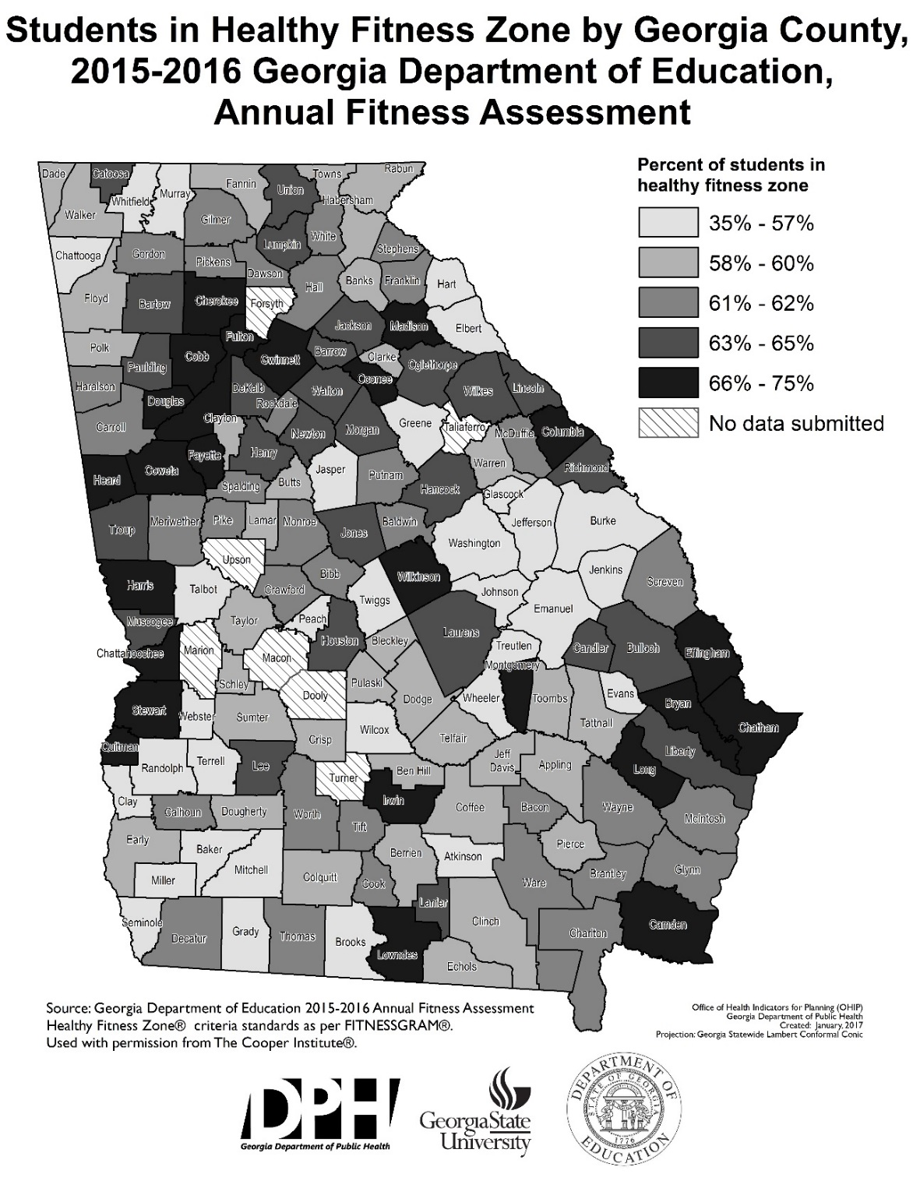

Slide 39
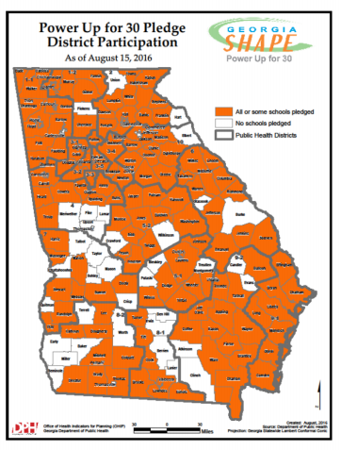
888 schools
1,900 teachers/ administrators
470,000 students
Notes:
Even though PU30 was voluntary, even tough we asked for an administrator, PE teacher, and classroom teacher to step away from school for 1 day to be trained on best practices to bring back to the schools---over 66% of schools rose to the occasion and began implementation through pledging to Power Up for 30…ultimately impacting over 450,000 students statewide. To this day, we still have schools asking for trainings or refresher for their staff.

Slide 40

Success #5:
Development of School Resources
Trainings
Physical Activity Resource Guide
Handouts
School PA self-assessment
Power Up for 30 Plan templates
Making the Pitch Slides and Notes
Success Stories
Incentives

Slide 41
Challenges
Keeping topic “front of mind” to state leaders & funding agencies
  Competing priorities
  Keep it exciting and relevant when media takes a break
Communicating progress – state to local
Documenting the various activities/initiatives happening in 159 counties

Slide 42
Challenges
Turnover in leadership – state agencies, advisory board, key partners
Sustained partner and participant engagement – ensuring we answer “what’s in it for them?”
Aligning messaging between partners with different priorities/beliefs

Slide 43
OBJECTIVE #4
Discussion:
Building Capacity for
Multi-sectoral Partnerships at State & Local Levels
Notes:
This session will review successes and challenges experienced when implementing a childhood obesity effort at the local, regional and state level. Participating stakeholders and their roles in addressing childhood obesity will be described including state departments of public health, education and early care along with public, private, county and district public health partners. A systems modeling tool used to educate legislators about childhood obesity will provide audience interaction. Finally, a discussion of how partnerships, professional development, technical assistance, and community interventions have been applied in targeted geographic locations to build capacity throughout the state in addressing childhood obesity.

Slide 44
Discussion Topics:
Building Capacity in Targeted Geographic Locations
New & Unique Partnerships,
Professional Development,
Technical Assistance Strategies,
“Layering” Community Interventions
Addressing & Measuring Racial Equity / Health Disparities
Notes:
This session will review successes and challenges experienced when implementing a childhood obesity effort at the local, regional and state level. Participating stakeholders and their roles in addressing childhood obesity will be described including state departments of public health, education and early care along with public, private, county and district public health partners. A systems modeling tool used to educate legislators about childhood obesity will provide audience interaction. Finally, a discussion of how partnerships, professional development, technical assistance, and community interventions have been applied in targeted geographic locations to build capacity throughout the state in addressing childhood obesity.

Slide 45
Discussion Debrief:
Building Capacity in Targeted Geographic Locations
New & Unique Partnerships,
Professional Development,
Technical Assistance Strategies,
“Layering” Community Interventions
Addressing & Measuring Racial Equity / Health Disparities
Notes:
This session will review successes and challenges experienced when implementing a childhood obesity effort at the local, regional and state level. Participating stakeholders and their roles in addressing childhood obesity will be described including state departments of public health, education and early care along with public, private, county and district public health partners. A systems modeling tool used to educate legislators about childhood obesity will provide audience interaction. Finally, a discussion of how partnerships, professional development, technical assistance, and community interventions have been applied in targeted geographic locations to build capacity throughout the state in addressing childhood obesity.

Slide 46
Summary: Lessons Learned
Strategic Partnerships: Long-term, collaborative partnerships are critical -- A “United Front”
  Make participation easy
Productive Sub-Groups: Attendance/ participation in work groups builds awareness & guides future activities.
  “Shared decision-making”
Document, Document, & Communicate:
  Track dollars invested
  Communicate along the way the slow, steady progress toward goal
Celebrates success: Award and recognition programs help!
Influential leadership is key!

Slide 47
GA Department of Education 2020 Vision
“By the start of the 2020 school year, at least 20% of the required menu for the student meal will be comprised of Georgia Grown products.”
“Every elementary and middle school student will have access to at least 30 minutes of physical activity per day.”
Richard Woods
State Superintendent
Source: http://www.gadoe.org/Documents/VISION_2020.pdf
Notes:
I will leave you with this, despite the challenges and successes, we have always stayed solution-minded. Since day one, the partnership between all entities has provided valuable insight, guidance, and collaborative efforts where schools can feel that their best interests and their students interests are top priorities. State Superintendent Woods announced this past year that by 2020, all schools K-8 will provide at least 30 minutes of PA per day for students. It is this type of momentum that leads to lasting efforts in schools. Thank you.

Slide 48
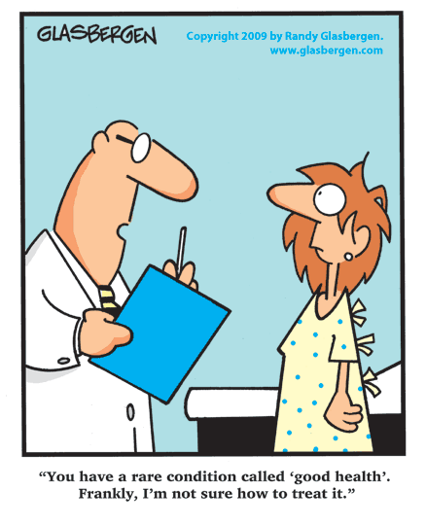
QUESTIONS?
Contact Us!
Emily Anne Vall
EmilyAnne.Vall@dph.ga.gov
Debra Kibbe
dkibbe@gsu.edu

