Slide 1
Pierce County Accountable Communities of Health: Community Voice Engagement for Community Health in the Medicaid Transformation Project February 15, 2018
Liszet Chavez-Avila, MSW
Pierce County ACH

Slide 2
Goal: Community inclusion in health care system reform

Slide 3
Objectives
Describe how historically community has been excluded from strategic planning & decision-making processes, even when they directly impact their health.
Identify specific strategies ACH Councils & community members develop to ensure countywide involvement, not just feedback from beginning of process
List specific core strategies, roles, & responsibilities the community will have in shaping the Medicaid Transformation Project

Slide 4
Question for the audience: Who takes care of you when you don’t feel well?
Notes:
Who takes care of you when you’re sick?
Parents, grandparents, kids,
How do they take care of you? Make you soup, know that you like to watch trash tv, understand your need for care
Who else but our loved ones to take better of you, they know you.
Family knows what you need, your community knows what you need.
Communities have been the core of community health for quite some time now.
Segway into next slides…

Slide 5
Origins of “Health Care”
Notes:
I will introduce the origins of our health care

Slide 6
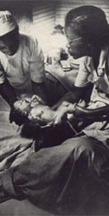
Midwives in our African American Community
Pillar of the community
Held the community together
Maintained traditions that solidified families
Notes:
The social role of the traditional African midwife was as pillar of the community, in many cases she held the community together, she maintained the traditions that solidified families and built community.
Midwifery has always been an honored and spiritual profession among Africans who continued their rich traditions, even while enslaved. Historically Midwives of Color have saved the lives of countless mothers and babies throughout the United States. Both free and enslaved African midwives provided midwifery care not only to their communities but also to families outside of the Black community.
Grand (Granny) midwives taught women how to be mothers and taught men how to be good husbands and fathers, they played a large part in shaping cultural perceptions of motherhood as well as functioning as officiate in the rite of passage of becoming a mother.
In addition to their medical expertise, midwives were bearers of cultural and communal standards.” -The Archeology of Mothering: An African-American Midwive’s Tale Laurie Wilkie (2003)
Resource:
International Center for Traditional Childbearing http://ictcmidwives.org/black-midwives/

Slide 7
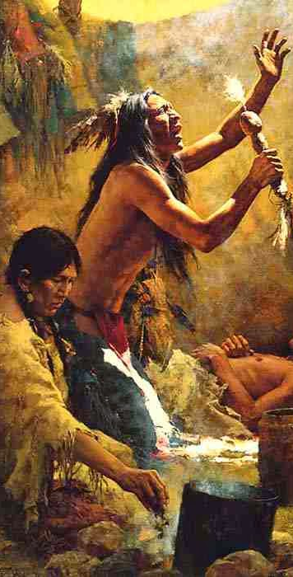
Medicine Men
All things in nature are connected and that spirits can promote health or cause illness.
Heal the body, emotional wellness, and harmony with their community and environment.
Herbal remedies, ceremonies, dances, praying, and chanting.
Notes:
Native American (NA) traditional healing is identified by the National Institutes of Health/National Center for Complementary and Alternative Medicine (NCCAM) as a whole medical system that encompasses a range of holistic treatments used by indigenous healers for a multitude of acute and chronic conditions or to promote health and wellbeing. While there are individual tribal differences (i.e., the use of specific healing practices), there are also shared health beliefs and interventional strategies, including a health promotion foundation that embraces bio-psycho-socio-spiritual approaches and traditions.
It is necessary to heal not only the physical parts of an individual, but also their emotional wellness, and their harmony with their community and the environment around them.
In addition to herbal remedies, the community often came together to help an ill person in ceremonies, dances, praying, and chanting.
Resource: https://www.ncbi.nlm.nih.gov/pmc/articles/PMC2913884/

Slide 8
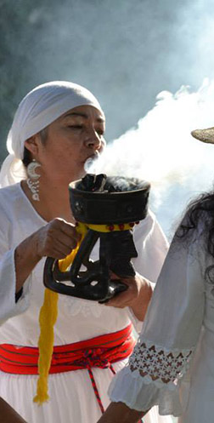
Curanderismo:
Based on Aztec, Mayan, and Spanish influences.
Delicate balance between health, nature, and religion.
Traditional beliefs, rituals, and practices that address the physical, spiritual, psychological, and social needs of the people who use it.
Notes:
Curanderismo in Mexico is based on Aztec, Mayan, and Spanish influences.
The ancient native cultures believed that a delicate balance existed between health, nature, and religion. Illness occurred when one of these areas was out of balance.
Curanderismo can be defined as a set of traditional beliefs, rituals, and practices that address the physical, spiritual, psychological, and social needs of the people who use it.

Slide 9
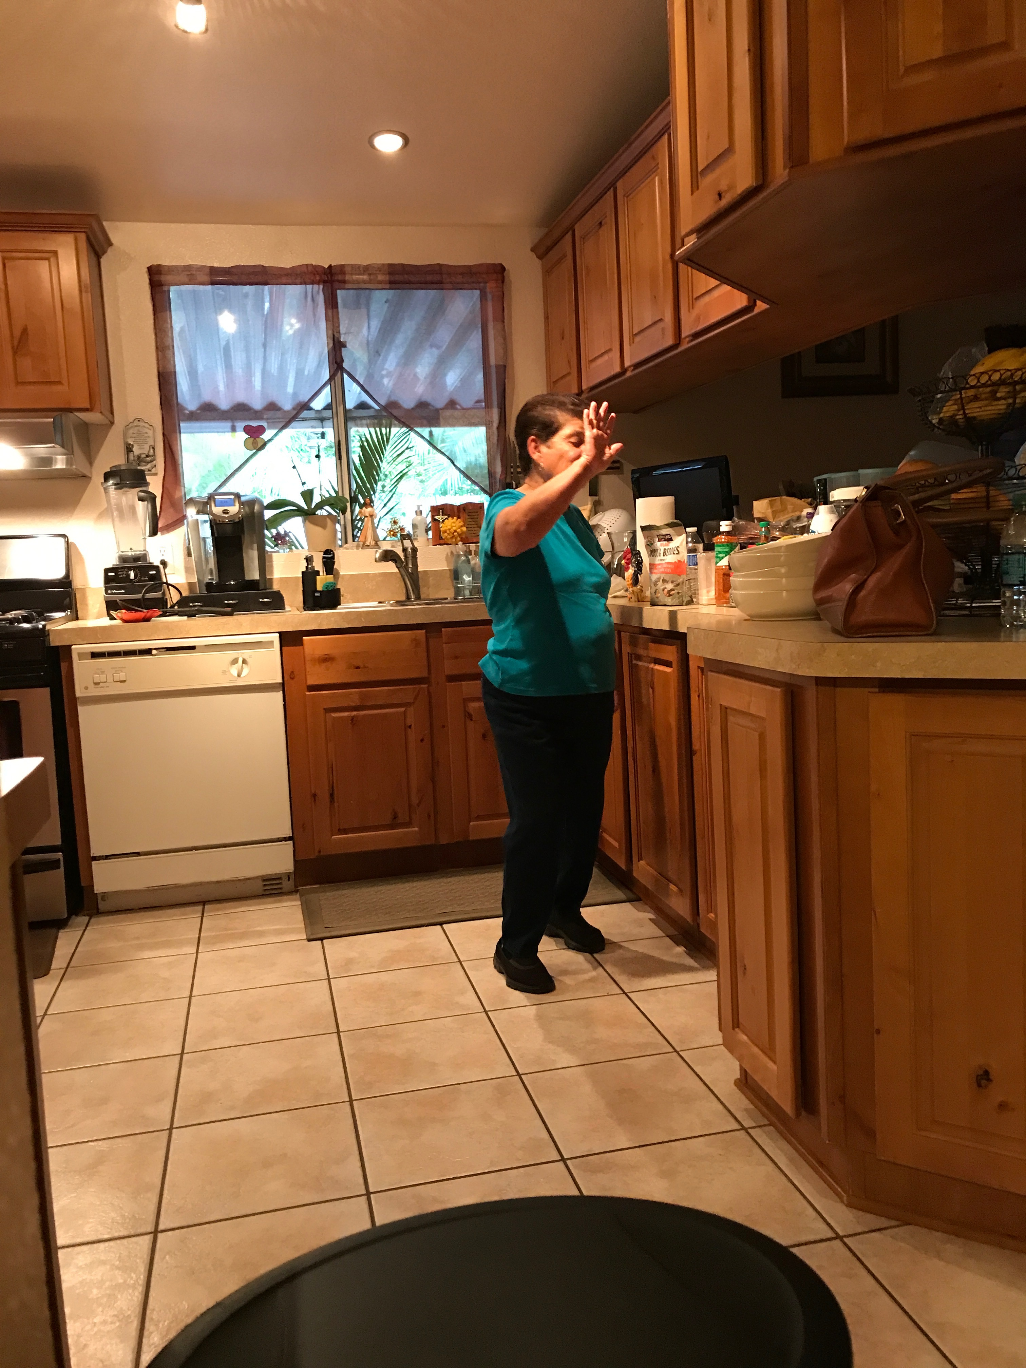
Grandma
Connection to the old ways
Let’s you know why you are hurt and what you need to do to prevent it from happening again
Please don’t tell her I used her picture
Notes:
Chances are, I will be taking care of grandma.

Slide 10
What are the commonalities?
Notes:
In looking at past practices from these cultures, what were some common themes we saw?
Practices of healing from learned traditions
Care according to our cultural views
It was what we knew
It was not only the physical aspect of healing, all had some type of bio-psycho-social model

Slide 11

Community: Our First Health Care
MIND
BODY
Health supported by those that knew you
Deep rooted knowledge of history, meaning, appreciation behind the practice
Mind, Body Soul
“Whole person health”
SOUL
Notes:
-Everyone knew what was needed for your health
-Larger sense of care from others when you needed the support
-It was not only about treating the illness or pain, it was looking more at the why you’re in pain and how you can help your mind and body find that health balance.

Slide 12

So where and why was community left out?

Slide 13
Emerging of Medical Profession
Post Civil War
Many “doctors”, no degrees
Apprenticeships selection
White, male, good character, intelligent, industrious, and literate
Industrial Expansion
Demographic and Economic Developments
1901 American Medical Association Constitution
1865-1900s
Science, demography, & industrial expansion
Education exclusivity
Private practice of medicine.
Mid 19th Century
Notes:
During the early 1900s, Thousands described as physicians, but only a small proportion of them actually possessed medical degrees.
Although early ‘doctors’ learned from apprentices, it still used holistic approaches. Refer to selection process: The selection process for persons in medical apprenticeships was at the individual discretion of practicing physicians, within broad normative criteria-that is, that the candidates be White, male, of good character, intelligent, industrious, and literate. It was also preferred that the prospective physician’s family background be reputable and prosperous. Although race is not alluded to in this passage, that the candidate be White and generally Northern European was given.
Rural or so –called horseback medicine has always existed as an economically marginal enterprise, both because of the range of travel involved in maintaining a medical practice and because barter rather than currency was often the medium of exchange.
For medical practice to become lucrative, increased levels of population concentration, improvements in transportation, and the replacement of barter system with currency all needed to evolve. These changes epitomized the 1865-1900 era of industrial expansion, Western migration, and immigration that transformed the nation to a modern industrial state.
The ground-breaking advancements in medical science of the post-Civil War period were complemented by demographic and economic developments that set the stage for the private practice of medicine to flourish.
The American Medical Association was the first entity to claim orthodox medicine and the voice of the medical profession.
Their approved 1901 constitution helped them gain control over the credentialing process
Excluded nonallopathic physicians.
Created structure whereby the membership representation at the state and national levels required membership in the county medical society.
Intended to get rid of the non-physicians and ‘incompetents
Permitted the local medical societies to enforce nonscientific norms of membership having to do with gender, race, ethnicity, and political views that conflicted with the interests of unfetted medical free enterprise.
As is from then to today, the medical profession remained largely the exclusive dominion of White male individuals-collectively committed to extending the profession’s political influence and economic advantage.
Since then, health and medicine has been focused to one certified medical provider having prime knowledge about the physical facet of health, not whole person care from community.

Slide 14
Consequences
Social Determinates of Health
Cost of Healthcare
US Health care system
Lack of community input in health reforms
Notes:
Social Determinants/ Conditions of Health: the circumstances in which people are born, grow up, live, work, and age, and the systems put in place to deal with illness.
Shaped by: economics, social policies, and politics.
Healthcare costs are escalating rapidly, partially due to unexpectedly high Medicare expenditures, rapid inflation in the economy, expansion of hospital expenses and profits, and changes in medical care including greater use of technology, medications, and conservative approaches to treatment. American medicine is now seen as in crisis. Patients with complex health needs account for a disproportionate share of health care spending in the US. Racial/Ethnic minorities and individuals with lower socioeconomic status are more likely to have multiple chronic health conditions, and thus higher health care costs. Ineffective communication process, limited ability to adapt to different cultures, inability to meet people where they are (“health literacy”)
Lack of community input in health reforms Any health reform that has to do with insurance or state health benefits gets constantly politicized to the growing costs of health care, the need to cut entitlement funds. The health reforms of the 1990s have given less attention to community participation and social values, focusing more on technical, economic and management factors in health systems. Health reforms in the 1990s, however, de-emphasised the welfare state and community participation and gave greater profile to the market. Social values were given less attention than the technical, economic and management factors in health systems.

Slide 15
Health Wars: The Community Strikes Back
Advocacy Groups for Rights of the People
Social Services and Non-Profits
Accessible to be used
Geographically, financially and culturally accessible
Growing Community Role in Development Process
Notes:
The mere existence of services in a certain administrative area does not prove that they are used or used correctly. Services have to be accessible to be used. This implies organizing a supply of care that is geographically, financially and culturally accessible.
The growing role of community in development processes is not simply a response to political lobbies or to an increased scale of Organization. It also emerges from a shift in the understanding of development processes. When people and human dimensions are defined as the core of development, then social exclusion itself becomes a facet of under-development and social networking a development asset. Under these terms, the fulfilment of human development will require concerted efforts of the State together with citizens and their Organization.

Slide 16
Community and Health Reform

Slide 17
Federal Approach
Affordable Care Act of 2010
Better Health
Better Care
Lower Cost
Centers for Medicare and Medicaid Services (CMS)
Center for Medicare and Medicaid Innovation
Health Care Delivery System Reform
Better Coordinated Care for Medicaid/Medicare Recipients
Broader value-based purchasing programs
?
Notes:
Federal and State Context
ACA triple Aim
Healthier WA. Make the ACA real
PCACH
Cross sector convener to improve the health of the county
Address Quadruple Aim: Practice Transformation and Social Determinants
Administer 1115 Medicaid Waiver

Slide 18
Medicaid Waiver 1115
Secretary of HHS may waive provisions of major health and welfare programs through negotiations with states, generally for five-year periods
Permits states to use federal Medicaid funds in ways not otherwise allowed under federal rules.
New population, ways to expand programs, and innovation.

Slide 19
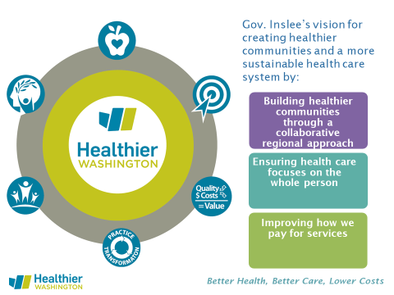
State Approach
Notes:
Healthier Washington is the name that the Heath Care Authority (HCA) uses to describe all “health systems transformation” work. In other words, it operationalizes the ACA in the state of Washington. Health systems transformation is about changing how people conceptualize health and how people believe we achieve health. This is both in clinical settings and in community settings. A common phrase around this work is “health is local” meaning it is the local circumstances that create the opportunity to be healthy. Since HCA is the agency tasked with purchasing “health,” they are the leads on setting up ACHs as the “local” strategy to improve health. Also, whole-person (physical and behavioral) and value-based purchasing.
It’s important to remember the larger initiative that this demonstration sits under, Healthier Washington. Essentially, Healthier Washington encompasses all the work happening at HCA and around the state that is transforming the health system to reward high-quality care, focus on whole-person health, and empower local communities to tackle their local health needs.

Slide 20
5 years from now
Current system
Fragmented care delivery
Disjointed care transitions
Disengaged clients
Capacity limits
Impoverishment
Inconsistent measurement
Volume-based payment
Transformed System
Integrated, whole-person care
Coordinated care
Activated clients
Access to appropriate services
Timely supports
Standardized measurement
Value-based payment
Notes:
The long-term vision of the demonstration is that we have a system that works best for those who are served by it.
Current system:
Fragmented clinical and financial approaches to care delivery
Disjointed care transitions
Disengaged clients
Capacity limits in critical service areas
Individuals impoverish themselves to access needed LTSS
Inconsistent measurement of delivery system performance
Volume-based payment
Transformed system:
Integrated systems that deliver whole person care
Coordinated care transitions
Activated clients
Optimal access to appropriate services
Timely supports delay or diver need for Medicaid LTSS
Standardized performance measurement with accountability for improved health outcomes
Value-based payment

Slide 21
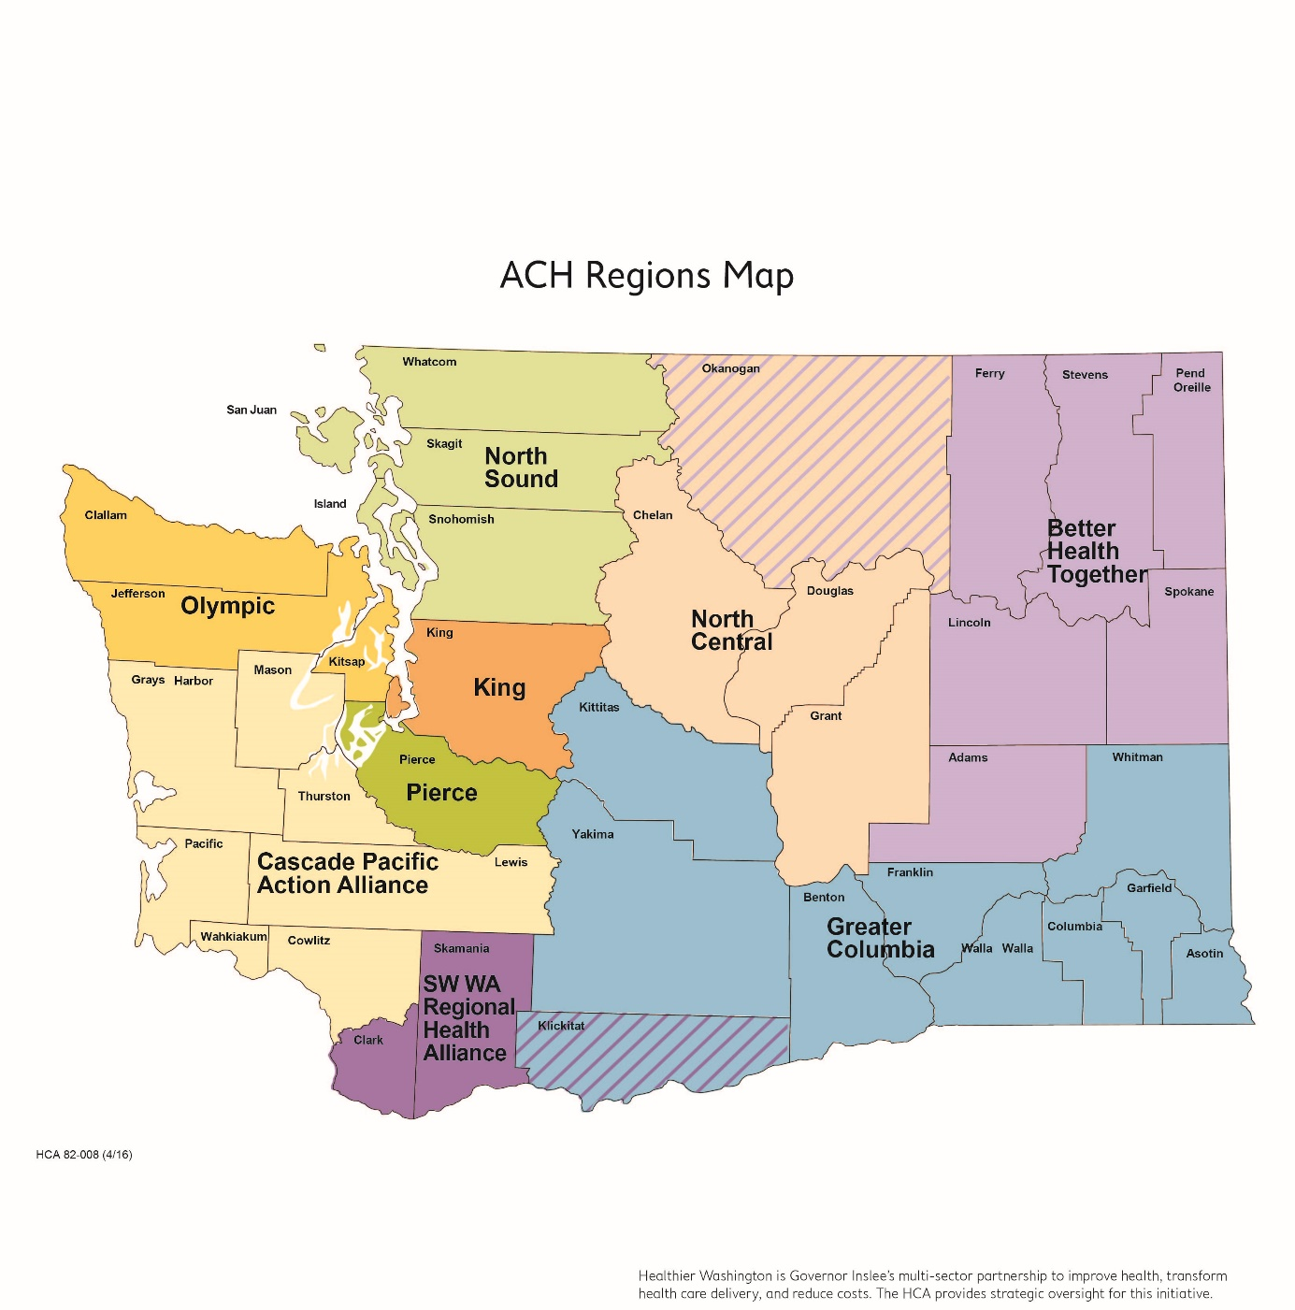
Regional Approach
Accountable Communities of Health
Established by Health Care Authority
Coordinate & oversee regional projects aimed at improving care for Medicaid beneficiaries
Apply for transformation projects, and incentive payments, on behalf of partnering providers within the region.
Solicit community feedback in development of Project Plan applications
Decide on distribution of incentive funds to providers for achievement of defined milestones
Notes:
ACHs were established by a state agency, the Health Care Authority (HCA)
HCA is responsible for purchasing Medicaid and Public Employee Benefits, they have an approximate annual budget of $10 billion
Coordinate & oversee regional projects aimed at improving care for Medicaid beneficiaries
Apply for transformation projects, and incentive payments, on behalf of partnering providers within the region.
Solicit community feedback in development of Project Plan applications
Decide on distribution of incentive funds to providers for achievement of defined milestones

Slide 22
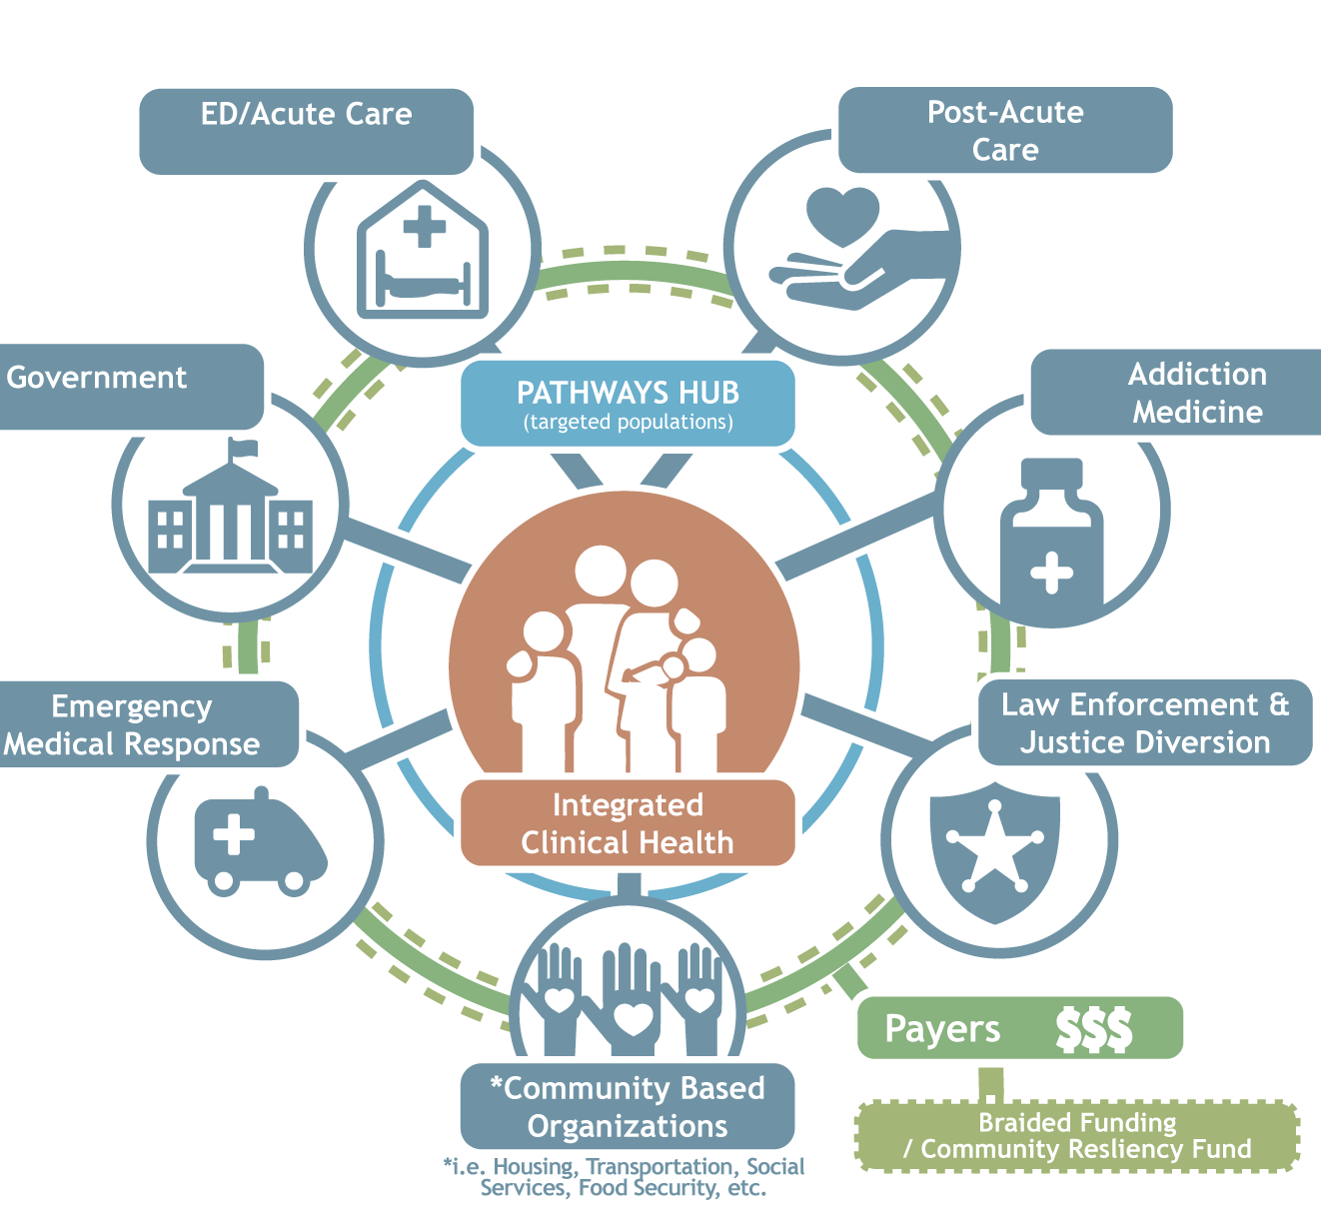
Pierce County ACH
Creates collaborative engagement between dedicated community partners.
Quadruple Aim
Community added Equity
Whole Person Health
Social conditions
Food
Environment
Housing
Notes:
The Pierce County ACH creates collaborative engagement between dedicated community partners. Together we learn, share, and act in order to positively transform our health care system
Quadruple Aim
Community added Equity
Currently, the healthcare delivery and financing system artificially separates physical, emotional, and social health. The ACH’s goal is to ensure health care focuses on the ‘whole person’.
Medicaid-funded mental health and substance abuse treatment will be integrated by next spring. The Health Care Innovation Plan calls for subsequent integration with physical health and addressing social and economic needs that affect health, such as housing, food, education, and employment.

Slide 23
Equity
Partnering with IHI on Science of Improvement
Leadership Alliance
Joy in Work
Workforce Development and Sustainability
100 Million Healthier Lives

Slide 24
Why?
Notes:
Why do we need to be equitable?
Why do we have to learn about how other’s get better?
Why do we have to take the people in consideration?
Refer to kids behind baseball fence picture: to make sure we have the kids AT the game, not feel content with giving them help to look over the fence. Keeping ourselves accountable to meeting the needs of each community as they are versus what we can provide

Slide 25
Authentic Community Engagement in Health Reform
Understand Systems and Barriers
Elevate community voice
Strengths & Needs
Solutions to their challenges
We need the community to help understand
Meaning behind data
Local informed solutions
Shape community feedback
Notes:
A key component of Healthier Washington is consumer engagement: Empowering people to share in the decision-making when it comes to their own health and the health of their families.
To understand the ways in which our systems and policies create barriers to health, we have to elevate the community’s voice in identifying what the community views as their own strengths, needs, and potential solutions to their challenges.
Pierce County ACH has worked diligently to invite as many Pierce County representatives to the discussion table
Bridge to their community’s needs
Keeping the ACH accountable to community inclusion
Having representatives from as many diverse entities to ensure cultural awareness

Slide 26
Question
Notes:
Question for the audience: What have been some past very common examples of how “community feedback” has been tried to obtain?
What has been the problem with those examples?
“One shot, one off”

Slide 27
Common, Often Ineffective Responses
Difficult and often unsuccessful
Design engagement efforts to fit the organization’s system
Provides Token Representation
Survey the community
Hold focus groups
Town meetings
Comm. Rep. in advisory board
Expect community to organize around ‘us’
Organization schedule
Acceptable conversations
Non-compensation for time & effort
Feeling of failure or lack of solutions
Notes:
“One-shot, One-off”
Difficult and often unsuccessful
We design our engagement efforts in ways that would work for our organizations and systems.
Provides token representation: survey the community, hold focus group and town meetings, or put a community representative on an advisory board.
Expect community members organize themselves around organizations’ schedules, speak in ways organizations find acceptable and to not be compensated for their time and effort.
Then we are surprised that the solutions we come up with do not speak to the people we are charged to serve and everyone leaves frustrated

Slide 28

Core Principles
System to enable community, system leaders, and policy makers
Infuse equity
“Who benefits?”
“Who are we missing?”
Nothing about us without us
Notes:
a. What is needed is a community engagement system that enable community members, system leaders and policy makers to learn and act together to do all of the work of the ACH.
b. Infuse equity into all decisions by asking ourselves, “Who benefits?”
c. Nothing about us without us

Slide 29
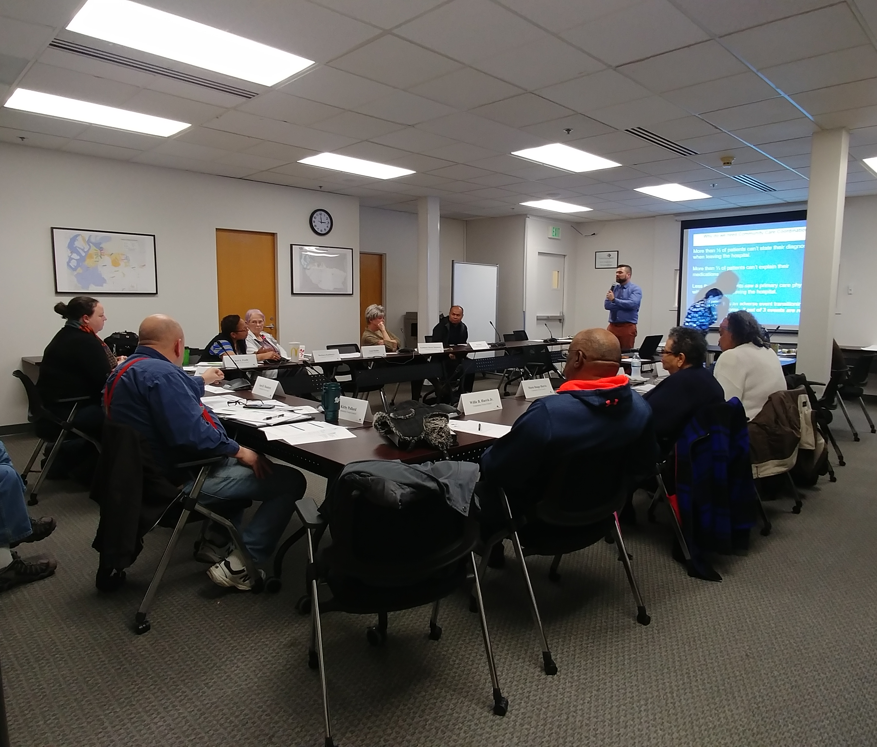
The Community Voice Council

Slide 30
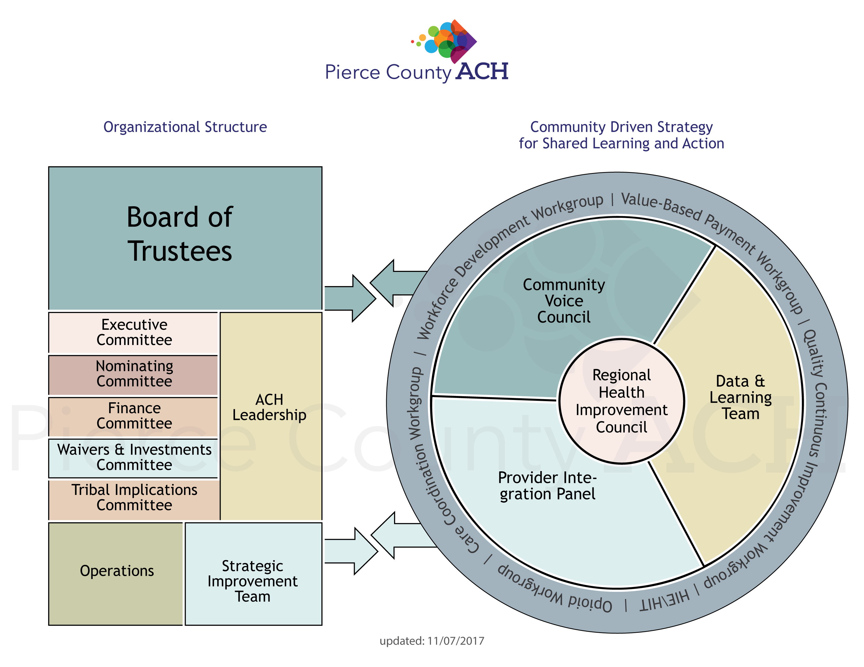
Our Community Voice Council
Notes:
i. Staff the council. Showing that authentic community engagement is worth the investment of dedicated staff. This individual will provide support to community members and organizational members of the ACH on how to support us learn and act together, so the norms of one group do not overshadow and dominate another.
ii. Majority of members will be Medicaid recipients, making sure that we are working with community members, not doing things for or to communities. “Nothing about us, without us.”
iii. Stipends. Valuing the contribution and effort of community members. Covering their costs.
iv. ACH recruits first members. Additional members are recruited by Community Voice Council members which promotes their leadership on the Council.
v. Food, helps people feel welcome and who doesn’t love free food? Food brings people together.
b. A minimum of 2 Medicaid recipients on all other ACH bodies. This will allow them to support one another in bringing their voice to the meetings. It is hard to stand up and make yourself heard in a room of people who share similar values and norms that are different than your own.

Slide 31
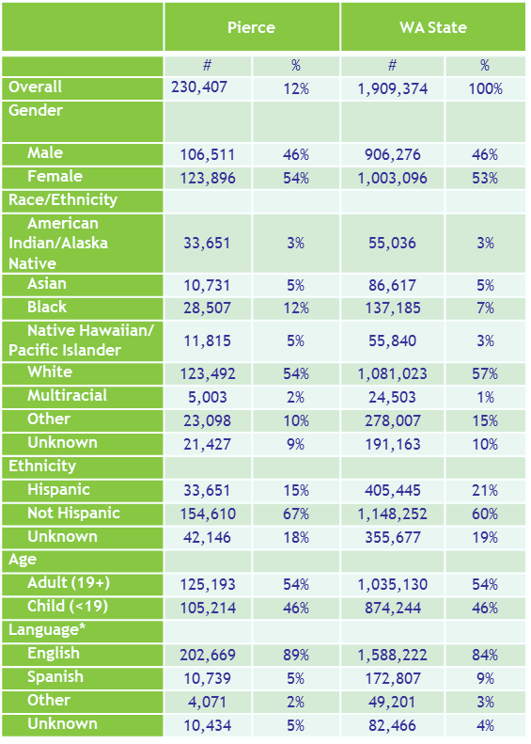
Recruitment for Community Voice Council
Communication
Ensure transparency
Consistency and clarity
Enough feedback and forum
Targeted to underrepresented populations and Medicaid recipients
Different strategies for different populations
Written and Oral
Notes:
Picture helps describe the Pierce County Medicaid population to ensure we keep in mind who we need at the table.

Slide 32
Community Engagement Strategies

Slide 33
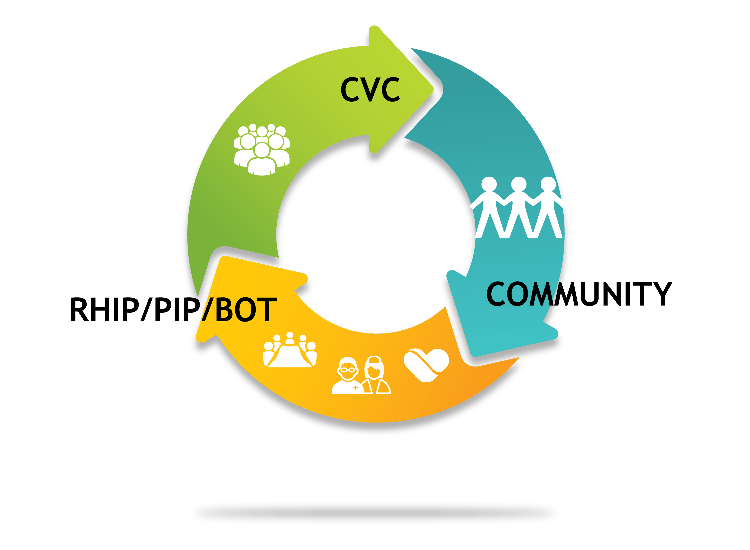
Outreach
Data
Systems
Local Wisdom
Notes:
i. Data: to help us target our communication efforts
1. Systems. Looking at pockets of Medicaid recipients. Poverty, etc. However, because this data is often at the zip code or legislative district level, sub populations who are struggling are often overlooked.
2. Local wisdom. Also engage with the local wisdom of people who have worked and lived in xxx county for decades to identified additional under represented communities.

Slide 34
Process
Message
Role
Action
“Get the community involved”
Inform members of your community
Gather data for projects
Help provide feedback
Gather community events and contact info for community leaders
Communities covered (Identify gaps)
Email addresses

Slide 35
CVC’s Action List
Forums
Gather community events and contact info for community leaders
Targeted
Communities covered (Identify gaps)
Agency Contacts
Email addresses
Community Health Workers
Notes:
Community Health Workers help reach members within these close knit networks. More on next slide

Slide 36

Community Health Workers (CHW)
The Role of Community Health Workers
Help reach members within close knit networks
Trusted members of the community, systems and/or policy makers
Provide valuable feedback from communities that may help improve the service delivery systems
Not just medical providers, but a member of your network who looks after you
Notes:
What our reform also intends to do is to enhance the role of the CHW
CHW’s are people who help you reach your health goals outside of the doctor’s office, guide you where you need the support, and are 360 degree communicators that may be more approachable or available than the ER or medical providers.
They are people you know and who know you and know what you need to be health again

Slide 37

Overview
Recognizing that whole person health is essential to health reform by reducing health care costs and addressing the social determinants of health
Community Engagement is necessary to understand system barriers and challenges, but must be involved in their solution development
Community Health Workers are just as essential as professional medical providers

Slide 38
Thank you!
Questions?
Liszet Chavez-Avila, MSW
Community Voice Council, Coordinator
Liszet@piercecountyach.org

