Slide 1
TRIP (Transporting Residents with Innovative Practices) Collaborating to Improve Transportation Access in One Rural Community
Weyling White, MBA & Shelisa Howard-Martinez, MPA ERHD
Communities Joined in Action 2018 National Conference
Thursday, February 15, 2018 11:15am-12:15pm
Notes:
What transportation barriers and challenges that communities, particularly rural ones, have? (Audience will provide responses.)
Desired Outcomes of Session:
An introduction about innovative approaches, including peer-to-peer learning, in addressing transportation barriers in a rural community in North Carolina
Insight about lessons learned and outcomes
Concrete steps that attendees can use for designing community transportation initiatives

Slide 2
Our Vision and Mission
Communities are healthy and committed to health equity for all.
Collaborating for health equity.

Slide 3
Our Work
Care Share was founded in 2008
Our current board is comprised of 28 representatives from state and local level healthcare and policy organizations
We help communities coordinate care and resources for underserved people through collaborative networks and models

Slide 4
Collaborative Networks and Models
A collaborative network is an entity comprised of multiple state or local partners who integrate medical, preventative, community, social, and economic resources to achieve collective outcomes through a coordinated system of care. The network has a shared vision, purpose, priorities, strategies, and objectives aligned to improve the health of the underserved
A collaborative model is an approach local communities use to improve access to care and health for underserved people

Slide 5
Our Technical Assistance Services
Facilitation: We are neutral conveners to create solutions
Collaboration Building: We work with communities to create long term collective buy-in through authentic partnerships and shared agreements
Resources: We collect and share promising practices for network development and operations

Slide 6
Our Services
Program Design and Evaluation: We provide guidance in specific programming and direct technical assistance with evaluation
Community Wide Planning: We facilitate a strategic planning process to create a three-year plan for networks and their communities
Funding: We leverage resources at the state and local level and support collaborative funding across networks and sectors

Slide 7
Because of support from our 2 primary funders, the Duke Endowment and Blue Cross Blue Shield Foundation of North Carolina, many of our technical assistance services are provided to communities free-of-charge

Slide 8
Peer-to-Peer Opportunities
Care Share coordinates shared learning experiences for representatives from both Collaborative Networks and Collaborative Models
Peer-to-peer opportunities are provided in a variety of ways including, webinars, conference calls, dissemination of promising practices documents and in-person meetings
Each year, the Duke Endowment convenes a meeting of Collaborative Networks from both North & South Carolina
Notes:
Transition to 2015 Transportation Summit with Linda Bonesteel from Tidelands Community Care Network.

Slide 9
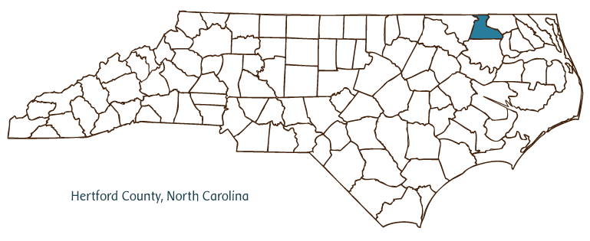

Slide 10
Notes:
Transition to Weyling.

Slide 11
Hertford Health Maintenance Alliance Members
Choanoke Area Development Association (CADA)
Choanoke Public Transportation Authority (CPTA)
Chowan University
Hertford County Cooperative Extension
Hertford County Department of Social Services
Hertford County Office of Aging
Hertford County Public Health Authority
Hertford County Public Schools
Pregnancy Care Center of Ahoskie, Inc.
Roanoke Chowan Community Health Center
Roanoke Chowan Community College
Vidant Roanoke-Chowan Hospital
Trillium

Slide 12
Hertford Health Maintenance Alliance –Strategic Priority Areas
Refine network operations
Address transportation barriers
Develop collaboration with Bertie County
Strengthen health education programming and capacity to address Social Determinants of Health (SDH)
Promote lasting community change (sustainability)

Slide 13
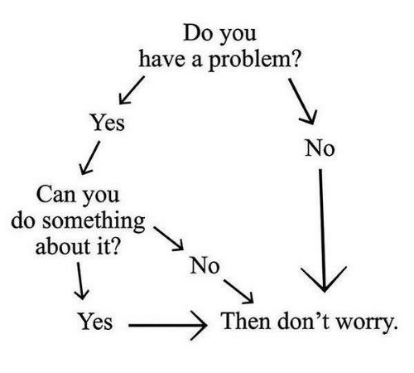

Slide 14
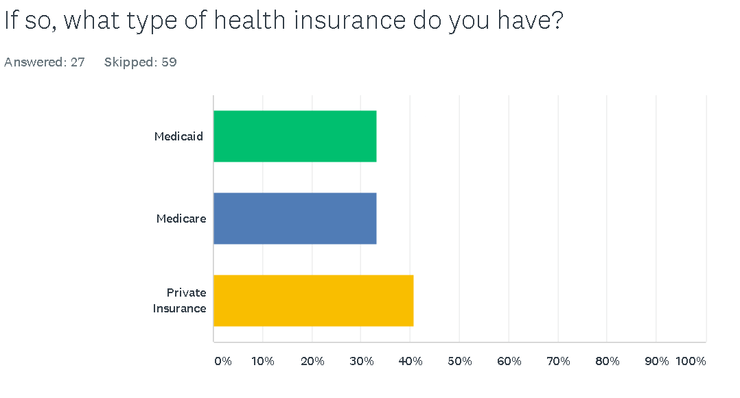
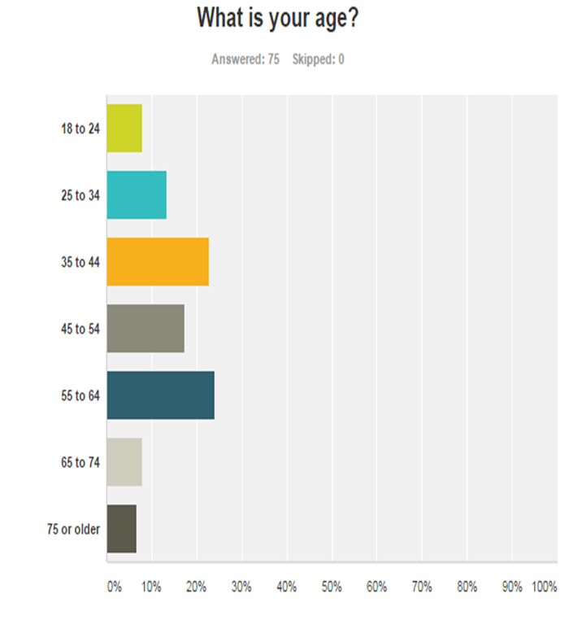
Transportation Survey - Demographics
Sample Size N=86
Residents of Hertford and Bertie Counties
60% uninsured
Notes:
Weyling - Do you want to share the results of the transportation survey?

Slide 15
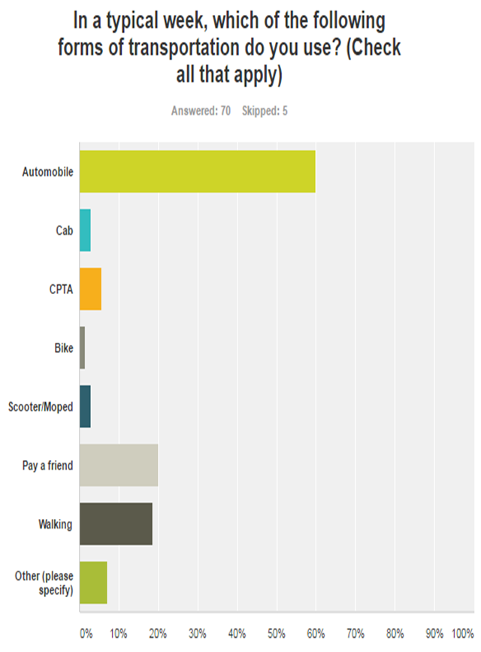
Transportation Survey

Slide 16
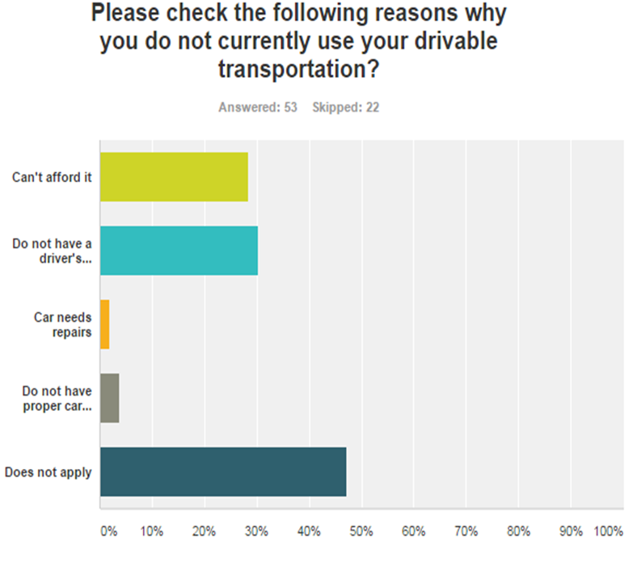
Transportation Survey

Slide 17
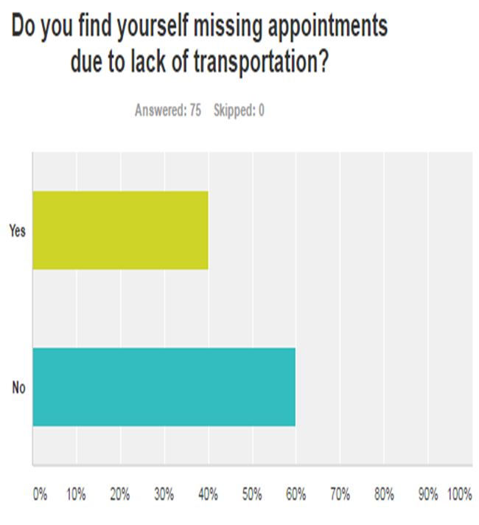
Transportation Survey

Slide 18
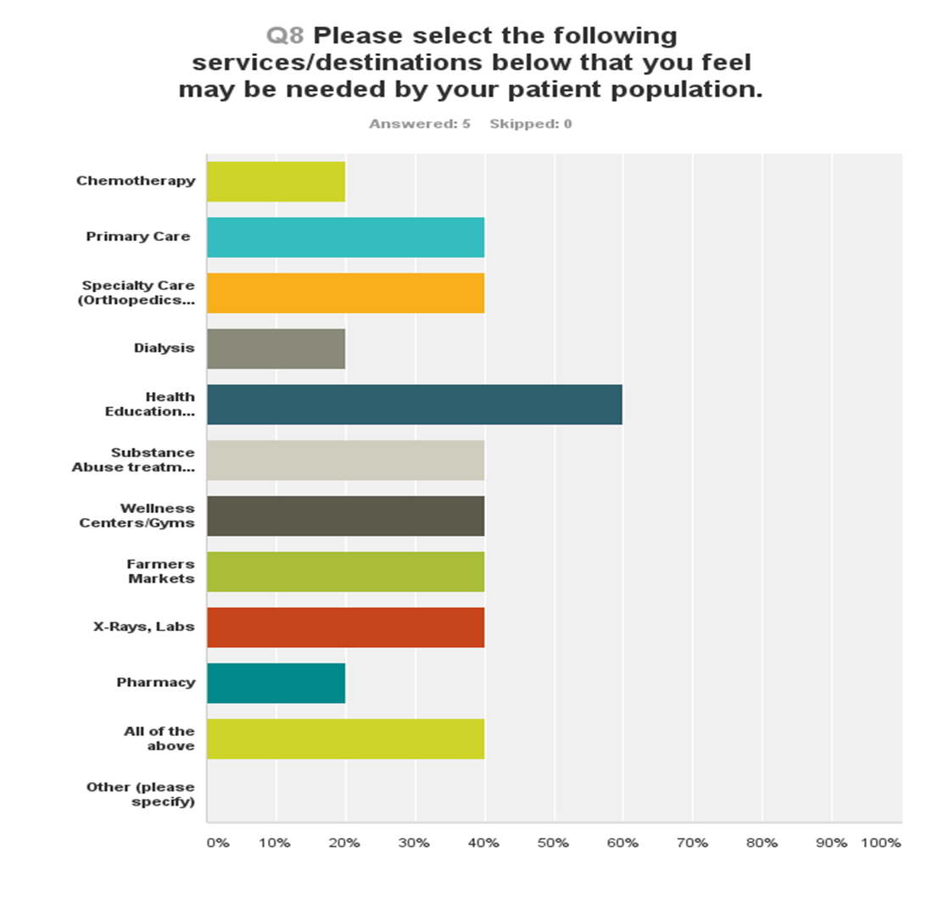
Transportation Survey

Slide 19
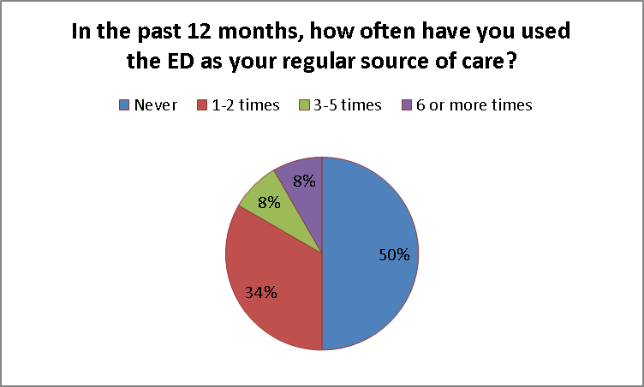

Slide 20
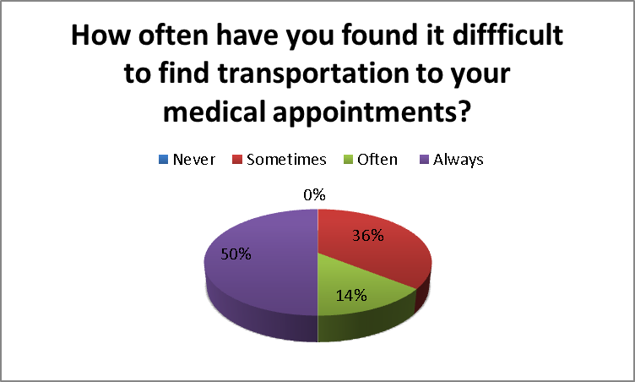

Slide 21
Financial and Food Barriers
92% cannot afford to see their doctor as often as they need to
82% receives assistance paying for primary care visits through sliding fee program
48% listed food bank or family and/or friends as a primary source of getting food

Slide 22
Medical Necessity
60% rated their overall health as fair, with 20% reporting poor
41% Sometimes has their health condition affect their ability to complete everyday tasks
67% of patients diagnosed with diabetes and patients with high blood pressure has self-reported only having their blood sugar and blood pressure checked during their visit with the PCP

Slide 23
May 2015 Hertford County Transportation Summit
Share findings from transportation needs survey
Share promising practice to address transportation needs
Identify & prioritize gaps
Design next steps, including develop core group to carry on work
Notes:
We used a small group process to analyze and prioritize gaps. Community members invited included local transportation providers.

Slide 24
May 2015 Hertford County Transportation Summit
Georgetown County | Hertford County
Population: 60,444 | Population: 24,308
Low Income Uninsured Adults: 5,052 | Low Income Uninsured Adults: 3,573
Living in Poverty: 36% | Living in Poverty: 24%
Less than High School Graduation: 16% | Less than High School Graduation: 22%
High Prevalence of: Obesity, Diabetes, Heart Disease and Stroke | High Prevalence of: Heart Disease, Stroke and Diabetes
Limited Public Transportation | Limited Public Transportation

Slide 25
Georgetown Community Care Network - Transportation Planning
Inventory all community resources
Identify gaps
Plan services
Consider creating a single entry point for community to utilize services
Engage the community

Slide 26
Georgetown Community Care Network – Next Steps
Educate community about existing transportation resources
Develop advocacy plans to increase transportation options for their community
Design a pilot to provide transportation to patients

Slide 27
Summit Findings
Gaps:
Timing of services, including coordination of rides and appointments
Regional coordination to providers outside of Hertford
Wait time
No transportation for non-medical/ healthcare services: pharmacy, WIC, grocery, other
Eligibility barriers - some transportation providers can only serve specific populations
Affordability including public bus service
Liability coverage
Knowledge of who needs services

Slide 28
Summit Findings
Priorities (in order)
Educating public about existing services
Fulfilling/ meeting on-demand/ late service requests
No transportation to non-medical/ healthcare services: pharmacy, WIC, grocery, other
Affordability, including public service
Timing of services, including coordination of rides and appointments
Lack of awareness about county geography and distance needed to complete trips

Slide 29
Next Steps
Invite key stakeholders to participate in process
Assemble core group to learn more about barriers for local transportation providers
Design pilot

Slide 30
Possible Solutions?

Slide 31
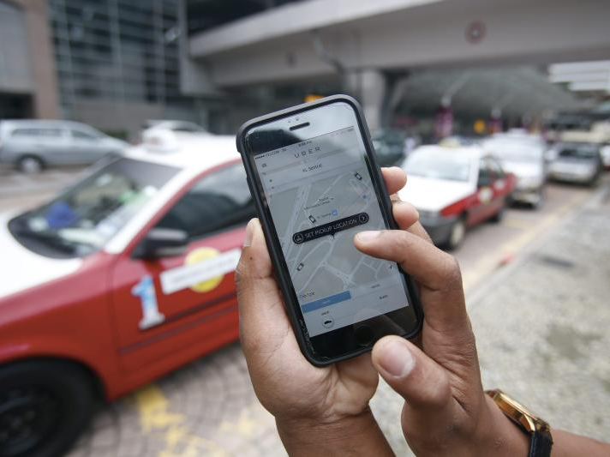

Slide 32
Can UBER work in a rural setting?
PROS vs. CONS

Slide 33
Patient-Centered Transportation
Patient
Pharmacy
Healthy Eating/ Active Living
Health Education
Healthcare

Slide 34
Transportation Pilot - Patient Populations
Uninsured Patients
Cancer Care
ED Frequent Faces
ACO
CHANGE
<50 Patients

Slide 35
Local Transportation Drivers
Collaboration
GPS Tracking
Patient Safety
200 mile radius
Waiting Time
Flexibility
Reimbursement
Communication

Slide 36
Driver Schedule

Slide 37
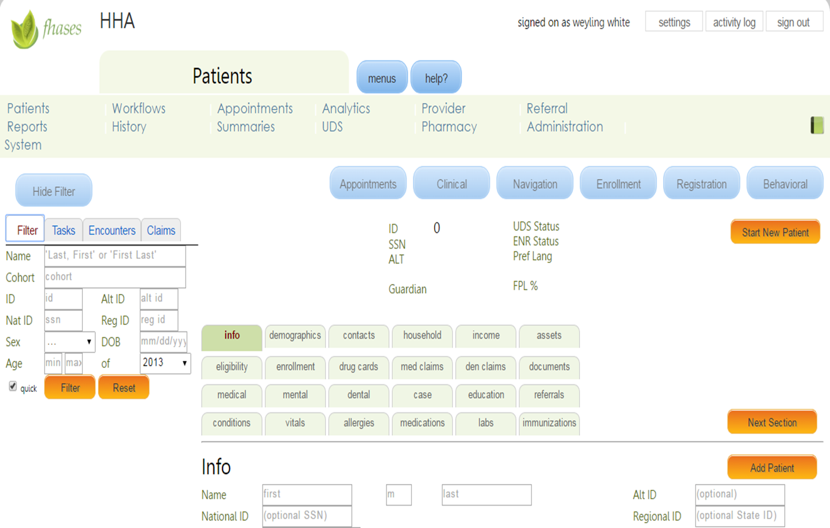
Fhases System

Slide 38
Reimbursement Rate & Model
$2.00 pick-up fee or meter drop
$1.00 Per Mile RT (Within Hertford/Bertie County)
$ 0.75 Per Mile RT (Out of Area)
$0.25 Per Minute Waiting Time
Estimated total trip cost (In Area): $41.60
Estimated total trip cost (Out of Area): $122.75

Slide 39
HHMA TRIP PILOT
Applied to Vidant Roanoke Chowan Hospital’s Foundation-
Fall 2016
Grant Awarded -
January 8, 2017
Pilot Launched- September 2017

Slide 40
First Quarter Destinations
LOCATIONS
SERVICES
Ahoskie Market
ECU Endocrinologist
ECU School of Dental Medicine
East Carolina Heart Institute
F2S2H Youth-Led Farmers’ Market
Hertford County Public Health Authority
Orthotics & Prosthetics East
Physician’s East
PORT Human Services
Roanoke Chowan Community Health Center
Vidant Behavioral Health
Vidant Medical Center
Vidant Neurosurgery
Vidant Physical Therapy
Vidant Wellness Center
Behavioral Health
Cardiology
Chemotherapy
Dermatology
Diabetes Education
General Surgery
Food Access
Orthopedics
Pain Management
Primary Care
Prescription Pick-up
Radiology
Substance Abuse Treatment

Slide 41
First Quarter Clinical Measures
Patient A: Enrolled in HHMA TRIP program on 10-9-17. Patient had not seen her doctor for diabetic needs since December 2015. Patient’s A1C level was 8.0 upon enrollment. Patient has had 3 primary care visits since TRIP enrollment and her current A1C level is 6.4.
Patient B: Enrolled in HHMA TRIP program on 9-18-17. Patient had uncontrolled hypertension. Patient’s highest level was 152/100. Patient has had 2 PCP visits since enrollment and has managed to bring his blood pressure reading down to 128/84.

Slide 42
First Quarter Clinical Measures….cont.
36% Patients with Diabetes and/or Hypertension
Diabetes only (1 patient): A1C level decreased from 11.8 to 8.5 within 3 months
Hypertension only (18%): 66% improved blood pressure (controlled);
Dual Diagnosis (15%): 1 patient improved levels for both
2 patients with improved bp levels but no change in A1C
1 patient with improved A1C level but no improved bp level
1 patient with no improvements
88% Reduction in ED Visits

Slide 43
First Quarter Utilization
Total Patients Enrolled = 33
Total miles transported = 2,115
Average waiting time per appointment = 1 hr. 13 mins
Total cost for all transports = $2,647.74
Average cost of TRIP transport = $55.56

Slide 44
Lessons Learned
Strong Contracts and Vetting Processes
Communication is key
Reliable Technology
Flexibility
Next Steps
Community Education
Full-Time Staff
MORE DATA

Slide 45
Design Process
Engage clients
Invite other stakeholders
Identify gaps, redundancies & assets
Design a plan
Build community awareness of existing resources

Slide 46
Questions & Answers

Slide 47
Thank you! Weyling J. White, MBA Practice Administrator Roanoke Chowan Community Health Center wwhite@rcchc.org Shelisa Howard-Martinez, MPA ERHD Director of Community Engagement Care Share Health Alliance showard-martinez@caresharehealth.org

