Slide 1

Opiate Use Reduction Network
Building Capacity and Impact Through System Integration

Slide 2
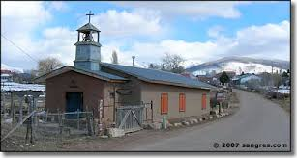



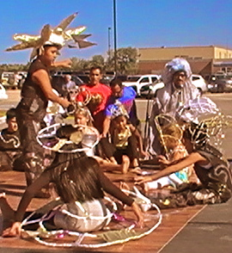


Slide 3
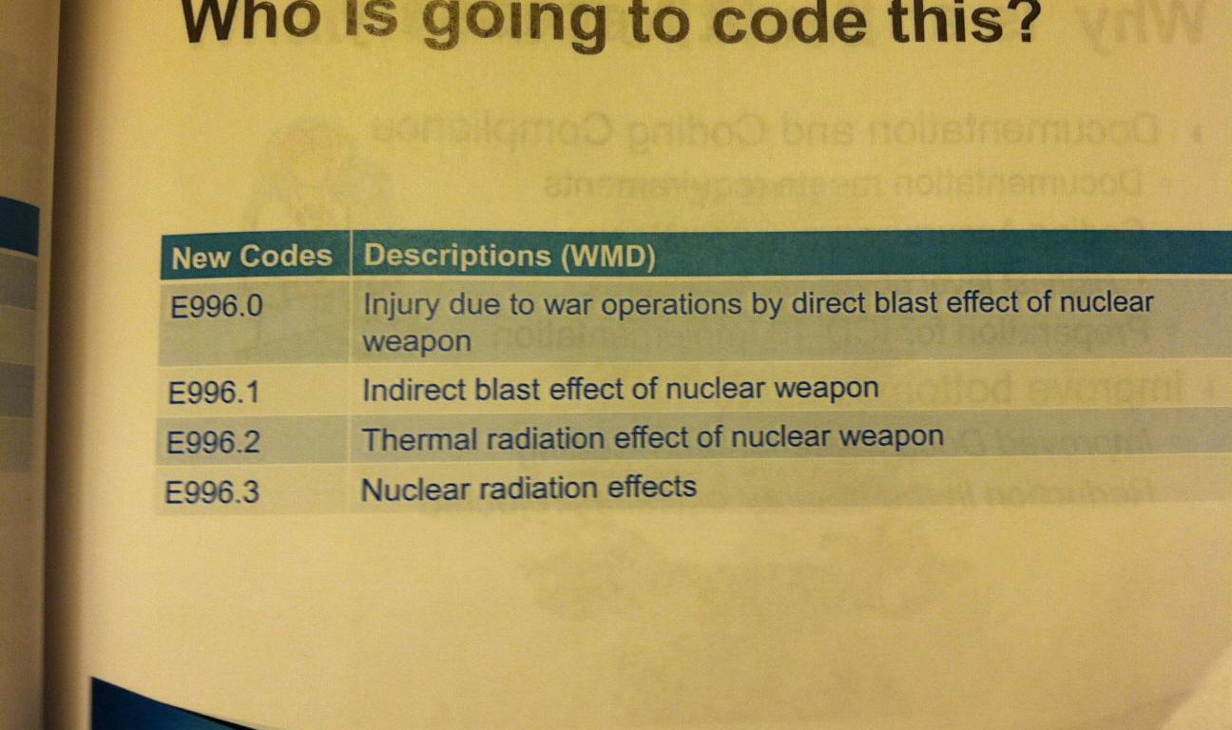
When services in Rio Arriba were not part of a system

Slide 4
What didn’t work for families
Nobody providing same day TB test or medical clearance
Stand-alone detox located 90 minutes to 3 hours from nearby residential programs
No automatic transition from detox to residential
No transportation to services
Providers unable to communicate about shared clients
Nobody measuring overall outcomes
Prescribers not checking PMP Database
Narcan largely unavailable
LEADING TO USE OF JAIL IN LIEU OF CARE

Slide 5
Rio Arriba Pathways
Pathways is a care coordination model that reimburses providers for achieving individual health outcomes.
Pathways targets high-risk, underserved populations.
Pathways is being implemented to coordinate Medicaid services in several states
Rio Arriba has been recognized by AHRQ for successful implementation of Pathways in a rural setting and for substance abuse treatment.

Slide 6
Early Pathways Successes (pre-OUR Network)
Over 90% of high risk pregnancies case managed using Pathways by RAHHS resulted in babies born free of unprescribed substances and with a birth weight of 5 lbs 8 oz or greater.
21% of high ER utilizers reduced their ER usage.
Immunizations of seniors increased by 5,000% or greater.

Slide 7
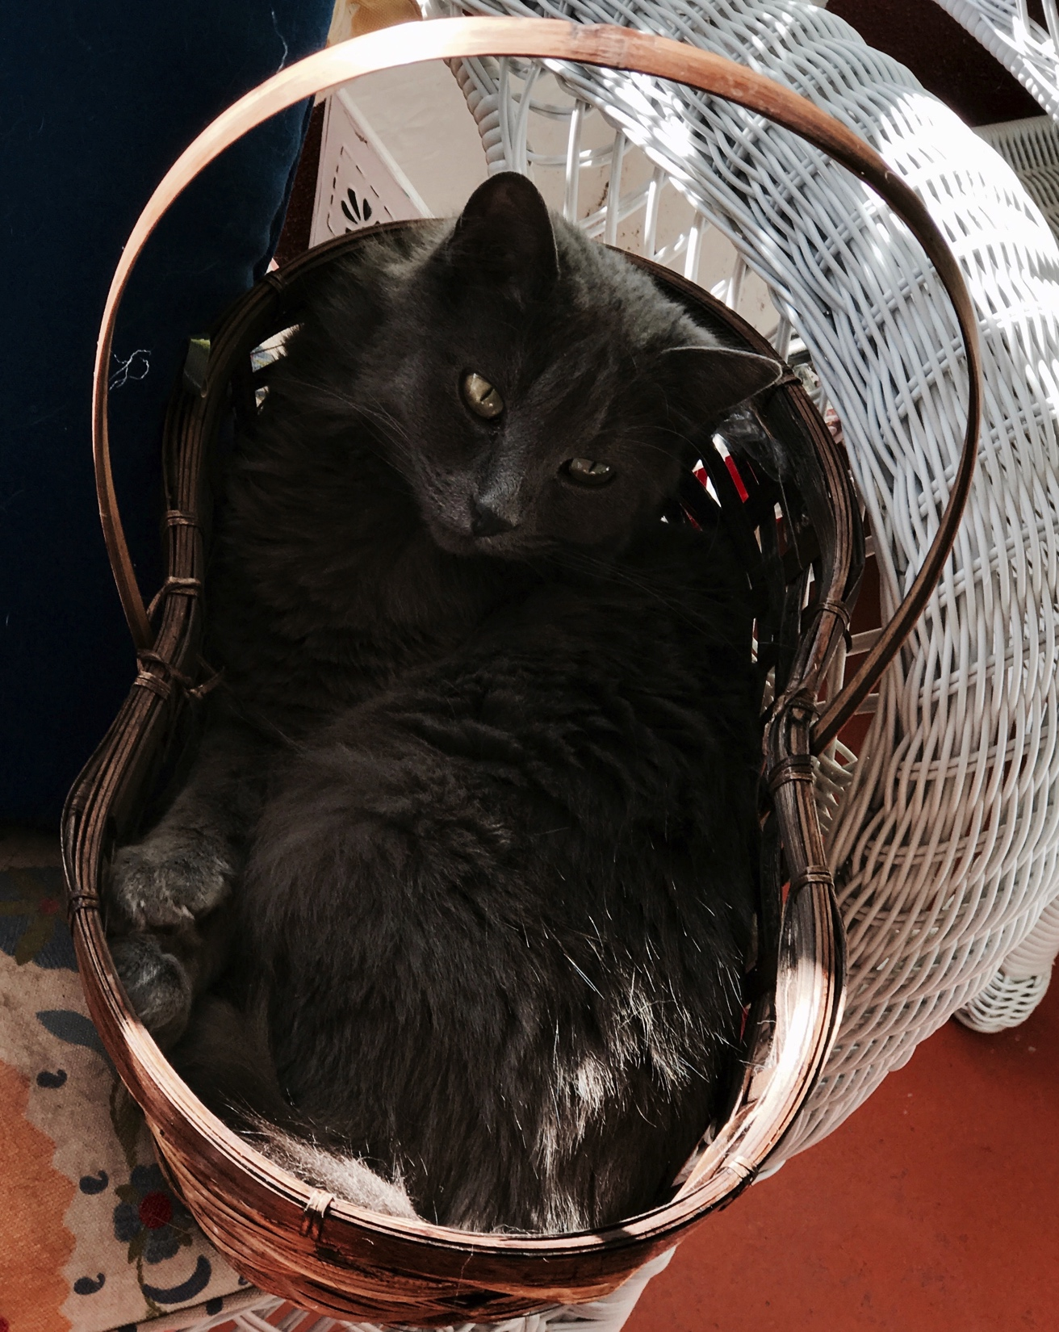
A Better Fit

Slide 8

Our clients
180 high utilizers account for most of our jail costs.
High jail utilization patterns resemble high ER utilization patterns
Repeat jail stays increase in duration over time, and anti-social behavior worsens
Jail costs can be reduced and care improved through pre-trial and pre-arrest diversion.

Slide 9
Chronic disease or crimE?
Disease Management Model
Crime Prevention Model
Primary care treatment plan agreed upon by individual and provider.
Use of positive incentives (with verification)
Use of positive language, empowering individuals to seek and maintain health
Intensive case management and other supports to encourage success
Relapse
Court mandate that must be strictly followed; “Felonization” removes supports needed for success.
Use of jail and other threats to force compliance
Use of negative language to shame “convicts” into behavior desired by an authority figure.
Probation and parole officers to monitor compliance
Recidivism

Slide 10
OUR Network Jail Diversion
All RASO deputies and EPD officers are trained to use, and carry Narcan, and are CIT certified. Santa Fe Mountain Center distributed Narcan widely. Rio Arriba’s OD death rate dropped 30% in 2015 and has not risen.
There is no single zip-code we can target in Rio Arriba to focus on health disparities, but there is a jail.
Rio Arriba has placed a PE Determiner/Case Manager in the jail, working with law enforcement and judges to divert non-violent offenders suffering from SUDs or mental illness into the healthcare system.
Residential treatment centers have incorporated MATs and detox into their service array.
A Medical director is developing an OUR Network MAT protocol and training providers in its use.
OUR Network is exploring capacity expansion by combining ankle bracelets, IOP, ICM and MAT into a single, integrated care regimen meeting judicial needs.
Key gaps include transitional living and ankle bracelets/court monitoring.

Slide 11

Navigating the H.I.T. Rungs of hell
Rio Arriba purchased (and extended) licenses to the web-based Pathways health information technology for up to 40 individual users.
Staff from RAHHS, Hoy, Santa Fe Mountain Center, HOPE, Las Cumbres, El Centro Family Health, Española Hospital, PMS, Las Clinicas Del Norte, RACSTOP and La Clinica de Tierra Amarilla have been trained in its use.
All 180 current RAHHS clients have been entered into the system.
Rio Arriba hub manager is assisting case managers to work with Pathway data, and working with CCS IT team to modify VPR for use with OUDS.
Need to adapt questions and model to meet the needs of intensive case managers (rather than care coordinators).

Slide 12
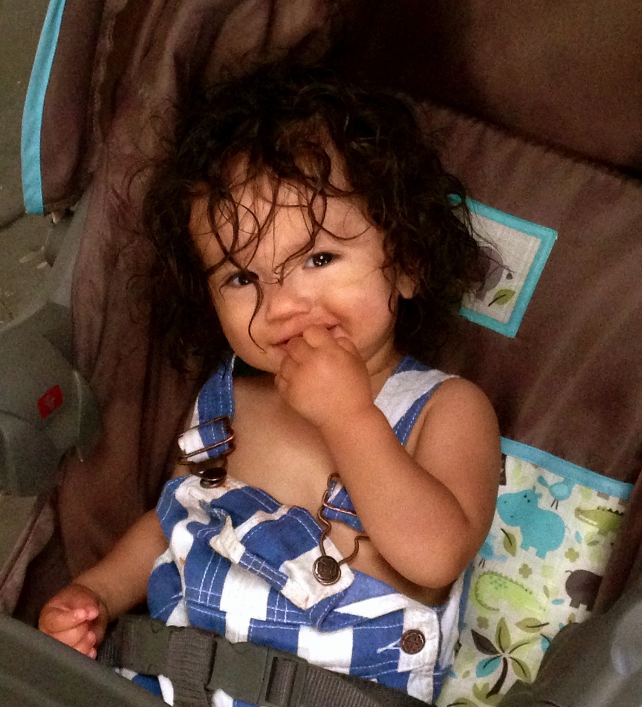

Slide 13
Targeting Rather than Rationing Care
Prospective clients will be assessed by the hub, as appropriate for one of three tracks: harm reduction, “IOP/Pre-OP/MAT,” or residential treatment.
Individuals referred to harm reduction will receive motivational therapy and be regularly re-assessed.
Santa Fe Mountain Center is modifying “Treat First” model for use with SUDs, enabling individuals on residential wait lists to access “Pre-OP” Tx. RACSTOP is able to provide Pre-OP through non-Medicaid funding.
Collaborative agreements between Hoy and Santa Fe Recovery Programs improve access to residential and reduce risk of leaving against medical advice.

Slide 14
Improving Options for Native Americans in the Justice System
Native Americans in the County jail often languish due to lack of communications across jurisdictions.
A new Native American Outreach Task Force seeks to improve Narcan distribution to the tribes, and to improve opportunities for referral to Native American serving organizations within Pathways. RAHHS has partnered with New Moon Lodge on a proposal to OMH for a clinical trial of Pathways, and has conducted Narcan training and dispensation to Ohkay Owinge Pueblo.
Non-Native American Pathways treatment programs are doing a better job of incorporating treatment practices relevant to tribal members.

Slide 15


Slide 16
Pregnant Women and Incarcerated Parents
The Healthy Families Task Force is developing referral protocols for pregnant women and families of small children impacted by SUDs.
The task force is composed of providers serving and developing a stream of care for families of pre-natal through K.
The team consists of First Born/Española Hospital, Tewa Women United (doulas), Breath of My Heart Birthplace, Las Cumbres Community Services (0-5), El Centro Family Health, Santa Fe Mountain Center, PMS, Santa Fe Recovery, RAHHS and Hoy.
Money has been included in the 2017 BHIZ budget for a case manager for Las Cumbres dedicated to pregnant women.
Santa Fe Recovery System has brought a residential program online for pregnant women and women with children.

Slide 17


Slide 18
Starting Small and Growing Big
Currently, the 180 RAHHS clients are entered into the system.
RAHHS began jail services in June.
PMS attorneys are assisting OUR Network to develop appropriate policies, procedures and documents for sharing of health information; in the meantime, we will jointly staff shared clients on a monthly basis, allowing RAHHS to enter data for clients primarily case-managed by PMS.
The Electronic Medical Record is being modified to meet Network needs.
Opiate Use Reduction Network will double its capacity by adding PMS as a full partner in care coordination, and by fully integrating IOP, ICM and MAT into a single regimen of care.

Slide 19
Changing Public Perception through Targeted Media
RAHHS and the Rio Arriba Community Health Council have worked successfully over a decade to change police culture and police response to substance abuse.
RAHHS is developing a multi-media campaign that integrates video, TV, radio, billboard, johnny boards, a website, and social media to build public understanding of and support for long-term recovery.
RAHHS and the Rio Arriba Community Health Council are working to build public perception of SUDS as a chronic disease that can be managed.
RAHHS and the Rio Arriba Community Health Council are working to build public confidence in IOP/Pre-Op combined with ICM and MAT as a viable treatment modality.

Slide 20

www.anewnormal.life The lost generation

Slide 21
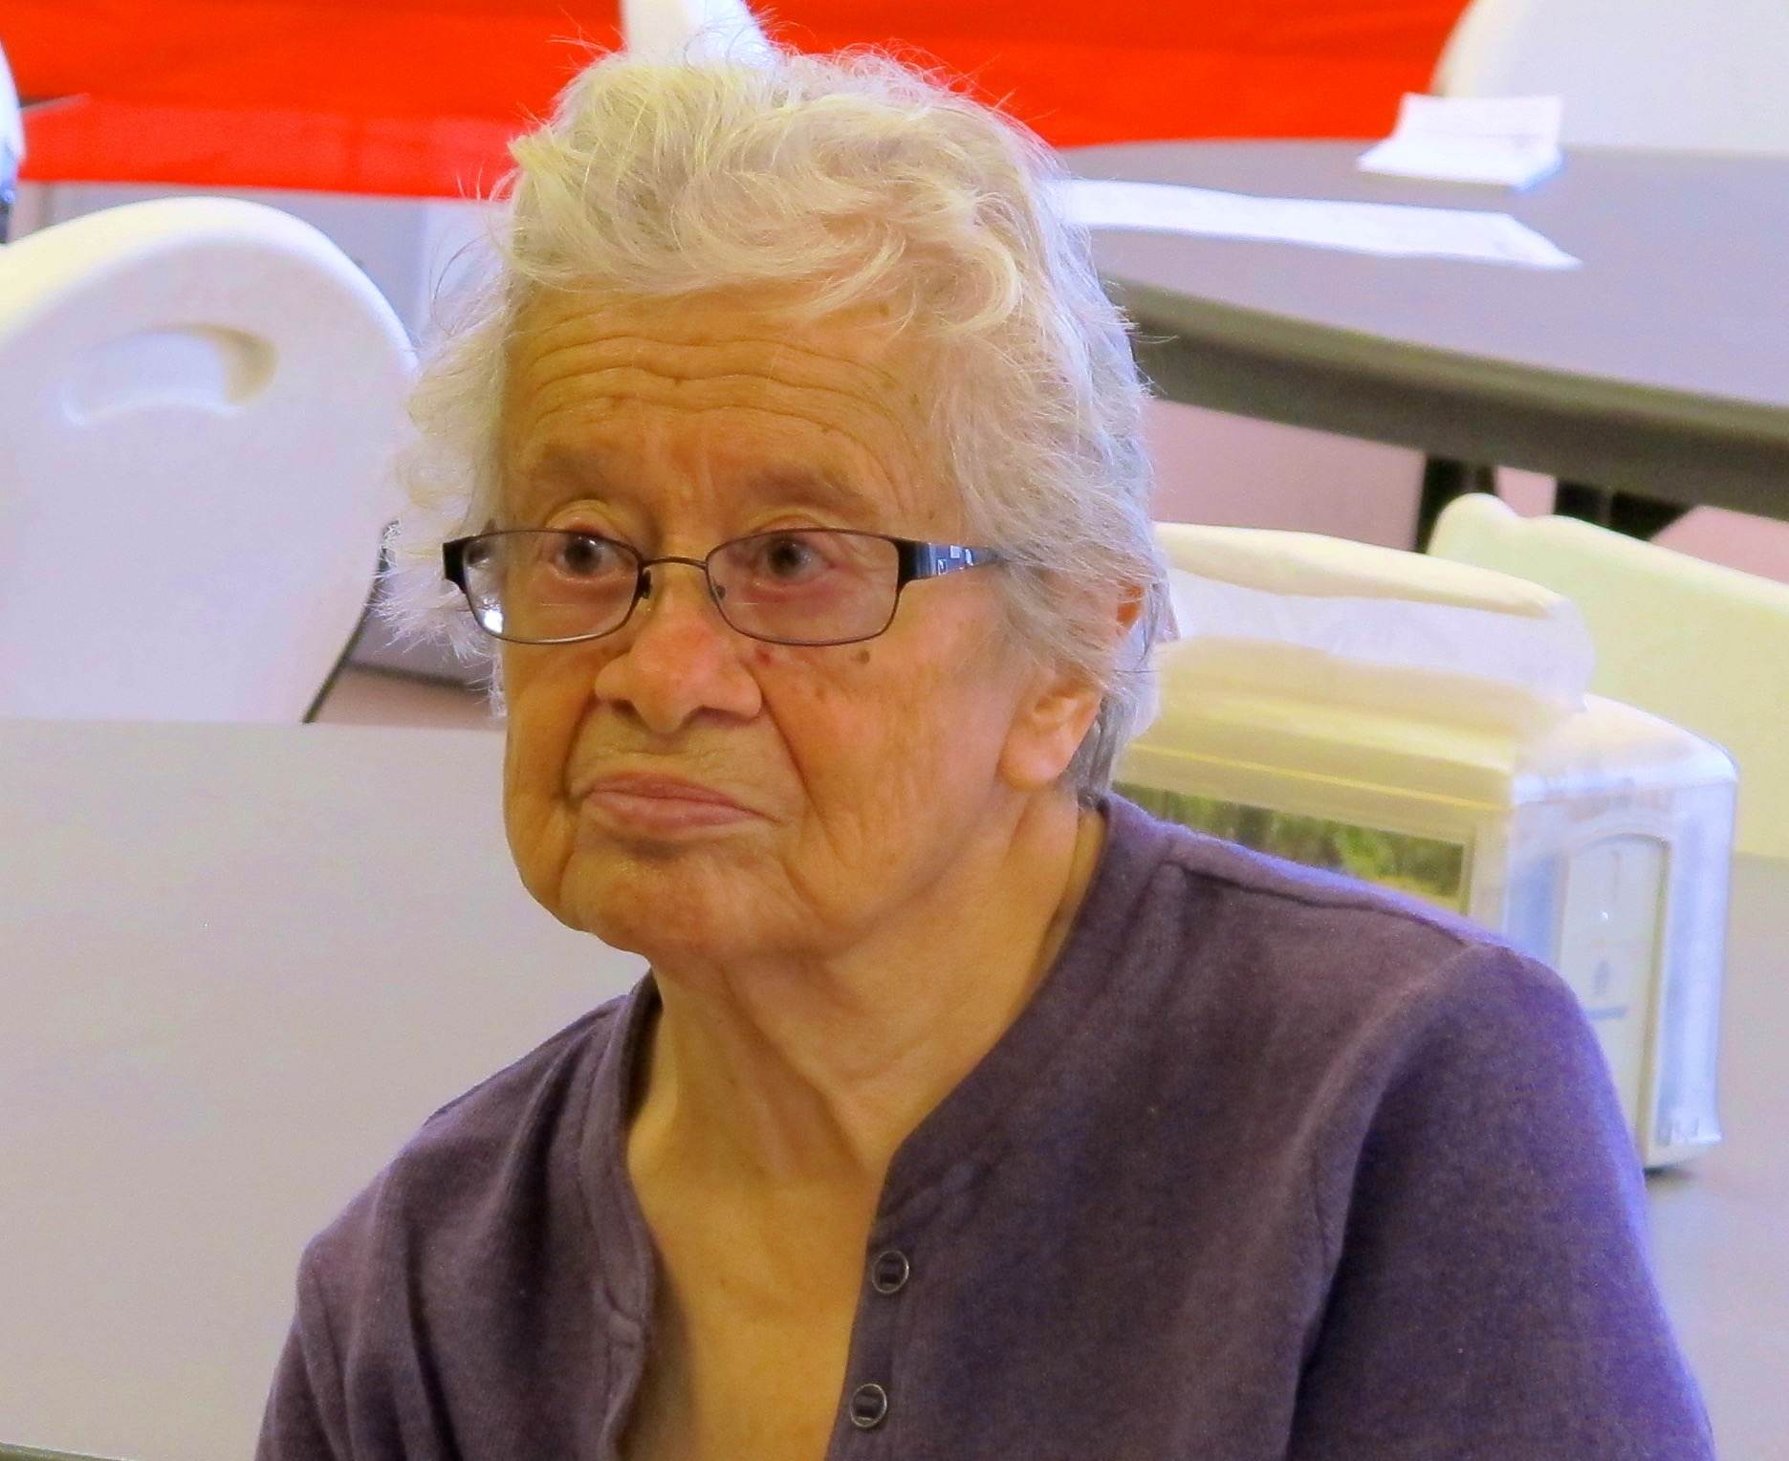

Slide 22
Applications to Senior Care
Rio Arriba applied the Pathways model to senior immunizations, increasing rates by 5,000%, and going from last to second in NM over three months.
Rio Arriba conducts medication management and fall prevention clinics at senior centers.
Rio Arriba has opened a Benefits Enrollment Center through NCOA, helping seniors to qualify for Medicaid, supplemental Medicare and other benefits. We screened 610 individuals and enrolled 478 in Medicaid and non-core benefits from June, 2016-February 2017.
Rio Arriba is poised to open the only Medicaid-funded adult day care in NM north of Santa Fe, and already serves ADC clients through AAA.
Rio Arriba has developed contracts with three of four MCOs to provide ADC through Medicaid.

Slide 23
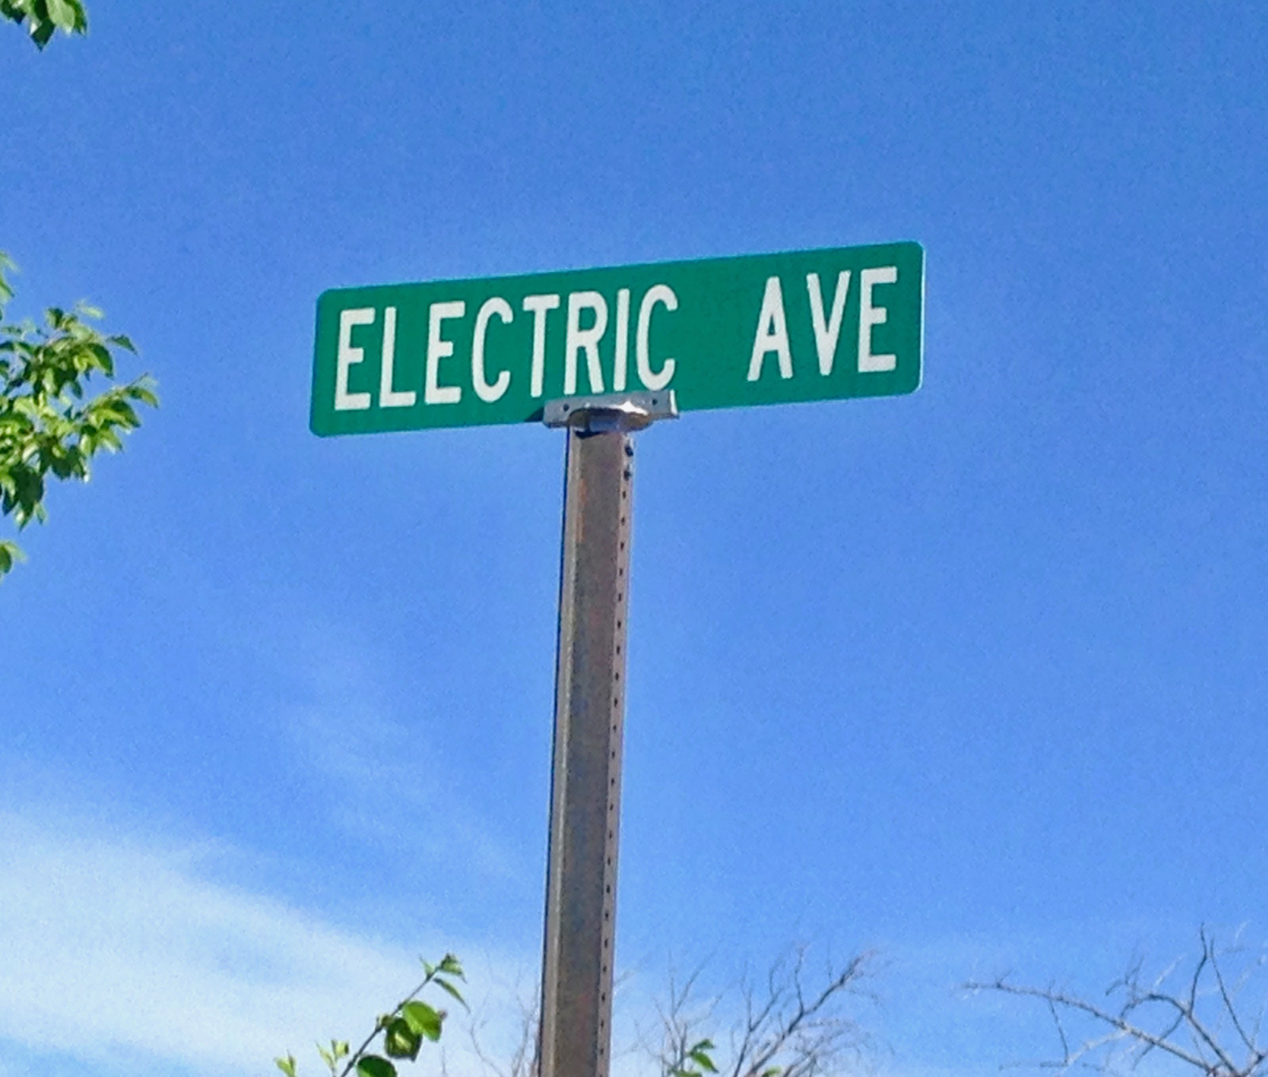
OUR Ask of Y.O.U.
We need assistance to develop a Medicaid billing structure that supports outcome-based collaborative care coordination as well as our direct service array and to move funding and policy to a positive chronic disease management model.

