Slide 1



Pathway to Health Equity:
Inter-professional Community Collaboration
Sylvia Caley, JD, MBA, RN
Legal Director – Health Law Partnership
Clinical Professor, GA State University College of Law
Robert Pettignano, MD, FAAP, FCCM, MBA
Medical Director – Health Law Partnership
Professor of Pediatrics, Emory University
Atlanta, GA

Slide 2
Disclosures
The speakers report no actual or potential conflicts of interest in relation to this program or presentation
The speakers have no relevant financial relationship with the manufacturer(s) of any commercial product(s) and/or provider(s) of commercial services discussed in this CME activity
The speakers do not intend to discuss an unapproved/investigative use of a commercial product/device in their presentation

Slide 3

We want to know
Who is in the Audience?

Slide 4
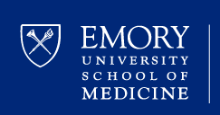


Who has heard of Medical-legal Partnership?
Can anyone describe what the term medical-legal partnership means?

Slide 5

Objectives
On completion of this presentation, you should be able to
  Describe:
    Socio-economic factors that impact health
    Medical Legal Partnership (MLP)
    The Health Law Partnership (HeLP) - Atlanta
      Components
    Legal issues that impact the delivery of care
  Identify potential cases where legal intervention is beneficial
  Review some applicable literature on the impact of legal interventions on health and well-being

Slide 6


Notes:
A lawyer walks into a hospital.
That may sound like the opening joke at a comedy club but if you really think it is a joke, the joke would be on you.
Not all illness is caused or exacerbated by medical reasons or patient/family non-compliance, although as physicians that is what we may assume. Often, patients present with health problems that have a legal dimension, and the presence of lawyers in the hospital who can assist with such problems can make a difference in outcomes.

Slide 7

Lawyer
PRE Health-Law Impression
Lawyer
Notes:
Now before I got involved in the Health Law Partnership, I had a preconceived idea of what lawyers looked like and it was something like this:

Slide 8
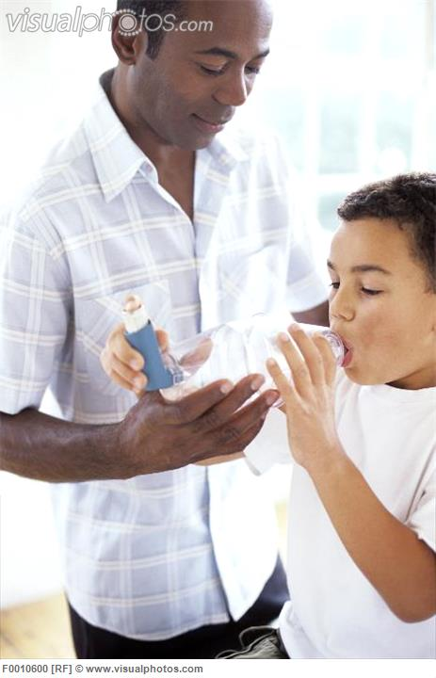
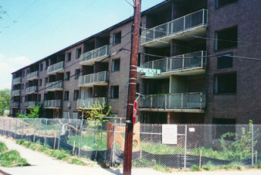
10 y/o - multiple hospital visits for wheezing then......
4 days in the PICU

Slide 9

What Determines

Slide 10
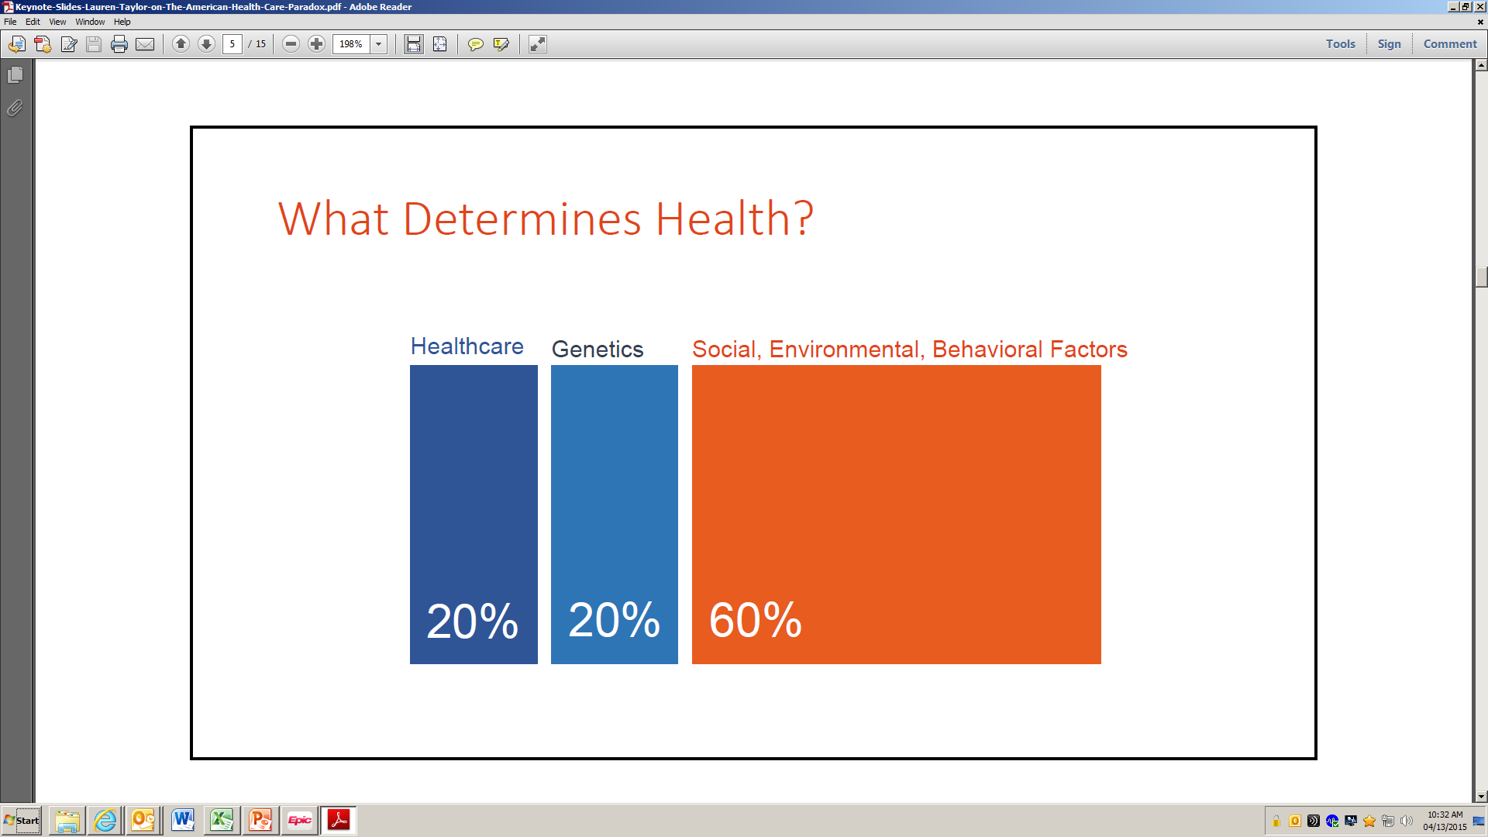
The American Health Care Paradox, Lauren A. Taylor

Slide 11
The American Health Care Paradox, Elizabeth Bradley and Lauren A. Taylor

Slide 12
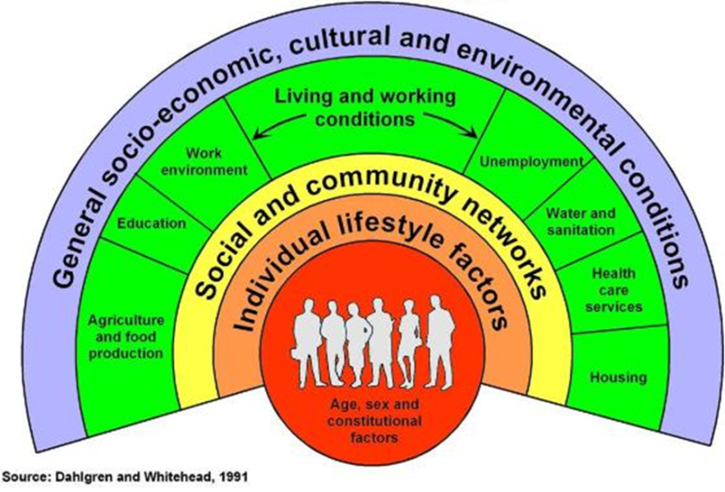
The American Health Care Paradox, Elizabeth Bradley and Lauren A. Taylor

Slide 13



The Need
At risk families have complex medical, social, and emotional needs
Many services administered in silos instead of in an integrated and coordinated manner

Slide 14
Why Collaborate
Notes:
Created by Childkind

Slide 15
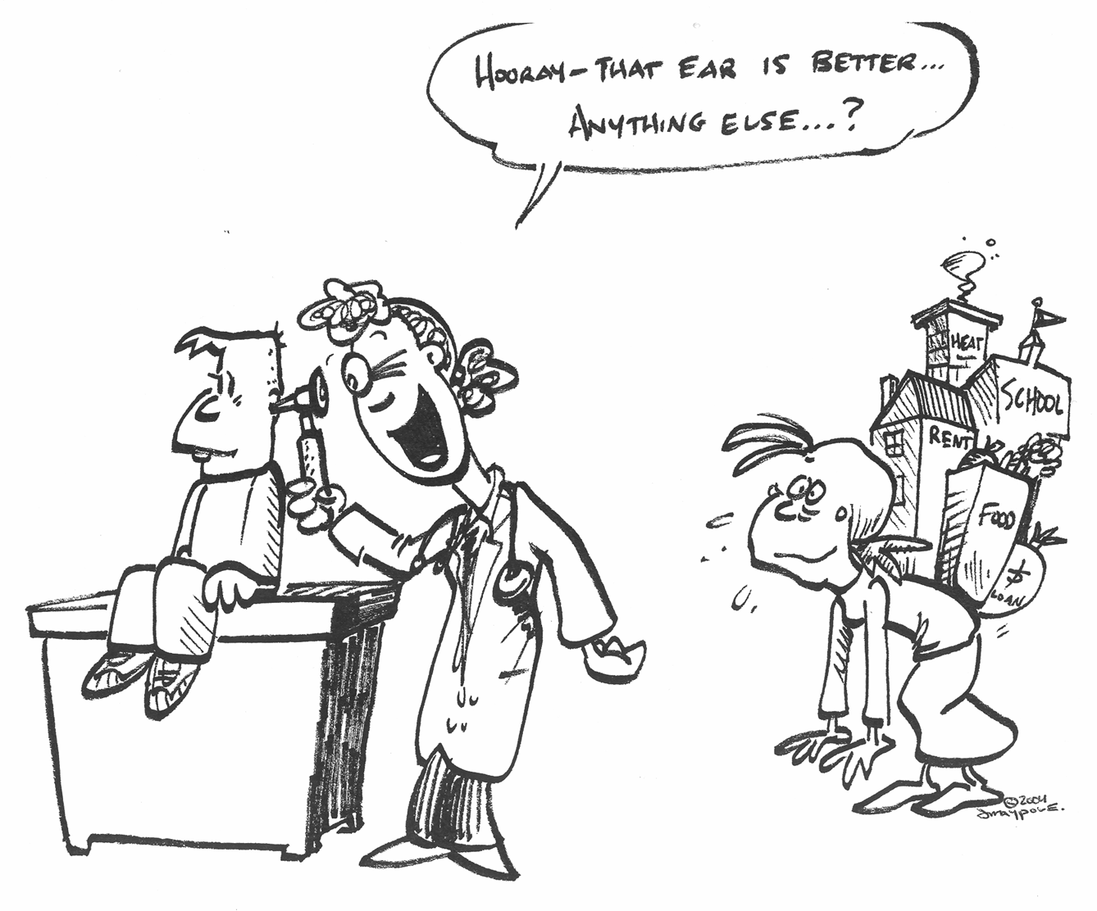
Why Collaborate #1
http://www.mlpforchildren.org/Nuts--Bolts.aspx Cartoon courtesy of Jack Maypole, MD (jackmaypole@yahoo.com)
Notes:
Medical-legal partnership is a healthcare delivery model that integrates legal assistance into patient care
15

Slide 16
Why Collaborate #1
http://www.mlpforchildren.org/Nuts--Bolts.aspx Cartoon courtesy of Jack Maypole, MD (jackmaypole@yahoo.com)
Notes:
Medical-legal partnership is a healthcare delivery model that integrates legal assistance into patient care
16

Slide 17

PARTNERS for Equity in
Child and Adolescent Health at Emory
Vision:
  To reduce health disparities ensuring that all Georgia children are more likely to be happy, healthy and productive members of society
  Created a family centered model for comprehensive primary care
    PACE

Slide 18
Pediatric primary care, Access to healthcare, Comprehensive family support and Education
An approach to addressing the complex medical, social, behavioral health, educational and legal needs of at-risk families

Slide 19

Team Composition
Primary Care Pediatricians from Emory
Specialty Pediatricians (asthma, SCD)
Behavioral Health Coordinator
Academic Success Coordinator
Hospital Teacher
Nurse Navigator
Lawyers (HeLP)
Students
    ‘There is wisdom in the counsel of many’
                Proverbs 15:22

Slide 20
How do we address the identified needs
Through Medial-Legal Partnership which :
  is a healthcare delivery model that integrates legal assistance as a vital component of medical care
  serves healthy, acutely ill and chronic/complex kids
  improves population health and helps manage utilization (cost effective)
  addresses specific needs and builds a differentiated patient and family experience
  engage doctors, lawyers and other health professionals to improve to improve the health and well being of their patients/clients
Notes:
In a population based approach to care, as you all know we take a broader view of health and the factors that influence the health of a community called “the socioeconomic determinants of health” like education, transportation, environment, food. Telling an asthmatic to take his medication is of little use if the house is infested with rodents, insects or mold!

Slide 21


Slide 22
Serves
  low-income families, at or below 200% of poverty level
Addresses
  social, environmental & economic factors that effect health & well-being
  legal issues across multiple disease categories
Educates
  healthcare and other professionals in a way that will improve their ability to address the social determinants of health

Slide 23

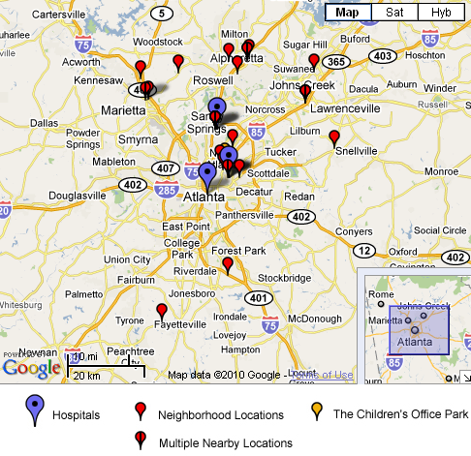
Referral Threshold
Child must be seen at Children’s Healthcare of Atlanta or any affiliated institution
  Marcus Autism Center, Rehab, urgent care, ED, CIN practices
Family must be ≤ 200% FPL
Cleared at Case Acceptance
What if:
  The family is over income
  Not a priority case
  Does not meet criteria

Slide 24
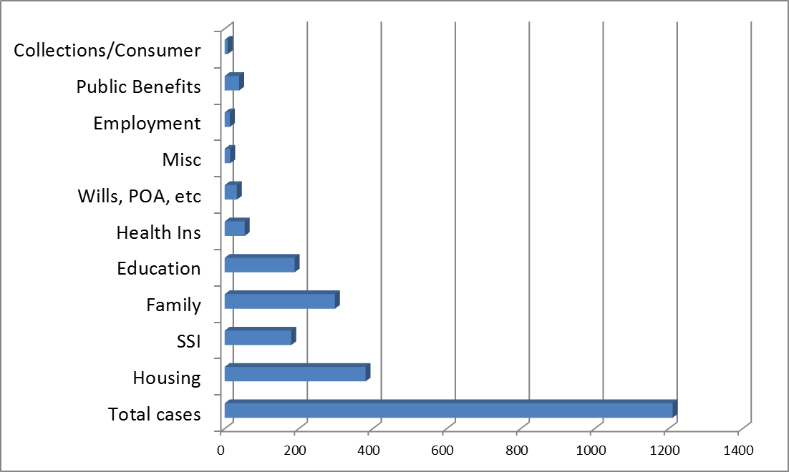
OUTCOMES
Managed a total of 121 cases since 2011
37 cases required HeLP intervention

Slide 25

HeLP - Outcomes by Cost Benefit
 |  | Individuals | Annual Amount
Education |  | 48 | $345,163.00
Social Security |  | 25 | $324,882.25
Housing |  | 328 | $296,133.71
Medicaid |  | 26 | $164,214.00
Public Benefits |  | 12 | $22,192.00
Consumer |  | 16 | $14,876.18
Family Law |  | 29 | $11,148.00
Wills, Ad Dir, POAs |  | 57
TOTAL |  |  | $1,178,609.14

Slide 26
10 y/o - multiple hospital visits for wheezing then......
4 days in the PICU
and a social work consult

Slide 27

So, why do you think a referral to SW was made?

Slide 28
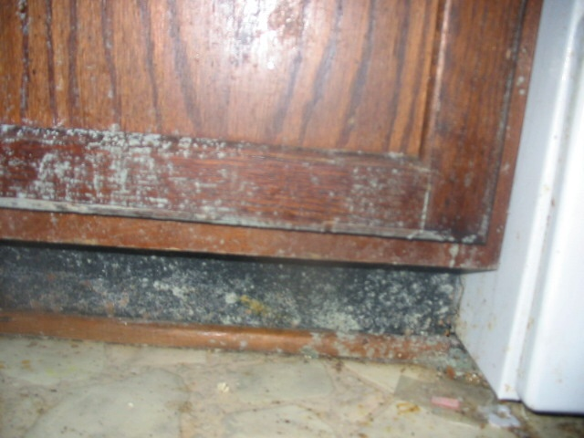

Slide 29
Case Study #1 - Legal Solution
Terminate existing lease without penalty
Obtain a new housing voucher
Expedite inspection of new apartment to facilitate moving
Abate payment to landlord under the Housing Assistance Payment contract
Identify private volunteer lawyer to assist client in obtaining damages from landlord for lost property
Medical Outcome:
  Reduced ED visits

Slide 30
Medical-Legal Partnership: Impact on Asthma
Results
  295 parents/guardians with 313 children with asthma were referred to the HeLP for legal intervention.
    89.5% were < 200% FPL
  59% (77/130) patients were in the appropriate grade in school
  62/130 reported missing a total of 1208 days of school due to their illness
  65/130 resulted in a measurable gain of benefits ($501,209)
  Non-financial benefits included access to education, family law (custody/visitation), estate planning (wills/advanced directives)
Pettignano R, Caley S, Bliss L. Can Access to a Medical-legal Partnership Benefit Patients with Asthma Who Live in an Urban Community. J of Healthcare for the Poor and Underserved May 2013; 24(2):706-717

Slide 31
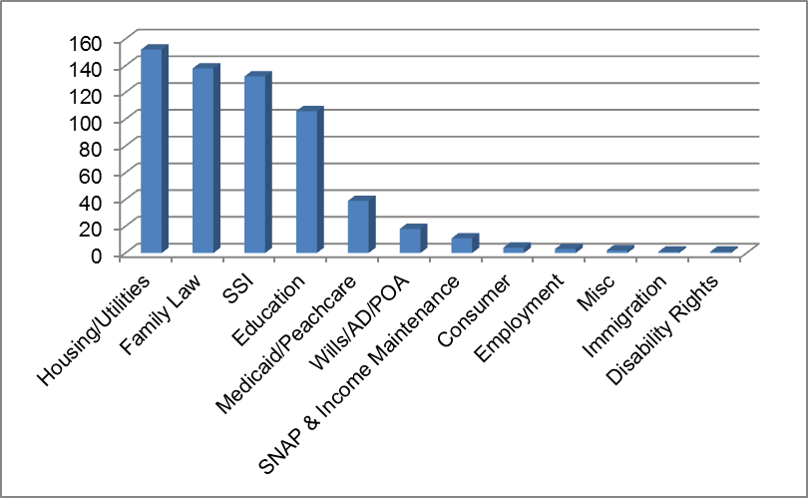

Legal Problems/Issues
Number of Cases
Notes:
31

Slide 32
Dependent Health Problems

Slide 33


Legal Cases Not Handled
Medical malpractice
Patient/family - adverse to the hospital
Parent - adverse to the child

Slide 34

Advocacy Case Study: Collaboration Identifies a Need
Children with Head & Neck Injuries

Slide 35
The Problem and Cause
Children 6 – 9 yrs
  MVA resulting in severe head & neck injuries
Booster seat or other protective device no longer required for child passengers ≥ 6 yrs use a seat belt
Rehabilitation team referred many to HeLP for legal problems stemming from their injuries
Staff from rehabilitation unit asks HeLP to fix the problem

Slide 36


What did we do?
Identified the public policy issue
  Kids should be in booster seats to age 8
    National Highway Traffic Safety Admin
    American Academy of Pediatrics
Identified the community partner
Set expectations and responsibilities
Did the work
  50 state survey
  Researched the science/engineering
  Developed the work product
Got buy-in
  Governor’s office of Highway Safety
  Get the Governor onboard
  Success!!!!

Slide 37
What’s in it for the Healthcare Partner I ??

Slide 38
The Health Law Partnership: Adding a Lawyer to the Health Care Team Reduces System Costs and Improves Provider Satisfaction
Results
  In 50 cases involving 62 children, HeLP was able to obtain or retain Medicaid coverage or benefits for 55 children
  At a minimum, HeLP secured potentially unreimbursed Medicaid payments for services provided by Children’s in the amount of $640 290.58 over 4-years
  For an average payment of $10 327.27 per recipient assisted
  Without this intervention the system would have to al-locate the charges to charity or indigent care.
Pettignano, Caley, McLaren. The Health Law Partnership: Adding a Lawyer to the Health Care Team Reduces System Costs and Improves Provider Satisfaction. J of Public Health Management & Practice. 18(4):E1-E3, July/August 2012

Slide 39
How do we make sure health-harming legal needs are identified now and in the future??

Slide 40
Socioeconomic Determinants of Health
Awareness
Upstream interventions for learners
  Student presentations:
    medicine, law, other professionals
  Trainee presentations
    residents, fellows, other
Screening
    population based vs. universal
Community engagement
Publications

Slide 41

MLP/Socioeconomic Determinants of Health
Awareness and Screening
Mandatory class for medical students at MSM
  Fundamentals of Medicine
Also attended by HeLP Clinic law students
Topics:
  Introduction to Medical Legal Partnership
  Collaboration and Case Studies – pediatric and elder patient
  Collaboration – pediatric role play and identification of legal and medical issues
  End of Life Issues – legal and medical
Survey approved by IRB
  Before first lecture
  After last lecture

Slide 42
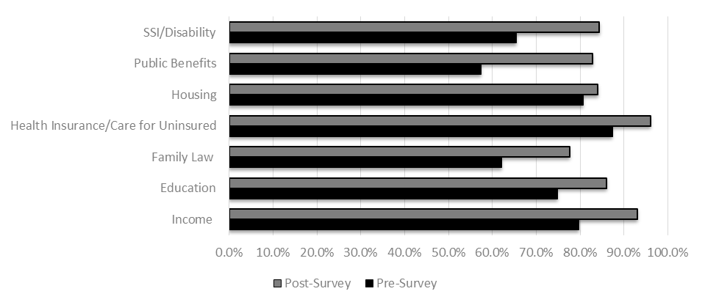


Likeliness to Screen Patients for Socioeconomic or Legal Issues

Slide 43
Study Conclusions
Inter-professional education increased
  awareness of how legal problems affect the health of patients
  the likelihood of screening for legal problems associated with the care of their patients
  likelihood that they would refer the patients to a legal resource for assistance
Inter-professional Medical-Legal Education of Medical Students: Assessing the Benefits for Addressing Social Determinants of Health
Academic Medicine, Innovation Report, 2017

Slide 44

American Association of Medical Colleges
Accelerating Health Equity, Advancing through Discovery (AHEAD)
  Goals
    develop and disseminate evidence that measures the impact of Medical-Legal Partnerships (MLP) on health inequities at the local level
    develop/implement metrics to evaluate the impact of MLP’s on:
      learner educational outcomes
      patient and community health; health inequities
      cost savings, institutional benefits, and efficiencies
Notes:
Discuss the development of the learner tool; how we used the EPA’s and core competencies
Discuss the projected contribution to the body of evidence supporting what we do.

Slide 45
What’s in it for the Healthcare Partner II ??

Slide 46

Potential to:
  Reduce barriers to discharge
  Reduce length of stay
  Decrease readmission
  Decrease ED utilization
Provides a differentiator other healthcare systems don’t have
Contributes to more enduring and satisfying patient/family relationships
Heightens the hospital, universities and training programs national profile
Training opportunities that address resident, medical student and other professions core competencies

Slide 47

POST Health-Law Impression
Our Lawyers

Slide 48


