Slide 1
Pathways Community HUB
Mark Redding
Akron Children's Hospital Population Health Research
Pathways Community HUB Institute, Quality Improvement

Slide 2
Improve Outcomes
Identify and address the factors
that change the outcome

Slide 3

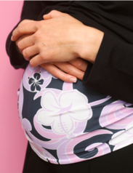

Wellness
Health
Care
Behavioral
Health
Racism
Schools
Health Insurance
Primary Care
Specialty Care
Screenings
Child development
Drug and ETOH
Depression
Anxiety
Domestic Violence
Social
Education Employment
Food
Clothing
Housing
Heat
Electricity etc.
Job Readiness
Self Esteem
Clothing
Application Assist
Safety
Safety
Healthy Foods
Infant
Childhood
Adult

Slide 4



Assess and Address Risk Factors

Slide 5

What Do We Know About Risk Factors
Some are immediate and some are upstream (preventive) – Healthy newborn going home to a smoke filled house.
Like Bowling Pins – Outcome Factors are
intrinsically tied together, inextricably
linked in outcome impact.

Slide 6
Outcome Focused System
What Are the Work Products of Addressing Risk?
Coordination of care the most broken component
Care Coordination – To identify the risk factors and coordinate connection to intervention
Direct Service – Intervention proven to address the risk factor

Slide 7
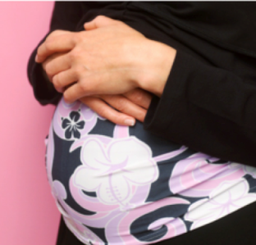


“Typical” Family at Risk Today
Marisol, 21
Mrs. Garcia, 52
Diabetic
Lives in 1 bedroom apt.
Limited income, works 32 hours
Financial stressors ?
Pregnant
Lost job
No housing
No transportation
Depressed ?
Angelina, 16 months
Needs medical home
Behind on imms.
Behind on well visits
Developmental concerns ?

Slide 8
Care Coordination and Service Approach
HHS
MEDICAID
MANAGED
CARE
EARLY
CHILDHOOD
CHILD
PROTECTIVE
SERVICES
HEALTH
PLAN
Marisol
Angelina
Mrs. Garcia
Multiple agencies involved – limited communication – No effective tracking of identified and addressed risk factors

Slide 9
Community Care Coordination
Find those at greatest risk
Identify their specific risk factors
Assure the packages of intervention are delivered that address the risk factors!

Slide 10


Community HUB
Care coordination
agencies
A comprehensive approach requires a community network
Client
Community Care Coordinator

Slide 11
Pathways Community HUB
Engagement of at risk client – Assess Risk
Initial Checklist – Captures Comprehensive Risk Issues
Track/Measure
Risk Factors Addressed
(Connections to Care)
By: Care Coordinator
Agency
Region
Assign Pathways
Name | Medical Home | Pregnancy | Social Service
CHW A | 5 | 2 | 10
CHW B | 1 | 3 | 4
CHW C | 9 | 15 | 18
Yes No Question
Initiation Step
Action Step
Site | Medical Home | Pregnancy | Social Service
Agency A | 50 | 25 | 22
Agency B | 64 | 17 | 35
Agency C | 40 | 32 | 19
 |  | Do you need a primary medical provider?
 |  | Do you need health Insurance?
 |  | Do you smoke cigarettes
 |  | Do you need food or clothing?
Action Step
Completion Step

Slide 12

Risk Factor Identified
Evidence based Intervention
Outcome
Risk Factor Confirmed Addressed
Notes:
12

Slide 13
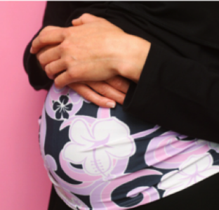


Care Coordination Funders
Community Care Coordinator
Care coordination
agencies
One Care Coordinator for the Entire Family
19
13

Slide 14
One Care Coordinator for the Entire Family
Marisol
Mrs. Garcia
Medical Referral PW – primary & specialty
Housing PW
Social Service Referral PW
Education PW - diabetes
Pregnancy PW
Employment PW
Housing PW
Medical Referral PW
Social Service Referral PW
Education PW – prenatal, parenting
Angelina
Medical Home PW
Immunization Referral PW
Medical Referral PW
Developmental Screening PW

Slide 15
20 Core Pathways – National Certification
Adult Education
Employment
Health Insurance
Housing
Medical Home
Medical Referral
Medication Assessment
Medication Management
Smoking Cessation
Social Service Referral
Behavioral Referral
Developmental Screening
Developmental Referral
Education
Family Planning
Immunization Screening
Immunization Referral
Lead Screening
Pregnancy
Postpartum

Slide 16

Standard Billing Codes
System of Pathway Billing Codes Used Used in Ohio
 |  | Normal Risk | High Risk | Modifier
Checklists
Initial Pregnancy Checklist | Completed one time at Member enrollment, 1st trimester engagement | G9001 | G9003 | R1
 | Completed one time at Member enrollment, 2nd trimester engagement | G9001 | G9003 | R2
 | Completed one time at Member enrollment, 3rd trimester engagement | G9001 | G9003 | R3
Pregnancy Checklist | Completed at each face-to-face encounter with Member | G9005 | G9010 | R
Pathways
Behavioral Health | Kept three scheduled behavioral health appointments | G9002 | G9009 | RB
Education | Educational module delivered. | G9002 | G9009 | RE
Family Planning | LARC (long-acting, reversible) or permanent method | G9002 | G9009 | G1
Family Planning | All other family planning methods | G9002 | G9009 | G2
Housing | Residing in affordable & suitable housing for 2 months. | G9002 | G9009 | RI

Slide 17
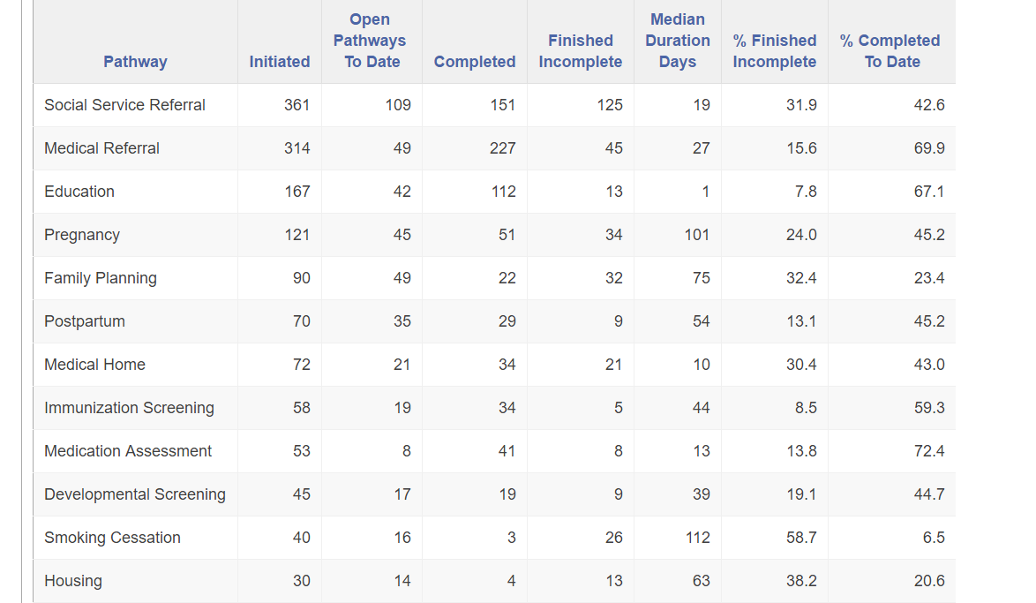
Risk Reduction Reports Now Live in 6 HUBs
Sample representative 1 HUB brief period of data

Slide 18
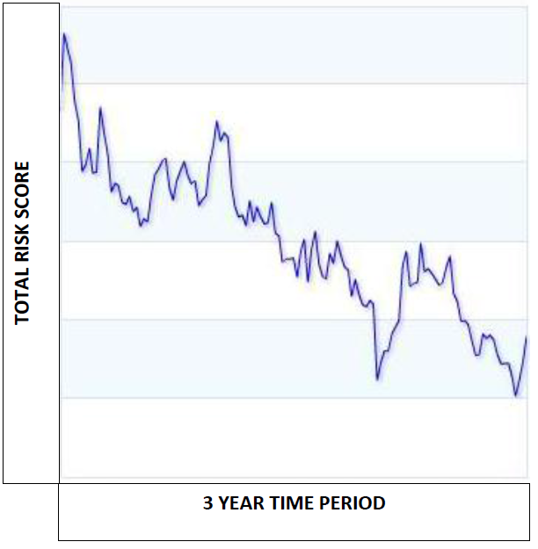
Measuring the Social Determinants of Health
Health
Behavioral Health
Social
Family & Personal Health Management

Slide 19
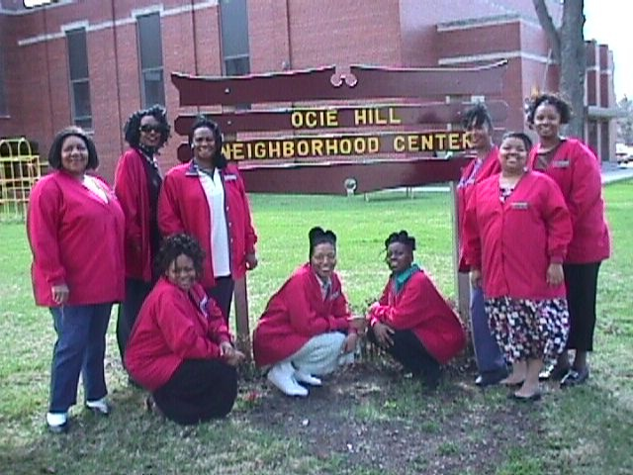
Engage Communities at Risk

Slide 20
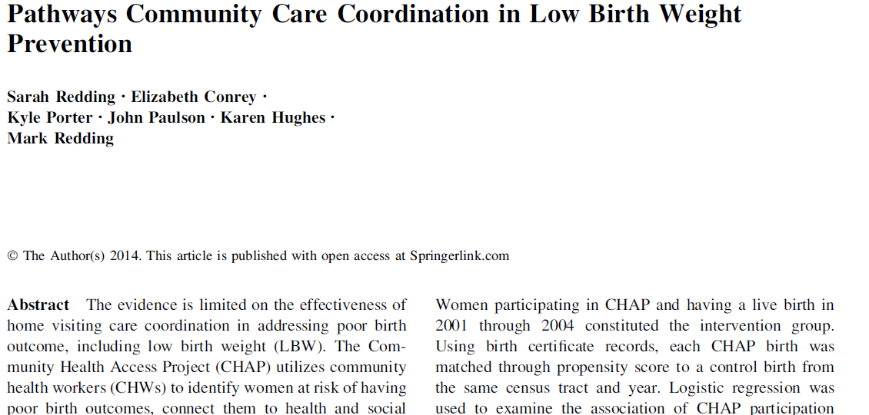
Published Study on Results
Cost Savings: $3.36 for 1st year of life; $5.59 long-term for every $1 spent
Pathway intervention over 4 years

Slide 21
LBW in Richland County

Slide 22
 | 2007 | 2008 | 2009 | 2010 | 2011 | 2012
Infant Deaths Total | 15 | 6 | 14 | 15 | 14 | 6
White Deaths | 11 | 6 | 12 | 13 | 13 | 5
Black Deaths | 4 | 0 | 2 | 2 | 1 | 1
Births, Total** | 1,606 | 1,523 | 1,517 | 1,339 | 1,353 | 1,410
White Births | 1,436 | 1,365 | 1,353 | 1,199 | 1,220 | 1,260
Black Births | 170 | 158 | 164 | 140 | 133 | 150

Slide 24
Resources
Journal of Mat and Child Health – 60% reduction in low birth weight and %500 return on investment
http://link.springer.com/article/10.1007/s10995-014-1554-4
AHRQ – Pathways Manual, Connecting Those at Risk to Care, and other supporting network publications.
https://innovations.ahrq.gov/sites/default/files/Guides/CommunityHubManual.pdf
AHRQ – Connecting Those at Risk to Care – The Quick Start Guide
https://innovations.ahrq.gov/sites/default/files/Guides/CommHub_QuickStart.pdf
National Certification – Pathways Community HUB – Rockville Institute
https://pchcp.rockvilleinstitute.org/
NQF - Priority Setting for Healthcare Performance Measurement: Addressing Performance Measure Gaps in Care Coordination
https://www.qualityforum.org/Publications/2014/08/Priority_Setting_for_Healthcare_Performance_Measurement__Addressing_Performance_Measure_Gaps_in_Care_Coordination.aspx
Association of Maternal and Child Health Programs (AMCHP)
http://www.amchp.org/programsandtopics/BestPractices/InnovationStation/ISDocs/Pathways%20Community%20HUB.pdf
Sarah Redding – sarah@chaphub.org
Mark Redding – mark@chaphub.org Community Health Access Project, 255 Hedges Street. Suite 115, Mansfield, Ohio 44902
CHAP-Ohio.com

Slide 25

Atlanta Airport
275,000 passengers a day. 2,500 + arrivals and departures daily.

Slide 27

Define The Work Products and Their Cost
Use American Business Models
To Identify and Address Risk

