Slide 1



Achieving Sprints of Change within the Marathon of Health System Transformation: A Technical Assistance Model February 2018
Allison Gertel-Rosenberg, MS
Nemours Children’s Health System
Stephanie Walsh, MD
Children’s Healthcare of Atlanta
Notes:
Achieving Sprints of Change within the Marathon of Health System Transformation: A Technical Assistance Model aimed at Supporting the Development of Policy Strategies to Address Upstream Determinants of Health among Hospital-Community Partners

Slide 2
Nemours Integrated Child Health System
0
Nemours is a non-profit organization dedicated to children's health & health care.
Nemours offers pediatric clinical care, research, education, advocacy, and prevention programs. Nationally, the goal is to improve child health and wellbeing, leveraging clinical and population health expertise.
Nemours operates Alfred I. duPont Hospital for Children and outpatient facilities in the Delaware Valley and a new state-of-the-art Children’s Hospital in Orlando and specialty care services in Northern/Central Florida.
Nemours focuses on child health promotion and disease prevention to address root causes of health
Preventing childhood obesity and emotional/behavior health were the first initiatives
Complements and expands reach of clinicians using broader, community-based approach
Notes:
2

Slide 3
Moving Health Care Upstream www.movinghealthcareupstream.org
Based on the notion that health systems can address persistent and costly health inequities by moving “upstream”-- beyond the walls of hospitals and doctor’s offices and into the community, collaborating with community-based organizations to address the root causes of disease
Supports health systems and other stakeholders in testing and spreading strategies to move upstream, informing the field and accelerating upstream movement
Collaborative effort co-led by Nemours and UCLA’s Center for Healthier Children, Families & Communities and funded by The Kresge Foundation

Slide 4
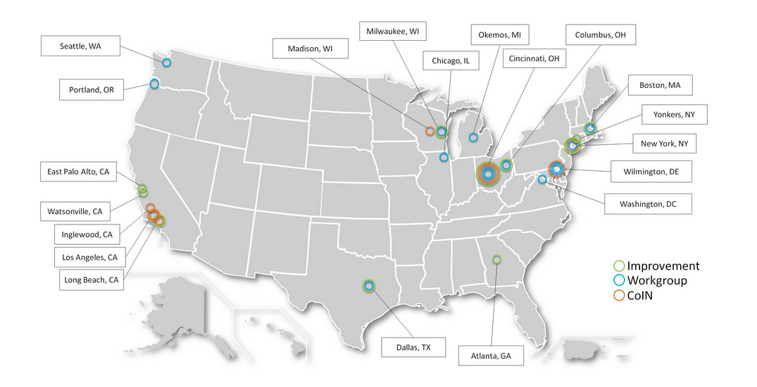
Moving Health Care Upstream www.movinghealthcareupstream.org
The Innovation Network is the tier focused on creating.
The Improvement Network is the tier focused on testing.
The Inspiration Network is the tier focused on disseminating.
Notes:
The Innovation Network is the tier focused on creating. Within the Innovation Network multiple Collaborative Innovation Networks (CoINs) are formed, each with its own topic. CoINs are formal networks that convene self-motivated leaders and change catalysts, who work together to create and test early versions of strategies to address the upstream determinants of health. CoIN members are provided with technical support and coaching from MHCU staff and faculty. Early stage prototypes developed in the Innovation Network are refined and tested more broadly in the Improvement Network.
The Improvement Network is the tier focused on testing. The Improvement Network is a formal network whose members agree to test strategies developed in the Innovation Network and share data with MHCU to further refine strategies. This active network of learners receives technical support and coaching from MHCU staff and faculty. Strategies that seem promising and ready for broad testing and adoption in the field are shared via MHCU’s Inspiration Network.
The Inspiration Network is the tier focused on disseminating. The Inspiration Network is an informal network of health care providers and other stakeholders interested in learning about, adapting and adopting promising population health strategies that work to address the upstream determinants of health. Inspiration Network members are those who participate in the MHCU website and/or follow MHCU on social media platforms, engaging with others in virtual learning and sharing.

Slide 5
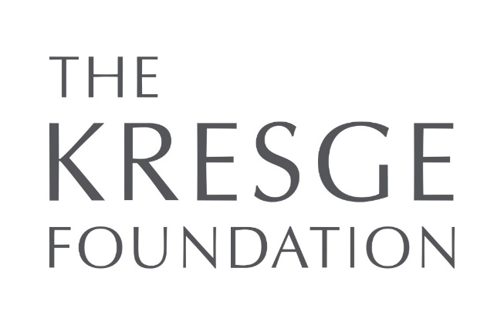


Policy Learning Lab Funders and Partners
Notes:
Also remember to thank the experts and our community partners willing to engage in this experiment with us

Slide 6
Moving Health Care Upstream: 2017 Policy Learning Labs
Goal: To accelerate the spread of best practice local and institutional policies that target upstream determinants of health in an effort to improve community-wide health indicators
17 communities focused on asthma and food insecurity
Happy medium between collaboratives and webinars
Identify and Define the Problem
Envision and Plan for Success
Review and Select the Policy
Develop and Adopt the Policy
Implement and Evaluate the Policy
Engage Key Players

Slide 7

Policy Development isn’t a sprint.

Slide 8

It’s a marathon…

Slide 9

…or possibly a Tough Mudder…

Slide 10
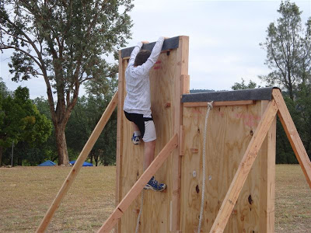
…with obstacles on the course.

Slide 11

How Do Policy Learning Labs Help?
Our focus isn’t the finish line off in the future. It’s on supporting teams in getting beyond obstacles slowing their progress in the here and now and giving them resources for the remainder of the journey.

Slide 12
Goal & Objectives
Ultimately, we hope that Policy Learning Labs will accelerate the spread of best practice local and institutional policies that target upstream determinants of health.
As measured by….
Increased understanding of the stages of upstream policy development;
Increased knowledge of resources to inform their work in each stage of upstream policy development;
Increased skills for identifying appropriate policy strategies for their community and creating associated policy tools;

Slide 13
Goal & Objectives (continued)
Increased connection to academic and on-the-ground experts who can inform and support their work;
Having the capacity to successfully complete their remaining stages of upstream policy development after the Learning Lab ends; and
Belief that participating in a Policy Learning Lab has informed and accelerated their work in a more efficient manner than would have been possible if they’d been working independently on identifying appropriate policy strategies for their community and creating associated policy tools.

Slide 14
Core Elements of Policy Learning Labs
Network of Peers
Group Meetings
Information sharing, presentations on topics of interest across teams
Custom TA and Consultation
Connection to a others engaged in similar work for peer-to-peer learning
“Deep dive” of consultation and targeted research on behalf of teams
Access to National Experts
“Quick hits” of consultation, linkages, and resources
Ongoing contact
As-needed contact

Slide 15
How Were Teams Selected?
Application process following an introductory webinar
Significant interest with more than 600 registrants for asthma webinar and 900 registrants for food insecurity webinar
Each team included a health care organization plus an entity from at least one other sector
Preference was given to teams that include a hospital, health system or community health center as the health care partner
Already completed preliminary planning and needs assessments
Wanted to focus on local, regional and/or state policy
Teams were ready for action
Teams were prepared for active participation in the learning labs
Notes:
Each team includes a health care organization plus an entity from at least one other sector (e.g., public health, education, social service, government). Preference was given to teams that include a hospital, health system or community health center as the health care partner. Beyond this, there were no preferences for team composition (number of members per team, sectors represented, etc.).
Our criteria also included the following:
~ Teams have already completed preliminary planning and needs assessments and have a definite interest in addressing social determinants (aka root causes) of asthma on a community-wide scale via organizational or public policy strategies. (Note: In the public policy realm the focus will be on local, regional and/or state policy. Federal policy is beyond the scope of this learning lab.)
~ Teams are ready for action! Work within this Policy Learning Lab will be based on ChangeLab Solutions' five step policy development process, with a focus on providing expert and consult related to Step #2 (Strategize Solutions) and Step #3 (Create Tools). Teams selected for participation were ready for action in these two areas.
~ Teams are prepared for active participation- maximizing the opportunity by taking part in all three virtual meetings, and by leveraging the experience and expertise of learning lab members, staff from ChangeLab Solutions and Moving Health Care Upstream, and other experts from around the country, both during and between virtual meetings.

Slide 16
Policy Learning Lab Topics
Root Causes of Asthma
Washington, DC
Grand Rapids, MI
Orlando, FL
Chicago, IL
Watsonville, CA
Food Insecurity
Denver Metro Region, CO
Atlanta, GA
Atlanta Metro Region, GA
New Orleans, LA
Harris County, TX
Tarrant County, TX
Anchorage, AK & surrounding rural counties
Los Angeles, CA
San Diego County, CA
Central Louisiana (10 rural parishes)
Blackfeet Reservation, MT
Seattle, WA
Notes:
ADD

Slide 17
Role of Teams: Define the Hurdles
“Our finish line is _______________, and the hurdles in the here and now are ___________________.
Having ___________________would really help us get over the next hurdle.”
Sample organizational procurement policies for private employers that promotes local purchasing of healthy food.
Models and case studies for use of code enforcement to promote health.
Sample messaging and data points used to sway key players toward your desired policy strategy
Notes:
Not $ or staff

Slide 18
Project Plan
Three PLL convenings:
Policy Level Setting
“The how” of Policy Development
TBD- based on most common topics raised by teams
Self-directed action periods between meetings
ChangeLab Solutions &/or MHCU
Subject matter experts
Peer-to-peer
Sub-groups
Internal work
Notes:
ADD

Slide 19
Value of Participation
Post participation interviews with 12 of 17 participating teams
100% responded that participating in this network has informed & accelerated their work
Major themes of value
Filled a gap
Catalyzed commitment and action
Created/cemented connections
Increased knowledge and skills
Provided stature
Notes:
100% felt that participating in this network has informed and accelerated your work in a more efficient manner than would have been possible if you’d been working independently on identifying appropriate policy strategies for your community and creating associated policy tools
Filled a gap- time, expense, know-how, time to conduct their own policy research and policy analysis; cost to pay someone to conduct policy research and policy analysis; staff does not have the capacity to conduct policy research and policy analysis at this level of quality and depth
Catalyst- being part of a formal group kept us accountable to dedicate the time; motivated us; catalyst for increased coordination and setting of priorities
Connections to / learning from- others on-the-ground; experts with broad national lens
Increased knowledge & skill- sample policies, prioritization, communication, data sets, etc.
Stature- our acceptance into a competitive national initiative increased our status in the eyes of leaders in our organization, which increased their buy-in, thus accelerating our work

Slide 20
Addressing Food Insecurity: A hospital and community effort
Children’s Healthcare of Atlanta
Notes:
Thank you so much for the opportunity to present today. We are excited to share a bit about our institutional policy work to impact food insecurity, and how our participation in the Moving Healthcare Upstream learning collaborative has helped us achieve our goals to date.
Today’s presentation will weave together the launch of a pilot program designed to help food insecure families access needed resources in the community with the ways in which participation in the Moving Healthcare Upstream learning collaborative helped guide and accelerate this project.

Slide 21
Defining the hurdles
“Our finish line is system-wide adoption of an institutional policy addressing food insecurity.
The hurdles in the here and now are assessing the problem, overcoming objection, addressing the implications, helping with the problem, demonstrating success, and obtaining leadership buy-in.
Having technical assistance, connections, focus, and credibility would really help us get over the next hurdle.”
Notes:
To set the tone for today’s presentation, I must first point to the framework posed by the learning collaborative. Using this framework, we set out to define success, to identify anticipated hurdles, and identify areas in which we knew we’d need support.
From that, we identified system-wide adoption of an institutional policy addressing framework to be our ultimate end-goal, or rather our “marathon”.

Slide 22
5-step policy development process
Identify and Define the Problem
Envision and Plan for Success
Review and Select the Policy
Develop and Adopt the Policy
Implement and Evaluate the Policy
Notes:
The 5-step policy development process framework served as a guide and an accelerant as we worked through the various stages of our project. Throughout my presentation, I will reference the steps outlined in this process.

Slide 23
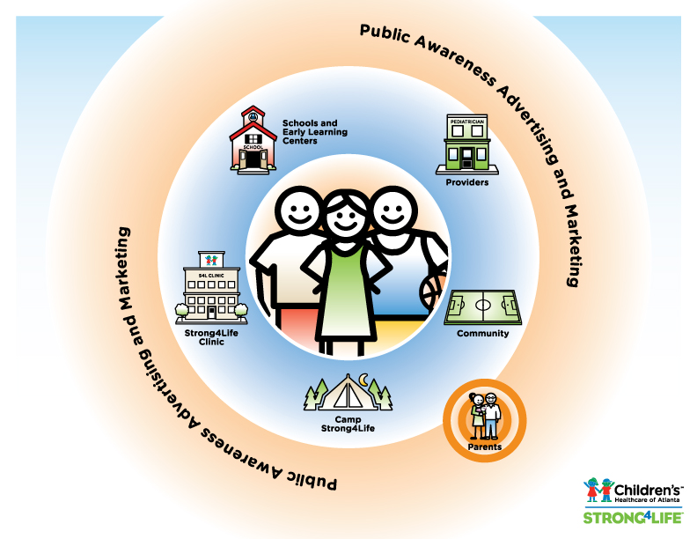
Notes:
But before we talk about our project, it’s probably helpful to provide participants with a brief overview of Children’s Healthcare of Atlanta and the Strong4Life movement.
In 2011, Children’s launched the Strong4Life movement, which is designed to improve the health and well-being of Georgia’s children. Our focus is on reducing the prevalence of childhood obesity through prevention and treatment initiatives for kids and the people who influence their lives. Strong4Life aims to leverage Children’s clinical and nutrition expertise, and thought leadership with other organizations who are joining in the fight against childhood obesity. Strong4Life impacts kids and families through programs and community partnerships designed to deliver consistent messages and support that bring about sustainable lifestyle change.
The Strong4Life approach addresses key influencers and environments where our kids live, learn and play. Our primary target audiences include:
Parents, who enforce healthy messages and habits at home
Healthcare providers, who are perceived as the primary source for healthcare information
Schools, where children spend much of their day
Kids in greatest need of clinical intervention and treatment
It is that last group – kids in greatest need of clinical intervention and treatment – with whom we decided to pilot our food insecurity screening and referral program, starting with the patients seen in the Strong4Life Clinic.

Slide 24

Strong4Life Clinic
S4L CLINIC
Notes:
The Strong4Life Clinic is an evidence-based medical weight management program. The model is family-based and utilizes a behavior-focused approach to provide resources and support to meet families where they are. The Clinic serves families primarily from the Metro Atlanta area, but also sees patients from other Georgia counties as well as other states. To date, the program has seen nearly 3,000 patients.
Eligibility:
BMI >85th percentile with a weight-related comorbidity
BMI >95th percentile without a weight-related comorbidity
Interdisciplinary team:
Medical provider(s)
Nutritionist
Exercise Specialis
Psychologist

Slide 25
Strong4Life Clinic
Notes:
And we’ve seen great success. 80% of patients who stay with the program stabilize or decrease their BMI.
But… our retention rate is only 50%. And we couldn’t seem to improve it, not for a lack of trying.
So we needed to try a new approach.

Slide 26
#1: Identify and define the problem
Consulted families
Improved practices
Considered what we were still missing
Notes:
In an effort to improve retention, we:
Asked:
-Surveyed families who didn’t return to Clinic
-Asked current patients about barriers, needs
Changed:
-Appointment times
-Appointment days
-Curriculum
-Parking
But still, this wasn’t enough. So then we asked ourselves: What are we still missing? The answer was that we were not addressing social determinants of health. We know that upstream determinants of health affect communities where kids live, learn and play – exactly what we are focused on through the Strong4Life initiative. However, though our work focuses on prevention and treatment initiatives and more specifically attempts to influence these environments, it does so in a very broad manner. The Clinic, however, gives us the opportunity to address these factors on an individual level.
We decided to start with household food security. That was the problem we sought to address.

Slide 27
Food insecurity
“Access to adequate food (being) limited by a lack of money or other resources” (USDA)
Food Insecurity
Time
Reference needed
Notes:
Food insecurity if defined by the USDA as “access to adequate food being limited by a lack of money or other resources”.
Food insecurity is waxing and waning, which means families may be periodically food insecure.
Food insecurity is associated with:
Hospitalizations
Poor health status
Underweight, overweight and obesity
Iron deficiency
Developmental delay
Academic underperformance
Behavioral problems
Mental illness (including anxiety, depression and suicidal thoughts)
Childhood malnutrition, which can lead to adulthood diseases
It seemed logical that we’d address food insecurity, given our clinical focus on childhood obesity and associated comorbid conditions.
We knew we needed to address food insecurity within our own walls to lend support and validation to our community based efforts.

Slide 28
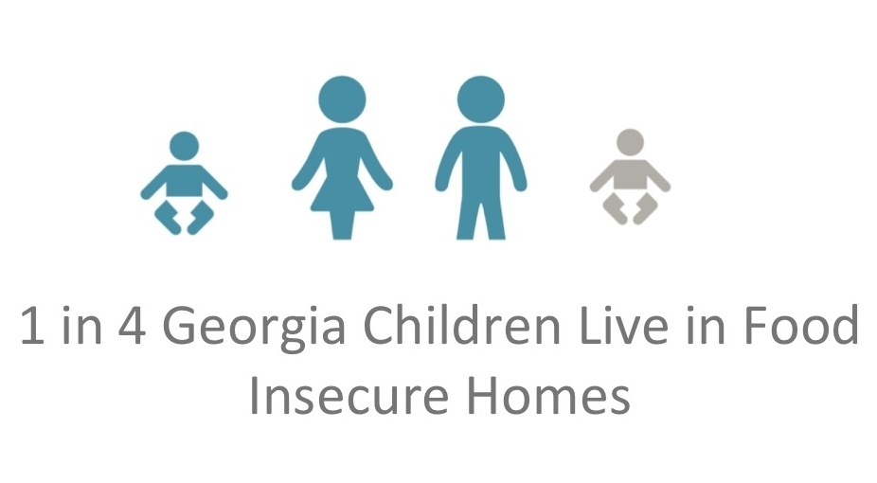
Childhood hunger in Georgia
Notes:
So let’s take a broad look at childhood hunger in Georgia.
In 2014, 1 in 4 children in Georgia lived in food-insecure households, higher than the national statistics of 1 in 6 children.

Slide 29
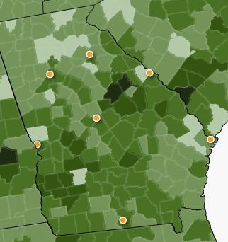
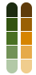
Childhood hunger and obesity
Estimated Prevalence of Overweight and Obesity
Food Insecurity Rates
Highest Risks
30% and above
25% - 29%
20% - 24%
15% - 19%
Lowest Risks
4% - 14%
FeedingAmerica.org
Notes:
While obesity is Strong4Life’s primary focus, there is a direct correlation between obesity and food insecurity in many Georgia communities.
Prevalence maps for Georgia show that counties with the highest rates of food insecurity also have the highest rates of childhood obesity.
While our work began in obesity and health behaviors, it was apparent that without adequate healthy food, our families would not be successful. Given the prevalence of food insecurity in the state, as well as the possible health consequences, we knew we needed to do something to address food insecurity as a pediatric healthcare system. Additionally, there is an urgent need for healthcare systems nationally to play a role in addressing social determinants of health. Therefore, we knew this was the right time to embark on something of this significance.

Slide 30
#2: Envision and plan for success
Assessing the Problem
Assessing the Solution
Is this a problem for families seen at the Clinic?
How have other systems addressed food insecurity?
Is this a problem for families seen by Children’s?
What does the research say?
What are the clinical recommendations?
Notes:
With the decision to address food insecurity made, we set out to assess the problem, envision potential solutions, and plan for success.
Through the pilot, we are assessing to what degree food insecurity is a problem for Clinic patients. As we expand the pilot to other areas of the system, we expect we will have a better sense of the prevalence rate throughout the system.
To explore potential solutions, we turned to other healthcare institutions to gauge their response to food insecurity, including Colorado Children’s Hospital and Kaiser Colorado. Our participation in Moving Healthcare Upstream helped us connect with many other healthcare systems, community-based partners and resources.
We also turned to the literature: American Academy of Pediatrics, Food Research and Action Center, Feeding America, Center for Health Law and Policy Innovation at Harvard Law School, Robert Wood Johnson Foundation, and others.
And we looked at the clinical recommendations regarding screening for food insecurity in healthcare settings (next slide).

Slide 31
Food insecurity and healthcare
American Academy of Pediatrics, 2015
Screen all patients at scheduled health maintenance visits
Screen with validated 2-question tool*
Facilitate referral of families to community resources
American Diabetes Association, 2017
Assess patients for food insecurity
Apply information to treatment decisions
Refer patients to community resources
Feeding America, 2017
Screen every patient at every visit
Provide referrals to community resources
Involve case managers or skilled outreach workers
Notes:
Healthcare systems are starting to be recognized as one venue where food-insecure families can be identified and connected to appropriate resources. Professional organizations, like the American Academy of Pediatrics, have made clinical recommendations regarding screening for food insecurity in healthcare settings. The AAP recommends that pediatricians use the Hunger Vita Sign to screen for food insecurity in practice (see next slide).
American Academy of Pediatrics, 2015
Screen all patients at scheduled health maintenance visits
Screen with validated 2-question tool*
Facilitate referral of families to community resources
American Diabetes Association, 2017
Assess patients for food insecurity
Apply information to treatment decisions
Refer patients to community resources
Feeding America, 2017
Screen every patient at every visit
Provide referrals to community resources
Involve case managers or skilled outreach workers

Slide 32
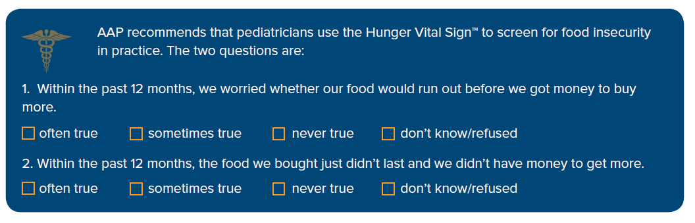
Hunger Vital Sign
Notes:
In our community work and our own clinic we have chosen to use the validated assessment questions recommended by the APP, also know as the hunger vital signs.
Households are at risk for food insecurity if the response is “often true” or “ sometimes true” to either or both questions.
A family may still be in need and qualify for assistance even if the response is “never true”.

Slide 33
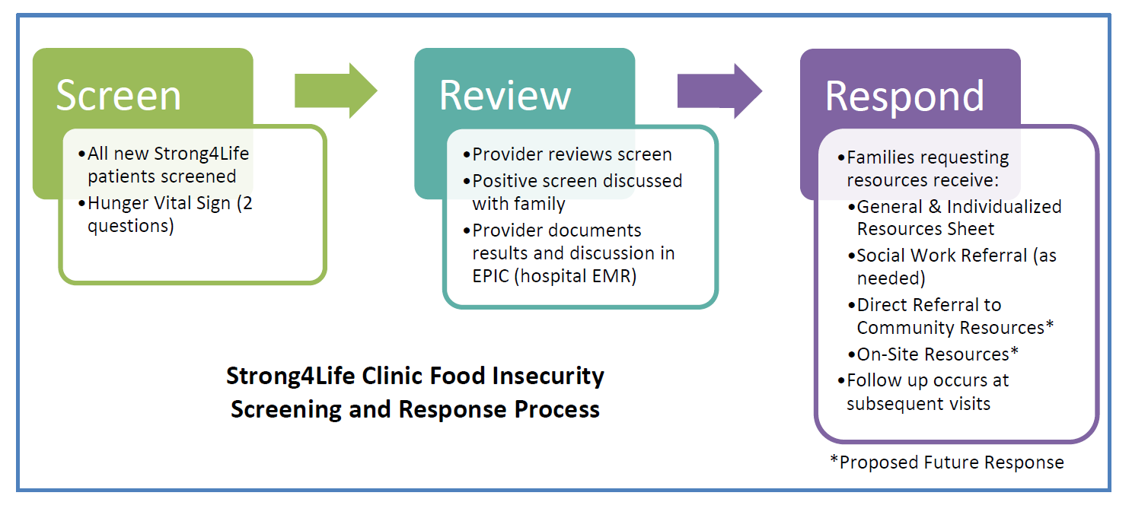
#3: Review and select the policy
Notes:
We knew that, in order to get leadership support, we would have to demonstrate a need for this project, as well as identify the steps we would take to address the problem.
We developed this 3 step patient screening and response process (or “policy”) to begin testing.
We screened all NEW patients using the Hunger Vital Sign
We reviewed screen results with patients and documented results in EPIC (our hospital EMR system)
We then provided families with general and individualized resource sheets, referrals to community resources, and social work referrals (as needed)
We knew this outlined process was not ideal but we had to start somewhere. We were willing to try and learn.
In phase I, we encountered numerous barriers. But this process allowed us to collect data on the prevalence of food insecurity among our Clinic patient population. With this, we were ready to make the case to leadership.

Slide 34

Making the case
Notes:
With prevalence data in hand, we decided to approach leadership to get the blessing to proceed.
We started by meeting with medical leadership to educate them on:
Food insecurity and its impact on the health of children
Screening recommendations
Implications of food insecurity screening in the healthcare setting
The Screen/Review/Respond process
Our proposed next steps
We developed a Policy Brief detailing the above topics, which we shared with leadership and which is available upon request.
At that meeting, we were able to obtain support to continue with the pilot, but there were still significant hurdles to overcome.

Slide 35

Implications of screening
Medical liability
Abuse and neglect
HIPAA
Notes:
Some of the biggest concerns voiced in discussions with leadership (and others) were related to medical liability, concern for abuse and neglect, and HIPAA considerations.
Medical Liability
Medical liability is typically grounded in standards of care and clinical guidelines; but there is currently no established standard of care for food insecurity. Current clinical recommendations are to screen and refer to community resources. The standards and recommendations are evolving as work in this area continues.
There are only a few social conditions that have legal implications for healthcare providers (examples include abuse and neglect, suicidality, homicidality). Additionally, risk factor screening may have different implications than do disease sign and symptom screening.
Abuse and Neglect: One of the biggest areas of concern was related to reporting instances of abuse and neglect in relationship to a positive screen for food insecurity. As you know, healthcare providers are obligate reporters of suspected child abuse and neglect. Accordingly, prior to moving forward with this pilot, we sought advice from Children’s legal counsel. In short, we learned the following:
Food insecurity screening is NOT a medical screening and should not be treated as such. Accordingly, it is critical to label the FI screen appropriately so as not to create any confusion. For example, the screen can be labeled a questionnaire.
While we feel morally obligated to help a family obtain needed services, we are not legally obligated to make sure that a family avails themselves of those resources. Our responsibility, within the scope of this project, is to clearly explain (to the families), the steps we will take to facilitate a relationship with the Food Bank. The family is responsible for managing that relationship once the referral has been made.
We are obligated to report a parent for neglect if there is evidence of neglect, regardless of their response to the food insecurity screener. If someone declines assistance, that is not necessarily evidence of neglect. Providers should continue to use their judgment to meet reporting obligations like they would in any other situation.
It is not our legal responsibility to make sure that the resources provided by our partner (the Food Bank) are sufficient. However, this is where it is very important to choose effective partnerships, which I will discuss in a later slide.
HIPAA
Having patients complete written disclosure requests or authorizations is a straightforward way to covered entities to share patient information with food banks in a manner consistent with HIPAA requirements.
To obtain patient authorization or written permission to disclose PHI, covered entities can have patients complete forms when they 1) check in for a visit, 2) meet with the doctor or another provider, or 3) make their next appointment
When a patient makes a disclosure request or completes a valid written authorization for a covered entity to share information with a food bank, the covered entity does not need any type of agreement with the food bank in order to share the patient’s information. In our case, we have elected to enter into a formal agreement (MOU) with the Atlanta Community Food Bank, in an effort to clearly define the roles and responsibilities of each partner. This type of partnership requires planning.
Of course, for any system wanting to take on their own food insecurity project, I would advise you to consult with your organization’s legal counsel. This situations I just discussed should not be construed as legal advice.

Slide 36
#4: Develop and adopt the policy
Refined existing tools
Created new tools
Addressed concerns
Engaged competent community partner
Integrated into EMR
Sought targeted research from the MHCU learning collaborative
Formally launched pilot
Notes:
Once we’d gotten support from physician leadership, and understood the legal concerns, we decided to better develop our policy and put it into motion.
In an effort to move beyond the “cold” referral, we decided to address certain aspects of our pilot to ensure it’s early success.
First, we refined existing tools, including the policy brief and the S/R/R/ process based on early feedback and lessons learned from the Phase I pilot. Then, we created new tools, including a process map, referral form, Authorization, and protocol
Next, we sought advice from our legal counsel regarding the concerns around medical liability, abuse and neglect, and HIPAA.
We engaged the Atlanta Community Food Bank to work with us and our families.
We integrated the referral into EPIC (EMR).
We sought targeted research from MHCU, which will be critical to future efforts to expand the program.
We formally launched the pilot in August, 2017.

Slide 37

Partnerships
Benefits Counselors offer assistance for numerous supports and services:
Federal nutrition programs
Local food pantries
Medicaid, Medicare
Notes:
In order to provide direct referral to community resources (or the “warm” hand-off), it was imperative that we develop a relationship with a strong community partner who had the ability and capacity to respond.
Accordingly, Strong4Life engaged the Atlanta Community Food Bank in the early implementation stages of the pilot. We are very fortunate that this local resource already provides significant support and resources to the Atlanta community and has relationships throughout the state via the Georgia Food Bank Association. Additionally, ACFB has in place, a strong data management reporting system, which will help us track efficacy and demonstrate results to leadership.
The Atlanta Community Food Bank has Benefits Counselors on staff, who are able to help families apply for a number of supports and services, including: food stamps, Medicaid, Medicare, WIC, TANF, child care assistance, and benefits check up. They are also able to refer families to food pantries and summer feeding sites.

Slide 38
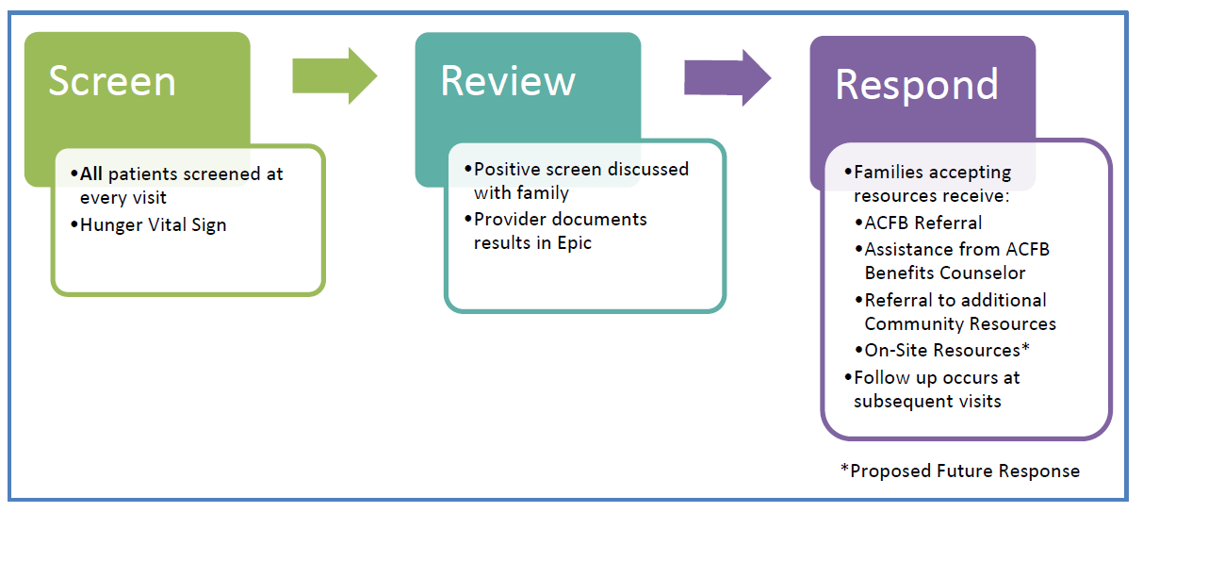
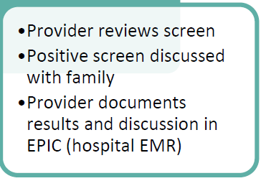
#5: Implement and evaluate the policy
Notes:
Next, we launched Phase II of our pilot, which looks similar to Phase I, but with some very important distinctions. We identified the need to screen all patients at every visit (given the waxing and waning nature of food insecurity), to integrate the referral into our EMR, and to provide a “warm” hand-off, which has been demonstrated to be more effective.

Slide 39
Preliminary results
34 families were referred between August – December, 2017.
Of those, 25 families (74%) were successfully contacted.
All 25 families (100%) were connected with benefits and/or food assistance.
Notes:
Families were generally interested in either SNAP or food pantry assistance, but rarely both.

Slide 40
Patient feedback
“The food bank called me when I was in the parking lot at our last visit.”
“They were so helpful and gave me resources.”
“My mom is happy that the person spoke Spanish.”
“I never heard from them.”
“There weren’t any resources in my area.”
“I don’t want to be referred..”

Slide 41
Lessons learned
Screen patients universally
Standardize screening at intake
Auto-fax referrals through EMR
Use a validated tool
Train staff to administer HVS tool
Build a strong partnership between medical care and community-based resources
Develop materials in (at least) English and Spanish
Seek to employ cultural competency in written and verbal communication
Develop strategies to “sell” this approach up the chain of leadership
Collect data and success stories
Engage physician leadership
Expect barriers
Have a quality improvement mindset
Participate in collaborative learning/engage strong learning partners
Notes:
Engage physician leaders, connect the cause to your mission. For us you cannot work to help families overcome obesity and eat healthy if they cannot afford food in general.
Engage community partners that can support your work. If you aren’t working with your local food bank, find them! They are a wealth of knowledge and information in this arena and have the resources for families who are weary of federal nutrition programs.
Expect barriers, seek out information from other institutions who have already addressed them and work to break through misinformation.
Operation with a quality improvement mindset.
Test your theories in small numbers before broad implementation. Talk to families and seek their input. Adjust your processes as you learn.
Participate in collaborative learning opportunities – in an effort to learn from others and share your work
Interaction with patients requires training. How families respond often depends on the personalities and sensitivities of the patients and providers involved.

Slide 42
Moving Healthcare Upstream
Connections
Technical
Assistance
Focus
Credibility
Notes:
Among the lessons learned was the need to participate in collaborative learning, or to at least engage a strong learning partner.
Participation in the Moving Healthcare Upstream Learning Collaborative was vital to the success of our pilot project. While we were fortunate to get approval for this project from physician leadership, we are still working hard to sell this project to other parts of the organization.
The group we have working on this pilot project is very dedicated to it’s success, but is also very small. At this time, we do not have resources (staff, money or otherwise) allocated to the project. Moving Healthcare Upstream provided us with support we otherwise would not have had:
Connections: Through our participation in the learning collaborative, we were able to connect with other healthcare systems and community partners who are working to address food insecurity. Through webinars and conference calls, we were able to learn from others as well as share our successes and lessons along the way. We’ve continued a relationship with Atlanta-area community partners working to address food insecurity on the community-level.
Technical assistance: We were fortunate to have a CDC Fellow on board when we first conceived of this project. She was able to conduct a literature review that helped us make our case via the policy brief and connected us with other systems, who were very generous in sharing resources, particularly Colorado Children’s process map. Outside of that, we simply did not have the manpower available to research a variety of other related topics, which will be critical to our argument to expand beyond the Strong4Life Clinic. The Moving Healthcare Upstream team provided us with a very thorough memorandum of resources outlining strategies for which we’d asked for assistance, including communication and messaging to sell this approach up the chain of leadership and to improve our messaging beyond the moral argument. They very clearly understood our initiative, including our struggles, and were able to customize resources to assist us in furthering our objectives. Additionally, they were able to provide information on the work and outcomes of other systems, including financial benefits available to systems that implement this type of intervention, what competitors in the healthcare space are doing to address food insecurity, and identifying outcomes for other similar programs.
Focus: As I mentioned, the staff we have working on this is very small. Many of us are clinical providers who see patients on a full-time basis. Our support staff also work on a variety of other projects. Because of this, we could have easily implemented the screen/review/respond process, but let go of other important aspects of the project, such as relationship-management, data/evaluation, grant seeking/writing, and progress reporting. Participation in the collaborative forced us to stay on top of many of the administrative tasks that have proven to be critical to the success of the project.
Credibility: Participation in this collaborative lent a tremendous amount of credibility to our project, in a variety of different ways. First, we were able to involve our community partner (the Atlanta Community Food Bank) in the collaborative, which kept them highly engaged and motivated to continue in this pilot. It also provided them with resources they might not otherwise have at their disposal. Second, we were honored to be invited to present our project on a national stage through a webinar focused on realistic, innovative local and institutional policy strategies that hospitals can use to address the root causes of food insecurity. Our participation in that event sparked interest in our initiative among hospital leadership as well as potential funders.
In short, we would not be as far along as we are in the process were it not for the technical assistance, support and connections afforded to us through this partnership.

Slide 43
What’s missing?
Institutional policy
Training and use of tool
Asset mapping
Education
Outcomes
Resources
Coding
Notes:
Training and use of tool: How are we asking the questions? Do our questions assess access to fresh produce? Does the tool lack sensitivity? In a recent study published in the American Journal of Public Health, researchers found that in an urban population with a high prevalence of food insecurity, the HVS-adapted tool recommended by the AAP lacked sensitivity, failing to detect more than a quarter of individuals with food insecurity. (Reference: Makelarski JA et al. Diagnostic accuracy of two food insecurity screeners recommended for use in health care settings. Am J Public Health. 2017.
Asset mapping: collect a robust database of Georgia food pantries. Determine eligibility and documentation requirements, particularly related to undocumented families.
Education – system wide education on the prevalence of food insecurity and available resources
Outcomes: Consider evaluating outcomes related to the screening/intervention process (BMI and other health outcomes, changes in food security status, changes in family risk, patient satisfaction).
Resources- seek funding for screening and intervention; on-site resources (food pantries, on-site WIC office, summer meals program, etc.)
Coding: The following diagnosis code can be used for positive screens: ICD-10-CM Diagnosis Code Z59.4 (lack of adequate food and safe drinking water). For the Hunger Vital Sign™, a patient screens positive for food insecurity if the response is “often true” or “sometimes true” to either or both of the statements. Depending on the situation, some providers may choose to use ICD-10-CM Diagnosis Code Z59.5 (extreme poverty).
Institutional policy – leadership buy-in for system-wide integration

Slide 44
Next steps
Demonstrate need
Reassess retention rates
Survey patients
Develop capacity
Expand
Demonstrate facility
Notes:
Demonstrate there is a need for this in other areas of the system. Demonstrate we are meeting the needs of our patients.
Reassess retention rate – did this make a difference in retention?
Survey patients – patient satisfaction, change in food security status, health outcomes
Develop capacity – at Children’s, at ACFB
Demonstrate ease and speed of screening to overcome objections related to capacity and insufficient resources.
Expand to other areas of the system

Slide 45

Resources
Addressing Food Insecurity: A toolkit for Pediatricians
www.frac.org/aaptoolkit
Food Research and Action Center (FRAC)
frac.org
Feeding America
Feedingamerica.org
Children’s Health Watch
childrenshealthwatch.org
Moving Healthcare Upstream
movinghealthcareupstream.org/
Notes:
This toolkit addresses all aspects of integrating and addressing food insecurity in your pediatric healthcare setting.
Includes list of all assistance programs with qualification criteria
Includes posters and pdfs that can be used as patient education materials in your office
Includes 10 advocacy steps that pediatricians can take to impact policy related to hunger and food insecurity.

Slide 46
Resulting Resources
Not just of value to those who participated
Compendium of research and TA memos
Full resource directory
Lessons learned (Q1 2018)
Root Causes of Asthma http://movinghealthcareupstream.org/innovations/using-local-institutional-policy-to-address-root-causes-of-asthma/meeting-materials-other-resources
Food Insecurity http://movinghealthcareupstream.org/innovations/using-local-institutional-policy-to-address-food-insecurity/meeting-materials-other-resources
Notes:
Pre-existing resources and tools that we curated for use by our teams
Resources and tools created by MHCU and ChangeLab Solutions for teams as part of this project
The compendium of research and technical assistance memos is a treasure trove of resources. It will be posted to the website in February but I don’t know if Front End will have it done in time for the conference. Maybe you could show the TA chart (and perhaps a sample memo?) so that the audience has a clear idea this resource. We can discuss.
Resources posted on the website are a sub-set of the total resources shared with the group. The full Resource Directory is saved as a PDF document on the website- it has clickable links to all of the resources. (Side note- Kiyah and I just finished updating the directory. I will be posting an updated version on the site this week. It would be worth sharing with the audience as well.)
We will be creating a Lessons Learned document related to the implementation model- which is likely of interest to our fellow conveners/facilitators who spend a lot of time trying to design models that low time burden on participants yet high impact on their work. Will be sharing this with the field in February on the website

Slide 47
Next Steps
Continue sharing lessons learned
Continued dissemination of resulting resources
Recruitment and implementation of second cohort of policy learning labs
Stay tuned for application announcement

Slide 48
Keeping In Touch
Social Media
@MHCUpstream
@ChangeLabWorks
@Nemours
Website
www.movinghealthcareupstream.org
Sign Up for MHCU Newsletter
Scroll to bottom at www.movinghealthcareupstream.org

Slide 49
Contact Us
Allison Gertel-Rosenberg, MS
Director, National Prevention and Practice
(302) 298-7602
agrosenb@nemours.org
Kate Blackburn
Manager, Practice and Prevention
(302) 298-7604
kate.blackburn@nemours.org
Stephanie Walsh, M.D.
Medical Director
(404) 785-6104
Stephanie.walsh@choa.org
Jenny Puestow, MSCM
Wellness Project Manager
(404) 785-7873
Jennifer.puestow@choa.org

