Slide 1
Prescription Safety Net Programs in Action-Outcomes and the Future
Communities Joined in Action 2018 Conference

Slide 2



Why Does Trinity Health Need a Safety Net Strategy for Prescriptions?
Facilitates sharing of information and availability of programs
Expands access to programs for our facilities
Makes free medication and prescription assistance programs more readily available to patients who need them
Notes:
You may be wondering why we have taken the time to put together a prescription safety net program when we operate in such a large geographic area? Many programs are available across our geographic area. In many cases, usage of these programs are based on a staff member knowing about the availability of the free or low cost medications. The Trinity Health prescription safety net programs allows all locations what programs are available in their regions. We have also started automating a few of these processes for Trinity prescribers and staff.

Slide 3

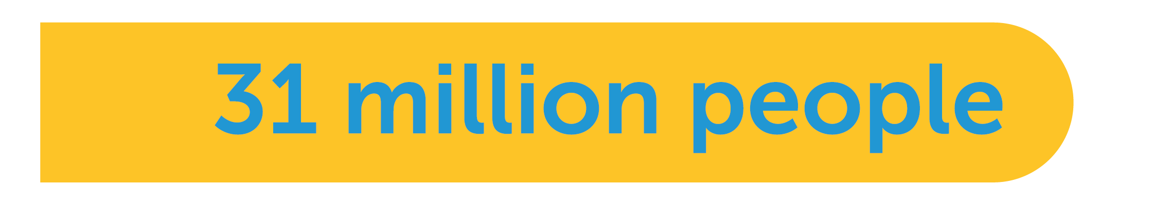
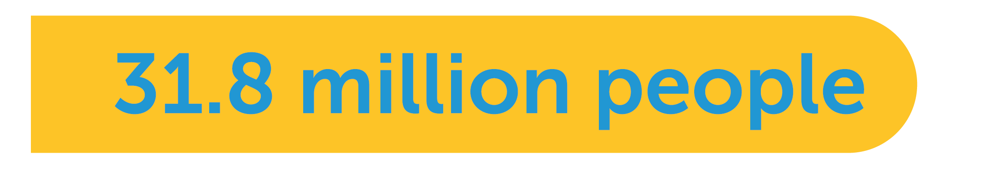
Large Base of Uninsured & Underinsured
(25% of the workforce) are underinsured
have no health insurance
The Henry J. Kaiser Family Foundation
Notes:
The need for prescription assistance –no cost and reduced cost medications is growing. 25% of the workforce is underinsured-this means they have a co-pay of $2,000 or more. 35 Million patients did not a prescription in 2014 due to cost. 19% of Medicare beneficiares enter the donut hole but only 3% come out.

Slide 4



Need for Prescription Assistance is Growing
High Costs of Meds Impacts Compliance
did not fill a needed prescription in 2014 because of cost
reported taking potentially dangerous steps to curb high medication costs
The Commonwealth Fund, Consumer Reports
Notes:
The need for prescription assistance –no cost and reduced cost medications is growing. 25% of the workforce is underinsured-this means they have a co-pay of $2,000 or more. 35 Million patients did not a prescription in 2014 due to cost. 19% of Medicare beneficiares enter the donut hole but only 3% come out.

Slide 5

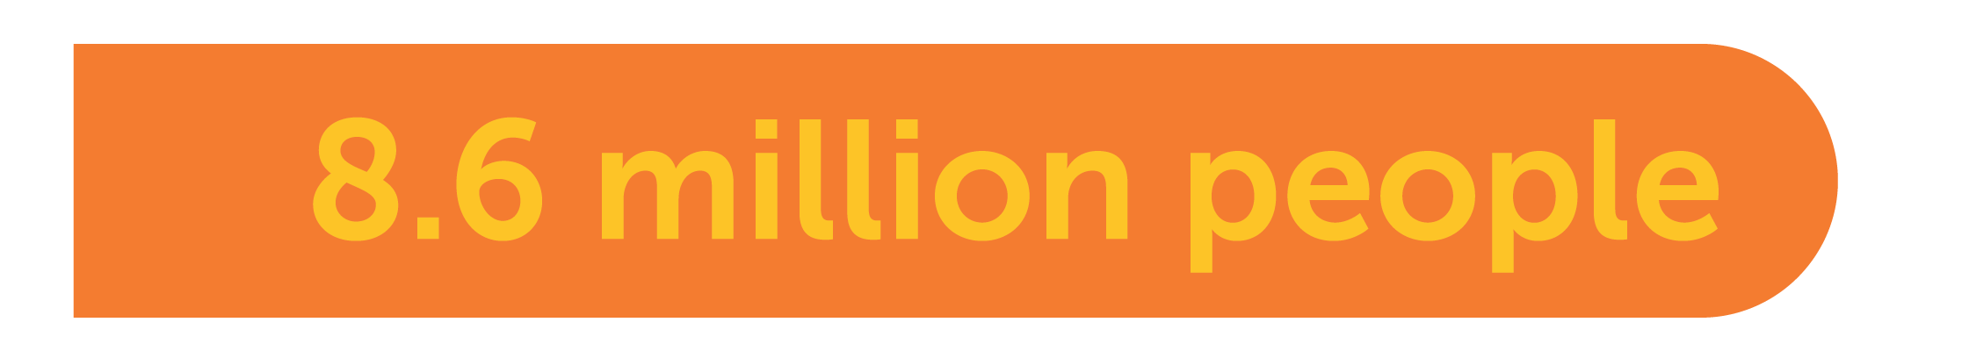
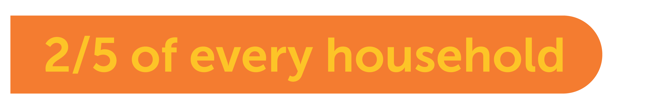
Need for Prescription Assistance is Growing
Growing Underinsured Population
purchased insurance with a high deductible from an Exchange
cannot afford their mid-level deductible
The Henry J. Kaiser Family Foundation
Notes:
The need for prescription assistance –no cost and reduced cost medications is growing. 25% of the workforce is underinsured-this means they have a co-pay of $2,000 or more. 35 Million patients did not a prescription in 2014 due to cost. 19% of Medicare beneficiares enter the donut hole but only 3% come out.

Slide 6

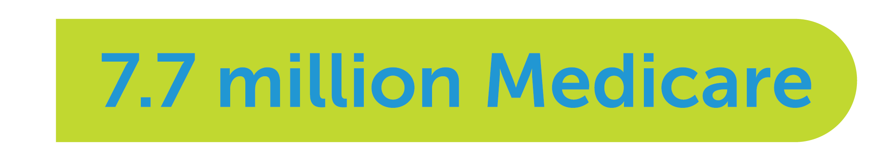
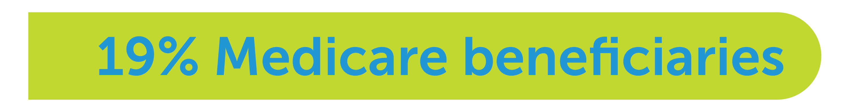
Need for Prescription Assistance is Growing
Medicare Doesn’t Meet Patient Drug Needs
eligible beneficiaries have no drug plan
enter the donut hole but only 3% come out
The Henry J. Kaiser Family Foundation
Notes:
The need for prescription assistance –no cost and reduced cost medications is growing. 25% of the workforce is underinsured-this means they have a co-pay of $2,000 or more. 35 Million patients did not a prescription in 2014 due to cost. 19% of Medicare beneficiares enter the donut hole but only 3% come out.

Slide 7
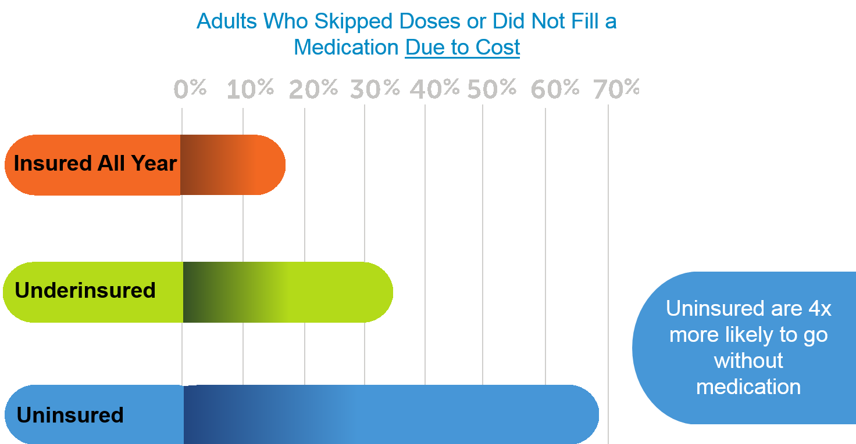
Adults miss doses due to COST
Insured
Under Insured
Not Insured

Slide 8
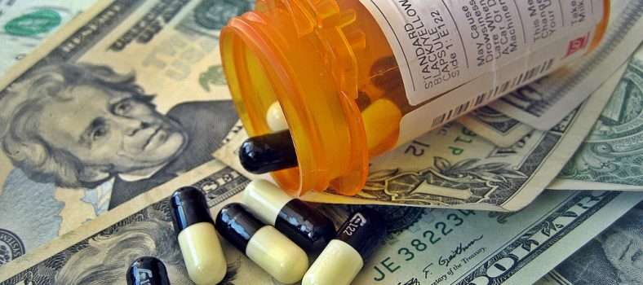
3-10% of overall health care spending Medication non-adherence in the U.S. accounts for
Notes:
Medication non-adherence in the U.S. accounts for $100 - $300 billion of annual avoidable health care costs or three to ten percent of overall health care spending.*
* Iuga, A.O., & McGuire, M.J. (2014). Adherence and health care costs. Risk Management and Healthcare Policy, 7, 35-44. http://doi.org/10.2147/RMHP.S19801

Slide 9
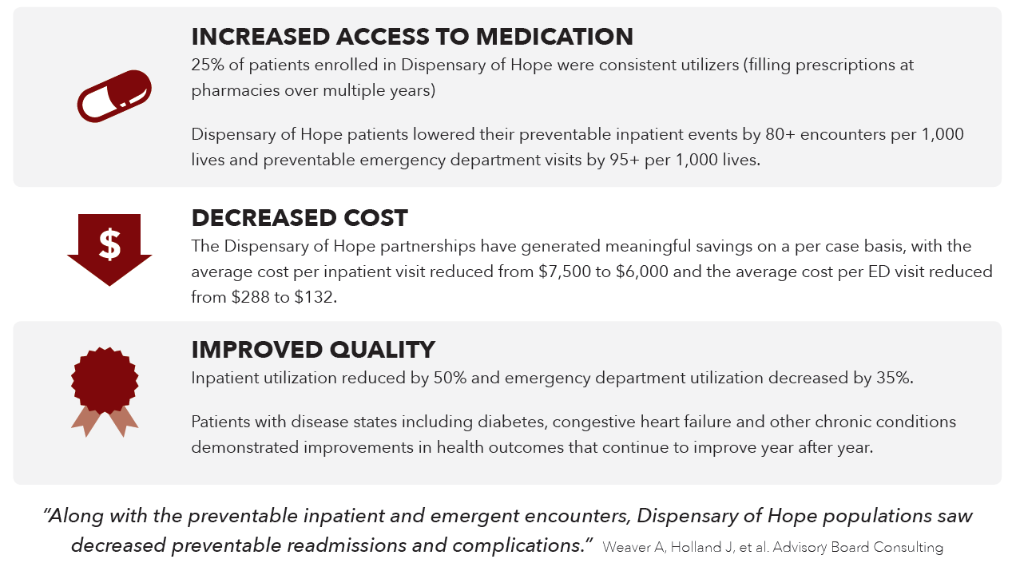
Decreasing Preventable Readmissions and Complications A Study by Dispensary of Hope
Notes:
In collaboration with the Dispensary of Hope and Saint Thomas Health, the Advisory Board Company studied 2.5 years of data, including: facility billing encounter detail, cost accounting and pharmacy utilization (including Dispensary of Hope patient enrollment and prescription history).
Once aggregated, these data sets established a clear picture of patient enrollment periods, use of Dispensary of Hope services and use of hospital services. Three primary analyses were considered: Patient Pre and Post Enrollment, Patients by Enrollment Year and Consistent Pharmacy Utilizers.

Slide 10
Streamlining the Prescription Safety Net
Option
Description
Cost
Immediate/ In-Office
Uninsured and under 200-300% FPL
Samples,
Dispensary of Hope or AmeriCares
Free
2. Regional/ Local Price List
Is medication on $4/Free list?
Fill at local chain offering $4/Free list
$4/30 days
$9/90 days
Is there a 340B program?
Fill at outpatient/
contracted pharmacy
Significantly reduced prices
3. Federal Program
Notes:
Multi-faceted strategy that connects patients with their prescriptions for the lowest price and most convenient access.

Slide 11
Streamlining the Prescription Safety Net
Option
Description
Cost
4. Prescription Assistance Programs
Able to complete paperwork?
Apply for manufacturer prescription assistance program (PAP) and NeedyMeds
Free but not timely, use samples and FamilyWize Program until medications are provided
Manufacturer co-pay coupon available?
Reduces out of pocket spending
Brand name only, savings limits apply, compare to FamilyWize pricing
5. Co Pay Coupons
6. Automated in EMR
No Other Options, FamilyWize Program
Automated in EMR
Reduced price equal to what insurance company pays
Notes:
FamilyWize is partnering with us to provide all of this information in one place at the right time for the right person. From the $4 list to the Pharmacy Assistance Programs to the coupons and down to the pharmacy specific prices utilizing FamilyWize, it will all be in one place for our prescribers.

Slide 12




Who is FamilyWize?
Helping millions of people nationwide
United Way partner
More than 10 million patients served
More than $1 billion saved for patients
Innovation for healthcare organizations and patients
EMR integration allows FamilyWize information to be transmitted automatically to any pharmacy
Mobile app provides price lookup tool for patients
Notes:
Who is FamilyWize? We have been helping patients afford their prescription medications for over 10 years. What started as a small, local program grew out the need to reduce the cost of prescription medications for the uninsured. Ten years later, with high deductible plans becoming the norm, we are needed more than ever. FamilyWize is an important layer in your prescription assistance safety net program.

Slide 13
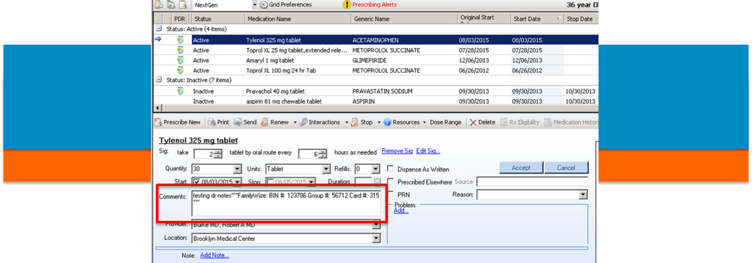
How Automation Helps
Program is completely automated.
Paper-based → electronic system
Assures patients are getting the lowest price
Moving with industry to electronic platform provides significant benefits to all parties
Notes:
FamilyWize has been assisting uninsured and underinsured patients for over 10 years. Originally, patients needed to remember to hand carry a document or card to obtain the FamilyWize discount. (Gen 1 image) Over the past year we have been able to automate this process-allowing the program information to automatically transmit with the prescription. As you can see in the image labeled Gen 2, the FamilyWize program information transmits in the comments section of the e-prescribed transmission. The program also attaches to the script if it is faxed or printed. This takes the burden off the patient –the pharmacist sees the patient is eligible for the FamilyWize program and applies the discount. In a case where the patient has both insurance and FamilyWize, the lower price is charged.

Slide 14
Over 1 MILLION DOLLARS saved!
 | Program to Date
Number of Patients | 33,120
Number of Scripts Filled | 41,528
Trinity Patient Savings | $1,294,192
% Savings | 44%
Notes:
Utilizing the EMRxcel integration in NextGen, we’ve saved over a Million dollars. Now that the Athena integration is live, we’re excited to see the results that will bring to our patients.

Slide 15

Automation is Key
Prescribers and patients benefit from automated prescription assistance programs
One source for all programs allows easy access to pricing options within the hospital/practice workflows
Patients receive program materials via multiple delivery systems - print, email via patient portal and text

Slide 16
Automation has Successfully Transformed the Use of the Savings Card
What’s Next ?
Pricing transparency at the point of prescribing empowers patients to price shop for their prescriptions with no additional steps
Automation of co-pay and manufacturers coupons that include all programs available
Automation of PAP program availability with current application forms

Slide 17
How Can a Health System Achieve Complete Automation of the Prescription Safety Net?
The One Source Portal
FamilyWize has partnered with Trinity Health and manufacturers to deliver an easy to use solution that includes all programs that are available to your patients
Screen Shot

Slide 18

Empowering Patients to Price Shop and Use Manufacturer's Programs
The One Source Portal will be available to consumers
Trinity Health wants to empower consumers to take control of their prescription costs
Allowing portal access and educating consumers to price shop in their zip code increases opportunity for savings

