Slide 1
Improving our FOCUS:
How Community Health Improvements Lead to Increased Hepatitis C Screenings and Further Linkage-to-Care
Communities Joined in Action
Erin Hultgren, MPH & Jennifer McCracken
February 16, 2018

Slide 2
Objectives
Understand Hepatitis C & the Scope of the Problem
Review Program Development & Collaboration
Share Experiences and Best Practices

Slide 3
Gaston Family Health Services
Mission
Gaston Family Health Services is a community sponsored, family-centered provider of health care, health education and preventive care services without regard to the ability to pay.
http://gfhs.info/
Notes:
GFHS is a community-sponsored, Family centered, Provider of health care, Health education and Preventive care services Without regard for the ability to pay.
We are not a free clinic. We see patients based on their household income and size. We see them at discounted rates.
As a Federally Qualified Health Center or Community Health Center our purpose is to provide primary care services to the underserved in the communities we serve.
More simply, we are a health care safety-net for the County’s most needy – that includes low-income Medicaid, Medicare and those without any insurance at all.

Slide 4
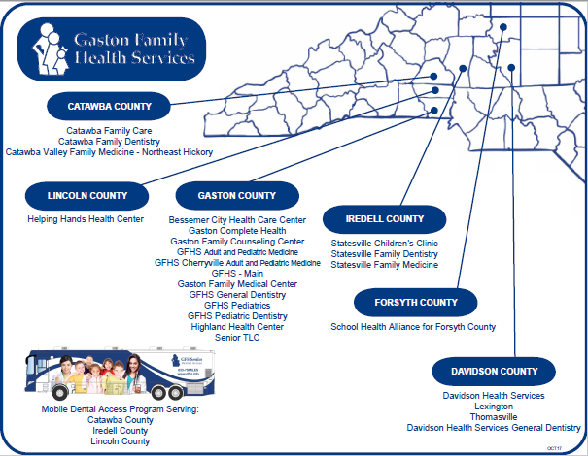
Where Do We Serve?
Notes:
What Services Do We Provide?
- Primary Care - Well Care, Sick Care & Chronic Disease Management
- Dental Care & Outreach
- Behavioral Health Counseling
- Diabetes Education
- Pharmacy Services & Medication Assistance
- HIV Case Management
- Specialty Care – Podiatry, Vision, Dysplasia Clinic
- Workplace Wellness

Slide 5
Hepatitis C (HCV)
Blood-borne virus that leads to Hepatitis C infection
Hepatitis C affects the Liver
Hepatitis C Infection can be Acute or Chronic
Chronic Hepatitis C is a serious disease that can result in long-term health problems, even death
Notes:
Majority of infected persons might not be aware of their infection because they are not clinically ill

Slide 6
Hepatitis C (HCV)
According to the CDC…
HCV is transmitted through large or repeated percutaneous exposures to infectious blood
Injection drug use
Receipt of donated blood, blood products, and organs
Needle stick injuries in health care settings
Birth to an HCV-infected mother
Notes:
Percutaneous – Passage through Skin
Injection drug use
Currently most common means of HCV transmission in U.S.
Receipt of donated blood, blood products, and organs
Once common but now rare in the U.S. since blood screenings began in 1992
Needle stick injuries in health care settings
Birth to an HCV-infected mother

Slide 7
Hepatitis C (HCV)
According to the CDC…
HCV can also be transmitted
infrequently through
Sex with an HCV-infected person
Sharing personal items contaminated with infectious blood, such as razors or toothbrushes
Notes:
HCV can also be spread infrequently through
- Sex with an HCV-infected person (an inefficient means of transmission)
- Sharing personal items contaminated with infectious blood, such as razors or toothbrushes (also inefficient vectors of transmission)
- Other health care procedures that involve invasive procedures, such as injections (usually recognized in the context of outbreaks)

Slide 8
Hepatitis C (HCV)
According to the CDC…
Who is at Risk for HCV Infection?
Current or former injection drug users
Recipients of clotting factor concentrates made before 1987
Recipients of blood transfusions or solid organ transplants before July 1992
Chronic hemodialysis patients
Persons with known exposures to HCV
Persons with HIV infection
Children born to HCV-positive mothers
Notes:
Current or former injection drug users
Including those who injected only once many years ago
Recipients of clotting factor concentrates made before 1987
1987 is when more advanced methods for manufacturing those products were developed
Recipients of blood transfusions or solid organ transplants before July 1992
1992 is when better testing of blood donors became available
Chronic hemodialysis patients
Persons with known exposures to HCV
Such as health care workers after needle sticks involving HCV-positive blood recipients of blood or organs from a donor who tested HCV-positive
Persons with HIV infection
Children born to HCV-positive mothers

Slide 9
Hepatitis C (HCV)
According to the CDC…
Who should be tested for HCV Infection?
Born from 1945 through 1965
Ever injected illegal drugs
Received clotting factor concentrates made before 1987
Received blood transfusions/solid organ transplants before July 1992
Ever received long-term hemodialysis treatment
Known exposures to HCV
Currently diagnosed with HIV infection
Have signs or symptoms of liver disease
Born to HCV-positive mothers
Notes:
Persons born from 1945 through 1965
Persons who have ever injected illegal drugs
Including those who injected only once many years ago
Recipients of clotting factor concentrates made before 1987
Recipients of blood transfusions/solid organ transplants before July 1992
Patients who have ever received long-term hemodialysis treatment
Persons with known exposures to HCV
Such as health care workers after needle sticks involving HCV-positive blood recipients of blood or organs from a donor who later tested HCV-positive
All persons with HIV infection
Patients with signs or symptoms of liver disease
Abnormal liver enzyme tests
Children born to HCV-positive mothers
To avoid detecting maternal antibody, these children should not be tested before age 18 months

Slide 10
Hepatitis C (HCV)
According to the CDC…
15%–25% of persons clear the virus from their bodies without treatment and do not develop chronic infection
For some people, HCV is a short-term illness but for 70-85% of people it becomes a chronic infection
Chronic HCV infection is the leading indicator for liver transplants in the U.S.
Notes:
A person infected with HCV mounts an immune response to the virus, but replication of the virus during infection can result in changes that evade the immune response. This may explain how the virus establishes and maintains chronic infection.

Slide 11
Hepatitis C (HCV)
According to the CDC…
Of every 100 persons infected with HCV
75 – 85 will go on to develop chronic infection
60 – 70 will go on to develop chronic liver disease
5 – 20 will go on to develop cirrhosis
1 – 5 will die from the consequences of chronic infection
Notes:
Of every 100 persons infected with HCV, approximately:
75–85 will go on to develop chronic infection
60–70 will go on to develop chronic liver disease
5–20 will go on to develop cirrhosis over a period of 20–30 years
1–5 will die from the consequences of chronic infection
liver cancer or cirrhosis

Slide 12
Hepatitis C (HCV)
According to the CDC…
There is No Vaccine for HCV
Individuals can become infected with a different strain of HCV after they have cleared the initial infection
Patients completing treatment are NOT Immune
Notes:
Prior infection with HCV does not protect against later infection with the same or different genotypes of the virus.
This is because persons infected with HCV typically have an ineffective immune response due to changes in the virus during infection.
For the same reason, no effective pre- or post-exposure prophylaxis (i.e., immune globulin) is available

Slide 13
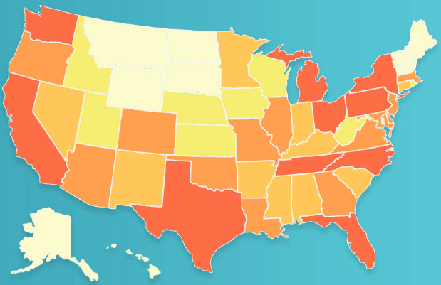
Why Is This Important?
In the United States…
Number of people living with Chronic Hepatitis C:
2.7 – 3.9 Million
Estimated Acute Hepatitis C Infections Occurred in 2014:
30,500
Estimated number of persons living Hepatitis C antibodies, 2010
Notes:
Hepatitis C
# of people living with Chronic HCV in the U.S.: 2.7 – 3.9 million
# of estimated new acute Hepatitis C infections in the U.S. during 2014: 30,500
-----------------------------
Globally, the World Health Organization reports that 399,000 die each year due to Hepatitis C
Access to HCV treatment is improving, but remains limited.
In 2015, of the 71 million persons living with HCV infection globally, 20% (14 million) knew their diagnosis.

Slide 14
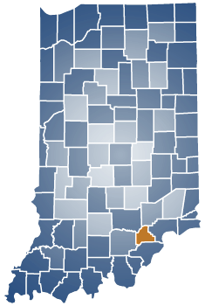
Why Is This Important?
Opioids, Injection Drug Use & Infectious Outcomes
    Southeastern Indiana (Scott County)
    Total of 229 people – HIV Positive
    More than 90% also co-infected with Hepatitis C
    Tied to sharing of needles among injection drug users
Notes:
Scott County, Indiana – Population Estimates in 2016 was 23,730
Began in February 2015, by May 2016 – 191. As of today, 229
What is the prevalence of HCV infection among injection drug users (IDUs)?
The most recent surveys of active IDUs indicate that approximately one third of young (aged 18–30 years) IDUs are HCV-infected. Older and former IDUs typically have a much higher prevalence (approximately 70%–90%) of HCV infection, reflecting the increased risk of continued injection drug use. The high HCV prevalence among former IDUs is largely attributable to needle sharing during the 1970s and 1980s, before the risks of blood-borne viruses were widely known and before educational initiatives were implemented.

Slide 15
Why Is This Important?
CDC Vulnerability Assessment
    Highlighted 220 Counties in the US most vulnerable (top 5%) to an HIV/HCV outbreak
    5 of 220 counties are in North Carolina
Notes:
The Centers for Disease Control and Prevention (CDC) conducted a vulnerability assessment for counties at risk of a possible rapid dissemination of HIV/HCV with people who inject drugs (PWID). The analysis was prompted by the outbreak of HIV infection among PWID in Scott County, Indiana.
Reviewed drug overdose deaths, prescription opioid sales, mental health services, health insurance coverage, urgent care facilities, vehicle availability, access to interstate, education, income, population density, poverty, race/ethnicity, unemployment, urban/rural status, Buprenorphine Prescription Capacity by Waiver, reported rate of acute HCV infection compared to model-estimated rate of acute HCV infection
The results of this assessment do not mean an outbreak of HIV or increases in hepatitis C transmission are imminent.
The preliminary results of the analysis identify potentially vulnerable jurisdictions where state, local, and federal authorities can work together to assess the risk of transmission of HIV and hepatitis C; control it if detected; and, prevent transmission from occurring in the future. The results of this assessment provide a planning tool to help states detect and prevent the introduction and spread of hepatitis C and avert HIV outbreaks like that which occurred in Indiana.

Slide 16
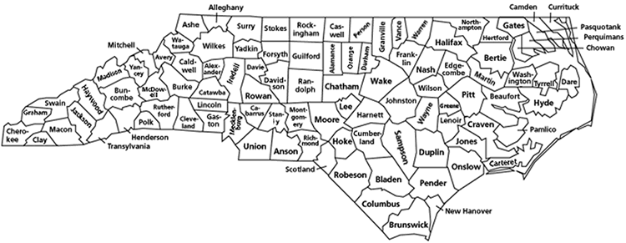
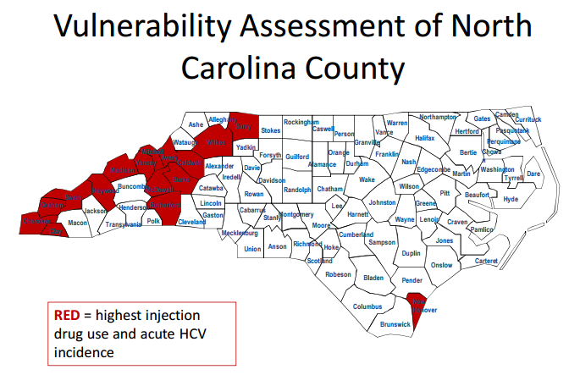
Notes:
Clay, Wilkes, Graham, Burke, and Cherokee
Proximity to Gaston County & All locations GFHS Serves
North Carolina repeated the CDC’s vulnerability assessment for the state and identified the following counties with the highest injection drug use and acute HCV incidence
Per Dr. Andrew Fleischauer’s (CDC/NC Public Health) presentation (Infectious Outcomes of Injection Drug Use) at the HIV Care in 2017: Clinical Update and Vulnerable Populations Conference

Slide 17
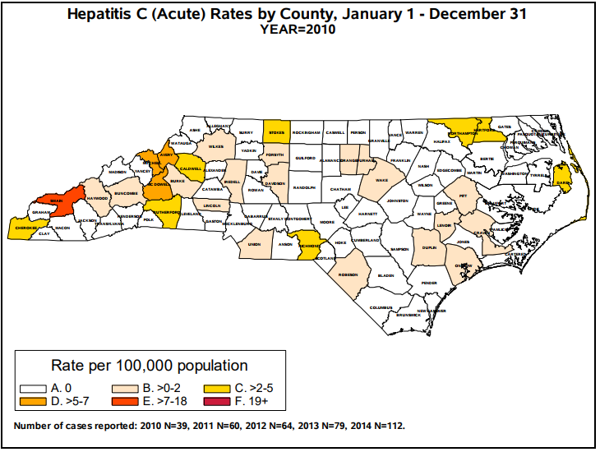
Why Is This Important?

Slide 18
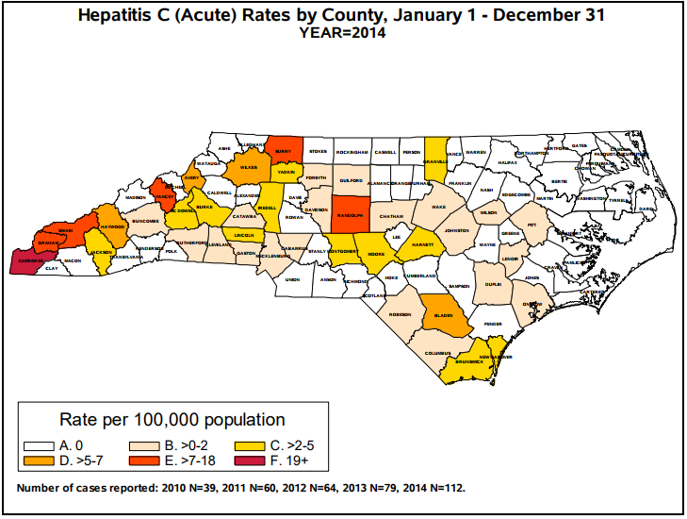
Why Is This Important?
Notes:
Per North Carolina Department of Health & Human Services:
Acute hepatitis C is underreported and underestimated
Acute hepatitis C Reported cases in NC have tripled during 2010-2014
185 Cases in 2016

Slide 19
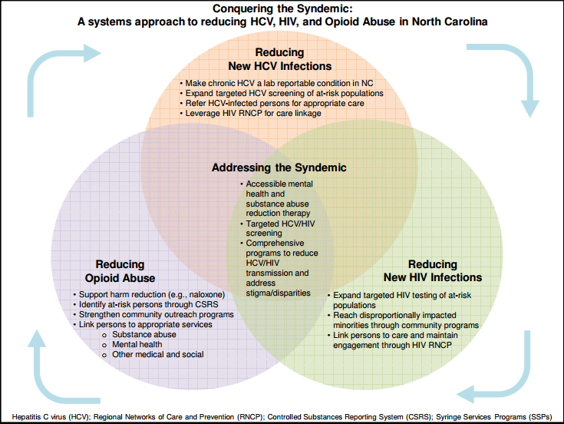
Why Is This Important?
Notes:
Per Dr. Andrew Fleischauer’s (CDC/NC Public Health) presentation (Infectious Outcomes of Injection Drug Use) at the HIV Care in 2017: Clinical Update and Vulnerable Populations Conference
syndemic
(noun) : the coincident onset and interaction of two or more diseases often as a consequence of social conditions that promote disease cluster and comorbidity or the convergence of two or more diseases that act synergistically to magnify the burden of disease
In this case coinfection of HIV and hepatitis C through injection drug use
Twenty-five percent (25%) of HIV-infected people are co-infected with hepatitis C
Fifty percent (50%‒90%) of HIV-infected injection drug users are co-infected with hepatitis C
7% of new HIV cases in 2014 were exposed through injection drug use
In the United States, we are facing two epidemics, chronic hepatitis C and emerging acute hepatitis C
Baby boomers, people born between 1945 and 1965, are five times more likely to be infected with chronic hepatitis C
This has led to a doubling in liver cancer rates during the last 10 years
# of people living with Hepatitis C antibodies in 2010 in NC: 117,300
# of Baby Boomers residing in North Carolina as of 2010: 2,002,850 (21% of the Total Population)
More emergent is acute hepatitis C, which is more related to the injecting drug use (IDU) epidemic
Individuals most affected are younger, male, white, and live in poorer rural communities
As mentioned earlier, North Carolina has 5 of the 220 counties in the country that may be vulnerable to increased hepatitis C acute infections
Since 2008, the numbers of acute HCV infections reported have increased dramatically, and are continuing to increase
The spike in new acute cases beginning in 2008 is related in part to the downturn in the economy, high unemployment rate and minimum wage jobs. These are the reported cases and projections are that the actual number could be as high as 14 times those reported.

Slide 20
Why Is This Important?
According to the National Viral Hepatitis Roundtable (NVHR)…
There are many communities disproportionately impacted by Hepatitis C
Symptoms of larger systems of stigma and health inequity
Notes:
There are many communities that are disproportionately impacted by Hepatitis C. The National Viral Hepatitis Roundtable (NVHR) specifically notes:
African Americans (comprise about 11% of the U.S. population but account for 25% of all Hepatitis C cases. And in 2014, chronic liver disease and cirrhosis were among the top 10 leading causes of death among African-Americans 45 to 64 years of age. Meanwhile, African Americans are nearly twice as likely as whites to be uninsured)
Baby Boomers (People born 1945-1965 are five times more likely than other adults to be infected with HCV and people born between 1945-1965 account for 73% of all hepatitis C- associated mortality)
Veterans (Veterans from the Baby Boomer generation are at a higher risk of having Hepatitis C than any other Veteran group)
People Who Inject Drugs
Hispanics and Latinos
Native Americans
People Who Are Incarcerated and Returning Citizens

Slide 21
What is the Community Need?
Identified a need to screen patients for Hepatitis C, following CDC guidelines in a normalized and destigmatized way
Notes:
Gaston Family Health Services (GFHS) identified a need to screen patients for Hepatitis C, focusing on patients born between 1945 and 1965 as well as those with a history of injection drug use. This needed to be completed in a normalized and destigmatized way so that patients had the opportunity to receive education, in addition to prompt and appropriate follow-up.
At GFHS, we aim to make screening and linkage-to-care a normalized part of routine primary care for everyone, regardless of race, insurance status, age, etc.
By moving away from a traditional targeted testing approach, screening is integrated into normal clinic flow while improving lab-based technologies so that patients have less follow-up labs to complete. This aids in decreasing stigma and increasing access to care.

Slide 22
The FOCUS Approach
Program by Gilead Sciences to work with partners to develop and share replicable model programs that embody best practices in HIV and HCV screening and linkage to care
On the ...
F
O
C
U
S
rontlines
f
ommunities in the
nited
tates
Notes:
In partnership with government agencies, health systems and others in 30+ highly impacted cities, FOCUS aims to:
Established in 2010, Gilead’s FOCUS program partners with health care organizations, government agencies, community organizations, and others to change the way clinical and community institutions approach HIV and HCV testing.
GFHS has received a grant from Gilead’s FOCUS program in order to pilot an integrated testing program at the GFHS-Hudson location for HIV and HCV testing. This grant will allow GFHS to hire a HIV/HCV Patient Navigator, cover the costs of Hepatitis C tests for the uninsured target population, incorporate modifications to EMR and improve our data collection process.

Slide 23
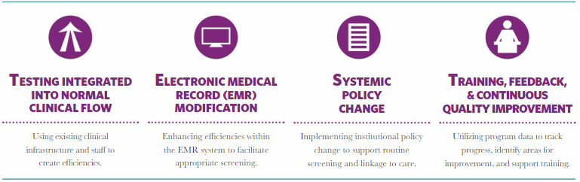
The FOCUS Approach

Slide 24
The FOCUS Approach
Start-Up Activities @ Gaston Family Health Services
Assigning Staffing and Resources
Orientation/Training for Providers and Clinical Staff
Updating Protocols and Processes
Modifications to the Electronic Medical Record (EMR)
Program Launch
Notes:
Start-Up Activities
Assigning Staffing and Resources
Program Manager
Patient Navigator
IT/EMR Consultant
Data Manager
Orientation/training for providers and clinical staff
Updating of protocols and processes
Updating forms and lab orders
Modifications to the Electronic Medical Record (EMR)
Program Launch

Slide 25
The FOCUS Approach
How is HCV Screening Conducted?
  HCV Antibody (Ab) Screening
    HCV Ab+ or HCV Ab-
  Qualitative tests to detect presence or absence of virus (HCV RNA polymerase chain reaction [PCR])
  Quantitative tests to detect amount (titer) of virus (HCV RNA PCR)

Slide 26
GFHS Testing Baseline:
Gaston County
HIV | TOTAL ESTIMATES | May 2016 Data | Jun 2016 Data
HIV Tests Performed | 5000 | 13 | 21
HIV Positive Patients Identified Through Testing |  | 0 | 0
Diagnosed Acute HIV Infections |  | 0 | 0
HIV Positive Patients (identified through testing) Attended First Appointment |  | NA | NA
HCV | TOTAL ESTIMATES | May 2016 Data | Jun 2016 Data
HCV Ab Tests Performed | 2750 | 33 | 46
HCV Ab Positive Patients Identified Through Testing |  | 4 | 15
HCV RNA Tests Performed |  | 8 | 9
HCV RNA Positive Patients Identified Through Testing |  | 3 | 6
HCV RNA Positive Patients (identified through testing) Attended First Appointment |  | 3 | 1
Notes:
By July 2016,
Performed 173 HIV Tests & 230 HCV Ab Tests

Slide 27
GFHS Testing Goals / Outcomes:
May 1, 2016 – July 2017
HIV | PROPOSED GOAL | FINAL ESTIMATES
# Eligible Patients | 12,646 | 6,972
# HIV Tests Conducted | 5,000 (40% of eligible) | 2,277 (33%)
# HIV Positives Identified | 30 (.6% positivity rate based on HD history) | 2
# Acute HIV Cases Identified | TBC | 0
# or % HIV+ LTC | 24 (80% LTC) | 1 (50% LTC)
HCV | PROPOSED GOAL | FINAL ESTIMATES
# Eligible Patients | 2,947 | 2,962
# HCV Tests Conducted | 2,750 (93% of eligible) | 2,261 (76%)
# HCV AB+ Identified | 275 (10% positivity rate) | 221 (10%)
# HCV RNA + Identified | 198 (72% of AB+) | 148 (67% of AB+)
# HCV RNA+ LTC | 138 (70% LTC) | 114+ (77% LTC)
Notes:
Race (for those that are RNA+ (148)
White 66%
Black or African American 32%
American Indian or Alaska Native 1%
Declined to Answer 1%
Insurance status
I don’t have a breakdown of this. We estimate that 50-60% are uninsured
Birth Cohort/ age data for RNA+
1945 – 1996
21 to 72 years old
Homeless if possible
Do not have this information
Reasons for lost to follow-up?
For Gaston: 116/158 linked. Are the other 42 lost? Or in progress? Both?

Slide 28
Community Engagement Activities
Meetings with the Local Health Department
Outreach to Identify Hepatitis C Treating Providers
Conversations with the Local Hospital
Participation in the Gaston Controlled Substance Coalition
Notes:
As GFHS developed the screening process, it was critical to involve our community partners.
Meetings were held with the local health department, including the establishment of bi-monthly meetings between GFHS and Gaston Co. Department of Health and Human Services - Public Health staff.
GFHS also completed outreach to identify providers in the community who were also treating Hepatitis C
GFHS conducted meetings with the local hospital at the beginning of this initiative to identify ways that lab processes could be improved
GFHS presented at the local Gaston Controlled Substance Coalition meeting in order to begin a larger discussion with coalition participants on the importance of Hepatitis C Screening protocols, linkage-to-care after diagnosis and education about Hepatitis C in order to decrease stigma and increase access to care.

Slide 29
Catawba County Public Health
Mission:
To promote, protect, and improve the health of the community by assessing and responding to needs, assuring services, developing policies, and fostering collaboration.
www.catawbacounty.gov/phealth

Slide 30
The Problem – Catawba County:
Catawba County Infectious Disease Physician concerned about increasing cases of Hepatitis C in the community
Catawba County Public Health (CCPH) leadership was contacted (at this time chronic hepatitis C was not state reportable)
Local testing and outreach assessed
Further testing and linkage to care options explored
CCPH formed the Catawba County Hep C Coalition
Notes:
- Funds for Hepatitis C Testing expanded to all LHDs

Slide 31
Catawba Co. Hepatitis C Coalition
Community-led/driven, CCPH provides administrative leadership
Partners include: Mental Health, Harm Reduction, Medical Community, State Public Health, Gaston Family Health Services, local free clinic, harm reduction, ALFA, local hospitals, Gilead
Deliverables:
  Networking
  Resource-sharing
  Enhanced understanding of services
  Development of referral process/network

Slide 32
Coalition deliverables:

Slide 33
Community Bridge Counselor
Provide patient navigation and care coordination to increase Hepatitis C Virus (HCV) testing and linkage to care among those newly diagnosed with HCV or those reestablishing care
Notes:
Navigate the health care system via individualized education, resources, referrals and advocacy for patients and their families
Assist patients with barriers to care, such as transportation, insurance status, stigma and other concerns about the diagnosis while collaborating with the community to build partnerships and resource networks

Slide 34
Community Bridge Counselor
FOCUS Bridge Counselor
Emergency Departments
Federally Qualified Health Centers
Local Health Departments
Local Jails
Homeless Shelters
Substance Use Treatment Programs
Mental Health Providers
Primary Care Providers
Community Based Organizations

Slide 35
Community Bridge Counselor
Initial Program Priorities
Establish Community Referral Process / Protocol
Community Outreach to Begin Building Partnerships
Assist with Community Education
Begin Working with Patients via Referral Process

Slide 36
Community Bridge Counselor
Initial Program Results – 1 Month
  Established Community Referral Process / Protocol
  Community Outreach to Begin Building Partnerships
  - 9 Meetings with Community Partners
  Begin Working with Patients via Referral Process
  - 9 Patient Referrals
  - 1 Already Linked-to-Care
Notes:
Within 1st week of February
6 Patient Referrals (5 from ALFA and 1 from CCPH)

Slide 37
Improving our FOCUS
Successes
  Community Conversations / Coalition
  Increased Screening, Patient Education, & Linkage-to-Care
Learned Lessons In Program Development
  Identify a Champion – Clinical Staff, LHD, Coalition
  Feedback is Needed – Quality Improvement
  Start Small – Intentional
Barriers & Potential Solutions
  Electronic Medical Records – Networking!
  Community Hesitations – Communication!
Notes:
How Community Health Improvements Lead to Increased Hepatitis C Screenings and Further Linkage-to-Care

Slide 38
Viral Hepatitis:
Are You At Risk?
Take this 5 minute
Hepatitis Risk Assessment
developed by the CDC
& get a personalized report
https://www.cdc.gov/hepatitis/riskassessment/index.htm

Slide 39
Future Needs for North Carolina
Community participation in screening practices based on CDC and USPSTF guidelines
Improved Lab Processes
Linkage to Care Discussions
Community Conversations
Notes:
FOCUS Partner since June 2016 (Frontlines of Communities in the United States)
Routine, Normalized, Destigmatized
Updated protocols and lab processes
Following CDC and USPSTF guidelines
Hepatitis C TLC
Test = Test High-risk populations for HCV, HIV and other Sexually Transmitted Infections (STI’s)
Link = Link medical care for HCV infection, Link mental health and substance use disorder treatment, Link social services assistance, as appropriate
Cure = Curative treatment and Eliminate onward transmission and reduce prevalence
Syringe Services Programs (SSPs) - Syringe Exchange Programs were legalized in North Carolina in July 2016 by the NC General Assembly
↓ the prevalence and transmission of hepatitis C
↓ the incidence of hepatitis C-associated liver cancer
↑ the number of high-risk persons who know their hepatitis C status
↑ the number of persons receiving hepatitis C prevention education, vaccination for hepatitis A/B, and education on liver health
↑ the number of HCV-infected persons linked to curative treatment and other services, such as mental health and substance use disorder treatment

Slide 40


Slide 41
References
Centers for Disease Control and Prevention (CDC). Hepatitis C FAQs for Health Professionals. https://www.cdc.gov/hepatitis/hcv/hcvfaq.htm#section1 Accessed 02/05/2018
Emory University, Rollins School of Public Health. HepVu. (https://hepvu.org/). Accessed 02/02/2018.
Fleischauer, Andrew. "Infectious Outcomes Of Injection Drug Use". 2017. Presentation. http://www.gahec.org/areafolders/resources/51805/Fleischauer%20-%20HIV-Hepatis%20Overlay%20in%20NC.pdf Accessed 06/12/2017
Indiana State Department of Health. HIV Outbreak in Southeastern Indiana. http://www.in.gov/isdh/26649.htm Accessed 02/02/2018.
J Acquir Immune Defic Syndr. 2016 November 01; 73(3): 323–331. doi:10.1097/QAI. 0000000000001098
National Viral Hepatitis Roundtable (NVHR). Health Equity. http://nvhr.org/policy/health-equity. Accessed 02/12/2018
North Carolina Department of Health and Human Services. 2016 North Carolina HIV/STD/Heptatitis Surveillance Report. http://epi.publichealth.nc.gov/cd/stds/figures/std16rpt_rev3.pdf. Accessed 02/02/2018.
North Carolina Department of Health and Human Services. Acute Hepatitis C Rates Increase in North Carolina, 2010 – 2014, by County. http://epi.publichealth.nc.gov/cd/figures/HepCRatesbyCountyandYear_May2015.pdf. Accessed 02/12/2018
North Carolina Department of Health and Human Services. Hepatitis C Fact Sheet 2016. http://epi.publichealth.nc.gov/cd/hepatitis/HepatitisCFactSheet2016_rev2.pdf. Accessed 02/05/2018.
North Carolina Department of Health and Human Services. Hepatitis C in Western North Carolina. http://epi.publichealth.nc.gov/cd/hepatitis/Region1and2_HepCAssessment102016.pdf. Accessed 02/12/2018.
World Health Organization. http://www.who.int/mediacentre/factsheets/fs164/en/ Accessed 02/05/2018.

Slide 42

Questions

Slide 43
Contact Information
Erin Hultgren, MPH
Program Manager
Gaston Family Health Services
Phone: 704-772-4701 | Fax: 704-671-1411
ehultgren@gfhs.info
Jennifer McCracken
Assistant Health Director
Catawba County Public Health
Phone: 828-695-5820 | Fax: 828-695-4410
jmccrack@catawbacountync.gov

