Slide 1

Collaborative Efforts to Reduce Health Inequities in Rural Communities

Slide 2
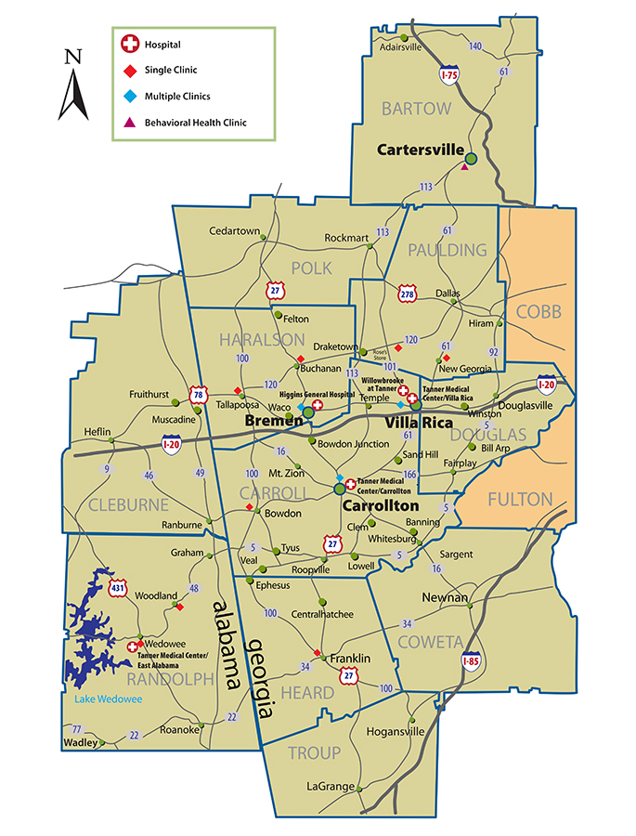
Tanner Health System
is a nonprofit, five-hospital health system serving a nine-county area of more than 350,000 people in west Georgia and east Alabama.
has a medical staff comprising more than 300 physicians representing 34 specialties.
has more than 3,200 employees.
has about 30 Tanner Medical Group practices in about 40 locations in west Georgia and east Alabama.

Slide 3




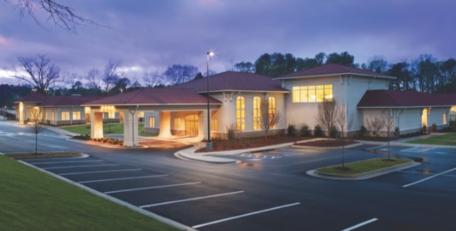
A growing, five-hospital, nonprofit healthcare system serving west Georgia and east Alabama.
Tanner Medical Center/Carrollton
Tanner Medical Center/Villa Rica
Tanner Medical Center/East Alabama
201-bed acute care hospital
40-bed acute care hospital
15-bed critical access hospital
Higgins General Hospital
Willowbrooke at Tanner
25-bed critical access hospital
92-bed behavioral health hospital
Notes:
2017—Wedowee Alabama

Slide 4

GET HEALTHY, LIVE WELL
MAJOR MILESTONES

Slide 5

DEFINING
PRIORITIES

Slide 6
DEFINING PRIORITIES:
THE CHALLENGE
7 out of 10 deaths and 75% of US health spending
Cancer
Stroke
Diabetes
Heart Disease
Impacted by:
Socio-economic factors
Rural setting

Slide 7

DEFINING PRIORITIES:
LIFESTYLE AND HEALTH
THE CENTERS FOR DISEASE CONTROL AND PREVENTION ESTIMATES…
80% of heart disease and stroke
80% of type-2 diabetes
40% of cancer
…COULD BE PREVENTED IF ONLY WE DID THESE FOUR THINGS:
Stop smoking.
Start eating healthy.
Get in shape.
Drink in moderation.

Slide 8
DEFINING PRIORITIES:
HOW WE COMPARE
2017 Health Rankings | U.S. Median | GA | Carroll | Haralson | Heard
Population | 312,471,327 | 9,687,653 | 110,527 | 28,780 | 11,834
Adult Smoking | 14% | 18% | 18% | 17% | 18%
Adult Obesity | 26% | 30% | 32% | 27% | 30%
Physical Inactivity | 19% | 23% | 28% | 26% | 25%
University of Wisconsin Population Health Institute. (2016). County Health Rankings 2015. Robert Wood Johnson Foundation. Retrieved from: http://www.countyhealthrankings.org/sites/default/files/state/downloads/CHR2016_GA.pdf
Georgia is the 20th most obese state
in the nation for adults
17th most obese state in the nation for children

Slide 9

DEFINING PRIORITIES:
2016 CHNA KEY ISSUES
Access to Care
Chronic Disease Prevention and Management
Obesity
Diabetes
Heart Disease
Cancer
Behavioral Health
Health Education and Literacy

Slide 10

A TARGETED
APPROACH

Slide 11




A TARGETED APPROACH:
GET HEALTHY, LIVE WELL
Physical Activity
Nutrition
Chronic Disease
Live Tobacco Free
EDUCATIONAL INSTITUTIONS | BUSINESS AND INDUSTRY
COMMUNITY | FAITH-BASED ORGANIZATIONS

Slide 12

A TARGETED APPROACH:
18 YEARS AND OLDER
Target those with one or more chronic conditions
Carroll – 64,807
Haralson – 16,528
Heard – 6,805
Target those with diabetes
Carroll – 9,167
Haralson – 2,439
Heard – 1,011

Slide 13

EVIDENCE-BASED PROGRAMMING
(EBP)

Slide 14

EVIDENCE-BASED PROGRAMMING:
FRESHSTART SMOKING CESSATION PROGRAM
Developed by the American Cancer Society. The evidence-based components of FreshStart include:
Motivational intervention activities
Practical counseling (problem solving skills)
Social support
Education about medication and approaches to quitting
Coping techniques

Slide 15

EVIDENCE-BASED PROGRAMMING:
DIABETES PREVENTION PROGRAM (DPP)
Developed by the CDC, designed to help participants achieve two goals:
Modest reduction in baseline weight of 5-7% with long term maintenance.
At least 150 minutes of physical activity per week.
Results:
Program members reduced their risk for diabetes by 58% when compared with the placebo group.
For every 2.2 pounds of weight loss achieved, risk for type 2 diabetes was reduced by 13%.
Reduced blood pressure, lower triglyceride levels & decreased medications

Slide 16

EVIDENCE-BASED PROGRAMMING:
LIVING WELL WITH CHRONIC DISEASE (CDSMP)
Developed at Stanford University
Participants in the CDSMP study:
Spent 0.8 fewer days in the hospital
Fewer outpatient visits
decrease in ED visits by 8%
decrease in hospitalization by 40%
Increased medication adherence

Slide 17

EVIDENCE-BASED PROGRAMMING:
LIVING WELL WITH DIABETES (DSMP)
Developed by Stanford University
Addresses diabetes disease process and treatment options
Participants in the DSMP study
Reduced A1C blood glucose levels
Reduced health distress
Fewer symptoms of hypo/hyperglycemia
0.8 fewer days spent in the hospital
Fewer outpatient visits
decrease in ED visits by 8%
decrease in hospitalization by 40%
Increased medication adherence

Slide 18

FOCUSING ON
GREATER IMPACT

Slide 19
FOCUSING ON GREATER IMPACT:
A NEW APPROACH
Community Engagement & Capacity
A Sustainable Evidence -Based Model
Reduce Health Disparities
Increase Access
Increase Patient Self-Management
Increase Community Involvement
Increase health literacy
Community -Clinical Linkages
Physician Referral + Patient Engagement
Community Involvement
GHLW communication loop of patient outcomes to clinics
Policy, System & Environmental
Priority Population
African American Health through Faith-based Organizations
Faith in Health Expansion

Slide 20
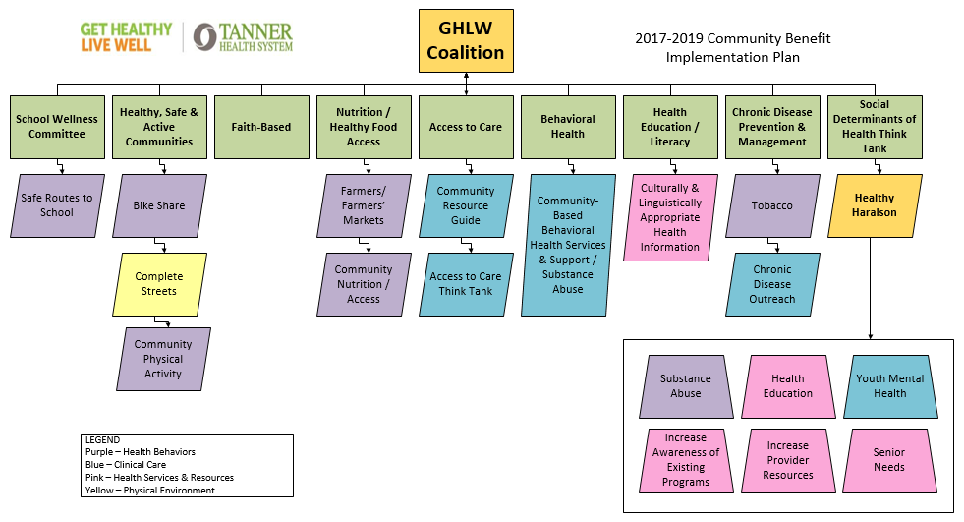
FOCUSING ON GREATER IMPACT:
GET HEALTHY, LIVE WELL COALITION

Slide 21
FOCUSING ON GREATER IMPACT:
BUILDING COMMUNITY CAPACITY
150 state, local and national partners
10 Business & Industry partners
17 Faith-Based church partners 5,465 members represented
School Partners across three counties
22 Task Forces and Subcommittees
2 Community Health Think Tanks
Over 500 Active Volunteers
10 Multi-Unit Housing Authorities
Trained to Teach EBP
4 Master Trainers
18 Stipend instructors
26 church lay leaders
49 CCL physicians referring to EBP
120 senior nursing students completed 20 hour preceptorship in Community Health
200 Kids Safe Routes to School
70 Community Garden Plots

Slide 22
FOCUSING ON GREATER IMPACT:
POLICY, SYSTEM AND ENVIRONMENTAL INTERVENTIONS
Impact of enacting clean air policies over 10 years
 | Reduce | Prevent | Save
CARROLL | Reduce smoking prevalence by 2.06% | Prevent 80 cases of respiratory disease 69 cardiovascular events 19 cases of cancer 23 smoking-attributable deaths | $1,736,000 in medical costs
HARALSON | Reduce smoking prevalence by 1.87% | Prevent 79 cases of respiratory disease 75 cardiovascular events 26 cases of cancer 24 smoking-attributable deaths | $1,691,000 in medical costs
HEARD | Reduce smoking prevalence by 1.86% | Prevent 83 cases of respiratory disease 79 cardiovascular events 26 cases of cancer 25 smoking-attributable deaths | $1,695,000 in medical costs
Community Health Advisor.org: This program calculates the impact of enacting clean air policies through a community-wide ordinance. Clean air policies include public-sector regulations or private-sector rules that prohibit smoking in indoor spaces and designated public areas.
Notes:
Priority Population
African American Health through Faith-based Organizations
Faith in Health Expansion
Community -Clinical Linkages
Physician Referral (5As)
Patient Engagement
Community Involvement
GHLW communication loop of patient outcomes to clinics
A Sustainable Evidence -Based Model
Reduce Health Disparities
Increase Access
Increase Patient Self-Management
Increase Community Involvement
Increase health literacy

Slide 23

FOCUSING ON GREATER IMPACT:
PRIORITY POPULATION
12 Local African American Churches in Carroll, Haralson, and Heard Counties
Focus Areas:
Chronic disease
Nutrition
Physical activity
Tobacco
Evidence-based programs, policy implementation, healthcare challenges, wellness councils

Slide 24
FOCUSING ON GREATER IMPACT:
COMMUNITY-CLINICAL LINKAGES
Patient enters clinic
Nurse assesses vitals
Patient is flagged
Doctor counsels patient
GHLW enrolls patient in class
Patient attends class
GHLW reports patient updates to provider
The GHLW Community-Clinical
Linkages Cycle

Slide 25

FOCUSING ON GREATER IMPACT:
COMMUNITY PARAMEDICINE PROGRAM PARTNERSHIP
Ambucare Rural Mobile Healthcare
Target Population: Uninsured residents in Haralson County (approx. 300 visits/year)
Target Issues to Address: Hypertension, Stroke, Diabetes
Participants in the home visit program receive services such as:
Complete Medical Assessments
Medication Reconciliation
Wound Care
Education
Blood Sugar Testing
A1C Testing
Cholesterol Screening
Blood Pressure Monitoring
Assistance with follow-up care
Assistance with social services

Slide 26

DEMONSTRATING
SUCCESS

Slide 27
DEMONSTRATING SUCCESS:
GET HEALTHY, LIVE WELL IN FAITH
Policy, Systems and Environmental Changes
100% of churches adopted a tobacco policy
100% of churches adopted a water policy
90% of churches integrated physical activity into church activities
82% of churches implemented an evidence-based program and have pastor/congregation members trained as peer leaders for these programs
55% of churches adopted a shared use guideline allowing use of indoor and/or outdoor facilities

Slide 28
DEMONSTRATING SUCCESS:
GET HEALTHY, LIVE WELL IN FAITH
Health Outcome Improvement:
Percent of church members with cholesterol in healthy range.

Slide 29
DEMONSTRATING SUCCESS:
GET HEALTHY, LIVE WELL IN FAITH
Health Outcome Improvement:
Percent of church members with borderline high cholesterol.

Slide 30
DEMONSTRATING SUCCESS:
GET HEALTHY, LIVE WELL IN FAITH
Health Outcome Improvement:
Percent of church members with hypertension, Stage 1 or 2 (Systolic 140 or higher mmHg or Diastolic 90 or higher).

Slide 31
DEMONSTRATING SUCCESS:
GET HEALTHY, LIVE WELL IN FAITH
Health Knowledge Improvement:
Percent of church members indicating their nutrition knowledge “very knowledgeable”.

Slide 32
DEMONSTRATING SUCCESS:
GET HEALTHY, LIVE WELL IN FAITH
Healthcare Behavior Improvement
Percent of church members who visited a healthcare professional 10 or more times in 12 months decreased each year

Slide 33
DEMONSTRATING SUCCESS:
MEET GHLW CHAMPION – WILLIE NELSON
Willie Nelson had been struggling with type 2 diabetes for 30 years. He now has his blood sugar under control thanks in part to the lessons he learned while participating in Get Healthy, Live Well’s Living Well with Diabetes program, which was offered at his church.
http://www.tanner.org/get-healthy-live-well/about-get-healthy-live-well/health-champions

Slide 34





GET HEALTHY, LIVE WELL:
RECOGNITION
Partner Up! For Public Health Hero
Tanner Medical Center/GHLW • 2013
Community Leadership Award
Tanner Health System/GHLW • 2014
Hospital of the Year
Tanner Medical Center/GHLW • 2014
Leadership Challenge Award
Tanner Medical Center/GHLW • 2015
Inaugural Healthy Georgia Award
Tanner Medical Center/GHLW • 2016
NOVA Award
Tanner Medical Center/GHLW • 2016
Finalist IHF Excellence Award for Corporate Social Responsibility
Tanner Health System/GHLW • 2017

