Slide 1
Creating Communities of Solutions
Technology Tools & Resources to Accelerate the Journey
Laura Howell, Project Manager
Institute for Healthcare Improvement, Boston, MA
Communities Joined in Action Conference | Breakout Track V
@100mlives, #100mlives
Notes:
Put into widescreen

Slide 2
Learning Objectives
Learn about the 100 Million Healthier Lives movement.
Understand the tools and resources that are available to communities as part of the 100MLives movement.
Receive concrete steps for accessing and utilizing the tools as part of the 100MLives movement.
Notes:
The purpose of today, isn’t that you walk away as an expert in all of the tools. Its to gain an understanding of what you can do, how to get started, and where to find more information to support you in utilizing them.

Slide 3
Guiding Questions
What brings you here today?
What’s the dream for my community?
What would help my community improve?
Notes:
Here: session, conference

Slide 4
Today’s Agenda
Topic | Duration
Overview of 100 Million Healthier Lives & Community of Solutions Framework | 15 minutes
Overview of Tools and Resources to Accelerate the Journey & Community Example | 30 minutes
How to Access the Tools | 15 minutes
Questions & Answers | 45 minutes

Slide 5
100 Million Healthier Lives

Slide 6
100 Million Healthier Lives 100mlives.org
Identity: An unprecedented collaboration of change agents pursuing an unprecedented result:
100 million people living healthier lives by 2020
Vision: to fundamentally transform the way we think and act to improve health, wellbeing, and equity.
Equity is the “price of admission.”
Convened by the Institute for Healthcare Improvement as a partnership
Notes:
Learning community

Slide 7
Principles Guiding How We Work
Partner deeply and respectfully in the process of creating change with people, organizations, and communities.
Promote equity, justice, strength, and wholeness in the process of creating health.
Adopt a humble posture of learning and improvement that acknowledges the importance of both stories metrics that matter.
Intentionally work to remove barriers in critical areas (e.g., payment reform, spread of good ideas) through intentional collaboration with traditional and nontraditional partners.
Make the way we work an example of what is possible.
Notes:
The how of what we are trying to live into

Slide 8
Theory of Change
Unprecedented collaboration
Innovative improvement
100 Million People Living Healthier Lives by 2020
System transformation

Slide 9
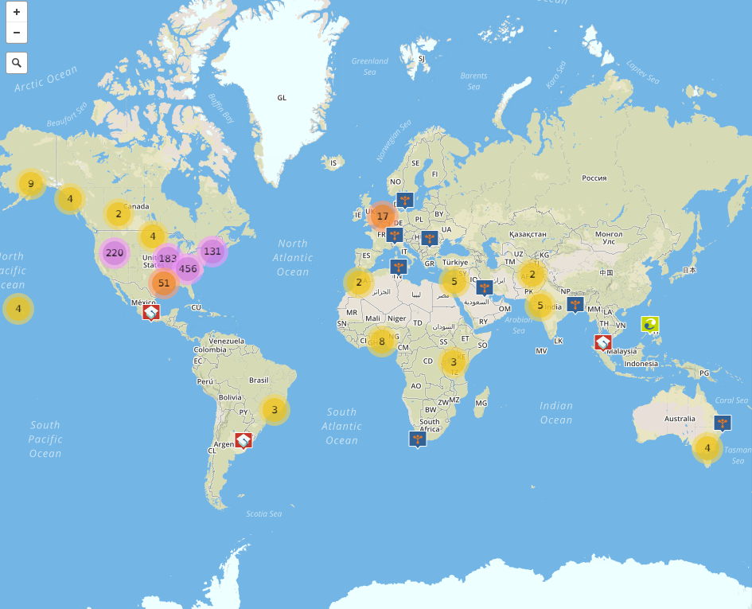
Our Growing Movement: >1200 members in 27+ countries worldwide
Interactive Map www.100mlives.org/map

Slide 10
What Do Our Members Care About? www.100mlives.org/approach-priorities
Children & Youth
Healthcare
Veterans
Elders / Aging
Mental Health
Others?
Indigenous Communities
Workplaces /
Employees
Chronic Disease
http://www.100mlives.org/approach-priorities/#hows

Slide 11
What Do Our Members Care About? www.100mlives.org/approach-priorities
Address equity gaps, asking “Who isn’t thriving? What would it take for that to change?” This is the “price of admission” in 100 Million Healthier Lives.
Address and improve social determinants across the continuum
Transform places of concentrated poverty to communities of solutions
Help all kids have a great start to life, with all the skills they and their families need to flourish from cradle to career
Support veterans to thrive
Reclaim the health, wellbeing, and dignity of indigenous communities
Make mental health everybody’s job and take a prevention approach to violence, trauma and addiction
Address the social, behavioral, and spiritual drivers of health and wellbeing across sectors.
Engage everyone in improving their own health and in building a culture and practice of healthy living for themselves and their peers.
Improve employee health and wellbeing
Address chronic disease and its risk factors (diet, exercise, smoking, sleep, stress, etc.).
Create the best possible wellbeing in the elder years and end of life
Notes:
Unprecedented collaboration via distributed leadership for all

Slide 12
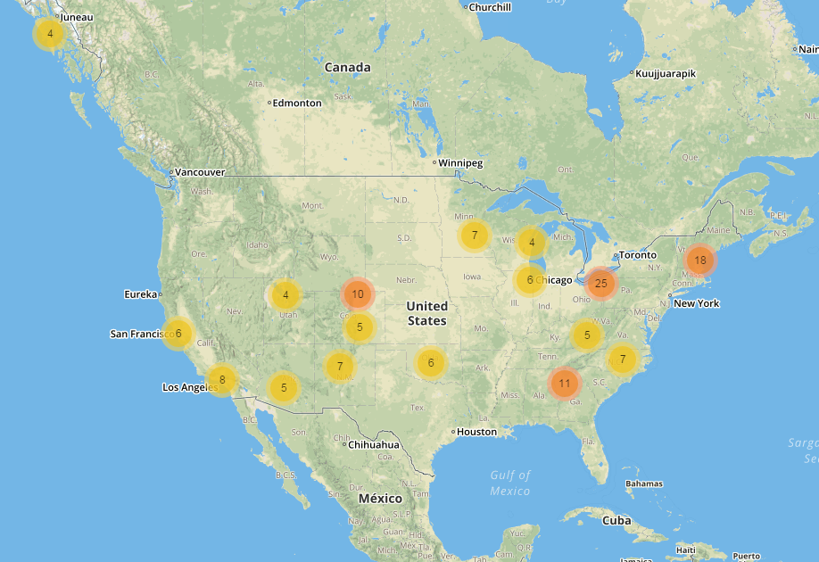
Communities Creating Change: SCALE Initiative www.100mlives.org/initiatives for stories
Cheshire County, NH
Oklahoma City, OK
Summit County, OH
Williamson, WV
Algoma, WI
Atlanta, GA
Bernalillo County, NM
Boston, MA
Cattaraugus County, NY
Chicago (Maywood),
Cleveland, OH
Hennepin County, MN
Jackson, MI
Laramie County, WY
Los Angeles, CA
Maricopa County, AZ
North Colorado, CO
Pueblo, CO
Raleigh, NC
Salt Lake City, UT
San Francisco, CA
San Gabriel Valley, CA
Sitka, AK
Waterville, ME
Notes:
mention the parnters and the funder
Food insecurity and chronic disease
Healthy eating, active living
Disability, shared use and complete street policies
Youth and adult homelessness
Opioid overdose
Poverty, education and economic development
Early childhood development and adverse childhood events
Living wages
Community based care coordination for high risk high cost patients
Teen pregnancy
Readmissions

Slide 13
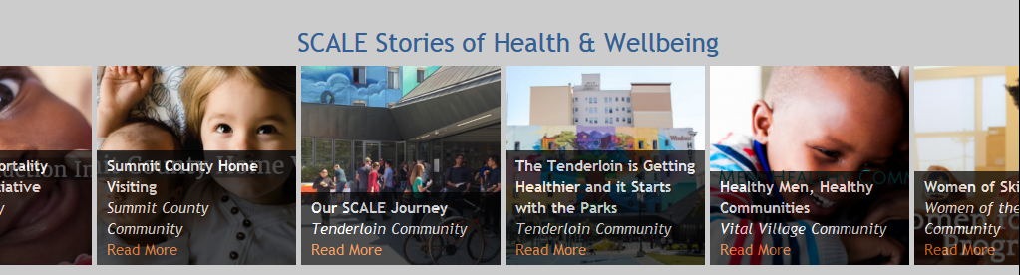
Communities Creating Change: SCALE Initiative www.100mlives.org/initiatives
Food insecurity and chronic disease
Healthy eating, active living
Disability, shared use and complete street policies
Youth and adult homelessness
Opioid overdose
Poverty, education and economic development
Early childhood development and adverse childhood events
Living wages
Community based care coordination for high risk high cost patients
Teen pregnancy
Readmissions

Slide 14
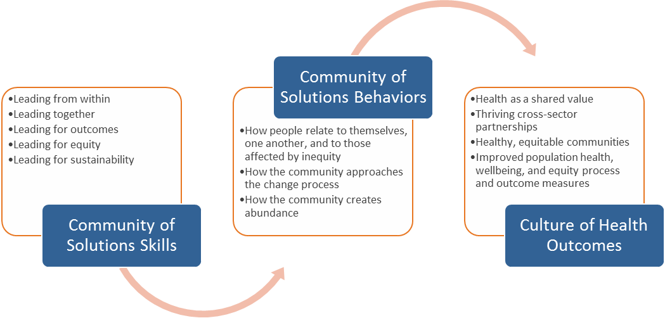
Community of Solutions Framework www.100mlives.org/initiatives
Notes:
To develop the Community of Solutions model, in addition to drawing from the literature and past experience, the SCALE Community Partners tested key concepts related to reflective practice (leading from within), collaboration (leading together), design thinking and improvement science (leading for outcomes), equity (leading for equity), and generative sustainability (leading for sustainability). This testing led them to identify skills (Community of Solutions Skills) that enable communities to develop a set of behaviors, processes, and systems (Community of Solutions Behaviors) that, over time, promise to lead to sustainable, growing improvements in health, well-being, and equity (Culture of Health Outcomes) (see Figure 3). The foundations of the model in literature and practice are described in the SCALE synthesis report on Approach to Generative Sustainability.

Slide 15
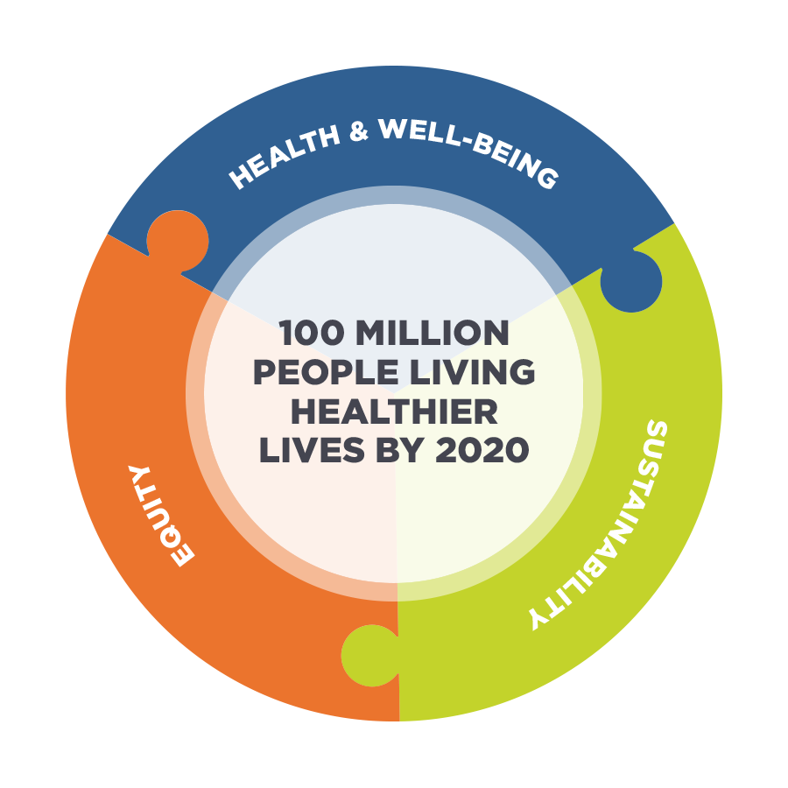

Measuring Healthier Lives Whose Lives Are Getting Better Because We Are Here?
COMMUNITY-SPECIFIC METRICS
Length of Life
Well-being
WALYs
Leading Indicators
www.100mlives.org/measure
Well-being x Life Expectancy =
Well-being Adjusted Life Years (WALYs)
Notes:
working at multiple levels, based off this framwrok at hte national level (measurement opening section) NVCHS

Slide 16

Measuring Healthier Lives Whose Lives Are Getting Better Because We Are Here?
Common Measures for Adult & Adolescent Wellbeing
Catalog 2,000+ measures
COMMUNITY-SPECIFIC METRICS
Length of Life
Well-being
WALYs
Leading Indicators
www.100mlives.org/measure
Well-being x Life Expectancy =
Well-being Adjusted Life Years (WALYs)

Slide 17
Tools and Resources to Accelerate the Journey

Slide 18
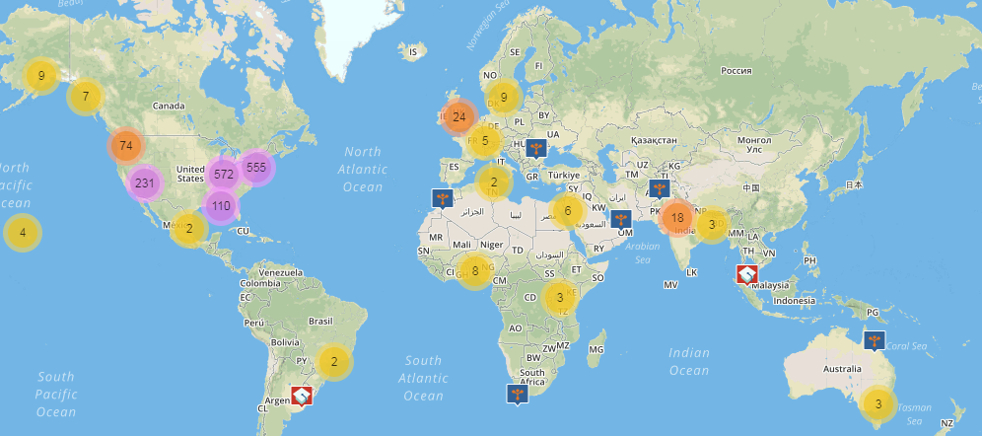
How “Technology” Helps Do the Work
Notes:
What’s the best thing about technology that you use.
Technology is a means to an end. The end is a community where everyone can say, “yes, I’m thriving”
Cell phone makes it easier to get to a hotel, see your loved ones when your half way across the country, check the weather outside
Co-design in order to understand what your needs are and how these tools can make what your doing easier

Slide 19
How “Technology” Helps Do the Work
What are other communities working on and where they are located?
Have a one-stop shop for all of these things?
How does my community know if the work we are doing is an improvement?
Learn what it takes to build leadership and capacity in my community?
How can we access stories and bright spots that you can use to accelerate my work?
Where can connect with others, share a news article, and celebrate successes or fail forward experience with others?
Notes:
Does anyone want to share what about these questions resonates for you and your community?

Slide 20
How “Technology” Helps Do the Work
Map of the Movement
Make people’s work visible to each other
100MLives Website
Help people connect seamlessly across all of these platforms
Measure What Matters
Help people measure, track, and share data across sectors
CHAI (coming 2018)
Learn and build capacity
Change Library & LiveStories
Make it easy to see the bright spots and resources
100MLives Online Community & LiveStories
Connect socially, build relationships, and share stories
Notes:
Building a connected, supportive infrastructure has been a central focus of the work in 100MLives. As we have focused on developing enabling conditions that support thousands of communities to make meaningful improvements in health, wellbeing, and equity globally, we have identified a number of core needs across communities that are currently barriers to achieving a Culture of Health.
To take questions from communities and bring the supports we heard were necessary for community health improvement to life

Slide 21
How “Technology” Helps Do the Work
Map of the Movement
Make people’s work visible to each other
100MLives Website
Help people connect seamlessly across all of these platforms
Measure What Matters
Help people measure, track, and share data across sectors
CHAI (coming 2018)
Learn and build capacity
Change Library & LiveStories
Make it easy to see the bright spots and resources
100MLives Online Community & LiveStories
Connect socially, build relationships, and share stories
Notes:
Building a connected, supportive infrastructure has been a central focus of the work in 100MLives. As we have focused on developing enabling conditions that support thousands of communities to make meaningful improvements in health, wellbeing, and equity globally, we have identified a number of core needs across communities that are currently barriers to achieving a Culture of Health.
To take questions from communities and bring the supports we heard were necessary for community health improvement to life

Slide 22
Anytown, OK
Fictional example to illustrate how you can utilize the tools & resources in your community

Slide 23
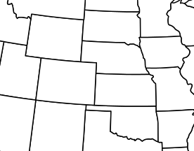
Anytown Oklahoma Collaborative
Location: Oklahoma
Population Size: 42,000
Target audience: Youth
Focus: Opioids/addiction, crime, HEAL initiatives
Sectors: social services, schools, public health agencies, health systems, non profits
This Photo by Unknown Author is licensed under CC BY-SA

Slide 24
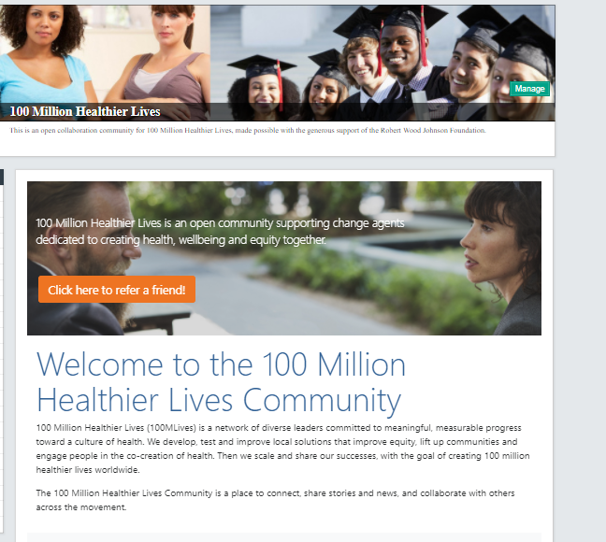
Anytown Oklahoma Collaborative Joining 100MLives through Online Community
connect.100mlives.org

Slide 25
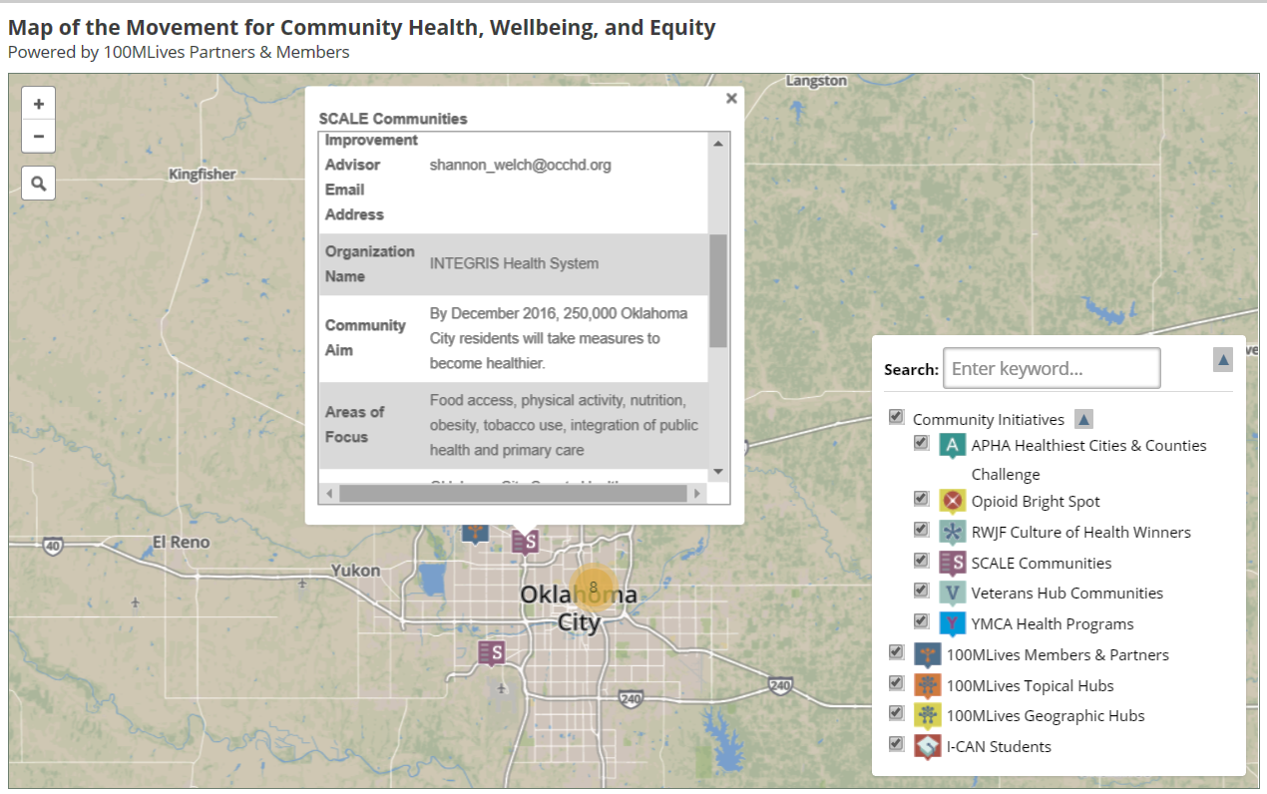
Anytown Oklahoma Collaborative Using Map of the Movement
100mlives.org/map

Slide 26
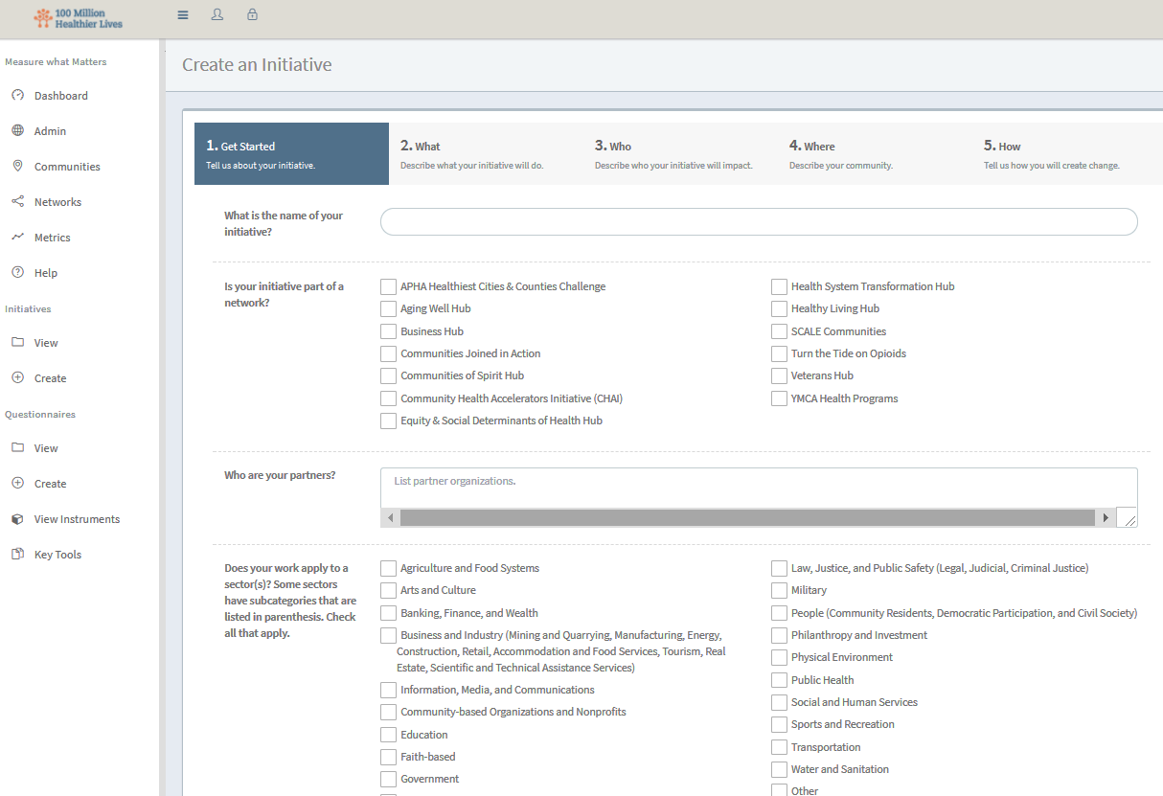
Anytown Oklahoma Collaborative Measuring what matters in Measure What Matters
100mlives.org/measure-what-matters

Slide 27
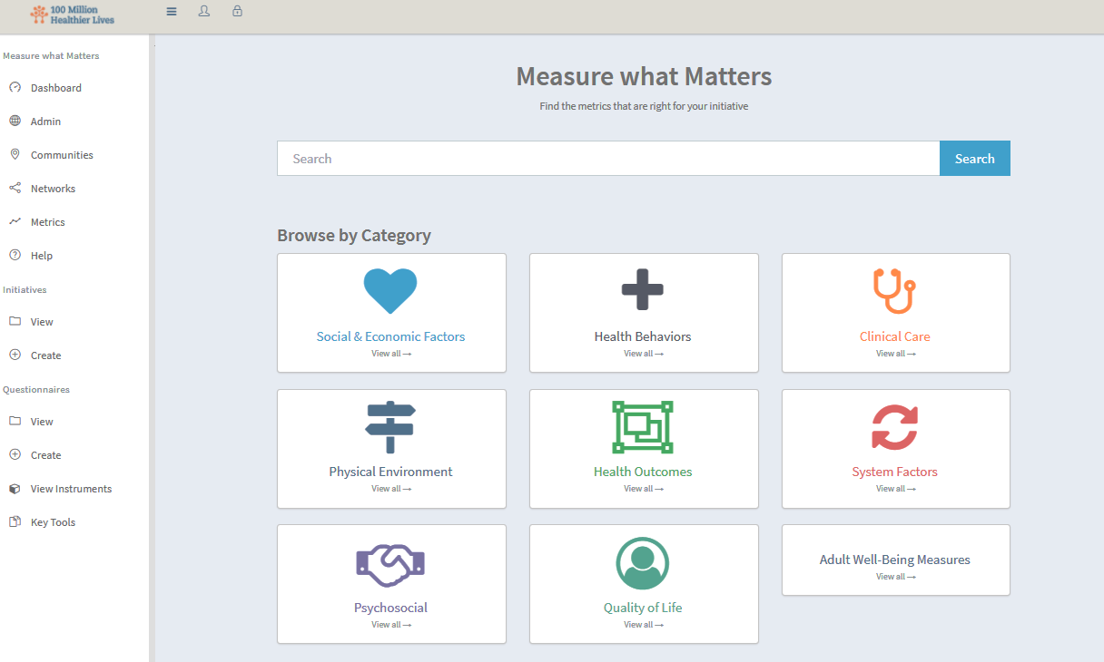
Anytown Oklahoma Collaborative Measuring what matters in Measure What Matters
100mlives.org/measure-what-matters

Slide 28
Menu of Measures at All Levels
People (examples) | Places (examples) | Systems (examples)
Length of life | Physical health: Access to healthy foods, walkability | Federal funding for pedestrian and bike programs
Well-being | Mental health: Perceived safety | Inequality in educational attainment
WALYs | Social well-being: High school graduation rate, unemployment rate | Percent growth in healthcare spending
Differences in health & well-being | Social well-being: social connectedness | Corporate contributions to education and community development
Years of potential life gained | Spiritual well-being: civic pride, hope, resilience | Political rights
People
Systems
Places
Health, wellbeing and equity
Notes:
Communities are working on very different scales (e.g., county change vs. specific ethnic group) – and need measures at different levels, including individual/pop, community, society.
Define each level and provide examples

Slide 29
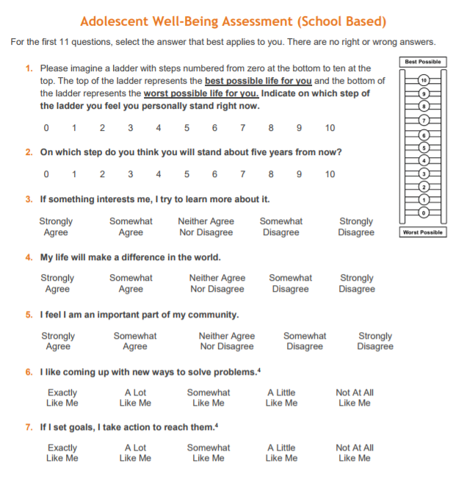
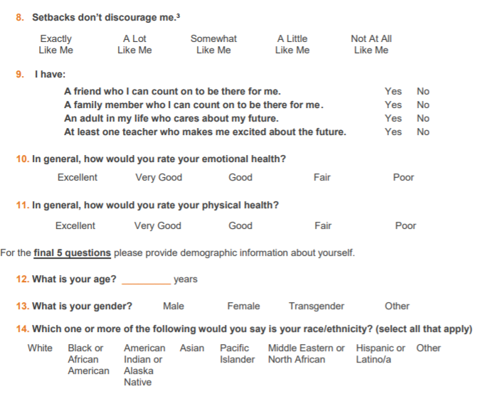
Anytown Oklahoma Collaborative Measuring what matters in Measure What Matters
Overall
Well-being
Social
Well-being
Emotional
Well-being
Physical
Well-being
Cognitive
Well-being
Meaning & Purpose

Slide 30
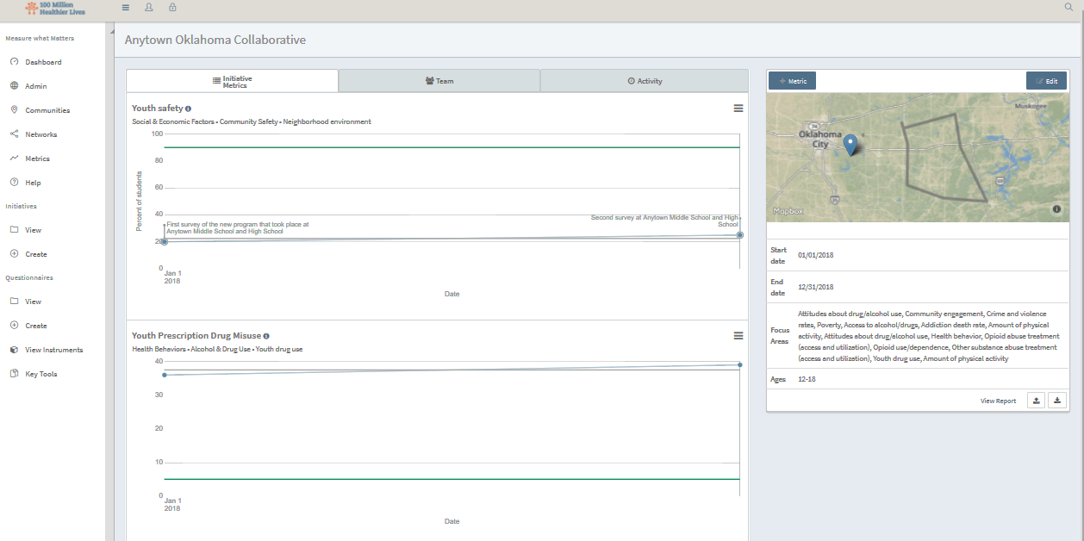
Anytown Oklahoma Collaborative Measuring what matters in Measure What Matters
100mlives.org/measure-what-matters

Slide 31
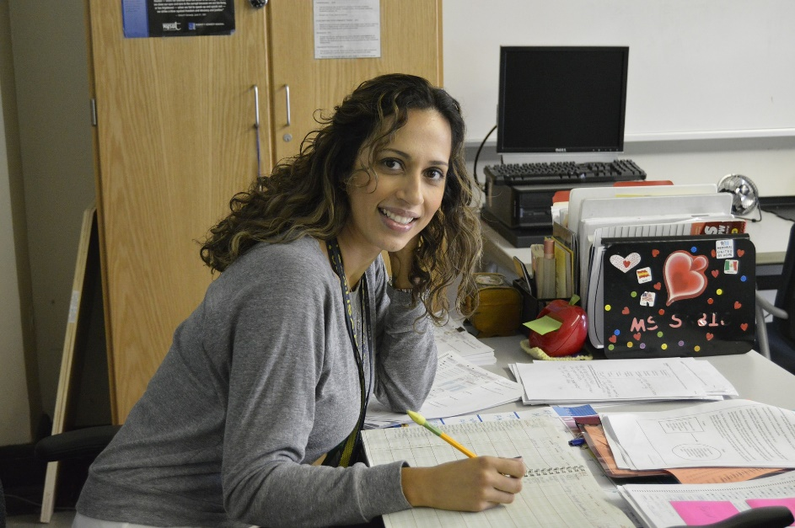
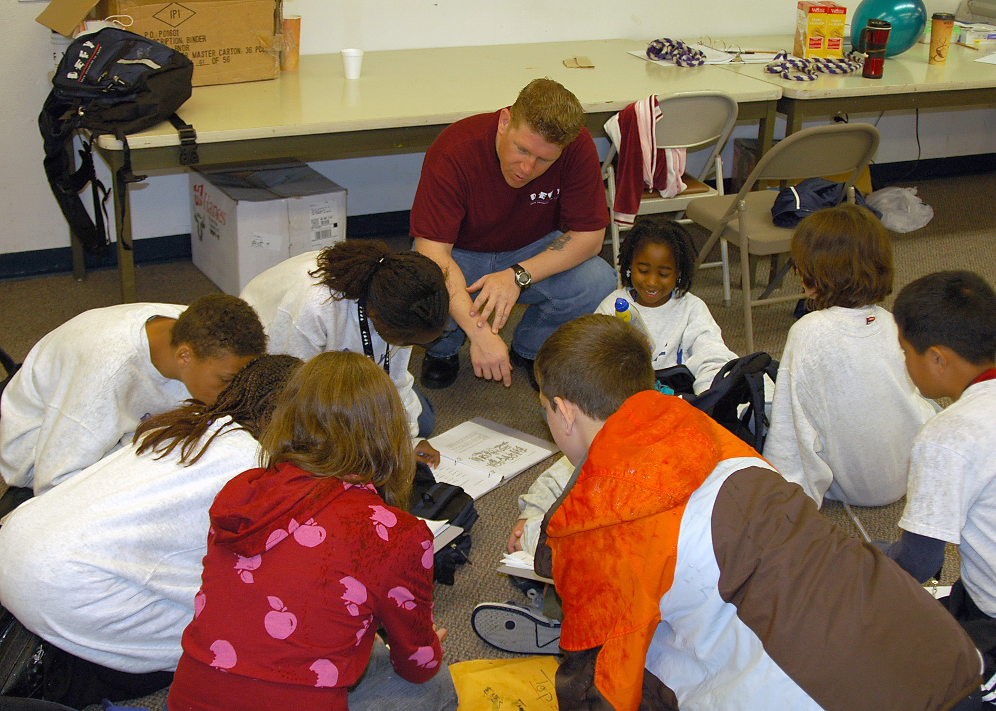
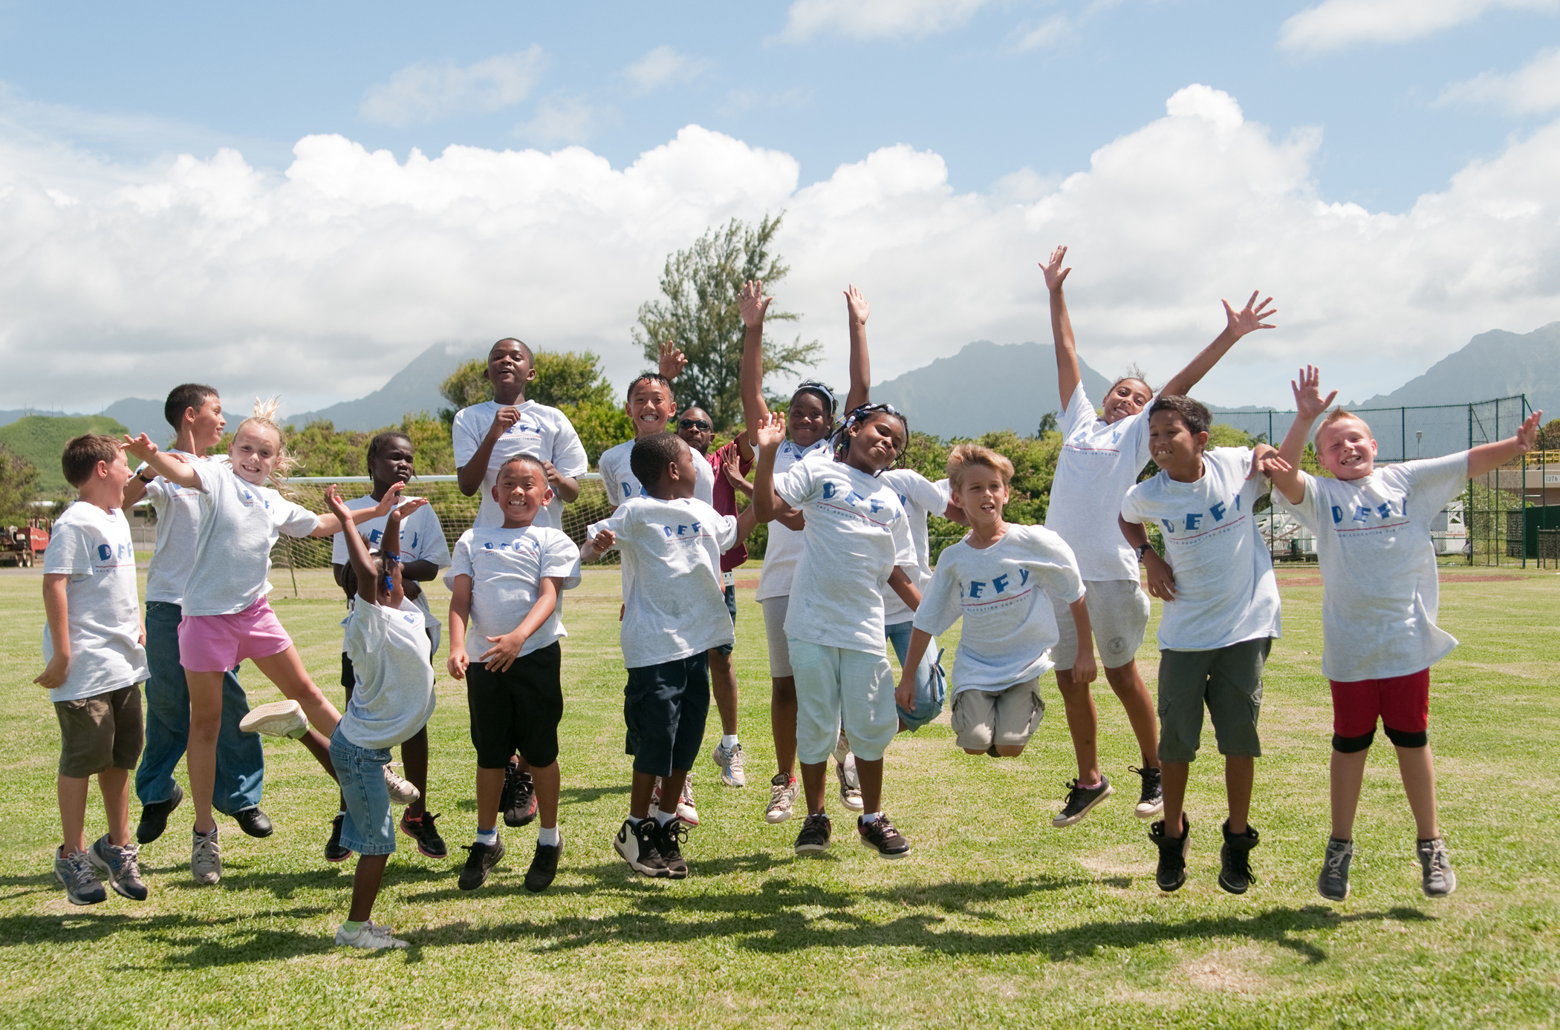
Anytown Oklahoma Collaborative Sharing the community story in Change Library

Slide 32
Deeper Dive: Tools & Resources

Slide 33
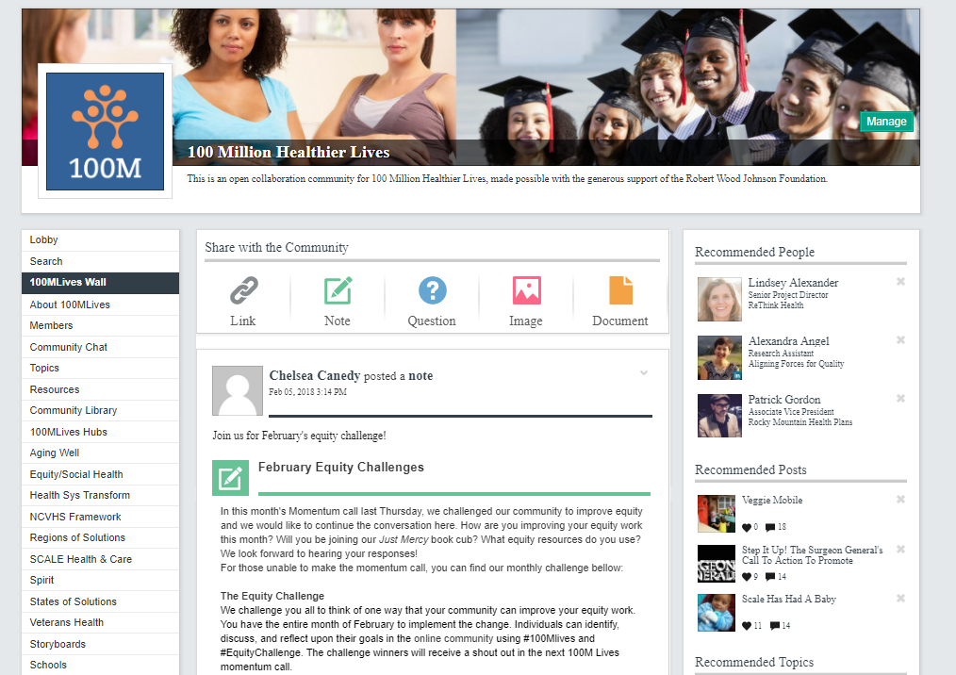
Online Community http://connect.100mlives.org
Exchange stories, find collaborators, learn and share with other individuals and organizations in the movement
Post documents, links, images, or photos to the 100mlives wall AND/OR other streams

Slide 34
Online Community http://connect.100mlives.org
Connect virtual using the built-in Zoom app
Community Library offers open source file sharing where you can create your own folders or collaborate with others on a document
Many ways to engage

Slide 35
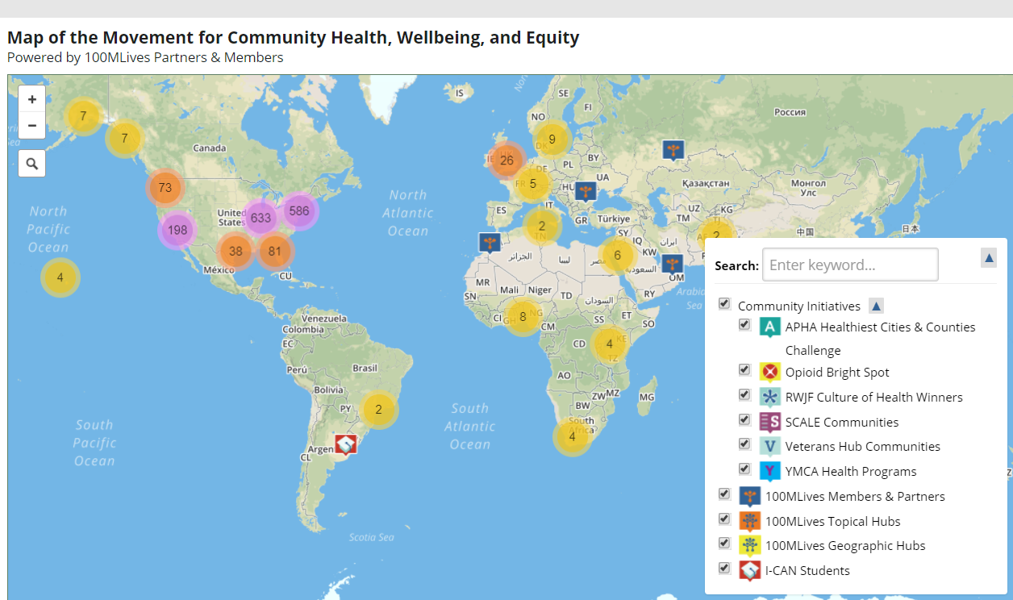
Map of the Movement www.100mlives.org/map
An interactive map of the individuals, partners, and communities to:
Make what people are working on visible to one another, to see who is “doing what,” and “where,” both by content area and geography
Facilitate collaboration across the movement

Slide 36
Map of the Movement www.100mlives.org/map
The map enables you to connect with over 1,200+ members of the movement in 27+ countries
Present your community’s initiatives and programs in a dynamic and visual way

Slide 37
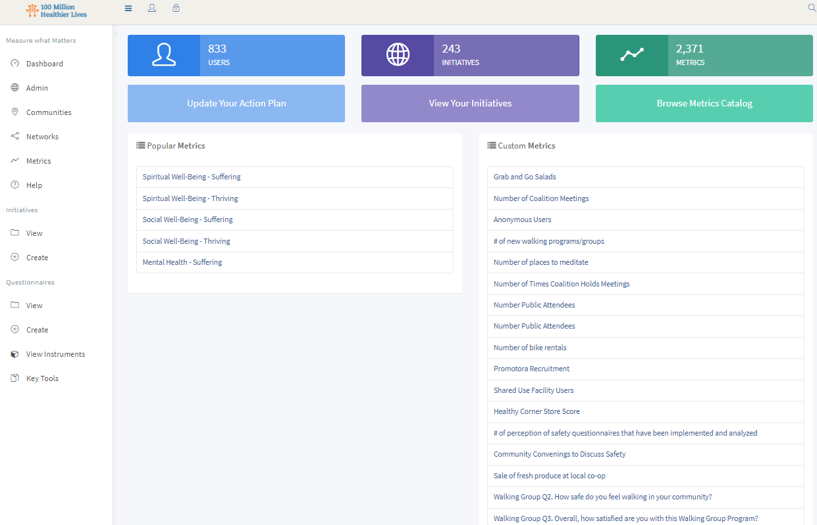
Measure What Matters www.100mlives.org/measure-what-matters
Answers the question, “Whose lives are getting better because we are here?”
The platform is built to make it easy for anyone to measure their progress for improvement

Slide 38
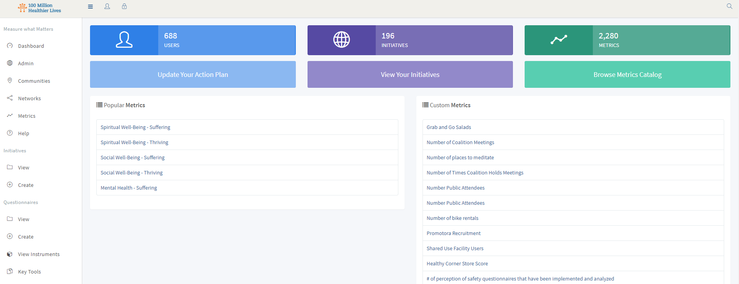
Measure What Matters www.100mlives.org/measure-what-matters
Sign up
Create an Action Plan
Set up your initiative
Select measures:
Community/population and individual indicators
Collect data to track your progress

Slide 39
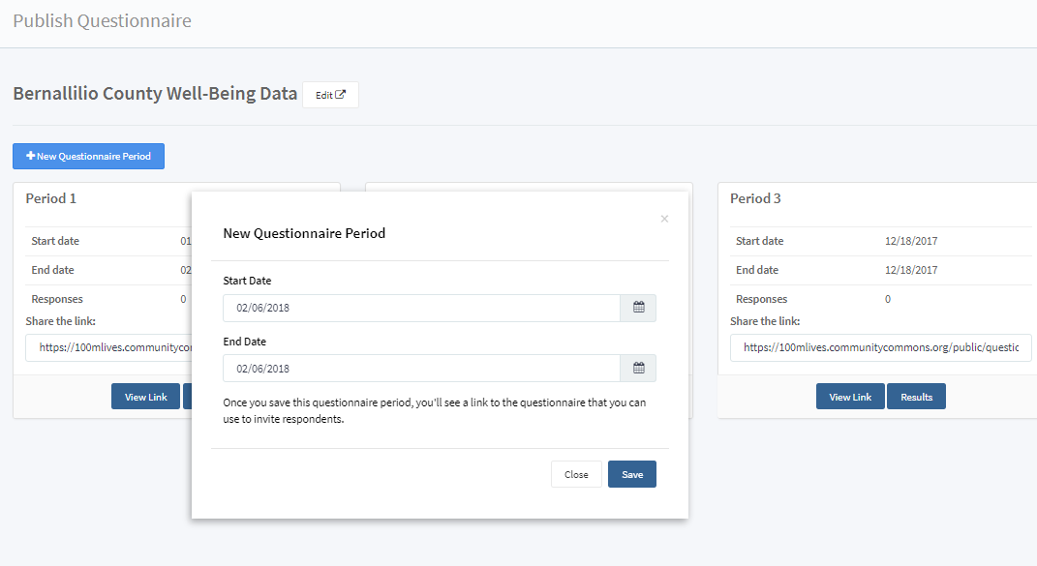
Measure What Matters www.100mlives.org/measure-what-matters
Metrics catalog of over 2,000 measures
Create questionnaires based on Adult and Adolescent templates, or create custom questionnaires

Slide 40
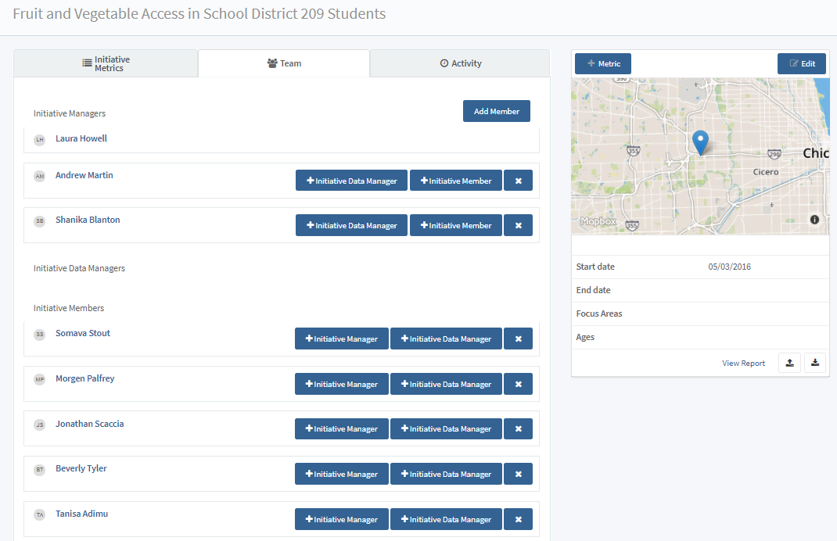
Measure What Matters www.100mlives.org/measure-what-matters
Track PSDA cycles
Add links to external resources
Comment with your teammates or coaches
Add stories to support the data

Slide 41
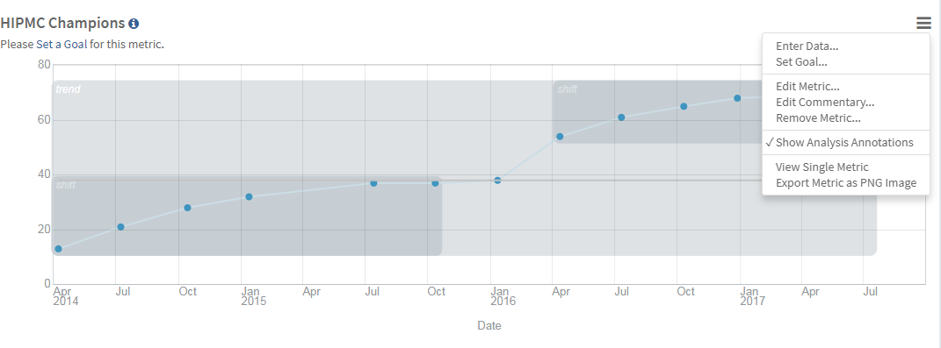
Measure What Matters www.100mlives.org/measure-what-matters
Upload/download CSV files
Easier ways to enter new data
Exporting metrics as images
View single measures to take a deeper dive
NEW analysis tools to show trends in your data!

Slide 42
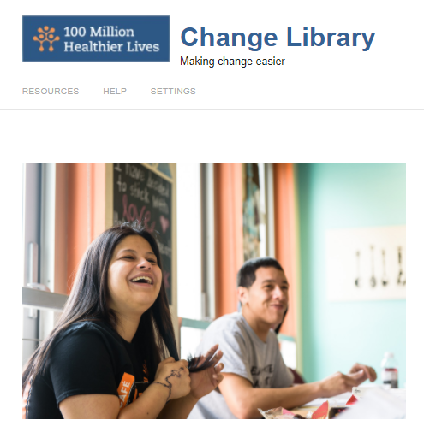
Change Library http://changelibrary.100mlives.org
Designed to help change makers discover practical solutions to improve health, wellbeing, and equity.
Contribute practical tips, tools, bright spots, and stories that have helped to accelerate improvement in your community

Slide 43
Change Library http://changelibrary.100mlives.org
Content is reviewed by a network of your peers and published for others to learn from
Content types:
Bright Spots
Stories
Tools

Slide 44
Accessing the Tools

Slide 45
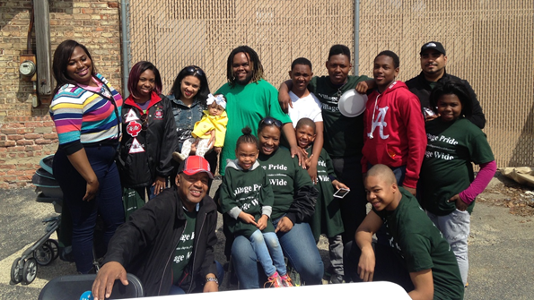
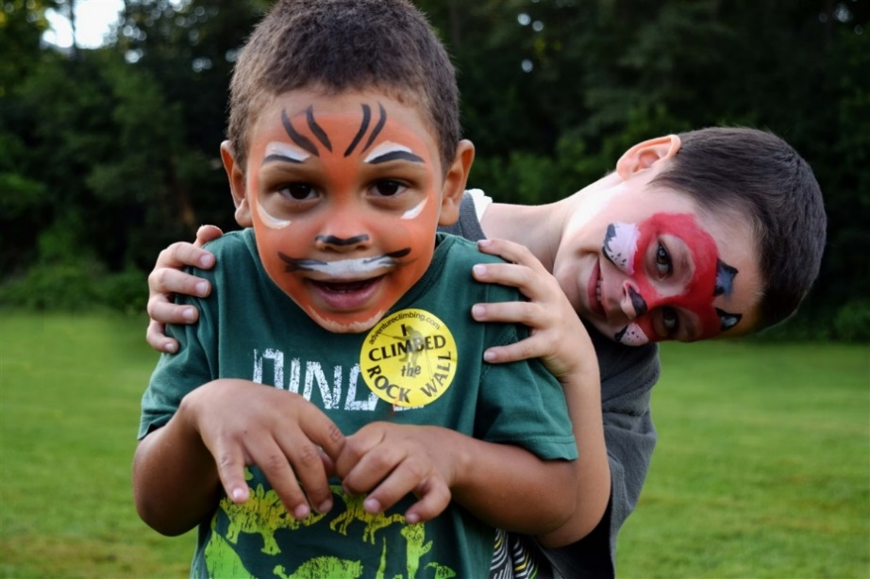
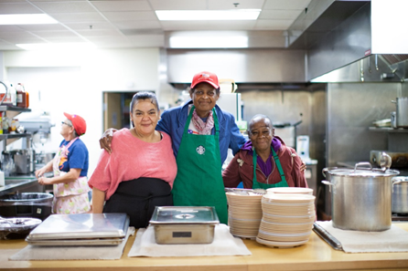
How to Access the Tools
Online Community: http://connect.100mlives.org
100MLives Website: www.100mlives.org

Slide 46
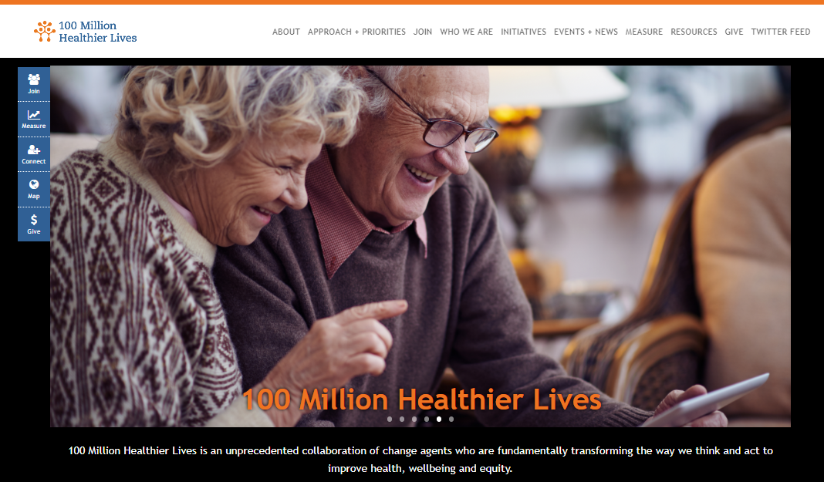
How to Access the Tools www.100mlives.org

Slide 47
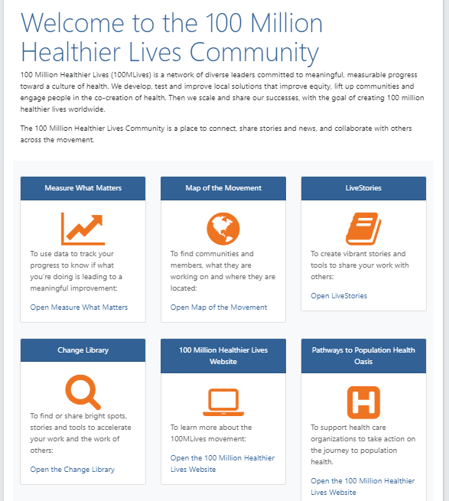
How to Access the Tools http://connect.100mlives.org
connect.100mlives.org
www.100mlives.org/measure-what-matters
www.100mlives.org/map
http://changelibrary.100mlives.org

Slide 48
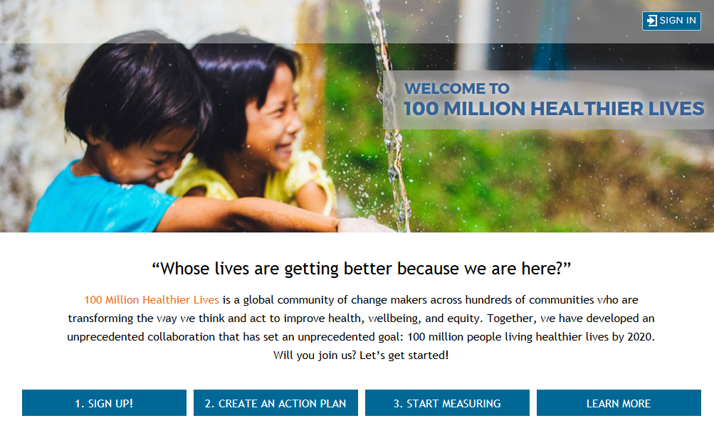
We invite you to join us! www.100mlives.org/measure-what-matters
Notes:
What joining means:
Willing to be visible
Working according to shared principles
Equity
Tracking progress in MWM

Slide 49
What we learned today..
About the 100 Million Healthier Lives movement.
What tools and resources are available to communities as part of the movement to accelerate community improvement in health, wellbeing, and equity.
The concreate steps for accessing and utilizing the tools!
Notes:
The purpose of today, isn’t that you walk away as an expert in all of the tools. Its to gain an understanding of what you can do, how to get started, and where to find more information to support you in utilizing them.

Slide 50
Questions

Slide 51
Thank you
Laura Howell lhowell@ihi.org
Institute for Healthcare Improvement
#100mlives @100mlives

