Slide 1
Addressing Racism: Lessons from 100 Million Healthier Lives
CJA National Conference
February 14, 2018

Slide 2
Introductions!

Slide 3
Your Turn!
Flash Introductions (30 seconds per person)
Your Name
Community you are from
Where you work/what you do
What do you hope to get out of today’s session that will dramatically change how you or your community addresses racism?
Notes:
Josh

Slide 4
100MLives Touchstones
Shannon Welch

Slide 5
100 Million Healthier Lives Touchstones for Collaboration
Be present as fully as possible. Speak your truth from your heart and mind.
Listen generously to each other’s truths. Trust that we all hold a piece of the puzzle and we need each other’s pieces to understand the whole picture.
Embrace differences and be open to learning from each other.
When the going gets rough, suspend judgment and get curious. Be quick to forgive and ask open questions to understand.
Honor each other’s learning and resourcefulness. Trust we will learn and contribute in our own way, that there is not need to “fix” each other.

Slide 6
Touchstones
Make space to pause and reflect to deepen our thinking.
Be willing to have meaningful conflict to create unprecedented goals and solutions. When needed, seek council for help with conflicts.
Allow your ideas to be developed further by others.
Seek common ground. When we can’t fully agree, commit to a unified decision and see what happens with a humble posture of learning. If we have made the wrong turn, we will discover it together and turn the right way together.
Accept that we will sometimes fail, but we will learn together and move forward.

Slide 7
Touchstones
Help each other to have the confidence to spread out wings, be creative and take on new roles.
Balance our yearning for change with patience in the process of change and growth.
Make the way we work together an example of what’s possible.

Slide 8
Session Learning Objectives
Rational Aims:
Become aware of at least one new way to address racism in your work
Practice using an equity lens
Begin understanding how to look at policy from a racism/equity lens
Engage in transformative discussions across cultural and social divides on an interpersonal/group level
Understand the concept of cultural humility and power

Slide 9
Session Learning Objectives
Experiential Aims:
Feel more comfortable being uncomfortable having community discussions on racism
Feel more confident working on policy changes that address racism and increase equity
Feel uplifted - that addressing racism is possible!

Slide 10
Agenda
8:30 - 8:55 Introductions, Touchstones, Objectives and Agenda
8:55 - 9:05 100 Million Healthier Lives’ Journey to Addressing Racism
9:05 - 9:30 Origin Stories
9:30 - 9:35 Wellness Now Oklahoma City’s Journey to Addressing Racism
9:35- 9:50 The Community of Solutions Framework
9:50 - 10:05 Break
10:05 - 10:15 Energizer
10:15- 10:20 Healthier Laramie County’s Journey to Addressing Racism
10:20 - 10:40 5 Whys Exercise - Understanding Root Causes
10:40 - 10:45 Proviso Partners’ Journey to Addressing Racism
10:45 - 11:10 Cultural Humility Exercise
11:10 - 11:35 Discriminatory Practices Exercise
11:35 - 11:40 Downtown Women’s Center’s Journey to Addressing Racism
11:40 - 12:00 Wrap-up and Commitment to next Steps

Slide 11
Overview of 100MLives

Slide 12
100 Million Healthier Lives www.100mlives.org
Identity: An unprecedented collaboration of change agents pursuing an unprecedented result:
100 million people living healthier lives by 2020
Vision: to fundamentally transform the way we think and act to improve health, wellbeing, and equity.
Equity is the “price of admission.”
Convened by the Institute for Healthcare Improvement as a partnership
Notes:
Learning community

Slide 13
Principles Guiding How We Work
Partner deeply and respectfully in the process of creating change with people, organizations, and communities.
Promote equity, justice, strength, and wholeness in the process of creating health.
Adopt a humble posture of learning and improvement that acknowledges the importance of both stories metrics that matter.
Intentionally work to remove barriers in critical areas (e.g., payment reform, spread of good ideas) through intentional collaboration with traditional and nontraditional partners.
Make the way we work an example of what is possible.

Slide 14
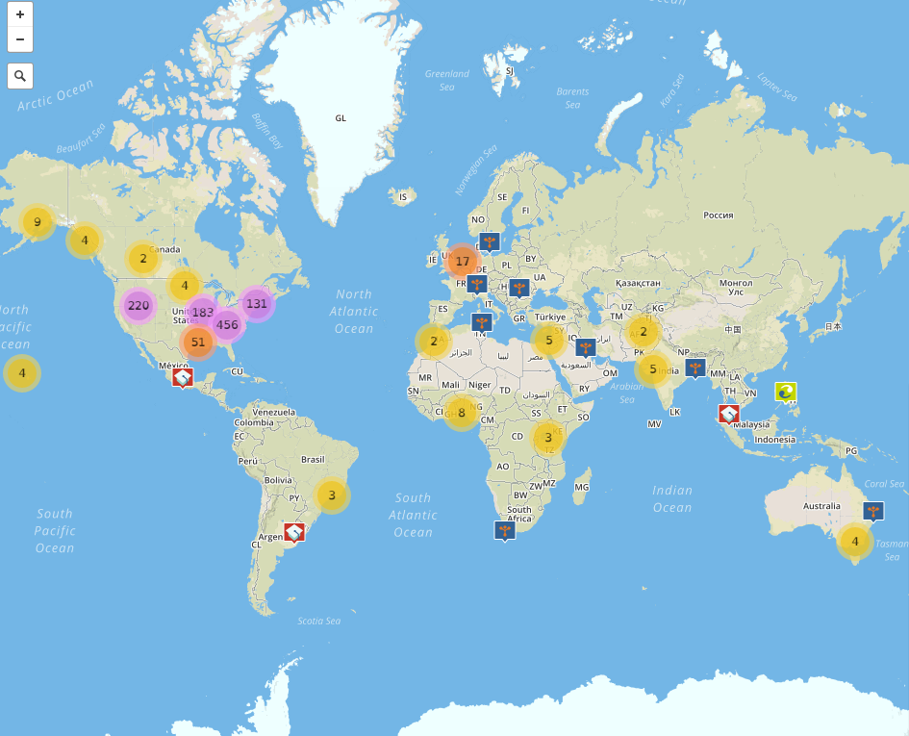
Who is In Our Growing Movement: >1100 members in 27+ countries worldwide
Interactive Map
www.100mlives.org/map
Notes:
In the time since we launched in October of 2014, the movement has welcomed to over 800 members in more than 15 countries worldwide, and growing.
This screenshot is from our interactive Map of the Movement, a tool that our partners at Community Commons built, where anyone can see WHO is a part of 100 Million Healthier Lives, WHERE in the world they are working, and WHAT are the specific “pieces of the puzzle” they are working on to create health, wellbeing, and equity.

Slide 15
Our continuing journey to Address Racism

Slide 16
Origin Stories

Slide 17
Origin Story
An Origin Story is a story of you and where you come from
It can be a narrative, prose, or poetic in nature

Slide 18
Origin Story Steps
Use the guiding questions on the next slide to help you think about what you want to include as a part of your story. You do not have to answer every question.
Pair and Share: Share your story with a partner uninterrupted. Listen attentively to your partner's story
Large Group Share: Reflect on the experience of writing and listening. What did you learn about yourself and others?

Slide 19
Guiding Questions to Create Your Origin Story
What is your background/ethnicity/race?
What culture do you associate most with?
Where did your ancestors come from?
What is the story of your people/family?
Where did you grow up?
In what economic class did you grow up?
What is your educational background?
What foods did you eat growing up?
What sayings/phrases did you grow up with?
How do you celebrate and/or what do your family gatherings look like?
What beliefs/religious practices do you have or hold?
What traditions did you grow up with?
What traditions do you keep, which do you not?

Slide 20
Wellness Now Oklahoma City’s Journey to Addressing Racism

Slide 21
Community of Solutions Skills and Behaviors
Addressing Racism requires a diverse set of skills and behaviors

Slide 22
SCALE Communities – Overall Content Theory
Community of solutions behaviors, processes, systems
Leading from within (LW)
Leading together (LT)
Leading for outcomes (LO)
Leading for equity (LE)
Leading for sustainability (LS)
Health as a shared value
Thriving cross-sector partnerships
Healthy, equitable communities
Improved population health, wellbeing and equity outcomes
How people relate to themselves, one another, and to those affected by inequity
How the community approaches the change process
How the community creates abundance
Community of solutions skills
Culture of health outcomes

Slide 23
How people relate to each other and to those who are most affected by inequity
They have gone from treating a community like a hierarchical organization and see it instead as a living organism made up of connected, interdependent parts - dynamic and responsive interchange between groups and levels
People with lived experience work together with community connectors and formal leaders to co-design and drive the change
A critical mass of people see themselves as stewards of the community’s wellbeing, with the agency and capacity to create change
Leaders across the community work together strategically to create the systems and policies needed to sustain long term change
They prioritize equity and create a change process that grows equity (ownership) of those with lived experience

Slide 24
How the community creates abundance
Leaders across sectors in a community coordinate and leverage their assets in usual and unusual ways to address the priority needs of the community, using an anchor institution approach.
They have the trust and governance processes in place to share resources and accountability
They prioritize the unlocking of trapped and untapped potential in people and organizations as a pathway to abundance
They see the development of leaders and their ability to contribute to the solutions at every level of the community as a key part of creating abundance
They invest in a change process which is dynamic and grows engagement, relationship, capacity, and the will for change

Slide 25
How the community approaches the change process
They believe change is possible and have a tangible motivating vision.
They focus on getting to meaningful outcomes for people and places—and adapt what those are, as they learn
They approach change in a dynamic way - they learn, adapt and fail forward as a normal part of creating change in small and big ways
They recognize that change can come from anywhere—and create the space for solutions to come from many different places.
They co-design change from the person and population up with people with lived experience.
They do not see themselves as terminally unique—and embrace the opportunity to learn from others. They display humility and a willingness to adopt solutions created by others.

Slide 26
Leading from Within
Leading from Within (LW) skills involve one’s inner journey as a leader, including the ability to:
Know yourself and what brings you to leadership
Reflect, “fail forward,” and change as needed
See and commit yourself to unlocking the leadership of others, especially those with lived experience of inequity and racism
Understand your “origin story” and how this affects your actions, behaviors and preconceived notions
Approach change from a place of abundance
Understand implicit bias
Value difference – Habits of the Heart: (Palmer P. , 2000)

Slide 27
Leading Together
Leading Together (LT) skills are grounded in the view of the community as a dynamic network of interacting people, organizations, and systems. It is necessary to lead together with others in a community to create effective, equitable change. Elements of Leading Together skills include:
Developing trust, relationships, and interconnectedness
Working through real and perceived power-dynamics and power differentials
Collaboration (including integrating people most affected by inequities and racism in your work)
Co-Designing solutions with people most affected by inequities and racism

Slide 28
Leading for Outcomes
Leading for Outcomes (LO) skills support communities in applying applying a core set of skills to more quickly make progress on its priority areas of work.
Innovation/Design Thinking – Using stories and experience to understand the experience of people affected by a change (e.g. structural racism)
Improvement science – Developing aims, drivers, and measures, and running tests of changes
Using Data - understanding who isn’t thriving (including who is affected by structural racism and other structural inequities)
Implementation skills – Making implementation easier, more effective, and more joyful

Slide 29
Leading for Equity
Leading for Equity (LE) skills apply Leading from Within, Leading Together, and Leading for Outcomes skills through an equity lens
Who isn’t thriving?
What would it take to change that?
Naming Racism (interpersonal and structural) as a core component of equity work
Committing to addressing racism

Slide 30
Leading for Sustainability
Leading for Sustainability (LS) skills facilitate an ongoing process of transformation in a community (generative sustainability) as opposed to maintaining programs as they are. Four key elements of sustainability are:
Environmental sustainability – Stability of the physical, political, and cultural environment
Resource sustainability – Availability of intrinsic (will for change, relationships) and extrinsic (financial, in-kind) resources needed to maintain, spread, and scale changes
People sustainability – Cultivation of change leaders in a community, especially those affected by inequities and racism
Change sustainability – Growth and sustainability of the change process.

Slide 31
For More on CoS Skills and behaviors
Read the SCALE Synthesis Reports: https://www.100mlives.org/initiatives/
Foundations for Community of Solutions
Overview of SCALE and a Community of Solutions

Slide 32
Take a Break!
You Deserve it!

Slide 33
Animal Round-up
Energizer!

Slide 34
5 Whys Exercise
Understanding Root Causes

Slide 35
5 Why Analysis: Root cause methods
The 5 whys is a question-asking technique used to explore the cause-and-effect relationships underlying a particular problem.
Each of the characters are African-American and live in the same low-income neighborhood.
At your table, write the problem down on your worksheet
ask and discuss why this problem occurred and write your answer
ask why at least 5 more times until you get to the root cause this problem.

Slide 36
Problem: Ray is not taking his hypertension as directed.
why
why
why
Why
Why

Slide 37
Problem: Vanessa was a straight A student in the high school and dropped out of College as a science major.
why
why
why
Why
Why

Slide 38
Problem: Janice is getting evicted from her third apartment in 2 years.
why
why
why
Why
Why

Slide 39
Problem: Ben has been unable to find work in the neighborhood.
why
why
why
Why
Why

Slide 40
Problem: John has uncontrolled diabetes.
why
why
why
Why
Why

Slide 41
5 Whys Analysis

Slide 42
Proviso Partners’ Journey to Addressing Racism

Slide 43
Cultural Humility

Slide 44
Cultural Humility
“Cultural humility is a lifelong process of self-reflection, self-critique and commitment to understanding and respecting different points of view, and engaging with others humbly, and authentically from a place of learning”
Tervalon & Murray-Garcia, 1998

Slide 45
Cultural Humility
Cultural Humility vs. Cultural Competence
Cultural competence is static, has an end product, and implies that one can function with a thorough knowledge of another culture
Cultural humility is dynamic, breaks down barriers, and goes beyond cultural competence by suspending what you know, or what you think you know, about a person and their culture
“To be culturally humble means that I am willing to learn.” -Joe Gallagher

Slide 46
Fishbowl Conversation

Slide 47
Fishbowl Conversation
“Race is a specious classification of humans created by Europeans, or whites, to assign human worth and social status using himself or white as the model of humanity and the height of human achievement, for the purpose of establishing and maintaining privilege and power.”
-Chisom & Washington, 1997
Through the lens of cultural humility, how has the manifestation of racism, individual and institutional, impacted you, and how can counter-storytelling of your narrative help in undermining racism?

Slide 48
Discriminatory Practices Exercise

Slide 49
Group Exercise and Discussion
You are members of a school board
Your task is to design a set of policies and procedures (as it relates to your students and the education you provide) that will inevitably cause disparities and gaps, specifically between people of color and white counterparts
AND the policies cannot explicitly discriminate, cannot be illegal and will not get you in trouble
What policies do you create?
Please jot down ideas on stickies

Slide 50
Now, what about our work?
What policies, practices, processes do we have in place that are discriminatory towards the communities?
What policies, practices, processes are we designing and refining that are discriminatory towards the communities?
How do you begin to address racism in the way we work and design?

Slide 51
Downtown Women’s Center’s Journey to addressing racism

Slide 52
Wrap-Up and Commitments

