Slide 1
It was the brainchild of Henry C. Kessler at the now-defunct York Cone Co., which made ice cream cones starting in the 1920s. Looking to expand the scope of the business, Kessler set out to invent a new candy, one that would meld chocolate and peppermint in perfect harmony. He wanted his candy to be firm and crisp, unlike other chocolate-covered peppermint candies

Slide 2
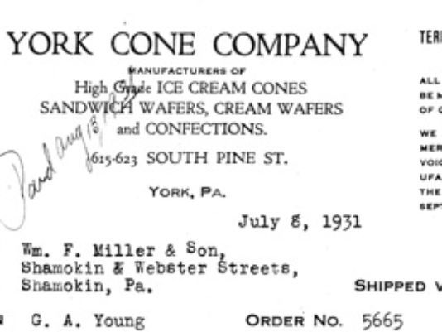

Slide 3
1920s - York Cone Company is established in York, PA.
1940 - YORK peppermint patties are introduced locally.
1972 - Peter Paul acquires the York Cone Company.
1975 - YORK peppermint patties begin national distribution.
1978 - Peter Paul merges with Cadbury Schweppes.
1988 - Hershey Foods acquires Cadbury Schweppes' U.S. confectionery operations.
1989 - Factory in York, PA closed.

