Slide 1
POSITIONING FOR SUSTAINABILITY:
THE POWER OF RESEARCH AND EVALUATION
Karen Minyard, Ph.D.
February 2018

Slide 2
SUSTAINABILITY
Programs or services continue because they are valued and draw support and resources.

Slide 3
GHPC Sustainability Framework
Strategic Vision
Positioning for
Collaboration
Leadership
Relevance & Practicality
Evaluation/Return on Investment
Communication
Efficiency & Effectiveness
Capacity
Sustainability

Slide 4
GHPC Sustainability Framework
Funding strategies
Indirect funding
Events
Earned income
Grants
Contribution/sponsorships
Government budgets

Slide 5
Research Project

Slide 6
What works for whom? How?
And in what circumstances?

Slide 7
REALIST EVALUATION CYCLE
Eliciting and formalizing the program theories to be tested
Collecting data on appropriate context, mechanism, and outcome attributes
Analyzing context-mechanism-outcome patterns to see which can be explained by the initial theory
Revising the program theory based on new insights

Slide 8
HYPOTHESES STATED AS “CONFIGURATIONS”
C + M = O
“The sign of a good evaluation is that it is able to explain the complex signature of outcomes.”
(Mark et al, 2000)
Notes:
Configurational Thinking
Key to program building
Describes how different components of a program need to be HARMONIZED
Approach to causality
Outcomes follow from alignment of a specific combination of attributes
RE develops and tests CMOCs
Recipes and Slot machines as examples

Slide 9
Context
The Four I’s:
Individual
Interpersonal
Institutional
Infrastructure

Slide 10
Observable
1.
Program
Activities
3.
Program
Outcomes
Resources
Opportunities
Constraints
Decisions
Choices
Not Observable
2.
e.g. Reasoning, preferences, norms, collective beliefs
Adapted from Wong, G., Westhorp, G., and Greenbaugh, T. (2012) Realist Synthesis RAMESES Training Matierials.

Slide 11
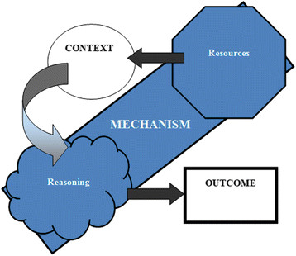

Slide 13
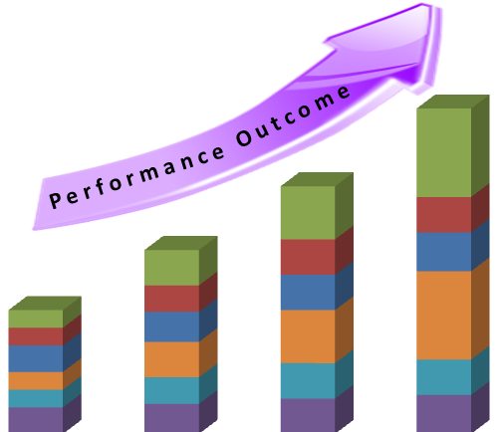

Slide 14
Notes:
Direct mpact
System impact
Leading vs lagging measures
Ind grp institu system
Group Outcomes – Exchanges of viewpoints, consensus, a shared view of the problem or actions, shared language, understanding of other participants
Organizational – changes in an individual organization. This might include a human resource, an organizational, investment, program, or policy change
System Change – multiple organizations and individuals make changes that impact the system. These can include partnerships, joint investments, policies.
For example, multiple hospitals pooling community benefit resources to invest together would be a system change, whereas, an individual hospital investing in a new way would be an organizational change.
There is actually another outcome – the methods outcome – using whatever is learned in another setting.
I adapted this from an article by Rouwette, Vennix, and van Mullekom, System Dynamics Review, 2002
Newton’s cradle is a demonstration of the observation of ReThink Health’s impacts. In a Newton's cradle, five small silver balls hang in a perfectly straight line by thin threads that attach them to two parallel horizontal bars, which are in turn attached to a base. When the ball on the end strikes the others it sends the one on the opposite end into the air. The balls in the middle appear calm. The impact produces a compression wave that propagates through the intermediate balls. This energy and momentum that are moving through the middle balls are not readily observable.

Slide 15
SENSEMAKING

Slide 16
STRUCTURE OF OUR WORK
Baseline data
June check-in
November check-in
Provide all data for 2018 on Jan. 15, 2019
CJA 2019 pre-conference sensemaking, dissemination, and next steps

