Slide 1
Delivering Value Through Hospital- Community Partnerships

Slide 2
Population Health Management
Prepare organization for value-based payment models
3 year goals
  85,000 → 300,000 lives in value-based arrangements
  90+% of our largest commercial contracts with value-based component
Central tenet: we must push care outside the walls
Modern Healthcare Interview with Bill Considine, CEO, Akron Children’s Hospital (02/10/2018)
~’We're in about 80 communities with some type of pediatric arm. We want to be in the schools, in the churches, in the neighborhoods, and work with other agencies in those communities; when you do that and open your ears, you learn about their issues. You need to reach out even more beyond your walls and we've been doing a good bit of that.’

Slide 3
Care Coordination Model
High
Medium
Low
Nurse
Social Worker
Patient Navigator (MA/lay person)
School-based nurse
Patient Centered Medical Home Practice
Community Health Worker
Partner Community Health Agency
Patient Risk
Intensity of Needs

Slide 4
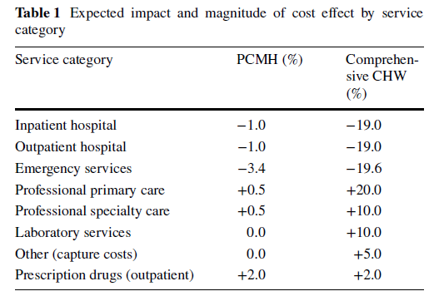
Integrated Primary care And Community Support Model (I-PaCS)

Slide 5

Capturing value requires alternative payment models
State / Federal Medicaid Innovation Funding
Risk-based subcontracting between hospitals - agencies
Capitation modeling to include community-based services
http://hcp-lan.org/workproducts/apm-refresh-whitepaper-final.pdf

